Slide 1
Biostatistics 226, Winter 2018
Course Overview
Jan 9 – Design of RCTs: How to avoid bias and achieve valid results
Jan 16 – Analyses: Baseline, Efficacy, and Safety
Jan 23 – Monitoring trials for efficacy, futility, and patient safety
Jan 30 – Cluster Randomized Trials
Feb 6 – Precision medicine I: SMART (Adaptive Trials)
Feb 13 – Precision medicine II: N-of-1 Trials
Textbook References
Lawrence Friedman, Curt Furburg, David DeMets. Fundamental of Clinical Trials, 5th edition, 2015.
The Essential Guide to N-of-1 Trials in Health. Editors: Jane Nikles, Geoffrey Mitchell. 2015.
ISBN 978-94-017-7200-6 (eBook), DOI 10.1007/978-94-017-7200-6
CONSORT extension for reporting N-of-1 trials (CENT)

Slide 2
Heterogeneity of clinical outcomes within and between individuals
A variety of factors that capture patient heterogeneity in clinical outcomes have long been recognized. These include
demographics: age, sex, and ethnicity
environmental influences: diet, smoking status, exercise, exposure to drugs, pollutants, toxins
clinical measures: symptoms, treatment modalities used, duration of the disease, general health status, patient selection criteria
Some of these reflect our genetic constitution; some affect our epigenome.
Epigenome—the complete array of chemical modifications to DNA and histone proteins that regulate the expression of genes ... thus also, regulate heterogeneity of clinical outcomes.
  Epigenetics—the study of any potentially heritable changes in gene expression or phenotype that occurs without any changes in the underlying DNA sequence
A dynamic cross-talk exists between epigenetic modifications and genetic background in case of complex disorders.
Further, the epigenome of an individual undergoes vigorous changes over the lifetime.
Ref: Sharma S. Ch 15 of Prognostic Epigenetics. https://doi.org/10.1016/B978-0-12-814259-2.00016-9
Notes:
A fixed effects analysis would estimate overall effect from 4 mean trajectories.

Slide 3
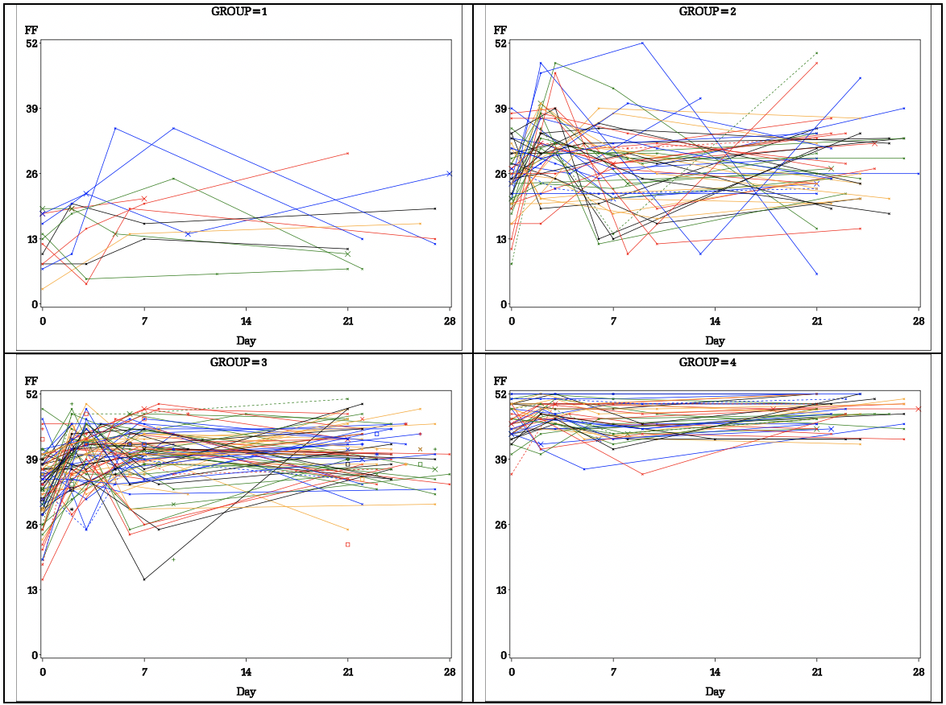
Example: Self-reported FACIT-Fatigue QoL Scores (range, 0 to 52)
A sample of 205 cancer patients receiving SOC outpatient blood transfusions shows high variability at baseline and in subsequent clinical course.
Four mean trajectories were identified using latent variable modeling.
Groups: 1) Low FFQoL (6%); 2) Moderate FFQoL (26%); 3) Moderate-High FFQoL (47%); 4) High FFQoL (21%).
Notes:
We can see that G3 experiences an immediate benefit that is sustained over 3-4 weeks.
There appears to be more heterogeneous responses in G1-G2, with initial benefits fading.
In contrast to G1-G3, those in G4 could not improve much due to having initial QoL close to the maximum score.
A random effects analysis would estimate overall effect from 4 mean trajectories, accounting for PT-to-PT and PT-by-Group variability.

Slide 4
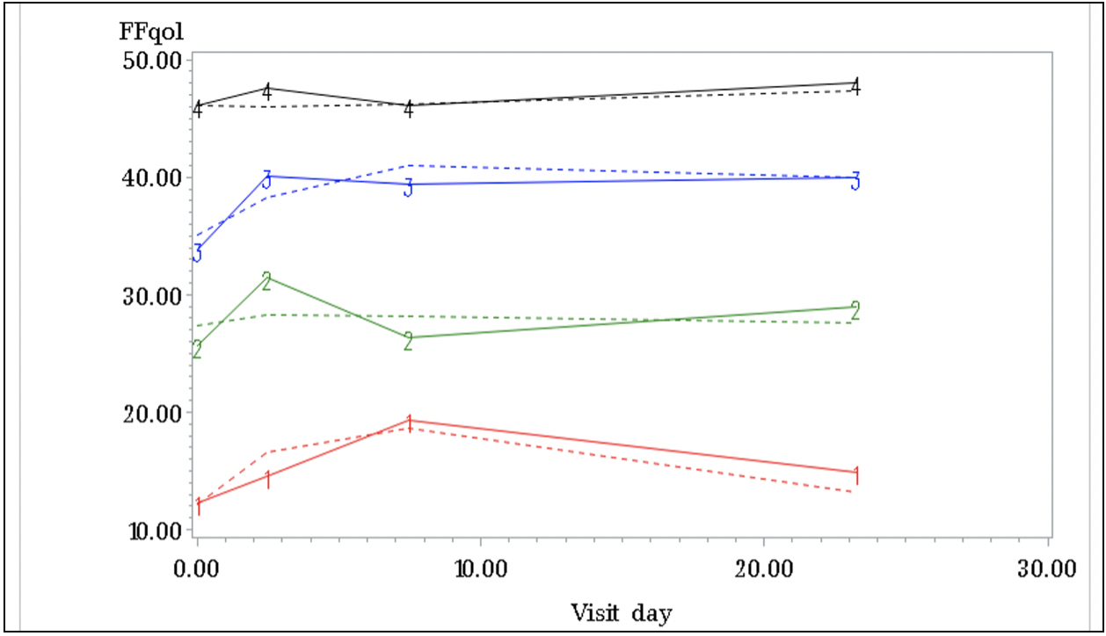
Example: Self-reported FACIT-Fatigue QoL Scores (range, 0 to 52)
A sample of 205 cancer patients receiving SOC outpatient blood transfusions shows high variability at baseline and in subsequent clinical course.
Four means represent the sample better than an overall mean would.
Observed trajectories (solid lines) and model-based trajectories (dashed lines) are averages of individual group members’ trajectories.
Groups: 1) Low FFQoL (6%); 2) Moderate FFQoL (26%); 3) Moderate-High FFQoL (47%); 4) High FFQoL (21%).
Notes:
A fixed effects analysis would estimate overall effect from 4 mean trajectories.
Analysis of covariance using baselines helps to eliminate (to an appropriate degree) the difference between patients

Slide 5
Heterogeneity of clinical outcomes within and between individuals
There are three obvious sources of variability in clinical trials.
Pure differences between patients: some are more seriously ill than others
Variability within patients: even given the same treatment they, or their measurements, may vary from time to time
Some patients react more favorably to a given treatment than other patients: patient-by-treatment variability
The parallel-arm trial does not and cannot distinguish between the three types of variability unless we can find meaningful ways of classifying subgroups.
A crossover trial can distinguish between the first type of variability and the other two but not easily between the second and third.
Multi-crossover single-patient trials, known as N-of-1 trials, are often employed when the focus is to make the best possible treatment decision for an individual patient.
Ref: Senn S. Applying results of randomised trials to patients. N of 1 trials are needed. BMJ. 1998 Aug 22;317(7157):537-8. No abstract available. PMID: 9712612 [Letter to the Editor.]
Notes:
A fixed effects analysis would estimate overall effect from 4 mean trajectories.

Slide 6
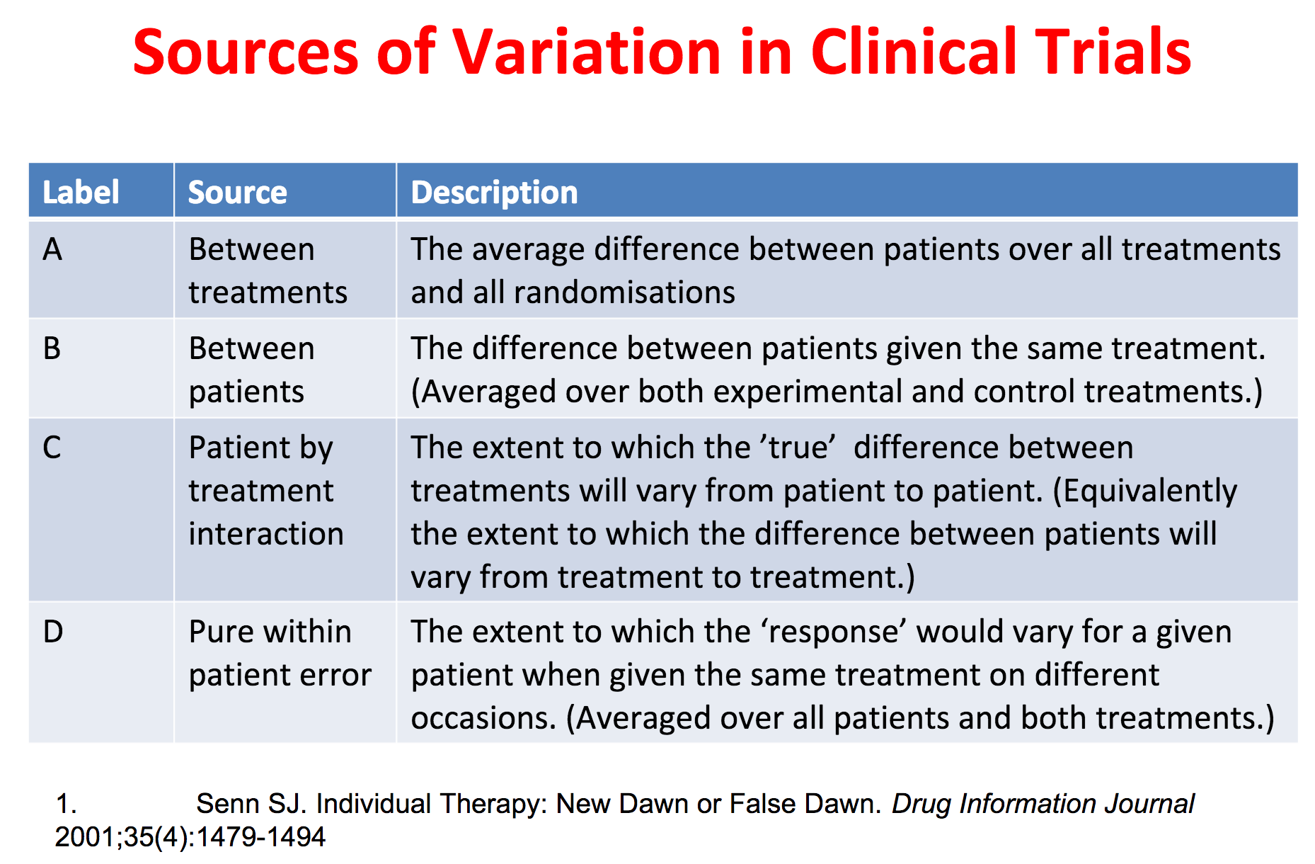
Heterogeneity of Treatment Effect: Study designs

Slide 7
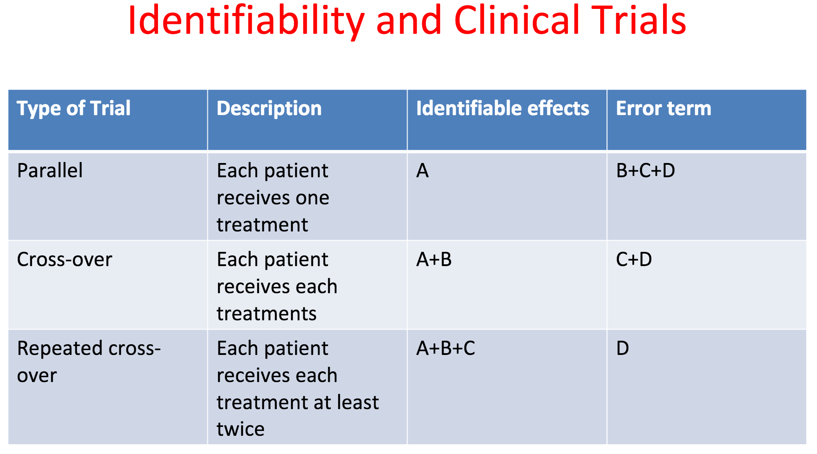
Heterogeneity of Treatment Effect: Study designs
Parallel Trials – Implicitly assume that “patient” is a random effect: The general level of outcome that would be seen in the absence of treatment varies randomly from patient to patient.

Slide 8
Multi-crossover single-patient trials, known as N-of-1 trials
N-of-1 trials are often employed when the focus is to make the best possible treatment decision for an individual patient with an on-going ~stable condition.
N-of-1 Trials, definitions
A trial design developed to increase the scientific rigor of longitudinal individual assessments.
A randomized, controlled multi-crossover study of an individual PPT’s responses to multiple interventions (typically two).
A trial can comprise a single individual.
They commonly comprise multiple individuals to allow comparison of treatments both within and across individuals.
  Data across individuals can be statistically aggregated
    To ‘borrow strength’ from similar patients when estimating individual treatment effects , and
    To provide average treatment effects.
Applications
A trial design developed to increase the scientific rigor of longitudinal individual
Notes:
A fixed effects analysis would estimate overall effect from 4 mean trajectories.

Slide 9
N-of-1 Trials – suitable settings
Stable chronic condition with heterogeneity of treatment effect (‘HTE) that is
responsive to study arms.
Can be applied to treatments given infrequently, in degenerative / fatal conditions
Short-acting interventions with rapid ramp-up and wash-out.
Measurable outcome.
Infrastructure support: Digital data collection, storage, and downloading
Applications
fentanyl for pain control in individuals with cancer
  Portenoy,R.K.,Burton,A.W.,Gabrail,N.,Taylor, D. & Fentanyl Pectin Nasal Spray 043 Study Group. Pain 151, 617–624 (2010).
temazepam for people with sleep disturbances
  Wegman, A. C. et al. Fam. Pract. 22, 152–159 (2005).
“Whatever their approach, trial designers must hunt down sources of variation.” Senn (2018) Nature
Notes:
A fixed effects analysis would estimate overall effect from 4 mean trajectories.

Slide 10
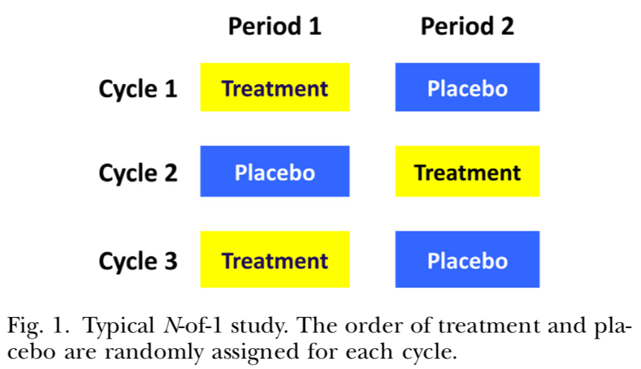


N-of-1 Trials – design features
Two interventions (one per period)
Arms paired within cycles
Few cycles (to conclude within a
reasonable time-frame;
to avoid confounding by time)
Few patients available
Build on Cross-over Designs
Simplest for n ≥ 2: Two sequences, AB and BA. Randomize n PPT per sequence.
Then, D_{AB} = Y_{2B} – Y_{1A} while D_{BA} = Y_{1B} – Y_{2A} , where subscripts denote periods. These two estimates reflect treatment effects, carryover effects, and patient effects.
Add a cycle: Two sequences, ABBA and BAAB. Randomize n PPTs per sequence.
Now D_{ABBA} and D_{BAAB} average over two estimates of the treatment effect per PPT.

Slide 11
N-of-1 Trials
Assessments
PPT outcomes are measured at set time intervals,
  Long enough for an intervention effect to show up
  Short enough for an intervention effect not to carry over into the next period ... If need be, add wash-out periods.
  → Aside from research needs, the assessment intervals must be logistically feasible for PPTs.
Multiple cycles per PT
  Can reduce # patients needed
  Can estimate treatment effects in individuals
  Providing a sequence of treatments to a patient gives rise to correlated outcomes
  Can be used to estimate variance components: Separates random patient-by-treatment interaction from pure within-patient error
After several crossover periods, period-level outcomes for the two interventions are compared using statistical analyses.
A balanced design can lead to a simple analysis.

Slide 12
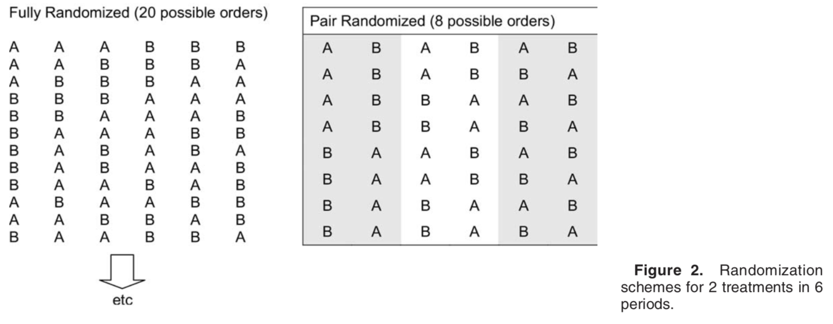
N-of-1 Trials – design features
Experimental units are times, clustered with PPT
    Restricted randomized design → Two arms equally represented over 6 periods: 6!/(3!3!) = 20 sequences.
    Randomized blocked design. → Two arms balanced within all 3 cycles: 2³ = 8 sequences
How many cycles to study?
Which options are most feasible and informative in small samples? **
Does the order of treatment matter, or do we just want to estimate A:B effect?
  → Recall SMART trials examined the order in which interventions were delivered.
Notes:
It is not known whether: each of these eight sequences is optimal for individual patients. Or whether a collection of the optimal and not-so-optimal N-of-1 trials will lead to optimal designs for estimating the average treatment effects

Slide 13
Since PTs are studied longitudinally, confounding by time could occur:
Over time, the disease could worsen.
Over time, the treatments could have cumulative effects.
A restricted randomized design (left panel) can avoid confounding from unknown sources. Blinding is more likely to succeed with this design, increasing validity.
A pair-blocked “counterbalanced” design (right panel) can mitigate confounding
with time trends, by estimating serial treatment effects within narrow intervals. However, blinding could fail with this design.
→ Based on SMART trials, we could consider a design that re-randomizes
after each cycle.
Notes:
Re-randomization

Slide 14
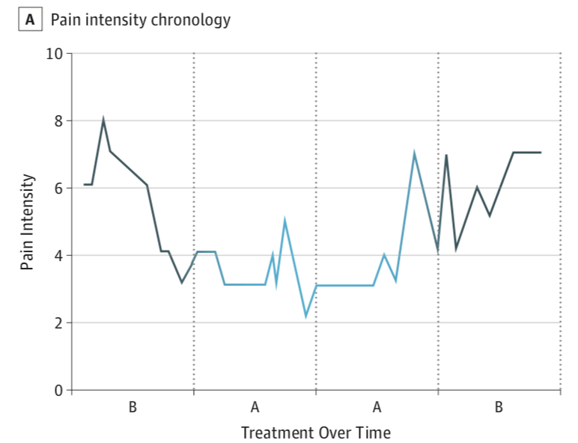
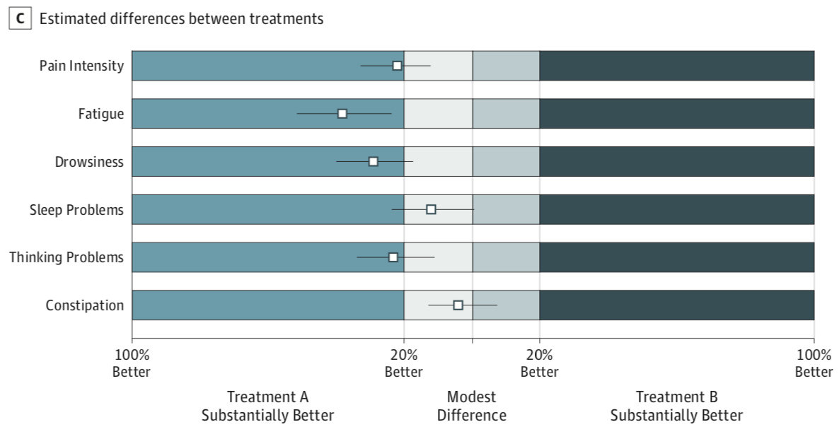
Timing of outcomes:
Within any period, it’s possible to assess outcomes more than once. Replicates increase precision of estimates. Trade-off: burden on PPT could lead to drop-out.
If a treatment has slow onset, the primary measurement could be at the end of the period … or based on within-period slopes Which is most informative?
The duration of periods should reflect the duration of treatment effects; wash-out periods could reduce carryover effects on the next period.
Multiple outcomes can be used,
to address needs of various stakeholders,
especially PT and PCP
to increase power via a composite or
concordance
Notes:
Re-randomization

Slide 15
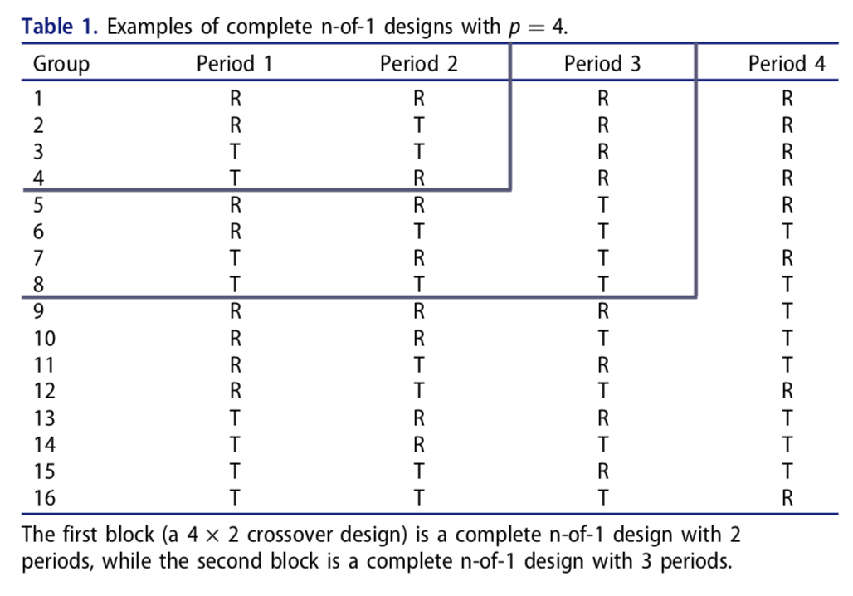
“Complete” N-of-1 Trials
All possible combinations of treatment assignment per paired intervention periods.
Chow & Chang, 10.1080/10543406.2019.1657441
Randomize PPT to a sequence. For T=2 and J=2, K =T^{j} = 2² = 4 sequences: {RR, RT, TR, TT}.
Within each period, expose PPT to the specified study arm, and collect outcome after a relevant interval.
Notes:
These are examples of (sequences x periods) 4x2, 8x3, and 16x4 trials.

Slide 16
N-of-1 Trials
A complete n-of-1 trial design has the following advantages:
Each subject is at his/her own control,
If the intended trial is a placebo-controlled study, it lifts the ethical issue of using placebo in the patients with critical conditions
Multiple cycles allows estimates of intra-subject variability,
It provides estimates for treatment effect in the presence of possible carry-over effect, and
Most importantly, it requires fewer subjects for achieving the study objectives of the trial design.
The N-of-1 trial design also suffers from drawbacks
Possible dropouts or missing data and
Patients’ disease status may change at each dosing period prior to dosing.
Chow & Chang, 10.1080/10543406.2019.1657441

Slide 17
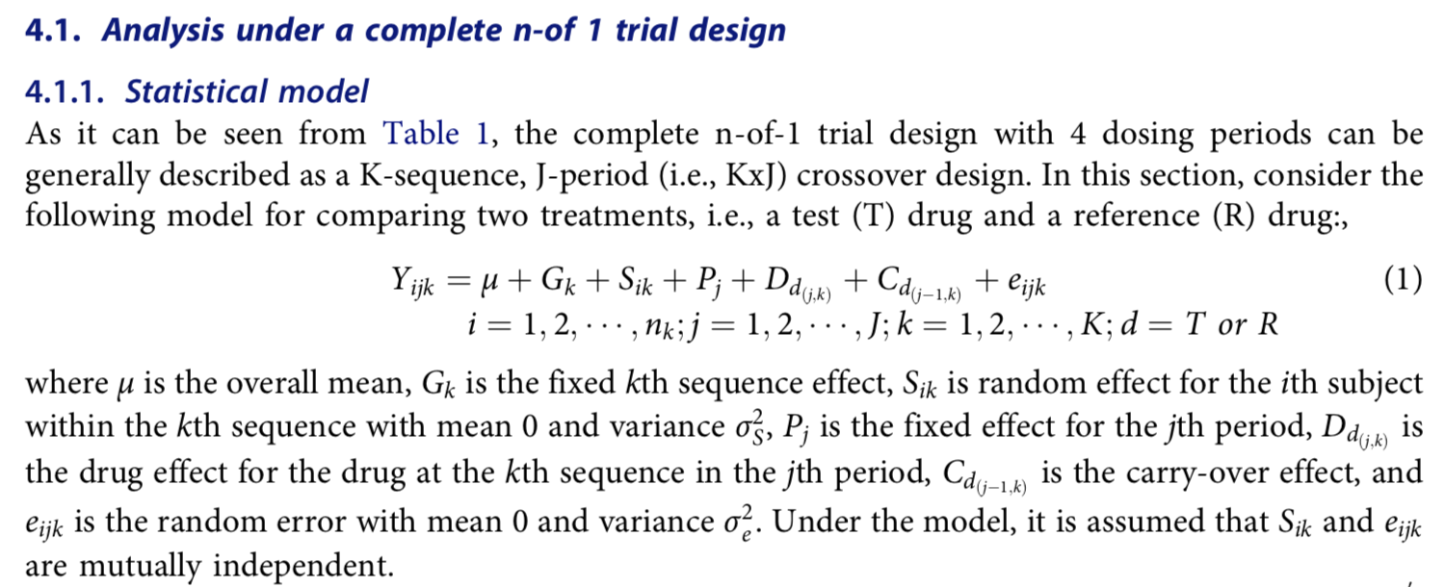
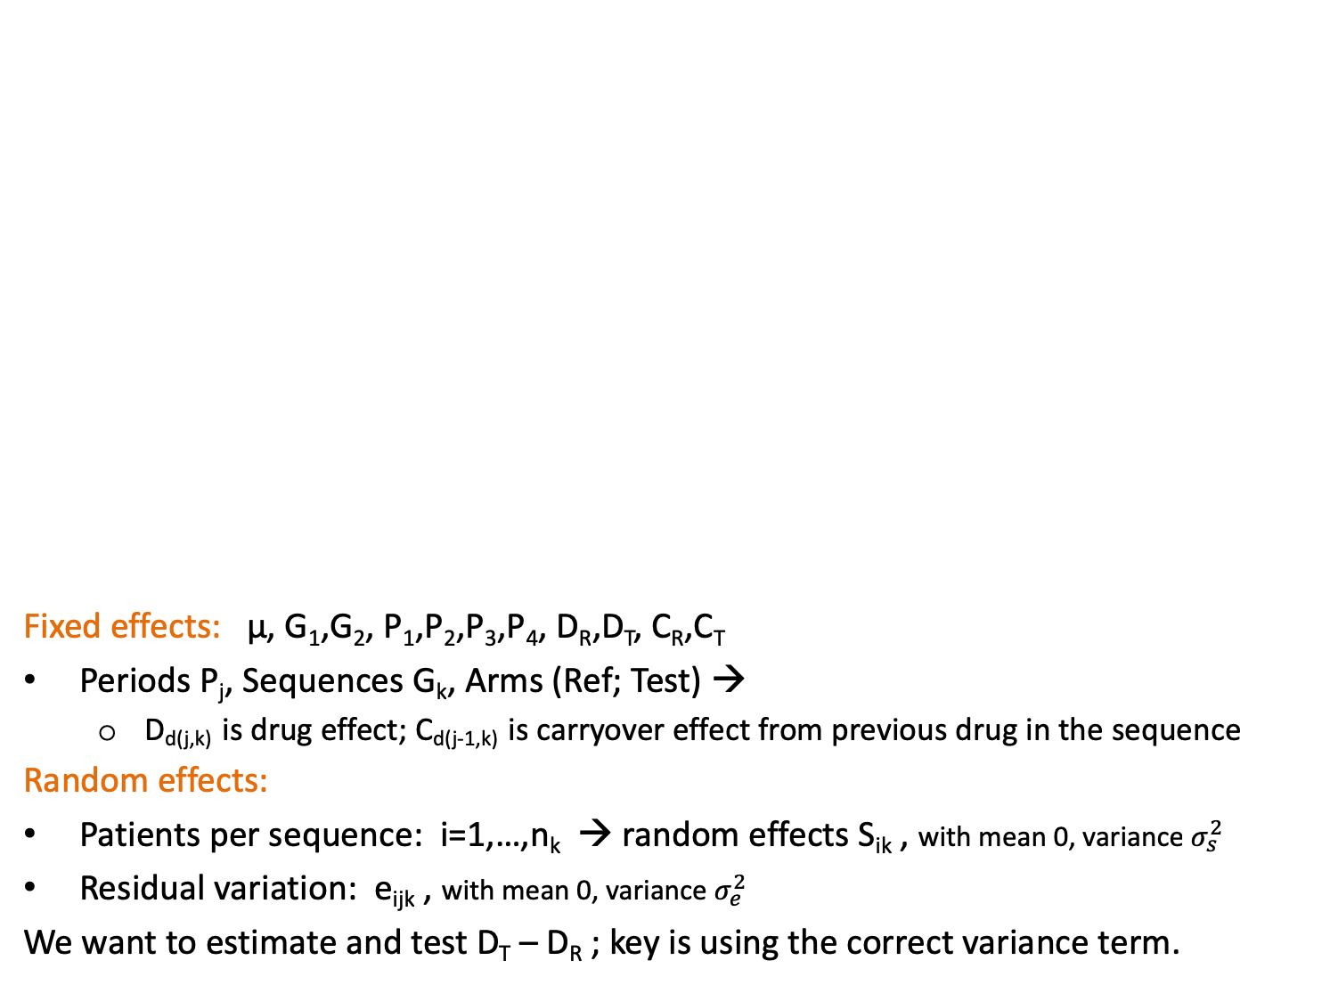
Fixed effects: µ, G₁,G₂, P₁,P₂,P₃,P₄, D_{R},D_{T}, C_{R},C_{T}
Periods P_{j}, Sequences G_{k}, Arms (Ref; Test) →
  D_{d(j,k)} is drug effect; C_{d(j-1,k)} is carryover effect from previous drug in the sequence
Random effects:
Patients per sequence: i=1,…,n_{k} → random effects S_{ik} , with mean 0, variance
Residual variation: e_{ijk} , with mean 0, variance
We want to estimate and test D_{T} – D_{R} ; key is using the correct variance term.

Slide 18
N-of-1 Trials – Analysis
The model assumed is a Normal–Normal mixture with variance components corresponding to
within-cycle, within-patient variation and
treatment-by-patient interaction.
Achieves relatively strong control for any local trend effects :
trends between cycles are eliminated and
within-cycle differences are treated as random carry-over …
can be eliminated either by
    Using washout periods
    By limiting measurement to the latter part of any treatment occasion
    Using more cycles
Chow & Chang, 10.1080/10543406.2019.1657441

Slide 19
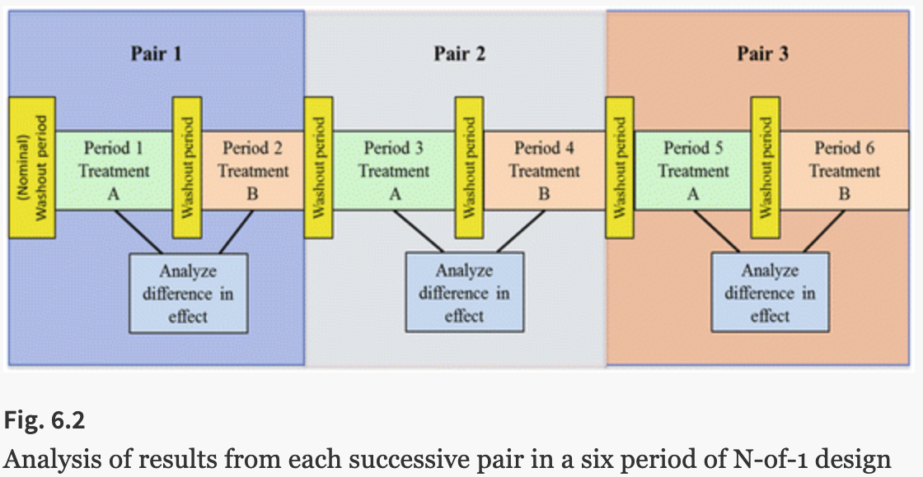
N-of-1 Trials – Analyses
Multi-period Cross-over Trials
For stable chronic conditions, it is common to take repeated measurements during the course of (clinical care or) a trial.
A summary measures approach works well, as long as info available per PT is fairly similar: (a) generate a patient-level summary across repeats; (b) analyze the summaries.
An advantage: The issue of the correlation between measures is finessed, rendered irrelevant by the tactic employed*.
A disadvantage: We cannot estimate patient-by-treatment interaction – the extent to which the effect of treatment varies from patient to patient – without random effects analysis.
Notes:
BIO 226 examples so far of summary measure approach :
Lecture 2, change scores; Lecture 3, insurance rates in India; Lecture 5, SMART HW

Slide 20
N-of-1 Trials, Designs and Analyses
Important contributor and expert in crossover designs: Stephen Senn [Statist. Med. 2004; 23:3729–3753]
  ‘HTE’ might be due
  to a nonhomogeneous PPT pool in the RCT or
to treatment-by-PPT interaction.
→ The key to understanding response is replication and careful analysis
Conventional crossover trials (much less parallel-arm trials) do not permit one to resolve residual error into
  PPT-by-treatment interaction and
  pure within-PPT variability.
To do that one needs a crossover design in which PPTs are repeatedly exposed to the same treatment. … We should welcome the opportunity to examine such interactions where the study design permits and guard against over-interpretation where it does not.
No Replication, No Interaction

Slide 21
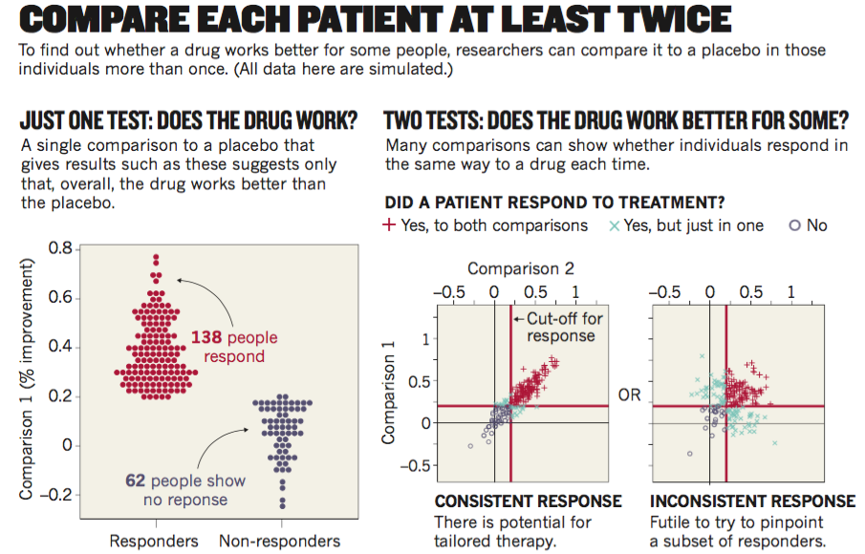
N-of-1 Trials, Designs and Analyses
Senn (2018) Nature

Slide 22
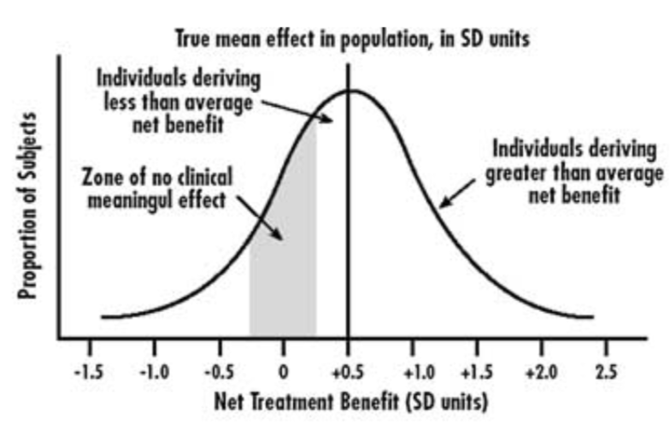
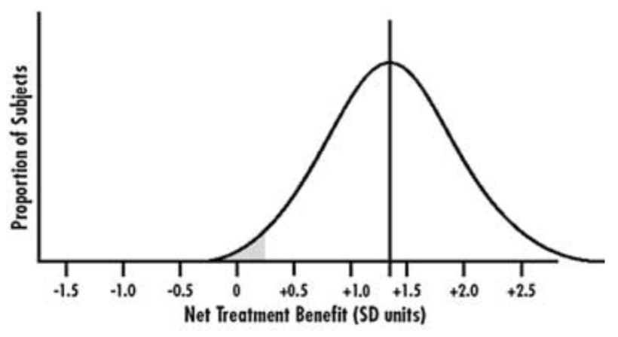
N-of-1 Trials, one rationale
: Heterogeneity of Treatment Effect (HTE) in RCT findings
Clinicians may face difficulties translating evidence from RCTs to individual patients:
RCTs focus on group average findings d: to reflect commonalities of disease and treatment experience
RCTs demonstrate through the 95% CI that a range of individual treatment effects (ITE) occur, without linking these to specific patient characteristics.
“If we could more precisely identify who benefits, we could expose beneficiaries only.”
Senn (2018, Nature) argues against this commonly held line of thinking (eg, Schork, 2013, Nature).
Notes:
In the race to identify effective interventions, RCTs may focus interventions that
provide early relief of morbidity → potentially requires only a single outcome measurement per PPT
Rather than providing sustained relief from an on-going illness (e.g., mental health) → potentially requires many outcome measurements per PPT

Slide 23
Combining N-of-1 Trials
S Senn. 2017. Statistical Methods in Medical Research
DOI: 10.1177/0962280217726801
Fixed effects model: Use if conclusions about the study PPTs are of interest, such as for causal analysis.
→ If n=12, arms=2, periods k=3: {2³}¹² = 8¹² possible sequences
Random effects model: Use if conclusions about the parent population are of interest, such as for prediction modeling.
Very different purposes for n-of-1 trials may require very different samples sizes.
For identifying treatments that ‘can’ have an effect, the fixed-effects analysis is reasonable and will yield the most modest requirement for sample size.
If a key purpose of beginning a set of n-of-1 trials is to provide improved methods of personalising treatment for individual future patients, rather many patients will need to be studied in the first place.
At the moment, this does not seem to be a realistic prospect. Much is talked about personalising medicine but little is done that treats components of variance seriously.
See also: Araujo A, Julious S, Senn S (2016) Understanding Variation in Sets of N-of-1 Trials. PLoS ONE 11(12): e0167167. https://doi.org/10.1371/journal.pone.0167167
Notes:
Once a set of n-of-1 trials have been run they can be used to inform treatment decisions for patients with only one, or for that matter no cycles.

Slide 24
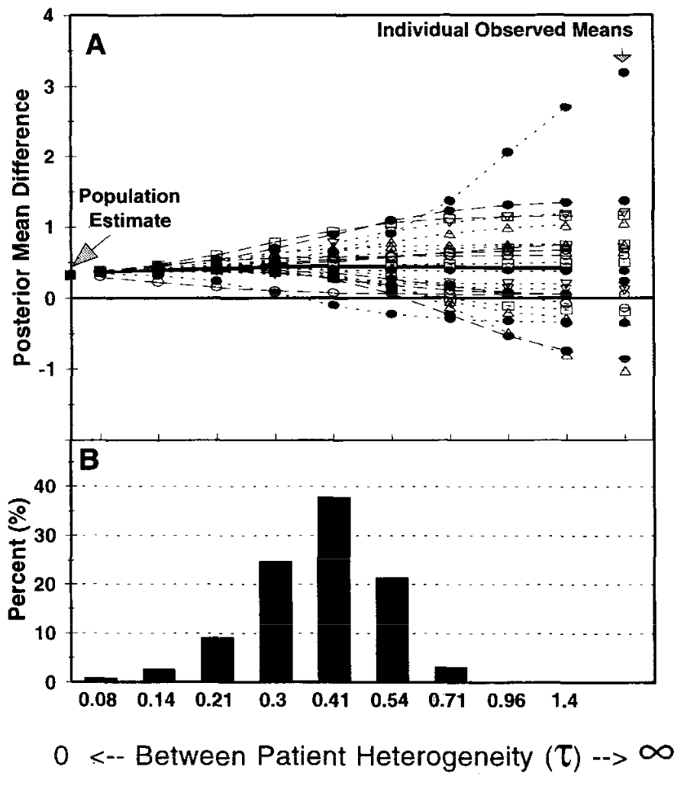
Combining N-of-1 Trials
Zucker, Schmid, et al.
J Clin Epidemiol 50(4), 1997
Goal: to estimate treatment
effectiveness for the population and
to use this population estimate to aid
in the evaluation of individual patients’
results.
Method: hierarchical Bayesian random
effects model to combine N-of-l studies
We demonstrate this patient-focused
method using published data from 23
N-of-l trial results comparing
amitriptyline and placebo for the
treatment of fibromyalgia.

Slide 25
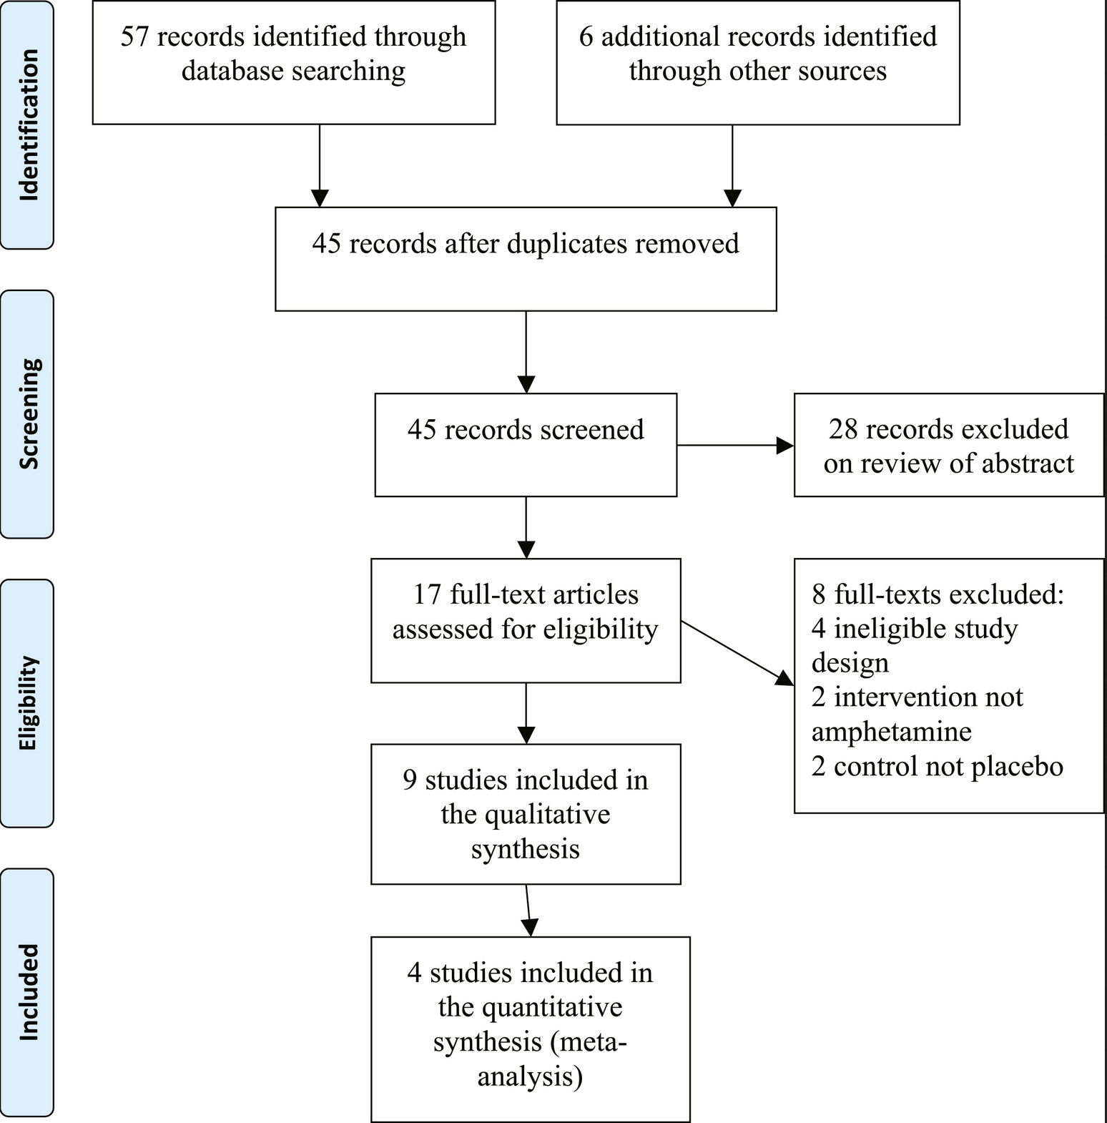
Combining N-of-1 Trials
Punja, Xu, Schmid, et al.
J Clin Epidemiol 76, 2016
Title: N-of-1 trials can be aggregated to
generate group mean treatment effects:
a systematic review and meta-analysis
A systematic review and meta-analysis of
n-of-1 evidence showed that amphetamines
and methylphenidate are superior to placebo
for pediatric ADHD on most outcomes.
This article also shows that n-of-1 trials can
be synthesized across individuals and studies.
As the trend toward individual patient data meta-analyses continues to grow, single-subject research, particularly n-of-1 trials, will contribute a rich source of data allowing for more powerful and reliable assessments of treatment effects.

Slide 26
Micro-Randomized Trials
Klasnja P, ..., Murphy SA, Health Psychol. 2015 Dec; 34(0): 1220–1228. doi: 10.1037/hea0000305
Micro-Randomized Trials: An Experimental Design for Developing Just-in-Time Adaptive Interventions
JITAIs -- mHealth technologies that aim to deliver the right intervention components
at the right times and locations to optimally support individuals’ health behaviors.
Intervention components are repeatedly randomized → allows researchers to assess how intervention components’ causal effects change over the course of the study.
Effect estimations take advantage of contrasts in outcomes
  between people assigned to different intervention options, and
  between times when a PPT is randomized to different intervention options.
A micro-randomized trial can help researchers answer the following questions:
What are the proximal and lagged effects of an intervention component?
How do the proximal and lagged effects of an intervention component change over time?
Which factors (time-invariant or time-varying) moderate an intervention component’s proximal or lagged effects?
Ideas are close to N-of-1 trials, but design does not necessarily repeat arms within PPTs.
Example: van Dantzig S, et al. Pers Ubiquit Comput (2013) 17:1237. https://doi.org/10.1007/s00779-012-0588-0

Slide 27

N-of-1 Trials, another rationale
: Longitudinal individual data collection is escalating rapidly → efficiency

Slide 28


Slide 29

Conclusions: Ideas on Methodological Research needed for N-of-1 Trials
Methods for combining results across multiple PPTs: Borrow strength.
Sequential stopping rules for monitoring evolving results.
→ Modify an individual’s intervention in presence of their own {efficacy, AEs}
Provide PPT-level methods for analyzing own data: Citizen Science
  Increase in public understanding of statistics and research
  Increase in understanding of own health and population health
  Increase in understanding of importance of adherence
  http://crowdandcloud.org/

