Slide 1
Follow-up and Adherence in Trials

Slide 2
Trial of the Week:
VITAL (Vitamin D and Omega 3 Trial)
Vitamin D believed by many to be “good for what ails ya”
Estrogen of decade: Fractures, CHD, cancer, dementia, etc.
Lots of observational data showing benefits
Vitamin D testing rapidly increasing and costly: necessary?
VITAL:
  RCT of Vitamin D (2000 IU/day) vs. placebo
    (secretly a factorial design)
  >25,000 people including high proportion of AA
  Funded by NIH
Manson et al, NEJM, 1/2009

Slide 3
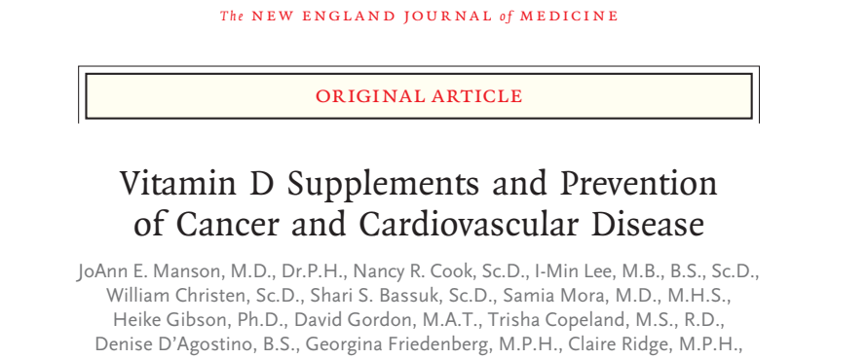
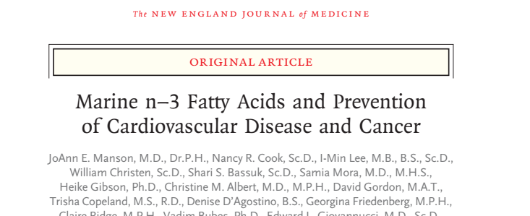

Slide 4
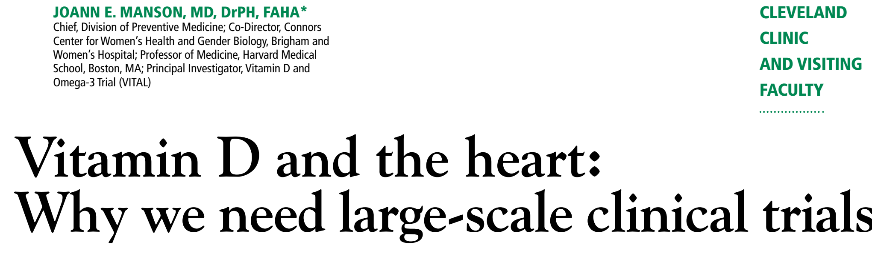
Rationale for VITAL

Slide 5
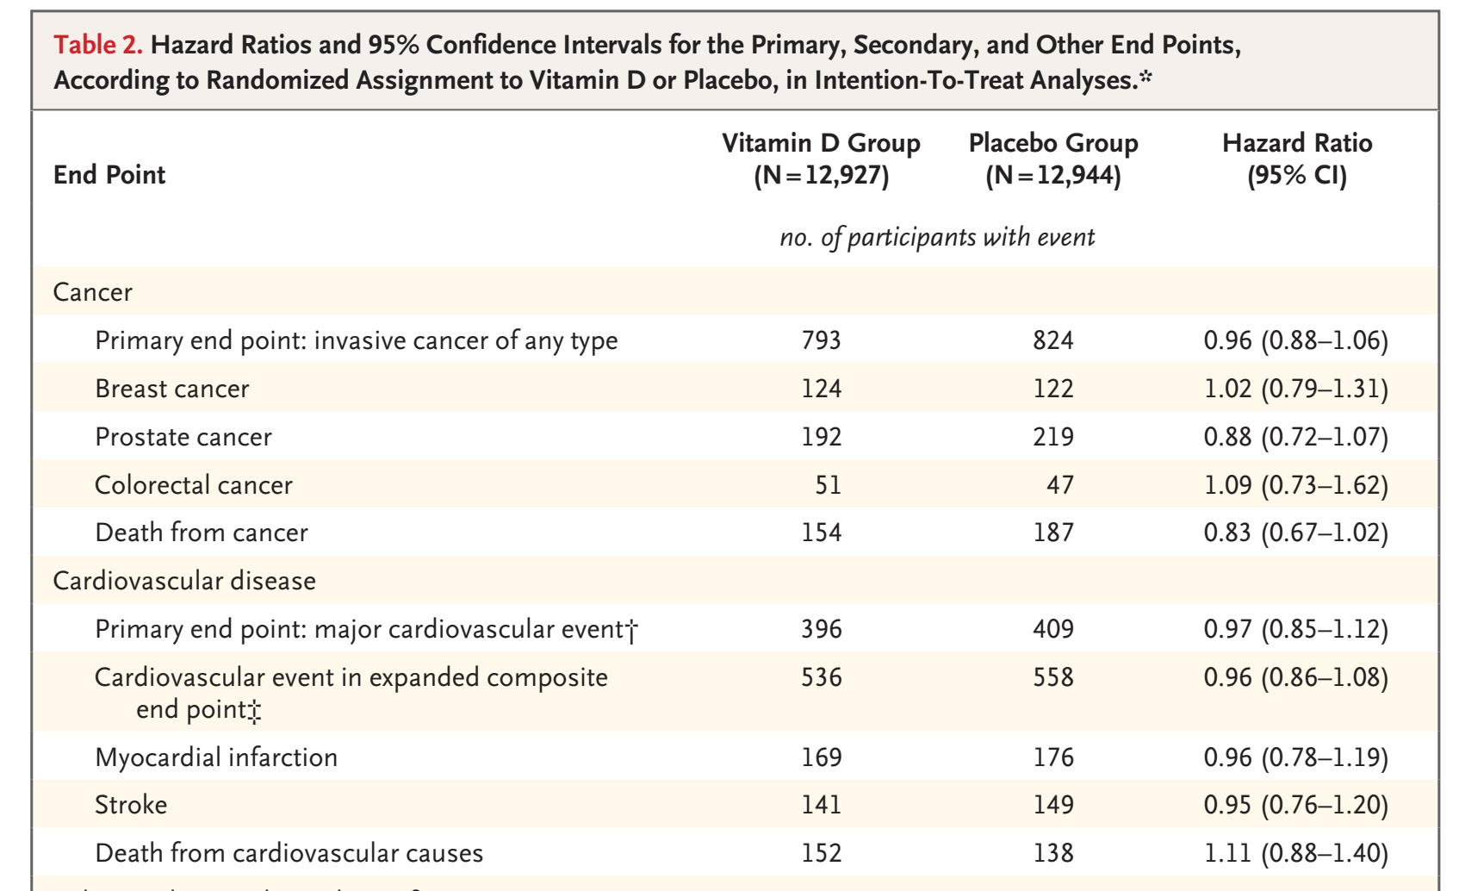
VITAL: Primary endpoints

Slide 6
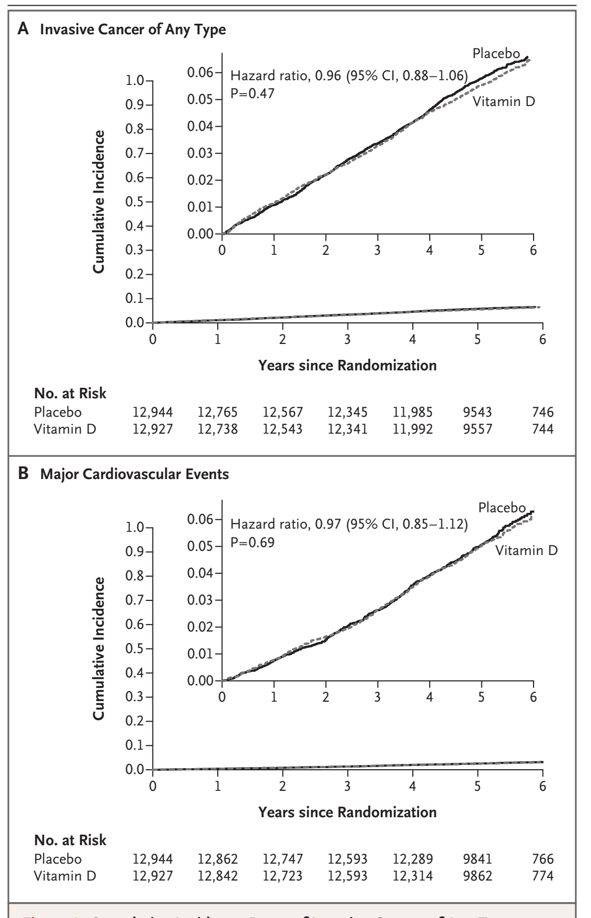

Slide 8
1. Follow-up and Adherence: Outline
Follow-up intensity and “styles”
Adherence
  Measurement
  Improving
ITT and other follow-up issues in analysis
CONSORT Guidelines and Diagrams

Slide 9
Follow-up in RCT’s
What happens after randomization
Carefully lay out procedures to be followed
Describe in protocol, on forms and in Operations Manual

Slide 10

Overview of Randomized Trial Design
Population
Apply intervention
Measure Outcome(s)
Select participants
Rand
Compare Outcomes
Measure Outcome(s)
Apply control

Slide 11
What Data to Collect at Follow up?
Primary outcome(s) and safety
Secondary outcomes
What else? first reaction: do everything on everyone at every visit
  e.g. labs or MRI’s at all visits
  But great opportunities for efficiencies and cost savings
  More parsimonious visit may decrease patient burden & increase adherence
  Ask the following about each assessment:
    How many visits?
    Do only at some visits?
    Do only on a subset?
    Don’t do at all

Slide 12
Intensity of Follow-up: How much? How often?
Intensity of follow up depends on study needs (and budget)
Maximal
  Lots of measurements done frequently
  Extreme: In-patient GCRC-type study
  Phase I and (sometimes phase II) studies
Minimalist
  Few follow up visits and measurements
  Extreme: large/simple trials
Advantages and disadvantages of each

Slide 13
More parsimonious measurements:
RCT of Zoledronic acid vs. placebo (osteoporosis)*
7765 participants
Primary outcome: hip and spine fractures (co)
Secondary outcomes include: changes in biochemical markers of bone turnover (2 markers)
Markers of bone turnover:
  Do on everyone at all visits? About 80,000 assessments
  Or do on subset of about 500 participants (7% of total, convenience sample)
  Only at some visits (every 6 months)
  95% cost savings vs. all participants at all visits: <4000
    @$100: $8,000,000 vs. $400,000
*Black et. al , NEJM, 5/07

Slide 14
Zoledronic acid and Mean Serum β-CTX
(total n=7765)
ZOL 5 mg
1.0
Placebo
0.9
Premenopausal
reference range
0.8
Annual dose
0.7
0.6
Mean Serum β-CTX (ng/mL)
0.5
0.4
0.3
0.2
0.1
0.0
0
6
12
18
24
30
36
Months
ZOL n = | 257 | 236 | 200 | 136 | 191 | 190 | 174
PBO n = | 260 | 248 | 214 | 156 | 196 | 197 | 170
Black DM, et al. NEJM. May 5, 2007
Notes:
Zoledronic Acid Reduced Mean Serum β-CTX
Assessment of biochemical markers of bone turnover such as serum β C-telopeptide (β-CTX) can be considered in terms of efficacy and safety. (See also bone safety slides.) These markers were reduced with ZOL compared with placebo and the effect was maintained over time.
The bone resorption marker serum β-CTX was measured every 6 months in a subset of patients. Serum levels decreased significantly at 6 months among patients receiving ZOL 5 mg compared with placebo, and were maintained, on average, within the low end of the premenopausal range (0.04 to 0.18 ng/mL) throughout the course of the trial. Reductions in β-CTX were significant compared with placebo at all time points (P < .0001).
At baseline, median levels of β-CTx were approximately 0.36-0.37 ng/mL for patients who received either ZOL or placebo.
Six months after the first dose, median levels decreased to 0.085 ng/mL for patients in the ZOL group and 0.329 ng/mL for placebo-treated patients.
All post-baseline visit median values for zoledronic acid-treated patients ranged between 0.04 and 0.18 ng/mL and were within the normal pre-menopausal range. Median values of approximately 0.4 ng/mL were maintained for placebo-treated patients.
At Month 36, patients in the ZOL group had an approximate 55% (95% CI: 49% to 60%) greater rate of reduction in bone resorption as measured by serum β-CTx compared to placebo-treated patients
Although values (on average) fall below the lower limit of the pre-menopausal range in the short-term following administration of ZOL 5 mg, they appear to increase within a month, and are within the pre-menopausal range by 6 months. At the end of every 12-month period, patients are on average well-established within the lower half of the pre-menopausal range.
Reference
Black DM, Delmas PD, Eastell R, et al. Once-yearly zoledronic acid 5 mg for treatment of
postmenopausal osteoporosis. Submitted for publication. [citation to be updated when
publication date is known]

Slide 15

Extreme Minimalist: Large and Simple Trials
A whole lot of people and focus on primary outcome
Randomize, do as few follow-up measurements as possible
Examples of how to streamline follow-up
  Few (or no) in-clinic visits..VERY expensive
  Physicians’ Health study: Randomize to aspirin or placebo, mail out drugs, follow-up by mail
  Use data collected for other purposes for follow-up/endpoints
    Population mortality
    Medical systems (Europe: Gov’t. health systems national data,
    U.S.: Medicare, Kaiser, and more recently EMR)
  Internet follow-up direct from participants

Slide 16


Example Large and Simple Trials:
UK Vitamin D trial
2700 people recruited by mail from general medical practice (UK)
Oral vitamin D (100k units) 4 x / year for prevention of fractures
Sent oral D (and placebo) via “post”
Ascertained fractures via “post” (and National Health Service data base)
Mortality via National statistics
Found decrease in fracture risk (possibly mortality)
BMJ. 2003 Mar 1; 326(7387): 469.

Slide 17
Vitamin D: Summary of 5 Yr. Results
VIT D PBO RR (p)
(n=1345) (n=1341)
Any fracture 8.8% 11.1% 0.8 (.04)
Hip, wrist, vert. 4.5% 6.5% 0.67 (.02)
Mortality 16.7% 18.4% 0.88 (.18)
CONCLUSION: Four monthly supplementation with 100 000 IU oral vitamin D may prevent fractures without adverse effects in men and women living in the general community
BMJ. 2003 Mar 1; 326(7387): 469.

Slide 18
Keeping Trials Simple
Efficiencies in Vitamin D trial:
  Simple selection criteria
  No follow-up clinic visits or measurements
  Outcomes self-assessed (mail, internet) or existing data (EMR)
Study very efficient (VERY)
  Cost of Vitamin D trial: about $500,000.
  Cost of WHI: about $1,000,000,000
Want to increase efficiency while maintaining quality
Minimize non-essential measurements

Slide 19
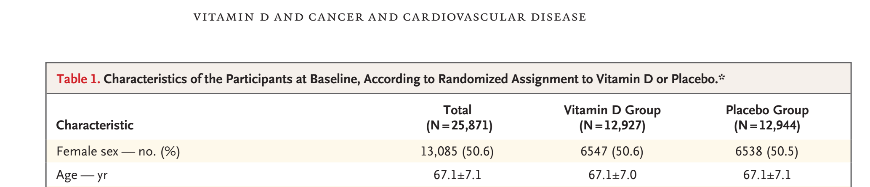
VITAL: How did they do it on NIH diet?

Slide 20
VITAL: How did they do it on NIH diet?
Patients recruited via internet and advertisements
Not seen in a clinic
Most went to a local lab for blood draw
Vitamin D or placebo mailed
Follow-up by phone/email
Patients recruited via internet and advertisements
Not seen in a clinic
Most went to a local lab for blood draw
Vitamin D or placebo mailed
Manson 2018 NEJM

Slide 21
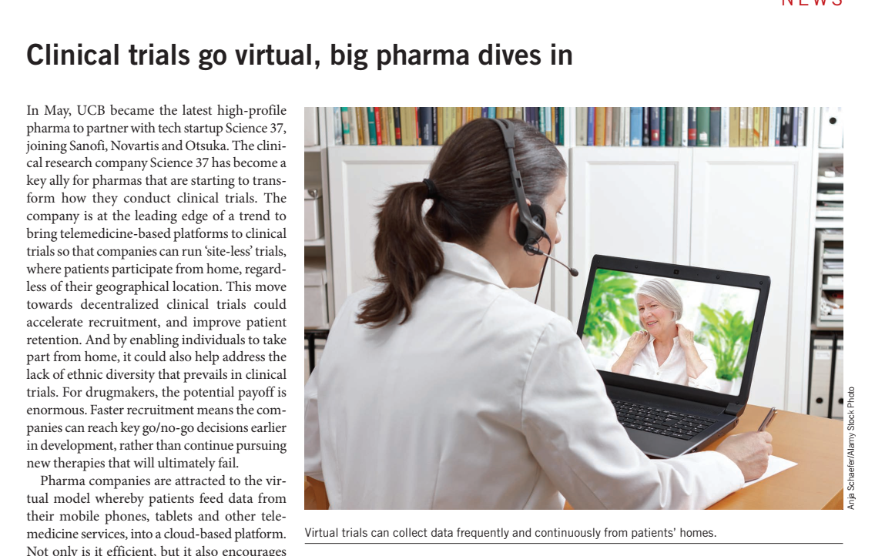
Site-less Clinical Trials

Slide 22
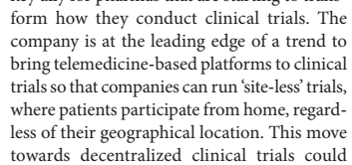
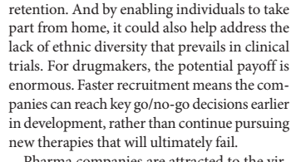
Site-less Trials
(Nature Biotech, 8/18)

Slide 23
Adherence (aka compliance)

Slide 24
Adherence (aka compliance)
Trial is meaningless unless participants use treatment
“Adherence” is a many faceted concept. 3 aspects:
  1. Medications/interventions
  2. Visit schedules/reporting
  3. Adherence to protocol (eg. Admitting only eligibles)
Lack of adherence can lead to:
  Bias in either efficacy or safety
  Decreased power
  Publication challenges
  Uninterpretable results

Slide 25
Adherence goals
Ideal: all participants continue to take meds (perfectly) and attend all follow-up visits to end
Why might participants stop medication?
  Side effects (real or perceived)
    Eg. In Zoledronic acid trial, ~25% had acute phase reaction
  Complex regimens (eg. self-injections)
  Want to take a true active medication
    New info on old medication
    New competing medication
  Want to stop active medication
    New info on old medication (e.g, ERT increases BC risk)

Slide 26
Adherence :
Medications

Slide 27

BAD HAIR DAY

Slide 28
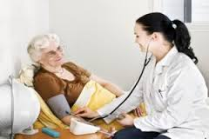
Some Examples of “Bad Adherence Days”
Women’s Health Initiative (HRT and CHD)
  After first year results seen by DSMB, letter sent to all participants “observed a small increase in cardiovascular disease among ppts on HRT”…
  Many stopped medications
PROOF trial (effect of Nasal Calcitonin on osteoporosis)
  1994 to 1999
  1997: Alendronate approved. Good results, excellent marketing
  Many dropped out of PROOF to take open-label alendronate

Slide 29
Adherence to intervention = adherence to visit schedule
Can have perfect visit adherence (come to all visits on time) but--
  Not take a single study med pill
  Take only 60% of pills
If miss visits or stop coming to visits, then generally don’t take study medication
  Exceptions do occur..could take study medications but not attend follow-up visits

Slide 30
Measuring Adherence
Medication-taking
  Just ask! (self report)
  Pill counts
  Biochemical assays for some drugs (blinding issues)
  High tech pill bottles
    Can count number of times bottle actually opened
  Blister packs may help assessments
Visit schedule
  N missed visits
  Visits within schedule
  etc.

Slide 31
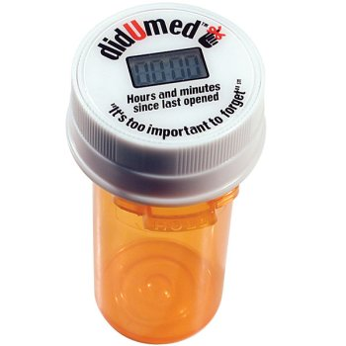
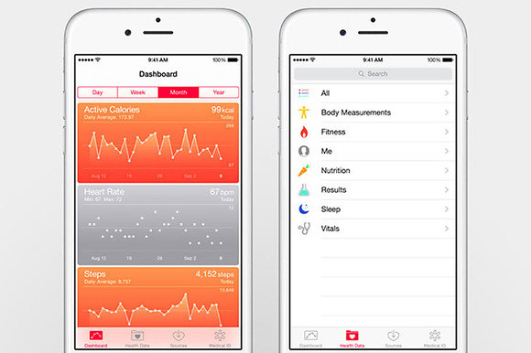
High Tech Approach to Medication Adherence

Slide 32
Effect of Stopping Medication:
Classical interpretation
Placebos start active medication==>become more like actives
Actives stop active medication and start “inactive”==>become more like placebo
Two groups become more similar
Treatment effect is underestimated/conservative
  Comforting
“Classical interpretation” may not hold:
  Example: patients stop study meds to take a medication that is better than active study medication

Slide 33
Adherence:
To Follow-up Visits

Slide 34
Impact of Loss to Follow-up
Primary concern if differential by treatment:
  Lose advantage of randomization
  Randomization no longer valid

Slide 35
Adherence to Follow-up Measurements
Goal: all visits all on time
If not possible? ????
Fall-back position: assess primary outcome on as many as possible

Slide 36
Goal: Primary Outcome on All
Large amount of missing data can lead to bias especially when LTFU varies by treatment
  Eg. Treated drop out more than placebo
  Randomization no longer valid
Other forms of bias may exist in those lost
  Older, sicker, more side effects, ...dead

Slide 37
Most Important: Complete Information for Primary Outcome
All randomized if possible
Techniques to assure complete follow-up for primary outcome
  Have all participants come to final “close out” visit (even if missed other visits)
  Bring visit to them (home visit or travel)
  Contact by telephone
  Use surrogate contact
  Use external data sources (National Death Index, Medicare, Kaiser, etc).

Slide 38
How to Increase Adherence in General
To medications and to follow-up
At each stage of study….

Slide 39
Strategies to enhance adherence: Design
Pre-randomization
  2 or more screening visits
  Exclude those who will move or non-adherent
Consider run-in period
  Trial run of drug/treatment
  Typically 2-4 weeks, usually placebo (not always)
  Value controversial
Intervention: less frequent/more convenient dosing
Study visits
  Close enough to maintain contact/not too close
Study measurements
  Painless, interesting, useful
  Give patients results (when possible)

Slide 40
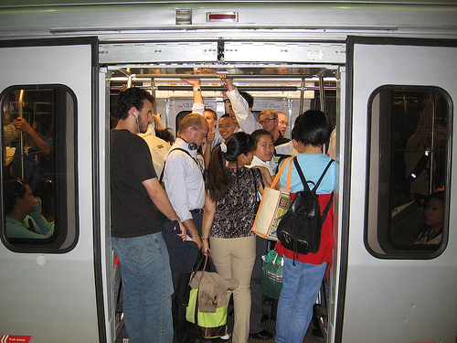

Strategies to enhance adherence: implementation
Educate participants
  Importance of science and their on-going participation
  Expectations for participation in study
Warm and fuzzy stuff
  Participants to feel appreciated
  Staff in clinic spend enough time
  Sensitive to ppts. scheduling needs
Ease of logistics/transportation to clinics
  Ex. Van for transportation: encourage group solidarity
  Reimbursement for travel
Parties/events with all participants

Slide 41
Other strategies to enhance adherence
Gifts (e.g. gift cards for moderate amounts)
Information, Newsletters, other
Emphasize prevention of early loss to follow-up
  Most drop outs occur in early study period
  FIT (4 years total); 2/3 of drop outs occurred in first year, most of those in first 6 months

Slide 42
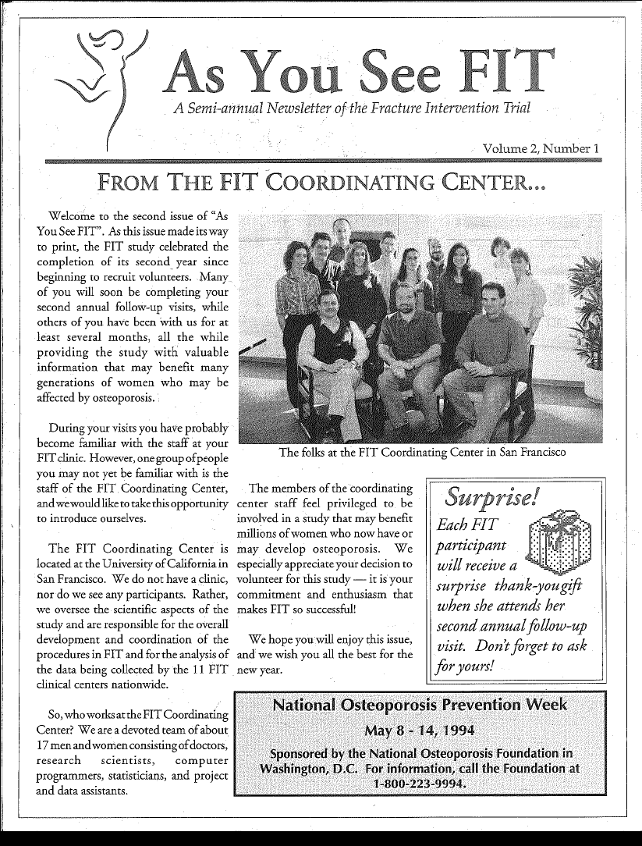
Newsletters for 6459 FIT study participants
Inside…
Taking medication
Q&A
Readers / Participant Stories
Insert for local clinics (11)

Slide 43
Newsletter for 6459 FIT study participants

Slide 44
Cookbook for participants at one site...

Slide 45

Participant reception

Slide 46
Adherence to Follow-up visits
Goal: visits all on time (within window)
Set appointments flexibly
Reminders prior to appt.
Give study calendar
Listen to concerns/problems

Slide 47
Monitoring adherence for managing study
Monitor adherence during study
Important to assess as go along
  Spot systematic or individual problems (and make corrections)
Can manage via study website

Slide 48
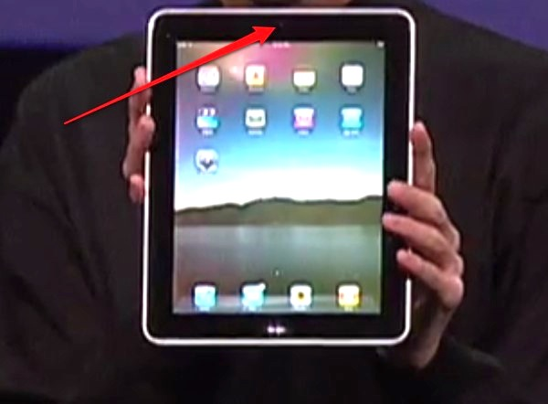


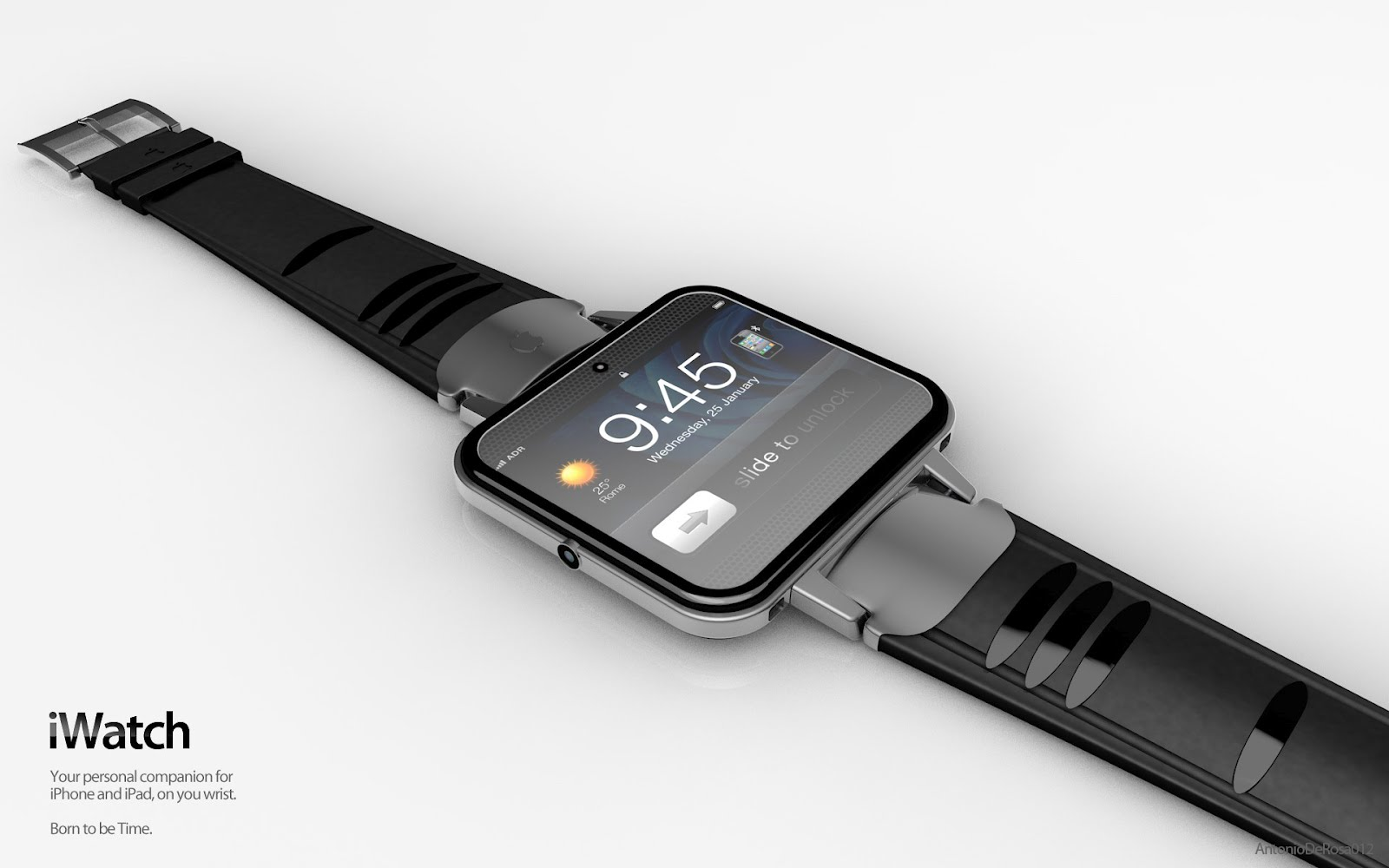
Modern ways to efficiently collect data/monitor study/enhance compliance

Slide 49
Follow-up visits for those who have stopped study medications?
Practice varies dramatically across studies
Option 1: Stop follow-up as soon as drug stops
Option 2: Continue to collect follow-up info
Advantages of each
  ??

Slide 50
Follow-up visits for those who have stopped study medications?
Practice varies dramatically across studies
Option 1: Stop follow-up as soon as drug stops
Option 2: Continue to collect follow-up info (highly recommended)
Saves money
Won’t see long term negative effects
Can do formal intention to treat analysis (ITT)
Can do all sorts of subsets and per protocol analyses
Increase costs

Slide 51
ITT:
Intention to Treat

Slide 52
Intention to Treat Analysis (ITT)*
ITT coined by AB Hill in textbook on Stat (1961)
One of the main Commandments of RCT bible
Original definition “All subjects will be analyzed according to the treatment group they were originally intended by the randomization process”
Incorporates several issues related to adherence
*Hollis and Campbell. What is meant by intention to treat analysis? BMJ 1999:319;670-4. (Syllabus)

Slide 53
Broader Interpretation of ITT
Most rigorous modern interpretation of ITT is broader and includes the following principles (Hollis, discussion):
  All patients randomized s/b included in analysis even if they didn’t start intervention
  Patients who were randomized but did not meet inclusion criterion should be included in ITT
  All patients included regardless of compliance to meds
  Ascertainment for primary outcome on all randomized

Slide 54
Two Purposes of ITT (from Hollis)
1. Maintain validity of original randomization
  Groups can only differ by chance
  Exclusion of some subjects post-randomization (e.g. didn’t take any pills) could create bias
  Medical/surgery example in Hollis (table 1)
2. Makes clinical trial more like real-world situation
  Clinicians in real world trials often deviate from protocols
  Especially important for pragmatic trials (e.g. behavioral interventions)
  (Probably a bit naive to compare any trial to the real clinical world)

Slide 55
Beware of “we did an ITT analysis”
The term “ITT” used differently in different studies
Probably does mean that all randomized (or most) were included in analysis
Examples of differences in meanings:
  In practice, ITT does NOT always mean that participants were followed beyond stopping study medications
  Very common to do Modified ITT (MITT): only include those who received at least one treatment (pill or ?)

Slide 56
How are ITT Principles Applied in Real Trials?
Hollis (1999) evaluated application of ITT in 249 trials in BMJ, JAMA, Lancet, NEJM
  About 50% (119 trials) reported using ITT
Found that most trials with (ITT claimed) violated one or more of their 4 ITT principles

Slide 57
Per-protocol analyses as alternatives to ITT
If all ppts. are followed regardless of adherence to medications, several types of options in addition to primary ITT
Various flavors of per-protocol:
Include only those patients who took all study medications and completed all visits (“completers analysis”)
Include all patients but only for the time that they remained on study medications (“on treatment analysis”)
If obtain complete follow-up on all ppts., can run several different types of analyses and any discrepancies could be informative.

Slide 58
Example of differing approaches
WRT ITT:
Coronary Bypass Surgery vs. Medical treatment
RCT of people with coronary blockage
  Randomized to surgery vs. medical treatment
768 men (with CHD)
Endpoint: Mortality 2 years after randomization
Some randomized to surgery only received medical treatment and vice versa
Different ways to deal with adherence in the analysis
Hollis and Campbell, BMJ 2004

Slide 59
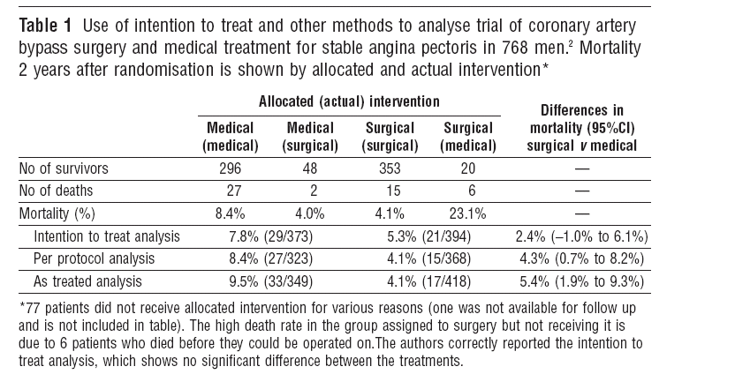
ITT analyses and alternatives
Hollis and Campbell, BMJ 2004

Slide 60
ITT analyses and alternatives
Hollis and Campbell, BMJ 2004

Slide 61
Per protocol analyses as alternatives to ITT
Hollis and Campbell, BMJ 2004

Slide 62
“As Treated” analyses as alternatives to ITT
Hollis and Campbell, BMJ 2004

Slide 63
Analysis based on post-randomization variables
Per-protocol limits analysis to adherers
Per-protocol is one example of analysis which stratifies based on post-randomization experience
  Other example: stratify based on attained value of surrogate
  In a statin trial, stratify results based on attained LDL at one year. VERY biased.
More generally, subgroup analyses by post-rand. factors are biased, sometimes extremely biased--BEWARE

Slide 64
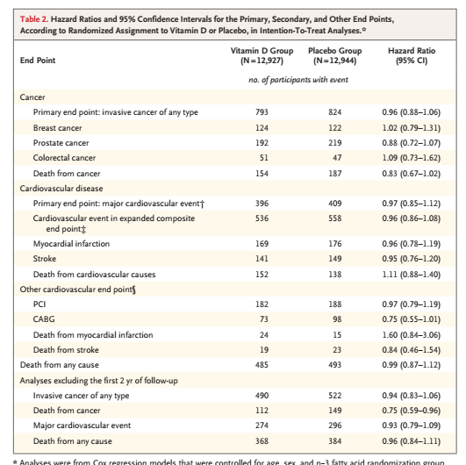

Where’s Waldo?
Can you spot the analysis group selected based on post-randomization factor(s)?
From VITAL (Manson, 2018, NEJM)

Slide 65

Can analysis be restricted to those who adhere?
Coronary Drug Project (CDP, NEJM 1980)
5 year mortality
Overall Adherence
> 80% (2/3) < 80% (1/3)
Clofibrate (n=1065) 18% 15% 25%

Slide 66
Can analysis be restricted to those who adhere?
Coronary Drug Project (CDP, NEJM 1980)
5 year mortality
Overall Adherence
> 80% (2/3) < 80% (1/3)
Clofibrate (n=1065) 18% 15% 25%
Placebo (n=2695) 19% 15% 28%
Lessons
Unknown/unmeasured confounders associated with compliance
Differ in placebo and active groups
Be wary of post-randomization groupings

Slide 67




Summary of ITT from Hollis & Campbell (1999) in BMJ:
The Brits: What they don’t do so well.....
They sure do talk gooder than us Americans

Slide 68
ITT: Key Messages (Hollis)
ITT gives a pragmatic estimate of benefit of treatment policy rather benefit in patients who receive treatment exactly as planned
Full application of ITT possible only when complete outcome available on all randomized
Many trials that claim ITT varied in handling of missing data, deviations from protocol, etc.
ITT often inadequately described and applied
Hollis and Campbell, BMJ 1999

Slide 69
Recommendations for ITT (Hollis)
ITT best regarded as complete trial strategy (design, conduct, analysis) and not simply analysis
Design
  Justify in advance any inclusion which if violated merit exclusion from ITT
Conduct
  Minimise missing response on primary outcome
  Follow up subjects who withdraw from treatment
Analysis
  Include all subjects according to randomization
  Investigate potential effects of missing response
Hollis and Campbell, BMJ 1999

Slide 70
Recommendations for ITT
Reporting
  Specify how ITT used (explicitly describe handling of deviations from randomization and missing responses)
  Report deviations and missingness
  Discuss potential effects of missing response
  Base conclusions on ITT analyses
Hollis and Campbell, BMJ 1999

Slide 71
Problems with ITT/full follow-up approach
ITT/full follow-up not holy grail
Does not estimate full biologic efficacy of drug/intervention
  Advising individual patients may depend on efficacy in individuals
May be anti-conservative for adverse effects
  per-protocol (limited to those who actually took meds) may be preferred
Primary analysis should be ITT
  Secondary analyses may be per protocol
  Explain discrepancies between ITT and pp

Slide 72
CONSORT Guidelines for Reporting Results of Trials
http://www.consort-statement.org/
Guidelines for standardized reporting of various aspects of follow-up in randomized studies
“The CONSORT Statement is intended to improve the reporting of a randomized controlled trial (RCT), enabling readers to understand a trial's design, conduct, analysis and interpretation, and to assess the validity of its results. It emphasizes that this can only be achieved through complete transparency from authors.”
Adopted by most top-tier and many other journals
http://www.consort-statement.org/

Slide 73
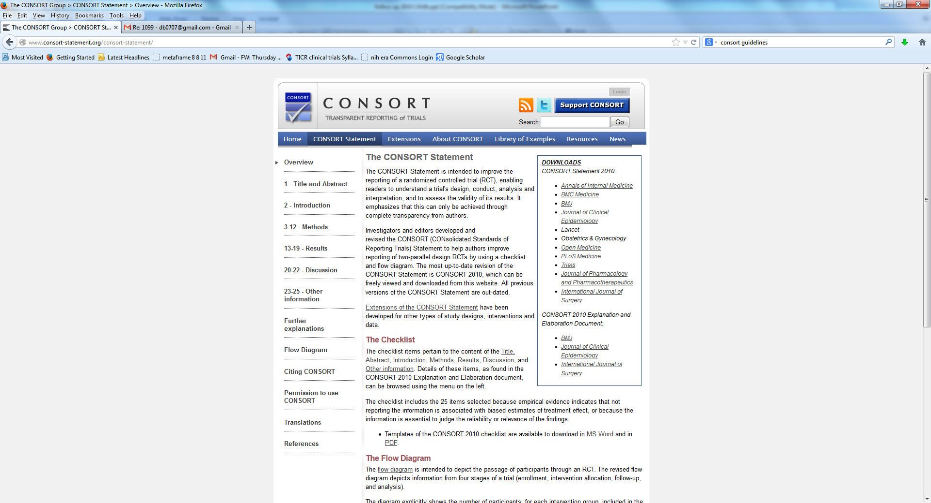
CONSORT checklist

Slide 74
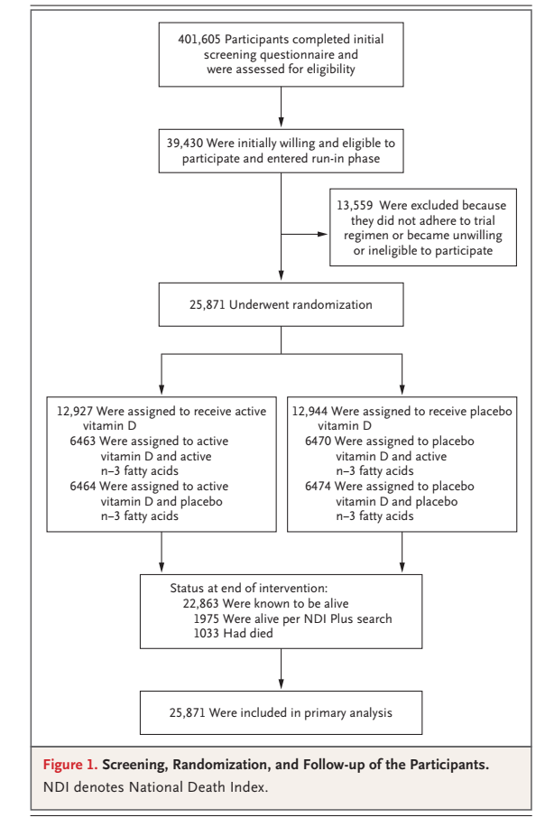
VITAL: CONSORT

Slide 75
Example of CONSORT Flowchart:
Trial of Zoledronic acid vs. placebo
(Annual IV dose)
Black, NEJM,
5/07

Slide 76
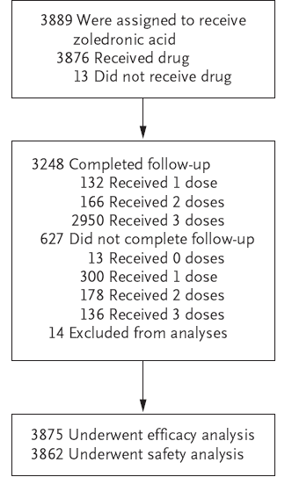
Includes information of completeness of follow-up and on medication-taking
Plus other stuff

Slide 77
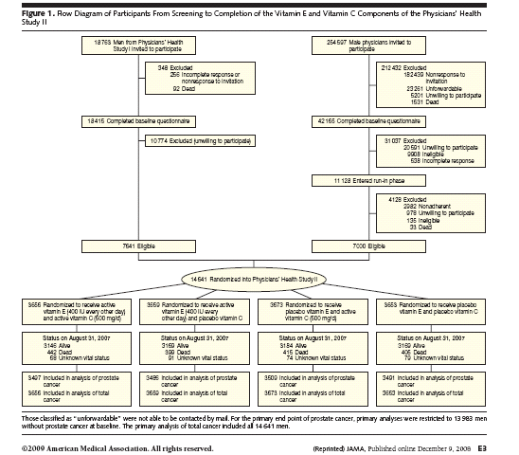
Another example of CONSORT Diagram:
Gaziano, Vit. C and E for Prostate CA
JAMA, 1/09

Slide 78
Follow-up and Adherence: Summary
Best trial (follow ITT principles):
  All participants remain on meds
  All randomized participants are followed for primary outcome until end of study
  Pre-planned analysis and handling of deviations from protocol
Design and implementation of study can help move toward that goal
Important to report details about adherence and how it could affect results
  CONSORT diagram is useful
  If designing or reporting a trial, follow CONSORT guidelines

Slide 79
THANKS!

Slide 80
Brief Introduction to Sample Size Planning for RCTs
Following slides or see
- Hulley DCR book
- Videos from DCR course

Slide 81
Introduction to Sample Size Planning
How large do I need to make my study?
All RCT’s involve a comparison of treatments..
  Dichotomous predictor variable (treatment vs. control)
  Simplest case: 2 group comparison
Only brief intro..(see Hulley p 50-81) or videos from DCR course

Slide 82
Overview of sample size planning
(Hulley p 55)
State null and alternative hypotheses (1 vs 2 sided)
Statistical test (depends on outcome type)
3. Choose effect size (more in Hulley)
  - Continuous: mean difference and variability
  - Dichotomous: difference in proportions
4. Set α (significance level) and 1-β (power)
5. Use sample size tables or formula to calculate required sample size

Slide 83
Example: Continuous Endpoint
(p 57 Hulley)
Albuterol vs. ipratropium bromide for asthma
Endpoint: FEV1 (lung function) at study end
Continuous, mean, t-test
Previous data shows mean FEV =2L in asthmatics
Investigator wants to detect difference of 10% (=0.2L)
SD of 1L for treated asthmatics

Slide 84
Example of sample size estimation
Null hypothesis: No difference in FEV1 between treatments (alternative: two sided)
Statistical test: T-test (FEV1 is continuous outcome)
3. Effect size: 10% increase in FEV1 (treated vs. control)
10% x 2 L=0.2 L. SD=1 L (previous). Standardized effect = Effect/SD=0.2/1 =0.2
4. α=.05 (two sided) and power = 0.80 (β=.2)
5. Can use table Hulley page 73. n=394 per group

Slide 85
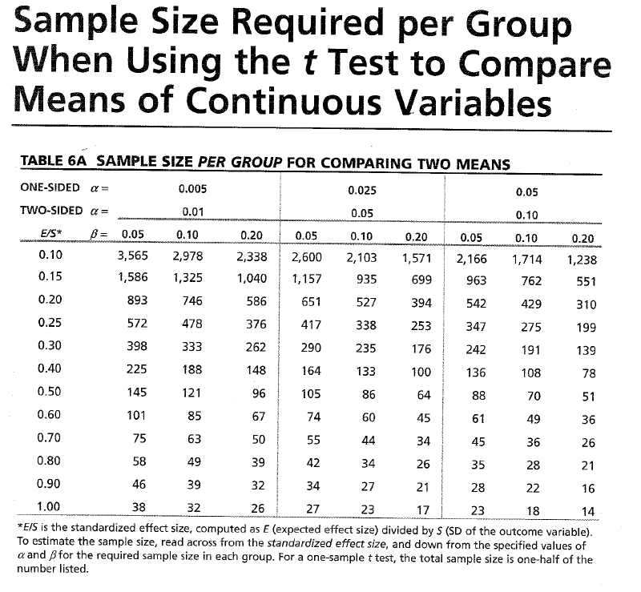
P 73
Hulley

Slide 86
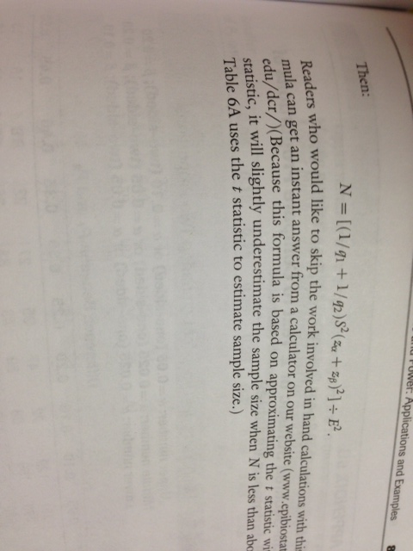

Slide 87
Samples size dichotomous outcome
Use Chi squared test
Effect size: Proportions with outcome in treatment 1 and in treatment 2
eg. 5% vs 10%
See Hulley page 58-59. Effect size:
Tai-Chi vs. running for back pain
Plan --joggers: 30% back pain
Reduced to 20% with Tai-Chi
α=.05 (two sided) and power = 0.80 (β=.2)
N=313 per group

Slide 88
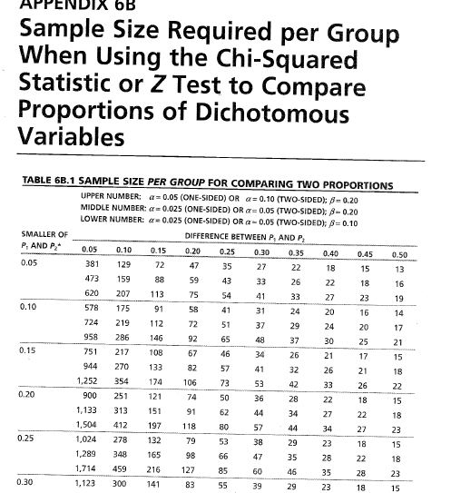
P75 Hulley
Hulley p 75
Back Pain: 20% vs. 30%

Slide 89
Choose statistical test
What is the type outcome of my study?
  A. Continuous (eg. Lipids, BP, depression score, FEV)
  Use T-Test to compare means across 2 treatment groups
  B. Dichotomous (event) or time to event
  Simplify for sample size as dichotomous
  Use Chi-squared test to compare proportion across treatment groups.
  C. Other situations: more than 2 treatments, non-normal outcome variable

Slide 90
Effect size
Most difficult part of sample size planning
Difference between treated and control groups (in truth).
What size of difference would make your treatment worthwhile?
What size of difference do you expect to see?
Often compromise, smaller effect requires larger sample size

