Slide 1
DCEA Journal Club

Slide 2
Questions for evaluation of CEA articles
1. What is the research question? Does the article clearly state what activities or services (or lack thereof) are being compared?
2. To what population, and disease or condition is the intervention relevant?
3. What is the study’s analytic perspective?
4. Is discounting handled properly?
5. List the major health outcomes and outcome measures.
6. Describe briefly how outcomes and costs are assessed.
7. What would you say is the greatest methodological strength of the analysis?
8. Neither paper has a “Limitations of this analysis” paragraph, so often found in the Discussion section. If you were going to write that paragraph, what points would you make?
9. I know we haven’t had the lecture on sensitivity analyses yet, but based on what you understand so far, do you think the SAs were handled properly and thoroughly?
10. Do you find the results / recommendations convincing? In your opinion, does the paper over- (or under-) claim the generalizability of its findings?

Slide 3
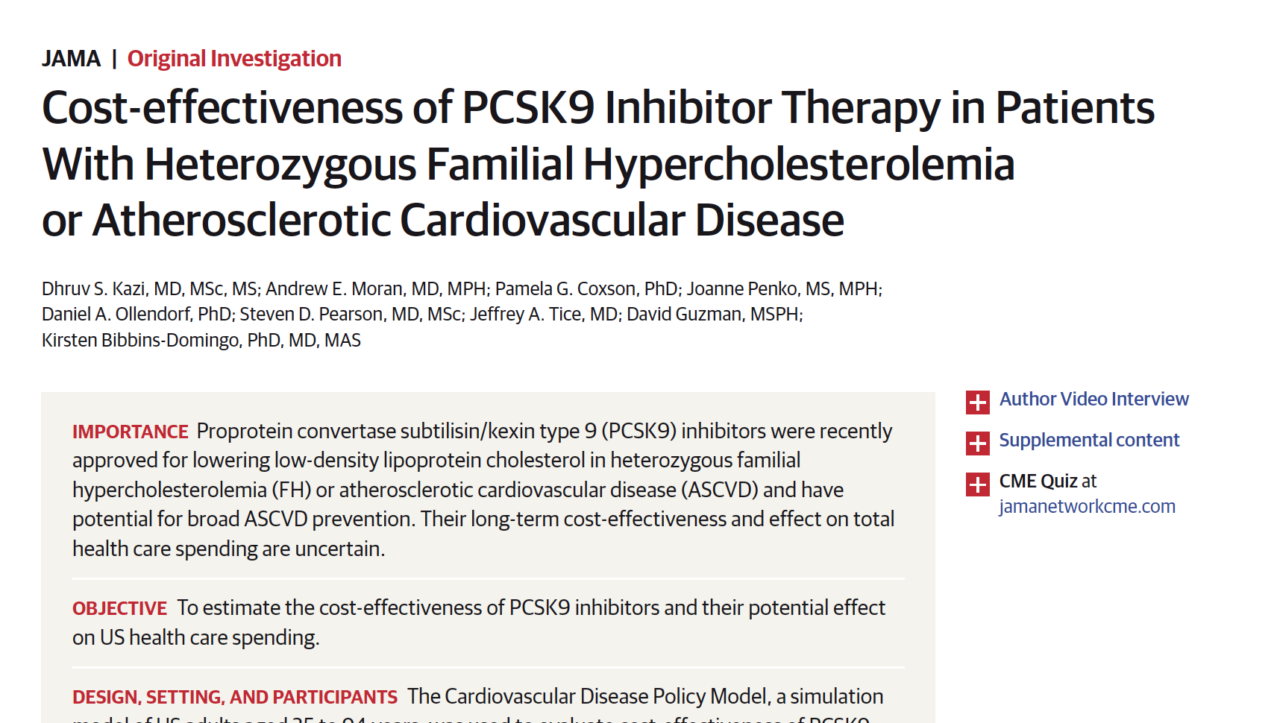

Slide 4
1. What is the research question?
What activities or services are being compared?

Slide 5
1. What is the research question?
Is PCSK9 Inhibitor therapy cost-effective in patients with familial hypercholesterolemia or ASCVD compared with statin therapy or statin + ezetimide?

Slide 6
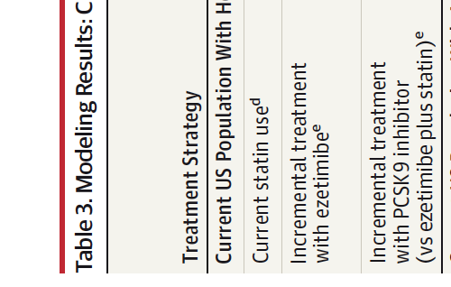
What activities or services are being compared?

Slide 7
2. To what population, and disease or condition is the intervention relevant?

Slide 8
2. To what population, and disease or condition is the intervention relevant?
Current US Population With Heterozygous FH for Whom Additional Lipid-Lowering Therapy Is Indicated
Current US Population With ASCVD for Whom Additional Lipid-Lowering Therapy Is Indicated

Slide 9
3. What is the study’s analytic perspective?

Slide 10
3. What is the study’s analytic perspective?
Health system

Slide 11
4. Is discounting handled properly?

Slide 12
4. Is discounting handled properly?
3% annually

Slide 13
5. List the major health outcomes and outcome measures.

Slide 14
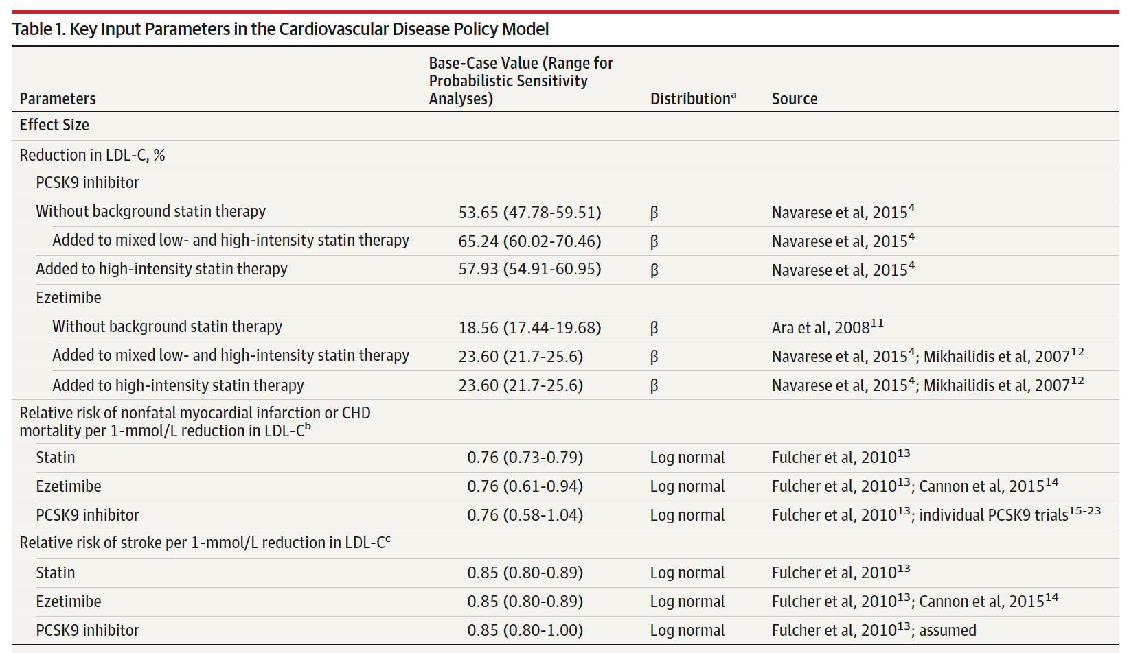

Slide 15
5. List the major health outcomes and outcome measures.
Primary Outcome Measure: ICER over lifetime horizon
Secondary Outcome Measures:
(1) incremental cost per life-year gained
(2) the number of patients that would need to be treated for 5 years to avert 1 major adverse cardiovascular event (MACE, defined as a composite of cardiovascular death, nonfatal MI, or nonfatal stroke)
(3) the price at which the drugs became cost-effective at a willingness-to-pay threshold of $100 000 per QALY
(4) the total effect on the US health care budget over the next 5 years if all eligible patients were to receive PCSK9 inhibitors
(compared with receipt of ezetimibe)
(5) the net monetary benefit of incremental therapy with a PCSK9 inhibitor at willingness-to-pay thresholds ranging from $50,000 to $1,000,000 per additional QALY.

Slide 16
6. Describe briefly how outcomes and costs are assessed.

Slide 17
7. What would you say is the greatest methodological strength of the analysis?

Slide 18
8. Neither paper has a “Limitations of this analysis” paragraph, so often found in the Discussion section. If you were going to write that paragraph, what points would you make?

Slide 19
9. I know we haven’t had the lecture on sensitivity analyses yet, but based on what you understand so far, do you think the SAs were handled properly and thoroughly?

Slide 20
9. Sensitivity Analyses
1-way sensitivity analyses –Table 1
Several prespecified scenario analyses were also performed, including
(1) using higher LDL-C thresholds to define heterozygous FH (LDL-C ≥250 mg/dL [6.46 mmol/L] without statin therapy or LDL-C ≥200 mg/dL [5.17 mmol/L] with statin therapy) and assuming a higherASCVD risk than predicted by LDL-C level (2 times the risk for individuals with heterozygous FH compared with individuals without FH for the same LDL-C level)
(2) modeling the main effect of ezetimibe and PCSK9 inhibitors on cardiovascular outcomes as seen in clinical trials (rather than based on the LDL-C hypothesis)
(3) initiating PCSK9 inhibitors only after incident MI (by simulating addition of PCSK9 inhibitors among those with incident MI in the base year)…

Slide 21
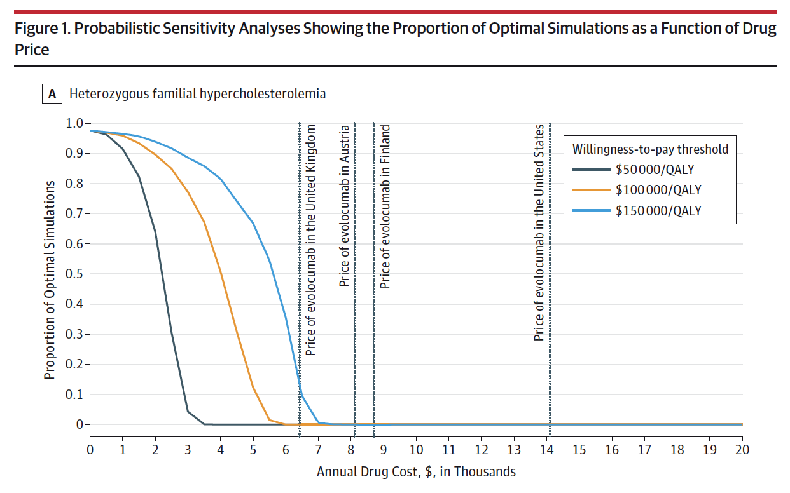

Slide 22
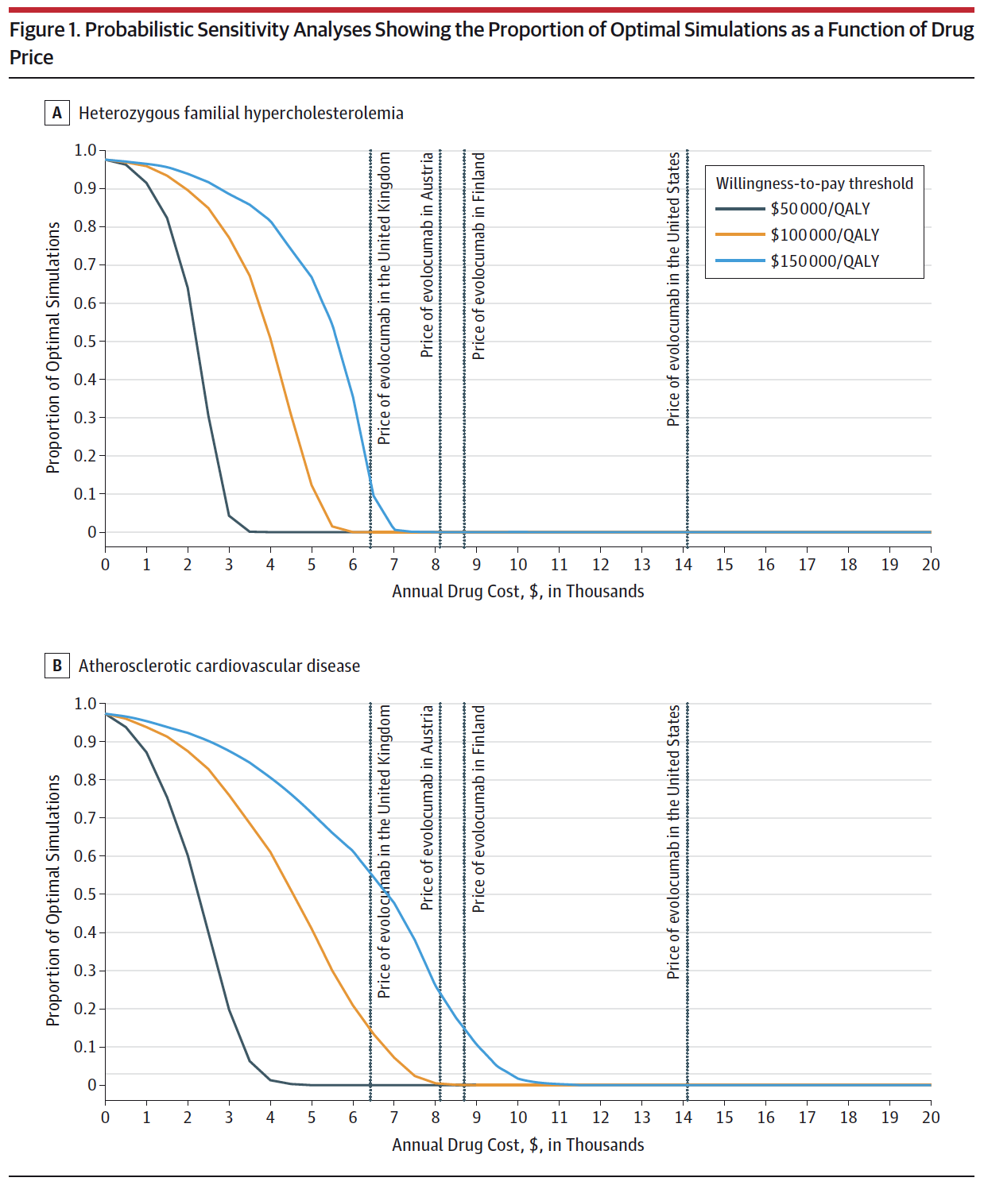

Slide 23
10. Do you find the results / recommendations convincing? In your opinion, does the paper over- (or under-) claim the generalizability of its findings?

Slide 24
10. Do you find the results / recommendations convincing? In your opinion, does the paper over- (or under-) claim the generalizability of its findings?
PCSK9 inhibitor use in patients with heterozygous FH or ASCVD did not meet generally acceptable incremental cost effectiveness thresholds and was estimated to increase US health care costs substantially. Reducing annual drug prices from more than $14,000 to $4536 would be necessary to meet a $100, 000 per QALY threshold.

Slide 25
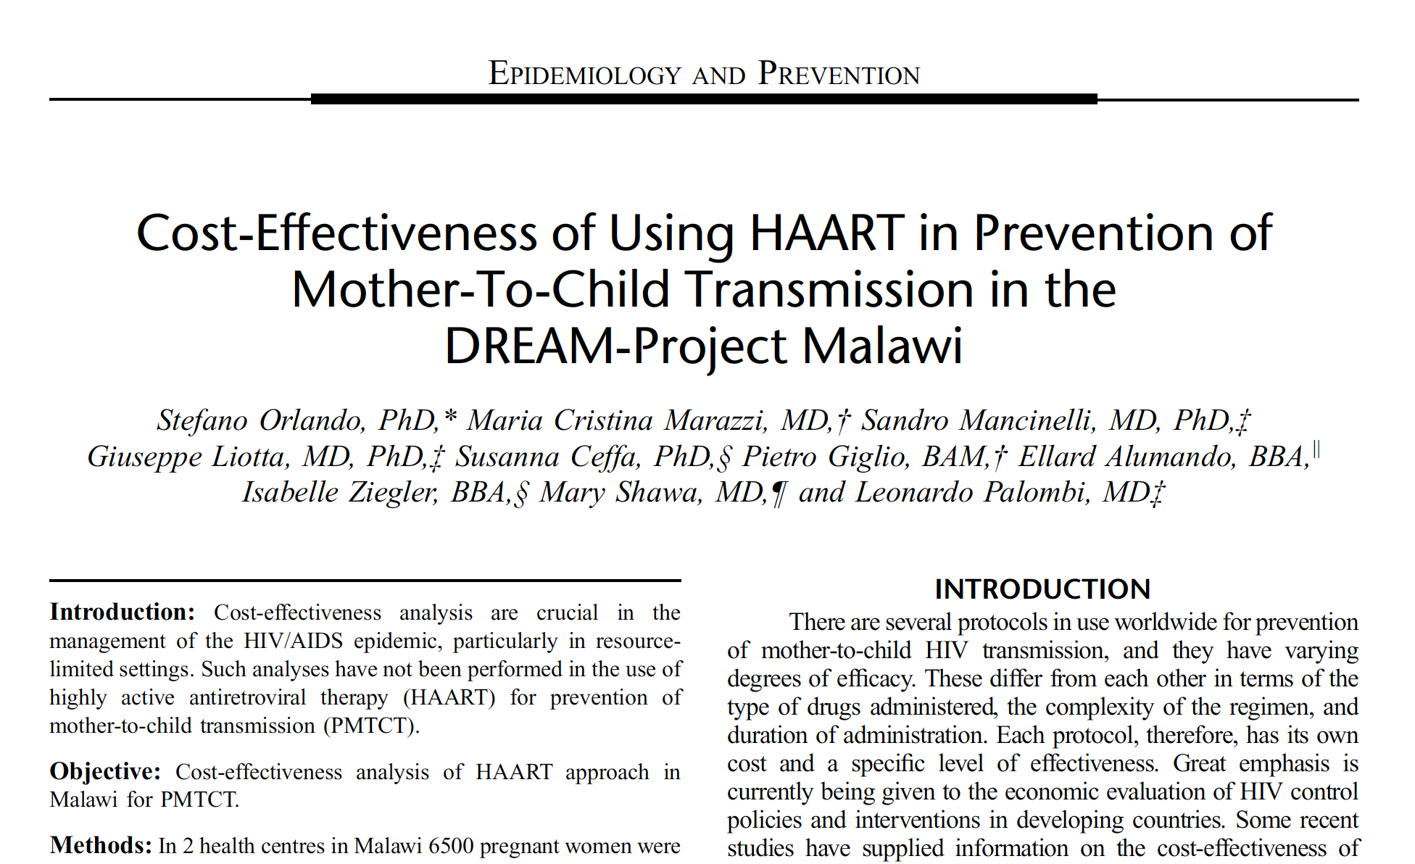

Slide 26
1. What is the research question?
What activities or services are being compared?

Slide 27
1. What is the research question?
Is (HAART) for prevention of mother-to-child transmission (PMTCT) cost-effective in Malawi compared with no intervention.
What activities or services are being compared?
HAART vs. no intervention

Slide 28
2. To what population, and disease or condition is the intervention relevant?

Slide 29
2. To what population, and disease or condition is the intervention relevant?
Pregnant women in Malawi

Slide 30
3. What is the study’s analytic perspective?

Slide 31
3. What is the study’s analytic perspective?
Private perspective, namely taking into account the costs borne by the service provider.
Public perspective, taking into account the costs borne by the local public health service and cost savings to the public sector given the number of infections averted.

Slide 32
4. Is discounting handled properly?

Slide 33
4. Is discounting handled properly?
Discount amounting to 15% for VCT in the base case (external benefits)
3% discount rate (0-6% in sensitivity analysis)
Discount rate for future benefits of 3% normally considered in cost-effectiveness analysis

Slide 34
5. List the major health outcomes and outcome measures.

Slide 35
5. List the major health outcomes and outcome measures.
Outcome measures:
Cost for infection averted
Cost for DALY saved

Slide 36
6. Describe briefly how outcomes and costs are assessed.

Slide 37
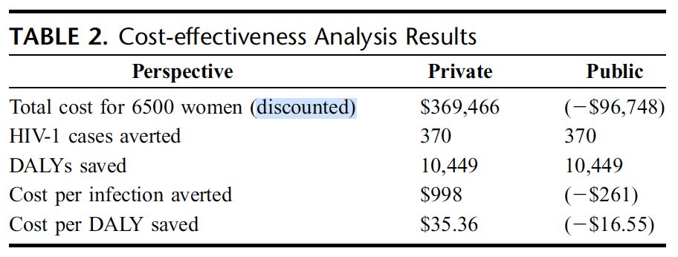

Slide 38
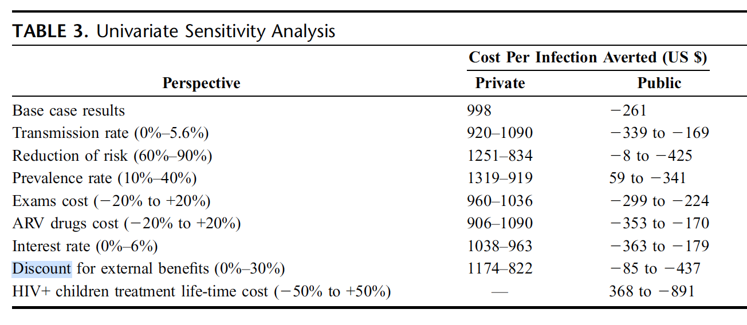

Slide 39
7. What would you say is the greatest methodological strength of the analysis?

Slide 40
8. Neither paper has a “Limitations of this analysis” paragraph, so often found in the Discussion section. If you were going to write that paragraph, what points would you make?

Slide 41
9. I know we haven’t had the lecture on sensitivity analyses yet, but based on what you understand so far, do you think the SAs were handled properly and thoroughly?

Slide 42
10. Do you find the results / recommendations convincing? In your opinion, does the paper over- (or under-) claim the generalizability of its findings?

Slide 43
PRIDE
Professionalism
Respect
Integrity
Diversity
Excellence

