Slide 1
The Ethical Foundation of Cost-Effectiveness Analysis in Resource Allocation for Global Health
Epi 213
February 27, 2019
Elliot Marseille, DrPH, MPP
Health Strategies International

Slide 2
What’s the problem?
Decision makers sometimes led to diverge from maximizing health outcomes because of ethical concerns:
CEA-bases life / death decisions on mathematically-derived ROI criteria.
Thus, technocratic, cold, lacks empathy.
Often violates every day ethical intuitions.
  Empathy
  Compassion
  Decisions based on “mere” efficiency criteria are suspect.
Many technical concerns regarding CEAs accuracy or reliability.
This talk confined to ethical concerns.

Slide 3
Goals of this presentation
Introduce you to the ethical foundations of cost-effectiveness analyses (CEA), namely utilitarianism.
Stimulate you to think critically about ethical arguments pertaining to resource allocation.
  Theoretical validity
  Practical implications
Persuade you that utilitarianism as expressed in CEA is usually the right basis for resource allocation decisions.
#3: Well, not exactly . . . rather it is to stimulate you to engage with my argument. If you reject or modify it, be explicit about your reasoning.

Slide 4
Utilitarianism - or “Deep pragmatism”:
Philosophy Underlying CEA
Stems from Consequentialism: Judge actions by outcomes not by intentions or by fidelity to abstract moral principle.
Utilitarianism: First articulated by Jeremy Bentham and John Stuart Mills
  Mills’ “Utilitarianism” published in 1863
  Joshua Greene – Moral Tribes (2013)
  Many others
Maxim of utilitarianism is, “Act in such a way as to generate the maximum quantum of well-being, happiness, or utility.”
In the context of global health, this implies:

Slide 5
Implications of Deep Pragmatism for Global Health
Allocate resources consistent with maximizing overall benefit, such as deaths averted or quality-adjusted life-years gained.
All lives have the same value. No basis for distinguishing between identified and statistical lives.
No special claim accrues to alleviation of inequality, except to the extent that privileging the poor, or those with less access to care is an efficient means to achieving #1, above.

Slide 6
Competing ethical principles
According to what principle(s) should funds for antiretroviral be divided between prevention (PrEP) and treatment?¹
Not enough $ to serve all who could benefit.
The trade-off is real.
1. Macklin R, and Cowan E, “Given Financial Constraints, It Would Be Unethical to Divert Antiretroviral Drugs from Treatment to Prevention”, Health Affairs, 2012.

Slide 7
Competing ethical principles
Macklin R, and Cowan E, “Given Financial Constraints, It Would Be Unethical to Divert Antiretroviral Drugs from Treatment to Prevention”, Health Affairs, 2012
Utilitarianism: Maximize health benefit
Rule of rescue: Identified lives get first claim
Urgent need: Greater urgency = greater claim on resources.
Equal worth: Since all lives have equal worth same care must be offered to all.
Equity: Divide resources so outcomes are distributed as equitably as possible; reduce disparities in health status.
Prioritarian: Resources provided to the least advantaged members in society.
Rights¹: Certain freedoms, process under law or material goods are due all human beings.
1. E. Marseille’s addition; not from Macklin and Cowan, 2012.
In allocating resources, what weight do we assign to each?
Should ”balance” be the goal?

Slide 8
That’s okay if these claims complement each other, but . . .

Slide 9
Where does that leave us?
“When principles conflict, it becomes necessary to balance competing concerns. There is no correct way of achieving this balance.” ¹
Why “balance”? And if balance, in what proportion?
“The ultimate goal, of course, is to achieve a utilitarian outcome tempered by considerations of equity and urgent need.” ¹
Why “of course”?
How does this help us?
It does not.
1. Macklin R, and Cowan E, “Given Financial Constraints, It Would Be Unethical to Divert Antiretroviral Drugs from Treatment to Prevention”, Health Affairs, 2012

Slide 10
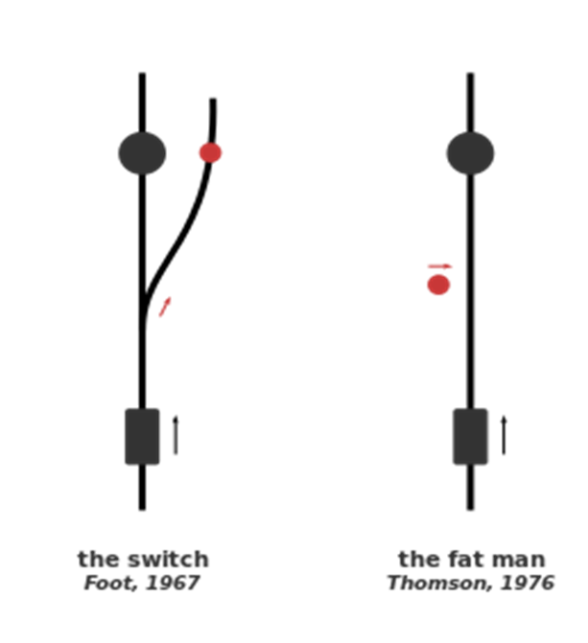
More trouble - Insights from “Trollyology”
One death if active vs five if passive.
Pull switch vs push someone onto tracks.
Is the anti-push intuition absolute?
Is visceral repulsion a sound basis for moral reasoning?

Slide 11
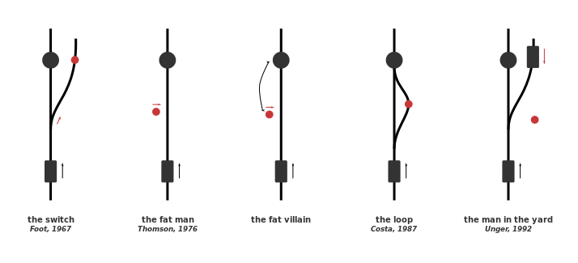
More Trollyology

Slide 12
Still more Trollyology
Do these thought experiments undermine your confidence in
everyday ethical intuitions?

Slide 13
Wait there’s more . . .
Are our ethical intuitions derived from
evolutionary pressures and cultural contingency?
Notes:
Loop: The set-up is like the original Switch case, Only this time the sidetrack loops back onto the main track. If there was nothing on the sidetrack, flipping the switch would not save the five workers (the trolley would collide with them eventually). Fortunately (or unfortunately), there is a single worker on the sidetrack. So if you flip the switch, the trolley will collide with (and kill) him and therefore stop before it loops back to the main track. Do you flip the switch? 81% of experimental subjects said “yes”.
Doctrine of Double Effect (DDE): It is impermissible to cause harm as a means to a greater good; but it may be permissible to cause harm as a side effect of bringing about a greater good.

Slide 14
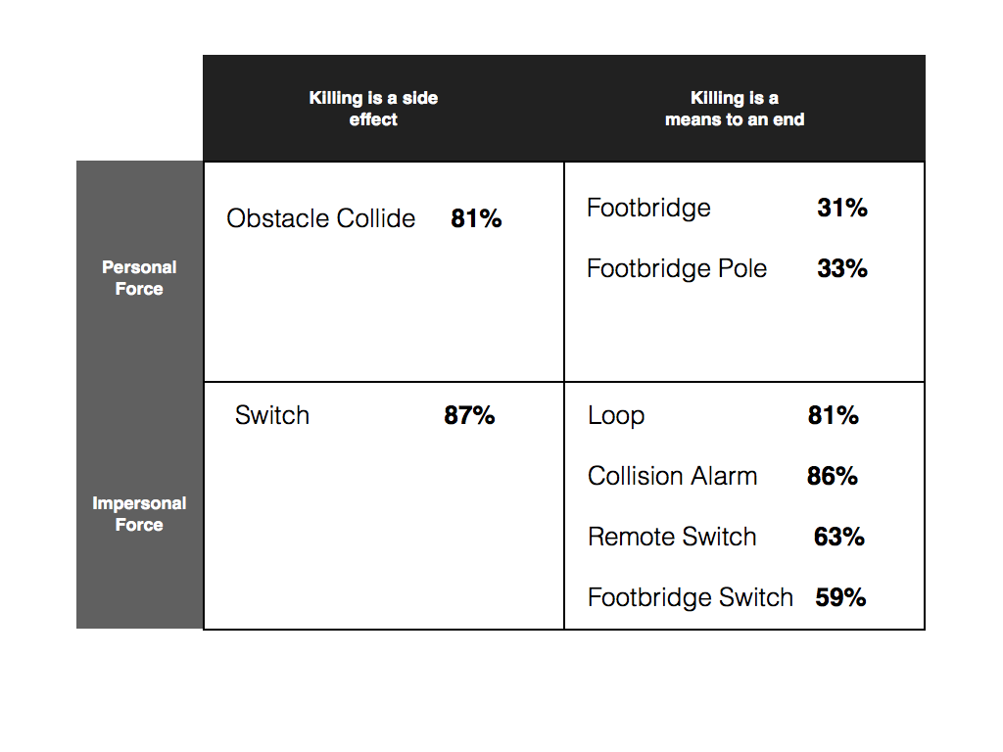
https://philosophicaldisquisitions.blogspot.com/2014/02/advanced-trolleyology-and-doctrine-of.html

Slide 15
“Is a statistical life worth less than an identified life?”
For example, are people who need treatment in a different ethical class from those who need prevention?

Slide 16

Or, is preferential treatment of identified lives a function of the evolution of ‘moral brains’ based on community affiliation?
One person’s statistical life = another person's identified life.
Might preference for identified lives thus be due to a failure of imagination?

Slide 17
The case against empathy¹ and the virtues of cold blood
Evidence that empathy is associated with
Narrow-minded / Parochial perspective
Innumeracy
Short-term thinking
Vindictiveness
Perhaps empathy makes us want to feel good rather than to do good.
1. Bloom P. Against Empathy: The Case for Rational Compassion: Barnes and Noble; 2016.

Slide 18
What I am not saying
Efficiency-based, CEA criteria are always best
for resource allocation.
Who wants to live in a world where a child is left to drown in a well, because rescue is not cost-effective?

Slide 19
What I am saying
If deviating from “Deep pragmatism” and efficiency,
confront the trade-off.
How many lives of richer people are you willing to trade off for the life of a poor person?
How many statistical versus identified lives?
Promotion of other values such as “Women’s rights and empowerment” versus immediate health benefit?

Slide 20
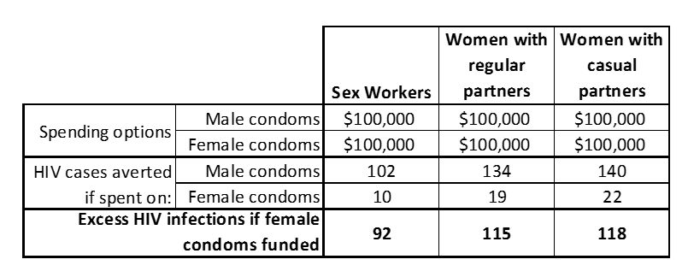
Confronting the trade-off between efficiency and a rights or equity-based resource allocation decision
Efficiency is not merely one criterion among many. It has its own ethical dimension.

Slide 21

Resolve the conflict between efficiency and other criteria?
Two sides of our nature.
  “Fast brain”: Emotional, empathic, small numbers
  “Slow brain”: Rational, calculating, large numbers
Undesirable and futile to deny our emotional, empathic natures. Expressed in:
  Clinical medicine.
  Many other areas of society pertaining to family and community.
“Global health” and “public health” pertain to populations and thus more abstract modes of reasoning are appropriate.

Slide 22
Thank you

