Slide 1

Genetic Susceptibility and Cancer
John S. Witte
wittelab.ucsf.edu

Slide 2

Choose Parents Wisely!
Jane Genovese, www.mindmapart.com
Notes:
http://www.youtube.com/watch?v=0OnwOKiMVb8

Slide 3
Overview
Heritability & Familiality
Association studies
Polygenic Risk Scores
Pleiotropy

Slide 4
1. Heritability
Evaluates the genetic contribution to a trait (e.g., cancer) in terms of variance explained.
Phenotype = Mean + Genetics + Environment
P = µ + G + E
Overall variation in Phenotype P
Var(P) = σ²_{P} = σ²_{G} + σ²_{E}
Notes:
4

Slide 5
Twin Studies
ACE Model: σ²_{P} = σ²_{A} + σ²_{C}+ σ²_{E}
A: Additive genetics
C: Common Environment
E: Unique Environment
Correlation in phenotype (P₁, P₂) among twins:
- Corr_{mz}(P₁, P₂) = r_{mz} = A + C [100% genes + Env]
- Corr_{dz}(P₁, P₂) = r_{dz} = ½A + C [50% genes + Env]
Heritability: h² = 2(r_{mz}- r_{dz} )

Slide 6
Example of heritability from Twin Study: Prostate Cancer
Twin registry (Sweden, Denmark, and Finland)
Twin | Concordant pairs (cp) | Discordant pairs (dp) | Concordance 2cp / (2cp+dp)
MZ | 197 | 807 | 0.33 (r_{mz})
DZ | 148 | 1719 | 0.15 (r_{dz})
heritability = 2(r_{mz}- r_{dz} ) = 2(0.33-0.15)
= 0.36
Mucci et al. JAMA 2016;315:68
(actual paper estimate uses Structural Equation Modeling, so differs)
Notes:
6

Slide 7
 | Twin/Family-Based Heritability | Array-Based Heritability
Cancer Site | Mucci et al. | Rashkin et al.
Bladder | 0.07 (0.02-0.11)^{e} | 0.08 (0.04-0.12)
Breast | 0.31 (0.11-0.51) | 0.10 (0.08-0.13)
Cervix | 0.13 (0.06-0.15)^{e,+} | 0.07 (0.02-0.12)
Colon | 0.15 (0.00-0.45) | 0.07 (0.04-0.10)
Endometrium | 0.27 (0.11-0.43) | 0.13 (0.07-0.18)
Esophagus/Stomach | 0.22 (0.00-0.55)⁺⁺ | 0.14 (0.07-0.21)
Kidney | 0.38 (0.21-0.55) | 0.09 (0.04-0.15)
Lung | 0.18 (0.00-0.42) | 0.15 (0.10-0.20)
Lymphocytic Leukemia | 0.09 (0.09-0.16)^{e,+++} | 0.14 (0.05-0.23)
Melanoma | 0.58 (0.43-0.73) | 0.08 (0.04-0.11)
Non-Hodgkin’s Lymphoma | 0.10 (0.08-0.10)^{e} | 0.13 (0.03-0.23)
Oral Cavity/Pharynx | 0.09 (0.00-0.60) | 0.04 (0.00-0.13)
Ovary | 0.39 (0.23-0.55) | 0.07 (0.01-0.13)
Pancreas |  | 0.06 (0.00-0.18)
Prostate | 0.57 (0.51-0.63) | 0.16 (0.13-0.20)
Rectum | 0.14 (0.00-0.50) | 0.11 (0.07-0.16)
Testis | 0.25 (0.15-0.37)^{e} | 0.26 (0.15-0.38)
Thyroid | 0.53 (0.52-0.53)^{e} | 0.21 (0.09-0.33)

Slide 8
Familial Aggregation

Slide 9
Harry Potter’s Pedigree
Muggle
Wizard /
Witch
Vernon Dursley
Petunia Dursley
Lily Evans
James Potter
Dudley Dursley
Harry Potter
Notes:
Study families.
Estimate ‘mode of inheritance’ & what type of genetic variant might be causal.
I.e., determine whether the disease appears to follow particular patterns (recessive, dominant, co-dominant, log-additive).
Estimate whether variants are rare or common, etc.

Slide 10
Filch?
Squib
Argus Filch
Notes:
May need to focus on parents
Ex: Poor phenotype may be caused by inadequate environment during development
Maternal / fetal incompatibility
Maternal infection
Maternal gene*diet interaction
“Trait” is “provision of poor fetal environment”

Slide 11
Familial Aggregation (PANSCAN)
 | Cases (%) | Controls (%) | Adjusted OR (95% CI)
Family history of pancreatic cancer in 1st degree relatives
No | 1,107 (93.6) | 1,162 (94.4) | 1.00
Yes | 76 (6.4) | 43 (3.6) | 1.76 (1.19-2.51)
Number of affected 1st degree relatives with pancreatic cancer
One | 70 (92.1) | 42 (97.7) | 1.70 (1.14-2.51)
Two or more | 6 (7.9) | 1 (2.3) | 4.26 (0.48-37.79)
Jacobs et al., 2010

Slide 12
How Does Family History Increase Risk of Cancer?
Table 2 FRR for first-degree relatives of cancer probands by site, in decreasing order of prevalence
Utah
Sweden
Site | FRR
Prostate | 2.21
Breast | 1.83
Colorectal | 2.54
Lung | 2.55
Uterine | 1.32
Melanoma | 2.10
Bladder | 1.53
Non-Hodgkin’s lymphoma | 1.68
Brain/CNS | 1.97
Cervix | 1.73
Ovary | 2.04
Stomach | 2.08
Kidney | 2.46
Oral cavity | 1.82
Thyroid | 8.48
Multiple myeloma | 4.29
Granulocytic leukemia | 2.94
Lymphocytic leukemia | 5.00
Hodgkin’s lymphoma | 1.25
Female genitalia | 2.22
Soft tissue sarcoma | 2.00
Testicular | 8.57
Gallbladder | 2.22
Larynx | 8.00
Total, mean | 2.12
Total, median | 2.15
Risch CEBP 2001:10:733-741

Slide 13
Overview
Heritability & Familiality
Association studies
Polygenic risk scores
Pleiotropy

Slide 14
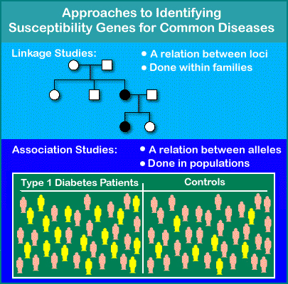
2. Association Studies
ROCHE Genetic Education (www)
Notes:
14
Compare alleles between individuals with extreme levels of a phenotype (i.e., cases and controls).
Association exists when cases are more (or less) likely than the controls to carry particular alleles (E.g., G).

Slide 15
Association Study Design:
Control Selection
Controls should be:
  Selected from the cases’ source population
  those individuals who, if they were diseased, would become cases

Slide 16
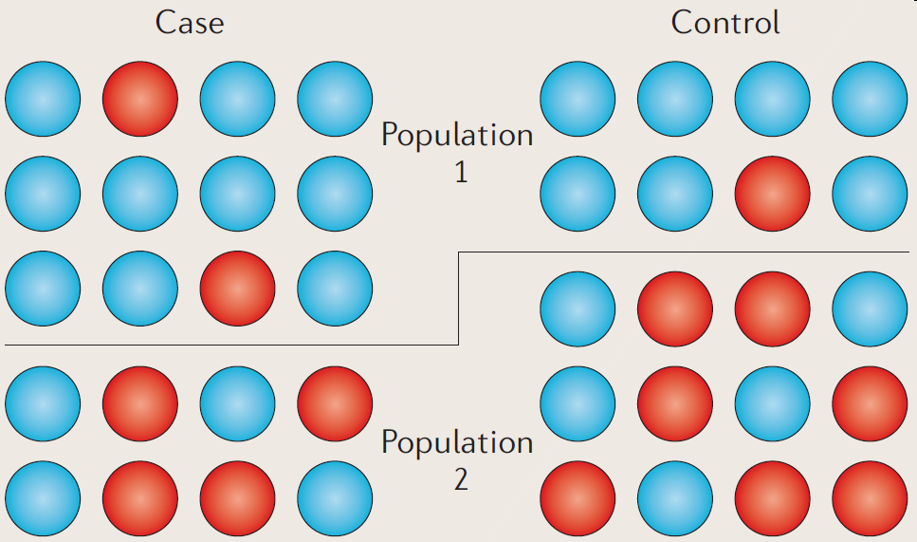
Population Stratification
Two populations have different allele frequencies and background rates of disease.
Can lead to biased association results.
Balding, Nature Reviews Genetics 2010

Slide 17
How can we address the potential bias due to population stratification?

Slide 18
Continuum of Assoc Study Designs
Population-based
“Ethnicity” Matched
Structured Assoc
Family-based
Population Stratification
Overmatching
(Bias (maybe)……………versus…............. less efficient)
Subpopulation
↑ Sharing of genes & envt.
Efficiency
Also, recruitment issues
Gene
Disease

Slide 19
Association Study Approaches
Direct vs Indirect
Candidate genes
Genome-wide Association Studies (common variants)
Exome-wide Association Studies
(rare variants)
All variants in genes/genome (sequencing)
  Expensive

Slide 20

Linkage Disequilibrium (LD)
LD: non-random association of alleles at two or more loci that descend from a single, ancestral chromosomes.
Important fundamental concept will come up repeatedly.
Hirschhorn & Daly, Nat Rev Genet 2005
Notes:
20

Slide 21
GWAS of Common Cancers
UK Biobank Cohort
Kaiser RPGEH Cohort
~500,000 individuals recruited (2006-2010)
Aged 40-69 at time of recruitment
  Many phenotype values with longitudinal follow-up
359,825 cancer-free controls
471-13,903 cases
~100,000 individuals recruited
50,525 cancer-free controls
162-3,978 cases

Slide 22
 | UKB | KP
Controls | 359,825 | 50,525
Female | 189,855 | 29,801
Male | 169,970 | 20,724
Cases
Bladder | 1,550 | 692
Breast | 13,903 | 3,978
Cervix | 5,998 | 565
Colon | 2,897 | 896
Endom | 1,414 | 623
Gastricesoph | 929 | 162
Kidney | 1,021 | 317
Leukemia | 594 | 258
Lung | 1,728 | 757
Melanoma | 4,271 | 2,506
NHL | 1,760 | 640
Oralpharynx | 930 | 293
Ovary | 1,006 | 253
Pancreas | 471 | 192
Prostate | 7,441 | 3,351
Testis | 713
Thyroid | 527 | 235
Rectum | 1,808 | 283

Slide 23
Cancer Site | SNP | Chromosome | Gene | Meta | Meta P
Bladder | rs76088467^{†,+} | 6 | CASC15 | 0.64 | 2.34x10⁻⁸
Breast | rs6752414^{†,+} | 2 | Intergenic | 0.88 | 1.81x10⁻⁹
Breast | rs8027730^{§,+} | 15 | FAM227B | 1.06 | 2.68x10⁻⁸
Cervix | rs10175462^{§,+} | 2 | PAX8 | 1.15 | 7.71x10⁻¹⁴
Cervix | rs2856437^{†,+} | 6 | PBX2 | 0.77 | 1.24x10⁻¹⁵
Colon | rs71518872^{§,+} | 8 | Upstream of ODF1 | 0.64 | 1.27x10⁻⁸
Colon | rs8114643§ | 20 | Intergenic | 0.83 | 2.10x10⁻⁹
Esophagus/Stomach | rs75460256^{†,+} | 2 | C2orf40 | 0.53 | 1.04x10⁻⁸
Kidney | rs112248293^{§,+} | 15 | RORA | 0.55 | 3.36x10⁻⁹
Lung | rs10863899§ | 1 | 5'UTR of RD3 | 1.18 | 1.91x10⁻⁸
Lung | rs146099759§ | 5 | Intergenic | 0.64 | 3.50x10⁻⁸
Lung | rs12543486^{†,+} | 8 | DLC1 | 1.26 | 3.51x10⁻⁸
Lymphocytic Leukemia | rs114490818† | 3 | Intergenic | 0.48 | 2.86x10⁻⁸
Lymphocytic Leukemia | rs61965473^{§,+} | 13 | Intergenic | 0.49 | 3.95x10⁻⁸
Lymphocytic Leukemia | rs78378222^{†,+} | 17 | 3'UTR of TP53 | 0.40 | 1.89x10⁻⁹
Melanoma | rs9818780^{§,+} | 3 | Intergenic | 0.91 | 3.16x10⁻⁸
Melanoma | rs12186662§ | 5 | ADGRV1 | 0.90 | 1.09x10⁻⁸
Melanoma | rs55797833^{†,+} | 9 | 5'UTR OF CDKN2A | 1.71 | 6.71x10⁻¹²
Melanoma | rs78378222^{†,+} | 17 | 3'UTR of TP53 | 0.67 | 1.18x10⁻⁸
Rectum | rs145503185§ | 9 | Intergenic | 0.55 | 4.36x10⁻⁸
Thyroid | 2:173859846_TA_T§ | 2 | RAPGEF4 | 1.36 | 3.49x10⁻⁸
Results

Slide 24
Limitations of GWAS
Individual ‘hits’ not very predictive
Explain limited heritability
Focus on common variation (not ‘whole genome association’)
Many associated variants are not causal
How can we move beyond GWAS?

Slide 25
Overview
Heritability & Familiality
Association studies
Polygenic risk scores
Pleiotropy

Slide 26
Polygenic Risk Scores (PRS)
Single SNPs not very predictive
Combining SNPs in a PRS substantially more so
where
  β_{i} = log(odds ratio) for SNPi from one cancer.
  xij = # of alleles for SNP i, person j in diff cancer.
  Large number of SNPs (m)

Slide 27
UK Biobank:
Individual Cancer PRS Results

Slide 28
Overview
Heritability & Familiality
Association studies
Polygenic risk scores
Pleiotropy

Slide 29
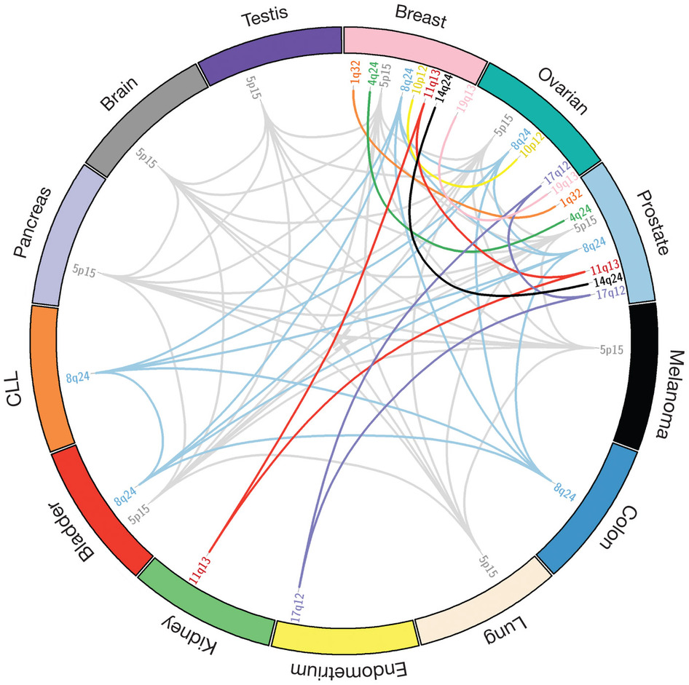
4. Pleiotropy
Substantial pleiotropy has been observed.
Important to:
  Clarify the biological underpinnings of disease
  Improve disease classification
  Allow for effective treatment
Sakoda, Jorgeson, Witte. Nature Genetics (2013)
Notes:
In addition, sharing of variant associations across cancer types has also been observed (pleiotropy)
In this diagram, we see examples of previously reported pleiotropic loci by cytogenic region in a range of cancers. If we look at colon cancer, we can see that 8q24 has shown to be associated with at least bladder, chronic limphocytic leukemia, prostate, and breast cancer. The question we wanted to ask was…. Do we see enrichment of genetic sharing within certain cancer types within the UK biobank?
Chronic lymphocytic leukemia
477 variants in GWAS catalog
OF the 477 this many are associated with a number cancers
Ghoussaini M, Song H, Koessler T, Al Olama AA, Kote-Jarai Z, Driver KE, et al. Multiple loci with different cancer specificities within the 8q24 gene desert. J Natl Cancer Inst 2008;100:962–6. 3. Rafnar T, Sulem P, Stacey SN, Geller F, Gudmundsson J, Sigurdsso
JW: Need to make figures larger. How about giving them their own slides (each of two figures) and removing the text and just saying the text while flashing through slides?

Slide 30
Methods for Examining Pleiotropy
Increasing Number of Variants
Single variant analyses
Polygenic risk scores (PRS)
Co-heritability
Notes:
There are many approaches that can be taken in order to assess pleiotropy, with three of those approaches being highlighted here. Each ordered by the number of variants included in the analysis. In the first box on the left, we list single variant lookups. In this case, we examine whether a SNP found to be a associated with a given cancer, is significantly associated with other cancers. This can be either based on lookups of p-values with each individual cancer, or through the identification of optimal set of cancers within a cross-cancer meta-analysis framework. In the next box we highlight polygenic risk scores. In this scenario we aggregate significantly associated SNPs for a given cancer into a risk score, weighted by the originating cancer-association effect size, and then apply that risk score to cancers of interest. Co-heritability is another method widely used to assess pleotropy in this case we take advantage of genome-wide genotyping data to assess cancer pairs.
For PRS: specifically applying PRS from one risk score to another
Co-herit: ass cancer pairs
JW: OK but for title how about “Approached to examining pleiotropy”?

Slide 31
Methods for Examining Pleiotropy
Increasing Number of Variants
Single variant analyses
Polygenic risk scores (PRS)
Co-heritability
Notes:
There are many approaches that can be taken in order to assess pleiotropy, with three of those approaches being highlighted here. Each ordered by the number of variants included in the analysis. In the first box on the left, we list single variant lookups. In this case, we examine whether a SNP found to be a associated with a given cancer, is significantly associated with other cancers. This can be either based on lookups of p-values with each individual cancer, or through the identification of optimal set of cancers within a cross-cancer meta-analysis framework. In the next box we highlight polygenic risk scores. In this scenario we aggregate significantly associated SNPs for a given cancer into a risk score, weighted by the originating cancer-association effect size, and then apply that risk score to cancers of interest. Co-heritability is another method widely used to assess pleotropy in this case we take advantage of genome-wide genotyping data to assess cancer pairs.
For PRS: specifically applying PRS from one risk score to another
Co-herit: ass cancer pairs
JW: OK but for title how about “Approached to examining pleiotropy”?

Slide 32
Single Variant Analyses
Prostate
Breast
Testicular
Melanoma
Colon
Bladder
Lung
Rectum
NHL
Ovary
Cancers
1 | 2 | ... | 100 | 101 | … | 1K | ... | 1M | …
Variants / SNPs

Slide 33
Single Variant Analyses
Prostate
Breast
Testicular
Melanoma
Colon
Bladder
Lung
Rectum
NHL
Ovary
Cancers
1 | 2 | ... | 100 | 101 | … | 1K | ... | 1M | …
Variants / SNPs

Slide 34
Single Variant Analyses
Prostate
Breast
Testicular
Melanoma
Colon
Bladder
Lung
Rectum
NHL
Ovary
Cancers
1 | 2 | ... | 100 | 101 | … | 1K | ... | 1M | …
Variants / SNPs

Slide 35
Single Variant Analyses
Prostate
Breast
Testicular
Melanoma
Colon
Bladder
Lung
Rectum
NHL
Ovary
Cancers
1 | 2 | ... | 100 | 101 | … | 1K | ... | 1M | …
Variants / SNPs

Slide 36
Single Variant Analyses
Prostate
Breast
Testicular
Melanoma
Colon
Bladder
Lung
Rectum
NHL
Ovary
Univariate analyses:
logit (Pr(Y=1|G, C)) = α + Gβ + Cγ
One-at-a-time for each SNP / cancer
Cancers
1 | 2 | ... | 100 | 101 | … | 1K | ... | 1M | …
Variants / SNPs

Slide 37
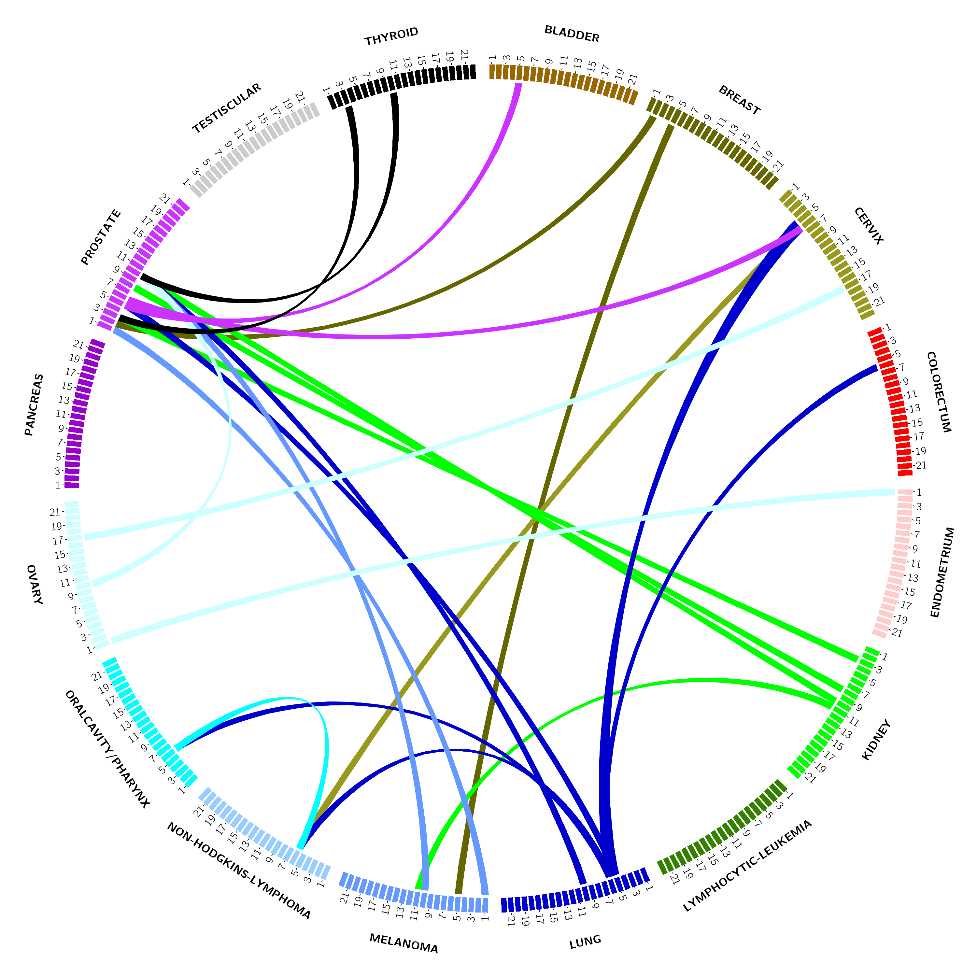
Application to UKB/ KP GWAS

Slide 38
Interesting Results
Notes:
Study mentioned also used asset to meta-analyze snps across cancers!

Slide 39
Methods for Examining Pleiotropy
Increasing Number of Variants
Single variant analyses
Polygenic risk scores (PRS)
Co-heritability
Notes:
There are many approaches that can be taken in order to assess pleiotropy, with three of those approaches being highlighted here. Each ordered by the number of variants included in the analysis. In the first box on the left, we list single variant lookups. In this case, we examine whether a SNP found to be a associated with a given cancer, is significantly associated with other cancers. This can be either based on lookups of p-values with each individual cancer, or through the identification of optimal set of cancers within a cross-cancer meta-analysis framework. In the next box we highlight polygenic risk scores. In this scenario we aggregate significantly associated SNPs for a given cancer into a risk score, weighted by the originating cancer-association effect size, and then apply that risk score to cancers of interest. Co-heritability is another method widely used to assess pleotropy in this case we take advantage of genome-wide genotyping data to assess cancer pairs.
For PRS: specifically applying PRS from one risk score to another
Co-herit: ass cancer pairs
JW: OK but for title how about “Approached to examining pleiotropy”?

Slide 40
Polygenic Risk Score Pleiotropy
Prostate
Breast
Testicular
Melanoma
Colon
Bladder
Lung
Rectum
NHL
Ovary
Cancers
1 | 2 | ... | PRS
Variants / SNPs

Slide 41
UK Biobank:
Cross Cancer PRS Results

Slide 42
Methods for Examining Pleiotropy
Increasing Number of Variants
Single variant analyses
Polygenic risk scores (PRS)
Co-heritability
Notes:
There are many approaches that can be taken in order to assess pleiotropy, with three of those approaches being highlighted here. Each ordered by the number of variants included in the analysis. In the first box on the left, we list single variant lookups. In this case, we examine whether a SNP found to be a associated with a given cancer, is significantly associated with other cancers. This can be either based on lookups of p-values with each individual cancer, or through the identification of optimal set of cancers within a cross-cancer meta-analysis framework. In the next box we highlight polygenic risk scores. In this scenario we aggregate significantly associated SNPs for a given cancer into a risk score, weighted by the originating cancer-association effect size, and then apply that risk score to cancers of interest. Co-heritability is another method widely used to assess pleotropy in this case we take advantage of genome-wide genotyping data to assess cancer pairs.
For PRS: specifically applying PRS from one risk score to another
Co-herit: ass cancer pairs
JW: OK but for title how about “Approached to examining pleiotropy”?

Slide 43
Co-heritability
Prostate
Breast
Testicular
Melanoma
Colon
Bladder
Lung
Rectum
NHL
Ovary
Cancers
1 | 2 | ... | 100 | 101 | … | 1K | ... | 1M | h²
Variants / SNPs

Slide 44
Co-heritability
Prostate
Breast
Testicular
Melanoma
Colon
Bladder
Lung
Rectum
NHL
Ovary
Cancers
Prostate | Breast | Testicular | Melanoma | Colon | Bladder | Lung | Rectum | NHL | Ovary
Notes:
Give example from the literature.
Josh Sampson recent results.

Slide 45
Co-heritability
Prostate
Breast
Testicular
Melanoma
Colon
Bladder
Lung
Rectum
NHL
Ovary
Cancers
Prostate | Breast | Testicular | Melanoma | Colon | Bladder | Lung | Rectum | NHL | Ovary
Notes:
Give example from the literature.
Josh Sampson recent results.

Slide 46
Genetic Correlation
Notes:
3.27e-04 = 0.05/153 = 0.05/(17^2/2)

Slide 47
Genetic Correlation
Cancer 1 | Cancer 2 | r_{g} | P-value
Bladder | Breast | 0.22 | 0.017
Breast | Gastricesoph | 0.26 | 0.0069
Colon | Rectum | 0.85 | 5.33E-07
Endom | Testis | -0.41 | 0.0064
Gastricesoph | Lung | 0.44 | 0.0035
Gastricesoph | Melanoma | -0.27 | 0.038
Gastricesoph | NHL | 0.40 | 0.0089
Gastricesoph | Rectum | 0.32 | 0.024
Lung | Melanoma | -0.28 | 0.0048
Melanoma | Testis | 0.23 | 0.028
NHL | Prostate | -0.21 | 0.012
Prostate | Thyroid | 0.23 | 0.013
Notes:
3.27e-04 = 0.05/153 = 0.05/(17^2/2)

Slide 48
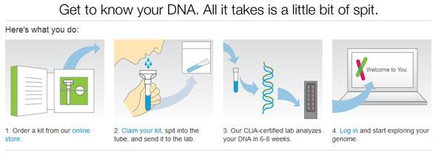
Direct to Consumer Genetic Testing
23andMe
Notes:
Go to 23andMe site, look at
Warfarin Sensitivity
Prostate Cancer Risk (note change from before)
Athletic ability: less likely to be a power athlete.

Slide 49
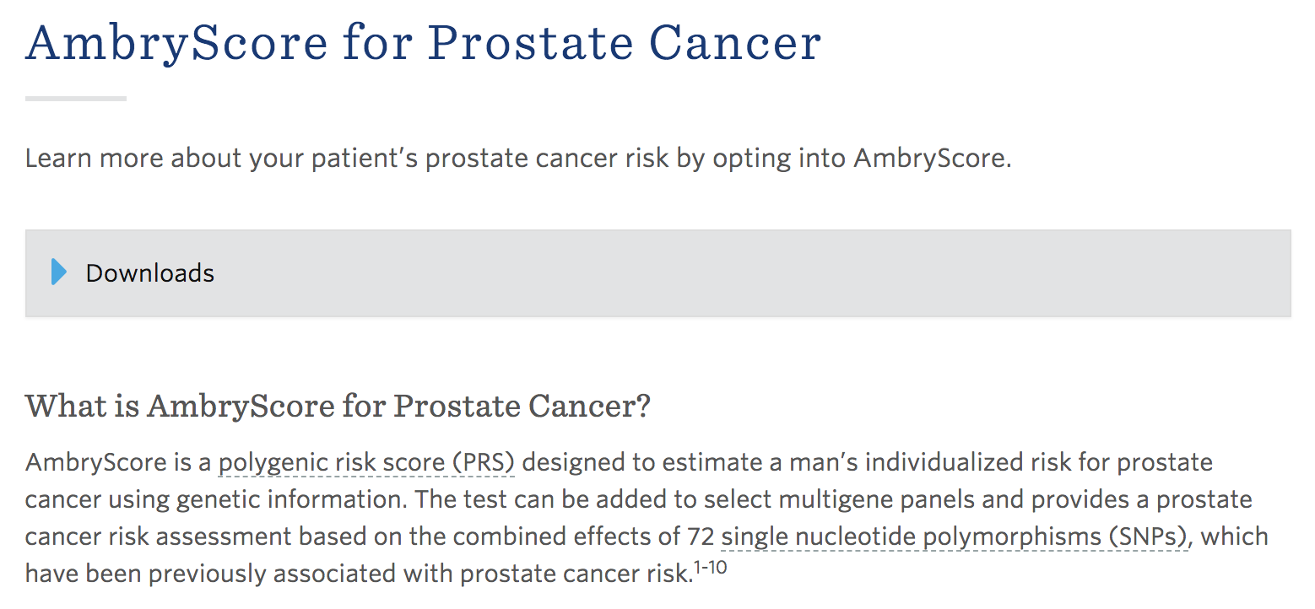
PRS to Consumers

Slide 50
Paper for Discussion
Integration of polygenic risk scores with modifiable risk factors improves risk prediction: results from a pan-cancer analysis

