Slide 1
NIH-sponsored, Multicenter Trials & Industry-sponsored Trials

Slide 2
Outline
NIH-style trials
Multicenter trials
Industry-sponsored trials
  Being a site in an industry study
  How to work with industry
    Publications
    Investigator-initiated studies
Using data from completed trials
Trial of the week (or year!)

Slide 3
Point of view..
You are an academic investigator
  Or possibly in clinical practice

Slide 4
NIH Clinical trials: from whence they came?
Sometimes proposed by investigators
  Tend to be smaller (R01?)
  More common historically and less so today
More likely a result of an NIH-generated request for proposal (RFP)
  Committee (or Congress) recommendation
  Funded as NIH-contract or “U” mechanism
  Work closely with/under NIH project officer

Slide 5
NIH Clinical trials:
What can I do with an RO1?
R01’s have $500k/year direct cost limits. 5 years, sometimes 6.
  Can request exceptions
If follow up ~ 1 year
  Randomize 50-100 assuming limited drug/intervention costs, not too intensive
  Most have continuous endpoint (look in Hulley)
Avoid clinic visits (follow-up online or by mail)
Limited but possible

Slide 6
NIH Multi-center
Randomized Trial Structure
NIH Project Office
Study Steering Committee
Central lab or other
Clinical Coordinating center
Clinical center
Clinical center
More Clinical centers
Data Coordinating Center (DCC)
Clinical center
Clinical center

Slide 7
NIH-style multicenter studies: the cast
NIH Project Office
  May have large or small role
  May have proposed project
  May run with iron fist through contract
Steering Committee
  Usually has representation from NIH, Coordinating centers and clinical centers
  Sets the policies; finalize protocol; ultimate arbiter

Slide 8
NIH randomized trial structure
NIH Project Office
Study Steering Committee
Clinical
Coordinating center (CCC)
Clinical center
Clinical center
More Clinical centers
Data Coordinating Center (DCC)
Clinical center
Clinical center

Slide 9
NIH-style multicenter studies: the cast
Clinical Coordinating Center (CCC)
  Organizes and operationalizes all aspects of study including Steering Comm, Communications, meetings, etc.
  In some cases, responsible for RCT origin
  Contributed data methods to the grant; leads the technical functions
Data Coordinating Center (DCC)
  In some studies…
  Creates forms, data entry systems, QC feedback,
  Data analysis
  May run DSMB separate from CCC
In smaller trials, CCC and DCC may be combined

Slide 10
NIH randomized trial structure
NIH Project Office
Study Steering Committee
Clinical Coordinating center
Clinical center
Clinical center
More Clinical centers
Data Coordinating Center (DCC)
Clinical center
Clinical center

Slide 11
NIH-style multicenter studies: the cast
Clinical Sites
  Recruit and follow patients
  Implement protocol
  PI usually participates in study-level discussions through Steering Comm.
  Trials with 5-10 clinical centers, all on Steering.
  > 20 centers, probably less participation

Slide 12
NIH study TOLSURF
Trial of surfactant in underweight premature infants (n=511)
Infants < 28 weeks GA, all given inhaled nitric oxide
Mean BW=701 gm
Randomize to surfactant or placebo
Endpoint: 36 week GA survival without BPD
Completed 2015 (cost a/o 2009 ~$10million)

Slide 13
NIH multicenter trial example
TOLSURF
NIH Project Office (NHLBI)
Study Steering Committee
25 clinical sites at academic med centers
Clinical CC
R. Ballard, UCSF, Peds
Clinical center
Clinical center
15 more centers
Data CC
D. Black,
UCSF, Epi
Clinical center
Clinical center

Slide 14
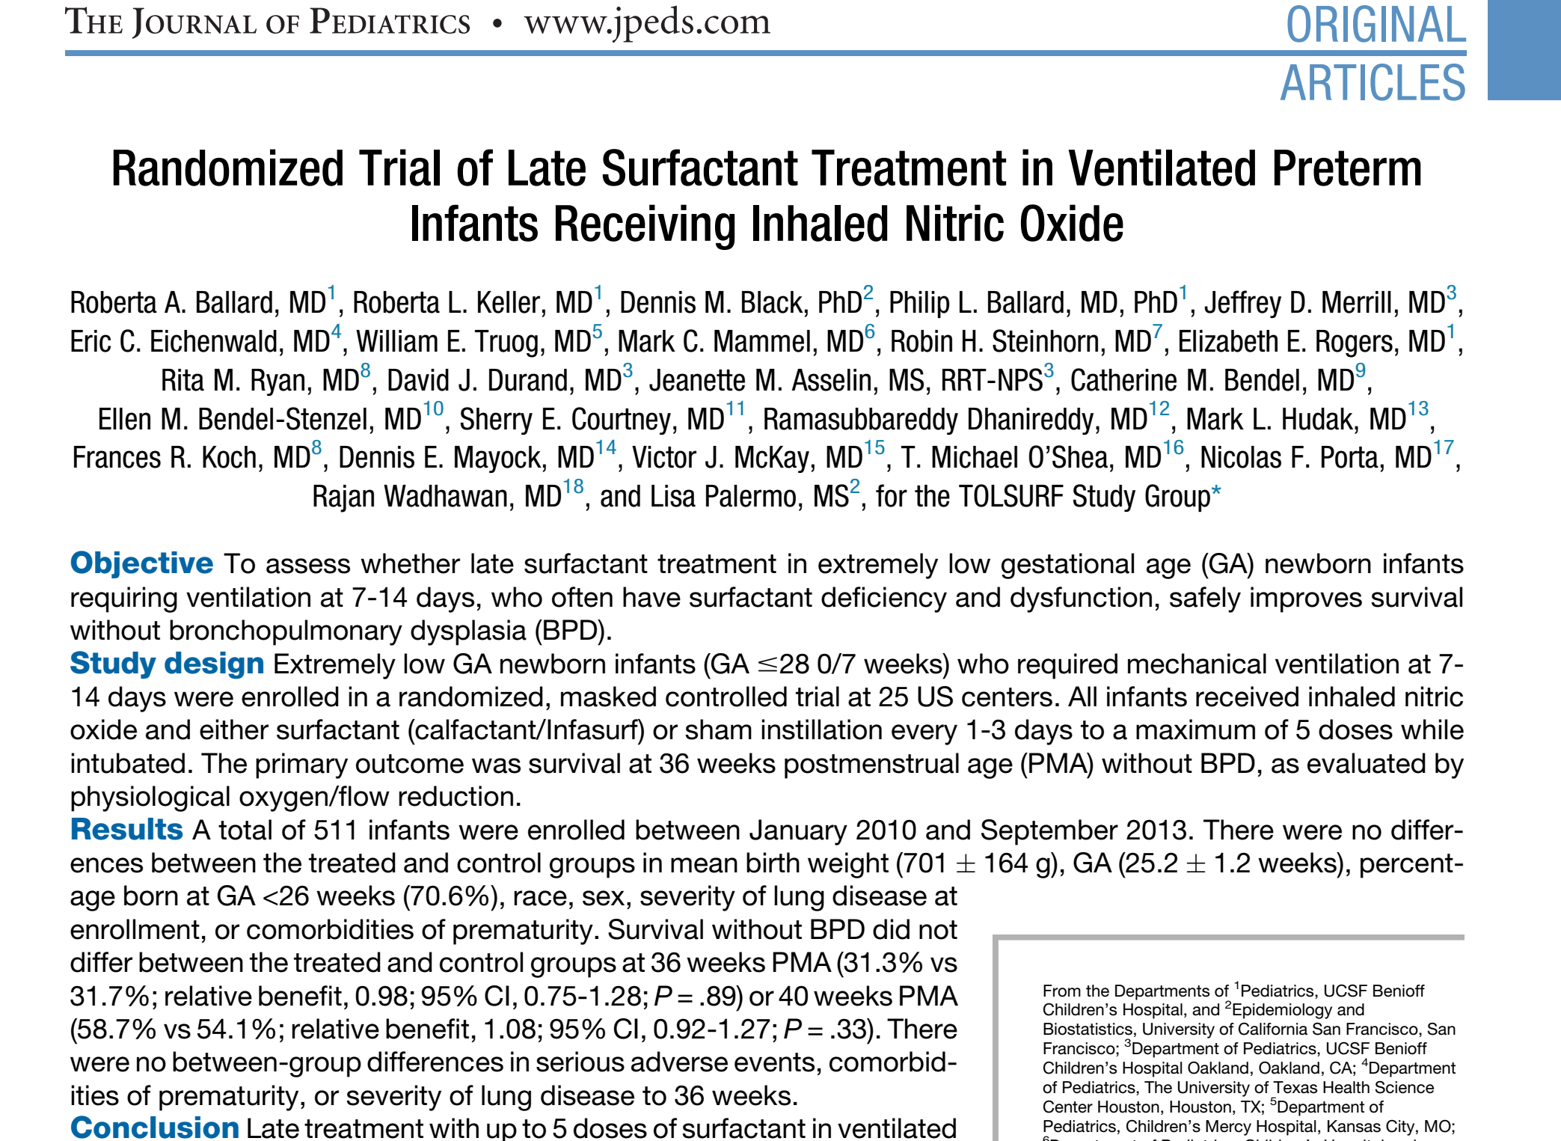
2015

Slide 15
Publications Committee
Publications and Analysis Committee
  Usually a subset of the Steering Committee
  Reviews and approves proposals for analyses for papers and abstracts.
  Reviews proposals for and ancillary studies
  Usually democratic

Slide 16
For a large study, ideally….
You will be the member of Steering committee
  Great to be Steering Committee Chair
  CCC (and DCC) PI: nice study-wide roles
Multicenter study proposals are complex
CCC PI or SC Chair: difficult and usually considered years into a career

Slide 17
Reasons to be a site
NIH multicenter study
Participate in scientific investigation
  Ideally on Steering Comm
Get an inside track on using study-wide data for publications
  Get academic credibility
  Career advancement
Support a research staff
Salary support (of course)

Slide 18
Cancer trials are run differently
NCI has networks of clinical sites and academic centers
More NCI sponsored trials
  Can be smaller and disease rarer
Industry and NCI may have more collaborations than other areas

Slide 19
NIH or Industry-sponsored multicenter clinical trial?
NIH trials come about from scientific or clinical question
  More intellectually stimulating
Ideal world: Randomized trials generated to examine interesting or clinically important research question
Real world: >95% of trials are industry funded
  NIH limited funding (and more limited in future likely)
  Key public health questions

Slide 20


Participate in Industry-sponsored RCTs?
?
?

Slide 21
Industry sponsored trials
Sponsor
- Designs the trial
- Analyzes data (usually)
Sponsor
CRO*
CRO (hired by sponsor)
- Chooses the sites*
- Creates the forms
- Collects/collates data
- Monitor sites
Clinical sites
- Recruit subjects
- Transmits data to CRO
*CRO = ‘Contract Research Organization
Companies that provide research services

Slide 22
Usual Industry Trials
Sponsor and CRO do it all
  Design study, develop forms and protocols
  Analyze data; selects authors; write the articles
Investigators at clinical sites
  Paid to recruit patients
  Investigator meetings
  Little role in design/implementation decisions

Slide 23
A few industry trials
More collaborative with investigators
  ‘Lead’ investigators involved in design
  Steering Committee (a few investigators)
  Publications Committee
Investigators
  Most still just paid to recruit patients
  Attend investigator meetings
  May have opportunities to write/generate secondary publications

Slide 24
Do you want to be a clinical site in an industry-sponsored trial?

Slide 25
Some reasons to be a site in the typical industry trial
Funding for you and/or staff
  Clinical practice context (profit?)
  Academic context
New treatment alternatives to patients

Slide 26
Funding: NIH vs. Industry?
Some advantages of industry funding in academic (UCSF) context
NIH and industry funding can be used for travel to scientific meetings (if its in the budget) and other things (eg. journal subscriptions)
Only industry funds can be saved for a ‘rainy day’
  Discretionary funding
  Future salary support or ‘sabbatical’
Industry funds can be used for more discretionary purposes not related to the industry study. Eg:
  Other unfunded research ($ for measurements, staff)
  Staff appreciation lunches
  Equipment

Slide 27
More reasons to be a site in the typical industry trial
Funding for you and staff
New treatment alternatives to patients
Profit
A chance for correlative science?
Authorship in publications
A step toward larger roles with the sponsor or in field
Value for career advancement?

Slide 28
Industry studies and academic credit
Participating as a site and coauthor gets little respect
Scientific leadership (lead authorship) in trials gets more respect
Grants from industry for independent research usually get less respect than the same research funded by NIH
  But NIH funds fewer than 5% of trials

Slide 29
Competitive recruitment
Trials have set recruitment goal
Industry pays per subject
Per capita funding more common: those who recruit most make most
  Possible to make $$$
  Possible to lose $$$
Top recruiter is often 1st author

Slide 30
Disadvantages of being a site in industry trials
Can lose money
Distraction from other types of work or research
Hassles
  Site monitoring by sponsor (always)
  FDA inspections (seldom)

Slide 31
Would you like to be a site?

Slide 32
What Industry looks for in sites
Past performance
  Number recruited
  Quality of data, retention, etc.
  Knowledge of FDA-style GCP
  Not a ‘problem site’
Current capability to recruit and follow
Reputation of the investigator
  Key Opinion Leader (“KOL”)
  Also contributes to science and publications

Slide 33
Being a site in NIH studies
What large NIH studies look for
Past performance
Rapid recruitment of large numbers
Good quality of follow-up, implementation of protocol
Responsive and involved colleagues
Scientific expertise

Slide 34
How to be a great clinical site
An excellent study coordinator
  Good attention to regulatory issues (eg. Careful data collection, etc)
A registry of patients (subjects)
  Characteristics
  Consent to be contacted for research
Excellent responsive admin support
  Contracts office
  IRB
Requires infrastructure (perhaps from U). Might want to consider private U.

Slide 35
Would you like to be a site?
Get a reputation
  Become a local or national leader
  Recruit successfully
Borrow a reputation
  Have a mentor or experienced colleague make contacts
Industry: Contact your local “MSL”
  Medical Science Liason or equivalent

Slide 36
Other types of support from industry
“Investigator initiated” funding
  May be small trial
  Support for other types of studies (epidemiology, cost-effectiveness studies)
  Data analysis project
    In sponsor’s data sets
    In your data sets
  Small studies ($25k to $200k)
    In some contexts, can be larger and funds more readily available (eg. for surgeons from device companies)
  Free drug for your own research
Educational funds
  Eg. CME programs

Slide 37
Publications and industry

Slide 38
Anatomy of a pharma sponsor
Research or ‘Clinical Development’ unit
  Usually scientists
  Goal: FDA approval of a safe and effective treatment
Marketing
  Usually business professionals
  Goal: make $
  They usually have more funding than Development
  Greater potential for bias

Slide 39
Publications
The “traditional”/common approach
Sponsors own the data
Data are usually analyzed by
  the sponsor’s statistician and medical writer
  a hired “Medical Communications” firm
External authors invited to author a paper
  They are given the analyses or a draft
  May write a draft or edit the sponsor’s draft

Slide 40
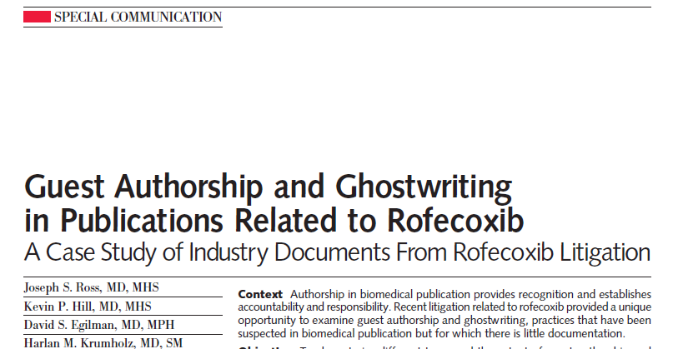
Ross JS JAMA 2008

Slide 41
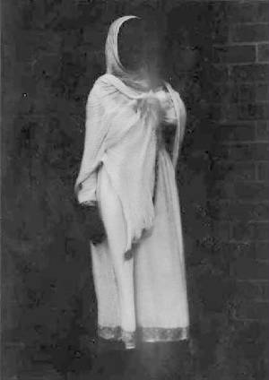
An example of guests and ghosts
- Rofecoxib trials
- The communications company completed analyses (and drafts) then invited the 1st author
JS Ross, et al.
JAMA 2008;299:1800-12

Slide 42
An example of guests and ghosts
- Rofecoxib trials
- The communications company completed analyses (and drafts) then invited the 1st author
- The initial draft of papers were written by the sponsor and sent to the author for editing.
JS Ross, et al.
JAMA 2008;299:1800-12

Slide 43
Concerns about guests and ghosts
“Some sponsors and contract communications companies analyze data and provide nearly complete draft articles for academic investigators who are then listed as 1st authors.”
DeAngelis & Fontanarosa.
JAMA 2008;299:1833-5

Slide 44

JAMA Principles, 2008
“For profit companies…should not be solely or primarily involved in…conducting the data analysis, and preparing the manuscript reporting study results. These responsibilities should primarily…be performed by academic investigators who are not employed by the company…
DeAngelis & Fontanarosa. JAMA 2008;299:1833-5

Slide 45
Increased disclosure of roles for authors in all RCT’s (including pharma)
Many➔ Most journals now ask all authors about roles in paper and is included
Who wrote the 1st draft?
Did you have “access” to data?
10 years ago, only top journals but now much more widely practiced

Slide 46
Industry is changing its practices
More careful about ghost writing
  Requiring that investigators participate, at least in conference calls
  Requiring authors to have some level of contribution to the paper (or at least ‘see and agree’)
  Disclosure of roles
All coauthors must disclose sources of income for potential COI
Companies must report ALL money paid to physicians for anything

Slide 47
An ideal approach to publishing from industry studies
Publications Committee
  With guidelines as a contract
  Reviews plans and papers before submission
  Minority voting representation from the sponsor
Data analysis by independent statistician under Pubs committee direction
Writing the paper
  By external authors
  No commercial writers; or writers assist investigators with tables, figures, editing.

Slide 48
Example of a “good” Industry/Academic collaboration
FREEDOM Trial of Denosumab (Amgen)
  Steering and Publications Committee: 1 scientist from Amgen
  Publication guidelines
  Had a prospective analysis plan
  Academic first author wrote the 1st draft - input from Amgen scientists
  Reviewed and approved by Pub Comm
  No reimbursement for time spent writing

Slide 49
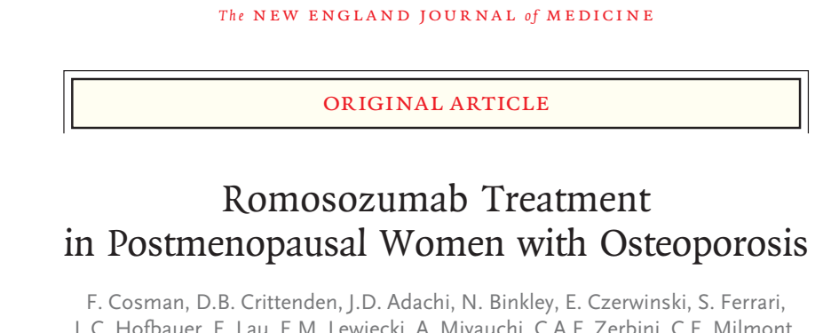
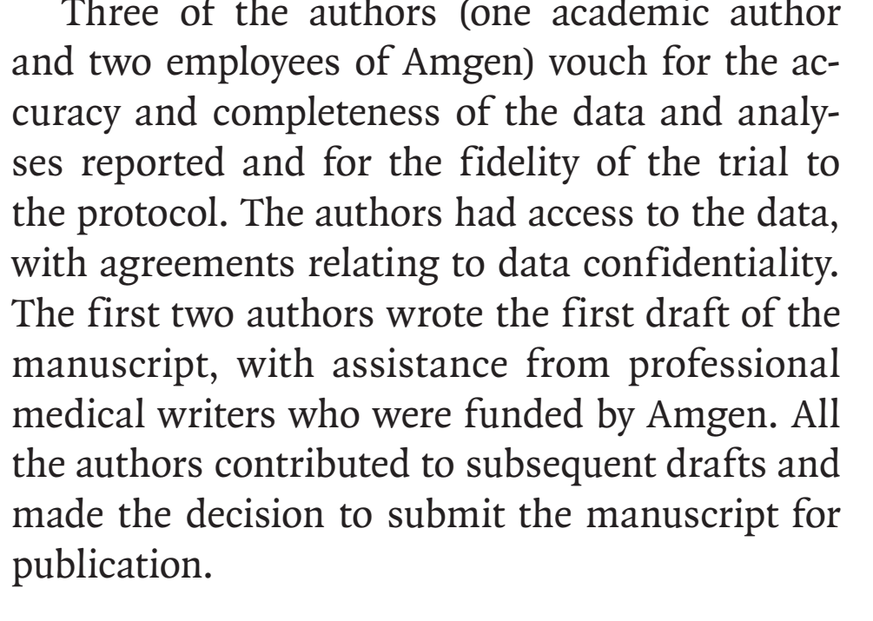
2017

Slide 50
Universities and Journals: Investigators must have ‘access to the data’
“Access to data” is vague
  Sponsors employ the data analysts
  Sponsor’s team directs and selects analyses
  Authors are rarely involved (or skilled) in data analysis, rarely look at direct data output

Slide 51
Universities: investigators must have ‘the right to publish’

Slide 52
Universities: investigators must have ‘the right to publish’
As a clinical site, your data is one small part of the larger trial; would be wrong to publish a part
  Hard to analyze and publish without support for analysis and writing

Slide 53
The Betty Dong Story
UCSF researcher
Did a study of Synthroid vs. generics in 1990
Funded by Boots Pharma (UK), maker of Synthroid
Results Syn=generics
Boots threatened to sue UCSF if she published
UCSF caved and bad impact on Dr. Dong
Big news story in WSJ and NYT a bit later
Results: If you do a study for pharma today, UCSF will require that your contract must say “you can publish regardless of funder approval”

Slide 54
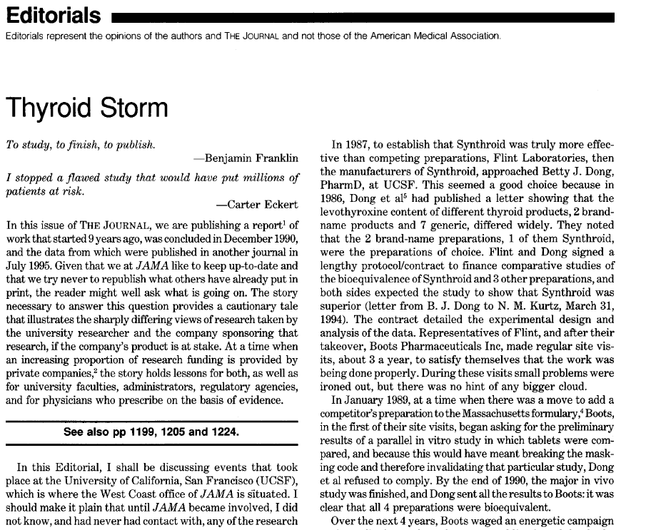
JAMA, editorial, April 1997

Slide 55
Public Release of Individual Data from Clinical trials: NEJM 1/15
Public and governmental pressure to make clinical trial results more transparent including release of individual patient data to the “public”
Pressure from
  FDA
  Journals
  Public

Slide 56
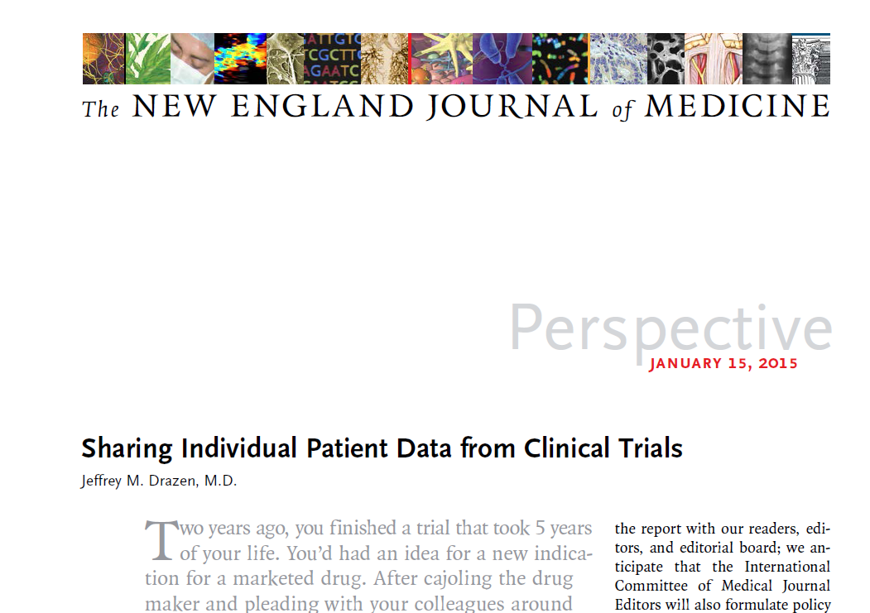
Public Release of Individual Data from Clinical trials: NEJM 1/15

Slide 57
Early Implementation of Individual Data Sharing
NIH
  Systems vary by institute
Some individual companies
Several organizations creating systems for data sharing across
One website represents effort to have a central clearinghouse for clinical trial data release across multiple companies
  (www.clinicalstudydatarequest.com)

Slide 58
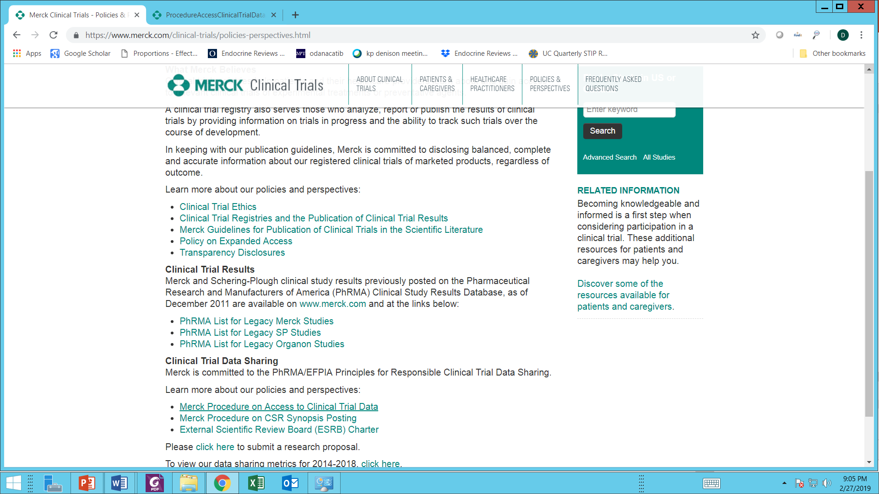

Slide 59
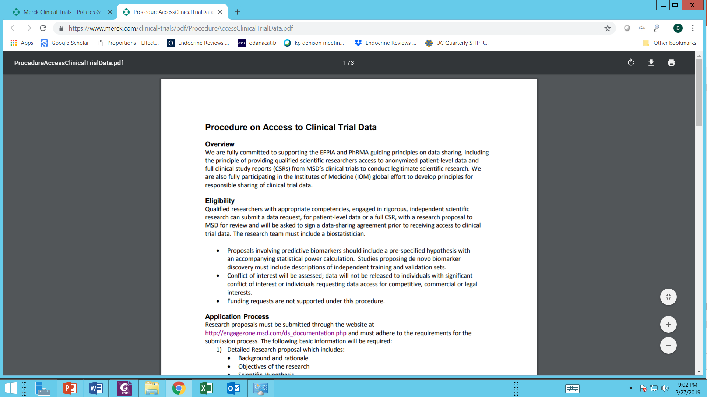

Slide 60
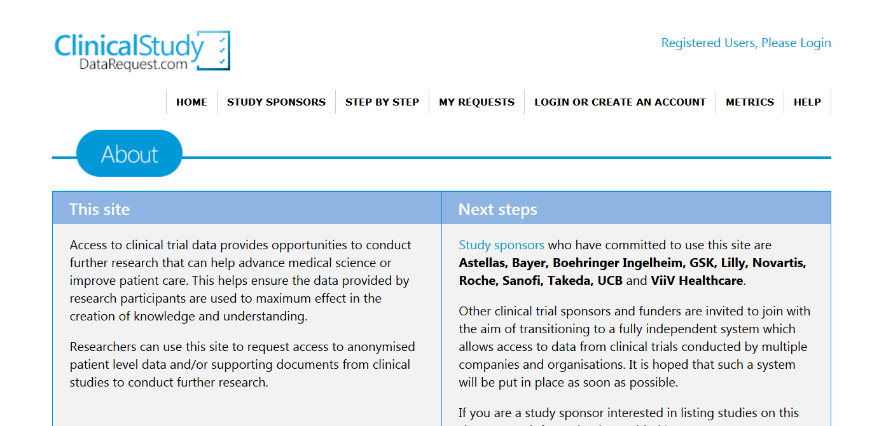
Apply to neutral committee
Must use data on the site with provided tools (SAS, Stata, etc)
Can combine studies on this website
Challenging for sponsors due to confidentiality
Mostly newer studies

Slide 61
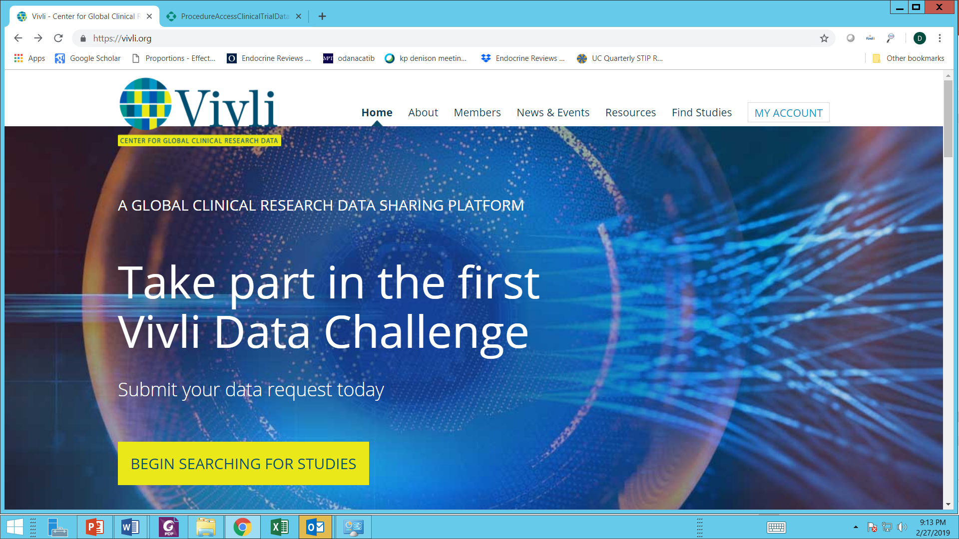

Slide 62
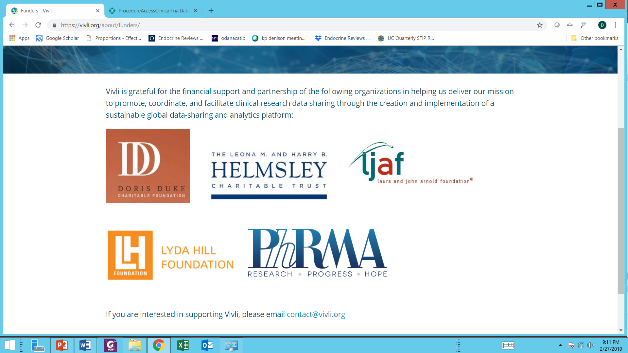

Slide 63
What Could You Do with Individual Data from an RCT(S)?
Epidemiologic work
  Perhaps use placebo only
  VERY rich and systematic data set
  Eg. Labs every year, all clinical events as AEs
  Does some newly identified baseline measure predict clinical outcome?
    Baseline: genetic or from serum or lab measure
    Clinical outcome: Endpoint or other outcome from Aes
Great opportunities for young investigators!

Slide 64
What Could You Do with Individual Data from an RCT(S)?
Super subgroup analysis
Perhaps combine data from several trials
RQ: Does lipid lowering reduce risk of CHD in women over age 80?
  Individual trials too few patients >80
  Obtain data from 10 statin trials
  Select women > age 80 and go to town!

Slide 65
Summary
Many advantages to participating as a site in multicenter NIH trials
  But NIH RCT’s are relatively uncommon
Industry studies offer more opportunities – and new treatments, but allow less participation
Follow principles for analyses and publications
Increasing scrutiny of industry practices
  More access and opportunities for academic investigators

Slide 66
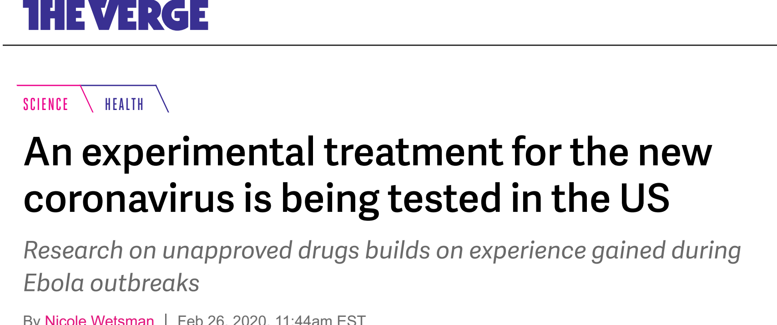
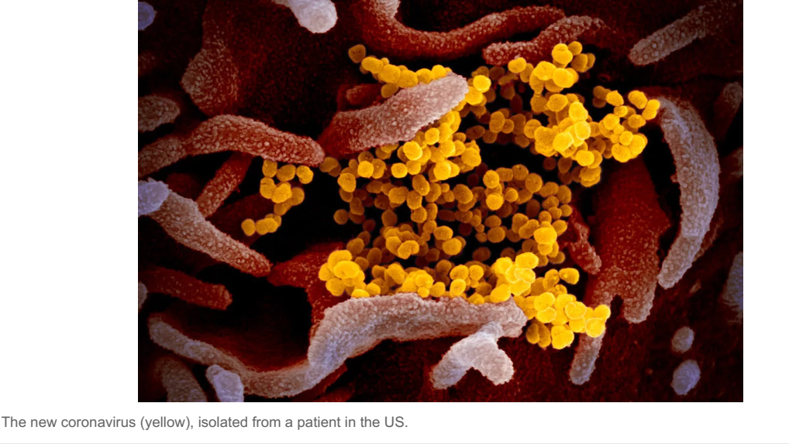
Trial of the week
https://www.theverge.com/2020/2/26/21154220/coronavirus-experimental-treatment-remdesivir-trials-us-china-ebola

Slide 67
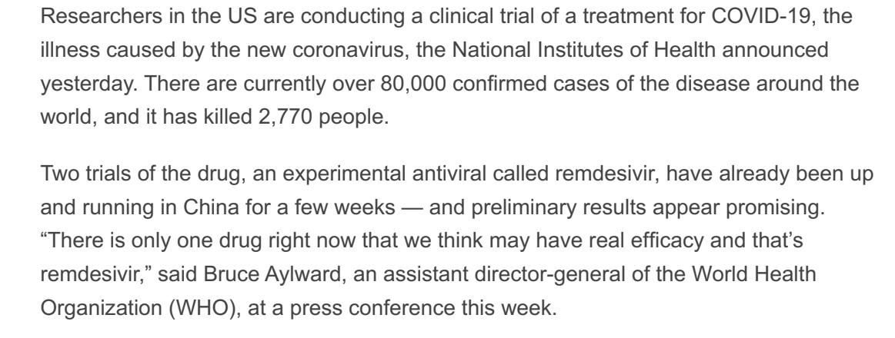

Slide 68
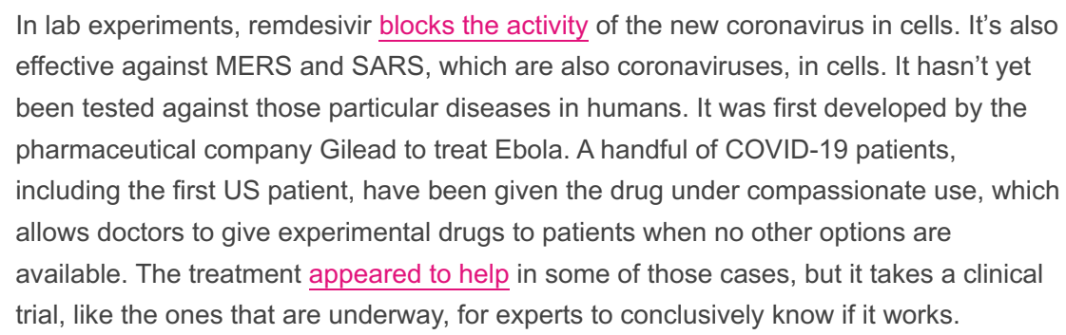

Slide 69
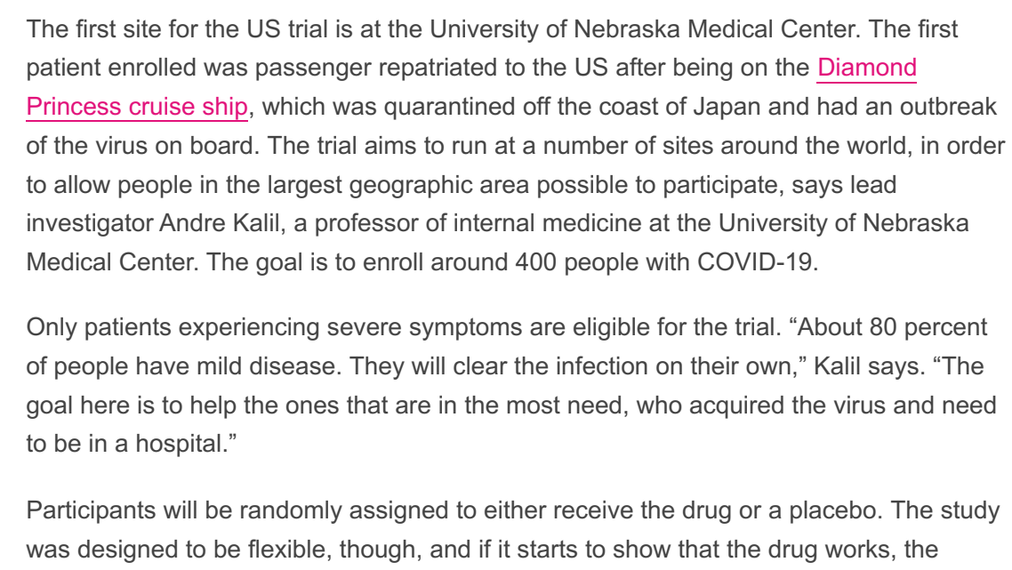

Slide 70
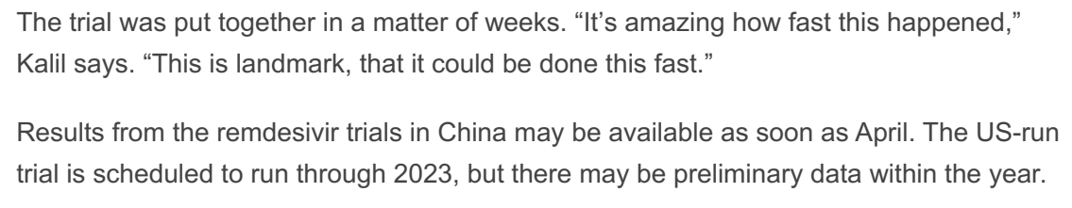

Slide 71
2 more formal trials https://fortune.com/2020/02/26/gilead-coronavirus-treatment-clinical-trials-remdesivir/
The two phase 3 clinical trials Gilead announced on Wednesday will enlist about 1,000 patients who have already contracted COVID-19. The participants will mostly be in Asia, the heaviest-hit region in a global health emergency that originated in China, although other nations with a high number of cases will also be involved. The trials are set to launch in March.
Phase 3 clinical trials ---- In remdesivir's case, Gilead says that the new pair of trials will test out two different dosing regimens for the drug. One group with more severe forms of the disease will get the antiviral intravenously for either five or ten days. (The length of time will be randomized.)
Another group with more moderate forms of COVID-19 will either get the treatment for five or 10 days, or receive existing treatments that are already on the market and used for other strains of coronavirus.

Slide 72
Thanks!

