Slide 1
Review: Interaction &
Effect Modification
Dan Kelly, MD, MPH
2/27/20

Slide 5
Interaction is scale-dependent
Additive Scale:
  Positive or super additive
  Negative or sub-additive
Multiplicative Scale:
  Positive
  Negative
If both exposures have independent effect on the outcome, there must be interaction on some scale
  RGL, p. 72-74

Slide 6
Notes:
Certain levels of RERI can suggest things about the type of interaction.
eg RERI>2 implies "epistatic" interaction in which there are individuals in the population who will have the outcome if and only if both exposures are present.
if RERI>0 and both exposures have positive monotonic effects, then there is an epistatic interaction
If RERI>1 and at least one of the exposures has a positive monotonic effect, then there is an epistatic interaction
pg 20-21 of VanderWeele and Knol's tutorial.

Slide 7
Summary metrics
There are several ways to summarize statistical Interaction
  Interaction Contrast on Additive Scale
  Measure of Interaction on Multiplicative Scale
  RERI_{RR}
  Attributable Proportion
  Synergy Index

Slide 8
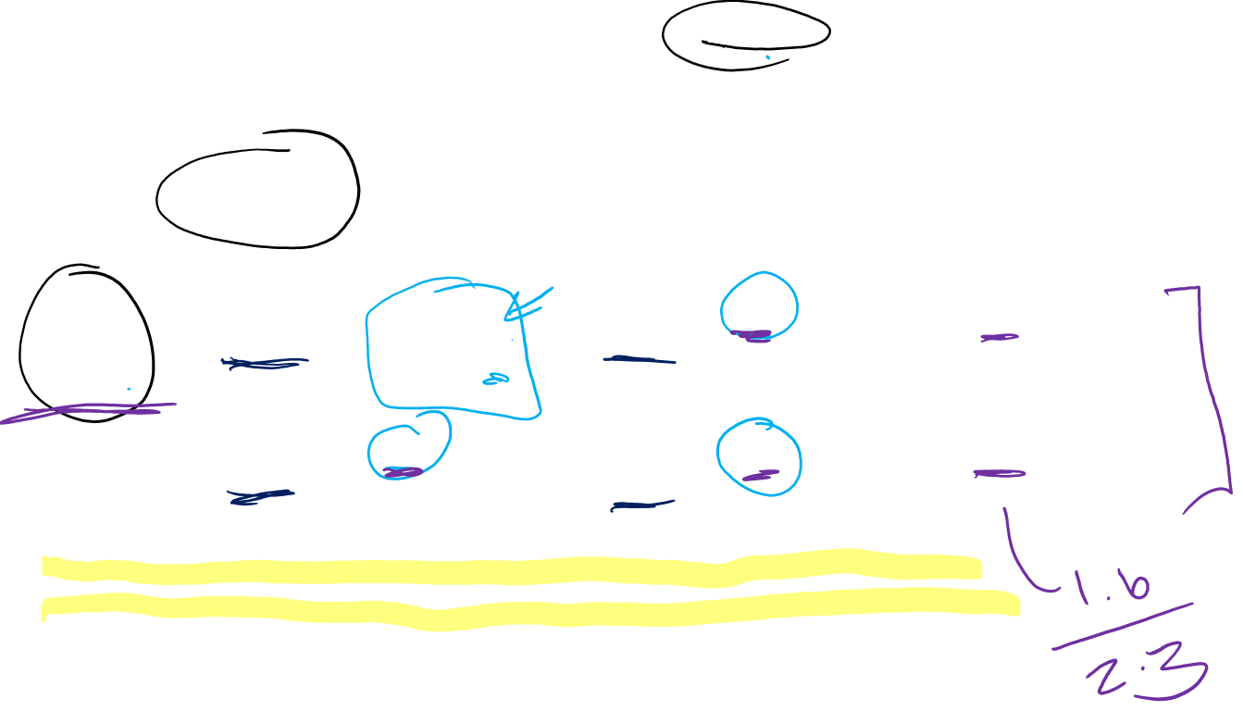
Ex. Presenting Statistical Interaction
 | No Smoking |  | Smoking
 | Probability of delayed conception | Prevalence ratio (95% CI) | Probability of delayed conception | Prevalence ratio (95% CI) | Prevalence ratio (95% CI) for smoking within strata of caffeine use
No caffeine use | 0.082 | 1.0 (reference) | 0.20 | 2.4 (1.4 to 4.1) p = 0.001 | 2.4 (1.4 to 4.1) p = 0.001
Heavy caffeine use | 0.19 | 2.3 (1.4 to 3.8) p = 0.001 | 0.13 | 1.6 (0.88 to 3.0) p = 0.13 | 0.70 (0.35 to 1.4) p = 0.31
Measure of effect modification on additive scale = -0.17; p = 0.018
Measure of effect modification on multiplicative scale = 0.29; p = 0.005
Notes:
This table is an example of detailed reporting on interaction. Goal - to present enough information such that readers can evaluate both scales (additive and multiplicative) even if you, as author, are interested in just one of the two.
Interaction contrast on additive scale: p₁₁ - p₁₀ - p₀₁+ p₀₀ = 0.13 – 0.20 – 0.19 + 0.082 = = -0.26 + 0.082 = - 0.178 (may be slightly off from their quoted -0.17 in the footnote due to rounding?)
Measure of Interaction on multiplicative scale: RR₁₁/RR₁₀RR₀₁ = 1.6/(2.3*2.4) = 0.29

Slide 9
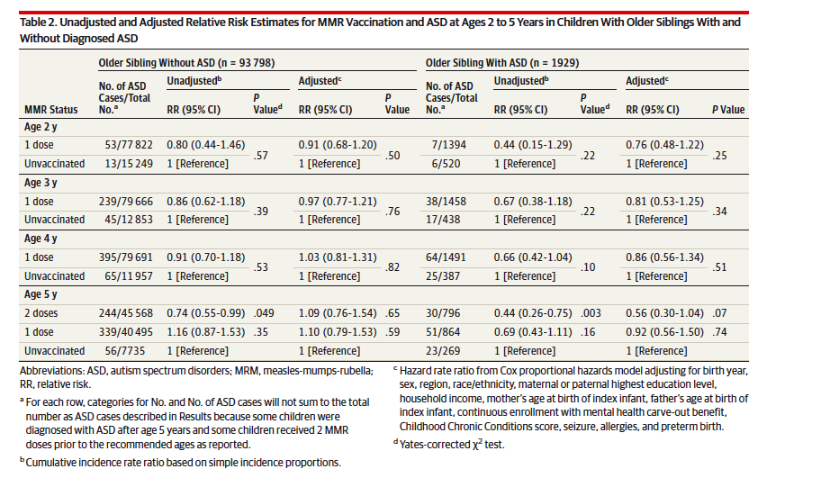

Ex: Reporting within strata with different ref groups
Notes:
https://www.ncbi.nlm.nih.gov/pubmed/25898051
This is an example where the authors had a very strong a priori interest in examining the association of MMR vaccination status in a younger sibling for the outcome of Autism Spectrum Disorder (ASD), stratified by whether that index child had an older sibling with ASD. The authors present their MAIN results within strata of older sibling status with separate reference groups.
One could say that in this study, the interest was more on “effect measure modification”

Slide 10
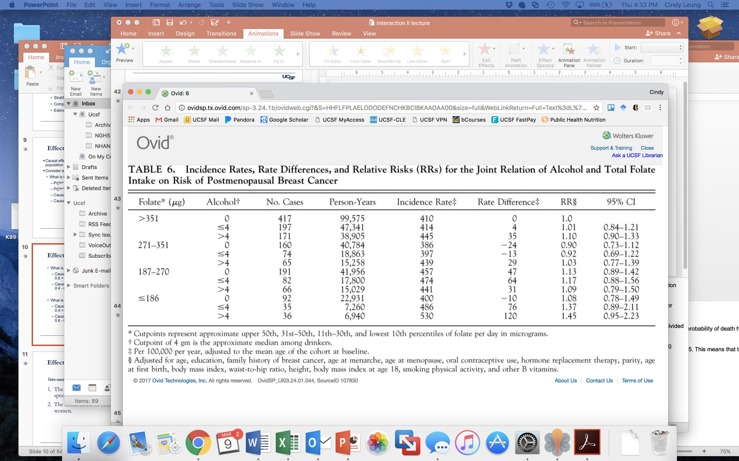

Ex. Using a common reference group
Sellers et al. Dietary folate intake, alcohol, and risk of breast cancer in a prospective study of postmenopausal women. Epidemiology 2001.
Notes:
Here, the authors show folate level as rows, stratified into quartiles (click).
Within each quartile, they then stratified by alcohol consumption ranging from none, moderate to high (click). They then show the incidence rate of breast cancer for each group (click), the corresponding rate difference, (click) and the incidence rate ratios (click). All of these comparisons are made to the lowest risk group – so women with high folate and low alcohol.
From this example, you can see how this presentation facilitates the comparison of results across levels of folate and alcohol, as well as which group has the lowest and highest risks of the outcome.

Slide 11
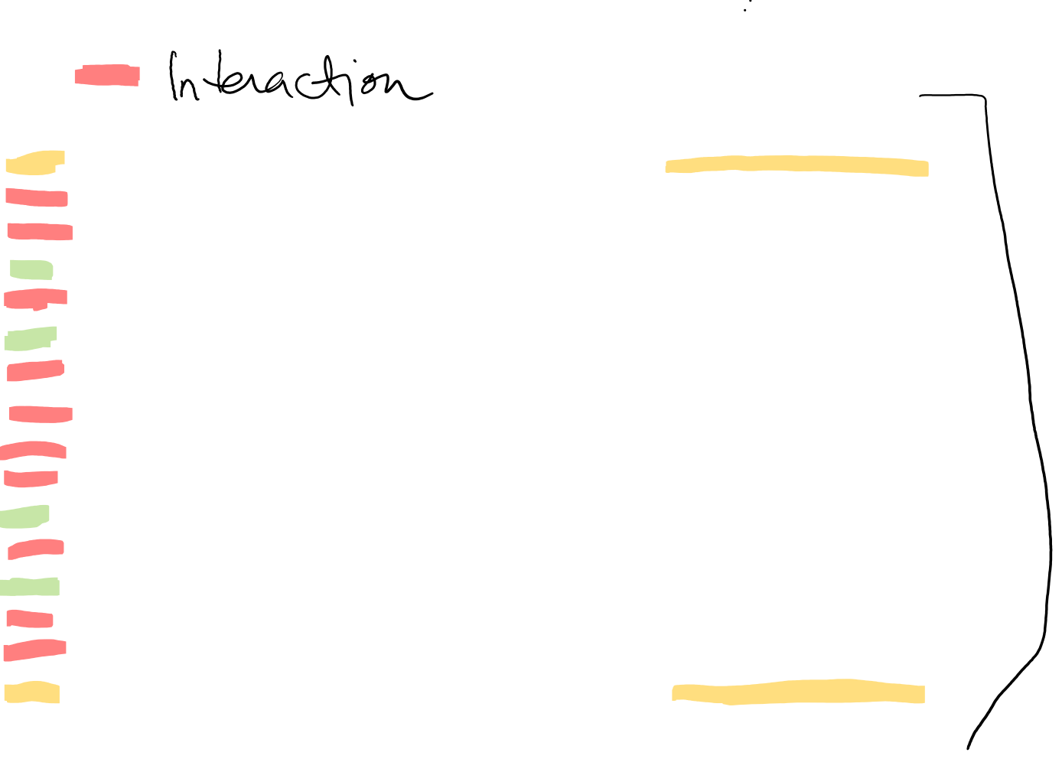
In Summary….
Type | Y^{a=1,e=1} | Y^{a=0,e=1} | Y^{a=1,e=0} | Y^{a=0,e=0} | Description of Causal Type
1 | 1 | 1 | 1 | 1 | Doomed (no effect)
2* | 1 | 1 | 1 | 0 | Single plus joint causation
3* | 1 | 1 | 0 | 1 | Preventive antagonism
4 | 1 | 1 | 0 | 0 | E has causal effect. A has no effect
5* | 1 | 0 | 1 | 1 | Preventive antagonism
6 | 1 | 0 | 1 | 0 | A has causal effect. E has no effect
7* | 1 | 0 | 0 | 1 | Preventive antagonism (mutual blockage)
8* | 1 | 0 | 0 | 0 | Causal synergism
9* | 0 | 1 | 1 | 1 | Preventive synergism
10* | 0 | 1 | 1 | 0 | Causal antagonism (mutual blockage)
11 | 0 | 1 | 0 | 1 | A has causal effect (preventive). E no effect
12* | 0 | 1 | 0 | 0 | Causal antagonism
13 | 0 | 0 | 1 | 1 | E has causal effect (preventive). A as no effect
14* | 0 | 0 | 1 | 0 | Causal antagonism
15* | 0 | 0 | 0 | 1 | Single plus joint prevention
16 | 0 | 0 | 0 | 0 | Immune (no effect)
Notes:
We can put all of this together now. Before, we discussed the 16 potential counterfactual outcomes that can happen when there are two binary exposures. Let’s go through these now and describe the causal type.
For types 1 and 16, there is no effect of A or E (click). Type 1 individuals would have died under any treatment combination. Type 16 individuals would have survived under any treatment combination.
For types 4, 6, 11, and 13, these are cases where either A had a causal effect of Y independent of E or E had a causal effect on Y independent of A. Types 4 and 13 are examples of where E has a causal effect but A has no effect. Types 6 and 11 are examples where A has a causal effect but E has no effect. Thus, for these types, there is no interaction between A and E on the effect of Y.
So, for these first 6 types, either one or both of the exposures have not effect.
For the other 10 types (indicated with *), what distinguishes them from the previous 6 we just described is that you have to know both exposures to know the response. The defining feature of these 10 other response types is that we cannot say what the effect of Z will be unless we also know the value for E; and vice versa – we can’t know the effect of E without also knowing the value for A. In other words, for these response types, the effect of one variable depends on the other, or each factor modifies the other. These response types correspond to interaction effects.

Slide 12
Overall Summary
Interaction vs. Effect Modification
Interpreting Coefficients – When you have an interaction term in model, interpreting the coefficients for the other variables change.
  Be careful, when in doubt, go back to ”basics” to appreciate what the coefficients mean
Interaction is scale-dependent (Additive & Multiplicative scales)
Summary metrics of interaction on additive and mult scales
Presenting Effect Mod and Interaction depends on your scientific question and focus.
  Good to show results in multiple ways - counts, absolute risks, relative measure with 1 reference group, summary metrics, etc
  Be aware how to interpret results when reference groups change
Counterfactual Framework & Causal Interaction

