Slide 1
E-Cigarettes or Conventional Cigarettes: Which is Worse?
Stanton Glantz, PhD
Professor of Medicine
UC San Francisco

Slide 2
About the same
For heart disease
For lung disease
Cancer evidence starting to emerge

Slide 3
BRITISH AMERI CAN TOBACCO
IMPERIAL
BRA N DS

Slide 4

Many shapes and sizes

Slide 5
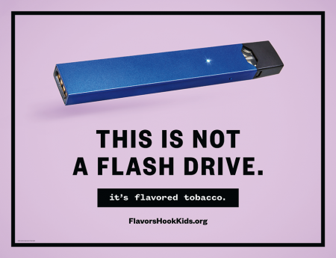
JUUL

Slide 6

Juul Launch Parties
June 4, 2015 https://twitter.com/JUULvapor/status/606656253885038592

Slide 7
More than clever marketing

Slide 8
More & faster nicotine absorption

Slide 9
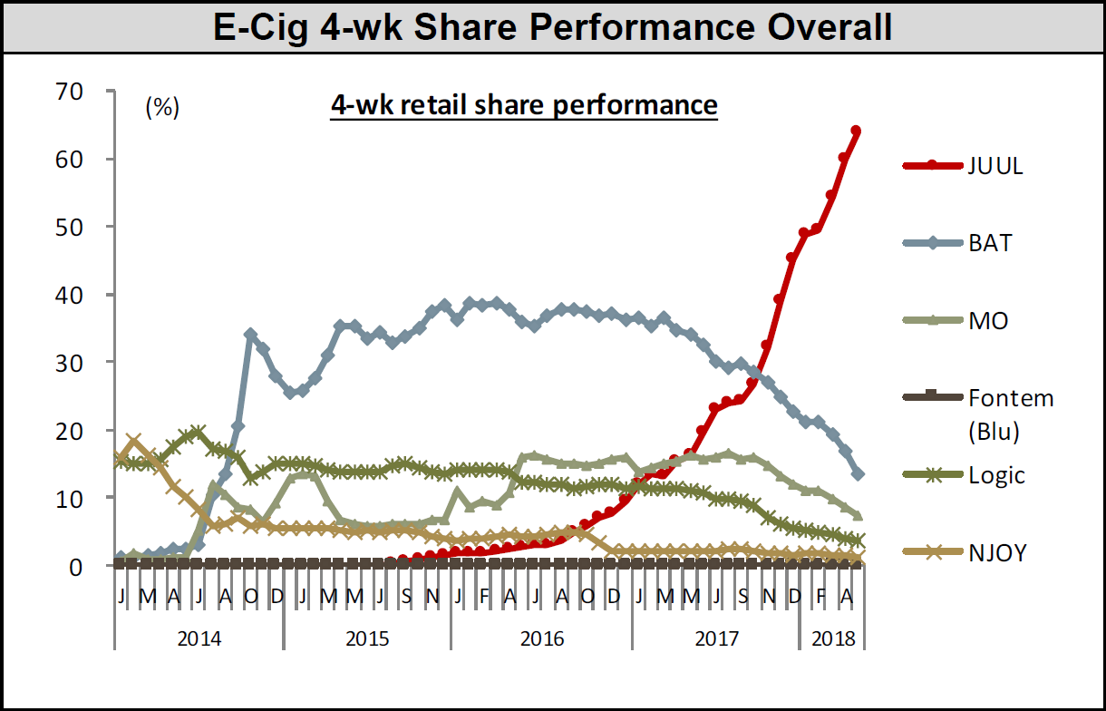
It worked
Source: Nielsen Total US xAOC/Convenience Database & Wells Fargo Securities, LLC (c/o TFK)

Slide 10
Ecigs and quitting: Two standards
E-cigs as medicine
  FDA Center for Drug Evaluation and Research
  Safe and effective
  Randomized clinical trials
E-cigs as consumer product
  FDA Center for Tobacco Products
  “Appropriate for protection of public health”
  Observational studies

Slide 11
Ecigs to quit: NEJM Paper
Clinical intervention
4 weeks intensive counselling
9 RCTs
  Show efficacy as clinical interventions
80% using ecigs at 1 year
  vs. 9% for NRT

Slide 12
Clinical trials: quitting benefit

Slide 13
Population Studies: no benefit

Slide 14
About like OTC NRT
6 month longitundal study in England
Reference: no cessation aids
Medication with specialist behavioral support: 2.58 (95% CI, 1.48-4.52)
Medication with brief advice: 1.55 (1.11-2.16)
OTC: 0.68 (0.49-0.94)
Kotz D, Brown J, West R. Prospective cohort study of the effectiveness of smoking cessation treatments used in the “real world”. Mayo Clin Proc 2014; 89: 1360–67.

Slide 15

What about kids?

Slide 16
USA (past 30 days)
NYTS

Slide 17
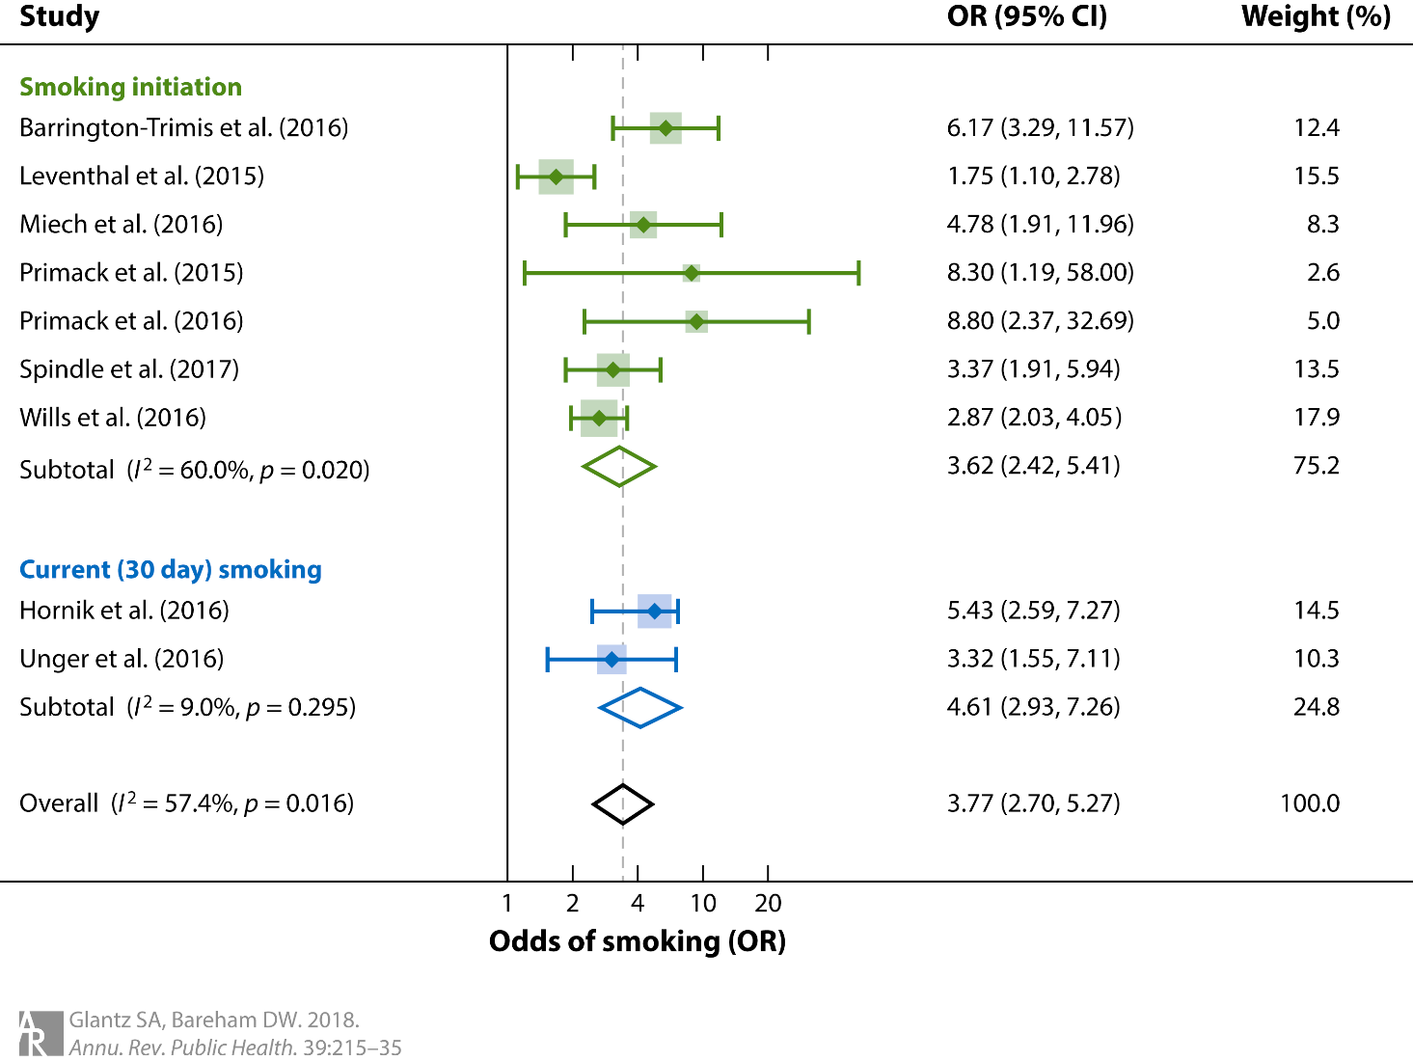
Longitudinal Youth Studies

Slide 18
80 kids start for every smoker that quits
Probably worse than that
Most optimistic quitting estimate
Youth numbers predate Juul & explosion of youth use

Slide 19
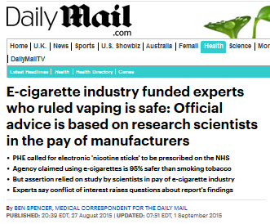
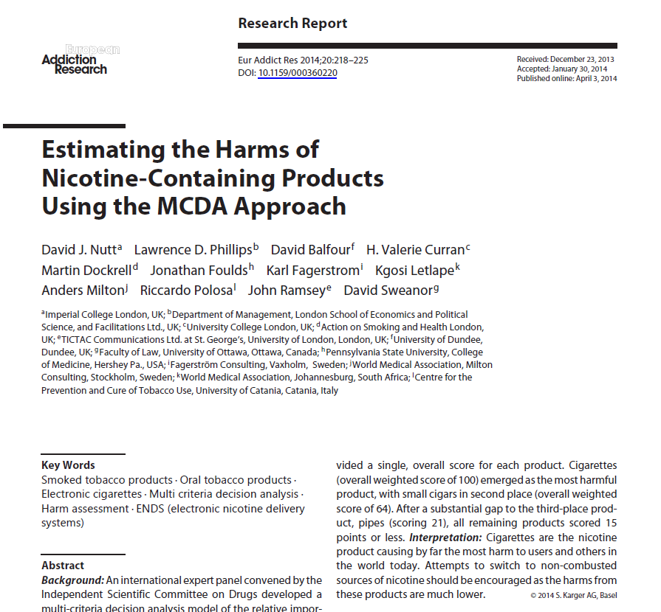
95% safer?
“lack of hard evidence for the harms of most products on most of the criteria”
“There was no formal criterion for the recruitment of the experts”
No actual evidence cited

Slide 20
E-cigarettes deliver lower levels of some toxins
Toxins | e-cigarette (15 puffs) | conventional cigarette | Nicotine inhaler
Formaldehyde (µg) | 0.20 - 5.61 | 1.6 – 52.0 | 0.20
Acetaldehyde (µg) | 0.11 - 1.36 | 52.0 – 140.0 | 0.11
Acrolein (µg) | 0.07 - 4.19 | 2.4 – 62.0 | ND
o-methylbenzaldehyde (µg) | 0.13 - 0.71 | -- | 0.07
Toluene (µg) | ND - 0.63 | 8.3 – 70.0 | ND
p,m-xylene (µg) | ND - 0.2 | -- | ND
NNN (ng) | ND - 0.00043 | 0.0005 - 0.19 | ND
NNK (ng) | ND - 0.00283 | 0.012 - 0.11 | ND
Cadmium (µg) | ND - 0.022 | -- | 0.003
Nickel (µg) | 0.01 - 0.03 | -- | 0.019
Lead (µg) | 0.003 - 0.057 | -- | 0.004
ND = Not Detected; -- = not reported Data from Goniewicz et al. 2013 using lowest and highest values reported
Notes:
Note: The numbers in the last column are the numbers in Maciej’s paper divided by 10 on the assumption that the dose was comparable to the ecigs inhalations. We need to check this.

Slide 21
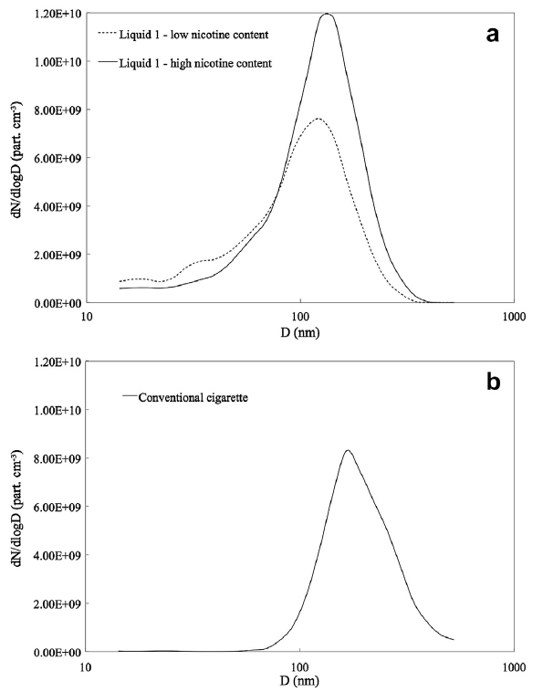
But, particles from e-cigs are like cigarettes

Slide 22



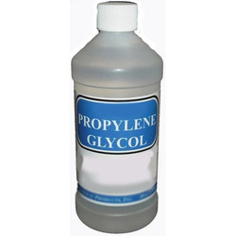


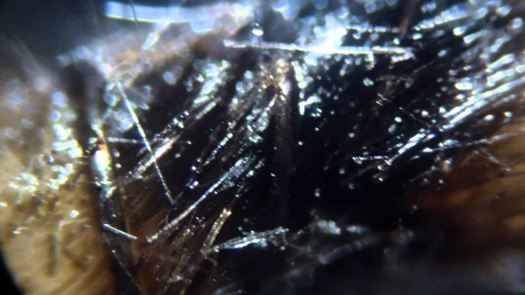
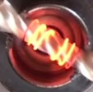
Lung toxicants in e-cigs
E-cigarette lung toxicity: Potential toxicants
VG
E-liquid Base
PG

Slide 23
COPD increased risk
2013-4 PATH
  including emphysema, chronic bronchitis
Ecigs every day or some day
Propensity score matching
  Including smoking and SHS
COPD odds ratio 1.86 (95% 1.22-2.83)
Perez et al. E-Cigarette Use Is Associated with Emphysema, Chronic Bronchitis and COPD. Am Thoracic Soc 2018 ttp://www.abstractsonline.com/pp8/#!/4499/presentation/19432
Notes:
A6245 / 402 - E-Cigarette Use Is Associated with Emphysema, Chronic Bronchitis and COPD
Add to Itinerary
May 23, 2018, 9:15 AM - 11:15 AM Room 11 A-B (Upper Level) - San Diego Convention Center
Participant M. F. Perez, N. Atuegwu, E. Mead, C. Oncken, E. M. Mortensen;
Internal Medicine, UConn Health, Farmington, CT, United States. Abstract Background: There has been an exponential increase in the use of electronic cigarettes (E-cig) in the United States and this has raised concerns about the effects of these products on lung health. Recent publications have shown an association between E-cig use and asthma in youths. In-vitro and animal studies have shown an inflammatory response to E-cigs similar to conventional cigarettes, which can lead to chronic obstructive pulmonary disease (COPD.) The purpose of this study is to examine the association between E-cig use and COPD in adults.
Methods: Adult 2013-2014 Population Assessment of Tobacco and Health (PATH) Study data was used for the analyses. E-cig use was defined as fairly regular use of E-cigs every day or some days and the prevalence of COPD was defined as having either emphysema, chronic bronchitis or COPD. Propensity score matching was used to balance potential confounders (e.g. use of other tobacco products, second-hand smoke) between the E-cig and non E-cig users. Logistic regression was then used to examine the association between E-cig use and COPD, while also adjusting for potential confounders. We utilized replicate weights and balanced repeated replication methods to account for the PATH Study’s complex survey design.
Results: 1,575 out of 32,247 people that participated in the survey met the criteria for E-cig use. The prevalence of COPD among E-cig users was 4.45% (95% confidence interval [CI] 3.70-5.19). The propensity-matched group was composed of 1321 E-cig users and 1321 non E-cig users. E-cig users had increased odds of having COPD odds ratio 1.86 95% confidence interval 1.22-2.83.
Conclusion: We showed that fairly regular use of E-cigs every day or some days is associated with an increased odds of having COPD in a large representative US adult cohort. This association exists even after adjusting for potential confounding factors. Due to the fact that the data is cross-sectional, it is unknown whether E-cigs could contribute to COPD development, or if people who have COPD are more likely to use E-cigs (possibly as a harm reduction method). Prospective data are needed to better determine the nature of this association.
http://www.abstractsonline.com/pp8/#!/4499/presentation/19432

Slide 24
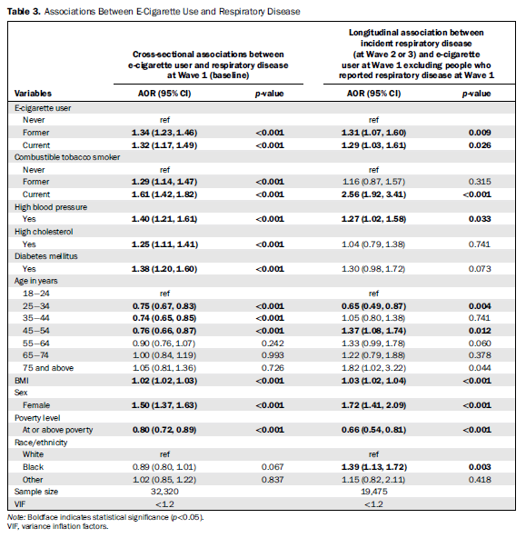
Respiratory Disease
Bhatta and Glantz. Am J Prev Med 2020; 58(2): 182-190

Slide 25
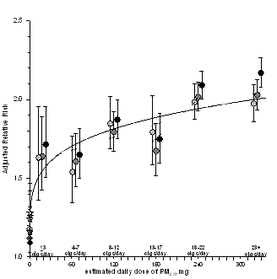
Nonlinear dose-response: particles and heart disease
Pope et al, Circulation, 2009

Slide 26
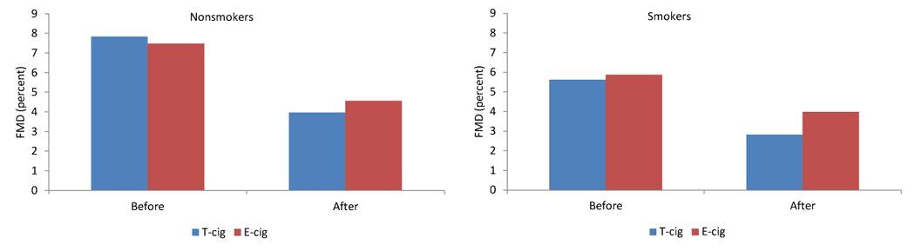
Vascular effects of cigarettes and e-cigs
Carneval et al, Chest 2016 doi:10.1016/j.chest.2016.04.012

Slide 27
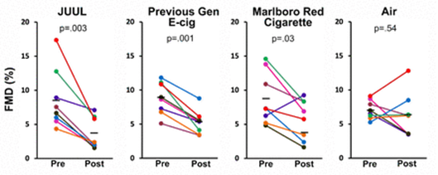
Juul like Marlboro Red
Rao, Liu, Springer https://www.biorxiv.org/content/10.1101/754069v1.full

Slide 28
Heart attack risk of cigarettes and e-cigs
Alzahrani , et al. Association Between Electronic Cigarette Use and Myocardial Infarction. Am J Prev Med. 2018 Oct;55(4):455-461

Slide 29
Adding 2015

Slide 30
Another study

Slide 31
What about early heart attacks?

Slide 32

USA Today

Slide 33


Letter writing to press journal

Slide 34
Continuing pressure

Slide 35


PMI Foundation for a Smokefree World

Slide 36
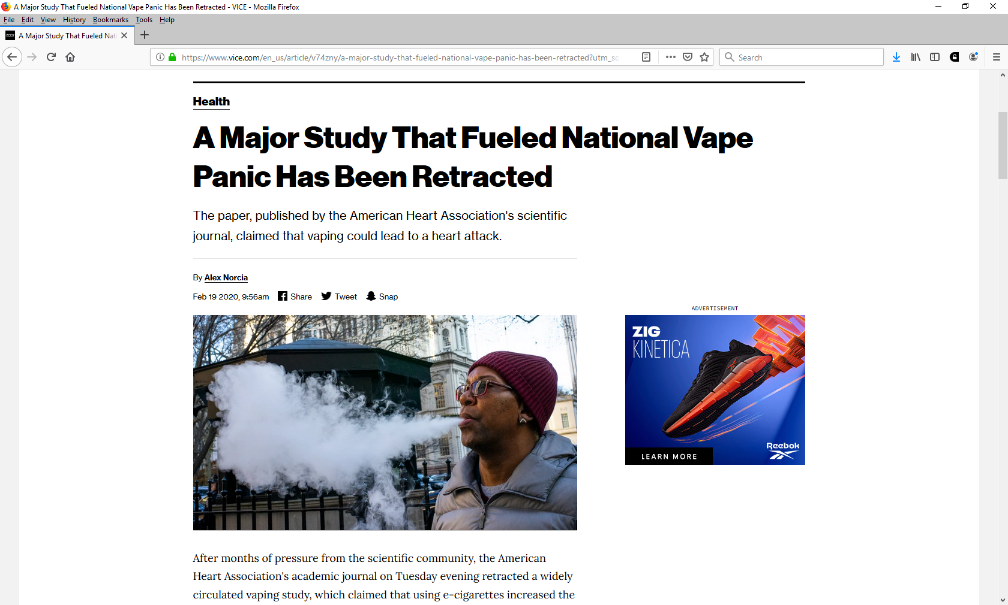
They won (for now)

Slide 37
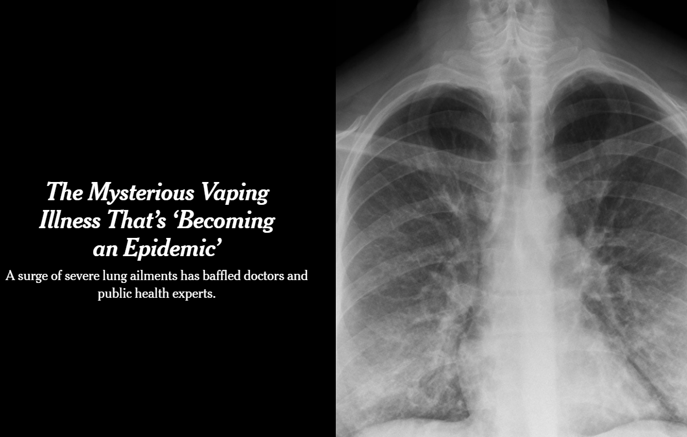
By Sheila Kaplan and Matt Richtel
An X-ray of a patient with a vaping habit, showing lung damage — densities or whitish cloud-like areas typically associated with some pneumonias, fluid in the lungs or inflammation.
Published Aug. 31, 2019
Updated Sept. 11, 2019
New York Times, 2019

Slide 38
Vaping and EVALI
2602 hospitalizations in all states, DC, 2 territories
57 deaths
All reported using e-cigarette or vaping products
  80% used THC products (35% exclusively)
  54% used nicotine products (13% exclusively)
“CDC recommends that you consider refraining from using e-cigarette, or vaping, products, particularly those containing THC.”
CDC, Jan 7, 2020

Slide 39
Dual use dominates
THC
CBD 36%
Both 51%
Nic 13%
CDC Dec 3, 2019 https://www.cdc.gov/tobacco/basic_information/e-cigarettes/severe-lung-disease.html

Slide 40
Lipid-Laden Macrophages

Slide 41
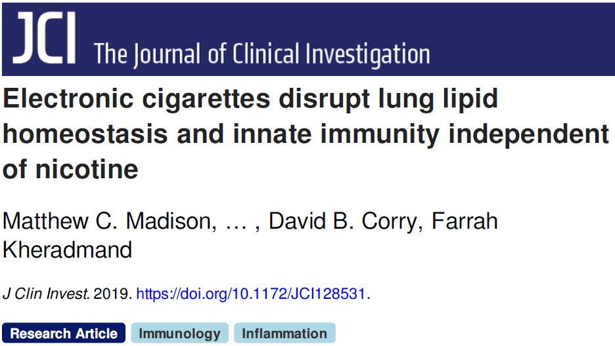

Slide 42
And …
All 17 cases show a pattern of injury in the lung that looks like a toxic chemical exposure, a toxic chemical fume exposure, or a chemical burn injury
Butt, et al. Pathology of Vaping-Associated Lung Injury. N Engl J Med. 2019 Oct 2. doi: 10.1056/NEJMc1913069.

Slide 43
E-cigs and Cancer
Tommasi et al. Deregulation of Biologically Significant Genes and Associated Molecular Pathways in the Oral Epithelium of Electronic Cigarette Users. Int. J. Mol. Sci. 2019, 20(3), 738; https://doi.org/10.3390/ijms20030738

Slide 44
Ecigs cause cancer in mice
54 weeks
Damage DNA
22.5% developed lung adenocarcinoma
57.5% bladder urothelial hyperplasia

Slide 45
A signal in the epidemiology
Subject to same criticism
Sitting on the paper
Do the Hill Criteria needs updating?

Slide 46
E-cigs pollute the air

Slide 47
What to tell smokers
Support quit attempts
For most, hurt quitting
Use FDA approved medication
  Counseling
If already using e-cig
  Not sure what getting
  Stop
  Do not use cigs at same time

Slide 48
The bottom line
Combustion is not as important as we thought
Rapid youth uptake
  Promoting progression to cigarettes
Deterring quitting
Pollute nonsmokers’ air
Dual use more dangerous than just smoking
EVALI
Expanding the tobacco epidemic

Slide 49


FlavorsHookKids.org

