Slide 1
Gene-Environment Interactions, Gut Microbiome
Iona Cheng
March 3, 2019

Slide 2

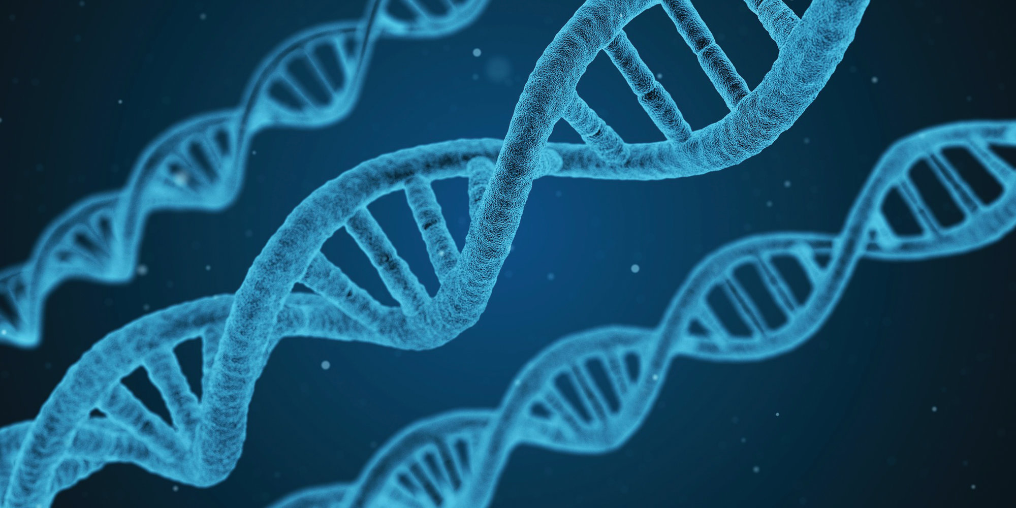



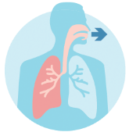
“Genetics loads the gun, but the
environment pulls the trigger”
-Francis Collins,
Director of National Institute of Health,
National Human Genome Research Institute
Complex disease result from the interplay of
genetic and environmental factors

Slide 3
Gene-Environment Interactions
Difference in the magnitude or direction of effect of an environmental exposure on disease risk/trait in people with different genotypes (or vice-versa)
Effect modification
Important because it may:
  Identify sub-populations with environmental exposures/genotypes at increased risk
  Clarify biological mechanisms of disease risk
  Increase power in association analysis
  Explain some of the missing heritability
Notes:
Effect modification: difference in the effect measure for one factor at different levels of another factor (OR differ by race/ethnicity, sex, smoking status)

Slide 4
Gene-Environment Interaction
Examples: Individuals with different genotypes could differ in…
  susceptibility to the health effects of exposures such as smoking, drinking, physical inactivity, etc.
  responses to life events such as trauma
  responses to medications (pharmacogenomics)
Notes:
Example Asian slow metabolism of smoking so they take in less cigarettes per day to maintain nicotine effects thus impacts their risk of lung cancer

Slide 5
Statistical Terms of Interaction
 | Interpretation
No interaction | The same effect of the exposure in people with different genotypes
Synergistic interaction | Greater effect of the exposure in people with a genotype of interest than in people with other genotypes
Antagonistic interaction | Smaller effect of the exposure in people with a genotype of interest than in people with other genotypes

Slide 6
Study designs to study G-E interaction
Adoption studies
Twin studies
Molecular epidemiologic studies
  Case-control
  Nested case-control
  Case-only
Notes:
Adoption studies have been used to investigate how similar individuals that have been adopted are to their biological parents with whom they did not share the same environment with. Additionally, adopted individuals are compared to their adoptive family due to the difference in genes but shared environment. For example, an adoption study showed that Swedish men with disadvantaged adoptive environments and a genetic predisposition were more likely to abuse alcohol.^{[13]}
Using monozygotic twins, the effects of different environments on identical genotypes could be observed

Slide 7
GxE Example:
Factor V Leiden Mutations, Oral Contraceptive Use, and Venous Thrombosis
Question: Could the occurrence of venous thrombosis in young women, who use OC, be explained by the factor V mutations?
Study Design: Population-based case-control study (155 ca/169 co), women ages 15-49, conducted in Netherland
OC information assessed my interview
Factor V (thrombosis susceptibility gene) tested by cleavage products in ethidium-bromide stained agarose gels. Missense variant Arg>Glu (R506Q). Frequency 3-5% in European ancestry populations.
Vandenbroucke et al., The Lancet 1994
Notes:
Factor V Leiden thrombophilia is an inherited disorder of blood clotting. Factor V Leiden is the name of a specific gene mutation that results in thrombophilia, which is an increased tendency to form abnormal blood clots that can block blood vessels

Slide 8
GxE: Stratifying by genotype
Factor V Leiden Mutations, Oral Contraceptive Use, and Venous Thrombosis
Strata
Cases
Controls
Odds Ratio
Factor V Leiden mutation:
(25x4)/(10x2) = 5.0
No Factor V Leiden mutation:
(84x100)/(36x63) = 3.7
G+E+
25
2
G+E-
10
4
G-E+
84
63
G-E-
36
100
Total 155 169
Vandenbroucke et al., The Lancet 1994

Slide 9
GxE: Alternative Method
Factor V Leiden Mutations, Oral Contraceptive Use, and Venous Thrombosis
Strata
Cases
Controls
Odds Ratio
G+E+: 34.7
G+E-: 6.9
G-E+: 3.7
G-E-: Reference
G+E+
25
2
G+E-
10
4
G-E+
84
63
G-E-
36
100
Total 155 169
Vandenbroucke et al., The Lancet 1994

Slide 10
GxE: Case-Only Study
Tests the association between the genotype and exposure in cases only
More efficient study design than case-control study
Greater statistical power than standard case-control studies with the same number of cases
Key assumption: G and E must be uncorrelated in the population from which the cases arose (the “source population”)
Higher false positive rate if assumption is violated

Slide 11
Possible bias in GxE Studies
Bias | Issues
Selection Bias | Inappropriate control population Incomplete case ascertainment Who are the non-responders? Those that refuse to participate or unable to provide data or blood/saliva sample?
Information Bias | Questionnaire errors Specimen handling Laboratory assays: Need for quality control measures
Confounding | Population stratification Epidemiologic confounders
Garcia-Closs et al., 2004
Notes:
Finally, the models that appear most powerful for detecting GxE interactions in simulation studies may not necessarily find the most interactions in real data. For example, the conventional case-control GxE design appears the least powerful in simulation studies; but in a recent study of colorectal cancer, this approach detected more of the GxE interactions than other putatively more powerful models. This counterintuitive observation may reflect limitations of the simulation studies’ applicability, or false positives in the colorectal study. Understanding what is underlying this conflicting result might help clarify the strengths and weaknesses of different methods for detecting GxE interactions.

Slide 12

III. Human Gut Microbiome
~3.3. million genes in the human gut microbiome
Notes:
Microbiome, or microbiota, is the collection of microbiobial organisms (bacteria, archaea, microbial eukaryotes and viruses) from a specific body site or environment, such as human gut.
It is reported that there are about 3.3 million unique genes in the human microbiome, which far exceeds the human genome made up of about 22,000 genes.
Some of these microorganisms promote human health, while others could cause or mediates pathogenic process.
How many genes are in the human genome? How many genes do you think are in the human gut microbiome?

Slide 13
Exposures and Cellular Processes
Linked to Health Outcomes
Involvement of Microbial Processes
DNA repair
Differentiation
Carcinogen
metabolism
Exposures
and microbial
processes
Exposures
Proliferation
Hormonal
regulation
Apoptosis
Inflammation
Immune
function
Adapted from
WCRF/AICR 2007 Expert Report
Notes:
Environmental exposures influence many of the pathways that are altered along the path to cancer including immune function, carcinogen metabolism, and inflammation
It is apparent that microbial processes in the human microbiome also influence many of these pathways

Slide 14
Microbiome in Epidemiology
Marker of exposure
  Direct effects: pathogen
  Indirect effects: microbial metabolites
A prognostic factor
    Eradication of a pathogen
    Dysbiosis: microbiome out of balance that leads to a disease state
A factor in disease etiology
    Disease risk
Notes:
When incorporating the microbiome into epidemiology, the microbiome can be thought of in three major ways:
As a marker of exposure. this can be a marker that measure direct effects like infection by a pathogen or indirectly when looking for microbial metabolites that then influence host health or when looking for changes in inflammation associated with innate immune response to microbial cell components
As a progostic factor
PATHOGEN. In this case, eradication of a pathogen or infectious agent can be used to estimate a chance of recovery or recurrence.
Microbiome concept of DYSBIOSIS change in the microbial community structure or diversity that is indicative of a system out of balance. Can be used to estimate recovery from a disease state.
A factor in disease etiology
Either an individual organism or a group of microbes with a unique physiology that may influence disease risk

Slide 15
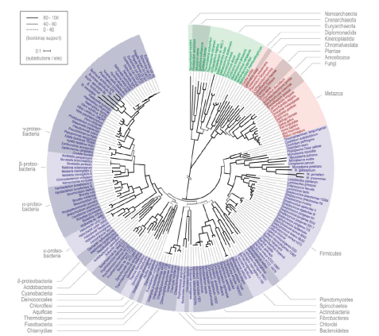
Phylogenetic tree of Life
Archaea
  Archaea, Bacteria, Eukaryotes, Viruses
  Genome size varies
Gene content varies
  Cell types vary
  Consortia of bacteria
  Many are not in pure culture –
Eukaryota
You are here
Bacteria
Ciccarelli et al, 2006,Science,311:1283
Notes:
I think that it is important to point out that the microbiome is unique.
On the left is a phylogenetic tree of the domains of life including Archaea, Bacteria, and Eucaryotes.
It is clear that bacteria dominate the tree.
The microbiome is different from eucaryotic systems and those differences should be considered when looking at the effects of the microbiome on exposures
In bacteria
There is variation in bacterial genomes
Synteny and gene content varies, Genome size varies
These things affect the scaffold that we use for assembly of genomes whereas there is one genome for humans with variation
Cell types vary which influences laboratory techniques for measuring
Most of the bacteria in human systems have not been isolated in pure cultures (so they are a black box)
AND, in fact, microbial metabolism that influences the FATE of environmental exposures is often carried our in CONSORTIA of bacteria. The end product from one metabolism is shared with another group the converts it to a different compound. This adds to the complexity of the system.
Add

Slide 16
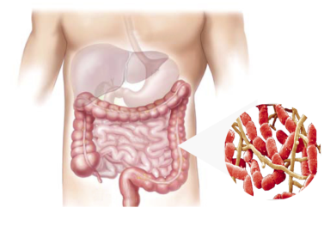
Molecular Approaches
to Measure the Gut Microbiome
Which microbes are there?
DNA
16S rRNA genes
What is the functional potential?
DNA
Metagenomics
What are the microbes doing?
RNA
Proteins
Metabolites
Metatranscriptomics
Metaproteomics
Metabolomics
Notes:
Since most of the bacteria on the human body are not in pure culture, we have relied on molecular approaches to characterize the human microbiome.

Slide 17
Bacterial Diversity in the Human Gut
Only 6 major phyla
>90% are Firmicutes & Bacteroidetes
(Eckberg et al., 2005, Science)
Notes:
17

Slide 18


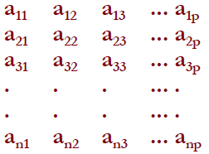
Assaying the Gut Microbiome:
16S rRNA Gene Pyrosequencing
Barcode
ID’s the
sample
1
2
3
Tag 16S genes
with
DNA barcode
Mix samples
and
sequence
Clip barcode
and
Align sequences
Phylogenetic
analysis
1
Binning
2
3
Multivariate
analysis
(After Hamady, et al.,2009, Genome Res.)
Notes:
Two mainstream methods in measuring microbiome are the 16s RNA ribosomal gene sequencing approach and megagenomic sequencing approach.
Our study has been employed the 16s method to generate microbiome data. The 16s approach specifically sequences a target region in bacterial genome namely called 16s ribosomal gene.
The 16s rRNA gene contains phylogenetically conservative region, which serves a great biomarker to detect presence of bacterial in the samples.
On the other hand, the 16s rRNA gene also contains highly evolving regions that allows us to differentiate and classify sequencing reads into specific taxonomic levels.

Slide 19
16S rRNA Gene Analysis
Intra-individual variation (Alpha diversity)
* the distribution of the different kinds of bacteria within an individual
* Shannon Index/Phylogenetic Diversity
Inter-individual variation (Beta Diversity)
* shared (white)
* unique to an individual (red, blue, or yellow)
* absent (black)
* Unifrac (distance metric)

Slide 20
Objective:
To conduct a genome-wide association study of the gut microbiome in the Multiethnic Cohort
First questions:
Quality control assessment of the gut microbiome
What will be our base model for the gut microbiome for GWAS analysis?
How does the gut microbiome vary by sex, race/ethnicity, lifestyle factors?

Slide 21
Multiethnic Cohort Gut Microbiome Study Population
Target 2,000 Core P01 MEC subjects (genotype)
Target 4,200 MEC control subjects with existing GWAS data
Screening questionnaire:
  Exclusions:
    Chemotherapy, insulin, hormones, weight-loss drugs within 6 mos
    Antibiotics within past 2 mos
    Bowel cleaning, colonoscopy within 2 mos
    Substantial weight gain or loss past 6 mos
Participation rate similar in men and women: Whites (60.9%), Native Hawaiians (53.6%), Japanese Americans (48.7%), African Americans (47.9%), Latinos (45.0%)

Slide 22




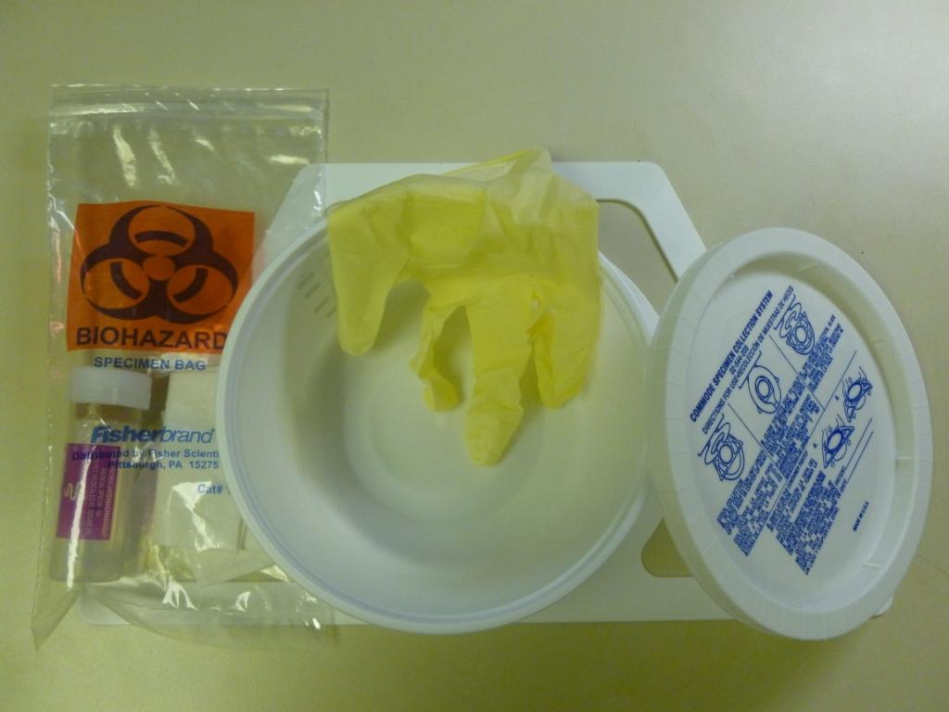

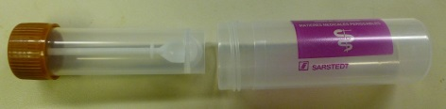
Biospecimens
overnight fasting (>8hrs) blood
(-80 °C; UH, USC)
Buffy coat
Clot
Lymphocytes
Plasma
RBC
Serum
shipped to labs
before analysis
on ice (<4hrs)
5 x 10 mL
mouthwash
stool kit for collection at home
periodically
shipped in bulk
to FHCRC
brought in person
to clinic
or via mail
UH
USC

Slide 23
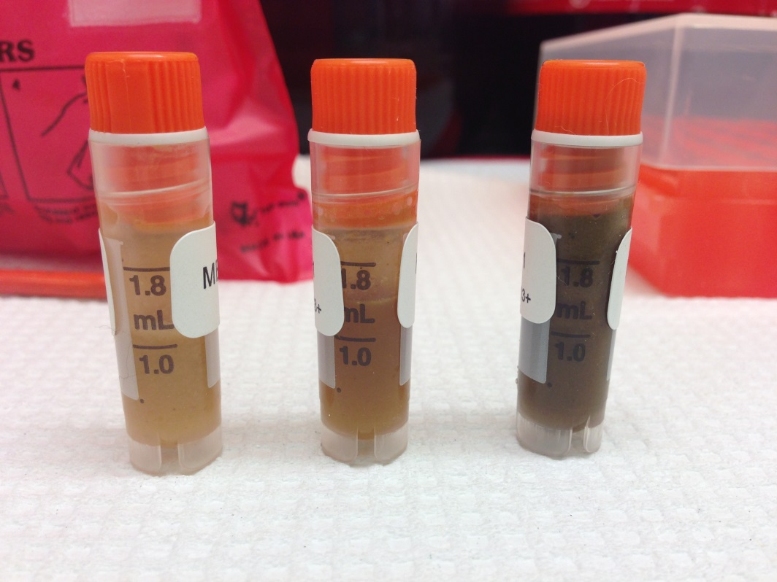
DNA Extraction Flow Chart
Samples thawed and noted
Homgenized, aliquoted
Frozen at -80C
Data entered in SQL database
Microbial DNA extraction
QC:
DNA yield
DNA Quality
If they pass QC:
Sent for sequencing

Slide 24
Sample Processing and DNA Extraction
Received: 6719 in RNAlater
Extracted: 6708 samples
Sent for sequencing: 6641
Absolute fail: 7.0%
Passed sequencing: 6176
DNA extraction
(n=3 subjects, duplicate extractions)
ICC ≥0.93 for alpha diversity
ICC ≥0.99 for beta diversity
ICC ≥0.97 for the most abundant phyla.
NTC controls: no amplification

Slide 25
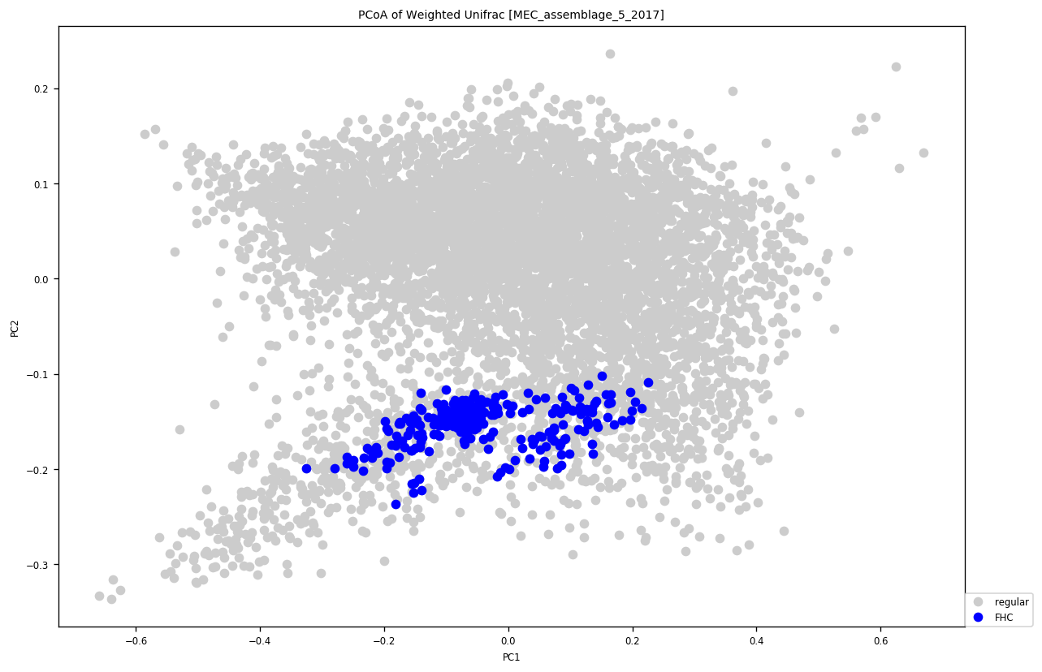
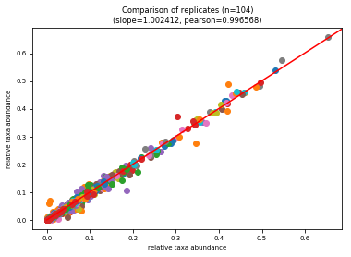
Quality Control Measures
FHC control
Duplicate MEC sample
n=104
r=0.997
m=1.002
Notes:
Multivariate analysis of samples and standards across different sequencing runs. The standard sample groups together although there is some variation, the duplicate samples group together within a run.
.

Slide 26
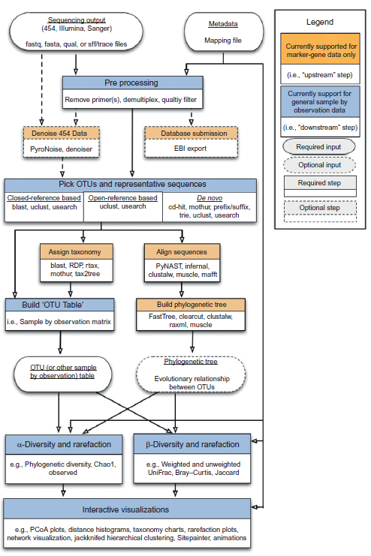
QIIME Pipeline
Notes:
While there are several bioinformatics tools available to process the raw sequencing reads, our study has used QIIME pipeline to process raw data.
QIIME pipeline works to collapse sequencing reads into operational taxonomic units, or OTU, based on sequence similarity.
And then, by comparing in-house or public reference database, it assigns taxonomy names to each OTU.

Slide 27
The Multiethnic Cohort Microbiome Reliability Study
Assess whether one sample from a participant captures the microbiome
  N~ 50 MEC participants every 6 mos for 2 yrs
  Recruited by race and sex
  Stool (Microbiome)(n~250)
Gut Microbiome
16S rRNA gene sequencing V₁₋₃ Illumina paired-end sequencing
Intra Class Correlation (ICC)
ICC= σ b₂ /(σ b₂ + σ ε₂ )
Reliability estimates of diversity, genera abundance
Weighted and unweighted UNIFRAC
Good reliability; ICC >0.6
B. Fu, Jlampe Labs
Notes:
>0.75 excellent, 0.6-0.74 good, 0.4-0.59 is fair, <0.4 poor

Slide 28
The Multiethnic Cohort
Microbiome Reliability Study
 | ICC
Phylum
Firmicutes | 0.64
Bacteroidetes | 0.62
Proteobacteria | 0.65
Actinobacteria | 0.67
Alpha diversity: diversity within sample
Phylogenetic diversity | 0.75
Shannon index | 0.67
Chao1 | 0.56
Beta diversity: diversity between samples
Unweighted UniFrac PC1 | 0.93
Weighted UniFrac PC1 | 0.65
Bray-Curtis PC1 | 0.94
Notes:
This model adjusted for covariates or just participant? Check this.
Range is good (.6-.74) to excellent for overall community estimates
We also have also looked at the reliability estimates for genera and found that the majority of the
Genera are good, those that are not tend to be genera of low abundance and prevalence.
alpha diversity, which is a measure of the diversity within samples; essentially we are asking, “how complex are these communities
beta diversity refers to the diversity between samples. This is essentially a measure of how similar or dissimilar the samples are

Slide 29
Characterizing the Gut Microbiome:
16S rRNA gene
16S rRNA gene, V1-V3
n=274
High between person variation
Bacteroidetes and Firmicutes dominate
Notes:
We have started to look at the microbiome in a subset of subjects, 300 men and women evenly distributed across ethnic/racial groups. The groups include Caucasians, Hawiians, Blacks, Asian, and Latinos.
This is the distribution of the microbiome across the whole group. The phyla Bacteroidetes and Firmicutes dominate the gut microbiome.

Slide 30
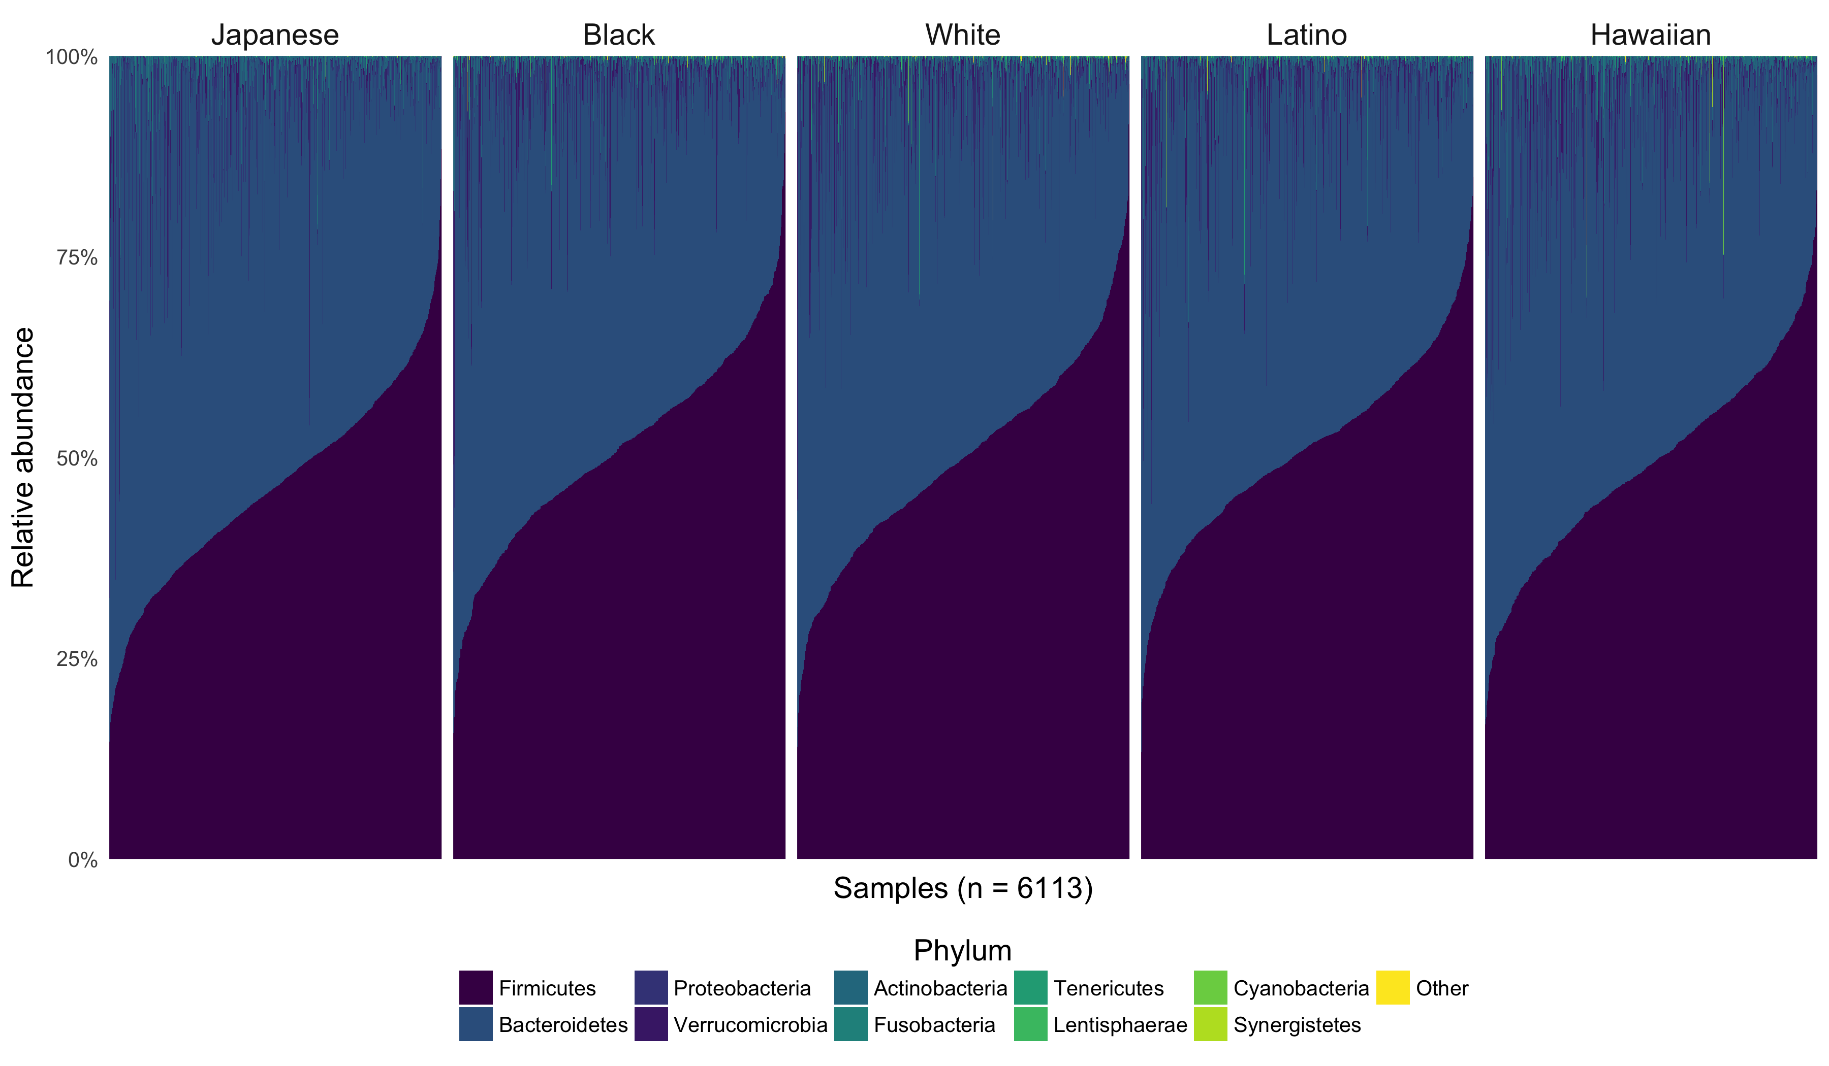
The distribution of phyla (%) across self-report ethnicity
Notes:
Supplementary Figure 3a. The distribution of phyla (%) across self-report ethnicity (n=6113).

Slide 31
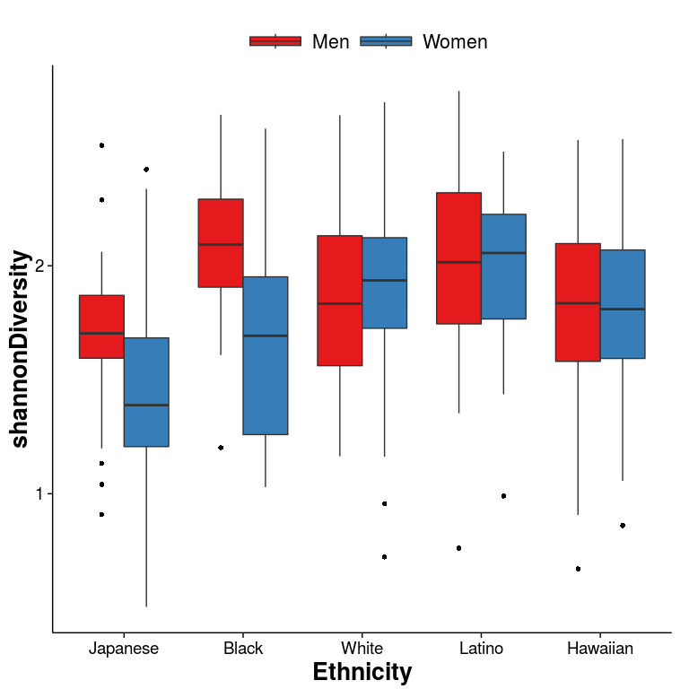
Characterizing the Gut Microbiome Diversity
Microbial diversity varies by sex in Japanese American and Blacks
Diversity is similar between White, Latino, and Hawaiian men and women

Slide 32
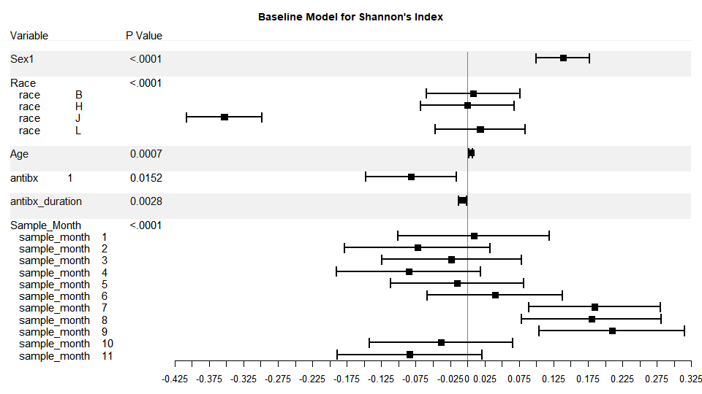
Baseline model for Alpha-diversity
Notes:
This figure shows you the direction and magnitude of the covariate effects on alpha-diversity (or Shannon’s Index).
To highlight, …
We see strong big drop in diversity for jpanese
Male
Sample month, July-Sep have higher diversity.
Antibiotics and

Slide 33
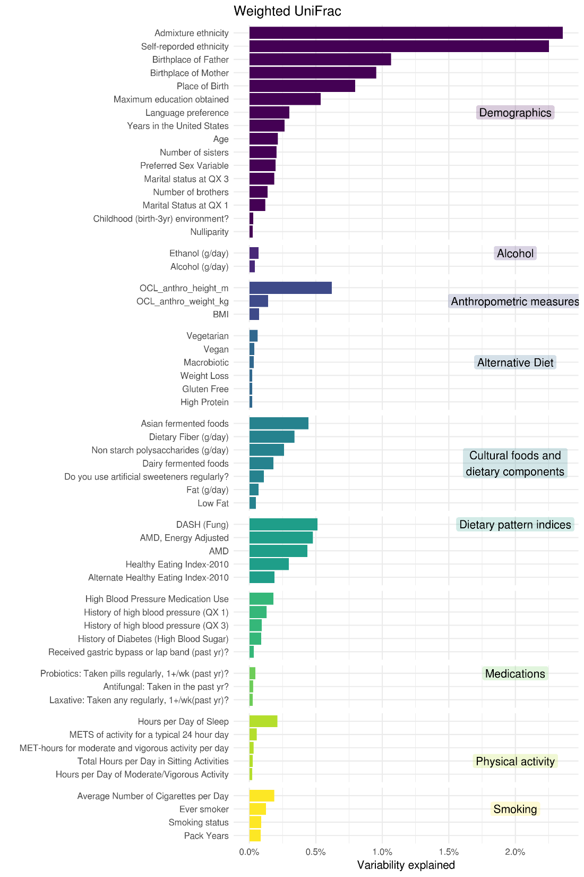
Variation in the GM explained by demographic and lifestyle factors (n=5,112)
Each variable was modeled as perMANOVA
Ethnicity, measured by genetic and self report ancestry, explained about 3% of the variation
Dietary patterns and other dietary intake explained less than 0.5% of the variation.

Slide 34
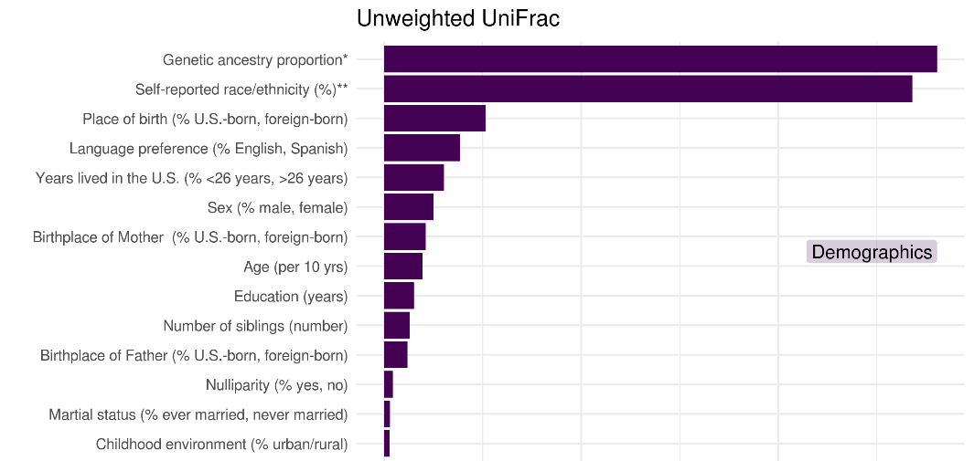
Association between Demographic Variables and the Microbial Community
0%
1%
2%
3%
Variability Explained
Notes:
perMANOVA of an unweighted unifrac matrix.
We looked at the amount of overall variation in the gut microbiome explained by pertinent demographic variables.
Genetic ancestry and Self reported ethnicity explained a small but statistically significant amount of variation in the microbiome.

Slide 35
Parental Birthplace May Influence
Child’s Gut Microbiome Composition
Mother
Father
Odds Ratio*
Notes:
However, when we look at the affects of some of the demographic variable on a genera by genera basis, we find some interesting associations.
Such as the birthplace of the parents seems to influence the child’s gut microbiome composition
126 out of 4305 comparisons
We used an ordinal logistic regression where the outcome variable is categorized into 5 or fewer levels.
BASELINE MODEL = GENERA= BMI, SELF-REPORT ETHNICITY, and BATCH
Follow up on overlap of M + F

Slide 36
Gut Microbiome and Diet
Odds Ratio
Higher dietary pattern scores (AMD) were associated with significant enrichment in bacteria associated with lean phenotypes (members of the family Christensellenaceae) and metabolism of phytochemicals.

Slide 37
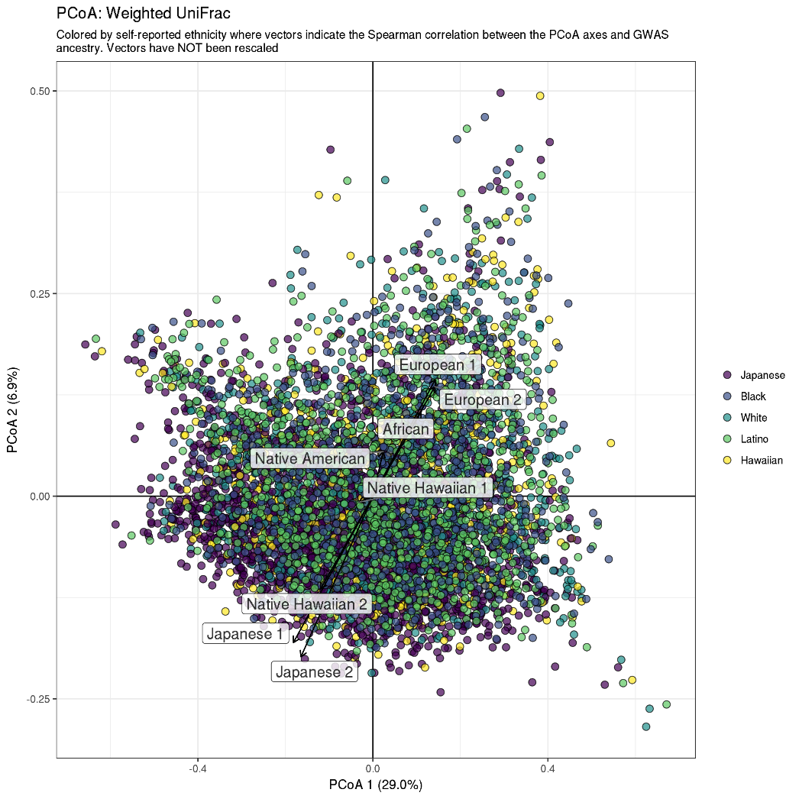
Self-Report Ethnicity, Genetic Ancestry, and the Microbiome
The microbiome categorized across different 5 self-report ethnicities (n=6113)
Vectors of ancestry proportions (n=5212)
  8 groups: South & North European, Japanese, Okinawa, African, Native American, Native Hawaiian, Native Hawaiian/Chinese/Filipino
Microbiome composition varied across ethnicity
R² = 0.026, p = 0.001 ; perMANOVA
Notes:
Supplemental Figure 3. Overlay plot of ancestral markers onto gut microbial community structure from 1638 subject in the MEC. Each ancestral vector is derived from principal component analysis of GWAS data from 1638 subjects. The length of the vector is related to the strength of the correlation. Inverse the matrices here where we use GWAS as the matrix 1 and then correlate the microbiome pcoa plots on top….Draw the vectors with the PCOA axis 1-10 on the GWAS background… on this plot…find out what the correlations are here…
Lots of discussion about this. Want to expand the story of the Japanese
Kachen to do a GWAS PCA with just the Japanese. Then we will do an overlay with the microbiome PCOA axes from just the microbiome group.
Keep this graph as a jumping point for the data….

Slide 38
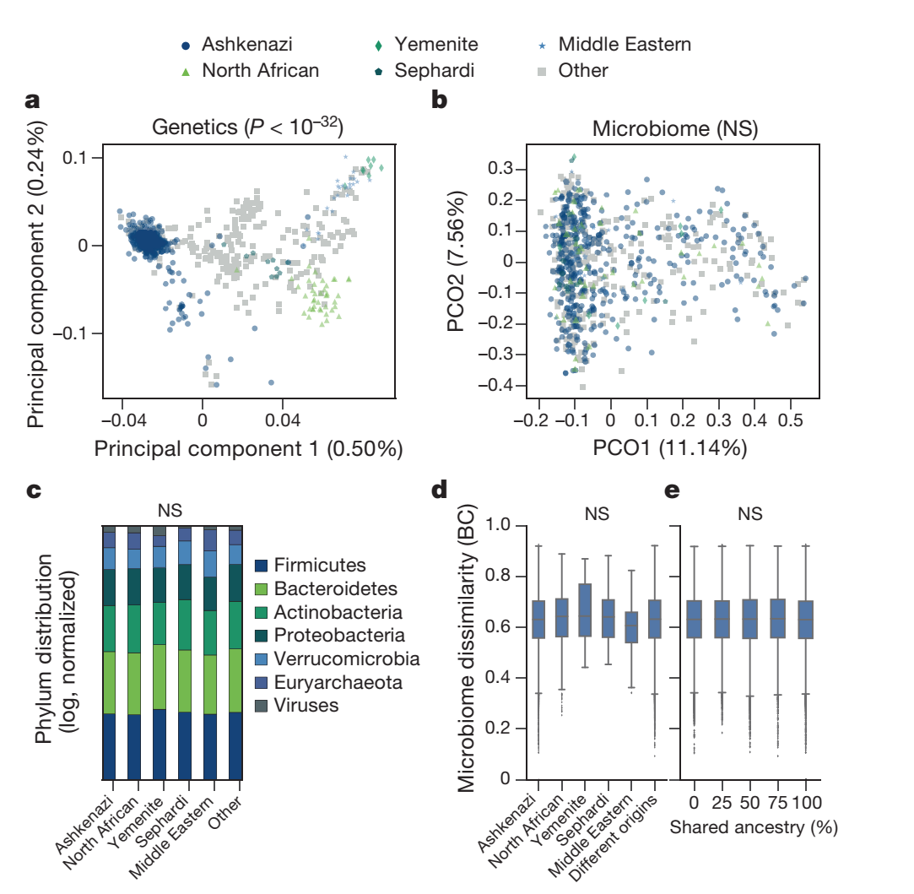
Genetic ancestry is not associated with microbiome composition
Ashkenazi (n=345), North
African (n=42), Middle Eastern (n=24), Sephardi (n=10), Yemenite (n=8) and admixed/other (other) (n=286) ancestries
  Rothschild, Nature Genetics, 2018
Notes:
Figure 1 | Genetic ancestry is not significantly associated with
microbiome composition. a, Genetic principal components are strongly
associated with self-reported ancestry, with Ashkenazi (n=345), North
African (n=42), Middle Eastern (n=24), Sephardi (n=10), Yemenite
(n=8) and admixed/other (other) (n=286) ancestries (P<10-32;
Kruskal–Wallis). b, As in a, but for microbiome principal coordinate
analysis (P>0.08; Kruskal–Wallis). c, The distribution of average
phylum abundance among 582 non-admixed individuals (in log scale,
normalized to sum to 1.0) is not associated with ancestry (P>0.05;
Kruskal–Wallis). NS, not significant. d, Box plots of Bray–Curtis (BC)
dissimilarities across all pairs of 737 individuals for whom the ancestries of
all grandparents are known, demonstrating that microbiome composition
is not associated with ancestry (P>0.06; Kruskal–Wallis test for the top
five Bray–Curtis PCOs). n=105,570 (Ashkenazi), 1,711 (North African),
528 (Middle Eastern), 136 (Sephardi) and 78 (Yemenite) same ancestry
pairs; n=61,048 different ancestry pairs. The lower and upper limits of
the boxes represent the 25% and 75% percentiles, respectively, and the top
and bottom whiskers represent the 5% and 95% percentiles, respectively.
e, Box plots of Bray–Curtis dissimilarities across pairs of 946 individuals
(including admixed individuals), organized according to shared ancestry
fraction (the fraction of grandparents of the same ancestry), for pairs with
0% (n=167,618), 25% (n=33,119), 50% (n=100,163), 75% (n=34,187)
and 100% (n=111,898) shared ancestry fractions. The lower and upper
limits of the boxes represent the 25% and 75% percentiles, respectively,
and the top and bottom whiskers represent the 5% and 95% percentiles,
respectively. The figure demonstrates that microbiome similarity is not
associated with ancestral similarity (P=0.73; Mantel test).

Slide 39
Gut microbiome and Host Genetics
Twin studies
  MZ and DZ similar GM compared to non-twin pairs (p<0.009)
  Another study showed similarity decreases when twins start living a part
  33 significantly heritable bacteria taxa have been identified. Hereditability estimates 10-30%
GWAS
  Israel (n=1056): No association (Rothschild, Nature Genetics, 2018)
  Germany (n=1812): VDR gene and gut microbial characteristics (Wang, Nature Genetics, 2017)
  Dutch (n=1515); 9 loci with microbial taxonomies & 33 loci with microbial pathways and gene ontology terms (Bonder, Nature Genetics, 2016)
  Hutterites (n=1415): No GWAS significant findings (Davenport, PLoS One, 2015)
Meta-analysis GWAS
  MiBioGene Consortium Initiative
  18 cohorts and 19,000 participants

Slide 40
GWAS of Gut Microbiome: Approach
Gut microbiome: 16S rRNA gene sequencing V₁₃ by Illumina paired-end sequencing
Genotype: Genotype MEGA^{ex} array (n=2000) & existing GWAS (n=4000)
Outcomes: alpha diversity, common genera
Genetic ancestry: PCA of 42K independent SNPs
Genetic ancestry proportions: ADMIXTURE program (Alexander, 2009)
Statistical Approach: Ordinal logistic regression; adjusting for age, sex, PCs, antibiotic use, batch, season
Replication: MiBioGene

Slide 41
Manhattan Plot Fusobacteria

Slide 42
Summary
The large study of the microbiome in a multiethnic population
General characterization of the microbiome shows
  Ethnicity/race explains a small but significant amount of variation in the microbiome
  Bacterial genera are significantly enriched in different racial/ethnic groups
  Acculturation across generation may be important
Continuing to assess the associations of the microbiome with ethnicity/race and the distribution of adiposity

Slide 43
Looking forward
Very large and well characterized cohorts may be the key to finding associations between the microbiome and disease
Population-based
Well-described
Rigorous inclusion criteria
Rigorous data collection
Standardization is needed across all aspects of sample collection, lab analysis, and bioinformatics analysis for pooling, as well as, new statistical approaches to account for covariates (Microbiome Quality Control Project, Sinha R et al, Nat Biotechnol 2017)
Development of large databases and repositories for the increasing volume of complex data
Allows pooling of information across studies which is especially important in cancer epidemiology and the microbiome

Slide 44
Questions
Thank you

Slide 45
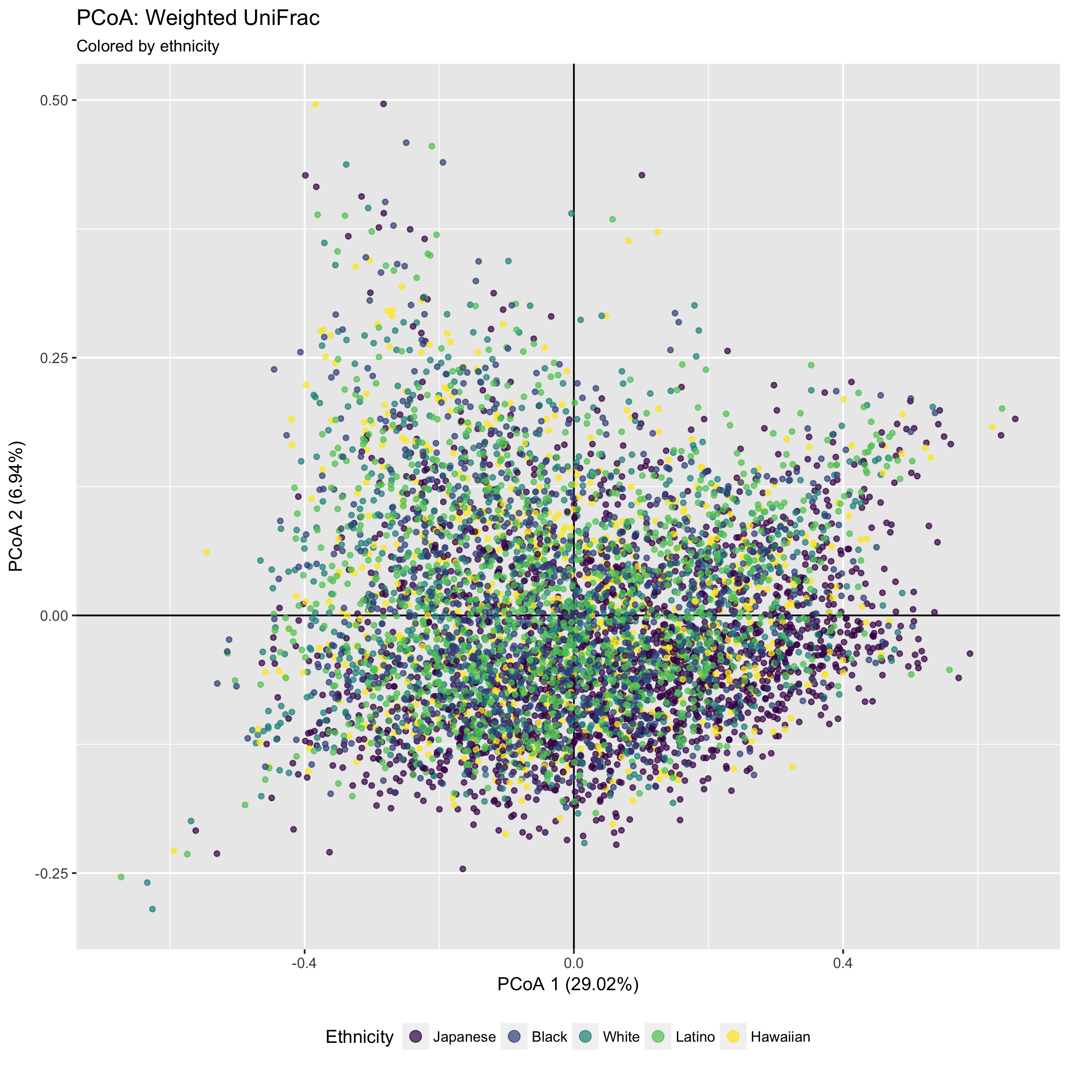
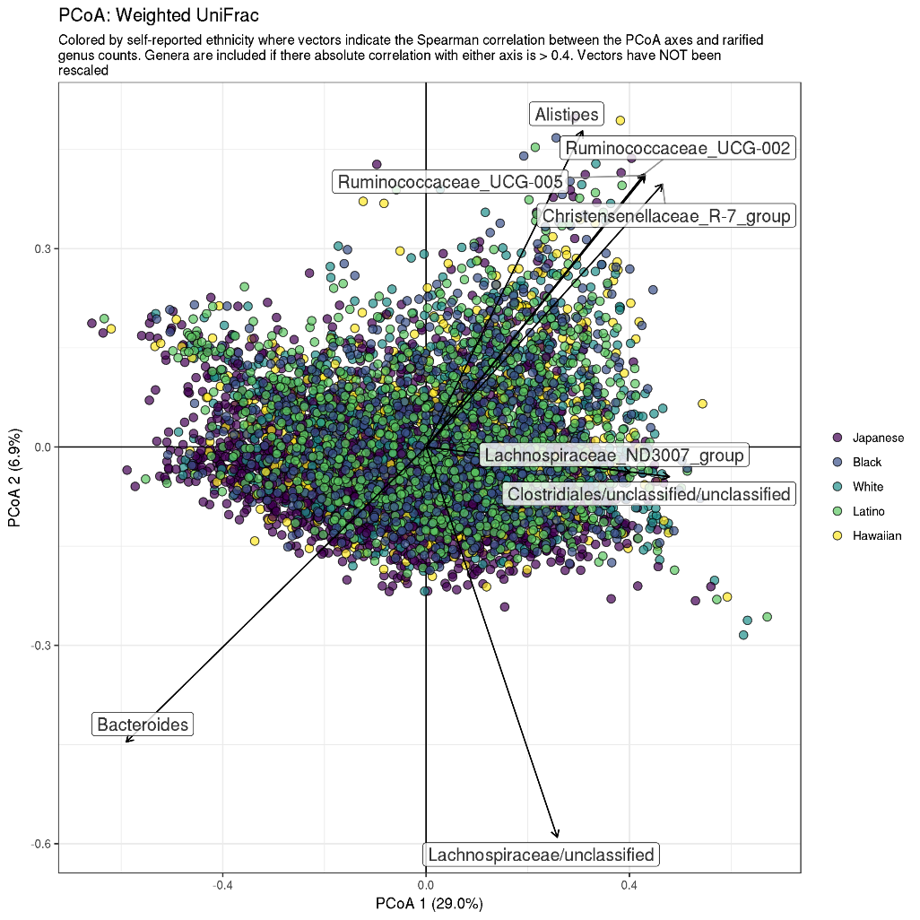
The Microbiome Varies Across Ethnicity
Significant differences by ethnic groups
25 genera
Significant differences by sex
17 genera
Bacteroides enriched in Japanese
Christensenellaceae enriched in whites
Notes:
OCIA wrt to
Simple correlation with the axes are overlain onto the matrix.

Slide 46
Core microbiome found in common to all ethnic groups

