Slide 1
Ionizing Radiation and Health:
What Do We Know, What We Do Not Know, Remaining Questions and Plan for Moving Forward
Epi 252 Cancer Epidemiology
Spring 2020
Lydia B. Zablotska, M.D., Ph.D.
Professor, Department of Epidemiology and Biostatistics
School of Medicine, University of California, San Francisco

Slide 2
Outline
Ionizing radiation as an IARC Group 1 human carcinogen
Methods for studying radiation-associated risks of cancer: risk projection vs. empirical studies
Summary of current knowledge on long-term health effects of radiation exposure
  Case Study 1: Risks from occupational exposures to ionizing radiation
  Case Study 2: Risks of diagnostic imaging
Remaining questions
Plans for moving forward

Slide 3
Outline
Ionizing radiation as an IARC Group 1 human carcinogen

Slide 4
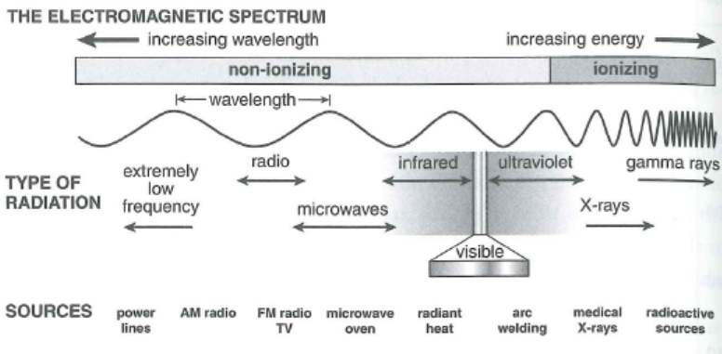
Radiation
Emission of energy as electromagnetic waves or as moving subatomic particles, especially high-energy particles that cause ionization
  Low-energy (long wavelength, lower frequency): e.g., electric and magnetic fields, radio waves
  High-energy (short wavelength, high frequency): e.g., ionizing radiation types such as gamma-rays, X-rays or alpha-particles

Slide 5
Ionizing radiation
Routes of exposure:
  Inhalation (alpha particles: radon decay products, beta particles: radioactive iodines)
  Ingestion (radioactive iodines)
  Direct whole-body (gamma and x-rays)
Injury depends on:
  Total dose
  Dose-rate (dose protraction)
  Percentage and region of the body exposed

Slide 6
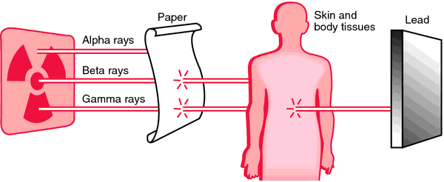
Modes of radiation exposures
Named after Greek alphabet in the order of their discovery

Slide 7
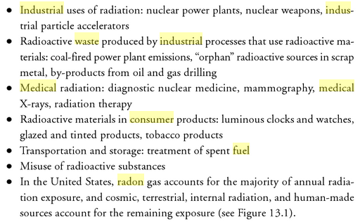
Artificial sources of radiation
Ray M. Merrill, Environmental Epidemiology: Principles and Methods, 2008.

Slide 8
Ionizing radiation
One of the best studied carcinogens
International Agency for Research on Cancer (IARC) classification of human carcinogens:
    Group 1: Carcinogenic to humans
    Group 2A: Probably carcinogenic to humans
    Group 2B: Possibly carcinogenic to humans
    Group 3: Unclassifiable as to carcinogenicity in humans
    Group 4: Probably not carcinogenic to humans
Ionizing radiation (x- and gamma-radiation) is carcinogenic to humans (Group 1)
Notes:
In the past 30 years, the IARC has evaluated the cancer-causing potential of more than 900 likely candidates, placing them into one of the following groups:

Slide 9
Effects of exposure to ionizing radiation
  Deterministic effects:
    Low-LET whole-body exposures > 4 gray
    effects above the threshold
    severity of effects depends on dose-rate
  Stochastic effects:
    Low to moderate doses
    no threshold
    increased probability of effects, no effect on
    severity
¹ IARC Monographs on the evaluation of carcinogenic risks to humans, Vol. 75, Ionizing radiation, 2000.
Notes:
9

Slide 10
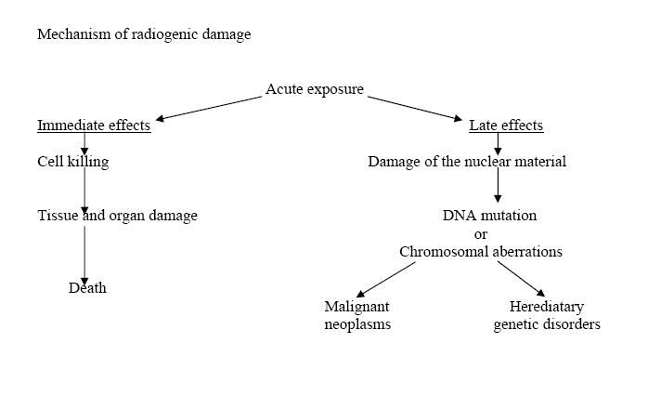
Ionizing radiation

Slide 11
Ionizing radiation exposures
Definitions
Absorbed dose – amount of energy imparted to the mass of exposed body or organ
  Low doses: <100 milligray (mGy)=10 rads
Equivalent dose – absorbed dose multiplied by the radiation weighting factor; used to compare different types of radiation
Effective dose – equivalent dose averaged over all organs; used in biomonitoring
  Low doses: <100 millisievert (mSv)=10 rems
Dose-rate – to characterize differences between instantaneous and protracted exposures
  Low dose-rates: <0.1 mSv per min
  Repair of sub-lethal DNA damage
→ effects of similar equivalent doses delivered at low and high dose-rates will be markedly different
Committee to Assess Health Risks from Exposure to Low Levels of Ionizing Radiation (BEIR VII -phase II), National Research Council, 2005.
Notes:
11
Absorbed dose – in Gy, ratio of imparted energy to mass of organ.
Equivalent dose = Absorbed dose * RBE – in Sv (low LET – 1Sv=1Gy, high LET – 1Sv=doseGy*RBE)
Effective dose = Equivalent dose averaged over all organs –- in Sv

Slide 12
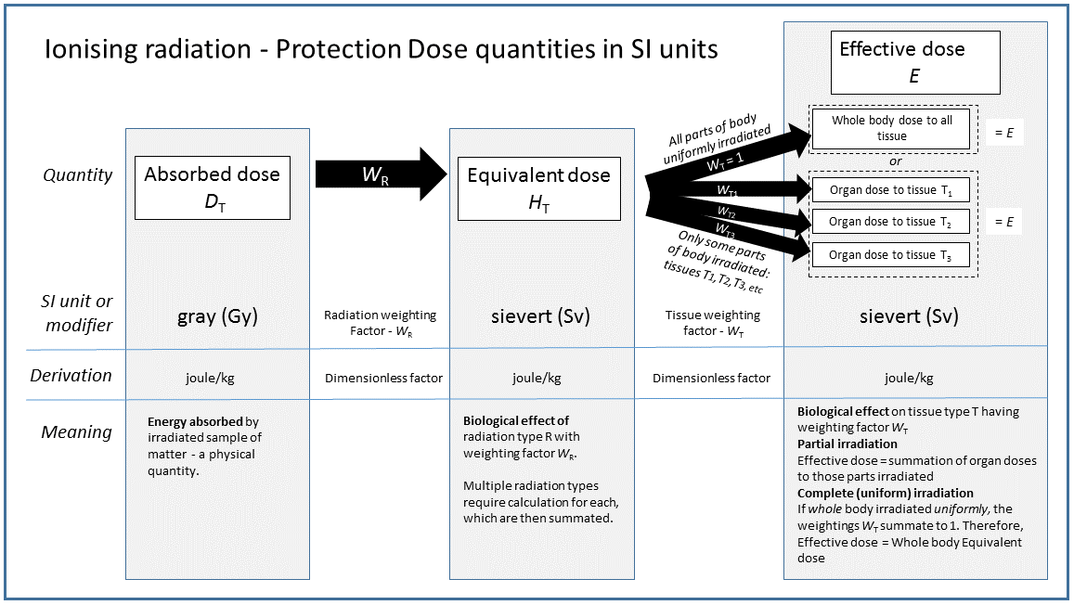
From https://en.wikipedia.org/wiki/Equivalent_dose

Slide 13
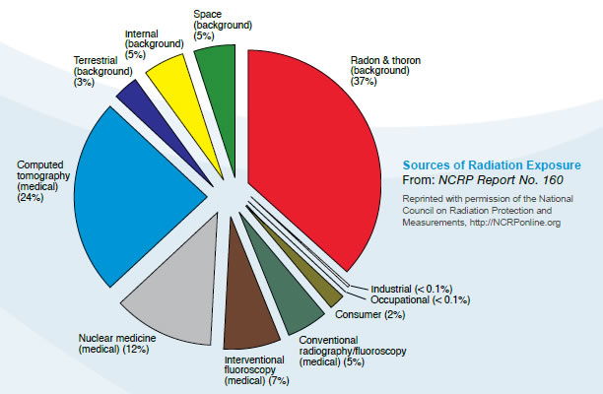

Average U.S. Radiation Doses and Sources

Slide 14
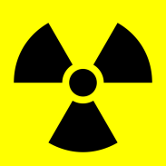

Ionizing radiation exposures
Radiation doses to the populations at risk in the U.S.
General public
  annual limit: 5 mSv (average annual effective dose – 3.6 mSv)
  ~ 80% - natural resources (radon) – 0.2-1.0 mSv
  <1% occupational exposures – 1-10 mSv
  ~ 20% - medical procedures – 1-2 mSv
Nuclear workers
  annual limit: 50 mSv
  104 nuclear reactors in the U.S.
  ~160,000 nuclear workers
  nuclear energy contributes over 20% of total electrical output
Medically exposed
  RT mean dose ~ 40-80 Gy
Dose
# At risk
Berrington de Gonzales and Darby, Lancet 2004.
Berrington de Gonzales, Arch Int Med 2009.
Notes:
14

Slide 15
Ionizing radiation exposures
Exposures and risks from medical exposures in the U.S.
General public
  ~ 20% - medical procedures – 1-2 mSv
  U.S., 2004¹
    962 x-rays/1,000/year
    AF% for leukemia = 0.9%
  U.S., 2007²
    72 million CT scans/year
    AF% for all cancers = 2.0% (29,000 of the 1.4 million cancers that are diagnosed annually in the US) could be related to past CT scan use
  U.S., 2011³
    85 million CT scans (20% increase in 4 yrs)
¹Berrington de Gonzales and Darby, Lancet 2004. ³ Miglioretti et al., JAMA Pediatr 2013.
²Berrington de Gonzales, Arch Int Med 2009.
Notes:
15

Slide 16
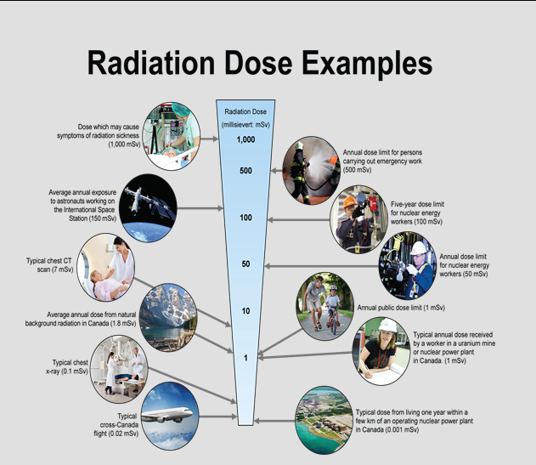
From
http://nuclearsafety.gc.ca/eng/resources/radiation/introduction-to-radiation/radiation-doses.cfm

Slide 17
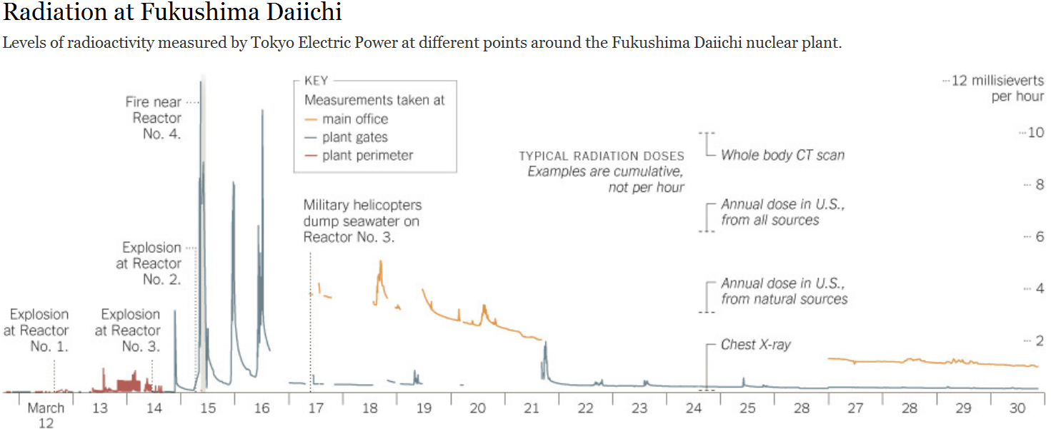
Ionizing radiation exposures: perspective
The New York Times, March 31st, 2011.

Slide 18
Outline
Methods for studying radiation-associated risks of cancer: risk projection vs. empirical studies

Slide 19
Methodological approaches
Risk projection method
  Primarily A-bomb data
  Risk models from other studies plus doses for particular group of population
  Advantages: More statistical power and precise confidence intervals
  Disadvantages: Need for extrapolation
Empirical method
  Direct descriptive and observational studies in affected populations
  Advantages: No need for extrapolation
  Disadvantages: Lack of statistical power
Notes:
19

Slide 20
Outline
Summary of current knowledge on long-term health effects of radiation exposure
  Case Study 1: Risks from occupational exposures to ionizing radiation
  Case Study 2: Risks of diagnostic imaging

Slide 21
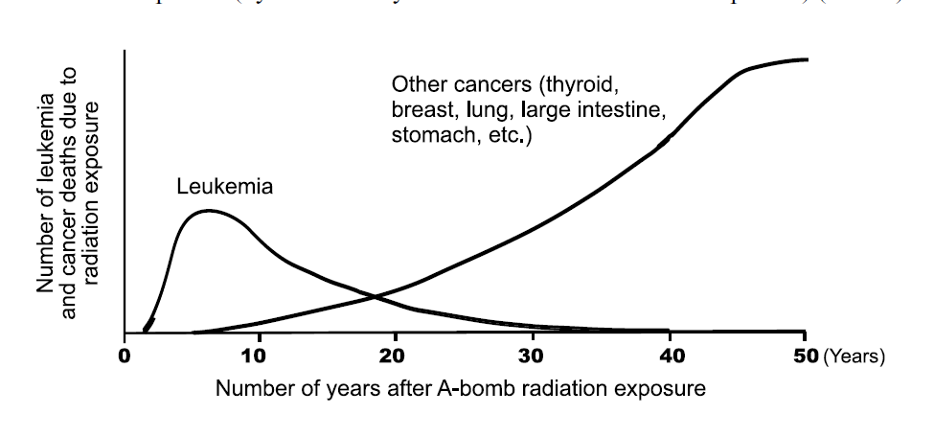
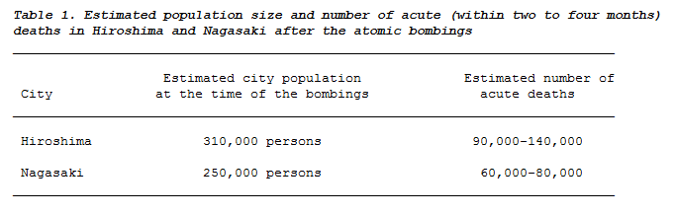
Study of survivors of atomic bombings in Hiroshima, Japan
Life Span Study (LSS) N=86,572
Mean dose=0.11 Gy, range 0-3.5 Gy
Immediately after the bombing¹:
20 years after the bombings: The only significant consequences were increases in cataracts, leukemia and thyroid cancer
30 years: A significant increase in solid cancers
50 years²:
      An unexpected increase in non-cancer diseases
      Solid cancers observed over 50 years: 10,127; due to radiation: 479 (4.7%)
      Leukemia observed over 50 years: 296; due to radiation: 93 (31.4%)
65 years: Leukemia and thyroid cancer form only a small fraction of the accepted total radiation-related health detriment
¹Medical Effects of the Atomic Bomb in Japan. Edited by A.W. Oughterson and S. Warren. New York: McGraw-Hill, 1956. ²Preston et al. 2004.

Slide 22
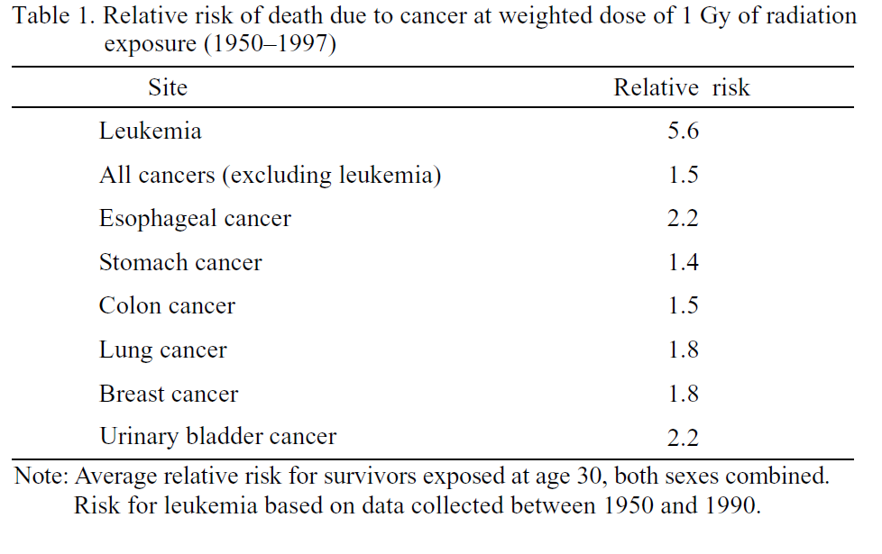
A-bomb study: main results
In Utero exposures:
  a reduction in IQ
  a higher incidence of mental retardation in heavily exposed
  some impairment in the rate of growth and development
Radiation Effects Research Foundation, 2007.

Slide 23
Predicted relative risks¹ for adult male exposed at low dose-rate
ERR/Sv=1.8
RR=1+ERR/Sv
Dose Solid cancers Leukemia
1 Sv 1.1 2.8
0.5 Sv 1.05 1.9
0.2 Sv 1.02 1.4
0.1 Sv 1.01 1.2
0.01 Sv 1.001 1.02
¹ Linear estimates based on A-bomb survivors reduced by a factor (DDREF) of 2.

Slide 24
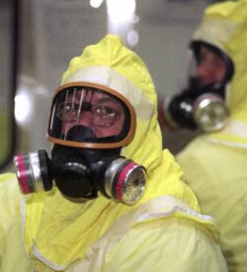
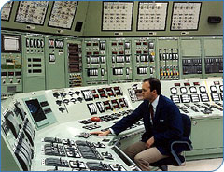
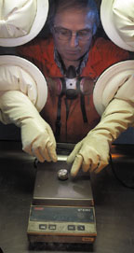
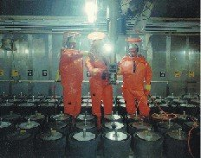
Case Study 1: Nuclear Workers

Slide 25
Nuclear Workers
Involved in the
production of nuclear power
manufacture of nuclear weapons
enrichment and processing of nuclear fuel
reactor or weapons research
The group does not include medical and dental workers or underground miners

Slide 26
Why study workers exposed to low doses of external radiation?
To verity the accuracy of current risk estimates based on A-bomb survivors and others exposed at high dose-rates
For risk assessment, interest is primarily in low doses and dose-rates
Uncertainty in the extrapolation process
Notes:
Up to now, the studies we’ve been discussing have involved high doses, and our current risk estimates …
For risk assessment, we’re mainly interested in lower doses.
For the most part the exposures of workers have been very carefully regulated with the expectation that risks would be minimal.

Slide 27
Why study workers?
Exposures deliberately limited as a protection to the worker
Dose estimates obtained from personal dosimeters worn by workers
Provide a direct assessment of risks at low doses and dose-rates
Power limited, but worker studies can detect serious underestimation of risk

Slide 28
Objectives of studies
Scientific
  To determine existence and magnitude of any dose-response bw E and D
  To apply to other similar situations to predict associated risks
    Caveat: in some studies doses too low and the corresponding estimates too imprecise
Public health
  To provide information to those affected about their likelihood of any health consequences
  To gather as much as possible direct information about the consequences
  To estimate public health expenditures
Notes:
28
Scientific objectives may be expressed as determining the existence and magnitude of any dose-response relationship between exposure and disease which can be applied to other similar situations.

Slide 29
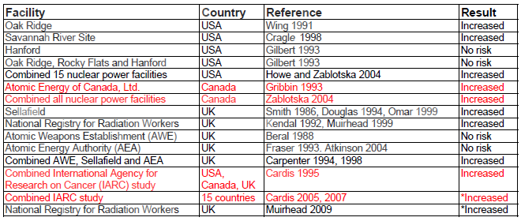
Empirical Evidence
Effects of low doses of radiation delivered at low dose-rates on the risk of solid cancer among nuclear workers
Notes:
29

Slide 30
Limitations of individual studies
  Insufficient power for internal analysis (small number of deaths, small effects)
  No information on lifestyle factors (possible confounders)
  Measurement errors in dosimetry
  Variability in reporting thresholds over time
  Total body doses vs organ doses
  Misclassification of causes of death

Slide 31
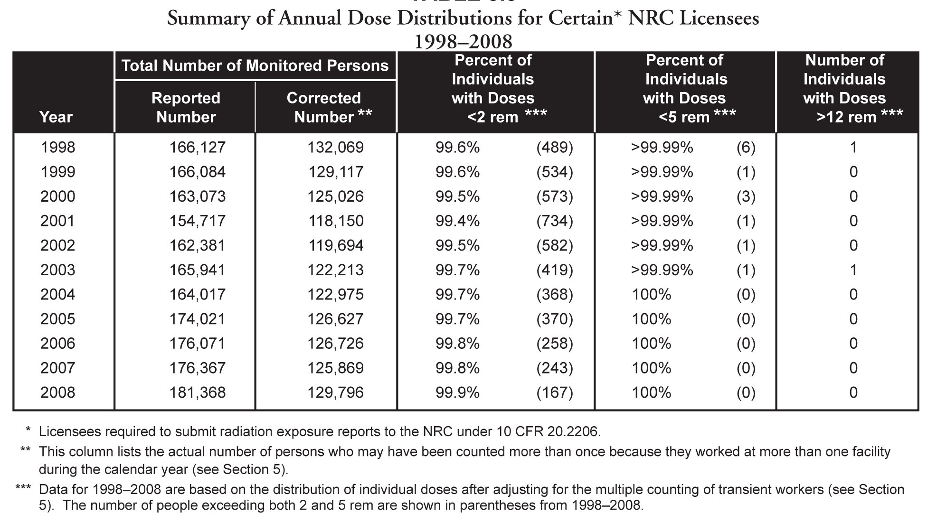
Empirical Methods
Low doses of radiation delivered at low dose-rates
5 rem = 50 milliSievert (mSv)
Occupational Radiation Exposure at Commercial Nuclear Power Reactors and Other Facilities, U.S. Nuclear Regulatory Commission, 2008.
Notes:
US NRC
Under the regulatory limits in 10 CFR 20.1201,
an annual TEDE greater than 5 rem, for an
adult occupational worker, is a dose that
exceeds the regulatory limits
Table shows that during 11 years from 1998 to 2008, the percentage of workers with <2 rem has been greater than 99%. The number of workers receiving an annual dose greater than 5 rem has been
<0.01% since 1998.

Slide 32
Estimation of Radiation-Associated Risks of Cancer for Nuclear Workers
Of interest for risk assessment:
0 - 0.1 Sv
Current risk estimates based on the A- bomb study:
Driven by doses of 0.5+ Sv
Worker-based estimates:
Driven by doses 0.1-0.5 Sv experienced by small number of workers with very high occupational exposures
QUESTION: WHAT COULD BE DONE???

Slide 33
ANSWER: Pooled Analyses
Obtain more precise estimates of risk
Opportunity for understanding differences and similarities in studies
  Comparable statistical methods
  Results in comparable format
Best overview or summary of studies

Slide 34
Pooled Studies of Workers
  Population Country Publication Dates
  Hanford/Oak Ridge/Rocky Flats US 1989, 1993
  AEA/AWE/Sellafield UK 1994
  IARC 3-country US/UK/Canada 1994, 1995
  IARC 15-country 2007
  INWORKS US/UK/France 2018

Slide 35
15-Country study of cancer risk among radiation workers in the nuclear industry^{1, 2}
Australia Lithuania
Belgium Slovakia
Canada Spain
Finland Sweden
France Switzerland
Hungary UK
Japan US (included Hanford, Idaho,
Korea Oak Ridge and 15 nuclear
power facilities)
¹Based on 19 cohorts from 15 countries.
² Cardis et al. 2005, 2007.

Slide 36
Common core protocol
Inclusion of cohorts – a priori criteria
Common definition of study population
Particular attention paid to identify and adjust for possible biases
  Selection
    Initial selection of healthy workers – internal comparisons
    Long term workers may be selected – careful adjustment
  Confounding
    … little information can be collected in large-scale cohorts
    Age, sex, calendar period, facility, country
    Socio-economic status (SES)
    Smoking – indirect assessment
Notes:
Exclusions:
Problems of dose estimation
Inadequate technology, monitoring
Recording of different quantities (%ALI, …)
Lack of information on chemical form, intake route, etc. for nuclides
Proportion of such workers generally small

Slide 37
Study population
All workers 598,068
Main exclusions
  Employed less than 1 year: 113,711
  Not-monitored for external radiation: 38,521
  Potential for substantial doses from
  radionuclide intake: 39,730
  Potential for substantial doses from
  neutrons: 19,041
Main study population: 407,391

Slide 38
Participating cohorts¹
¹Based on 19 cohorts from 15 countries. ² Most of the study population were men (90%) and they received 98% of the collective recorded dose.
Notes:
A total of 407 391 workers were included in the analyses, 24 158 (5.9%) were known to have died during the study periods, 6,794 from cancer. The total duration of follow-up was 5 192 710 person-years and the total collective recorded dose (unlagged) was 7 892 Sv. Most of the study population were men (90%) and they received 98% of the collective recorded dose. The overall average cumulative recorded dose was 19.4 mSv; the cohort specific average cumulative dose ranged from 3.8 mSv in CEA-COGEMA (France) to 62.3 mSv in Switzerland.

Slide 39
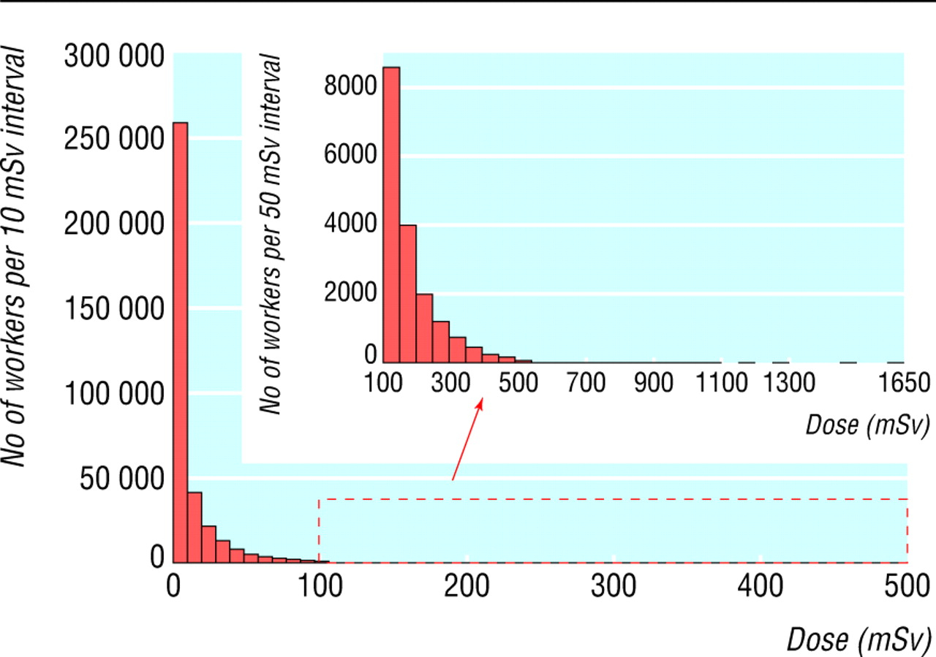
Distribution of cumulative radiation doses
Cardis et al. BMJ 2005.
Notes:
The distribution of recorded doses was very skewed (Figure 1). 90% of the workers had received cumulative doses below 50 mSv and less than 0.1% had received cumulative doses greater than 500 mSv over their entire career in the nuclear industry.

Slide 40
Results – 15-country study
Non-cancer analysis¹
¹Based on 17 cohorts from 14 countries with SES information.

Slide 41
Results – comparison with study of atomic bomb survivors
Non-cancer analysis

Slide 42
15-country study: Summary of findings
A strong healthy worker effect
A significant association between radiation dose and all-cause mortality, mainly attributable to all cancer mortality
Among 31 cancers studied, significant association was found for lung cancer and multiple myeloma
Risk of leukemia was increased but not significant
No increased risk of CLL
Little evidence for a relationship between mortality from non-malignant diseases and radiation dose
The most informative low-dose radiation study to date
Risk estimates compatible with the risks found in studies at higher doses

Slide 43
Limitations of low dose worker studies
Low statistical power and imprecisely estimated risks
Uncertainties in dose estimates
Strong potential for confounding, especially by unmeasured socieconomic and lifestyle factors
Strong potential for bias
  Canadian example

Slide 44
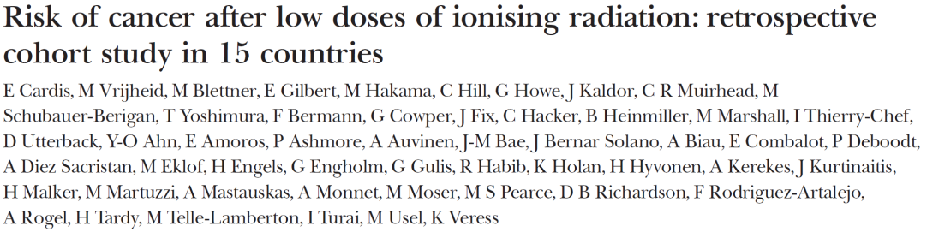
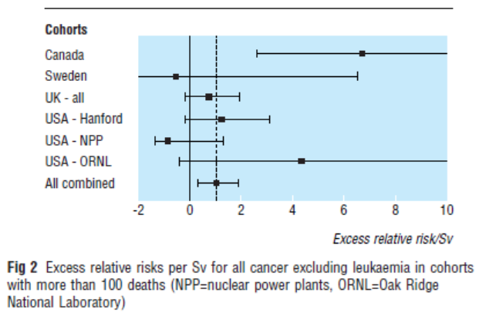
15 countries ERR/Sv = 0.97 (90% CI 0.28, 1.77)
excluding Canada ERR/Sv= 0.58 (90% CI 0.10, 1.39)

Slide 45
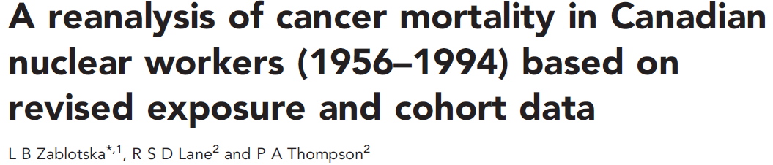

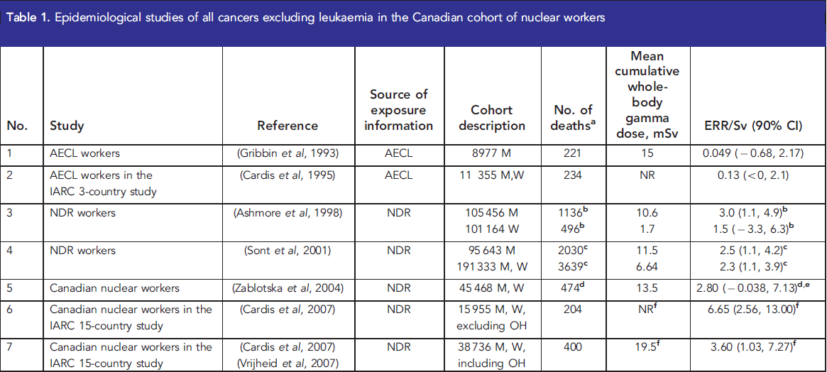

Slide 46
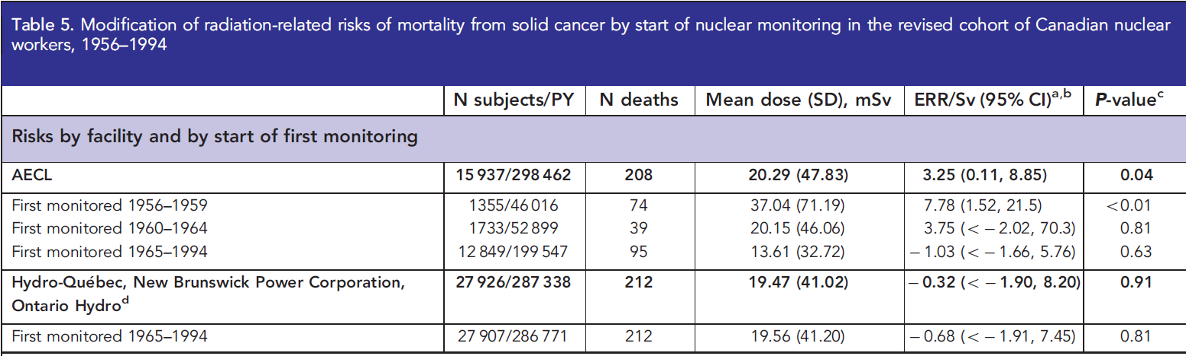
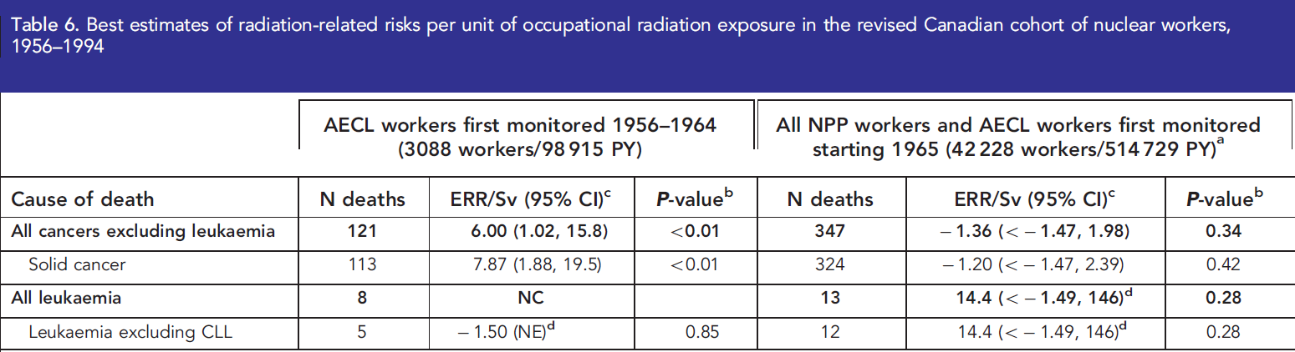

Slide 47
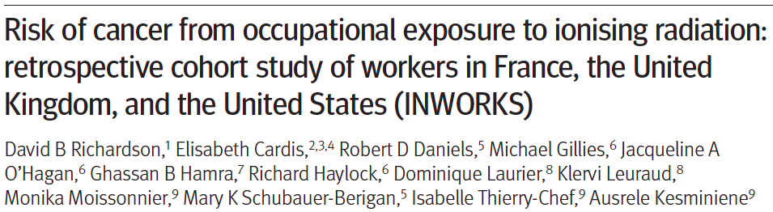
308,297 workers in the nuclear industry from France, UK and US
8.2 million person-years of follow-up
Mortality from all cancers excluding leukemia increased with cumulative dose by 0.48 per Gy (90% CI: 0.20 to 0.79), lagged by 10 years
  Much closer to the estimate from the A-bomb study
  No apparent differences between instantaneous and protracted exposures
Richardson et al. 2015

Slide 48
Results – comparison with the study of atomic bomb survivors
All cancers and leukemia separately
Cardis et al. Rad Res 2007.

Slide 49
What is the role of low-dose nuclear worker studies?
Most informative of studies of persons exposed at low doses and dose-rates
Statistical uncertainties and high potential confounding impose important limitations
Notes:
The radiation worker studies are the most informative studies of persons exposed at low doses. They have the major advantage of doses that have been objectively estimated through the use of personal dosimeters. If we have any hope of direct information, it’s likely to come from the worker studies.

Slide 50
What has been learned from studying workers exposed to low doses of external radiation?
Indicate that extrapolation from high dose studies has not seriously underestimated risks
Provide some evidence of association of leukemia and exposure at low doses and dose-rates
Leave open the possibility that risks may be overestimated
Notes:
What have we learned from these studies?
First, the direct study of workers, especially the 3-country study, has shown that it is unlikely that linear extrapolation has seriously underestimated risks.
For leukemia, the worker studies provide some direct evidence of risk at low doses and low dose rates. Although this evidence must still be regarded somewhat tentatively, it certainly means that worker studies can’t be used to support the position that there is no risk at low doses and dose rates.
There is considerable interest in whether risks at low doses and dose rates might be lower than those predicted by extrapolation, and even whether or not there might be a threshold below which there is no risk. Unfortunately, the worker studies are uninformative on this issue. Sampling uncertainty alone makes it very difficult to distinguish between no risk and the very small risks predicted from high dose studies. The possibility of bias adds to the difficulty.

Slide 51
Interpreting low-dose studies with respect to risk estimation:
SOME CAVEATS
Ecologic studies: ignore
Studies with only external comparisons: ignore
Studies must consider potential confounders:
  Socioeconomic status
  Healthy worker effect
  Duration of employment
  Smoking for many cancers and other diseases
  Etc.
Interpretation must take into account multiple comparisons
If no statistically significant association, consider the width of the confidence interval to see what risks can reasonably be excluded
Check for consistency with estimates from high-dose studies
Consider plausibility of results

Slide 52
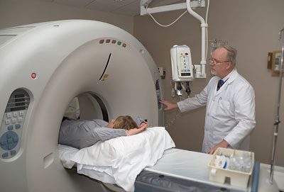

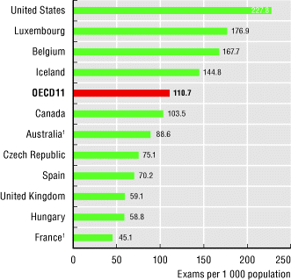
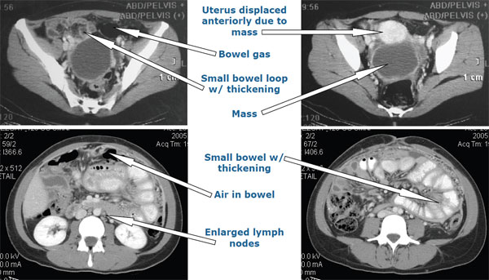
Case Study 2:
CT scans

Slide 53
Summary of findings on risks associated with different types of radiation exposures.
 | High-dose acute exposures |  | Low-dose fractionated exposures
Outcome | A-bomb | Radiation cancer treatments | Occupational exposures | Diagnostic X-ray examinations
All solid cancers | sign increase¹² | increase in most studies¹ | increase in most studies¹ | no studies
Individual cancers | sign increase for most sites, including oral cavity, thyroid, esophagus, stomach, colon, liver, lung, breast, ovary, bladder, CNS¹³ | sign increased for breast, lung, thyroid, stomach, esophagus, colon, bladder; no increase for cancers of prostate, liver, pancreas¹⁴ | conflicted due to low statistical power^{15,16} | sign increase for breast,¹⁷ esophagus¹⁸ in adults and brain in children;^{5,6} no increase for lung,¹⁹ thyroid¹
Leukemia excl CLL | sign increase²⁰ | sign increase¹⁴ | increase in most studies¹ | sign increase for childhood exp^{5,6}; no studies of adult exp.
CLL | sign increase²⁰ | no risk¹⁴ | sign increase in Chernobyl workers;²¹ no increase in most studies¹ | no studies
MM | conflicted^{20,22} | no risk | conflicted¹ | no studies
NHL | sign increase in men²³ | conflicted¹ | conflicted^{1,16} | no studies
CVD | sign increase⁸ | sign increase²⁴ | conflicted^{16,24} | sign increase in childhood exp⁷

Slide 54
Bone marrow doses from various radiation exposures.
Study | Bone marrow dose, mGy, mean (range)
Canadian Fluoroscopy Cohort Study | 78 (0-4,901)
Massachusetts Fluoroscopy Cohort Study¹⁸ | 90 (0-4,000)
Whole-body CT scan⁴² | 16 (0-30)
Chest or abdomen CT scan⁴⁰ | 5 (0-10)
Chest X-ray⁴⁰ | 0.02 (0-0.03)
Nuclear workers from the U.S.,³⁹ Canada⁴³ and U.K.¹⁶ | 25.7 (0-322), 21.6 (0-679), 24.9 (0-100)
Chernobyl cleanup workers from Ukraine²¹ | 92 (0-3,220)
A-bomb study² | 640 (0-4,540)

Slide 55
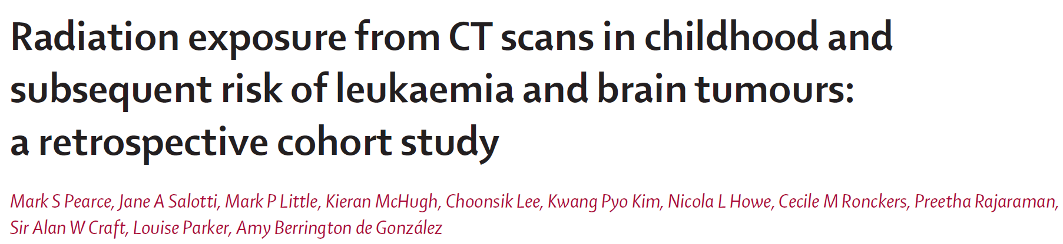
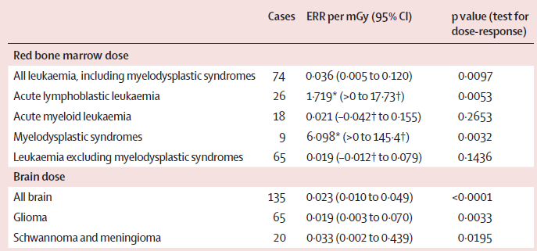

Slide 56
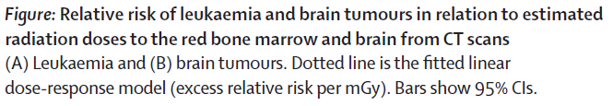
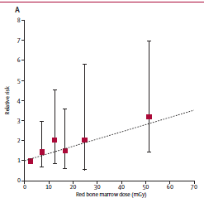
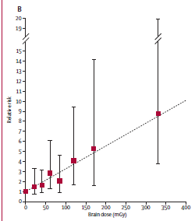

Slide 57
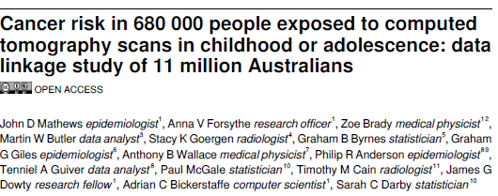
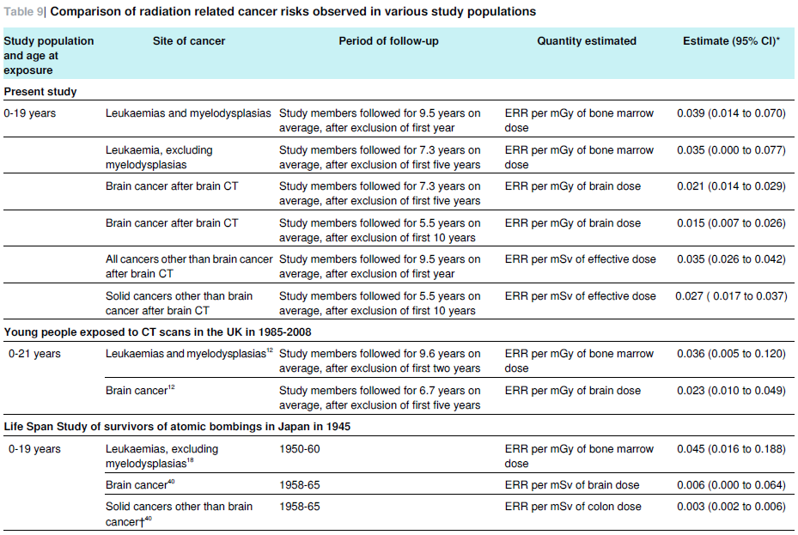

Slide 58
CT scans and leukemia and brain cancer: Further developments
Impact of underlying conditions?
  Collected and reviewed additional clinical information, underlying cause of death and pathology reports
  Excluded participants with cancer-predisposing conditions or previous unreported cancers
  Reduced risk estimates
Trends in CT scan parameters and doses for paediatric CT scans?
  Dose was approximately halved starting around 1990
Berrington et al. 2016
Lee et al. 2016

Slide 59
Outline
Remaining questions
Plans for moving forward

Slide 60
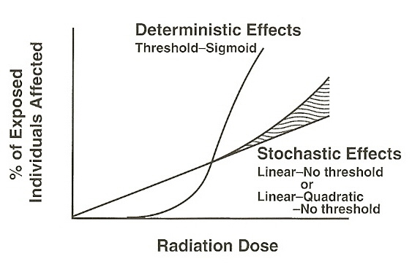
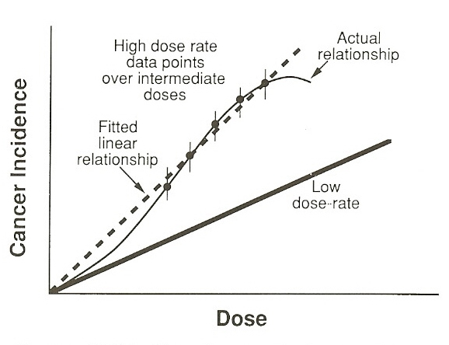
Knowledge gaps in the literature on radiation-related risks of cancer and non-cancer from protracted exposures to low doses of radiation
Effects of protracted exposures
Relative biological effectiveness of various types of radiation
Shape of the radiation-cancer dose-response at lower doses
Existence of a threshold below which radiation exposure does not cause harmful effects
Effects of radiation on different types of cancer
Genetic and lifestyle differences between different populations
Differences in mechanisms of radiation damage and cellular responses for different cancers
Source: Hall, Radiobiology for the Radiologist, 2000.
Source: Hall, Radiobiology for the Radiologist, 2000.
Notes:
60

Slide 61
Plans for moving forward
Analyses taking into account uncertainties in radiation dose estimates
Gene-environment interaction studies
Improvements in measurements, especially in the low-dose range
Better estimates of risk from X-ray radiation (relevant for CT scans → Canadian Fluoroscopy Cohort Study)

