Slide 1

Systematic Reviews
EPI 214 Spring 2020 (1 unit)

Slide 2
Systematic Reviews
EPI 214
Course Goals
  Learn the skills necessary to design and complete a systematic review (but know when to seek statistical help)
  Be able to critique published systematic reviews
  Have a fun and interesting class

Slide 3
Course Overview
Class | Goal
Lecture 1 | Designing a systematic review
Lecture 2 | Protocol Development / Literature searching
Lecture 3 | Analytical methods
Lecture 4 | Performing a meta-analysis with STATA
Lecture 5 | Advanced Topics
Lecture 6 | Critiquing a systematic review

Slide 4
Grading and Homework
Grading is not a priority, but a requirement
  60% homework
  40% final exam
Homework
  All electronic: e-mail homework to:
  ucsfsystematicreviews2020@gmail.com
  If you must miss a class, e-mail HW before class.
  No credit for late HW.
Final Exam:
  Will be posted on website on May 5
  Please complete and e-mail by May 19, 5pm

Slide 5
3 Homework Assignments + 1 Final
Assignment | Description | Due On | Submit to:
HW 1 | Brief Protocol | April 14 | ucsfsystematicreviews2020@gmail.com
HW 2 | STATA Problem Set | April 28 | ucsfsystematicreviews2020@gmail.com
HW 3 | Brief Critique of 2 systematic reviews | May 12 | ucsfsystematicreviews2020@gmail.com
Final Exam | Systematic review exercises in STATA | May 19 | ucsfsystematicreviews2020@gmail.com

Slide 6
TICR Professional Conduct Statement
Clarifications for this class
I will maintain the highest standards of academic honesty
I will neither give nor receive aid in examinations or assignments unless such cooperation is expressly permitted by the instructor
I will conduct research in an unbiased manner, reports results truthfully, and credit ideas developed and work done by others
I will not use answer keys from prior years
I will write answers in my own words, and, when collaboration is permitted, acknowledge collaborators when answers are jointly formulated

Slide 7
EPI-214: Lecture 1
Designing a Systematic Review (Meta-analysis)
Introductory Lecture
Ashok Krishnaswami, MD,MAS,FACC
Staff Cardiologist, Clinician Researcher, Kaiser Permanente San Jose Medical Center
Associate Professor (Adjunct), UCSF, Department of Epidemiology and Biostatistics
Slides adapted based on Stephen Bent, MD, Elaine Allen, PhD
Books: Systematic Reviews in Health Care. Meta-analysis in context. Edited by M. Egger et al. BMJ
Introduction to Meta-analysis. M. Borenstein et al. Wiley

Slide 8
Today’s Agenda
Where does meta-analysis lie in the spectrum of research ?
  What’s being said about Meta-analysis ?
Narrative Review vs Systematic Review
Steps to conduct a systematic review

Slide 9
Trying to Get at The BODY of Evidence
Pyramid of Evidence
Circulation. 2008; 118: 1675-1684
Although mentioned, meta-analyses
Not on the pyramid.
Heterogeneity of Treatment Effects

Slide 10
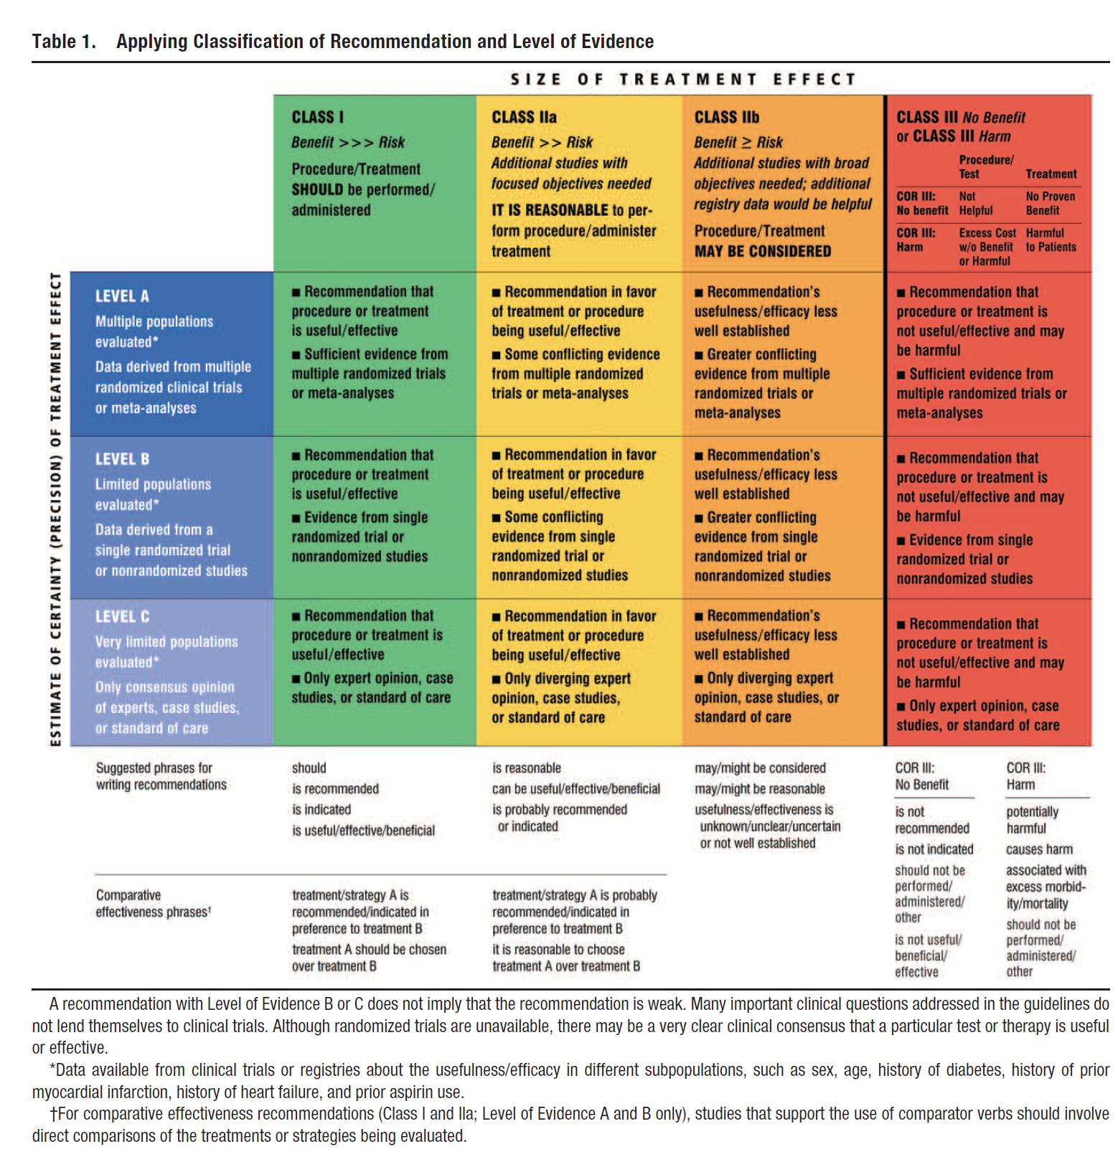
Applying Classification of Recommendation and Level of Evidence

Slide 11
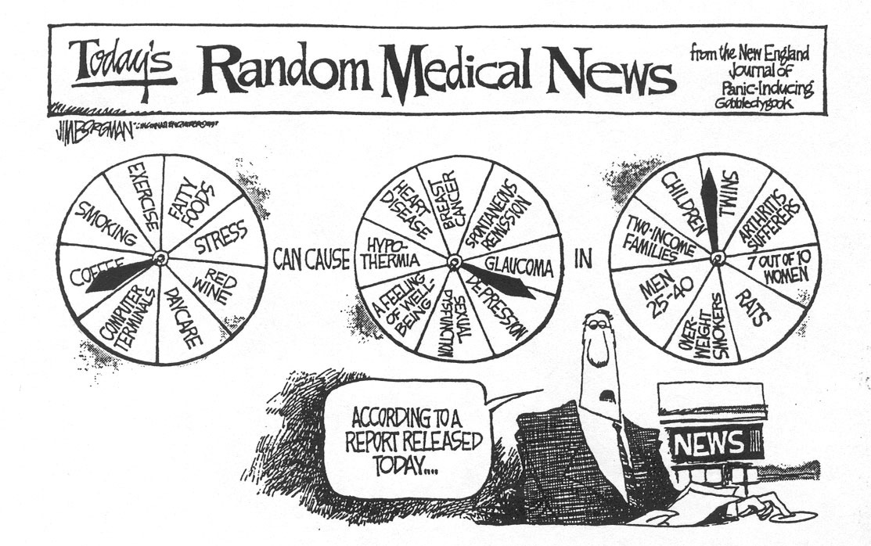
Notes:
Of course, I don’t need to convince you why we need to have valid studies, but I do want to point out that there is a lot at stake in our work and we want to avoid contributing to this type of cartoon. Here we have a news broadcaster with three pinwheels - one for exposure, one for outcome, and one for population - and the broadcaster is randomly spinning these wheels.
Obviously, this cartoon reflects how at least some portion of the public feels about what we do in clinical research. Having a given exposure cause a given disease one day but not the next causes the public to lose faith in our work. Since it is the public by in large who funds our work it is incumbent upon us to be very careful.

Slide 12
Many physicians believe (incorrectly) that there is something magical about a meta-analysis.
A meta-analysis is an observational study, but the author does no original
work. Someone simply notices that several articles have data that pertain to a
common topic and that they might show similar patterns.
It is Important to Understand its Limitations. Nothing new here.
Circulation. 2017;136:2097–2099. DOI: 10.1161/CIRCULATIONAHA.117.030209

Slide 13
Why learn about systematic review?
The best way to summarize evidence on a scientific topic
Concisely communicates findings to others in the field
Identifies author(s) as experts
Identifies areas for future study
Perfect for background of grants
Don’t need to do primary data collection (so can be done while waiting for data from other projects)
You have to do the work anyway, so might as well get a publication!
You can effect change in clinical management even if you never actually perform on ?
  We hope that you do
Notes:
13
But let’s back up for a minute and try to think about why we are doing a systematic review in the 1st place – so let me ask you – why should you or anyone else conduct a systematic review?

Slide 14
Narrative review
Uses informal, unsystematic and subjective methods
Searching quality and synthesis not described
Disadvantage
  may have preconceived biases and may overestimate value of some studies

Slide 15
Narrative Review

Slide 16

Meta- Analyses can be very POWERFUL
Death of Rosiglitazone - ? Right or Wrong

Slide 17
What’s a Systematic Review?
“A review of the evidence on a clearly formulated question that uses systematic and explicit methods to identify, select and critically appraise relevant primary research, and to extract and analyze data from the studies that are included in the review.”
Cochrane Collaboration

Slide 18
…and meta-analysis?
Statistical combination of >= 2 studies to produce single estimate of effect of exposure
Notes:
NOTE: meta-analysis is simply the statistical combination of findings; it should not be considered as a type of review

Slide 19
Differences between Narrative and Systematic Review
 | Traditional review | Systematic Review | Meta-analysis
Author | An individual | A team | A team
Search strategy | Individual | Based on a protocol | Based on a protocol
Summary Conclusion | Author’s judgement | Can be qualitative | Summary statistical techniques

Slide 20
Cumulative Meta-analysis: A call for the need to incorporate into practice sooner
Antman EM et al: JAMA. 1992;268:240-248
Notes:
20
Here is an example of how a systematic review might have been able to affect change in clinical management – this is a technique called “cumulateive meta-analysis,” which shows an updated meta-analysis after each new study is/was conducted. On the right, you see a table showing when the therapy was recommended by various sources. If a systematic review had been published, thrombolytic therapy might have been used more frequently, and might have saved lives.

Slide 21
Rapid growth
Pubmed search
on 07/08/11:
Systematic review : > 1.6 million hits
  Meta-analysis: 48,747
  1/1/1990:
  Systematic review 300,994 hits
  Meta-analysis 845

Slide 22
Systematic review
Driven by evidence-based medicine movement and Cochrane collaboration
Advantages:
  Reduces bias
  Replicable
  Resolves controversy between conflicting findings
  Provides reliable basis for decision making

Slide 23

The Cochrane Collaboration
International systematic review initiative
Archie Cochrane’s vision led to the opening of the first Cochrane centre (in Oxford, UK) in 1992 and the founding of the Cochrane Collaboration in 1993
Source: http://www.cochrane.org/cochrane/archieco.htm
Notes:
The Cochrane Collaboration is a group of over 27,000 volunteers in more than 90 countries who review the effects of health care interventions tested in biomedical randomized controlled trials.[3] A few more recent reviews have also studied the results of non-randomized, observational studies. The results of these systematic reviews are published as "Cochrane Reviews" in the Cochrane Library.

Slide 24
Resources required for systematic reviewing
Can be time consuming
Team science (to reduce bias)
Bibliographic software (e.g. Endnote)
Statistical software (STATA,others)

Slide 25
Meta-analyses
IPD*
Systematic reviews
*IPD= individual participant data

Slide 26
Example of an Individual Patient Level Data Study
Outcomes of Coronary Artery Bypass Graft Surgery Versus Drug-Eluting Stents in Older Adults
http://www.acc.org/latest-in-cardiology/articles/2017/08/17/15/27/outcomes-of-cabg-surgery-versus-drug-eluting-stents-in-older-adults

Slide 27
So….
Simple or complex…
You can do a systematic review on just about any topic

Slide 28
Systematic Reviews that never make it….why do some fail?
Too large a search (> 1000 references)
Too many studies
  e.g., Beta-blockers for hypertension
  “sweet spot” for residents/fellows is 5-15
Pauses - get all the way up to analysis!
Concern that findings are not novel

Slide 29
Think of it as THREE PARTS
APPROPRIATE GATHERING !
STATISTICAL ANALYSIS
INTERPRETATION

Slide 30
8 steps of a systematic review Bent et al. 2004
1 Formulate research question
2 Develop review protocol
3 Initiate search strategy
4 Apply inclusion /exclusion criteria
5 Quality appraisal
6 Data abstraction
7 Analysis
8 Interpret findings

Slide 31
Step 1
Formulate research question

Slide 32
FINER criteria for research question
Feasible
Interesting
Novel
Ethical
Relevant
Think beyond the first step
Hulley S, et al. 2001 Designing Clinical Research
Notes:
Usually the best if systematic reviews and meta-analyses are conducted by teams that include investigators with both methodologic and content expertise.

Slide 33
Formulation of an etiology question
Exposure
Outcome
Is smoking a risk factor for lung cancer?
Patient
Exposure
Are people who smoke regularly at a greater risk of developing lung cancer as compared to those who do not smoke?
+ cohort & case-control studies
Outcome
Comparison

Slide 34
Formulation of a diagnosis question
Test (intervention)
Outcome
Is MRI a good test for breast cancer?
Test (intervention)
Outcome
Is MRI a more sensitive and specific test in diagnosing breast cancer as compared to mammography?
Comparison

Slide 35

Journal Article

Slide 36
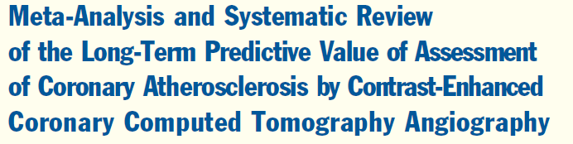
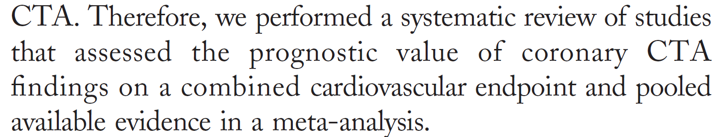
CT technology has progressed
Has pretty pictures
Know it is useful
But till recently lack of robust outcome data

Slide 37
Step 2
Develop review protocol

Slide 38
Protocol
Background
Objectives
Pre-determined selection criteria
Planned search strategy
Planned data abstraction
Proposed method of synthesis of findings
Notes:
Background
give rationale for systematic review as well as importance of research question

Slide 39
Register your protocol
Notes:
Background
give rationale for systematic review as well as importance of research question

Slide 40
Writing the protocol
The Protocol is the a priori work-plan for the eventual review. It lays out your plan in detail.
USE PICO
  Population
  Intervention
  Comparison
  Outcomes (primary / secondary)
Sometimes given as PICOT (T= Timeframe)
Helps limit/better define scope of project
Guides data extraction
A priori PICO questions limit the risk of selection bias

Slide 41
Step 3
Initiate search strategy

Slide 42
Where to locate studies
Pubmed
CINAHL
Web of Science
EMBASE
PsychINFO
Librarians can help here

Slide 43
Comprehensively search
databases to find all relevant studies
PubMed
EMBASE
Cochrane Central Register of Controlled Trials (CENTRAL)
CINAHL
Web of Science
PsycINFO
LILACS
Databases from LMIC
Dissertation abstracts
Clinical trials registers
Handsearching of journals
Reference lists
Conference abstracts
Personal communication
Anything else you can think of.
**NO RESTRICTIONS ON LANGUAGE

Slide 44
The Search
Search (chronic kidney failure OR chronic renal failure OR chronic kidney disease OR chronic renal disease OR ckd[tiab] OR end stage renal disease OR ESRD OR "kidney insufficiency" OR "renal insufficiency" OR "renal failure" OR "kidney failure" OR hemodiafiltration OR hemodialysis OR dialysis OR kidney, artificial) AND (myocardial revascularization[mh:noexp] OR angioplasty, balloon, coronary OR atherectomy, coronary OR coronary artery bypass OR internal mammary coronary artery anastomosis OR myocardial revascularization OR coronary revascularization OR cardiac revascularization OR cabg OR angioplasty OR coronary stenosis/surgery[mh:noexp] OR atherectom*[tiab] OR (stent[tiab] OR stents[tiab] OR stenting[tiab] OR stents[mh] AND (coronary OR cardiac OR myocardial))) NOT (acute kidney[ti] OR acute renal[ti]) NOT (animals[mh] NOT humans[mh]) .

Slide 45
Step 4 STUDY SELECTION
Apply inclusion /exclusion criteria
You now have all the articles you could ever want
Can get rid of some just from the abstract or title
Good program to get is ENDNOTE
Than narrow it further till you get final articles you want to review very closely

Slide 46
Exclusion criteria
Keep log of excluded studies
Note reasons for exclusion
Have eligibility checked by more than one reviewer
Develop strategy to resolve disagreements

Slide 48
Step 5
Quality Appraisal

Slide 49
Quality Scoring of Publications
Examines design and reporting
Jadad scoring technique (5 point Max)
Randomization (1 + 1 points)
Blinding (1 + 1 points)
Withdrawals (1 point)
Slide courtesy of I. Elaine Allen, PhD
(1996, Controlled Clinical Trials)
This followed the earlier 3 page quality scoring technique suggested by:
Chalmers TC, Smith H, Blackburn B, Silverman B, Schroeder B, Reitman D, Ambroz
A: A method for assessing the quality of a randomized control trial. Controlled Clinical
Trials 2:31-49, 1981
http://en.wikipedia.org/wiki/Jadad_scale

Slide 50
How do we assess the methodological quality of studies?
  Internal Validity:
      Allocation bias confounding
      Attrition
      Statistical analysis
      Intervention integrity
      Withdrawals and dropouts
    External Validity:
    generalizability or applicability
Important points:
Numerous tools are available for assessing methodological quality of clinical trials and observational studies.
Cochrane Collaboration recommends against the use of scales yielding a summary score.
Notes:
Many quality instruments also contained items that were not directly related to internal validity, such as whether a power calculation was done (an item that relates more to the precision of the results) or whether the inclusion and exclusion criteria were clearly described (an item that relates more to applicability than validity). Scales were more likely than checklists to include criteria that do not directly relate to internal validity. The Collaboration’s recommended tool for assessing risk of bias is neither a scale nor a checklist. It is a domain-based evaluation, in which critical assessments are made separately for different domains. It was developed between 2005 and 2007 by a working group of methodologists, editors and review authors. Because it is impossible to know the extent of bias (or even the true risk of bias) in a given study, the possibility of validating any proposed tool is limited. The most realistic assessment of the validity of a study may involve subjectivity: for example an assessment of whether lack of blinding of patients might plausibly have affected recurrence of a serious condition such as cancer.

Slide 51
Difficult to justify assigning ‘weights’ to different items in the scale
Scales shown to be unreliable assessments of validity
Less likely to be transparent to users of the review
Use of Jadad scale is explicitly discouraged because of:
-strong emphasis on reporting rather than conduct
-does not cover one of the most important potential biases, allocation concealment
Preferable to use simple approaches for assessing validity that can be fully reported (i.e. how each trial was rated on each criterion).
Why is the use of scales for assessing quality or risk of bias discouraged?
Jüni (1999)

Slide 52
Step 6
Data abstraction

Slide 53
Data abstraction
Design and pilot data abstraction form
Consider >1 reviewer
Consider blinding of observers to authors, institutions and journals

Slide 54
Data abstraction
Using a pre-piloted data abstraction form, authors separately abstract the data and study characteristics from each study determined to be eligible for inclusion.
Source
Study ID
Review author initials
Citation and contact details;
Methods
Study design;
Total study duration;
Sequence generation;
Allocation sequence
concealment;
Blinding;
Other concerns about bias;
Participants
Total number;
Setting;
Diagnostic criteria;
Age;
Sex;
Country;
[Co-morbidity];
[Socio-demographics];
[Ethnicity];
[Date of study];
Interventions
Total number of intervention groups;
For each intervention and comparison group of interest:
  Specific intervention;
  Intervention details (sufficient for replication, if feasible);
  [Integrity of intervention];
  Outcomes
  Outcomes and time points (i) collected; (ii) reported*;
For each outcome of interest:
Outcome definition (with diagnostic criteria if relevant);
Unit of measurement (if relevant);
For scales: upper and lower limits, and whether high or low score is good
Results
Number of participants allocated to each intervention group;
For each outcome of interest:
Sample size;
Missing participants;
Summary data for each intervention group
(e.g. 2×2 table for dichotomous data; means and
SDs for continuous data);
[Estimate of effect with confidence interval; P value];
[Subgroup analyses];
Miscellaneous
Funding source;
Key conclusions of the study authors;
Miscellaneous comments from the study authors;
References to other relevant studies;
Correspondence required;
Miscellaneous comments by the review authors.

Slide 55
Step 4: Data Abstraction

Slide 56
Step 4: Data Abstraction

Slide 57
8 steps of a systematic review Bent et al. 2004
1 Formulate research question
2 Develop review protocol
3 Initiate search strategy
4 Apply inclusion /exclusion criteria
5 Quality appraisal
6 Data abstraction
7 Analysis
8 Interpret findings

Slide 58
Step 7 Analysis
This is the ONLY statistical part
The next lecture will focus on this

Slide 59
Synthesizing the Evidence
NARRATIVE SYNTHESIS
primary studies explained qualitatively and summarized
META-ANALYSIS
findings summarized and then combined statistically
Notes:
Before deciding which approach to take, it is important
to tabulate the findings from the studies and examine
heterogeneity (i.e. diversity of studies).

Slide 60
Is there heterogeneity?
Narrative Review
Addressing Heterogeneity through statistical analysis; subgroup analysis, etc.
This is actually the most enjoyable part of Meta-analysis

Slide 61
Step 8
Interpret findings

Slide 62
Interpretation of results
  Strength of the evidence
  Explanations of effectiveness
  Applicability
  Trade-offs between benefits and harms
  Implications for practice
Notes:
These issues should be included in the discussion and recommendations section of a systematic review:

Slide 63
Applicability (generalizability) of results
To whom can the review results be applied?
Are there any compelling reasons why the evidence should not be applied under certain circumstances?
^{Biological factors}
^{Cultural factors}
^{Variation in baseline risk}
^{Technology, skill, cost, etc.}

Slide 64
Trade offs between benefits, harms and costs
Discuss adverse effects (potential for harm)
E.g. compute number needed to harm that
indicates how many patients need to be exposed to a risk factor over a specific time period to cause harm in a patient that would not have otherwise ^{been harmed}
If possible, discuss cost issues
Notes:
NNH is defined as the inverse of the attributable risk. Intuitively, the lower the number needed to harm, the worse the risk-factor.
If possible, discuss cost issues No need for a formal economic analysis!
With the emergence of the GRADE (Grading of Recommendations, Assessment, Development and Validation) framework, individual SRs may not need to get into trade-offs
GRADE statement:http://www.cdc.gov/mmwr/preview/mmwrhtml/mm6118a3.htm

Slide 65
Implications of the systematic review
For patient care or public health:
Review found no evidence at all or weak evidence
Review found evidence that clearly supports
^{intervention}
Review found clear evidence of lack of benefit
Review found clear evidence of potential for harm
Review found evidence of important trade-offs
between known benefits and known adverse
^{effects}

Slide 66
Notes:
Standard Table 1 in a SR/MA
Listing all studies

Slide 67
Notes:
We wanted to show the number of studies that reported the particular variable (%)

Slide 68
Conclusion:
“need for a randomized clinical trial”

Slide 69
Conclusions
Hope you came away with an appreciation of importance of meta-analysis and understanding of this type of research
Maybe one or two may venture into this land
There is NO REASON to FEAR it.
The single observational study/RCT is for debate in the halls, scientific sessions and at parties.
Systematic review/MA is a fundamental method of reporting on the body of evidence.
  But it is a narrow focus

