Slide 1
Systematic Review
Practicalities of Search and Reference Management
Evans Whitaker, MD, MLIS
UCSF Medical Library
evans.whitaker@ucsf.edu

Slide 2
Materials for class
The “bundle”
This PowerPoint
Epi214 2020 an in-depth handout with everything I know, or think I know, about searching
Epi214 Search a handout with some basic information and commentary to the article mentioned below
Epi214SearchStudent goes through an example of taking a question to a search. There are a few tips included near the end of the document
PLoS article we will refer to during the session with comments
There are links to secondary documents (Zotero for one) in the primary documents

Slide 3
Accompanying Document & Preliminaries
Bookmarks – discussed in Epi 214 2020 handout
Bookmarklet – demonstrated in this video
Set up and configure your MyNCBI account – see page 1-2 of this handout https://ucsf.box.com/s/pe4fc9rbmor00883moxmyjopu6fn2eyz
Sign up for and set up Zotero - if you don’t use something else already
  This document covers Zotero:
  https://ucsf.box.com/s/qx4perkhm6045jnwjzb0ehffzgzmwqs3

Slide 4
Plan for watching the video
Stop and do/try things as we go
Email me with questions or ask at Zoom session
We will use a PLoS article as a touchpoint: https://journals.plos.org/plosone/article?id=10.1371/journal.pone.0186856
  What question are they answering?
  What concepts would you include in a search?
  What is their search strategy?
  What sources did they search in?

Slide 5
Is searching for information for a systematic review different?
How so?

Slide 6
Summary of today’s content
Systematic review searches:
  are sensitive (large results sets)
  search in more than one database
Approach each database the same way
Reference managers and purpose-built software make your task easier
Keep detailed records of searches, dates, numbers
  Start writing your protocol at the beginning
  Search, criteria, any your plan will evolve

Slide 7
Bookmarks, etc.
Use UCSFwpa on campus
PulseSecure may block your access to a small subset of library materials
Set Bookmarks
Library.ucsf.edu
PubMed.ucsf.edu
Uptodate.ucsf.edu
Bookmarket (to help with off-campus PDF access)

Slide 8
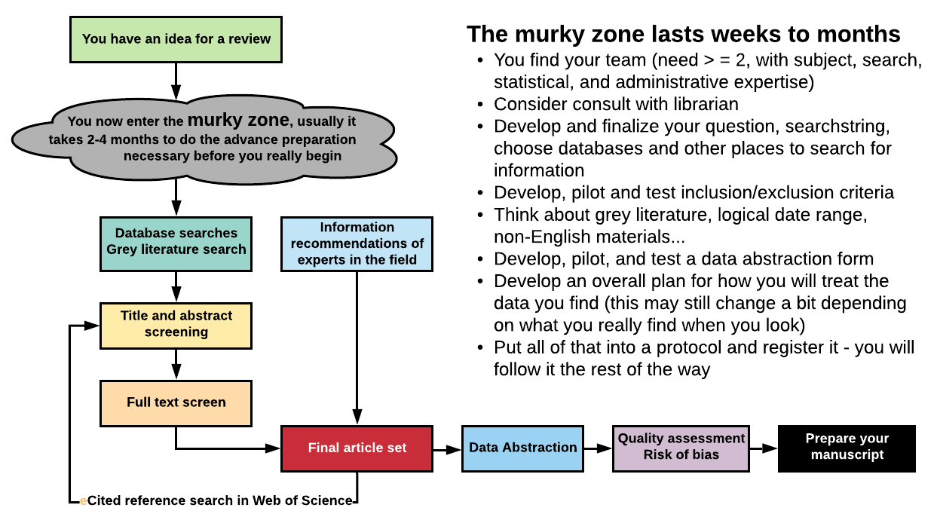
Steps of a Systematic Review

Slide 9
UCSF Library Global Search
Search engine leads to everything to which UCSF Library has access
Search “understands” AND, OR, ( ), “ “
  AND, OR must be all capital letters
Like Google Scholar = a good place to start
Can export to a reference manager
Video how-to-use here: https://ucsflibrary.zendesk.com/hc/en-us/articles/360005370714

Slide 10
PLoS article search:
(“Atrial Fibrillation”[mh] OR “Atrial Flutter”[mh] OR ((atria OR atrium OR atrial) AND (fibrillation OR flutter)))
AND
((“Heart Rate”[mh] OR “Anti-Arrhythmia Agents”[mh] OR ((rate OR rhythm) AND control) OR antiarrythmic therap* or ((atrioventricular node OR catheter OR surgical) AND ablation*) OR cardioversion*) OR ((beta OR calcium channel) AND blocker*) OR (Propranolol OR carvedilol OR esmolol OR timolol OR metoprolol OR atenolol OR bisoprolol OR nebivolol OR verapamil OR diltiazem OR digoxin OR flecainide OR propafenone OR encainide OR moricizine OR dofetilide OR amiodarone OR sotalol OR disopyramide OR quinidine OR ajmaline OR procainamide OR dronedarone OR ibutilide OR lidocaine OR phenytoin OR mexiletine OR tocainide))
AND
(random* or blind* or placebo* or meta-analys*)
This search finds almost ~5,000 in PubMed. The team screened >15K articles! This is massive, and probably too much for most teams to accomplish.

Slide 11
Concepts using PICO(TT)
P: Atrial fibrillation/flutter
I: Rate control
C: Rhythm control
O: Outcomes
  Primary: all-cause mortality, serious adverse events, and quality of life
  Secondary: stroke, ejection fraction
TT: Question type: this is a therapy question
Publication type: “We searched for trials comparing any rhythm control strategy with any rate control strategy in patients with atrial fibrillation or atrial flutter"

Slide 12
The search that might result
("Atrial Fibrillation"[Mesh] OR "Atrial Flutter"[Mesh] OR ((atria OR atrium OR atrial Fibrillation" AND (fibrillation OR flutter)))
AND
((rate OR rhythm OR heart-rate OR heartrate) AND control)
AND
(random OR randomized OR randomization or blind OR blinded OR blinding OR placebo OR placebos OR placeboes OR trial)
Finds ~3,000, better, but still very large numbers

Slide 13
Database searching… approach each database the same way
Clarify your question
Identify concepts in the question
Where will you search?
  Pick a database to begin with
  Orient yourself → how is database structured/organized?
    Look for one-page search summary
    Is there a dictionary or glossary for the database?
First concept → Find your words
Repeat for each concept
Assemble search using AND, OR, ( )
Try it out and then fix it!
Test your search vs. “knowns”; sort by relevance/ scan ~50
Translate your search to work in other databases
Add results to Zotero (or equivalent)
  PubMed for today
“Controlled vocabulary” +
keywords + synonyms
  Use Search Details

Slide 14
Databases
Organized to facilitate “retrieval”
Controlled vocabulary - examples
  MeSH
  Emtree
  CINAHL headings
  Thesaurus for ProQuest databases
  Web of Science does not use one
Notes:
Medical Subject Headings (MeSH)
search MEDLINE for all known synonyms for a concept at the same time.

Slide 15
Find terminology
SRs require a sensitive search
  Modified to decrease the irrelevant results = decreased work for you
  Find the balance of sensitivity and specificity
To ⬆ sensitivity
  Find all the different ways an author might phrase the same thing (synonyms)
    Be opportunistic, watch for new ways of saying things
  (Most) Databases use a “controlled vocabulary” to help
  Think of a “controlled vocabulary” as a dictionary or glossary for a database
  A “controlled vocabulary” helps you find the best words to use in your search, when you use these terms the database will do a synonym seach.
Notes:
Medical Subject Headings (MeSH)
search MEDLINE for all known synonyms for a concept at the same time.

Slide 16
Search multiple databases to increase sensitivity
Numbers of journals (approximate) | Description
>20,000 | Estimated number biomedical journals worldwide
10,000 | Number of well-established, believable biomedical journals worldwide
10,000 | Journals in Web of Science, however this database covers arts and humanities, social sciences as well as biomedicine and other sciences. Biomedicine accounts for about 6,000 journals
8,200 | Embase includes MEDLINE
5,200 | PubMed/MEDLINE
4,000 | PsycINFO

Slide 17
Name | Pros | Cons | Articles
PubMed MEDLINE | Biomedicine New content Precise indexing (MeSH) Free global access | Two parts Most difficult to use well | 30 M 26.5 M
Embase | Biomedicine Adds 8-10 M to MEDLINE Intuitive Emtree | Picky search interface Cost | 37 M
Web of Science | Arts, humanities, Social sciences, sciences Cited reference searching | No controlled vocabulary Cost | 40 M
PsycINFO | Focused on psychology Thesaurus | Cost | 4.5 M
CINAHL | Focused on nursing and allied health. Has CINAHL Headings | Search interface not user-friendly Cost | 5.4 M
ERIC | Focused on education. Freely available government version | UCSF buys a version | 1.5-2 M
Cochrane Library | Curated set of systematic reviews (CDSR) and the clinical trials used for them (CENTRAL) | Strange search interface | 9 K-SysRev 1 M- CENT
What about Google?
Google Scholar is good for beginning and ending your SR search
  Set Preferences to increase usefulness
  Use it to find words and get a quick sense of how much is out there about your topic
Google with domain limits can be good for grey literature

Slide 18
Pick Resources Depending on Your Topic and Available Resources
Biomedical question: PubMed, Embase, BiosisPreviews(?)
Psychosocial component: add PsycINFO, Sociological Abstracts, Web of Science
Educational component: add ERIC
Cost Analysis/Economic component: add Business databases e.g., Business Source Complete
Nursing and allied health: add CINAHL
Cited reference searching: use Web of Science
  For articles not found in WoS can use reference list scanning from PDF plus Google Scholar for newer articles citing an article

Slide 19
The special case of PubMed
Two-part structure
  (MEDLINE and “part of PubMed NOT in MEDLINE”
New interface will replace “legacy” interface by end 2020
Hard to use well
MeSH

Slide 20
MEDLINE vs. PubMed
PubMed
28.3M
MEDLINE
24.8M
Publishers supply
information
Indexers
add MeSH
Notes:
PubMed is unique due to its two part structure
This makes PubMed harder to use
You will have it wherever you go, it covers a large percentage of the world’s biomedical literature and may contain newer material than the others, so we will start here.

Slide 21

Some punctuation
systematic review
“systematic review”
“systematic review”[ti]
“systematic review”[tiab]
“systematic review”[sb]
Some punctuation
MEDLINE vs. PubMed/MeSH
Complex Searches
Save your work

Slide 22
Complex Search Construction
Problem, Scenario or Question:
Identify key concepts (usually 2-4)
  → Call them A, B, C
Identify MeSH and synonyms for each concept
Assemble with AND, OR and ( )
Result: (A_{mesh} OR A_{syn1} OR A_{syn2} OR …. ) AND
(B_{mesh} OR B_{syn1} OR B_{syn2} OR …. ) AND
(C_{mesh} OR C_{syn1} OR C_{syn2} OR …. )

Slide 23
Save the Search and Results
Create alert in PubMed = save search
Add results to a reference manager
  Cab create a PubMed results folder
  Note the date of search and the results numbers in your “diary”

Slide 24
Two Additional PM Tools
Advanced keeps your search history and is a place to edit and mix-and-match results
Search details is a place to see what PM did with your search. Use that information to edit your search

Slide 25
Embase
Use the same approach…

Slide 26
PsycINFO
The same approach…

Slide 27
Web of Science
Broad content
No controlled vocabulary
Use same search as PubMed but take out the PM specific punctuation → [ti], etc.
  WoS is OK with MeSH
Best use may be cited reference searching
  Look up title of article you like (remember WoS does not have everything)
  Notice citation patterns and related articles

Slide 28
Zotero
Hopefully, you signed up and set it up?
Import → we have talked about that as we went
Organization and writing we will talk about now
If you have questions or issues with Zotero please let me know

Slide 29
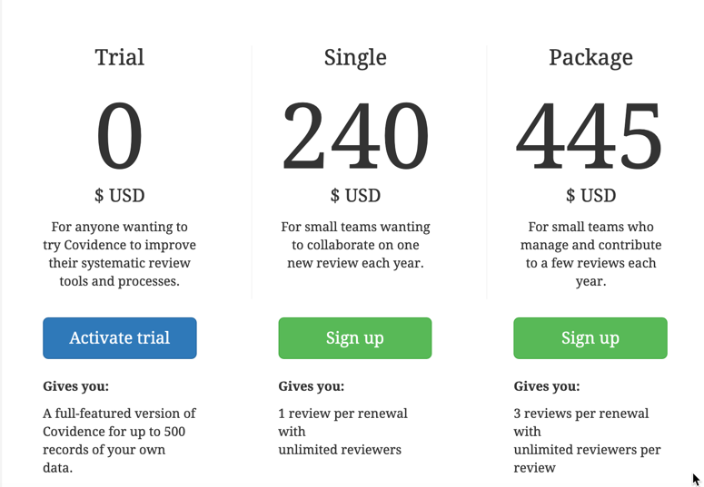
Covidence
Purpose-built
software to help with
  Title and abstract
  screening
  Full text screening
  Data abstraction
Don’t use if you are
doing a SR with qualitative data
Free Trial does 1 systematic review for 1 person
  Good way to see what this software does
  Max 500 items
Alternatives → Excel, database programs

Slide 30
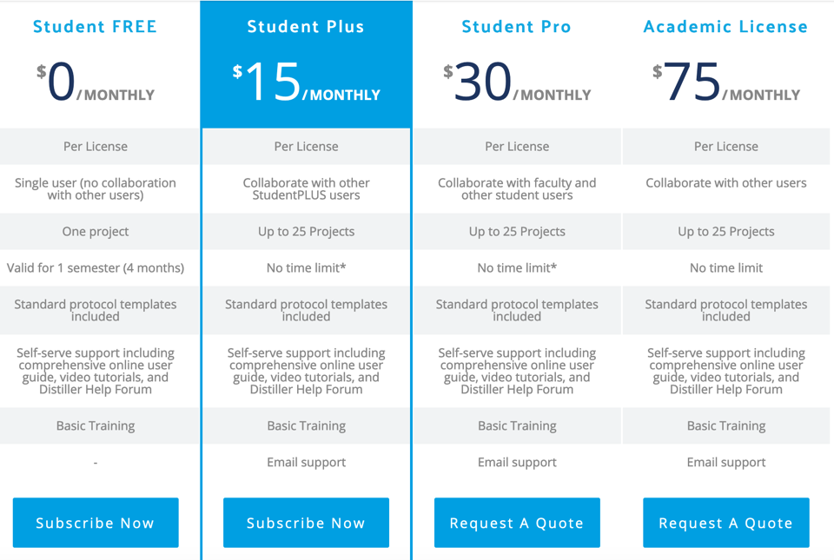
Distiller SR
Purpose-built software to help with
  Title and abstract screening
  Full text screening
  Data abstraction
Alternatives → spreadsheet programs, database programs.

Slide 31

(https://rayyan.qcri.org/)
Purpose-built software to help with
  Title and abstract screening
From Qatar
Free, works well
Export to spreadsheet, database for data extraction.

Slide 32

Don’t let this happen…
…call a librarian!

