Slide 1
Designing Clinical Research
Course History and Objectives
Mark Pletcher, MD MPH
Dept of Epidemiology and Biostatistics, and Medicine
Recorded July 6, 2020
Notes:
Good morning, and welcome to Designing Clinical Research! Let me congratulate you on finding our Training in Clinical Research Program, and for enrolling in this course. I believe this course is the longest continuously-running Epidemiology course in the University, and the first of it’s type in the country. If you are thinking about embarking on a career in clinical research, you are in the right place.

Slide 2
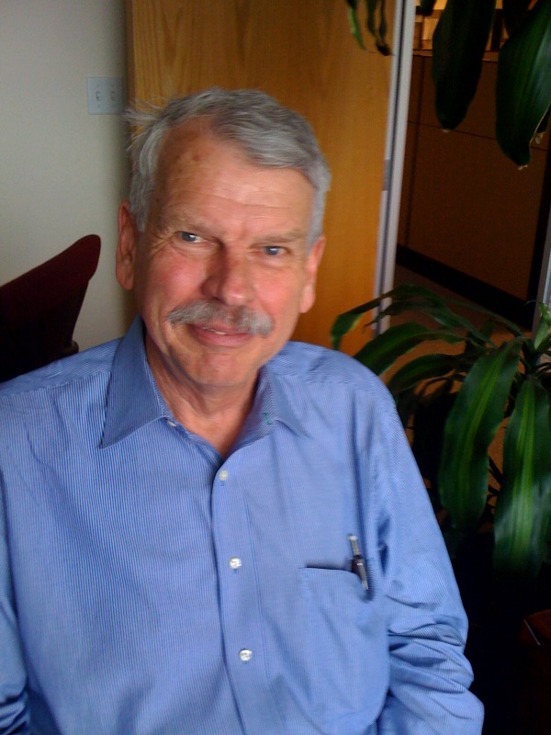
History of the Course
Started ~1985 by Steve Hulley
  Steve wrote the book
  Designed the course
    Focus on building a Study Protocol for a real study
  Led course for over 20 years (through Summer 2009)
Notes:
Designing Clinical Research has a venerable history. Launched over 30 years ago, DCR is the oldest and longest-running course taught by our Department of Epidemiology and Biostatistics, and the starting point for all of our Training in Clinical Research Programs including our Summer Clinical Research Workshop, our 1-year Advanced Training in Clinical Research Certificate Program, and our 2-year Master’s i

Slide 3
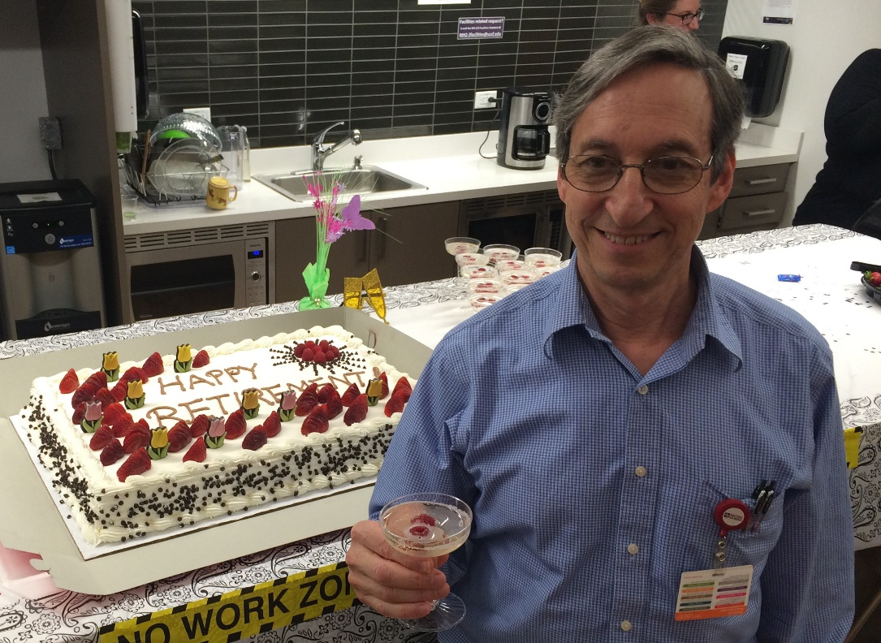
History of the Course
Led by Tom Newman 2009-2015
  Emeritus Clinical Epidemiology Division Chief, recently retired
  Co-Author of the Book

Slide 4
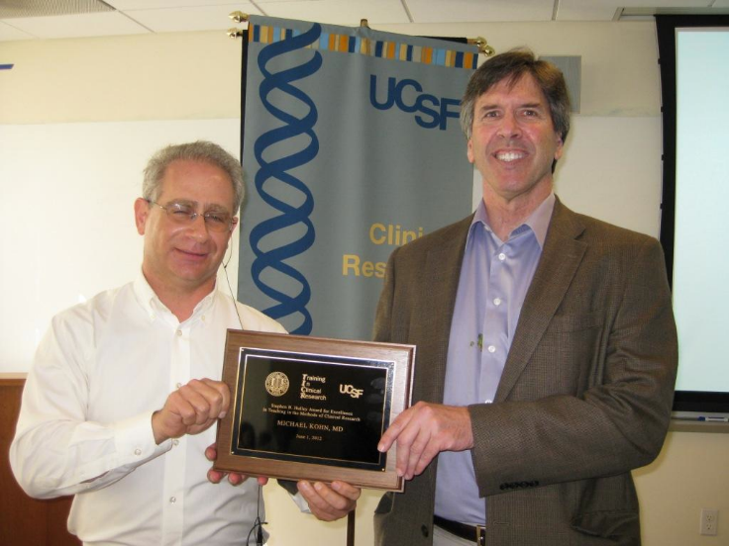
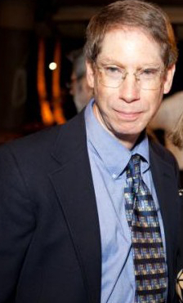
History of the Course
Michael Kohn
  Course Co-Director 2004-2011
  Online sample size calculators
  Lecturer
Joel Simon, Course Co-Director
  Small Group Leader since 1992
  Course Co-Director since 2012
Both have played instrumental roles refining and honing DCR materials over the years

Slide 5
History of the Course
I have directed the course since 2016
  UCSF Med School, Internship and Residency
  MPH at UC Berkeley
  Took this course in 2001
  Joined Epidemiology Department Faculty 2003

Slide 6
Approach and Philosophy
Research study design is the art of the possible
  Research occurs in the real world: no study is perfect
  A good study design is a beautiful thing
  Theory → Reality → Theory
  Feasibility is all important
Notes:
Although research is perhaps the quintessential scientific discipline, I would argue that the design of clinical research studies, like most design processes, also includes a strong element of artistry – it is the art of the possible.
Research must occur in the real world. That means that there is inherent messiness in the process – there is noise, error, randomness, and mistakes made both by study staff and participants.
A good study design, which can actually be implemented in the real world but which minimizes error and bias and maximizes the scientific value of the study, is a truly beautiful thing.
When we design a study, we start with theory – what we think we know about the natural world – and then we must grapple with reality to make observations in that natural world and try to meaningfully inform our theory.
To do this, we NEED to grapple with reality – so feasibility is all-important. If your study is not actually feasible, then it is truly not useful.

Slide 7
Approach and Philosophy
How to “add a brick to the temple of science*”
  Understand what’s already there
  Find a gap
  Design something feasible to fill the gap
  Execute
  Interpret and publish
* https://www.ncbi.nlm.nih.gov/pmc/articles/PMC3524311/
Notes:
I really like this metaphor of “adding a brick to the temple of science” as a way to describe the scientific process. What we’re doing here is first trying to …

Slide 8
Approach and Philosophy
How to “add a brick to the temple of science*”
  Understand what’s already there
  Find a gap
  Design something feasible to fill the gap
  Execute
  Interpret and publish
Epi 202:
Designing Clinical Research
* https://www.ncbi.nlm.nih.gov/pmc/articles/PMC3524311/

Slide 9
Approach and Philosophy
Learn by doing
  Design a study and compose a 5-page study protocol
    MAKE IT REAL
    Modest studies are OK
      Your means are limited
      Do your best, design for feasibility in the near future
    Weekly assignments will build towards that protocol

Slide 10
Course Objectives
Acquire an introductory skill set for designing and interpreting clinical research
Produce a complete clinical research protocol, including background, sampling, measurements, and data analysis

Slide 11
Course Overview
Weekly schedule
Lectures
Small group discussion sessions
Reading the book
Written assignments
Final project
5-page protocol

Slide 12
Designing Clinical Research
We hope you’ll enjoy the course.

