Slide 1
Sample Size and Power
Steven R. Cummings, MD
Professor of Medicine, Epidemiology and Biostatistics
Director, S.F. Coordinating Center

Slide 2

The Key to Long Life?
Resveratrol
In the skin of red grapes
Makes mice
  Run faster
  Live longer

Slide 3
The Key to Long Life?
Resveratrol
In the skin of red grapes
Makes mice
  Run faster
  Live longer
Mimics ‘sirtuin:’
senses energy; controls DNA transcription; produces more
mitochondria.

Slide 4
What I want to show
Consuming resveratrol prolongs healthy life

Slide 5
What I want to show
Consuming resveratrol prolongs healthy life
How many participants do I need to answer the question?

Slide 6
Ingredients for Estimating Sample Size
Testable hypothesis
Study design
  Type of variables and statistical test
Effect size
Power and alpha

Slide 7
Sample Size Ingredients
Testable hypothesis
Study design
  Type of variables and statistical test
Effect size
Power and alpha

Slide 8
My research question
Does consuming resveratrol lead to a long and healthy life?

Slide 9
What’s wrong?
Does consuming resveratrol lead to a long and healthy life?

Slide 10
What’s wrong?
Does consuming resveratrol lead to a long and healthy life?
Not testable
Vague
Needs to be measureable

Slide 11
“Consuming resveratrol”
Needs to be quantifiable
I could measure resveratrol intake in a cohort, then follow-up for survival free of disease…

Slide 12


An alternative to
“Consuming resveratrol”
A rigorous design: randomized placebo-controlled trial
A known quantity of resveratrol vs. placebo
Comparing red wine to placebo would be difficult
But resveratrol supplements are widely available

Slide 13
A specific, measured, predictor
A dose of resveratrol vs. placebo

Slide 14
I need a measureable endpoint
“Prolongs healthy life”
Not measurable
A measureable endpoint: mortality rate
  Over a specified period of time - 3 years

Slide 15
The question is becoming a hypothesis
Do people randomized to get a resveratrol supplement have a lower mortality rate than those who get a placebo?

Slide 16
Specify the population
Do people randomized to get a resveratrol supplement have a lower mortality rate than those who get a placebo?

Slide 17
The study subjects
Elderly men and women (≥70 years)
  Because the question applies to both genders
  Because they have a relatively high mortality rate: enough ‘events’ within a feasible period of study

Slide 18
The research hypothesis
(AKA the‘alternative’ hypothesis)
Men and women > age 70 years randomized to get a resveratrol supplement have a lower mortality rate than those who get a placebo.

Slide 19
The research hypothesis
(AKA the‘alternative’ hypothesis)
Men and women > age 70 years randomized to get a resveratrol supplement have a lower mortality rate than those who get a placebo.
However, it cannot be tested statistically
Statistical tests only reject null hypothesis - that there is no effect

Slide 20
The Null Hypothesis
Men and women > age 70 years randomized to receive a resveratrol supplement do not have lower mortality rate than those who receive placebo

Slide 21
The Null Hypothesis
Men and women > age 70 years randomized to receive a resveratrol supplement do not have lower mortality rate than those who receive placebo
Can be rejected by statistical testing

Slide 22
Ingredients for Sample Size
We have a testable hypothesis
We need study design and type of variables
For the purposes sample size estimates, there are 2 types of study design: descriptive and analytical

Slide 23
Descriptive studies
Only one variable
Sample size is based on the desired width of the confidence interval
What is the mean red wine intake of centenarians?
  Confidence interval for the mean

Slide 24
Descriptive studies
Only one variable
Sample size is based on the desired width of the confidence interval
What is the mean red wine intake of centenarians?
  Confidence interval for the mean
Covered in the textbook

Slide 25
Analytical studies
Predictor and outcome variable(s)
Comparisons
  Examples:
  Observational: compare the mean red wine intake in centenarians vs. 60-80 year olds
  Trial: People who receive resveratrol have lower mortality compared with those who get placebo

Slide 26
Randomized trial
We will use the example of a randomized trial
Compare an amount of resveratrol to placebo
It is the most rigorous way to answer the question

Slide 27
Ingredients for Sample Size
 Testable hypothesis
Study design: analytical (RCT)
→Variables and statistical test

Slide 28
The class of statistical test depends on the types of variables
Outcome
Predictor Categorical Continuous
Categorical Chi-square t-test
Continuous t-test Correlation
Simple but works for
most early study planning

Slide 29
The class of statistical test depends on the types of variables
Outcome
Predictor Categorical (Sex) Continuous (BP)
Categorical (Smoke) Smoke * M/F Smoke * BP
Continuous (Weight) Weight * M/F Weight * BP
Simple but works for
most early study planning

Slide 30
The types of variables for a clinical trial?
Men and women > age 70 years randomized to receive a resveratrol supplement do not have lower mortality rate than those who receive placebo
Dichotomous: resveratrol or placebo
Mortality
  The proportion that have died (e.g. 3%)
  Dichotomous

Slide 31
The types of variables for a clinical trial?
Men and women > age 70 years randomized to receive a resveratrol supplement do not have lower mortality rate than those who receive placebo
Dichotomous: resveratrol or placebo
Mortality: more complex:
  Time to event Dichotomous, % survival, works
  More complex: consult a biostatistician or software

Slide 32
The types of variables?
Men and women > age 70 years randomized to receive a resveratrol supplement do not have lower mortality rate than those who receive placebo
Dichotomous: resveratrol or placebo
Mortality “rate:”
  Alternative: time to event (death)
  More complex. Consult a biostatistician.

Slide 33
The types of variables?
Men and women > age 70 years randomized to receive a resveratrol supplement do not have lower mortality rate than those who receive placebo
Dichotomous: resveratrol or placebo
Continuous: mortality rate
What’s wrong?

Slide 34
The types of variables?
Men and women > age 70 years randomized to receive a resveratrol supplement do not have lower mortality rate than those who receive placebo
Dichotomous: resveratrol or placebo
Continuous: mortality rate
  It is a proportion at certain times
  For example, 3% at 1 year

Slide 35
The class of statistical test appropriate for the trial
Outcome
Predictor Categorical Continuous
Categorical Chi-square t-test
Continuous t-test Correlation

Slide 36
The class of statistical test appropriate for the trial
Outcome
Predictor Categorical Continuous
Categorical Chi-square t-test
Continuous t-test Correlation

Slide 37
Ingredients for Sample Size
 Testable hypothesis
 Study design: analytical (RCT)
  Type of variables and statistical test
Effect size
Power and alpha

Slide 38
Estimating the effect size
For randomized trials,
Start with the expected rate in the placebo
Usually available from population or cohort studies
In this case, we know the proportion that dies by age:
3-4% per year*
A 3-year trial, cumulative proportion = 10%

Slide 39
Effect size the hardest part
What should I assume for the effect of resveratrol on mortality?

Slide 40
Effect size the hardest part
Ways to choose an effect size:
What is likely, based on other data?
Do a pilot study
Estimate based on effect on biomarkers
What difference is important to detect?
  “We don’t want to miss a __%_ difference”
What can we afford?

Slide 41
The effect of resveratrol on mortality rate?
What is likely, based on other data?
  No data in humans!

Slide 42
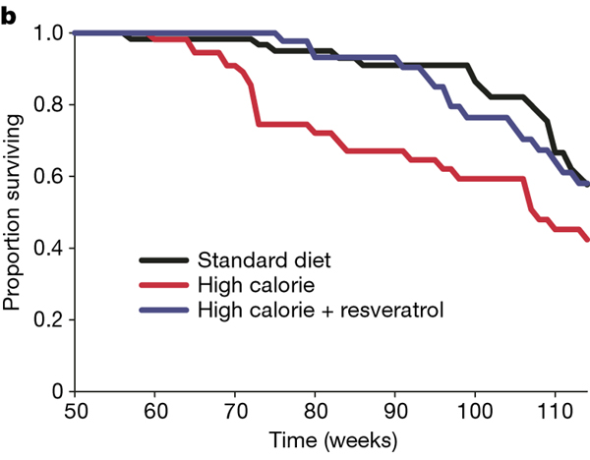
Resveratrol pronged survival of mice fed high calorie diet
~ 25%
Baur, Nature 2006

Slide 43
The effect of resveratrol on mortality rate?
What is likely, based on other data?
Pilot study??
  Small pilot studies generally produce unstable estimates of effects and variance – because they are small ☺

Slide 44
The effect of resveratrol on mortality rate?
What is likely, based on other data?
Do a pilot study
Estimate based on effect on biomarkers
  Biomarkers for mortality and effect of resveratrol? No. (We’ll return to this).

Slide 45
The effect of resveratrol on mortality rate?
What is likely, based on other data?
Do a pilot study
Estimate based on effect on biomarkers
What difference is important to detect?
  Resveratrol is cheap.
  I don’t want to miss a 1% decrease!
  Absolute decrease: 10% vs. 9%

Slide 46
The effect of resveratrol on mortality rate?
What is likely, based on other data?
Do a pilot study
Estimate based on effect on biomarkers
What difference is important to detect?
  I don’t want to miss a 1% decrease
What can we afford?
  1%: the trial will be too big & expensive
  5%: the trial will be smaller and cheaper

Slide 47
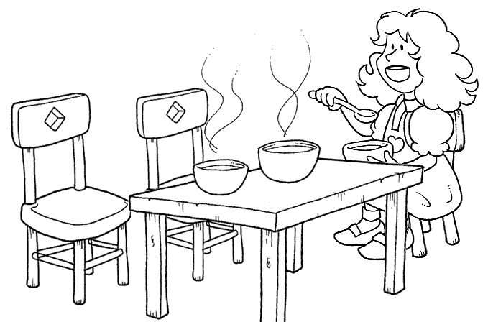
The Science of Effect Sizes
Too large!
Smaller effect is important to health
Larger effect is important for your budget
5%

Slide 48
The Science of Effect Sizes
Too large! Too small!
Smaller effect is important to health
Larger effect is important for your budget
5%
1%

Slide 49
The Science of Effect Sizes
Too large! Too small! Just right!
It requires
good judgment,
balancing science
and feasibility
Smaller effect is important to health
Larger effect is important for your budget
2%
5%
1%

Slide 50
Effect size
Men and women > age 70 years randomized to receive a resveratrol supplement do not have lower mortality rate than those who receive placebo
Placebo rate: 10%
Resveratrol rate: 8%
It would be important to find (I don’t want to miss) a 2% difference
  (20% decreased relative risk)
2% difference

Slide 51
Ingredients for Sample Size
 Testable hypothesis
 Type of study: analytical (RCT)
 Study design
   Type of variables and statistical test
Effect size
→Power and alpha

Slide 52
𝝰 (alpha)
The probability of finding a ‘significant’result if there is no association
“Type 1 error”
P-value

Slide 53
To convince people that an effect is not due to chance
Customarily, a result is ‘statistically significant’ if P<0.05
In other words,
Probability of a type I error = 5%
𝝰 (alpha) = 0.05

Slide 54
If I need to convince skeptics reduce the chance of a false +
Very small chance that a positive result is an error
𝝰 (alpha) = 0.01
P<0.01
A smaller 𝝰 means larger sample size

Slide 55
Two-sided vs. one-sided 𝝰
A 2-sided 𝝰 assumes that the result could go either way
  Recognizes that you have two chances of finding something that isn’t really there
    Resveratrol decreases mortality
    Resveratrol increases mortality
A 1-sided hypothesis assumes that the result could, plausibly, go only one way

Slide 56
One-sided 𝝰
You may believe that your effect could only go one way!
  Resveratrol is‘natural.’ It could not increase mortality!
Be humble.
  The history of research is filled with results that contradicted expectations

Slide 57
One-sided 𝝰?
There is a consensus: vitamin D is good for muscle and bone!
Vitamin D trial (Sanders et al, JAMA 2010):
  ~1500 IU of vitamin D/d
  Significantly increased the risk of falls and fractures in elderly women and men
A 1-sided test is almost never the best choice

Slide 58
ß (beta)
The probability of missing this effect if it is really true
AKA Type 2 error
Power (1- ß)

Slide 59
Power (1- ß)
The probability of finding this effect size is statistically significant if it is really true

Slide 60
If it’s true, I don’t want to miss it
The chance of missing the effect (ß)
is “customarily” 20%
In other words
Probability of a type II error = 0.20
ß (beta) = 0.20
Power = 1- ß = 0.80
“80% power”

Slide 61
I really don’t want to miss it
ß = .10
Power (1- ß) = 0.90
Greater power requires a larger sample size

Slide 62
We have all of the ingredients
 Testable hypothesis
 Study design (RCT)
 Statistical test: Chi-squared
 Effect size 10% vs. 8%
 Power: 0.90; alpha: 2-sided 0.05

Slide 63
How to get the numbers
Tables in the DCR book
  Quick estimates and effects of varying assumptions
Online sample size calculators
  Also fast and you don’t have to carry around DCR!
Sample size software
  Many valuable features

Slide 64
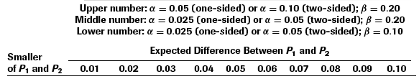
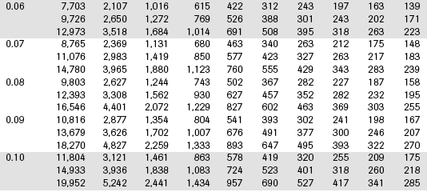
From Table 6B.2
Comparing two proportions
2-sided 𝝰 = 0.05
Power = 0.90
Treatment
proportion

Slide 65
From Table 6B.2
Sample size: 4,401
Per group!
Total: 8,802
Does not include drop-outs
  20% drop-out: 11,002 total sample size!

Slide 66
Appropriate responses
Shock
Depression
Consider alternative approaches

Slide 67
Alternatives
Tweak 𝝰: one-sided
  Almost never appropriate
Tweak the power: 0.80

Slide 68
From Table 6B.2
Comparing two proportions
2-sided 𝝰 = 0.05
Power = 0.80
Treatment
rate

Slide 69
Alternatives
Tweak 𝝰: one-sided
  Almost never appropriate
Tweak the power: 0.80
  Modest effect: 3,308 (6,616 total)
  (not including loss to follow-up)

Slide 70
Alternatives
Increase the effect size
  10% vs. 6% (4% difference)
  Resveratrol reduces mortality by 40%!

Slide 71
From Table 6B.2
Comparing two proportions
Treatment
rate

Slide 72
Increasing the effect size
10% vs. 6%
Makes a big difference!
769 / group; 1,538 total (no dropouts)
However, still large (and not affordable)
Not believable

Slide 73
Alternatives: a new hypothesis
Change the outcome measure
  Continuous measurement
  A precise measurement
A‘surrogate’for mortality rate:
  Strongly associated with mortality rate
    and
  Influenced by resveratrol
Walking speed

Slide 74
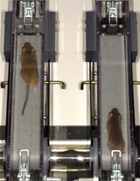
Mice on resveratrol
Mice fed resveratrol
  Live 25% longer
  Run faster
  Have greater endurance

Slide 75
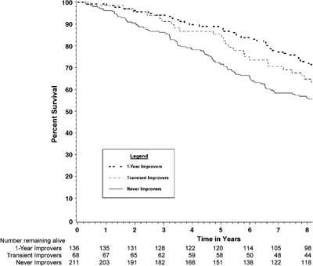
People who walk faster live longer
Faster by ≥0.1 m/s
Slower
~20% decreased
mortality rate

Slide 76
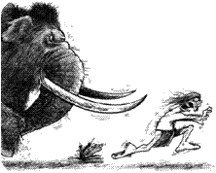
Fast walkers have lower mortality
An evolutionary perspective

Slide 77
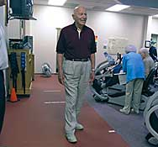
Walking speed
Easy and cheap!
Measure time over a 6 meter course

Slide 78
New endpoint needs a new hypothesis
Among 70 year old men and women, those randomized to resveratrol will not have a greater change in walking speed than those assigned to placebo.

Slide 79
The new ingredients
 New testable hypothesis
 Study design: analytical (RCT)
 Statistical test?
  Continuous variable
  Difference between means

Slide 80
Type of statistical tests
Depends on the types of variables

Slide 81
The new ingredients
 Testable hypothesis
 Study design (RCT)
 Statistical test: T-test
 Effect size ??
 Power: 0.90; alpha: 2-sided 0.05

Slide 82
The new ingredients
 Testable hypothesis
 Study design (RCT)
 Statistical test: T-test
→Effect size: ?

Slide 83
What effect size for an effect of resveratrol on walking speed
A continuous measurement that might indicate that resveratrol may influence
mortality

Slide 84
What we know about walking speed and mortality rate
Faster
Slower

Slide 85
What we know about walking speed and mortality rate
Faster by ≥0.1 m/s
Slower
~20% decreased
mortality rate

Slide 86
The new ingredients
 Testable hypothesis
 Study design (RCT)
 Statistical test: T-test
Effect size: 0.1 m/s
HOWEVER, Continuous variables, like gait speed, also need to consider variance (variability) in the measurement
Noisy measurements will need more subjects to find an effect

Slide 87
Standardized effect size: E/S
Sample size depends on the ratio of E/S
  E: Effect size (difference in means)
  S: Standard deviation for measurement
You need smaller sample size if
  There is a greater effect (E)
  More precise measurement: lower Standard Deviation (SD)

Slide 88
What we need to determine E/S for our trial
Effect size (E) for change in walking speed
+0.1 m/s
I need S: Standard deviation
Standard deviation of the change

Slide 89
S (Standard Deviation)
Standard deviation for the measurement
  Cross-sectional data: 0.25 m / sec
However, we are interested in change
Standard deviation of change in speed?
  From longitudinal studies: 0.2 m / sec

Slide 90
E/S
E: Effect size: 0.1 m/sec difference in change
S: Standard deviation: 0.2 m/sec
E/S = 0.5

Slide 91
The new ingredients
 New testable hypothesis
 Type of study: analytical (RCT)
 Statistical test: t-test
  Continuous variable
  Difference between means
Effect size: 0 vs. 0.1 m/sec change
  E/S = 0.5
 Power: 0.80; 2-sided alpha: 0.05

Slide 92
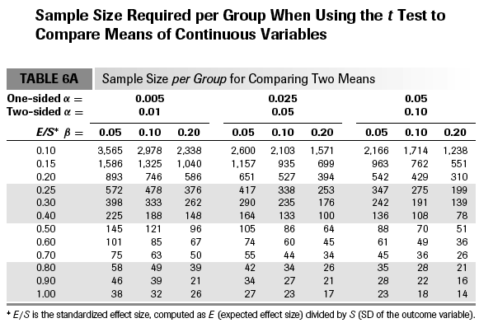

Slide 93
The new ingredients
 New testable hypothesis
 Type of study: analytical (RCT)
 T-test
 Effect size: E/S = 0.5
 Power: 0.80; alpha: 0.20
Sample size: 64 per group; 128 total
With 20% drop out: 160 total

Slide 94
The new ingredients
 New testable hypothesis
 Type of study: analytical (RCT)
 T-test
 Effect size: E/S = 0.5
 Power: 0.80; alpha: 0.20
Sample size: 64 per group; 128 total
With 20% drop out: 160 total
A trade-off: feasibility vs. clinical importance

Slide 95
On-line calculator and software
http://www.sample-size.net/
pspower (Vanderbilt)
biostat.mc.vanderbilt.edu/wiki/Main/PowerSampleSize
Requires PC or PC emulator on mac
Graphs & text describing the sample size and power

Slide 96
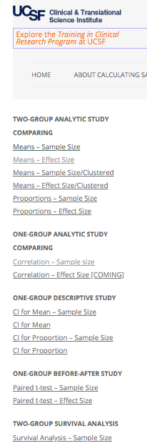
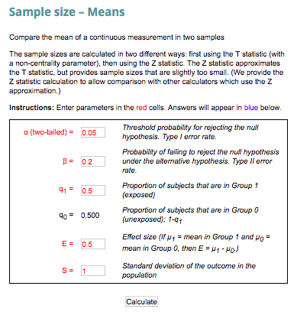

Slide 97
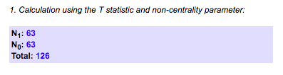

Slide 98
Summary
Estimate sample size early
Systematically collect the ingredients
Effect size is the most difficult and important judgment
Alternatives that reduce sample size
  Compromise power
  Increase effect size
  Use continuous outcomes

Slide 99
Summary
Estimate sample size early
Systematically collect the ingredients
Effect size is the most difficult - and important - judgment
Alternatives that reduce sample size
  Compromise power
  Increase effect size
  Use continuous outcomes

Slide 100
Thank you

Slide 101
On-line calculator and software
http://www.sample-size.net/
pspower (Vanderbilt)
biostat.mc.vanderbilt.edu/wiki/Main/PowerSampleSize
Requires PC or PC emulator on mac
Graphs & text describing the sample size and power

