Slide 1
Observational Study Designs
Kirsten Bibbins-Domingo, PhD, MD, MAS
Lee Goldman, MD Endowed Chair in Medicine
Professor of Epidemiology and Biostatistics and Medicine
Vice Dean for Population Health and Health Equity
UCSF School of Medicine

Slide 2
Objectives
To understand the difference between descriptive and analytic observational studies
To identify the strengths and weakness of different designs and apply different study designs to the same research question

Slide 3
My research question as a resident
Many of my heart failure patients are young. Why is that?
What can I do to prevent my patients from developing heart failure?

Slide 4
Descriptive vs. Analytic
Risk Factors
Heart Failure
Descriptive Questions
What proportion of patients in my clinic have heart failure?
What is the average age of patients with heart failure in my clinic?
Analytic Questions
Is race/ethnicity associated with heart failure among my patients?
Is excessive consumption of sugar-sweetened beverages associated with heart failure among my patients?

Slide 5
Analytic Studies
Attempt to establish a causal link between a predictor/risk factor and an outcome.
You are doing an analytic study if you have any of the following words in your research question:
  causes, leads to, compared with, more likely than, associated with, related to, similar to, correlated with, greater than, less than
Predictor
(risk factor)
Outcome
(disease)

Slide 6
Hierarchy of Study Types?
Descriptive
Case report
Case series
Survey
Analytic
Observational
Cross sectional
Case-control
Cohort studies
Experimental
Randomized
controlled trials
Strength of evidence for causality between a risk factor and outcome

Slide 7
Key elements of study design
Timing of the study
  Prospective
  Historical
Timing of variable occurrence & measurement
  When are predictors and outcomes measured?
How the subjects will be sample

Slide 8
How can I get started on my research questions?
Observations in clinical practice
  Describing cases of heart failure in clinic
    Case report or Case series
  Describe characteristics of all heart failure patients (e.g. average age)
Moving from descriptive to analytic studies
  What are the risk factors associated with developing heart failure?

Slide 9
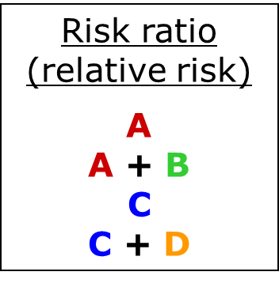
Measures of association
 |  | Disease
 |  | Yes | No
Risk Factor | Yes | A | B
 | No | C | D

Slide 10
Study Design #1
Cross-sectional study
National Health and Nutrition Exam Survey (NHANES)
Outcome: “have you been told by a doctor that you have heart failure?”
Multiple possible predictors (demographic, behavioral/lifestyle, other risk factors)
Research question: Is hypertension associated with heart failure risk?

Slide 11
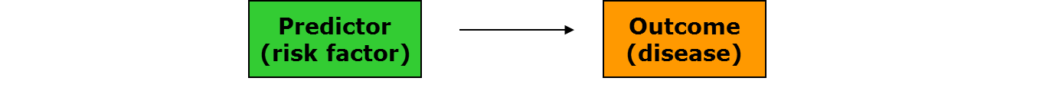
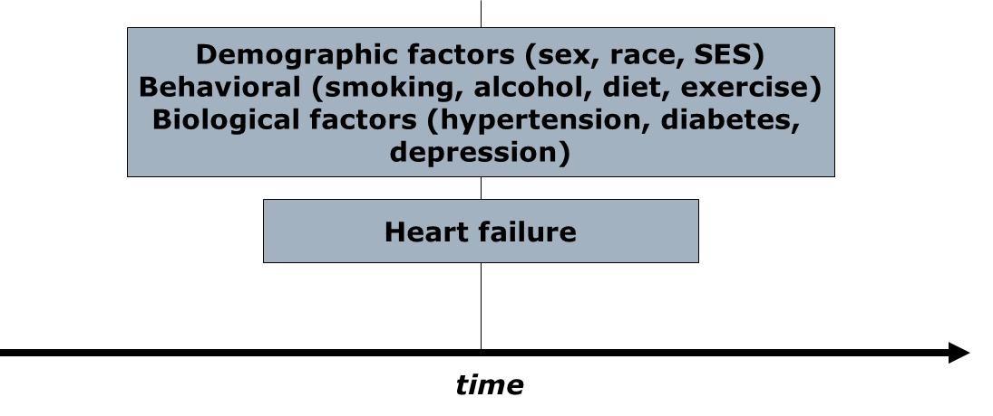
Cross-sectional study: structure

Slide 12
Cross-sectional Study: Pluses
+ Prevalence
+ Fast/Inexpensive - no waiting!
+ No loss to follow up
+ Associations can be studied
Many well-known cross-sectional studies
  NHANES
  California Health Interview Survey (NHIS, CHIS)
  Behavioral Risk Factor Surveillance Survey (BRFSS)

Slide 13
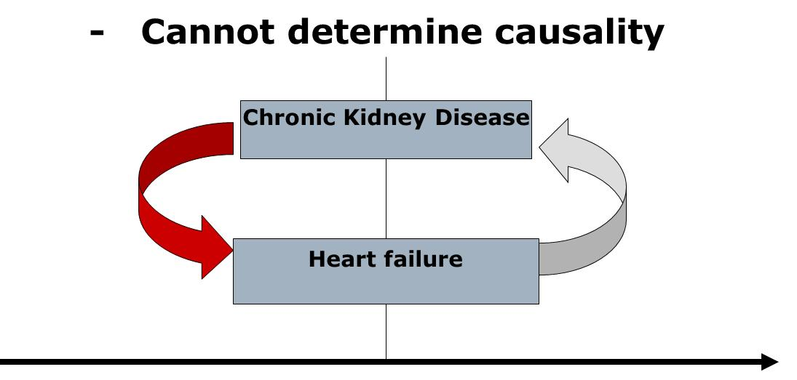
Cross-sectional study: minuses

Slide 14
Cross-sectional study: minuses
Cannot determine incidence
Cannot study rare outcomes

Slide 15
What if you are interested in the rare outcome?
Heart failure in adults before age 50
Heart failure in adults before age 30
Heart failure in children
ANSWER: A Case-Control study

Slide 16
Study Design #2
A case-control study
Cases: Adults with premature heart failure (18-50 years)
  General medicine vs. cardiology/ UCSF vs. community practice
Controls: Adults 18-50 without heart failure
  Who are the appropriate controls?
Potential predictors: Many – may be based on questionnaire
Hypothesis: Hypertension early in adulthood are more likely to have premature heart failure.

Slide 17
Case control studies
Investigator works “backward” (from outcome to predictor)
Sample chosen on the basis of outcome (cases), plus comparison group (controls)
Predictor
(risk factor)
Outcome
(disease)

Slide 18
Case-control study structure
present
CASES
Patients with heart failure before
Age 50
RISK FACTORS
Demographic
Behavioral
Biological
Genetic
CONTROLS
Patients without
Heart failure
time

Slide 19
Case control studies
Cannot yield estimates of incidence or prevalence of disease in the population (why?)
Odds Ratio is statistics

Slide 20
Measures of association
Odds ratio
A
B
C
D
Also…
A D
C B
 |  | Disease
 |  | Yes | No
Risk factor | Yes | A | B
 | No | C | D

Slide 21
Case-control Study: pluses
+ Rare outcome/Long latent period
+ Inexpensive and efficient: may be only feasible option
+ Establishes association (Odds ratio)
+ Useful for generating hypotheses (multiple risk factors can be explored)

Slide 22
Case-control study-minuses
Causality still difficult to establish
  Selection bias (appropriate controls)
    Caffeine and Pancreatic cancer in the GI clinic
  Recall bias: sampling (retrospective)
    Abortion and risk of breast cancer in Sweden

Slide 23
Case-control - “the house red wine”
Rely tampons and toxic shock syndrome:
  High rates of toxic shock syndrome in menstruating women
  Suspected OCPs or meds for PMS
  Cases: 180 women with TSS in 6 geographic areas
  Controls: 180 female friends of these patients and 180 females in the same telephone code
  Tampon associated with TSS (OR = 29!)
  Super absorbency associated with TSS (OR 1.34 per gm increase in absorbency)
  Led to “RELY” brand tampons being taken off the market.

Slide 24
Where are we?
Cross-sectional studies and case-control studies are important for generating hypotheses about risk factors for heart failure.
What’s missing? - strengthening evidence for a causal link between risk factors and heart failure.
Use results from our previous studies to apply for funding for a prospective cohort study!

Slide 25
Elements of a cohort study
Predictor
(risk factor)
Outcome
(disease)
Selection of sample from population
Measures predictor variables in sample
Follow population for period of time
Measure outcome variable
Famous cohort studies
  Framingham
  Nurses’ Health Study

Slide 26
Prospective cohort study structure
The present
The future
MI, CHF, stroke, ESRD, LEA
Everyone else
time

Slide 27
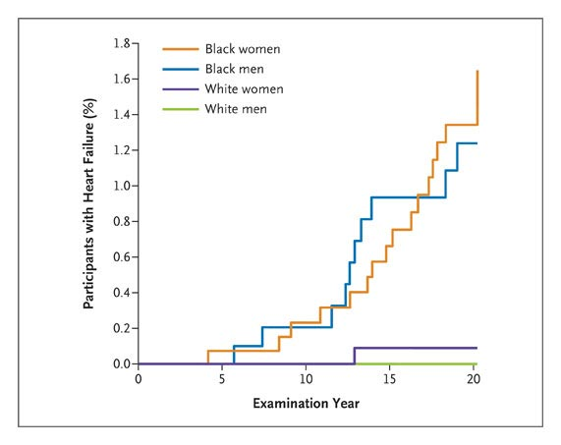
New Cases of Heart Failure in the Black and White Young Adults
In CARDIA- >5000 young adults in their 20’s and 30’s followed for 20 years:
1 in 100 black men and women develop heart failure before age 50.
Blood pressure elevation in 20’s was strongest predictor (HR well as development of diabetes over 20 years.
Source: Bibbins-Domingo et.al. NEJM 2009; 360(12):1179-90.

Slide 28
Clinical factors over 20 years associated with heart failure among black participants
 | Multivariate Cox models with time-varying covariates
 | Hazard Ratio | p-value
Systolic BP (per SD)* | 1.4 (1.1-1.9) | 0.006
Diabetes | 3.8 (1.6-9.1) | 0.002
*Diastolic blood pressure is retained in the model when systolic blood pressure is
omitted - adjusted HR 1.5 (95% CI, 1.1 to 2.1; P = 0.01)

Slide 29
Strengths of cohort studies
Know that predictor variable was present before outcome variable occurred (some evidence of causality)
Directly measure incidence of a disease outcome
Can study multiple outcomes of a single exposure (RR is measure of association)

Slide 30
Weaknesses of cohort studies
Expensive and inefficient for studying rare outcomes
Often need long follow-up period or a very large population
Loss to follow-up can affect validity of findings

Slide 31
Variations on cohort studies
Retrospective cohort
  Identification of cohort, measurement of predictor variables, follow-up and measurement of outcomes have all occurred in the past
  Much less costly than prospective cohorts
  Investigator has minimal control over study design
Case-cohort
  Cases and controls identified within an existing cohort study
  Like a classic case-control study, but benefits from better characterization of participants in cohort study

Slide 32
A study type for every budget, purpose, and research question
Descriptive
Case report
Case series
Survey
Analytic
Observational
Cross sectional
Case-control
Cohort studies
Experimental
Randomized
controlled trials
A study type of every budget, purpose and research question

Slide 33
Plasma Natriuretic Peptide Levels and the Risk of Cardiovascular Events and Death
Thomas J. Wang, M.D., Martin G. Larson, Sc.D., Daniel Levy, M.D., Emelia J. Benjamin, M.D., Eric P. Leip, M.S., Torbjorn Omland, M.D., Philip A. Wolf, M.D., and Ramachandran S. Vasan, M.D.N Engl J Med 2004; 350:655-663
BACKGROUND: The natriuretic peptides are counterregulatory hormones involved in volume homeostasis and cardiovascular remodeling. The prognostic significance of plasma natriuretic peptide levels in apparently asymptomatic persons has not been established.
METHODS: _____________________3346 persons without heart failure. Using proportional-hazards regression, we examined the relations of plasma B-type natriuretic peptide and N-terminal pro–atrial natriuretic peptide to the risk of death from any cause, a first major cardiovascular event, heart failure, atrial fibrillation, stroke or transient ischemic attack, and coronary heart disease.
RESULTS: During a mean follow-up of 5.2 years, 119 participants died and 79 had a first cardiovascular event. After adjustment for cardiovascular risk factors, each increment of 1 SD in log B-type natriuretic peptide levels was associated with a 27 percent increase in the risk of death (P=0.009), a 28 percent increase in the risk of a first cardiovascular event (P=0.03), a 77 percent increase in the risk of heart failure (P<0.001), a 66 percent increase in the risk of atrial fibrillation (P<0.001), and a 53 percent increase in the risk of stroke or transient ischemic attack (P=0.002). Peptide levels were not significantly associated with the risk of coronary heart disease events. B-type natriuretic peptide values above the 80th percentile (20.0 pg per milliliter for men and 23.3 pg per milliliter for women) were associated with multivariable-adjusted hazard ratios of 1.62 for death (P=0.02), 1.76 for a first major cardiovascular event (P=0.03), 1.91 for atrial fibrillation (P=0.02), 1.99 for stroke or transient ischemic attack (P=0.02), and 3.07 for heart failure (P=0.002). Similar results were obtained for N-terminal pro–atrial natriuretic peptide.
CONCLUSIONS: In this community-based sample, plasma natriuretic peptide levels predicted the risk of death and cardiovascular events after adjustment for traditional risk factors. Excess risk was apparent at natriuretic peptide levels well below current thresholds used to diagnose heart failure.

Slide 34
Needlestick Injuries among Surgeons in Training Martin A. Makary, M.D., M.P.H., Ali Al-Attar, M.D., Ph.D., Christine G. Holzmueller, B.A., J. Bryan Sexton, Ph.D., Dora Syin, B.S., Marta M. Gilson, Ph.D., Mark S. Sulkowski, M.D., and Peter J. Pronovost, M.D., Ph.D.
N Engl J Med 2007; 356:2693-2699
BACKGROUND: Surgeons in training are at high risk for needlestick injuries. The reporting of such injuries is a critical step in initiating early prophylaxis or treatment.
METHODS: We surveyed surgeons in training at 17 medical centers about previous needlestick injuries. Survey items inquired about whether the most recent injury was reported to an employee health service or involved a “high-risk” patient (i.e., one with a history of infection with human immunodeficiency virus, hepatitis B or hepatitis C, or injection-drug use); we also asked about the perceived cause of the injury and the surrounding circumstances.
RESULTS: The overall response rate was 95%. Of 699 respondents, 582 (83%) had had a needlestick injury during training; the mean number of needlestick injuries during residency increased according to the postgraduate year (PGY): PGY-1, 1.5 injuries; PGY-2, 3.7; PGY-3, 4.1; PGY-4, 5.3; and PGY-5, 7.7. By their final year of training, 99% of residents had had a needlestick injury; for 53%, the injury had involved a high-risk patient. Of the most recent injuries, 297 of 578 (51%) were not reported to an employee health service, and 15 of 91 of those involving high-risk patients (16%) were not reported. Lack of time was the most common reason given for not reporting such injuries among 126 of 297 respondents (42%). If someone other than the respondent knew about an unreported injury, that person was most frequently the attending physician (51%) and least frequently a “significant other” (13%).
CONCLUSIONS: Needlestick injuries are common among surgeons in training and are often not reported. Improved prevention and reporting strategies are needed to increase occupational safety for surgical providers.

Slide 35
First-Trimester Use of Selective Serotonin-Reuptake Inhibitors and the Risk of Birth Defects
Carol Louik, Sc.D., Angela E. Lin, M.D., Martha M. Werler, Sc.D., Sonia Hernández-Díaz, M.D., Sc.D., and Allen A. Mitchell, M.D. N Engl J Med 2007; 356:2675-2683
BACKGROUND: The risk of birth defects after antenatal exposure to selective serotonin-reuptake inhibitors (SSRIs) remains controversial.
METHODS: We assessed associations between first-trimester maternal use of SSRIs and the risk of birth defects among 9849 infants with and 5860 infants without birth defects participating in the Slone Epidemiology Center Birth Defects Study.
RESULTS: In analyses of defects previously associated with SSRI use (involving 42 comparisons), overall use of SSRIs was not associated with significantly increased risks of craniosynostosis (115 subjects, 2 exposed to SSRIs; odds ratio, 0.8; 95% confidence interval [CI], 0.2 to 3.5), omphalocele (127 subjects, 3 exposed; odds ratio, 1.4; 95% CI, 0.4 to 4.5), or heart defects overall (3724 subjects, 100 exposed; odds ratio, 1.2; 95% CI, 0.9 to 1.6). Analyses of the associations between individual SSRIs and specific defects showed significant associations between the use of sertraline and omphalocele (odds ratio, 5.7; 95% CI, 1.6 to 20.7; 3 exposed subjects) and between the use of paroxetine and right ventricular outflow tract obstruction defects (odds ratio, 3.3; 95% CI, 1.3 to 8.8; 6 exposed subjects). The risks were not appreciably or significantly increased for other defects or other SSRIs or non-SSRI antidepressants. Exploratory analyses involving 66 comparisons showed possible associations of paroxetine and sertraline with other specific defects.
CONCLUSIONS: Our findings do not show that there are significantly increased risks of craniosynostosis, omphalocele, or heart defects associated with SSRI use overall. They suggest that individual SSRIs may confer increased risks for some specific defects, but it should be recognized that the specific defects implicated are rare and the absolute risks are small.

Slide 36
Effect of Cigar Smoking on the Risk of Cardiovascular Disease, Chronic Obstructive Pulmonary Disease, and Cancer in Men Carlos Iribarren, M.D., M.P.H., Ph.D., Irene S. Tekawa, M.A., Stephen Sidney, M.D., M.P.H., and Gary D. Friedman, M.D. N Engl J Med 1999; 340:1773-1780
BACKGROUND: The sale of cigars in the United States has been increasing since 1993. Cigar smoking is a known risk factor for certain cancers and for chronic obstructive pulmonary disease (COPD). However, unlike the relation between cigarette smoking and cardiovascular disease, the association between cigar smoking and cardiovascular disease has not been clearly established.
METHODS: _______________study among 17,774 men 30 to 85 years of age at base line (from 1964 through 1973) who were enrolled in the Kaiser Permanente health plan and who reported that they had never smoked cigarettes and did not currently smoke a pipe. Those who smoked cigars (1546 men) and those who did not (16,228) were followed from 1971 through the end of 1995 for a first hospitalization for or death from a major cardiovascular disease or COPD, and through the end of 1996 for a diagnosis of cancer.
RESULTS: In multivariate analyses, cigar smokers, as compared with nonsmokers, were at higher risk for coronary heart disease (relative risk, 1.27; 95 percent confidence interval, 1.12 to 1.45), COPD (relative risk, 1.45; 95 percent confidence interval, 1.10 to 1.91), and cancers of the upper aerodigestive tract (relative risk, 2.02; 95 percent confidence interval, 1.01 to 4.06) and lung (relative risk, 2.14; 95 percent confidence interval, 1.12 to 4.11), with evidence of dose–response effects. There appeared to be a synergistic relation between cigar smoking and alcohol consumption with respect to the risk of oropharyngeal cancers and cancers of the upper aerodigestive tract.
CONCLUSIONS: Independently of other risk factors, regular cigar smoking can increase the risk of coronary heart disease, COPD, and cancers of the upper aerodigestive tract and lung.

Slide 37
Helicobacter pylori Infection and Gastric Lymphoma
Julie Parsonnet, Svein Hansen, Larissa Rodriguez, Arnold B. Gelb, Roger A. Warnke, Egil Jellum, Norman Orentreich, Joseph H. Vogelman, and Gary D. Friedman N Engl J Med 1994; 330:1267-1271
BACKGROUND: Helicobacter pylori infection is a risk factor for gastric adenocarcinoma. We examined whether this infection is also a risk factor for primary gastric non-Hodgkin's lymphoma.
METHODS: This _____________study involved ______________(230,593 participants). Serum had been collected from cohort members and stored, and all subjects were followed for cancer. Thirty-three patients with gastric non-Hodgkin's lymphoma were identified, and each was matched to four controls according to cohort, age, sex, and date of serum collection. For comparison, 31 patients with nongastric non-Hodgkin's lymphoma from one of the cohorts were evaluated, each of whom had been previously matched to 2 controls. Pathological reports and specimens were reviewed to confirm the histologic type of the tumor. Serum samples from all subjects were tested for H. pylori IgG by an enzyme-linked immunosorbent assay.
RESULTS: Thirty-three cases of gastric non-Hodgkin's lymphoma occurred a median of 14 years after serum collection. Patients with gastric lymphoma were significantly more likely than matched controls to have evidence of previous H. pylori infection (matched odds ratio, 6.3; 95 percent confidence interval, 2.0 to 19.9). The results were similar in both cohorts. Among the 31 patients with nongastric lymphoma, a median of six years had elapsed between serum collection and the development of disease. No association was found between nongastric non-Hodgkin's lymphoma and previous H. pylori infection (mathed odds ratio, 1.2; 95 percent confidence interval, 0.5 to 3.0).
CONCLUSIONS: Non-Hodgkin's lymphoma affecting the stomach, but not other sites, is associated with previous H. pylori infection. A causative role for the organism is plausible, but remains unproved.

Slide 38
Adherence to a Mediterranean Diet and Survival in a Greek Population
Antonia Trichopoulou, M.D., Tina Costacou, Ph.D., Christina Bamia, Ph.D., and Dimitrios Trichopoulos, M.D. N Engl J Med 2003
BACKGROUND: Adherence to a Mediterranean diet may improve longevity, but relevant data are limited.
METHODS: We conducted a __________________________involving 22,043 adults in Greece who completed an extensive, validated, food-frequency questionnaire at base line. Adherence to the traditional Mediterranean diet was assessed by a 10-point Mediterranean-diet scale that incorporated the salient characteristics of this diet (range of scores, 0 to 9, with higher scores indicating greater adherence). We used proportional-hazards regression to assess the relation between adherence to the Mediterranean diet and total mortality, as well as mortality due to coronary heart disease and mortality due to cancer, with adjustment for age, sex, body-mass index, physical-activity level, and other potential confounders.
RESULTS: During a median of 44 months of follow-up, there were 275 deaths. A higher degree of adherence to the Mediterranean diet was associated with a reduction in total mortality (adjusted hazard ratio for death associated with a two-point increment in the Mediterranean-diet score, 0.75 [95 percent confidence interval, 0.64 to 0.87]). An inverse association with greater adherence to this diet was evident for both death due to coronary heart disease (adjusted hazard ratio, 0.67 [95 percent confidence interval, 0.47 to 0.94]) and death due to cancer (adjusted hazard ratio, 0.76 [95 percent confidence interval, 0.59 to 0.98]). Associations between individual food groups contributing to the Mediterranean-diet score and total mortality were generally not significant.
CONCLUSIONS: Greater adherence to the traditional Mediterranean diet is associated with a significant reduction in total mortality.

