Slide 1
Learning Healthcare System Research Projects
Mark J. Pletcher, MD MPH
Designing Clinical Research
Sept 11, 2018

Slide 2
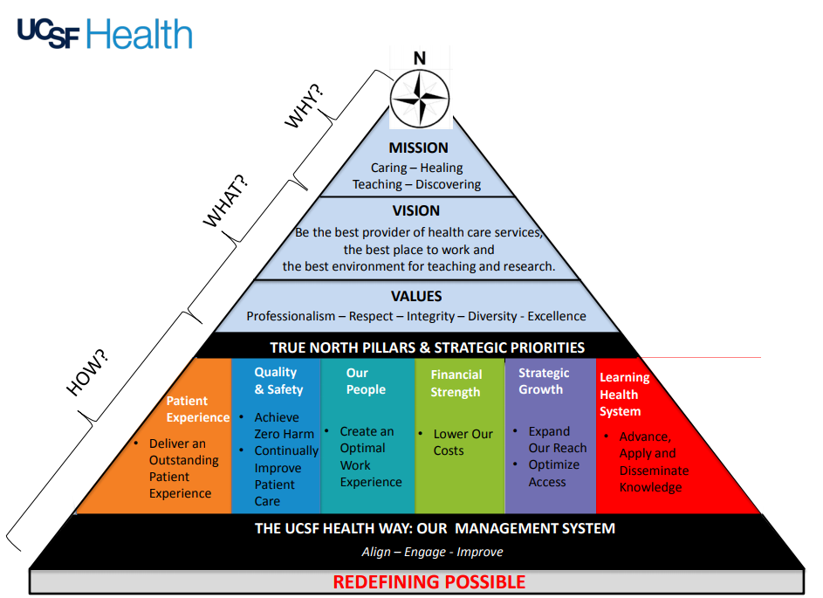

Slide 3
UCSF’s True North Pyramid

Slide 4
UCSF’s True North Pyramid
The Learning Health System “Pillar”

Slide 5
Outline
What is a Learning Healthcare System?
“Embedded” randomized controlled trials
  Definitions
  Ethics
  Design
  Pitfalls
  Oversight and implementation decision-making
Future opportunities at UCSF and beyond

Slide 6
What is a Learning Healthcare System?
A vision from the National Academy of Medicine
  All spurred by the advent of electronic health records?

Slide 7
What is a Learning Healthcare System?
National Academy of Medicine (IOM):
  “Science, informatics, incentives, and culture are aligned for continuous improvement and innovation, with best practices seamlessly embedded in the delivery process and new knowledge captured as an integral by-product of the delivery experience.”
http://www.learninghealthcareproject.org/section/background/learning-healthcare-system
Best Care at Lower Cost: The Path to Continuously Learning Health Care in America
https://www.ncbi.nlm.nih.gov/books/NBK207218/

Slide 8
What is a Learning Healthcare System?
National Academy of Medicine (IOM):
  “Science, informatics, incentives, and culture are aligned for continuous improvement and innovation, with best practices seamlessly embedded in the delivery process and new knowledge captured as an integral by-product of the delivery experience.”
http://www.learninghealthcareproject.org/section/background/learning-healthcare-system
Best Care at Lower Cost: The Path to Continuously Learning Health Care in America
https://www.ncbi.nlm.nih.gov/books/NBK207218/

Slide 9
What is a Learning Healthcare System?
“…a system that gains knowledge from every care delivery experience and is engineered to promote continuous improvement.”
http://www.learninghealthcareproject.org/section/background/learning-healthcare-system
Best Care at Lower Cost: The Path to Continuously Learning Health Care in America
https://www.ncbi.nlm.nih.gov/books/NBK207218/

Slide 10
What is a Learning Healthcare System?
“…a system that gains knowledge from every care delivery experience and is engineered to promote continuous improvement.”
http://www.learninghealthcareproject.org/section/background/learning-healthcare-system
Best Care at Lower Cost: The Path to Continuously Learning Health Care in America
https://www.ncbi.nlm.nih.gov/books/NBK207218/

Slide 11
What is a Learning Healthcare System?
“…a system that gains knowledge from every care delivery experience and is engineered to promote continuous improvement.”
Randomized controlled trials (RCTs) are the best way to gain knowledge…
  A vision: every patient is randomized at least once during their encounter…
http://www.learninghealthcareproject.org/section/background/learning-healthcare-system
Best Care at Lower Cost: The Path to Continuously Learning Health Care in America
https://www.ncbi.nlm.nih.gov/books/NBK207218/

Slide 12
What is a Learning Healthcare System?
NIH Collaboratory
  Funded 2012 as a result of the LHS vision
  Goal – strengthen capacity for large-scale RCTs that engage health care systems
  Focus on “pragmatic” clinical trials → http://rethinkingclinicaltrials.org

Slide 13
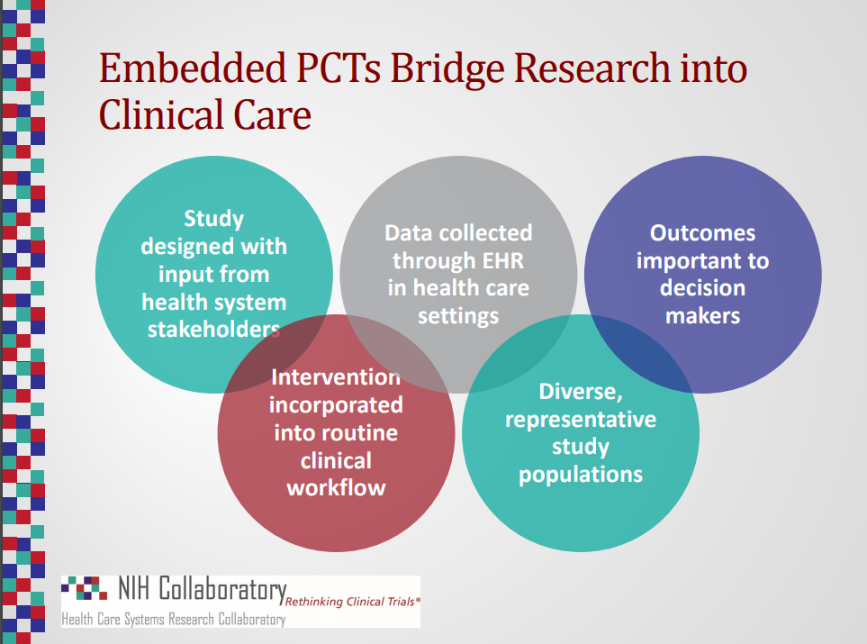
PCT = Pragmatic Clinical Trial
https://www.nihcollaboratory.org/Products/NIH-Collaboratory-Program-Overview-Slides.pdf

Slide 14
PCT = Pragmatic Clinical Trial
https://www.nihcollaboratory.org/Products/NIH-Collaboratory-Program-Overview-Slides.pdf

Slide 15
What is a learning healthcare system?
EHR systems make it easy to:
  Implement randomization
  Influence care in different ways
  Measure outcomes
Can we “embed” RCTs in our healthcare system at UCSF?

Slide 16
Embedded RCTs
What does it mean to embed an RCT?
  Embedded in EHR technology
  Embedded in clinical workflow

Slide 17
Embedded RCTs
Embedded in EHR technology
  Randomization implemented by APEX (our Epic EHR)
  Intervention(s) are delivered by APEX
    APEX is designed to support clinical decision-making and “nudge” clinicians to deliver better care
  Outcomes are measured using APEX data

Slide 18
Embedded RCTs
Embedded in clinical workflow
  “Unsuspecting” clinicians will encounter the intervention
    Whether they know it or not
    No prior knowledge of the research required
  Must not perturb usual care “too much”
    Extra time, unbillable services, etc
    Patient consent? Extra data collection?
  Allow clinicians (and patients) to make clinical decisions
    Pragmatic, non-protocolized interventions

Slide 19
Embedded RCTs
Three flavors:
  Randomized Explanatory Trials
  Randomized Comparative Effectiveness Trials
  Randomized Quality Improvement Trials

Slide 20
Types of Embedded RCTs
Type of RCT: | Explanatory | Comparative effectiveness | Quality improvement
Goal | Learn something about the world | Estimate tradeoffs between accepted alternatives | Implement cautiously, learn
Intervention (A) | Experimental condition | One reasonable option | A putative improvement in quality
Control (B) | Control condition | Another reasonable option | Usual care
A priori hypothesis | A=B (equipoise) | A=B (equipoise) | A > B
End result | Generalizable knowledge (publication) | Informed decision-making | Implementation (or not)
Informed consent | Required | ? | Waived

Slide 21
Types of Embedded RCTs
Type of RCT: | Explanatory | Comparative effectiveness | Quality improvement
Goal | Learn something about the world | Estimate tradeoffs between accepted alternatives | Implement cautiously, learn
Intervention (A) | Experimental condition | One reasonable option | A putative improvement in quality
Control (B) | Control condition | Another reasonable option | Usual care
A priori hypothesis | A=B (equipoise) | A=B (equipoise) | A > B
End result | Generalizable knowledge (publication) | Informed decision-making (publication) | Implementation (or not)
Informed consent | Required | ? | Waived

Slide 22
Types of Embedded RCTs
Type of RCT: | Explanatory | Comparative effectiveness | Quality improvement
Goal | Learn something about the world | Estimate tradeoffs between accepted alternatives | Implement cautiously, learn
Intervention (A) | Experimental condition | One reasonable option | A putative improvement in quality
Control (B) | Control condition | Another reasonable option | Usual care
A priori hypothesis | A=B (equipoise) | A=B (equipoise) | A > B
End result | Generalizable knowledge (publication) | Informed decision-making (publication) | Implementation (or not)
Informed consent | Required | ? | Waived

Slide 23
Types of Embedded RCTs
Type of RCT: | Explanatory | Comparative effectiveness | Quality improvement
Goal | Learn something about the world | Estimate tradeoffs between accepted alternatives | Implement cautiously, learn
Intervention (A) | Experimental condition | One reasonable option | A putative improvement in quality
Control (B) | Control condition | Another reasonable option | Usual care
A priori hypothesis | A=B (equipoise) | A=B (equipoise) | A > B
End result | Generalizable knowledge (publication) | Informed decision-making | Implementation (or not)
Informed consent | Required | ? | Waived
This is a bit radical

Slide 24
Types of Embedded RCTs
Type of RCT: | Explanatory | Comparative effectiveness | Quality improvement
Goal | Learn something about the world | Estimate tradeoffs between accepted alternatives | Implement cautiously, learn
Intervention (A) | Experimental condition | One reasonable option | A putative improvement in quality
Control (B) | Control condition | Another reasonable option | Usual care
A priori hypothesis | A=B (equipoise) | A=B (equipoise) | A > B
End result | Generalizable knowledge (publication) | Informed decision-making | Implementation (or not)
Informed consent | Required | ? | Waived
Litmus test: Implementation occurs with the “flip of a switch”

Slide 25
Types of Embedded RCTs
Informed consent is a major barrier
  Cost, time, disruption
  Not required for quality improvement (QI)
Randomized QI (RQI) Trials
  Sweet spot for the Learning Healthcare System?
    Enables efficient “A/B Testing” within a healthcare system
    Not the focus of NIH Collaboratory
  Must meet strict criteria to waive informed consent
    Minimal risk
    Consent not feasible (“could not be carried out practicably”)

Slide 26
Quality improvement vs. research (tangent!)
Why is the distinction between QI and research important?
  Research requires IRB approval
  Research requires informed consent, or waiver of consent only under certain special conditions
  Research RCTs generally require equipoise

Slide 27
Quality improvement vs. research (tangent!)
Dichotomy?
Research
Quality improvement

Slide 28
Quality improvement vs. research (tangent!)
Spectrum?
Research
Quality improvement

Slide 29
Quality improvement vs. research (tangent!)
Spectrum?
Research
Quality improvement
Consent + IRB?
No consent/No IRB?

Slide 30
Quality improvement vs. research (tangent!)
Spectrum?
Research
Quality improvement
Consent + IRB?
No consent/No IRB?
Where do you draw the line?

Slide 31
Quality improvement vs. research (tangent!)
Distinct but overlapping
Research
Quality improvement

Slide 32
Quality improvement vs. research (tangent!)
Distinct but overlapping
Research
Quality improvement
No consent required
Need IRB approval

Slide 33
Quality improvement vs. research (tangent!)
Distinct but overlapping
Research
Quality improvement
No consent required
Need IRB approval
Randomized Quality Improvement Trials

Slide 34
Quality improvement vs. research (tangent!)
Isn’t all research designed to improve quality of healthcare and thereby improve health of patients?

Slide 35
Study completed
Publication and knowledge dissemination
Secondary Primary
Implementation at UCSF
Implementation elsewhere

Slide 36
Study completed
Publication and knowledge dissemination
Secondary Primary
Implementation at UCSF
Implementation elsewhere
Research that is NOT quality improvement

Slide 37
Study completed
Study completed
Publication and knowledge dissemination
Implementation at UCSF
Secondary Primary
Publication and knowledge dissemination
Implementation at UCSF
Implementation elsewhere
Implementation elsewhere
Research that is NOT quality improvement

Slide 38
Study completed
Study completed
“Flip a switch”
Publication and knowledge dissemination
Implementation at UCSF
Secondary Primary
Publication and knowledge dissemination
Implementation at UCSF
Implementation elsewhere
Implementation elsewhere
Research that is NOT quality improvement
Quality improvement research

Slide 39
Randomization Ratio
1:1
1:0
Study completed
Study completed
“Flip a switch”
Publication and knowledge dissemination
Implementation at UCSF
Secondary Primary
Publication and knowledge dissemination
Implementation at UCSF
Implementation elsewhere
Implementation elsewhere
Research that is NOT quality improvement
Quality improvement research

Slide 40
Study completed
Evaluation?
Publication and knowledge dissemination
Implementation at UCSF
Quality improvement that is not research…
Secondary Primary
Implementation at UCSF
Implementation elsewhere
Research that is NOT quality improvement

Slide 41
Quality improvement vs. research (tangent!)
Distinct but overlapping
Research
Quality improvement
No consent required
Need IRB approval
Not everyone is on the same page with this concept…

Slide 42
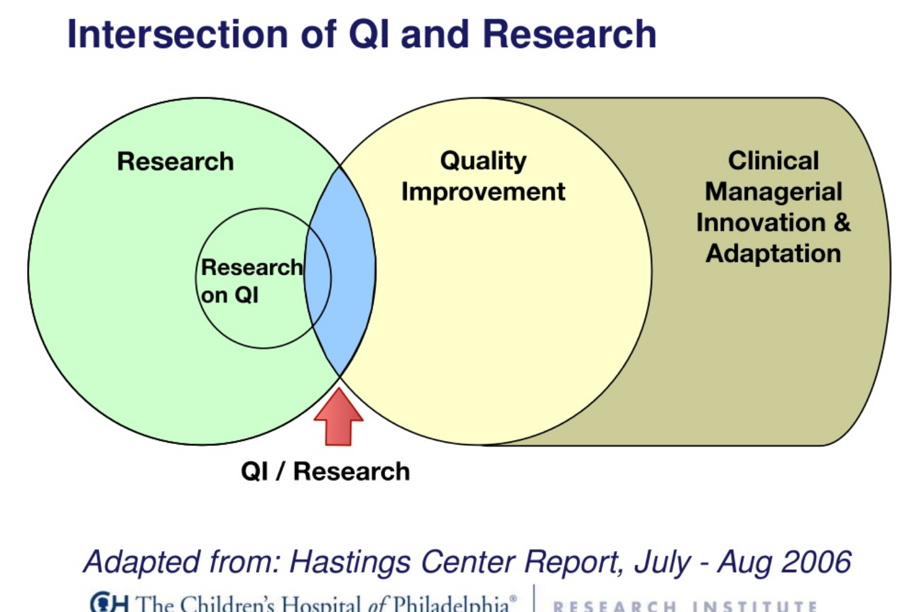
https://www.slideshare.net/msschreiner/irb-challenges-qi-vs-research

Slide 43
RQI Examples
CTSI-supported embedded RCTs at UCSF
Calls for proposals
  Identify a health outcome measurable by APEX query
  Propose a scalable intervention to improve the outcome
  Design an RCT to evaluate impact
CTSI supports investigator time + in-kind support
  APEX programming, study design, data work, etc
  2 supported in Year 1, 5 in Year 2

Slide 44
RQI Example #1: Hypoglycemia
Hypoglycemia events in the hospital
  Lead – Rob Rushakoff
Background
  Uncommon, but should be predictable and preventable
  Risk score exists
Plan
  Implement risk score, alert clinicians with advice

Slide 45
RQI Example #1: Hypoglycemia
Alert via Carelink to Clinical Team, with advice
Predict hypoglycemia
R
Inpatients
Usual care
= predictive analytics
= modification of workflow
R
= randomization

Slide 46
RQI Example #2: COPD orders
Standardizing COPD orders
  Lead – Ari Hoffman
Background
  Lots of standard COPD treatments that are not getting done at UCSF; and readmission rates are high
Plan
  Develop standard orders (2 versions), and insert into admission order sets for persons at high risk

Slide 47
RQI Example #2: COPD orders
Insert standard orders into admission orders
Predict COPD at discharge
R
ED patients
Usual care
= predictive analytics
= modification of workflow
R
= randomization

Slide 48
RQI Example #3: Healthy Start
Nomogram for expected weight loss in neonates
  Lead – Valerie Flaherman
Background
  Well babies are expected to lose weight in first weeks
  But losing too much weight is dangerous
  Nomogram and web tool exists
Plan
  Autopopulate web-based nomogram and show to clinicians as guide to supplementation

Slide 49
RQI Example #3: Healthy Start
Predict weight loss
Display nomogram + guidance on feeding
Well-baby nursery
R
Usual care
= predictive analytics
= modification of workflow
R
= randomization

Slide 50
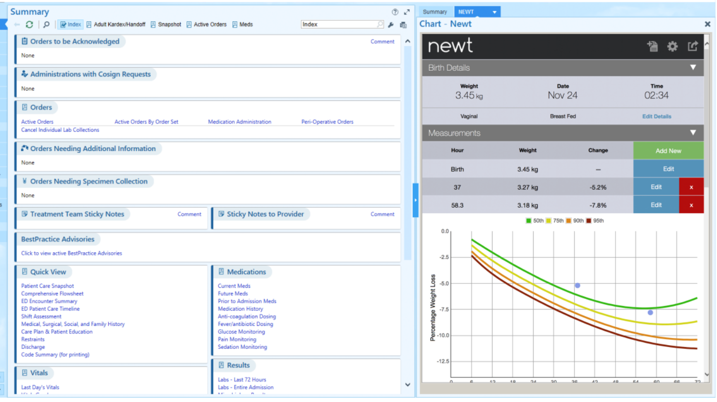
RQI Example #3: Healthy Start
Screenshot

Slide 51
RQI Example #4: PICU extubation
Guiding extubation in PICU with prediction models
  Lead – Deborah Franzon
Background
  Extubation in PICU is high stakes event
    Get off vent as soon as possible; avoid re-intubation events
  Tons of data in the ICU → predict success?
Plan
  Predict extubation attempts; and predict extubation success
  Show results to clinicians (or not)

Slide 52
RQI Example #4: PICU extubation
Predict extubation
Display predictions, red/orange/green coding
Intubated patients
R
Usual care
= predictive analytics
= modification of workflow
R
= randomization

Slide 53
Anyone notice the structural difference between first 2 and second 2?

Slide 54
Alert via Carelink to Clinical Team, with advice
Predict hypoglycemia
R
Inpatients
Usual care
Insert standard orders into admission orders
Predict COPD at discharge
R
ED patients
Usual care
Predict weight loss
Display nomogram + guidance on feeding
Well-baby nursery
R
Usual care
Predict extubation
Display predictions, red/orange/green coding
Intubated patients
R
Usual care

Slide 55
Two RCT design options
Predictive analytics PRIOR to randomization, guides which patients to enroll
Predictive analytics AFTER randomization, guides modified workflow in intervention arm

Slide 56
Clinical Decision Support (tangent)
“Clinical decision support (CDS) provides clinicians, staff, patients or other individuals with knowledge and person-specific information, intelligently filtered or presented at appropriate times, to enhance health and health care.”
https://www.healthit.gov/topic/safety/clinical-decision-support

Slide 57
Clinical Decision Support (tangent)
“Clinical decision support (CDS) provides clinicians, staff, patients or other individuals with knowledge and person-specific information, intelligently filtered or presented at appropriate times, to enhance health and health care.”
= predictive analytics
= modification of workflow
https://www.healthit.gov/topic/safety/clinical-decision-support

Slide 58
Two RCT design options for testing Clinical Decision Support (CDS)
RCT to examine the impact of [workflow modification] vs. usual care on [health outcome] in patients with [X] identified as being likely to benefit according to predictive analytics
RCT to examine the impact of predictive-analytics-guided [workflow modification] vs. usual care on [health outcome] among patients with [X]

Slide 59
Predictive analytics introduce an element of unpredictability!

Slide 60
Pitfalls of RCT design #1
Alert via Carelink to Clinical Team, with advice
Predict hypoglycemia
R
Inpatients
Usual care
Retrospective analyses showed low but important numbers of hypoglycemia events in prior years

Slide 61
Pitfalls of RCT design #1
Alert via Carelink to Clinical Team, with advice
Predict hypoglycemia
R
Inpatients
Usual care
Retrospective analyses showed low but important numbers of hypoglycemia events in prior years
RCT launched
6 months into trial:
  Rates of events were NEAR ZERO in both arms

Slide 62
Pitfalls of RCT design #1
Alert via Carelink to Clinical Team, with advice
Predict hypoglycemia
R
Inpatients
Usual care
Retrospective analyses showed low but important numbers of hypoglycemia events in prior years
RCT launched
6 months into trial:
  Rates of events were NEAR ZERO in both arms
- Events still occurring at UCSF were essentially NOT PREDICTABLE by standard methods.
- Trial was stopped and CDS abandonded!
- Randomization ratio 1:1 → 0:1

Slide 63
Pitfalls of RCT design #1
Alert via Carelink to Clinical Team, with advice
Predict hypoglycemia
R
Inpatients
Usual care
Lessons learned:
  Real-time prediction different than prediction using stored data (Chronicles data vs. Clarity data)
  Run prediction algorithm prospectively, in the background without modifying workflow, before launching RCT
    Prospective validation of predictive analytics
    Evaluate potential impact before modifying workflow

Slide 64
Pitfalls of RCT design #2
Predict weight loss
Display nomogram + guidance on feeding
Well-baby nursery
R
Usual care
What primary outcome?
  Exclusive breastfeeding = 74.4% overall
  Readmissions = 5% overall

Slide 65
Exclusive breastfeeding rates
Usual care Intervention
74.4% ?
Predict weight loss
Display nomogram + guidance on feeding

Slide 66
Exclusive breastfeeding rates
Usual care Intervention
Low risk→breastfeed
89.3%
59.5%
74.4%
Predict weight loss
High risk→Supplement
Overall

Slide 67
Exclusive breastfeeding rates
Usual care Intervention
Low risk→breastfeed
89.3% 95%
59.5% No change
74.4% ?
Predict weight loss
High risk→Supplement
Overall

Slide 68
Exclusive breastfeeding rates
Usual care Intervention
Low risk→breastfeed
89.3% 95%
59.5% No change
74.4% 77.25%
Predict weight loss
High risk→Supplement
Overall rates depend on proportion in each category
If 50:50 in Low:High risk

Slide 69
Exclusive breastfeeding rates
Usual care Intervention
Low risk→breastfeed
89.3% 95%
59.5% No change
74.4% 77.25%
Predict weight loss
High risk→Supplement
Overall rates depend on proportion in each category
If 50:50 in Low:High risk
Sample size of 2600, power to detect 74% vs. 77.25% with 2-sided alpha 0.05 is…
…only 40%!

Slide 70
Readmission rates
Usual care Intervention
Low risk→breastfeed
2% (no change?)
8% 6%
5% 4%
Predict weight loss
High risk→Supplement
Overall rates depend on proportion in each category
If 50:50 in Low:High risk
Sample size of 2600, power to detect 5% vs. 4% with 2-sided alpha 0.05 is…
…only 20%!

Slide 71
Readmission rates
Usual care Intervention
Low risk→breastfeed
2% (no change?)
8% 6%
5% 4%
Predict weight loss
High risk→Supplement
Dilution of impact!
Overall rates depend on proportion in each category
If 50:50 in Low:High risk
Sample size of 2600, power to detect 5% vs. 4% with 2-sided alpha 0.05 is…
…only 20%!

Slide 72
“Appropriate Care”
Usual care Intervention
Low risk→breastfeed
89.3% 95%
40.5% 80%
64.9% 87.5%
Predict weight loss
High risk→Supplement
Overall rates depend on proportion in each category
If 50:50 in Low:High risk
Sample size of 2600, power to detect 64.9% vs. 87.5% with 2-sided alpha 0.05 is…
… >99%!

Slide 73
Pitfalls of RCT design #2
Predict weight loss
Display nomogram + guidance on feeding
Well-baby nursery
R
Usual care
What primary outcome? POWER
  Exclusive breastfeeding = 74.9% overall 40%
  Readmissions = 5% overall 20%
  Appropriate Care = 64.9% >99%

Slide 74
Pitfalls of RCT design #2
Predict weight loss
Display nomogram + guidance on feeding
Well-baby nursery
R
Usual care
Lessons learned:
  Compromise required on health impact outcome
  Expect dilution of effect size when with predictive analytics-guided intervention

Slide 75
Statistical approach in RQI Trials
Is standard hypothesis testing the right statistical approach?
  Frequentist vs. Bayesian
  Examine point estimate and CI instead of looking at p-values?

Slide 76
Interim monitoring
Role of a Data and Safety Monitoring Board (DSMB)
  Independent board helps oversee interim monitoring
  Expensive, not feasible for every embedded RCT?
  But embedded trials still need oversight?
LHS Oversight Committee
  Guide study design planning, outcome selection
  Recommendations on full implementation
  We have newly established an LHS OC at UCSF…

Slide 77
UCSF Learning Healthcare System
Supporting embedded RCTs at UCSF
  APEX programming support
  Data analysis support
  RCT design support
  LHS Oversight Committee oversight
Hoping to scale up operations
  Negotiations with UCSF Health
  Harder than they look…

Slide 78
Key points
Embedded RCTs
  Efficient and rigorous way to “learn”
  Strict ethical criteria for waiving informed consent
    RQI Trials are both research and quality improvement
Clinical decision support RCTs
  Predictive analytics + modified workflow
  Two study design options
    Predictive analytics can go before or after randomization…
  Impact is inherently diluted when intervention guided by predictive analytics…
This is a young field, lots of opportunity!

Slide 79
Key points
Questions? Feedback?
Embedded RCTs
  Efficient and rigorous way to “learn”
  Strict ethical criteria for waiving informed consent
    RQI Trials are both research and quality improvement
Clinical decision support RCTs
  Predictive analytics + modified workflow
  Two study design options
    Predictive analytics can go before or after randomization…
  Impact is inherently diluted when intervention guided by predictive analytics…
This is a young field, lots of opportunity!

