Slide 1
EPI 218
Data Types, Data Dictionaries, Normalization, Relationships, Keys
Michael A. Kohn, MD, MPP
20 August 2020

Slide 2
Main Points
Spreadsheet vs. data management application
  Dedicated column heads/data dictionary
  Field types with automatic validation
Normalization
  One-to-many relationships
  Primary key, foreign key
Exporting from Access to Stata

Slide 3
Epi 218 2020
Lecture 4 -- Segment 1
Intro
Data Management Application
  Dedicated column heads/data dictionary
  Field types with automatic validation

Slide 4
JIFee
Jaundice and Infant Feeding Study
Methods:
Design-Nested double cohort study.
Setting-Kaiser
Subjects-Infants with neonatal hyperbilirubinemia and randomly selected non-hyperbilirubinemia infants
Predictor Variable-Presence or absence of hyperbilirubinemia
Outcome Variable- IQ score (ranging from 55 to 145) at age 5
Analysis- ?
Newman, T. B., P. Liljestrand, et al. (2006). "Outcomes among newborns with total serum bilirubin levels of 25 mg per deciliter or more." N Engl J Med 354(18): 1889-900.

Slide 5
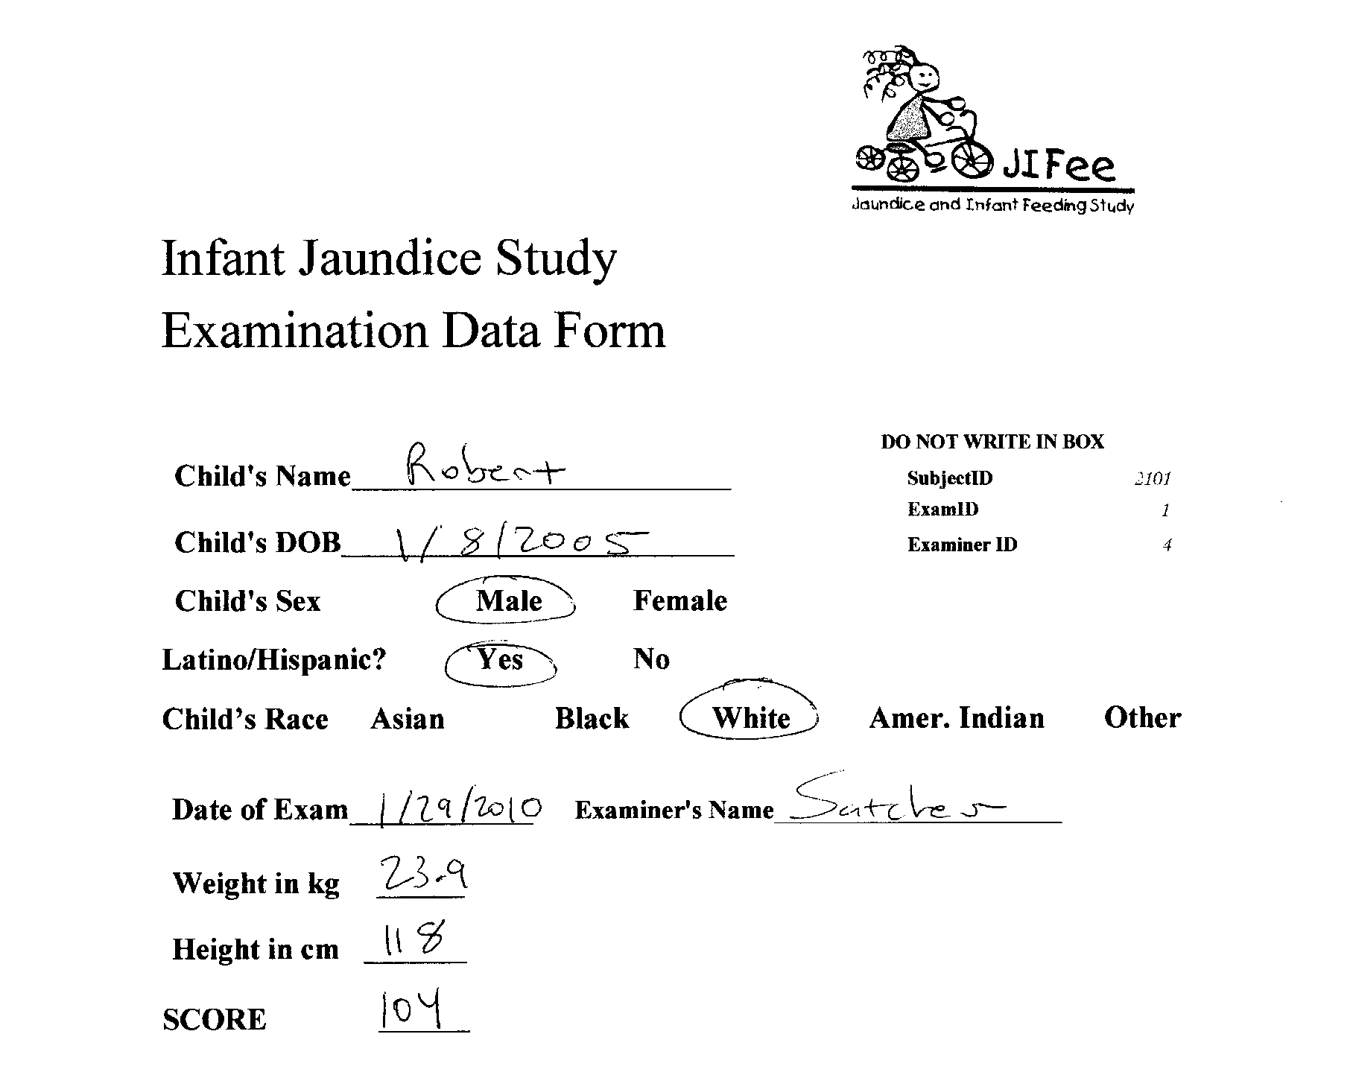

Slide 6
Demonstration: Creating a Data Table
Label columns and enter rows of data in datasheet view
Where is predictor on data collection form?

Slide 7
Demonstration: Data Dictionary
Table design view:
field (=column) names,
data types,
definitions,
validation rules
(More on data types, free-text vs. coded responses, later)

Slide 8
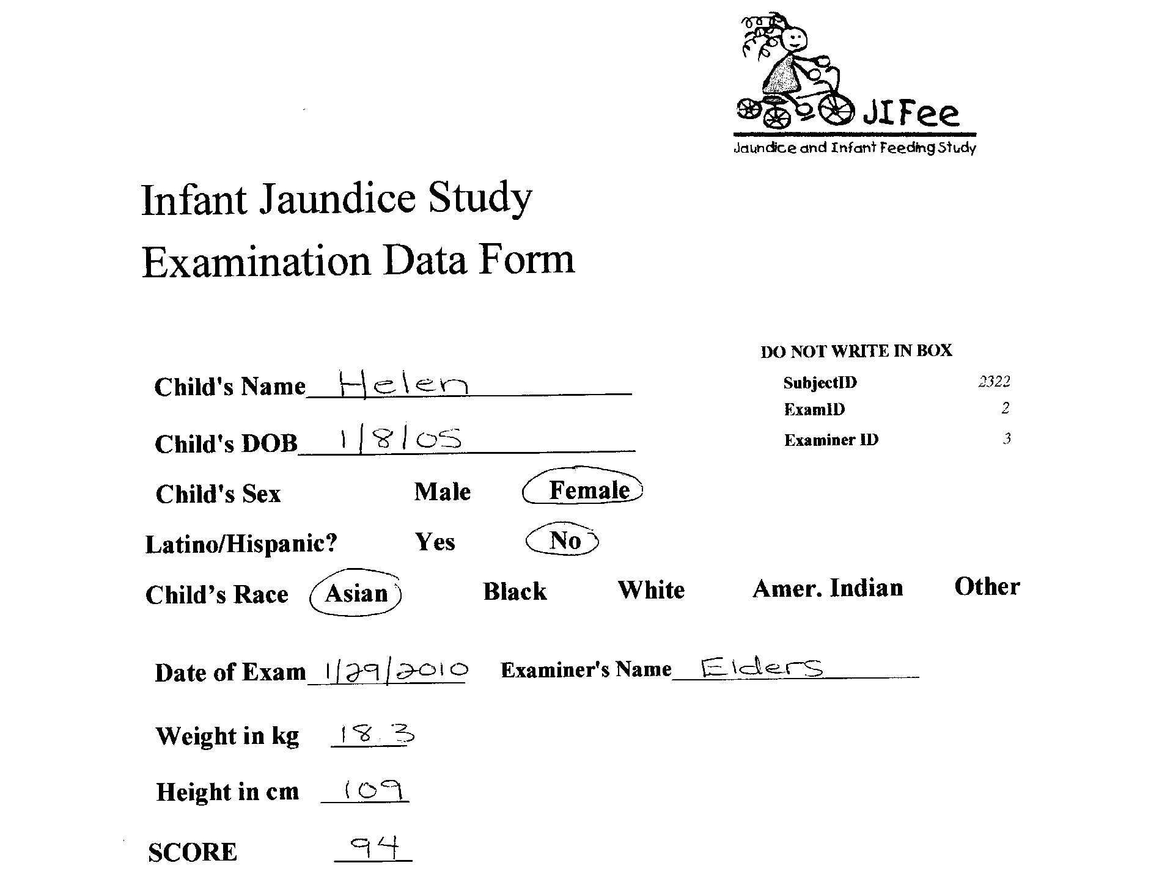

Slide 9
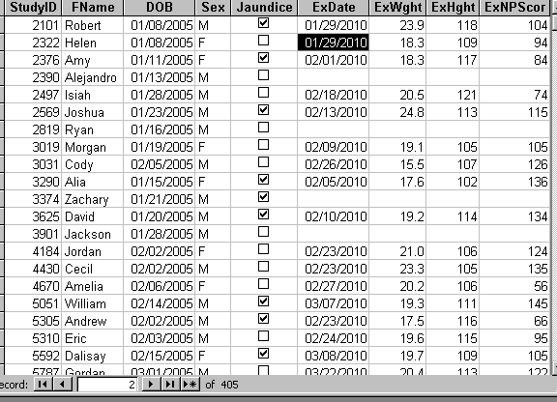
Acceptable table showing one set of exam results per participant.
(BabyExamForFigure3)

Slide 10
Demonstration
Disallowed values
Duplicate primary keys

Slide 11
Loose End: Yes/No fields
Binary fields are not very useful, because you can’t distinguish “No” from blank (not valued).
Create a combo box like we will use for Race in Lab 1 with 0 for “No” and 1 for “Yes”. This allows blank.
Always use 0 for “No” and 1 for “Yes”. This is called an indicator variable. The mean of an indicator variable for an event is the event’s probability of occurring. This is the “Fundamental Bridge” between expected value and probability. – paraphrasing Joseph Blitztein, Introduction to Probability, CRC Press, 2014, p 151. http://projects.iq.harvard.edu/stat110/home

Slide 12
Epi 218 2020
Lecture 4 -- Segment 2
Normalization
  One-to-many relationships
  Primary key, foreign key

Slide 13
Table of Study Subjects
Table of Study Subjects
Row = Individual Infant
Columns = ID#, Name, DOB, Sex, Hyperbilirubinemia
If some subjects have more than one set of measurements, what do you do?

Slide 14
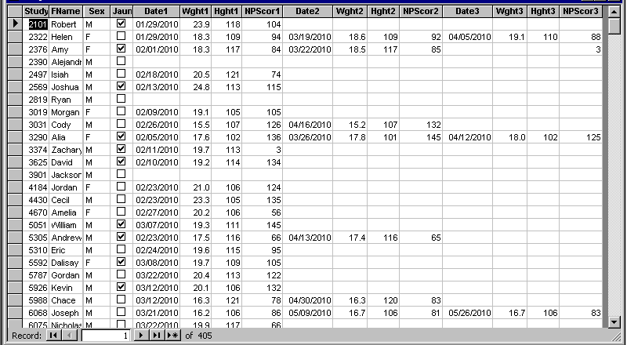
Undesirable table showing multiple exam results per study participant.
(BabyExamForFigure4)

Slide 15
Demo
Find highest IQ Score
Find all exams done in April

Slide 16
Common Error
If you find yourself creating multiple columns for the same measurement, e.g., Date1, Score1, Date2, Score2, Date3, Score3, …
Or if your table is more than about 30 columns wide,
  It is time to restructure your table.

Slide 17
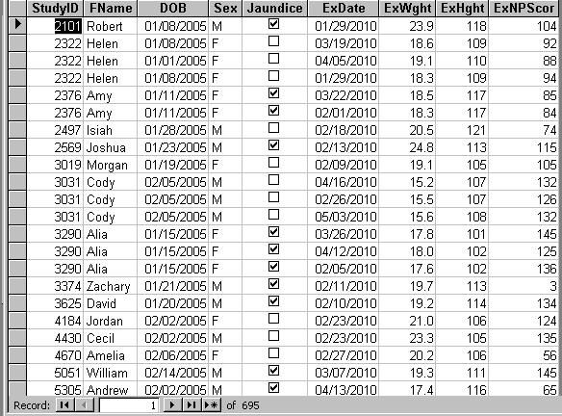
Undesirable table with participant-specific data duplicated for each exam. (Note problem with Helen’s DOB.)
(ExamBabyForFigure5)

Slide 18
Demo
Find highest IQ Score
Find all exams in a particular month
What is Helen’s birth date?
What happened to Alejandro, Ryan, Zachary, and Jackson?

Slide 19
Normalization
If some infants have multiple exams,
“normalize” the records into two tables, one for subjects and one for examinations.

Slide 20
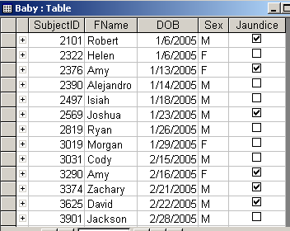
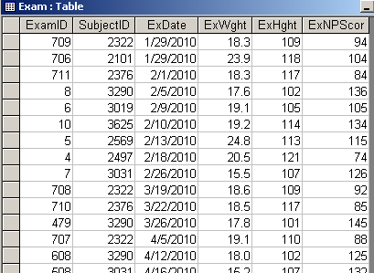
Data normalized into two tables: one (“Baby”) with rows comprising subject-specific information; the other (“Exam”) with rows comprising exam-specific information. Note that Helen can only have one birth date. Subjects with no exams, e.g. Alejandro, still appear in the database. “SubjectID” functions as the primary key in the “Baby” table and as the foreign key in the “Exam” table.

Slide 21
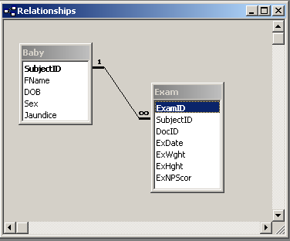
Figure 7. Relationships diagram showing the one-to-many relationship between the table of subjects (“Baby”) and the table of measurements (“Exam”).

Slide 22
Demonstration
Inability to create integrity violations with normalized tables.

Slide 23
Epi 218 2020
Lecture 4 -- Segment 3
Exporting from Access to Stata

Slide 24
Same Table in Stata
Rows = Records; Columns = Fields
Special row at the top for column headings (=field names)
Built-in data dictionary
Automatic validation

