Slide 1
EPI 218 Lecture 5
RDBMS Concepts
Michael A. Kohn, MD, MPP

Slide 2
Epi 218 Lecture 5
Segment 1 -- Front-end (Forms)/Back-end (Tables)
Segment 2 -- Final Project
Segment 3 -- Revisit the concept of the Relational Model and normalization (+ Easter Egg)
Segment 4 – Data entry auditing in REDCap

Slide 3
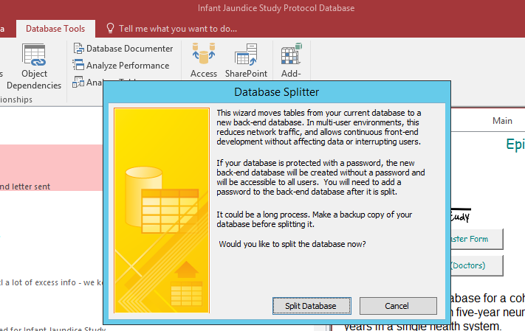
Front End (Forms)/ Back End (Tables)
Notes:
Once you have your tables, forms, queries, and reports in decent shape, you should “split” your database into a back end containing only the tables and a front end containing everything else (forms, queries, and reports). This allows you to work on your front end without interrupting users. You can add new queries and reports and change forms, while they are using an old front end attached to the production data tables. If you change a table, usually by adding a new field, you will have to replace the back-end, which may require stopping data entry.

Slide 4
Epi 218 Lecture 5 Segment 2
Final Project

Slide 5
Epi 218 recommends
Collect data using REDCap instruments
Use Access as the data repository
Export from Access to Stata for analysis

Slide 6
Epi 218 recommends
Collect data using REDCap instruments
  Web-based
  Easy to develop instruments
  Audits data entry

Slide 7
Epi 218 recommends
Use Access as the data repository
  store and manage additional data that does not come in via REDCap instruments
  derive new fields (e.g. parsed fields*)
  query data for study progress and findings
  meet reporting requirements
  link separate projects together

Slide 8
Epi 218 recommends
Export from Access to Stata for analysis

Slide 9
Final Project: Part A
Share, Upload, or Demonstrate Your Data Collection System
Due 9/17/2020
Share or upload a copy of your research study data collection system*.
We prefer a system that you are currently using or will use for a research study.
However, a demonstration or pilot system is acceptable.
*If you are unable to share your system or package it in a file to upload, we can work out another way to review your database.

Slide 10
Final Project: Part A
Send in or Demonstrate Your Study Data Collection System
Due 9/17/2020
If you are doing secondary analysis of data collected by someone else,
obtain the data collection forms* used in the original data collection,
set up a new system that you would use for a follow-up study.
*Often easily obtained by doing a Google search or emailing the author of the original study.

Slide 11
Final Project: Part A
Send in or Demonstrate Your Study Data Collection System
Due 9/17/2020
At least 2 data collection forms/instruments
At least 1 repeatable instrument or event (REDCap) or 1 form/subform (Access)
Include 6 realistic test records or more if necessary to demonstrate system
Format fields and set field types (date, integer, text) appropriately

Slide 12
Final Project: Part B
Submit Your Data Management Plan
Due 9/17/2020
Data collection and entry
  Who will fill out the forms from Part A?
  How and when will they fill them out?
General description of repository (back end) for storage and management of data
  REDCap alone is not adequate
Error checking and data validation
Derivation of new variables, monitoring
Querying and reporting
Security/confidentiality
Back up

Slide 13
Data Repository / Back End
Access – recommended
Other RDBMS – great but more advanced
Stata .dta files -- acceptable
SAS/SPSS files – acceptable
REDCap alone – great front end, but not acceptable for storage and management
Excel – not acceptable

Slide 14
The Relational Model and Normalization
Epi 218 Lecture 5 Segment 3

Slide 15
“Willy”
DOB 2/20/2010 20:18
PEDS questionnaire in 2013, 2014, and 2015*
Neuro Exam and WPPSI in 2015
7 contacts in call log
Neonatal bilirubin “trajectory” as follows
* Corrected from earlier lecture

Slide 16
Willy (DOB=2/20/2010 19:18
Cord blood DAT Neg, T bilirubin as follows:
2/21/2010 21:11 11.5
2/22/2010 06:06 15.0
2/23/2010 10:29 24.0
2/23/2010 20:34 25.7
2/24/2010 06:40 25.0
2/24/2010 20:38 22.2
2/25/2010 05:36 21.4

Slide 17
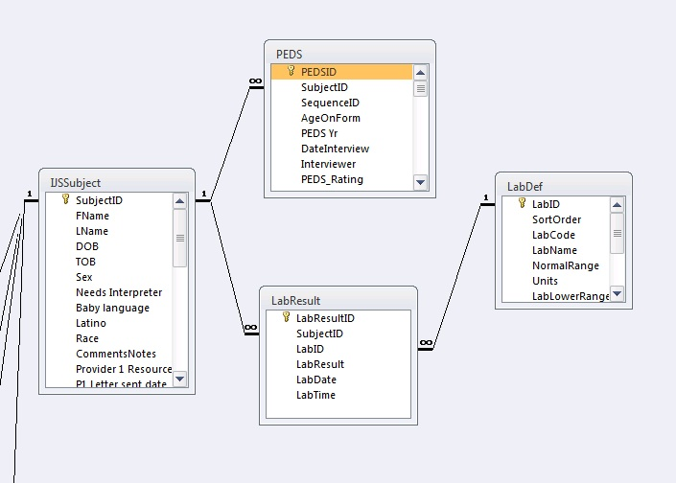

Slide 18
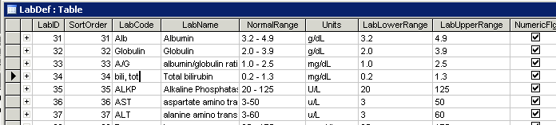
LabDef Table

Slide 19
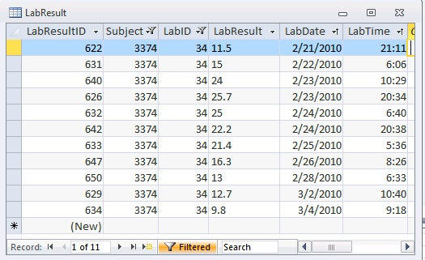
LabResult Table

Slide 20
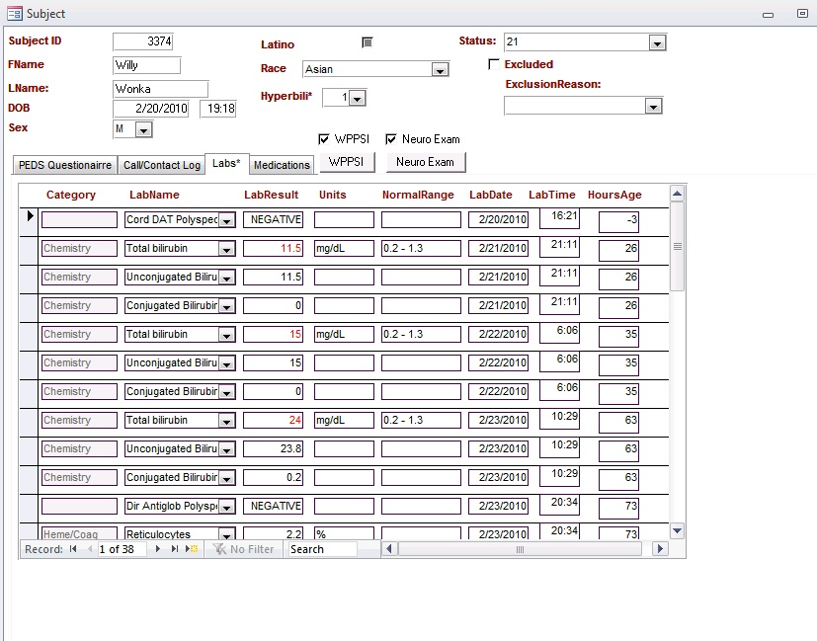

Slide 22
Quiz: Field(s) Storing Willy’s T Bili Results
Which Table?
LabDef
LabResult
PEDS (=Exam table from Lab 4)
Subject
None of the above

Slide 23
Quiz: Field(s) Storing Normal Range for T Bili
Which Table?
LabDef
LabResult
PEDS (=Exam table from Lab 2)
Subject
None of the above

Slide 24
Quiz: Fields for Birth Weight and Gestational Age
Which Table?
LabDef
LabResult
PEDS (=Exam table from Lab 4)
Subject
None of the above

Slide 25
Quiz: Fields for List of Interviewers for PEDS Questionnaire
Which Table?
LabDef
LabResult
PEDS (=Exam table from Lab 4)
Subject
None of the above

Slide 26
RDBMS and SQL
All RDBMS’s are SQL based
Oracle
SalesForce.com (originally RDBMS.com)
Microsoft SQL Server
MySQL
Microsoft Access

Slide 27
Select Queries
Select queries (aka “Views”) organize, sort, filter, and display data.
Queries use (SQL), but you don’t have to learn it, because of graphical query design tools.
A query can join data from two or more tables, display only selected fields, and filter for records that meet certain criteria.

Slide 28
Demonstration
Show T Bili trajectory of all hyperbili subjects with age in hours
(time permitting) “Select/Group By” query showing maximum bilirubin for each hyperbili subject
(MAKTbili, MAKTbiliMax, MAKTbiliMaxHoursOld, MAKTBiliMaxHoursOldSummary)

Slide 29
Select Queries Produce “Table-Like” Results
Note that the result of a select query that joins two tables, displays only certain fields, selects rows based on special criteria, and calculates age and BMI still looks like a table in datasheet view.
But, remember that it is a dynamic “view” of data from the underlying tables.

Slide 30
Undesirability of Storing Calculated Values
Store raw data, not calculated fields, e.g., store dates and times; calculate intervals.
Storing a patient’s birth date allows calculation of his or her exact age on the date of a particular measurement.

Slide 31
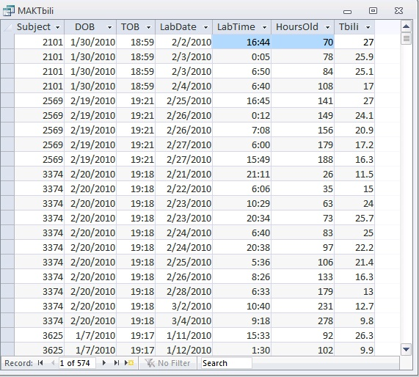
Storing calculated fields such as “HoursOld” is undesirable. What if the Time of Birth for SubjectID 3374 (Willy) is corrected in the “Subject” table?

Slide 32
“Action Queries” Change Data
Update Query -- changes the values of specific fields in existing records
Append (Insert) Query -- adds new records (rows) to a table
Delete Query -- deletes records from a table

