Slide 1
Repeated Measures, Lecture 2, Part 1
Charles E. McCulloch,
Division of Biostatistics,
Dept of Epidemiology and Biostatistics,
UCSF

Slide 2
Outline
Two overarching analysis approaches to accommodating correlation: Generalized estimating equations (GEE) and mixed models.
Longitudinal designs
Lecture 2 covers numerical outcomes, so the analogs of linear regression.
Part 1: GEE (xtgee) methods
Summary

Slide 3
Analyses for correlated data
Generalized estimating equations (GEEs)
  Stata xtgee
Mixed effects (ME) models
  Stata meglm
  Or specialized routines for different outcome types
    Numeric (mixed)
    Binary (melogit, meprobit)
    Count (mepoisson)
    Ordered categorical (meologit, meoprobit)
Interpretations are virtually the same for corresponding correlated and non-correlated analyses (linear/linear, logit/logit)
Notes:
Focus on use of the two main repeated measures routines in Stata (xtgee and mixed). There are many others.

Slide 4
Analyses for correlated data
Generalized estimating equations (GEEs)
  Only works for one level of clustering (e.g., patients).
  Requires largish number of clusters (ideally > 50) and works best when the number of clusters >> number of observations per cluster.
  Does not require modeling of the correlation when using “robust” standard errors.
  No overall measure of model fit like likelihood or R².
  Less robust than mixed effects models to possible bias due to missing data or dropout.
Notes:
Only works with a “single” level of clustering, but can loosen that by clustering at the “top” level. For example with two compartments per two knees (and only one time point) can work with clusters of size 4 as long as we have, say, 50 people.
Key is the second point. If we have 50 people, xtgee will be fine with two compartments per two knees per person as a cluster of size 4. But would work less well with 7 visits within 16 compartments within two knees = 7*16*2 = 224 per person with only 50 people. Now the number of observations per person is quite a bit larger than the number of people.

Slide 5
Analyses for correlated data
Mixed models
  Can handle a wider variety of data structures. For example times within patients within doctors or compartments within knees within time within subjects.
  Requires modeling the correlation.
  Gives additional information about the correlation.
  Based on likelihood fits, so can conduct likelihood ratio tests to compare two model fits.
  More robust to potential bias due to missing data and dropout.
Notes:
Contrasting the advantages/disadvantages of mixed models.

Slide 6
Consider first longitudinal data
Longitudinal design: Individuals (interpreted broadly) are measured repeatedly over time.
Key features: Can analyze change over time within an individual.
GEE methods are a very common approach for longitudinal data when there are large numbers of individuals and not so many repeated measurements.
Notes:
What are the advantages of looking at change within individual with respect to causal inference?

Slide 7
Measuring change
Notes:
Positive association between age and cognitive functioning??

Slide 8
Modified Mini-mental State Exam
Numerical score from 0 to 100
Tell patient “I'd like to test your memory; say these words: boat, cucumber, wire” (up to 3 points for 3 correct answers)
Tell patient “Begin with 100 and count backwards by 7” (up to 5 points for five correct answers)
Tell patient “Can you name the three objects I named before?” (up to 3 points for 3 correct answers)

Slide 9
Measuring change
Notes:
Same diagram, but now get a completely different impression. Namely that functioning decreases with age.

Slide 10
Analyzing change with longitudinal data
Example (SOF): It is well known that women who are overweight and obese have higher bone density. However, is the change in bone mineral density related to whether a woman is obese at baseline? We will define obese as BMI > 30.
How should we get started?

Slide 11
Example: SOF basics
. xtset id visit
panel variable: id (unbalanced)
time variable: visit, 2 to 8, but with gaps
delta: 1 unit
. xtdes
id: 10001, 10002, ..., 42486 n = 8590
visit: 2, 4, ..., 8 T = 5
Delta(visit) = 1 unit Span(visit) = 7 periods
(id*visit uniquely identifies each observation)
Distribution of T_i: min 5% 25% 50% 75% 95% max
1 1 2 3 5 5 5
Freq. Percent Cum. | Pattern
---------------------------+---------
2275 26.48 26.48 | 1.111.1
1734 20.19 46.67 | 1.111..
1696 19.74 66.41 | 1......
926 10.78 77.19 | 1.11...
….
99 1.15 90.94 | 1.1.1..
89 1.04 91.98 | 1..11.1
689 8.02 100.00 | (other patterns)
---------------------------+---------
8590 100.00 | X.XXX.X
Notes:
Start with the descriptive statistics we introduced last time. Note visit names are relatively arbitrary (they aren’t years into the study). And total BMD was not measured at each visit.

Slide 12
Example: Individual BMD plots

Slide 13
Example: BMD/Obesity
Notes:
Let’s look at the BMD example. Usually start with a scatterplot to assess linearity and distribution of outcome. I like superimposing a LOWESS curve, which fits a smooth line, but does not make any further assumptions about the form of the relationship. Differences between groups (on average) hard to see since small in relation to variance. So let’s look at mean values.

Slide 14
Example: BMD/Obesity
Notes:
Here are the plots just of the mean values.

Slide 15
Analyzing change with longitudinal data
Including a variable for time (or visit) describes the change over time.
Inclusion of time (or visit) interactions with baseline predictors allows analysis of whether baseline predictors are associated with change over time.
Inclusion of a time-varying predictor (e.g., BMI at sequential visits) allows analysis of whether change in that predictor is associated with change in the outcome.
Notes:
Average change per unit time is described by the coefficient of time (or per visit). To see if a factor predicts change, include an interaction with time. Does younger age at meno predict faster change? Include an age at meno by time interaction.
More detail on time-varying predictor in a bit.

Slide 16
How to handle “time” in a longitudinal analysis
We often try to model the shape of the change in the outcome over time.
There is a natural “ladder” of handling a time predictor like visit, moving from simpler (to model and interpret) and more restrictive to more flexible: linear, quadratic, spline (flexible smooth fit), categorical.
Moving up the “ladder” is a simple way to test adequacy of the simpler model.
Notes:
E.g., linear is easy to fit, easy to interpret, but highly restrictive.
Just test for statistical significance of higher step on ladder. For example, compare linear to spline. If spline is statistically signficant then you need a nonlinear term in the model.

Slide 17
Example: BMD/Obesity
Want to characterize the change over time and see if it is the same or different between the obese and non-obese.
Plot suggests that the trend might not be linear over time.
So we need to check.

Slide 18
Example: BMD/Obesity
. xtgee totbmd visit##obese, i(id) robust
GEE population-averaged model Number of obs = 26829
Group variable: id Number of groups = 8468
Link: identity Obs per group: min = 1
Family: Gaussian avg = 3.2
Correlation: exchangeable max = 5
Wald chi2(9) = 3733.60
Scale parameter: .0169246 Prob > chi2 = 0.0000
(Std. Err. adjusted for clustering on id)
------------------------------------------------------------------------------
| Robust
totbmd | Coef. Std. Err. z P>|z| [95% Conf. Interval]
-------------+----------------------------------------------------------------
visit |
4 | -.0164933 .0004961 -33.25 0.000 -.0174655 -.015521
5 | -.0270842 .0006331 -42.78 0.000 -.028325 -.0258434
etc.
Summary information about hierarchy
Overall model test (rarely useful)

Slide 19
Example: BMD/Obesity
If there are interactions between two variables in the model, the “main effect” of each of those variables is the effect when the other is at its reference value.
------------------------------------------------------------------------------
| Robust
totbmd | Coef. Std. Err. z P>|z| [95% Conf. Interval]
-------------+----------------------------------------------------------------
visit |
4 | -.0164933 .0004961 -33.25 0.000 -.0174655 -.015521
5 | -.0270842 .0006331 -42.78 0.000 -.028325 -.0258434
6 | -.0383912 .0007898 -48.61 0.000 -.0399392 -.0368432
8 | -.0513558 .001284 -40.00 0.000 -.0538725 -.0488391
|
1.obese | .033644 .0018641 18.05 0.000 .0299904 .0372976
|
visit#obese |
4 1 | .0064715 .0014952 4.33 0.000 .0035411 .009402
5 1 | .0044571 .0017778 2.51 0.012 .0009727 .0079415
6 1 | .0057885 .0021825 2.65 0.008 .0015108 .0100661
8 1 | .0008468 .0032882 0.26 0.797 -.005598 .0072916
|
_cons | .7410788 .0013913 532.65 0.000 .7383519 .7438057
------------------------------------------------------------------------------
On average, BMD drops by .0165 from visit 2 to visit 4 in the non-obese
On average, BMD drops by .051 from visit 2 to visit 8 in the non-obese
On average, BMD is higher by 0.033 for the obese at visit 2.
The difference in the drop for obese v. non-obese between visits 2 and 4 is 0.0064
Notes:
-0.0164 = BMD drops by 0.0164 between visits 2 and 4 for the non-obese (reference group)
-0.0513 = BMD drops by 0.0513 between visits 2 and 8 for the non-obese
0.03364 = BMD is higher by .0336 for the obese at visit 2 (reference group)
0.0064615 = difference in the drops between visits 2 and 4 for obese compared to non-obese is 0.0065. Drop in non-obese is 0.0165, so drop in obese must be 0.01 (from -0.0164933+0.0064715 = -0.01002 or by subtraction -0.01 – [-0.0165] = 0.0065)

Slide 20
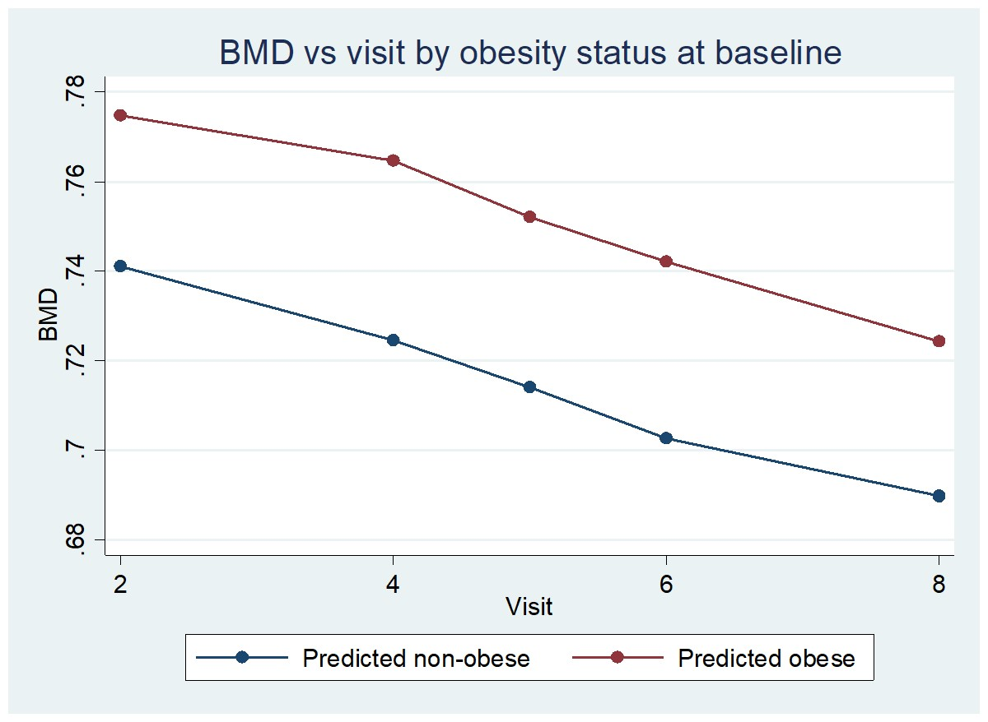
Example: BMD/Obesity
0.0100 = visit 4 effect in obese
0.033 = “obesity” effect
0.0165 = visit 4 effect in non-obese
Difference in drops is
-0.010-(-0.0165)= 0.0065

Slide 21
Example: If you prefer tables
. margins visit#obese
Adjusted predictions Number of obs = 26,829
Model VCE : Robust
Expression : Linear prediction, predict()
------------------------------------------------------------------------------
| Delta-method
| Margin Std. Err. z P>|z| [95% Conf. Interval]
-------------+----------------------------------------------------------------
visit#obese |
2 0 | .7410788 .0013913 532.65 0.000 .7383519 .7438057
2 1 | .7747228 .0021152 366.27 0.000 .7705771 .7788684
4 0 | .7245855 .0014573 497.22 0.000 .7217293 .7274418
4 1 | .764701 .0019559 390.97 0.000 .7608676 .7685345
5 0 | .7139946 .0015048 474.47 0.000 .7110452 .7169441
5 1 | .7520958 .0019877 378.37 0.000 .7481999 .7559916
6 0 | .7026876 .0015825 444.04 0.000 .699586 .7057892
6 1 | .7421201 .0021336 347.82 0.000 .7379382 .7463019
8 0 | .689723 .0018483 373.17 0.000 .6861005 .6933456
8 1 | .7242138 .0030273 239.22 0.000 .7182803 .7301473
------------------------------------------------------------------------------
. *Drop in obese group from visit 2 to 4 is from .7747228 to .764701
. di .764701-.7747228
-.0100218
Notes:
Margins command is very useful for getting mean predicted values adjusting for other covariates.

Slide 22
Back to the science: BMD/Obesity
. testparm visit#obese
( 1) 4.visit#1.obese = 0
( 2) 5.visit#1.obese = 0
( 3) 6.visit#1.obese = 0
( 4) 8.visit#1.obese = 0
chi2( 4) = 22.20
Prob > chi2 = 0.0002
The rate of change in BMD during the study is different for the obese and non-obese. The obese change less (since all the interaction coefficients are > 0).

Slide 23
Back to the science:
Checking the linearity assumption
. xtgee totbmd c.visit##obese visit##obese, i(id) robust
. testparm visit#obese
( 1) 4.visit#1.obese = 0
( 2) 5.visit#1.obese = 0
( 3) 6.visit#1.obese = 0
chi2( 3) = 19.02
Prob > chi2 = 0.0003
The categorical interaction is statistically significant after fitting linear, therefore linear inadequate. Stick with categorical visit variable.
Notes:
Here we include both a linear term (c.visit#obese) that is allowed to vary by obese/non-obese. And a categorical visit term that makes no assumptions about the form of the changes over time (or its dependence on obesity). As usual, the test of one term in the model is adjusted for all the others. So, in particular, the categorical fit is adjusted for the linear. Because it is still statistically significant when accounting for a linear relationship, there is evidence for nonlinearity. Need to stick with a model with a categorical time variable and cannot simplify to linear.

Slide 24
Example: BMD/BMI (time varying predictor)
Including a time-varying predictor automatically models a change over time
BMD_{t} = b0+b1*BMI_{t} implies
BMD_{t} – BMD_{t-1} = b1*(BMI_{t} – BMI_{t-1})
So change in BMD is predicted by change in BMI.
Notes:
So you do not need to include interactions with time for a time-varying predictors (as distinct from a time-invariant predictor).

Slide 25
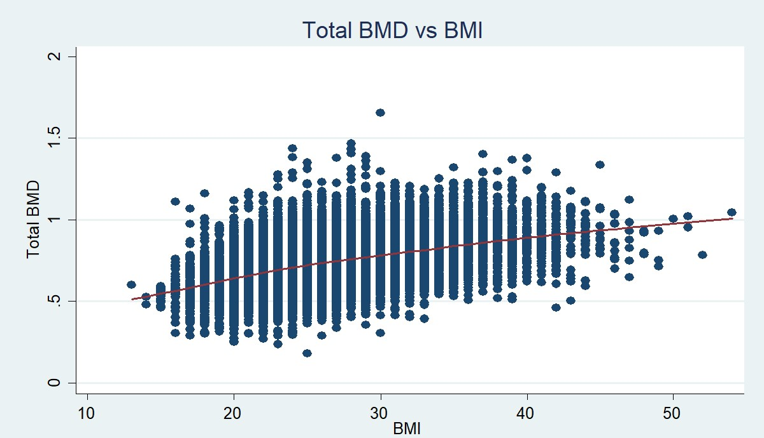
Ex 2: BMD/BMI (time varying predictor)
Does BMI predict total BMD? LOWESS plot
Notes:
Now turn to a time-varying predictor.

Slide 26
Example 2: xtgee
. xtgee totbmd bmi, i(id) robust
GEE population-averaged model Number of obs = 26,829
Group variable: id Number of groups = 8,468
Link: identity Obs per group:
Family: Gaussian min = 1
Correlation: exchangeable avg = 3.2
max = 5
Wald chi2(1) = 1639.11
Scale parameter: .0146148 Prob > chi2 = 0.0000
(Std. Err. adjusted for clustering on id)
------------------------------------------------------------------------------
| Robust
totbmd | Coef. Std. Err. z P>|z| [95% Conf. Interval]
-------------+----------------------------------------------------------------
bmi | .0091548 .0002261 40.49 0.000 .0087116 .009598
_cons | .4890844 .0060705 80.57 0.000 .4771865 .5009823
------------------------------------------------------------------------------
Notes:
Hard to interpret when you don’t know the units. Highly statistically significant but large sample size. Important?

Slide 27
Example 2: Standardize
. egen bmi_std=std(bmi)
. egen totbmd_std=std(totbmd)
. xtgee totbmd_std bmi_std, i(id) robust
(Std. Err. adjusted for clustering on id)
------------------------------------------------------------------------------
| Robust
totbmd_std | Coef. Std. Err. z P>|z| [95% Conf. Interval]
-------------+----------------------------------------------------------------
bmi_std | .3218237 .007949 40.49 0.000 .3062439 .3374035
_cons | -.0317306 .0096224 -3.30 0.001 -.0505903 -.012871
------------------------------------------------------------------------------
A one standard deviation change in BMI is associated with a .3 standard deviation change in total BMD.
So a small to moderate sized effect using the usual rules of thumb (0.2 = small, 0.5 = medium 0.8 = large).
Notes:
Note – no change in statistical significance since the association has the same strength with scaling.

Slide 28
Example 2: Check linearity
Assess linearity in BMI
. xtgee totbmd_std c.bmi_std##c.bmi_std, i(id) robust
--------------------+----------------------------------------------------------------
bmi_std | .3362406 .0077491 43.39 0.000 .3210527 .3514284
|
c.bmi_std#c.bmi_std | -.0179974 .0041768 -4.31 0.000 -.0261838 -.0098111
|
_cons | -.0131305 .0103411 -1.27 0.204 -.0333986 .0071377
-------------------------------------------------------------------------------------
Since a quadratic term is statistically significant, the linearity in BMI assumption is not correct. Is it an important deviation? A plot of the predicted values versus BMI shows that the quadratic effect is minimal.

Slide 29
Longitudinal analysis strategy
Assess if a predictor is time-varying or time-invariant (use xtsum if you don’t know)
Time-varying (like BMI) – just include it as a predictor.
Time-invariant (like obesity at baseline) – include it in the model as well as the interaction of that variable with the time variable. A longitudinal relationship is tested by testing the interaction.

Slide 30
Summary
Approximately normally distributed outcomes can be handled with mixed models (mixed) or generalized estimating equations (xtgee).
Mixed models have the advantage of handling multiple levels of clustering and more explicit modeling of sources of variability and correlation. Better with missing data.
Generalized estimating equations (when using the robust option) makes fewer assumptions.

