Slide 1

Biostat 202: Opportunities and Challenges of “Big Data”

Slide 2
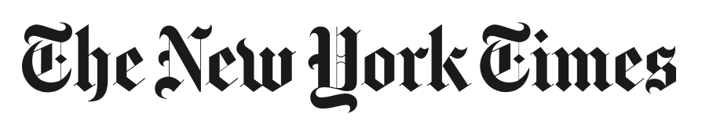
That was just for fun, but

Slide 3
That was just for fun, but

Slide 4
Thought #1
Big data and data mining can be used for good or evil.

Slide 5
Biostat 202: Opportunities and Challenges of “Big Data”
Aaron Wolfe Scheffler,
Division of Biostatistics,
Department of Epidemiology and Biostatistics
Biostat 202

Slide 6
Course outline
Introduction
Getting data (large databases, electronic health records)
Managing data
Algorithms (prediction, clustering)
Variable importance
Causal inference and big data
Describing data with tables and figures
Case studies

Slide 7
Is this course for you?
High-level survey course
Fast, comprehensive, but not deep
No programming, graphical computer interface
Not statistics!
Goal: teach basic fluency in language and methods of machine learning/data mining in big data
More details on the syllabus

Slide 8
Outline for today
What is big data? And since computers are so fast these days, is it really any different than what we have been doing all along?
Data mining.
Causality versus prediction.
Overfitting and spurious associations.

Slide 9
Is Big Data new?
My father was also statistician (b. 1949).
Worked with scans
from early GE CT
machine (~ 1984)
Images were Gb and had to be stored on main-frame in the hospital!
Notes:
Photo credit: https://radiologykey.com/computed-tomography-8/

Slide 10
Is Big Data new?
So even in my father’s time, he had “big” data.
Scan needed to be put onto 12 inch floppy disk and physically mailed to doctor’s office, compressed first.
Today it goes to the cloud, straight to iPad!
Notes:
Photo credit: https://www.ibm.com/ibm/history/exhibits/mainframe/mainframe_PP4381.html

Slide 11
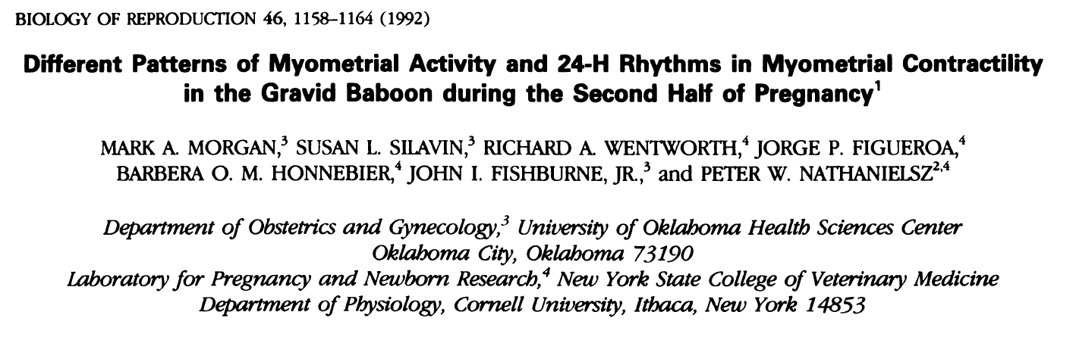
Big Data in the 1990s
Methods: Continuous EMG …were sampled at 32 Hz … Fast Fourier Transform and power spectrum analysis were performed …to quantify myometrial activity as contractures or contractions.
Notes:
In the 1980s and 1990s I worked with Peter Nathanielsz (MD, PhD, DVM) and his group studying determinants of premature birth. He would hook up electrical leads to monitor muscle movement and distinguish contractions from other movements.

Slide 12
Big Data in the 1990s
13 baboons studied.
At least two electrical leads per animal.
Up to 67 days of observation.
Record electrical activity of uterine muscles 32 times per second
About 4.8 billion data points (~4.5 GB)
Notes:
4 GB was well beyond the storage capacity of those days (Volume). Instead we summarized data as we went (using a Fast Fourier transform) and periodically saved those results. Also Velocity: we needed hardware to summarize the data, couldn’t do it using software.

Slide 13
Thought #2
Big data isn’t the same as big information.
In this example, 4.8 billion data points from only 13 animals.
Notes:
Only 13 animals.

Slide 14
Data isn't information. ... Information, unlike data, is useful. While there’s a gulf between data and information, there’s a wide ocean between information and knowledge. What turns the gears in our brains isn't information, but ideas, inventions, and inspiration. Knowledge—not information—implies understanding. And beyond knowledge lies what we should be seeking: wisdom.
— Clifford Stoll, High-Tech Heretic: Reflections of a Computer Contrarian (2000), pp. 185-186.
Notes:
https://en.wikipedia.org/wiki/Clifford_Stoll: Clifford Stoll, astronomer.

Slide 15
What is “Big Data” today?
Electronic health records (EHR).
Data collected electronically at a personal level (e.g., Fitbit monitors).
Web based surveillance (e.g., Google Flu Trends).
Imaging data (e.g., CAT Scan, MRIs).
Digital Exhaust (noun). Unstructured information or data that is a by-product of the online activities of Internet users.
Omics data (e.g., genomic, proteomic, or exposome)

Slide 16
What is “Big Data” today?
Is “big data” really any different than what we have been doing for decades other than a steady increase in volume?
Yes
Handling poor quality and heterogeneous data.
Harder to practice reproducible research.
Dealing with data “velocity.”
Possibility of real time decision making.
Algorithmic association detection. “Data mining” and “machine learning.”
Notes:
Just finished workding on a project merging Medicare data with data collected in a cohort study. Took 2.5 years to refine the algorithms for doing things like deciding on short versus long term nursing home stays.
Can’t “look at your data”. Need sophisticated visualization techniques to try to understand it and deal with anomalous data points.

Slide 17
Why data mining?
Example: OA biomarkers project (one of the project datasets).
In a cohort of individuals at risk for knee osteoarthritis, can we predict who will go on to develop painful knee arthritis?
Full study has 1000s of predictors
  measurements of the knee based on Xray (width of the space between bones at many locations)
  MRI (degree of degeneration in various locations of the cartilage)
  blood sample (numerous bone turnover markers)…
Notes:
Can’t manually build models in cases where there are a plethora of possible variables to include. Even with the simplest linear models and 40 predictors there are 2^40 = 1.1x10^12 possible models (2^40). If you could look at one model a second 24 hours a day it would take you about 35,000 years to consider them all. Many current projects have many more than 40 predictors and consider models that are much more complicated.

Slide 18
Why data mining?
Building a model to predict painful knee osteoarthritis with, say, 30 predictors. Since each predictor can be in or out of the model, there are 2³⁰ possible models. Suppose you could review 1 per second:
2³⁰ = 1.1 x 10⁹ seconds
= 18 million minutes
= 300,000 hours
= 12,500 days
= 34 years to check them all

Slide 19
Why data mining?
Example: decision tree algorithm for OA biomarkers subset

Slide 20
Not just a fad
Patient Centered Outcomes Research Institute
Has funded 33 health data networks (PCORnet) to the tune of $140m that link together electronic health record systems in order (in part) to conduct:
“observational studies of multiple research questions, including prevention and treatment, at low marginal cost”
by leveraging
“data from real-world clinical experiences of patients within their system”
Notes:
Here is a lot of hype surrounding big data and data mining.
From the PCORI “National Priorities for Research and Research Agenda” downloaded from
http://www.pcori.org/assets/PCORI-National-Priorities-and-Research-Agenda-2012-05-21-FINAL.pdf
On 7/11/12

Slide 21
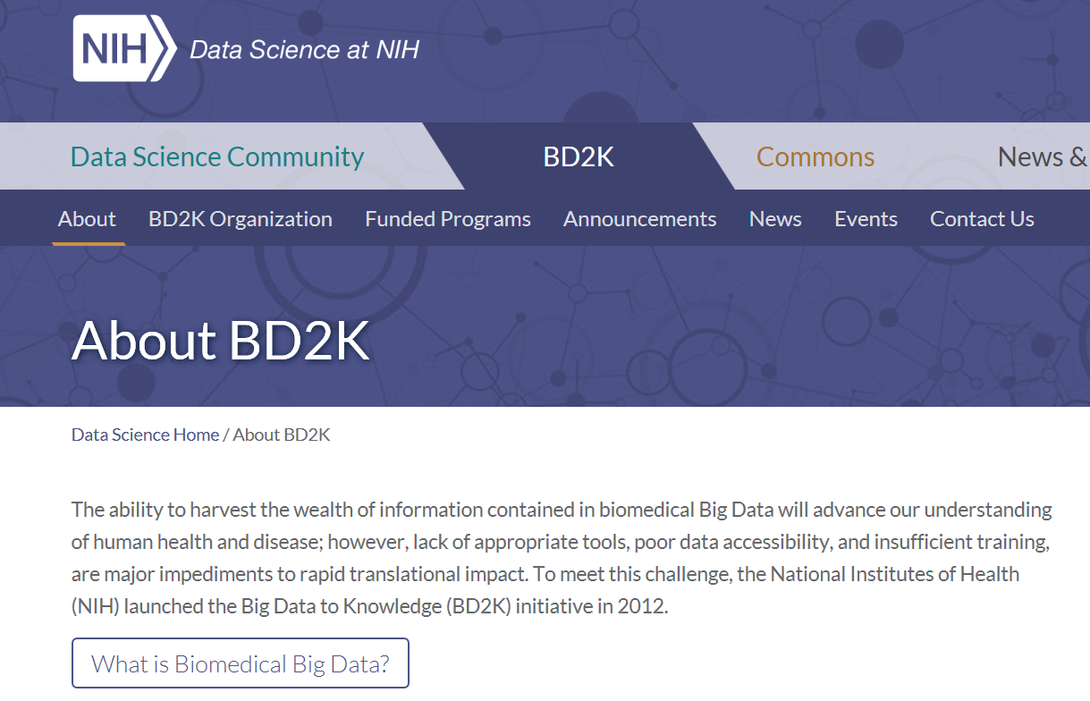
Not just a fad

Slide 22
Not just a fad
The advantages of large datasets are undeniable:
Ability to fit flexible models.
Ability to investigate heterogeneity and subgroups. “Precision medicine.”
Easy to validate predictive rules.
High precision.

Slide 23
Not just a fad
The advantages of large datasets are undeniable:
Ability to fit flexible models.
Ability to investigate heterogeneity and subgroups. “Precision medicine.”
Easy to validate predictive rules.
High precision.
But there are a number of caveats.
Notes:
Next slide: But they aren’t a cure-all

Slide 24
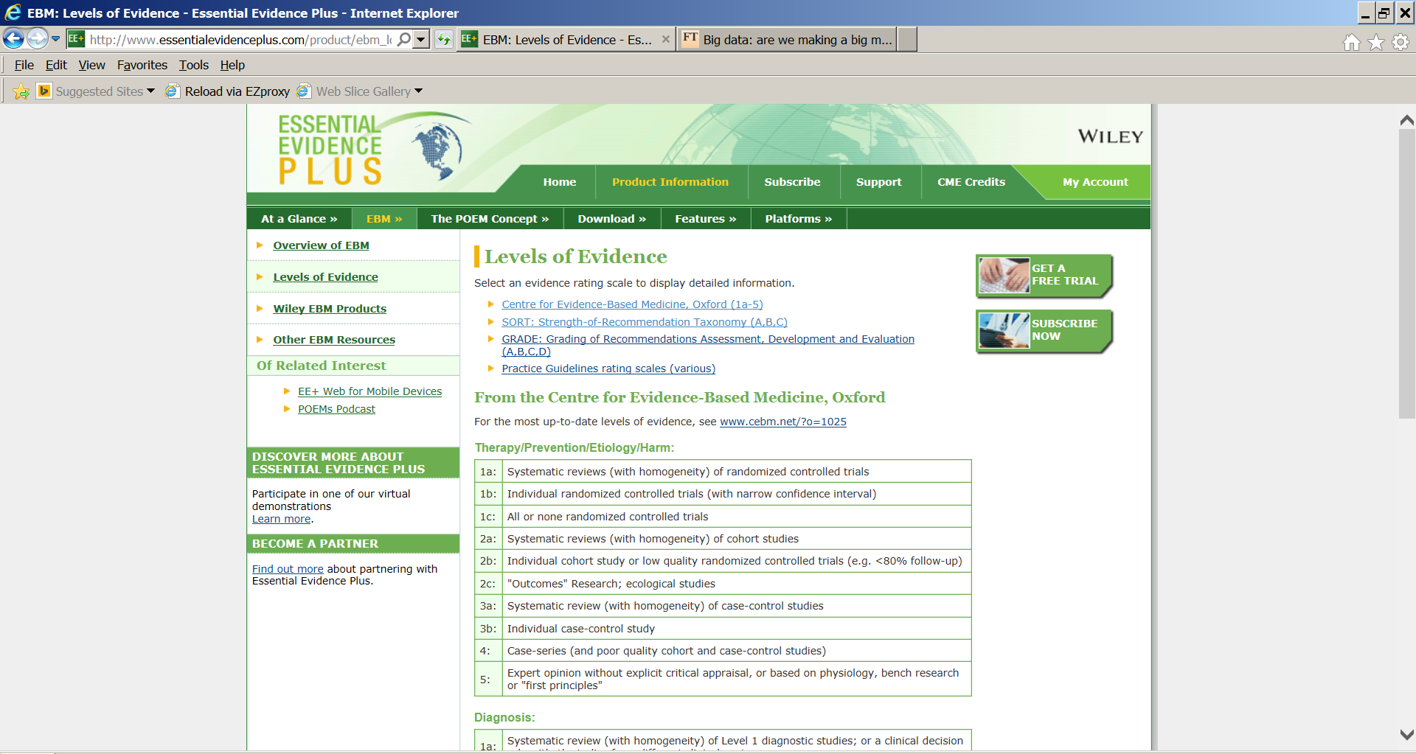
Osteoarthritis Initiative
Electronic health record based study
Notes:
Many venues of science rate the “quality” of evidence. Here is a typical classification of the type of study.
Most of the examples of big data are observational studies not designed for research purposes. That puts us way down on the list and suggests we need to take care.

Slide 25
Big Data – more is better, right?
Why does data quality vary?
In 1936, the Literary Digest conducted a presidential poll (Landon v. Roosevelt). They mailed 10 million postcards and received 2.4 million back.
Notes:
Example taken from Statistics by Freedman, Pisani, and Purves (https://www.amazon.com/Statistics-Fourth-David-Freedman-ebook/dp/B00SLB5Q72)

Slide 26
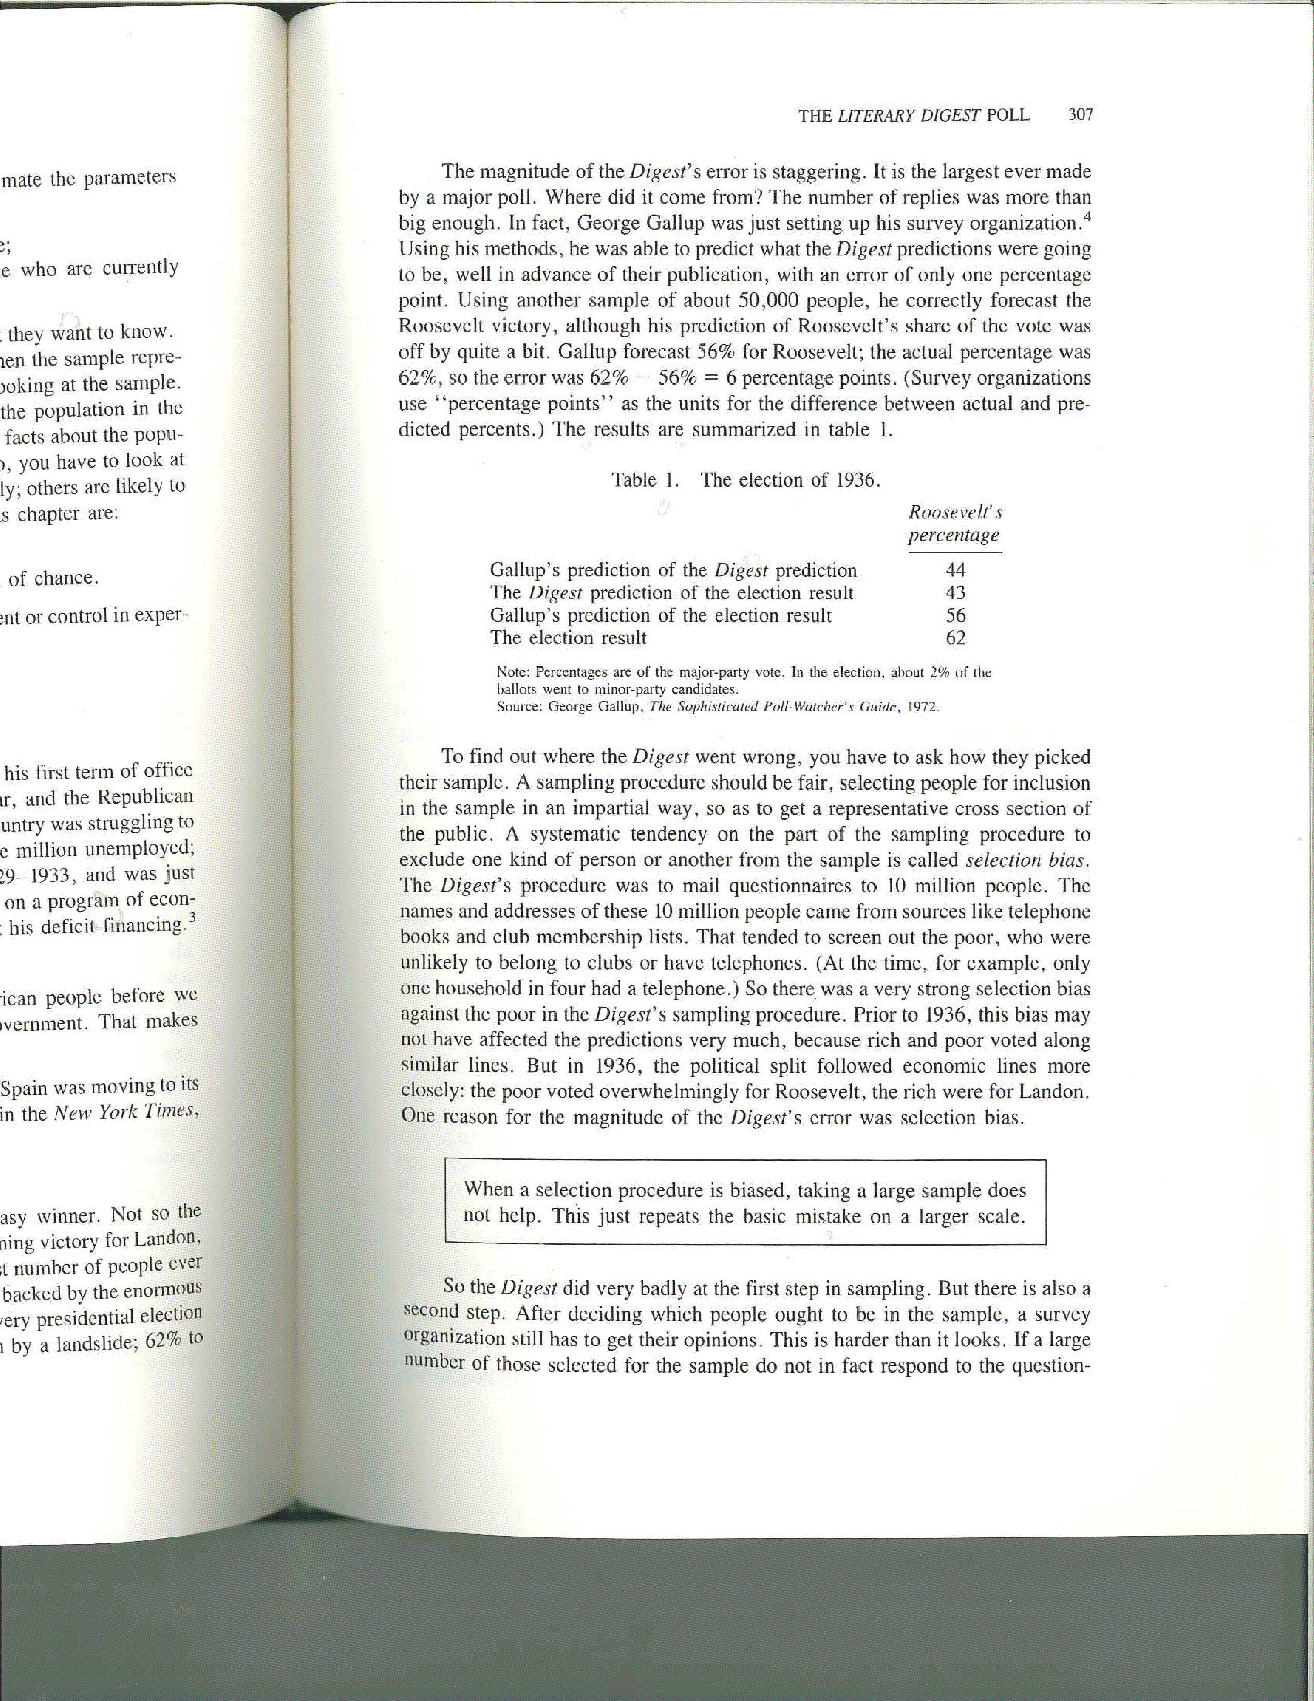
The Literary Digest Poll
Literary Digest collected 2.4 million responses and projected a solid victory for Alf Landon.
George Gallup surveyed 50,000 individuals and predicted a solid victory for Roosevelt

Slide 28
Thought #3
Having big data doesn’t help if it was selected in a biased way.

Slide 29
Prediction versus causality
Correlation (prediction): measure of the strength and direction of the relationship between two variables
Causation: Will intervening upon X change occurrence of Y?
Notes:
Photo credit: https://towardsdatascience.com/correlation-is-not-causation-ae05d03c1f53

Slide 30
Prediction versus causality
Everyone in the science community understands the difference between causation and correlation.
Data-mining and machine learning algorithms are only based on correlations.
In my work on research projects, pure prediction problems make up only a small portion.
Usually interested in causation, i.e., understand the cause of illness or develop interventions that cause improvement.

Slide 31
Some bona fide prediction problems
Early detection of cancer.
Identifying high risk patients for closer monitoring. For example, patients likely to be readmitted to the hospital within 30 days.
Prediction of disease epidemics.
Key aspects: Not concerned with causal interpretation of the effect of variables included in the model or interpreting presence of absence of the variable in the model causally. Focus on accurate prediction, not p-values and testing.

Slide 32
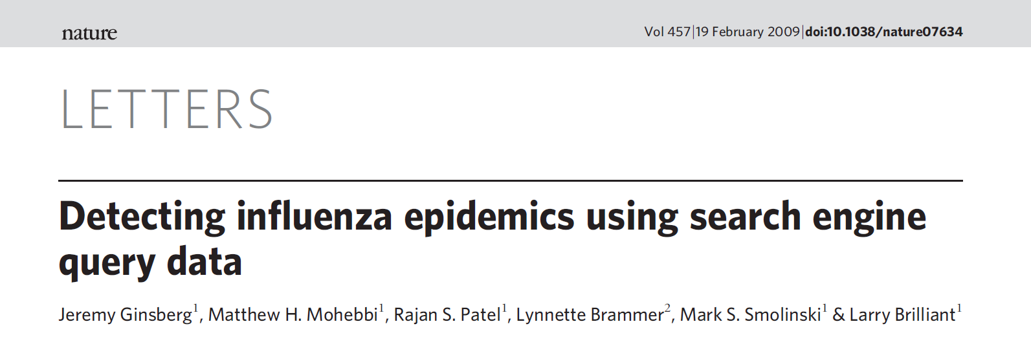
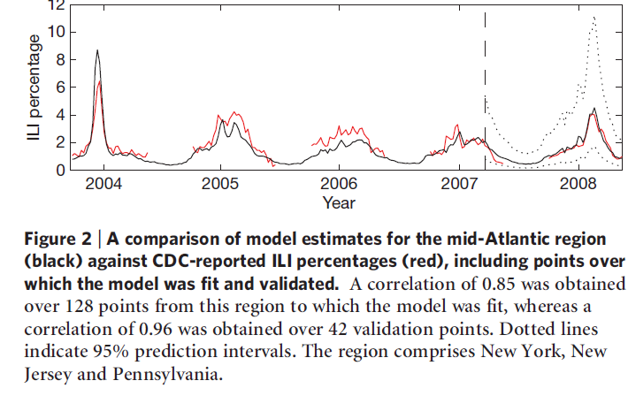
Big Data Prediction: Google Flu Trends
Notes:
Can we use the frequency of Google searches to predict the flu epidemic? For example, monitoring the frequency of a search such as “cold or flu remedy”.

Slide 33
Google Flu Trends
Used “hundreds of billions of searches” to build the model.
Reduced to weekly counts of 50 million common searches for each state for 6 years.
(50 million)*(50 states)*(52 weeks)*(6 years) or about 8x10^11 possible predictors.
Built a model based on 2003 to 2007 to predict the CDC reported percentages of ILI (influenza like visits) before they were released in 2008.

Slide 34
Big Data Prediction: Google Flu Trends
Notes:
Were able to accurately predict the CDC reported percentages of ILI (influenza like visits) before they were released in 2008 (correlation between actual and predicted of 0.96).

Slide 35
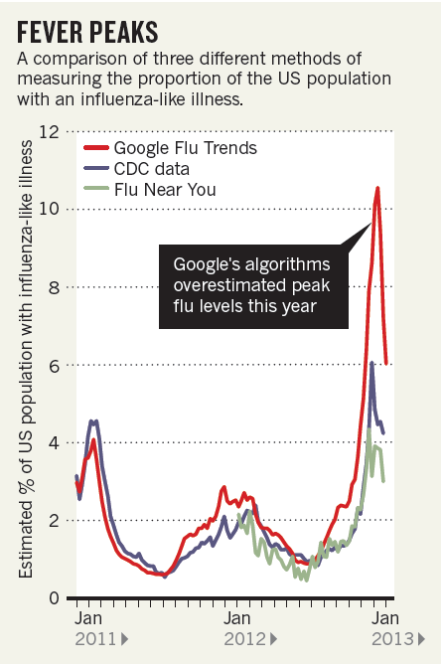
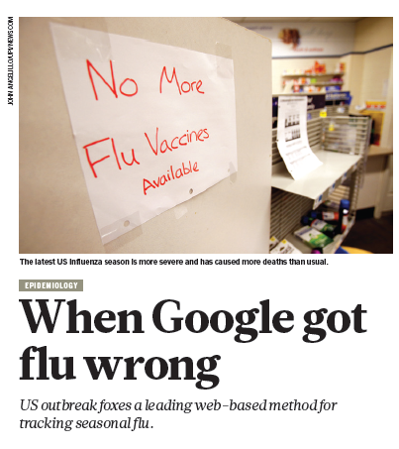
Big Data Prediction: Google Flu Trends
Butler: Nature vol. 949, p.155 Feb 14, 2013
Notes:
But it broke in 2009 and, after recalibration, again in 2012.

Slide 36
Why did it break?
The underlying conditions under which the model was developed changed.
The model wasn’t built with any biological insight. It was built (in a sophisticated way) on correlations.
It was built on weekly counts of the 50 million most common search queries but only 6 years of flu data.
See Thought #2
Notes:
So a massive amount of data but a small amount of information in terms of flu seasons.

Slide 37
Thought #4
Compared to causality, prediction is easy since you only have to understand associations and correlation.
Until it isn’t.

Slide 38
Correlation versus causation
Many big data “successes” are solely prediction.
Data mining methods can help you predict 30 day readmission rates but may not tell you how to improve them.

Slide 39
Correlation versus causation
There is the feeling that if we just take enough measurements we will understand causal effects:
“There is now a better way. Petabytes allow us to say: ‘Correlation is enough.’ We can stop looking for models. We can analyze the data without hypotheses about what it might show. We can throw the numbers into the biggest computing clusters the world has ever seen and let statistical algorithms find patterns where science cannot.” Wired Mag. 6/2008

Slide 40
Correlation versus causation
And it continues:
“The new availability of huge amounts of data, along with the statistical tools to crunch these numbers, offers a whole new way of understanding the world. Correlation supersedes causation, and science can advance even without coherent models, unified theories, or really any mechanistic explanation at all.
There's no reason to cling to our old ways. It's time to ask: What can science learn from Google?

Slide 41
Epidemiologists have long studied the pitfalls of using observational studies to infer causation.
A fundamental idea in causal inference is to compare the same person with and without an intervention or condition. Can’t usually measure the person under both conditions.
For example, observe the same person with and without a history of knee injury to understand its impact on later osteoarthritis.
Notes:
Called potential outcomes or counterfactuals

Slide 42
Thought #5
If you are interested in causation you can’t measure it all.
You can, at most, measure half of it all and that half is subject to selection bias.

Slide 43
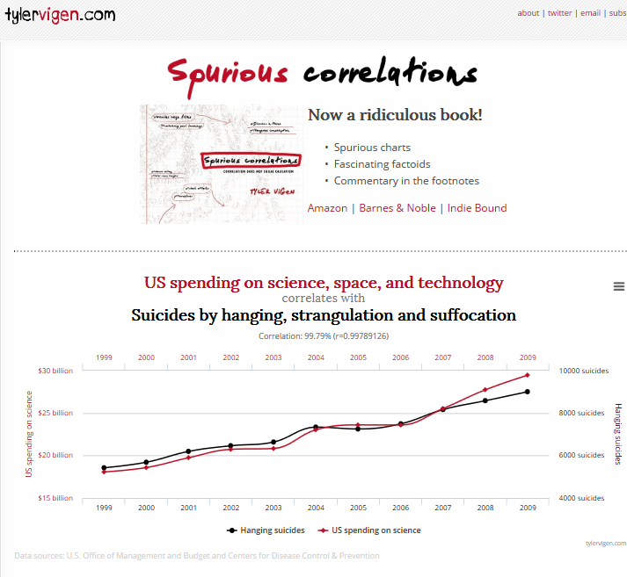
Notes:
“Spurious correlation” is a bit of a lazy phrase, but I will stick with it because it is evocative. Correlation between two variables that is not the result of any direct relationship. There is a whole web site devoted to it.

Slide 44
Need to beware of overfitting
Overfitting, trying too hard to find a model that closely matches data
Revisited the OA example and added in 3 spurious (randomly generated) variables, spurious1, spurious2, spurious3
Tree: spurious1
We will work very hard to avoid overfitting!
Notes:
Not a general recommendation for stepwise.

Slide 45
Thought #6
Modern machine learning methods are just as good or even better than the more usual statistical methods at finding spurious correlations.
  Usual solution: validation data set or subsets.
Flexibility also makes it harder to conduct reproducible research.

Slide 46
Having our cake and eating it too:
Big data and randomized trials
“Early Supported Discharge for Improving Functional Outcomes After Stroke”
PCORI funded project to compare a more comprehensive package of post-stroke services with usual care.
Randomize most stroke patients in North Carolina by randomizing hospitals to intervention or control.
Outcomes collected electronically: death, recurrent stroke, use of transition billing codes, proportion re-hospitalized.

Slide 47
Thought #7
We can have our cake and eat it too.

Slide 48
Thoughts on Big Data
Data mining can be used for good and evil.
Big data isn’t the same as big information.
Modern machine learning methods can search for associations quickly and flexibly.
Having big data doesn’t solve selection bias.
Distinguish prediction problems from causal investigation.
Data mining methods are good at finding spurious associations and hard to use reproducibly. Need to wary of overfitting.
Randomization can be used with big data.

Slide 49
Resources
First class Thursday, July 30 1:00 PM. Lab to follow.
Contact info: aaron.scheffler@ucsf.edu
Download Orange Data Mining Software: https://orange.biolab.si/download/
Course website: https://courses.ucsf.edu/course/view.php?id=7510

