Slide 1

Biostat 202: Data Management, Storage, & Cleaning
or
The Many Lives of Research Data
Aaron Wolfe Scheffler
Assistant Professor, Biostatistics & Epidemiology
aaron.scheffler@ucsf.edu

Slide 2
Last time – getting data
It helps to know the format and layout of a dataset you want to analyze.
Paying attention to data formatting issues can save LOTS of time later.
Defining variable roles is important in Orange Data Mining.
Access to rich data is easy.
Finding your way around can be hard.
Look for tools (tutorials, browsers),
Or get professional help (Library, ARS and CTSI).

Slide 3
Outline for today
Why discuss data management and storage?
Data management
Data storage
Data cleaning
Notes:
Switching gears to thinking about creating, maintaining and curating our own datasets.
Identify UCSF resources throughout.

Slide 4
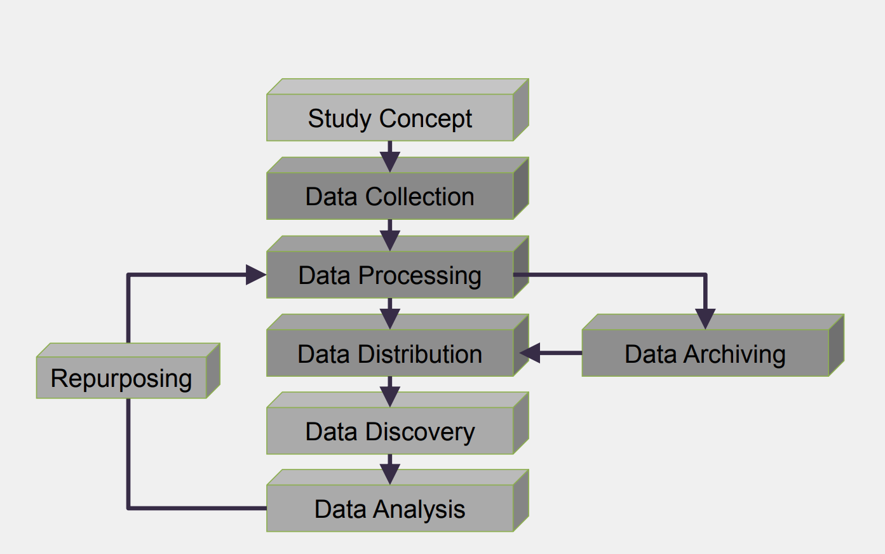
Research data life cycle – dynamic!
Notes:
Image source: https://ocw.mit.edu/resources/res-str-002-data-management-spring-2016/workshop-materials/MITRES_STR002S16_IntroDM.pdf

Slide 5
What might your data look like?
Survey responses
Demographics
Focus group interviews
Queried EHR data
Images
Laboratory measurements
Computer modeling
Simulations
Specimen samples
Notes:
Image source: https://ocw.mit.edu/resources/res-str-002-data-management-spring-2016/workshop-materials/MITRES_STR002S16_IntroDM.pdf

Slide 6
Why discuss data management and storage?
Save yourself time in the future
Ensure data integrity
Retention requirements
Promote and protect yourself!
Support open research
Protect and secure your data
Notes:
Further content: https://libraries.mit.edu/data-management/plan/why/

Slide 7

Data management
Notes:
Further content: https://libraries.mit.edu/data-management/plan/why/

Slide 8
Save yourself time in the future
Earlier you consider data management issues, the better.
Storage needs?
Access needs?
Software needs?
Security needs?
  E.g. protected health information (PHI)
KEEP YOUR DATA NEAR YOUR SOFTWARE!
Notes:
Further content: https://libraries.mit.edu/data-management/plan/why/
Software and data need to be ”in the same place”

Slide 9
Case study from my work:
Electronic fetal monitoring to predict hypoxic-ischemic encephalopathy
Storage needs? 100 Gb for fetal heart rate signals alone
Access needs? Multisite team
Software needs? Statistical and machine learning software required
Security needs? Secure server located physically at Kaiser

Slide 10
Ensure data integrity
How would someone else use your data?
Develop comprehensive data documentation, i.e. metadata
Metadata should include
  Provenance/Lineage
  Methodology
  Codebooks
Cornell guide on data documentation
  https://data.research.cornell.edu/content/readme
Notes:
Further content: https://libraries.mit.edu/data-management/plan/why/

Slide 11
Data provenance and processing
Notes:
NIS documentation: https://www.hcup-us.ahrq.gov/db/nation/nis/nisdbdocumentation.jsp

Slide 12
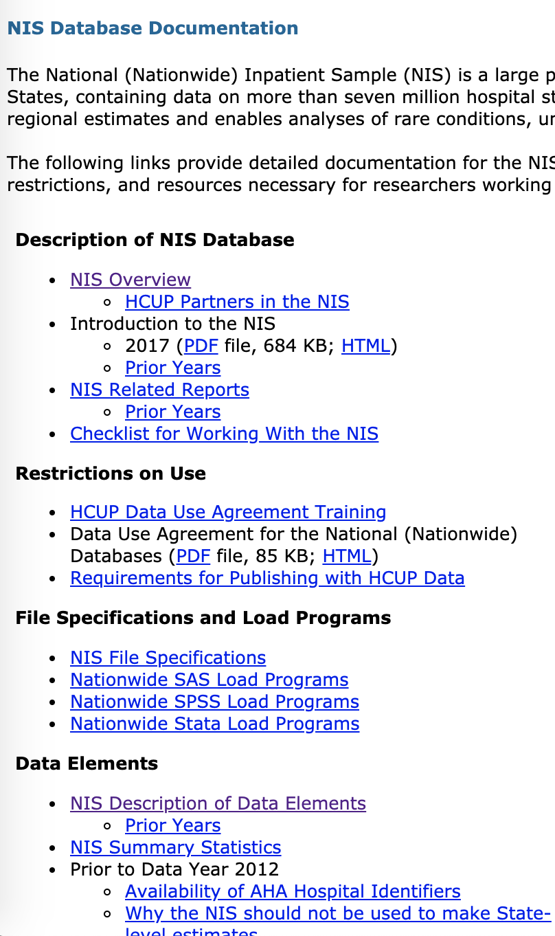
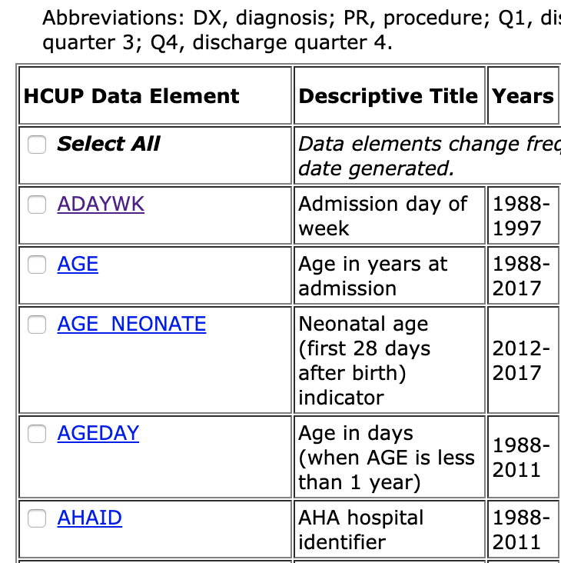
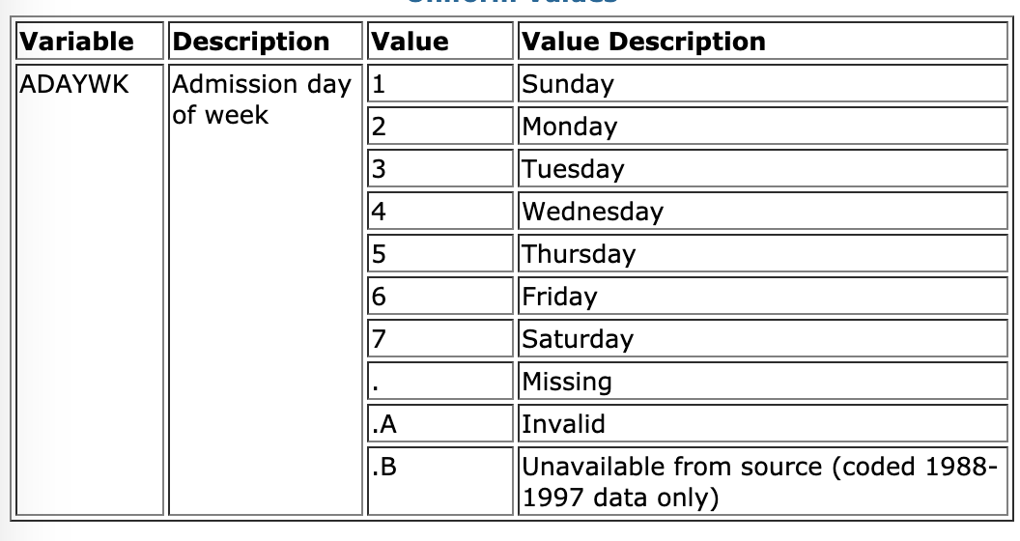
Example metadata and codebook: NIS
Metadata
Codebook
Notes:
NIS documentation: https://www.hcup-us.ahrq.gov/db/nation/nis/nisdbdocumentation.jsp

Slide 13
Retention requirements
Your data will have multiple “demands”: funding source, publisher, and data application.
Many funding sources (NSF, NIH) require formal data management and sharing plans.
In addition, you might be required to archive the data for some period of time.

Slide 14
Retention Best Practices: It Depends
IRB OHRP Requirements: 45 CFR 46 = 3 years from completion
NIH: = minimum of 3 years final report submission.
HIPAA Requirements: = minimum of 6 years from date of signed authorization
FDA Requirements 21 CFR 312.62.c = 2 years following the date a marketing application is approved for the drug or the investigation is discontinued and FDA is notified.
VA Requirements: At present records for any research that involves the VA must be retained indefinitely per VA federal regulatory requirements.
Intellectual Property Requirements - Any research data used to support a patent through must be retained for the life of the patent in accordance with Intellectual Property Policy.
Questions of data validity: you must retain all of the original research data until such questions or allegations have been completely resolved.

Slide 15
Promote and protect yourself!
Well documented data allows others to make use of your data collection - increases your research profile.
Proper knowledge of data management and retention protects you against liability.
Data integrity also protects you against questions of data validity.

Slide 16
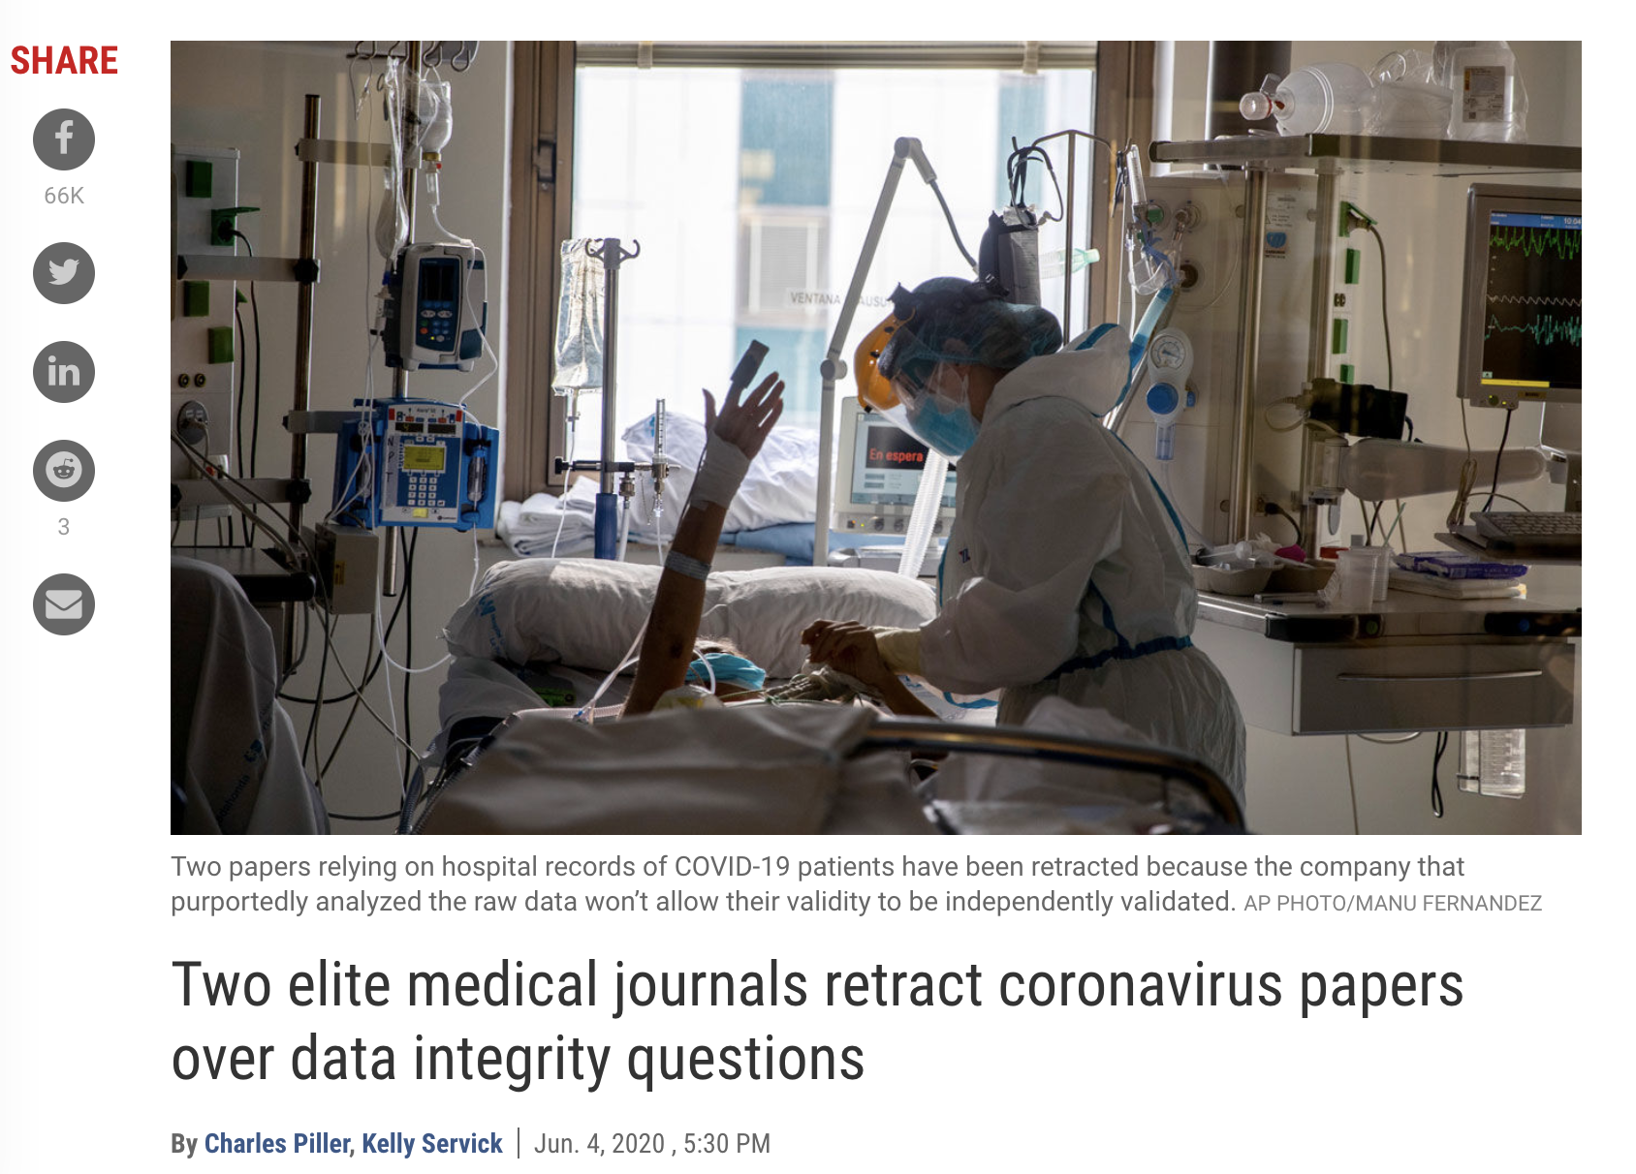
Show me the data!
Notes:
Put up or shutup: https://www.sciencemag.org/news/2020/06/two-elite-medical-journals-retract-coronavirus-papers-over-data-integrity-questions

Slide 17
Data management at UCSF - personal tools
DMPTool (free)
  Helps researchers generate data management plan
  https://dmptool.org/
UCSF Library Data Science Initiative (free)
  Consultations, workshops and resources
  https://www.library.ucsf.edu/ask-an-expert/data-science/
Notes:
Summary: https://data.ucsf.edu/research/data-management

Slide 18
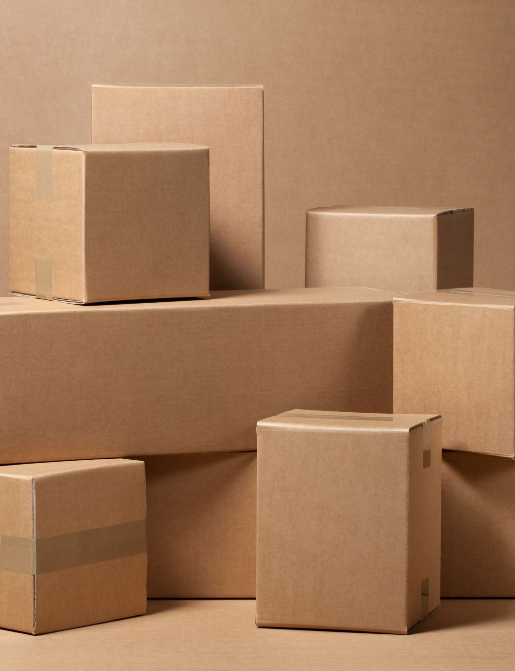
Data storage
Notes:
Further content: https://libraries.mit.edu/data-management/plan/why/

Slide 19
Protect and secure your data
Data is like currency. Would you leave your money on the street?
Proper data storage ensures that you will not lose your data.
Data security is also needed to be compliant with IRB, funding agencies, etc…

Slide 20
Your laptop is vulnerable: data loss and intrusions
Notes:
Image source: https://www.tvovermind.com/office-space-printer-scene-no-reason-whatsoever/

Slide 21
UCSF storage: redundant and secure
Notes:
Image source: https://i2.wp.com/www.opensourceforu.com/wp-content/uploads/2019/02/Data-Duplication-illustration.jpg?fit=900%2C633&ssl=1

Slide 22

Does UCSF storage differ From data on your laptop?
Size?
Goals?
Back-up?
Version control?
Privacy?
  Anonymizing
  HIPPA
  Stored only on secure server

Slide 23
Data storage: 3-2-1 rule
  Three copies of your data
  Two types of media (hardrives)
  One offsite location
  Many UCSF data services will offer forms of this in their subscription plans.
Notes:
Summary:

Slide 24
Data management at UCSF - storage
UCSF Box [free, not great for backup]
  Secure, enterprise, cloud-based storage solution. Offers unlimited amounts of storage and an encrypted, HIPAA-compliant folder.
  https://it.ucsf.edu/service/cloud-storage-box
MyResearch ($)
  Combined secure environment and software resources
  Backed up automatically for a fee
  https://myresearch.ucsf.edu/myresearch
UCSF Backup Services ($)
  https://it.ucsf.edu/service/backup-services
Notes:
Summary:

Slide 25
Data management at UCSF - professional database help
Data Management Consultation ($) - EHR
  https://consult.ucsf.edu/data-management
Data System Services, DEB ($)
  REDCAP programming
  https://epibiostat.ucsf.edu/data-systems-services
Notes:
Summary: https://data.ucsf.edu/research/data-management

Slide 26
Make UCSF work for you!
  As members of this community, you have access and membership to many resources!
Notes:
Summary: https://data.ucsf.edu/research/data-management

Slide 27

Data Cleaning

Slide 28
Garbage in, garbage out

Slide 29
Data cleaning
Major steps in data cleaning
Visualize the data
Outlier detection
Missingness

Slide 30
Major steps in data cleaning
Visualize the data
Remove unwanted data (duplicate entries, irrelevant entries)
Fix structural errors
Resolve inconsistencies
Plausibility check
Detect and filter outliers
Characterize and address missing data
Transform data
  Derive new variables
  Center/scale data
Reduce data, i.e. dimensional reduction

Slide 31
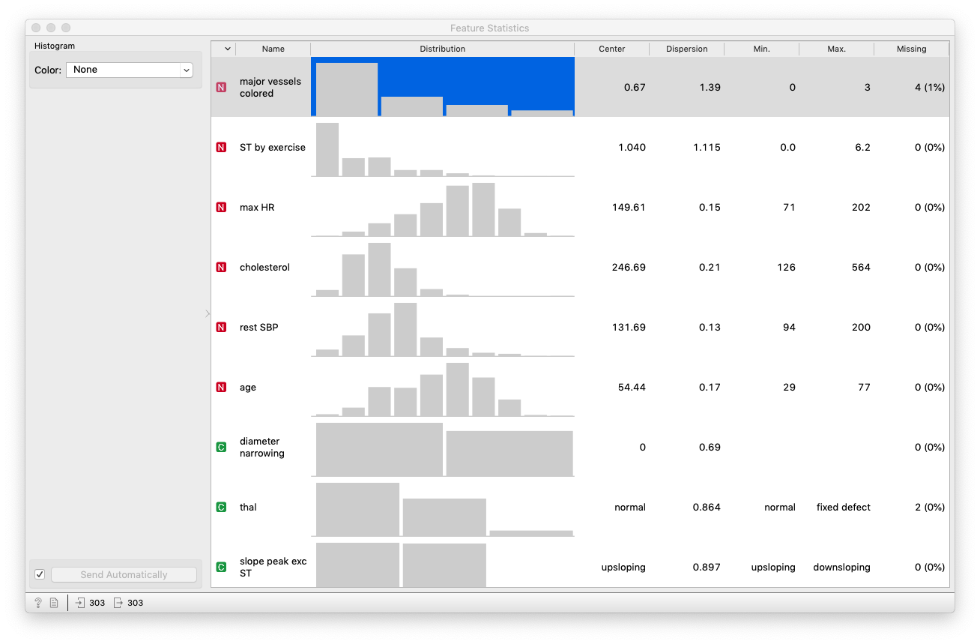
Visualize the data – “Feature Statistics” widget
Notes:
Image source: https://wordtracker-swoop-uploads.s3.amazonaws.com/uploads/ckeditor/pictures/2694/content_duplicate.png

Slide 32
Outlier detection (1)
An outlier is a data point that differs significantly from other observations.
Outliers can be detected visually, but in large datasets we need algorithmic methods to detect
Notes:
Image source: https://miro.medium.com/max/1400/1*TbUF_HTQ6jOhO8EoPnmekQ.jpeg

Slide 33
Outlier detection (2)
Outliers can be due chance or data corruption
Outliers can influence out algorithms, cause poor prediction or confusing results
Ultimately, you can choose to keep them, discard them, or transform them (think Fare variable in titanic).
MAKE SURE TO DOCUMENT YOUR DECISIONS!!!

Slide 34
Missing data
Missing data may be due to
  Refusal to answer
  Equipment malfunction
  Data not entered due to error
Blank entries are good to indicate missing
Missing data may need to be inferred or imputed to avoid bias

Slide 35
How to handle missing data?
Ignore the data (bad)
Fill in the missing values manually (e.g. call the patient, not viable generally)
“Impute” or fill in the missing values (best if original source cannot be verified)

Slide 36
Missing data imputation
Use the mean to fill in the missing value (okay)
Use the mean for all samples belonging to the same class to fill in the missing value: (smart)
Use the most probable value to fill in the missing value: inference-based such as Bayesian formula or decision tree or regression (smarter)
Multiple imputation techniques examining sensitivity of estimates to imputation (smartest?)
What can Orange do for you? (In class!)

Slide 37
Orange for data management and cleaning
Visualize data
Feature construction
Merging & concatenating
Impute missing data
Detect outliers

Slide 38
Summary
Data management and storage are necessary not only to protect your research efforts but also for compliance.
Data integrity can help you and others use your data.
Don’t store important data on your laptop! Use 3-2-1 rule when possible.
Garbage in, garbage out
Data cleaning decisions have critical impact on subsequent analysis and interpretation.

Slide 39
Coming up…
Starting next week, we will begin a 3-week journey into machine learning and algorithms.

