Slide 1
Biostat 202: Opportunities and Challenges of “Big Data”:
Machine Learning 1:
Introduction & Regression
Aaron Wolfe Scheffler
Division of Biostatistics
Department of Epidemiology and Biostatistics

Slide 2
Goal: Use machine learning algorithms for the purpose of prediction or identifying patterns in data
Case study: dataset from a heart disease study, want to predict systolic blood pressure
1. Data
2. Train/fit model
3. Output
4. Interpret
Prediction
Dimension Reduction
Clustering
Algorithm(s)
= INFORMATION?

Slide 3
Overview of machine learning (ML) lectures
ML Lecture 1: Introduction to ML and supervised learning [regression]
  Machine learning/data mining “definition”
  Structured vs unstructured data
  Supervised vs unsupervised machine learning
  Linear regression
  Validation
ML Lecture 2: Supervised learning [classification]
  Introduction to classification/evaluating classifiers
  Validation continued
  Logistic regression
ML Lecture 3: Supervised learning, continued [classification]
  Classification, continued: K nearest neighbors, decision trees, support vector machines, neural networks
  Cross validation
  Combining models: boosting, bagging, deep learning
ML Lecture 4: Unsupervised learning [clustering/dimension reduction]
  Clustering
  Data reduction and PCA
Orange throughout

Slide 4
Overview of this lecture
Machine learning/data mining “definition”
Structured vs unstructured data
Supervised vs unsupervised machine learning
Linear regression
Validation (central to evaluating predictions)

Slide 5
A historical view
https://tinyurl.com/y37tgvt6

Slide 6
Machine learning definitions
Artificial intelligence (AI) is any technique which enables computers to mimic human behavior.
Machine learning is a subfield of artificial intelligence centering on the application of algorithms and statistical models. In 1959, Arthur Samuel defined machine learning as a “Field of study that gives computers the ability to learn without being explicitly programmed”.
  Data Mining is the process of identifying patterns and associations in large data sets.
Deep learning is a subfield of machine learning that utilizes artificial neural networks. This technology underlies many recent successful applications of machine learning.

Slide 7
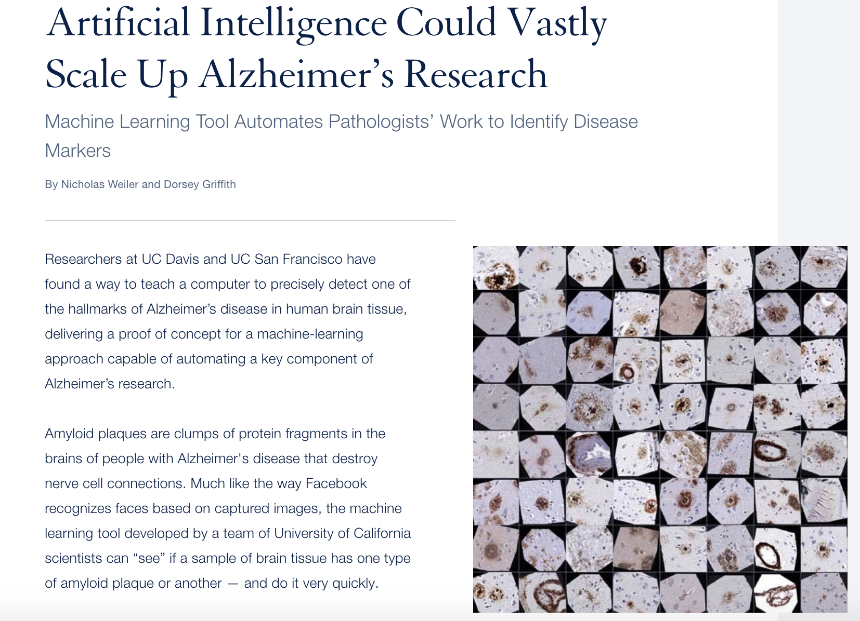
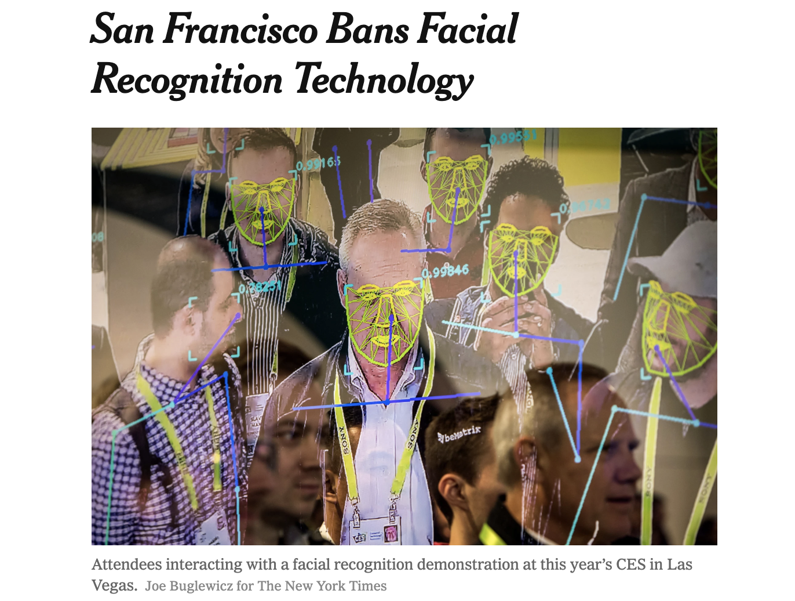
Local headlines
https://tinyurl.com/yypt6mv7

Slide 8
Machine learning and statistics
The purpose of machine learning is to form predictions or detect patterns in data
Statistics is an older field which overlaps with machine learning but focuses more on describing associations and quantifying uncertainty
Many techniques (such as linear regression) are utilized in both fields while others (neural networks) tend to be considered strictly machine learning

Slide 9
Analysis pipeline
1. Data
2. Train/fit model
3. Output
4. Interpret
Prediction
Dimension Reduction
Clustering
Algorithm
= INFORMATION?

Slide 10
“Big Data”
https://hac.nursing.umich.edu/2018/02/26/big-data-finding-its-mark/
Big Data
All Data

Slide 11
Big Data – large N and large P
Big data can be thought of in two ways
Large N = large number of subjects – implies more information for fitting complex models or ones with many predictors
  E.g. Assignment 2 - NEISS Injury database (360K records)
Large P = large number of predictors, or complex relationships between predictor and outcome
  E.g. Project 2 Cancer survival (243 records, 21K features)

Slide 12
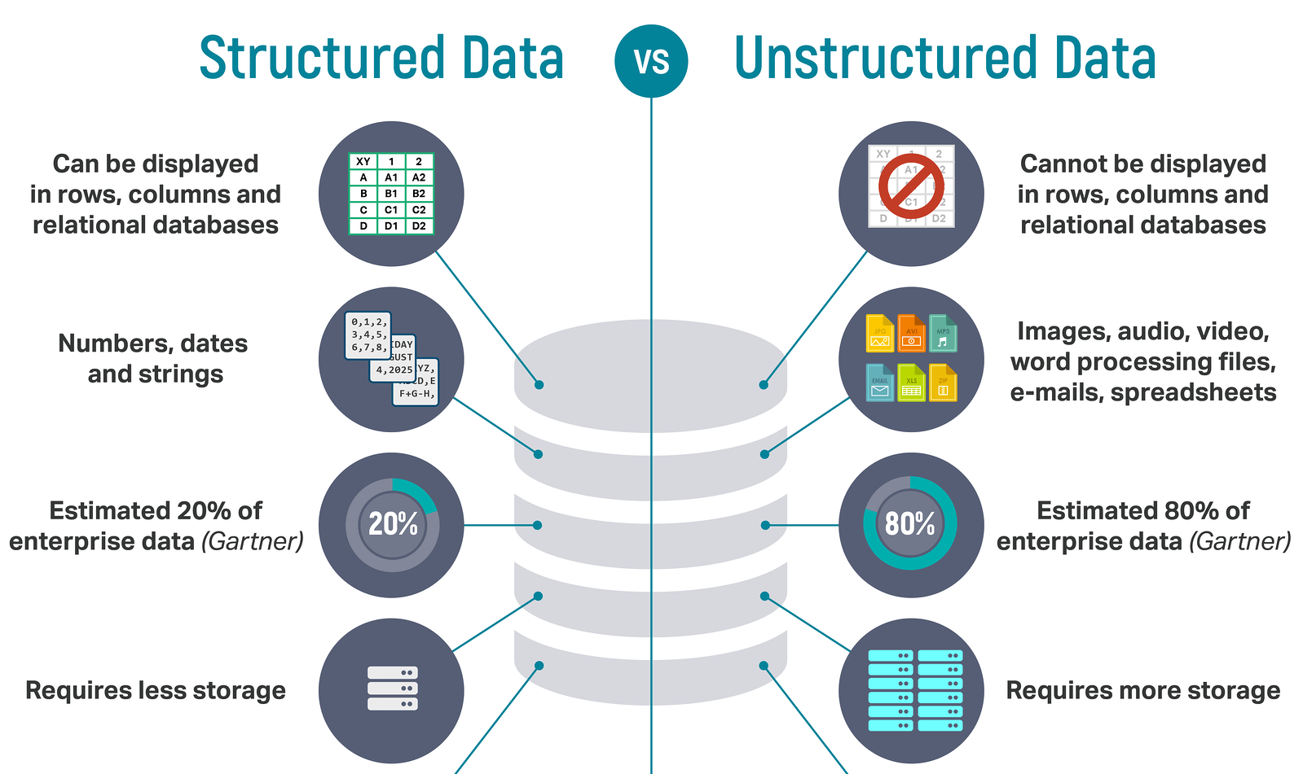
Structured vs unstructured data
https://tinyurl.com/yxhz3568
Our focus

Slide 13
Analysis pipeline
1. Data
2. Train/fit model
3. Output
4. Interpret
Prediction
Dimension Reduction
Clustering
Algorithm(s)
= INFORMATION?

Slide 15
Supervised vs unsupervised
Supervised Learning
Have data where you know outcome in order to train the model
Train the model to predict future outcomes from sets of predictors
Unsupervised Learning
No specified outcomes
Cluster data points into groups with “similar” properties (clustering)
Or reduce data to fewer variables in some way that still captures important structure of the data
Prediction: Regression (continuous outcomes) and classification (categorical outcomes)
Clustering and data reduction

Slide 16
Supervised vs unsupervised
Machine Learning
Supervised
Regression (continuous outcome)
Classification (categorical outcome)
Unsupervised
Clustering
(grouping observations)
Data Reduction (transforming variables)

Slide 17
Prediction problems
Predict the CD4 count in a patient 6 months from now based on current CD4, viral load, demographic and lifestyle variables
Predict whether a patient will develop breast cancer based on genetic, demographic, and lifestyle variables
Predict whether or not, and what type of dementia a patient has based on MRI of the brain

Slide 18
Definitions
Instance (also Item, Record) = observation:
  an example, described by a number of attributes,
  e.g. a person can be described by age, gender, blood pressure and level of physical activity
Attribute or Field = variable or feature
  measuring aspects of the Instance, e.g. age
Class or Label = class or group
  grouping of instances/observations, e.g. disease type
Target = outcome, response, dependent variable – the variable that you want to predict
Input = predictor, covariate, independent variable – the variables you will use to predict
Parameter – any characteristic that defines our machine learning model

Slide 19

Linear regression
Start simple with one feature/predictor
We will move onto multiple predictors later…
Gauss
Legendre

Slide 20
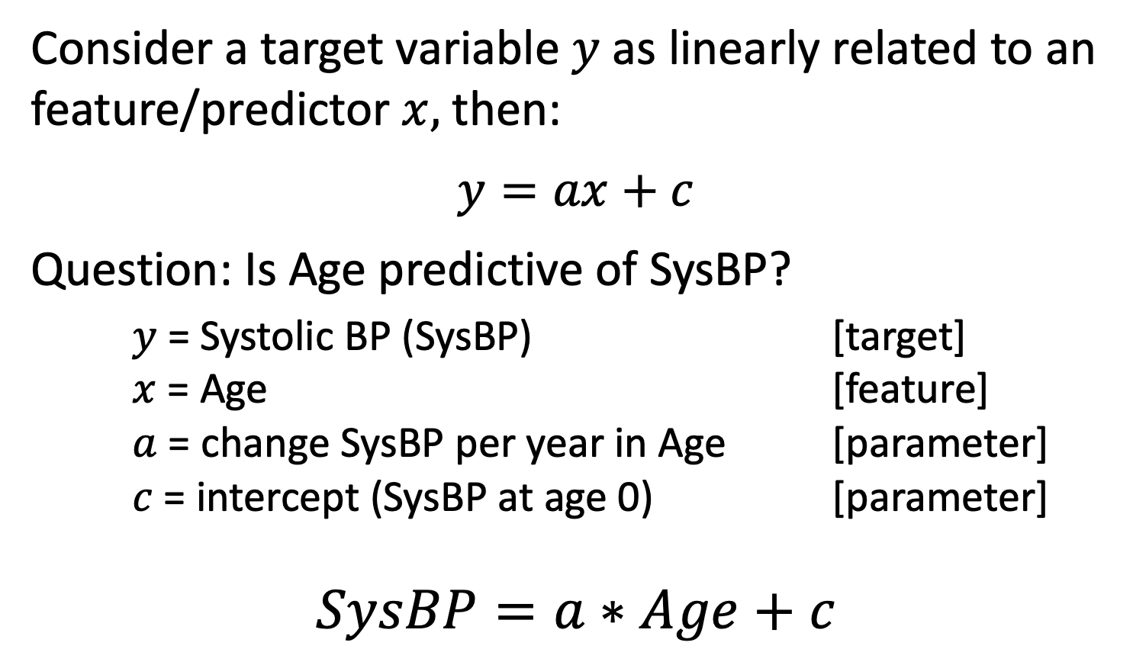
Linear regression
Consider a target variable $y$ as linearly related to an feature/predictor $x,$ then:
$$y=ax+c$$
Question: Is Age predictive of SysBP?
$y$ = Systolic BP (SysBP) [target]
$x$ = Age [feature]
$a$ = change SysBP per year in Age [parameter]
$c$ = intercept (SysBP at age 0) [parameter]
$$SysBP=a∗Age+c$$

Slide 21
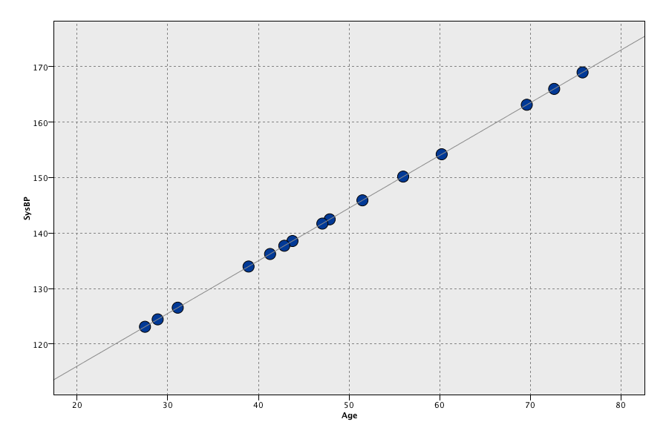


Fitting linear regression
$$y$$
SysBP
Age
$$x$$

Slide 22
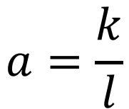


Fitting linear regression
$$y$$
slope
$$a=\frac{k}{l}$$
SysBP
$$k$$
Intercept?
$$l$$
Age
$$x$$

Slide 23

Fitting linear regression
$$y$$
slope
$$a=\frac{k}{l}$$
SysBP
$$k$$
intercept
$$l$$
$$c$$
Age = 0
Age
$$x$$

Slide 24
Making a prediction
$$y$$
SysBP
Predicted SysBP
Age
$$x$$
New subject age 40

Slide 25
Fitting linear regression
But data (almost) never lie on a perfect straight line. The data also contain:
  Measurement error
  Between subject variability (e.g. not all people of a certain age have the same Systolic BP)

Slide 26
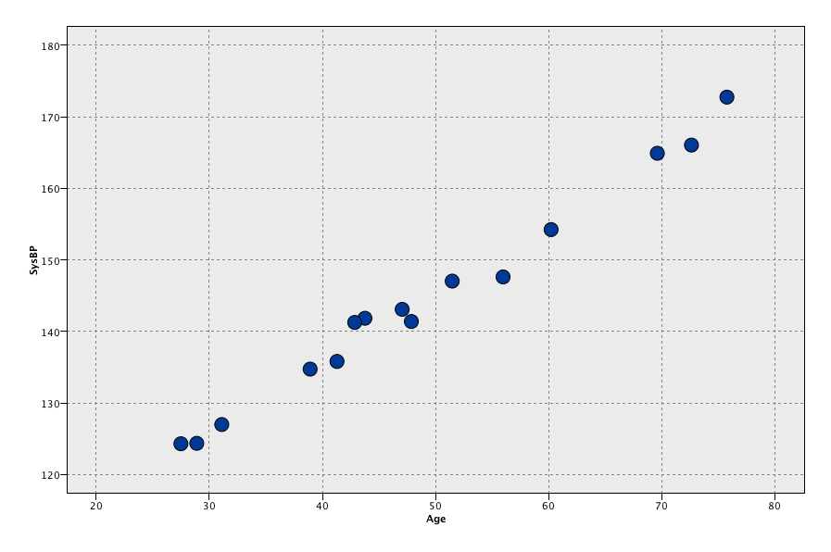
Data with measurement error
SysBP
Age

Slide 27
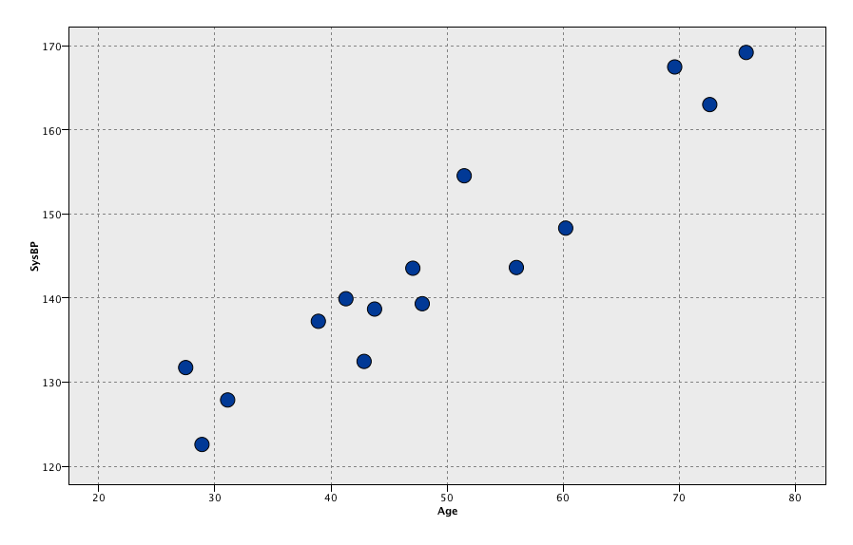
Data with measurement error plus biological variability
SysBP
Age

Slide 28
How to choose a fitted line?
SysBP
Age

Slide 29
How to choose a fitted line?
SysBP
One possible line
Age

Slide 30
How to choose a fitted line?
We want to fit a straight line to give us a relationship, but which one is ‘best’?
SysBP
Age

Slide 31


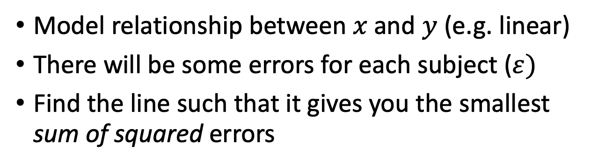
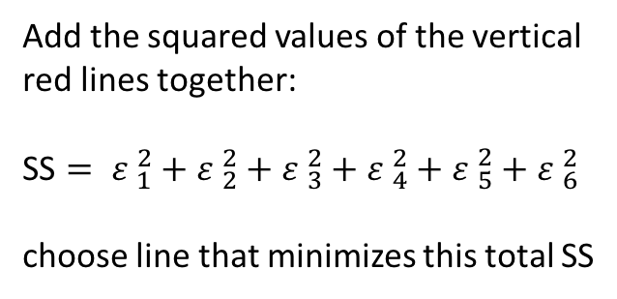





Best linear relationship
Model relationship between $x$and $y$ (e.g. linear)
There will be some errors for each subject ($ε)$
Find the line such that it gives you the smallest sum of squared errors
$$ε_{6}$$
$$ε_{5}$$
Add the squared values of the vertical red lines together:
SS $= {ε }_{1}^{2}+{ε }_{2}^{2}+{ε }_{3}^{2}+{ε }_{4}^{2}+{ε }_{5}^{2}+{ε }_{6}^{2}$
choose line that minimizes this total SS
$$ε_{4}$$
$$ε_{5}$$
$$ε_{2}$$
$$ε_{3}$$
$$ε_{1}$$

Slide 32
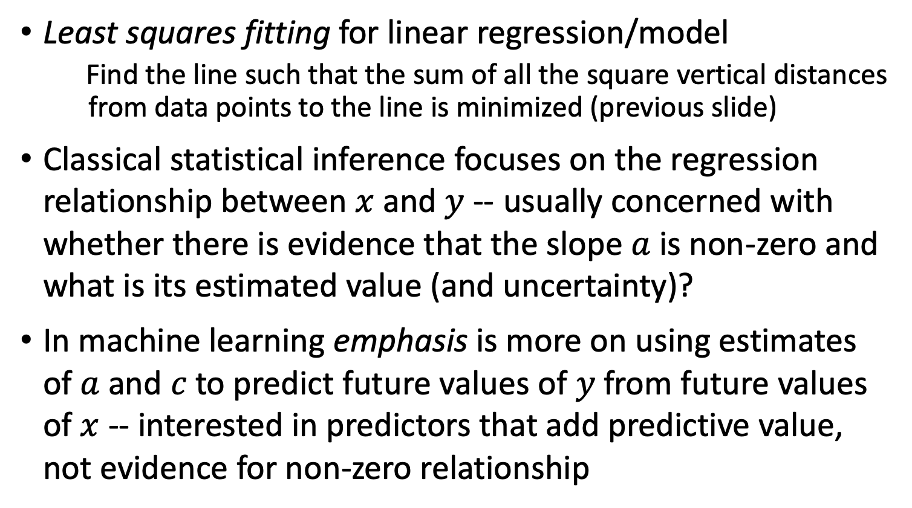
Model training
Least squares fitting for linear regression/model
  Find the line such that the sum of all the square vertical distances from data points to the line is minimized (previous slide)
Classical statistical inference focuses on the regression relationship between $x$ and $y$ -- usually concerned with whether there is evidence that the slope $a$ is non-zero and what is its estimated value (and uncertainty)?
In machine learning emphasis is more on using estimates of $a$and $c$to predict future values of $y$ from future values of $x$ -- interested in predictors that add predictive value, not evidence for non-zero relationship

Slide 33
Why straight line? What about?
SysBP
Age

Slide 34

Or even?
SysBP
Age
Issue?
Overfitted?

Slide 35
Overfitting

Slide 36
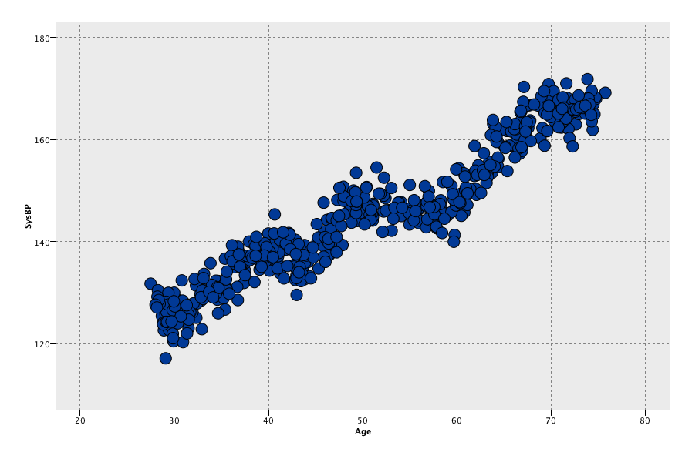
What about with more data?
SysBP
Age

Slide 37
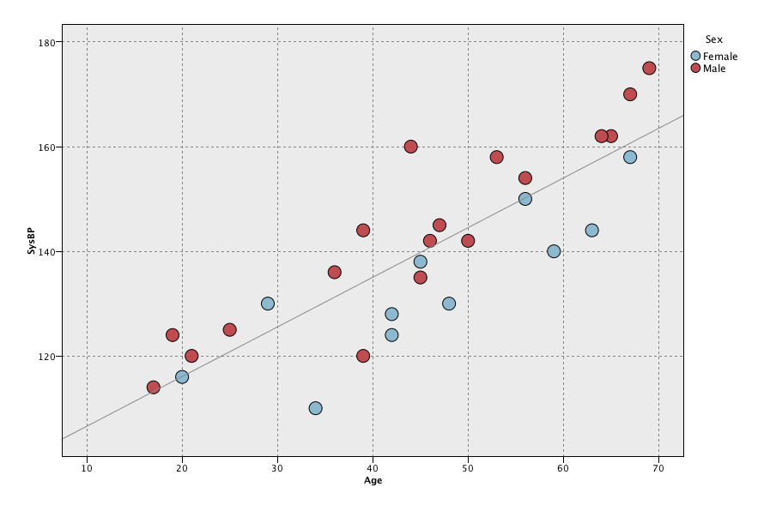
Separate by Sex
What if we consider sex, in addition to age, as a predictor of SysBP?
Sex
Blue F
Red M
SysBP
Age

Slide 38
Separate by Sex
Do trends in SysBP vs Age differ based on sex?
SysBP
Age

Slide 39
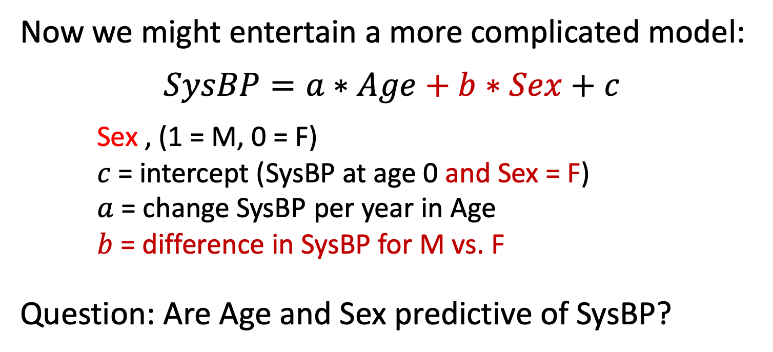
Multi-predictor models
Now we might entertain a more complicated model:
$$SysBP=a∗Age+b∗Sex+c$$
Sex , (1 = M, 0 = F)
$c$= intercept (SysBP at age 0 and Sex = F)
$a$ = change SysBP per year in Age
$b$ = difference in SysBP for M vs. F
Question: Are Age and Sex predictive of SysBP?

Slide 40
Age and Sex as predictors
Sex
Blue F
Red M
Gray line = original fit, no sex predictor
SysBP
Age

Slide 41
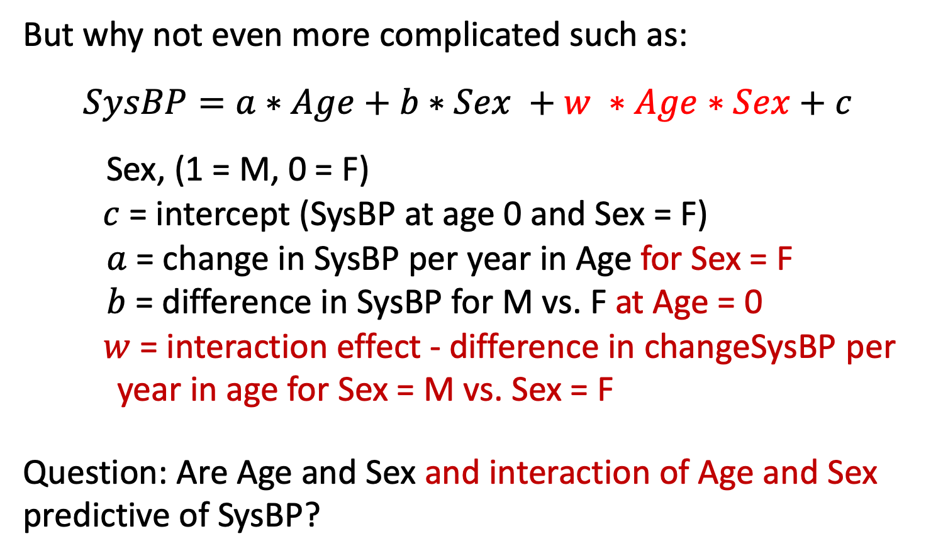
And interactions
But why not even more complicated such as:
$$SysBP=a∗Age+b∗Sex +w ∗Age∗Sex+c$$
Sex, (1 = M, 0 = F)
$c$= intercept (SysBP at age 0 and Sex = F)
$a$ = change in SysBP per year in Age for Sex = F
$b$ = difference in SysBP for M vs. F at Age = 0
$w$ = interaction effect - difference in changeSysBP per year in age for Sex = M vs. Sex = F
Question: Are Age and Sex and interaction of Age and Sex predictive of SysBP?

Slide 42
Age and Sex interaction
Sex
Blue F
Red M
Gray line = original fit, no sex predictor
SysBP
Age

Slide 43
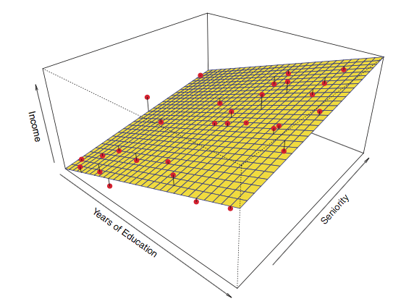
Linear regression with two (continuous) predictors
SysBP
Chol
Age

Slide 44

Multiple (predictor) linear regression
Question of interest: Which of the features $x1,x2,…,x$_{n} are predictive of $y$ and how do we model their effect on $y$?

Slide 45

Model selection
Want to find “true” predictive patterns in the data
Want to avoid overfitting spurious detail – do not confuse noise for signal
Solution – independent validation – reserve some data that has not been used in model fitting for the purpose of model evaluation and comparison.
Nonlinear trends
Many predictors

Slide 46
Validation
Validation: an approach for model evaluation and comparison
Select the model that produce the lowest predictive error in independent validation data.
But we can’t use the same data we trained the model to in order to assess how well it did – could be perfect fit but not generalize to other data
So we deliberately leave data aside for “testing”…

Slide 47
Validation using training/test data
Randomly split data into training and test sets (often ~2/3 for train, 1/3 for test)
Build a regression model using the training set and evaluate it using the test set
Strategies vary based on the # instances/observations (at least 100, preferably > 1000) – depends on model
Note: we will return to this theme continuously, it is a critical aspect of machine learning

Slide 48
Training/Test
Training set (2/3)
Data
Testing set (1/3)

Slide 49
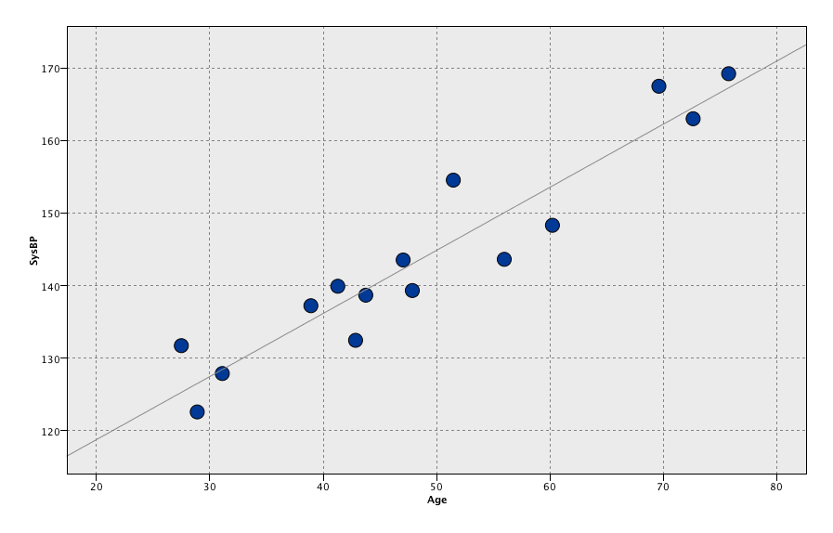
Training/Test
Training set (2/3)
Data
Build regression model
Evaluate predictions
Testing set (1/3)

Slide 50
Training/Test
Training set (2/3)
Data
Build regression model
Evaluate predictions
Testing set (1/3)
Evaluate predictions

Slide 51
Evaluation metrics for continuous predictions
Linear correlation^2 (r^2) – square of correlation coefficient between the observed target values and predicted target values
Mean absolute error (MAE) -- the average absolute deviation between observed target values and predicted target values
observed
predicted
0

Slide 52
Analysis pipeline
1. Data
2. Train/fit model
3. Output
4. Interpret
Prediction
Dimension Reduction
Clustering
Algorithm(s)
= INFORMATION?

Slide 53
Review of this lecture
Machine learning/data mining “definition”
Structured vs unstructured data
Supervised vs unsupervised machine learning
Regression (supervised)
Validation (central to evaluating predictions)

Slide 54
Thursday’s Lecture
  Introduction to classification
  Evaluation metrics for categorical predictions
  Validation and testing, continued
  Logistic regression

Slide 55
Case study – Heart data
  Data:
    n = 303
    14 attributes
  Target:
    SysBp: systolic blood pressure
  Predictors:
    Age: age (years)
    Sex: gender
    ChestPain: chest pain type
    Chol: cholesterol
    Fbs: fasting blood sugar >120 mg/dL
    restecg: resting electrocardiographic results
    MaxHR: maximum heart rate achieved
    ExAng: exercise induced angina
    Oldpeak: ST depression induced by exercise
    Slope: slope of peak exercise ST segment
    Ca: # of major vessels colored by flouroscopy
    Thal: Thallium stress test
    AHD: diagnosis of heart disease (1 = yes, 0 =no)
Goal: Predict systolic blood pressure using multiple linear regression.

