Slide 1
Biostat 202: Opportunities and Challenges of “Big Data”.
Machine Learning 2:
Supervised learning [classification]
Aaron Wolfe Scheffler
Division of Biostatistics
Department of Epidemiology and Biostatistics

Slide 2
Review of last lecture
Goal: We are not trying to create AI, but rather use some machine learning algorithms for the purpose of prediction or identifying patterns in data.
1. Data
2. Train/fit model
3. Output
4. Interpret
Prediction
Dimension Reduction
Clustering
Algorithm(s)
= INFORMATION?

Slide 3
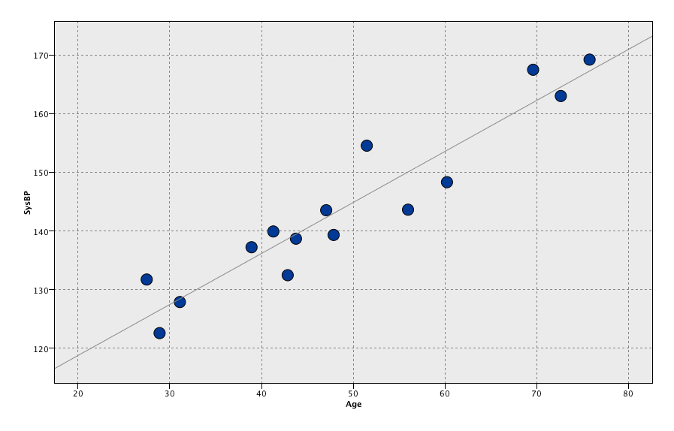
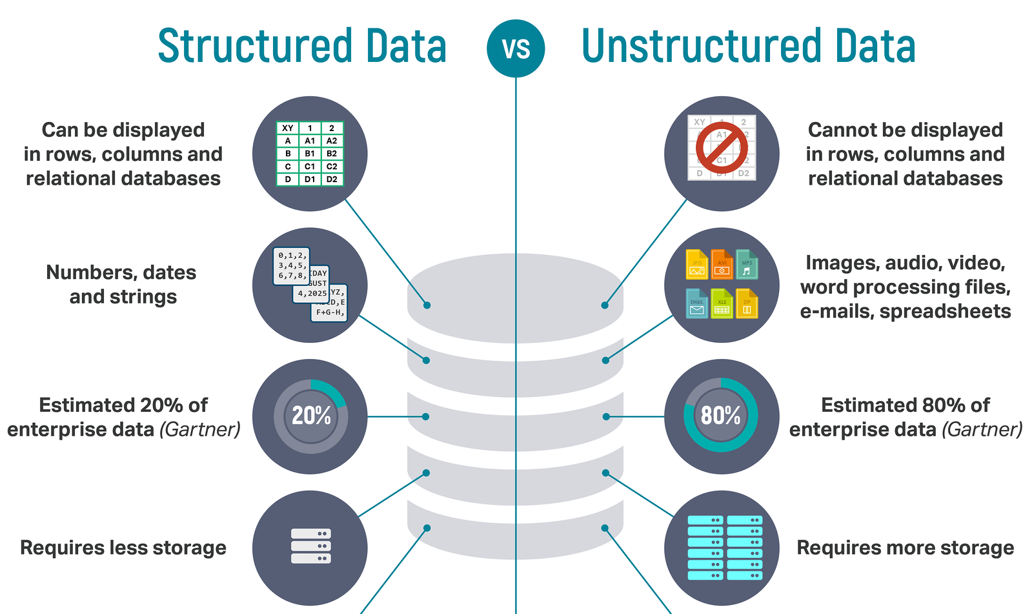
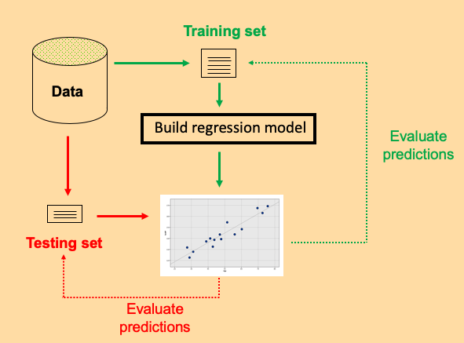
Review of last lecture
Machine learning definition
Types of data
Types of machine learning
Regression [supervised]
Validation

Slide 4
Overview of this lecture
  Introduction to classification
  Evaluation metrics for categorical data
  Validation and testing, continued
  Logistic regression

Slide 5
Classification

Slide 6
Classification
Machine Learning
Supervised
Regression (continuous outcome)
Classification (categorical outcome)
Unsupervised
Clustering
(grouping observations)
Data Reduction (transforming variables)

Slide 7
Classification
Objective – given set of features, a categorical outcome, and some training data, generate a rule (classifier) to predict which category each instance belongs to
Classifier is applied to new data where the outcome (i.e. target category) may or may not be known
Let’s look at a toy example trying to classify 1st vs. 6th grade girls based on height and weight….

Slide 8
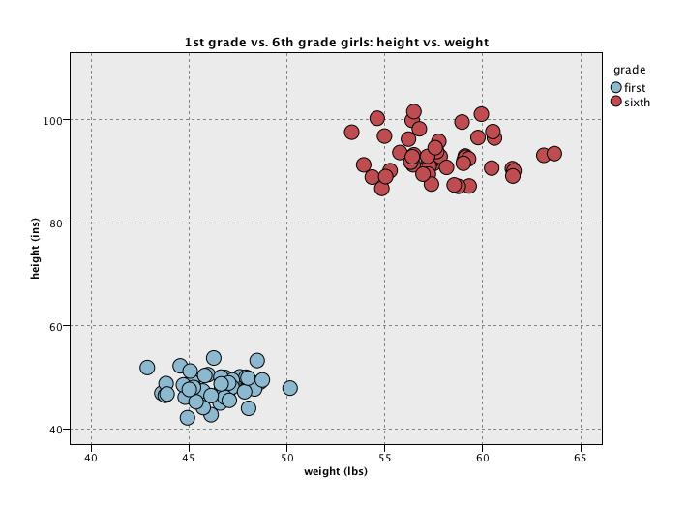
2D classification example

Slide 9
2D classification example
Classification Rule

Slide 10
2D classification example
Classification Rule
Classification Rule predicts new data points above the line to be 6th grade

Slide 11
2D classification example

Slide 12
2D classification example
Many classification rules are possible…

Slide 13
But in real problems the separation is unlikely to be so neat
Consider 1st grade boys vs. 1st grade girls

Slide 14
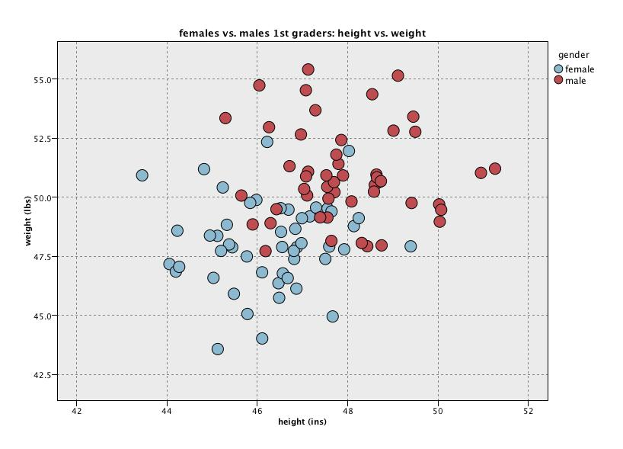
2D classification example

Slide 15
2D classification example
Tension: misclassifying many points

Slide 16

2D classification example
Tension: don’t believe real - overfitting

Slide 17
The central tension in machine learning
Want to find true predictive patterns in the data
But, want to avoid overfitting spurious detail: i.e. don’t want to make the model capture apparent patterns due to noise - we want results that are likely to be generalizable to future observations
Solution – validation – reserve some data that has not been used in model fitting for the purpose of model evaluation and comparison
To perform model evaluation for categorical outcomes, we’ll need some definitions…

Slide 18
Definitions
Weight
Predict girl
Classification Rule
Predict boy
Height
Girl (positive class)
Boy (negative class)

Slide 19
Definitions
True Positive (TP) – observation is positive and was predicted as positive
Weight
Predict girl
Classification Rule
Predict boy
Height
Girl (positive class)
Boy (negative class)

Slide 20
Definitions
True Positive (TP) – observation is positive and was predicted as positive
True Negative (TN) – observation is negative and was predicted as negative
Weight
Predict girl
Classification Rule
Predict boy
Height
Girl (positive class)
Boy (negative class)

Slide 21
Definitions
True Positive (TP) – observation is positive and was predicted as positive
True Negative (TN) – observation is negative and was predicted as negative
False Positive (FP) – observation is negative and was predicted as positive
Weight
Predict girl
Classification Rule
Predict boy
Height
Girl (positive class)
Boy (negative class)

Slide 22
Definitions
True Positive (TP) – observation is positive and was predicted as positive
True Negative (TN) – observation is negative and was predicted as negative
False Positive (FP) – observation is negative and was predicted as positive
False Negative (FN) – observation is positive and was predicted as negative
Weight
Predict girl
Classification Rule
Predict boy
Height
Girl (positive class)
Boy (negative class)

Slide 23
Definitions
True Positive (TP) – observation is positive and was predicted as positive
True Negative (TN) – observation is negative and was predicted as negative
False Positive (FP) – observation is negative and was predicted as positive
False Negative (FN) – observation is positive and was predicted as negative
Classification accuracy – proportion of observations classified correctly
    = (#TP + #TN)/N
    = (4 + 4)/10 = 80%
Weight
Predict girl
Classification Rule
Predict boy
Height
Girl (positive class)
Boy (negative class)

Slide 24
Definitions
True Positive (TP) – observation is positive and was predicted as positive
True Negative (TN) – observation is negative and was predicted as negative
False Positive (FP) – observation is negative and was predicted as positive
False Negative (FN) – observation is positive and was predicted as negative
Classification accuracy – proportion of observations classified correctly
    = (#TP + #TN)/N
    = (4 + 4)/10 = 80%
Weight
Predict girl
Classification Rule
Predict boy
Height
Girl (positive class)
Boy (negative class)

Slide 25
Cost-benefit
Cost-benefit analysis – assessment of predictive performance when some errors matter mor than others
Consider scurvy, a disease where treatment involves taking a simple cheap and benign medicine to cure it (e.g. taking vitamin C), but if the disease is undetected and thus untreated, the consequences are severe.
In that case, I would want to put much more weight on missing disease (positives) than missing no disease (negatives); i.e. consequences of false negatives are much worse than false positives.
For example, we might make the penalty (cost) for a false negative be 10 or 100 times that of a false positive

Slide 26
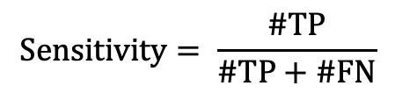
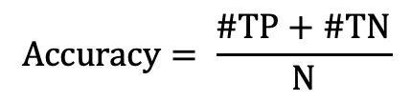
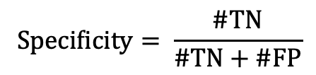
Confusion Matrix
Prediction\Truth | Negative | Positive | Total
Negative | #TN | #FN | #FN + #TN
Positive | #FP | #TP | #TP + #FP
Total | #FP + #TN | #TP + FN | N
Metrics obtained from confusion matrix:
$$Accuracy= \frac{\#TP+\#TN}{N}$$
$$Sensitivity= \frac{\#TP}{\#TP+\#FN}$$
$$Specificity= \frac{\#TN}{\#TN+\#FP}$$

Slide 27
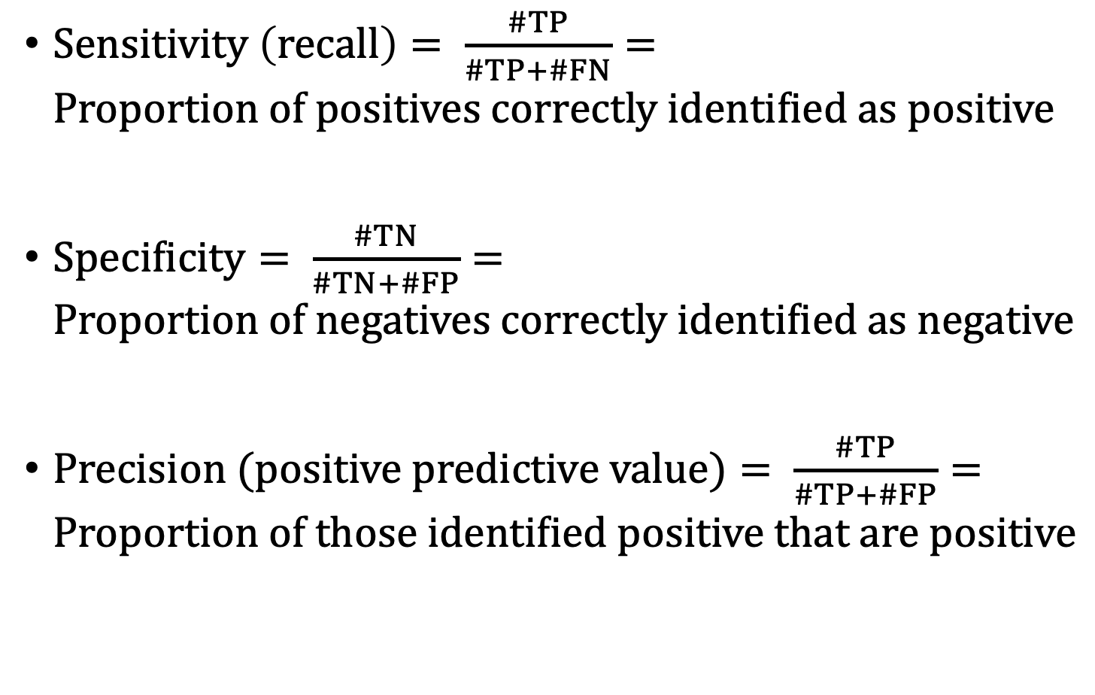
Sensitivity (recall), Specificity, and Precision
$Sensitivity \left(recall\right)= \frac{\#TP}{\#TP+\#FN}=Proportion of positives correctly identified as positive$
$Specificity= \frac{\#TN}{\#TN+\#FP}=Proportion of negatives correctly identified as negative$
$Precision (positive predictive value)= \frac{\#TP}{\#TP+\#FP}=Proportion of those identified positive that are positive$

Slide 28
Sensitivity (recall), Specificity, and Precision: scurvy example
The test has a 70% sensitivity if 70% of sailor scurvy+ are identified as scurvy+
The test has a 40% sensitivity if 40% of sailor scurvy- are identified as scury-
The test has a precision of 80% if 80% of sailors predicted to be scurvy+ are truly scuvry+
Notes:
Some language to help out.

Slide 29
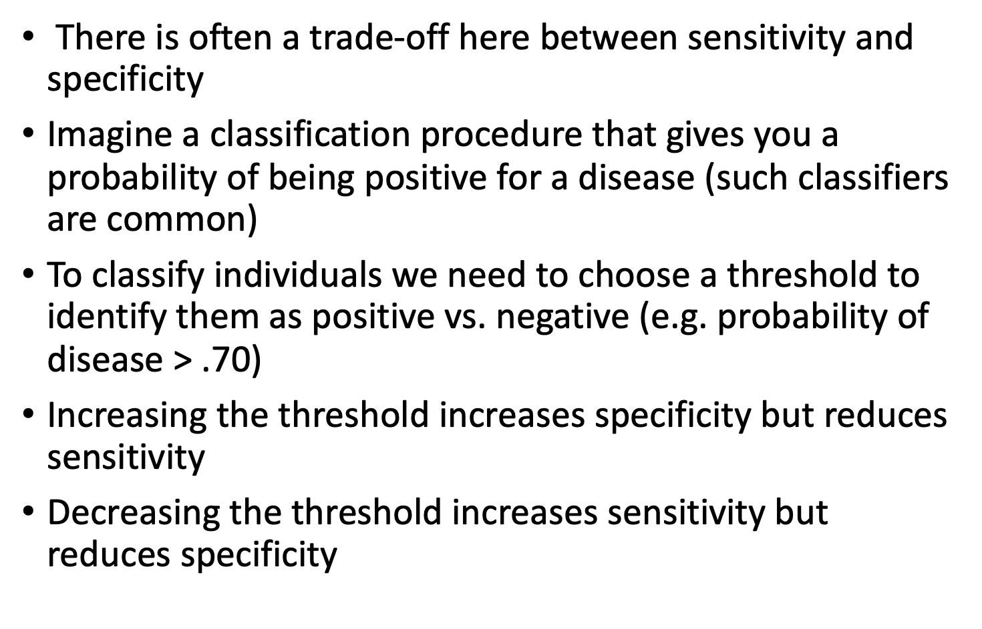
Sensitivity and Specificity: a trade-off
There is often a trade-off here between sensitivity and specificity
Imagine a classification procedure that gives you a probability of being positive for a disease (such classifiers are common)
To classify individuals we need to choose a threshold to identify them as positive vs. negative (e.g. probability of disease > .70)
Increasing the threshold increases specificity but reduces sensitivity
Decreasing the threshold increases sensitivity but reduces specificity

Slide 30


Receiver operating characteristic (ROC) curve
Definition: The ROC curve is a graphical summary of the performance of a classifier when the classification threshold is varied.
Sensitivity
1 - Specificity

Slide 31




Choosing threshold based on ROC
  Rule 1: predict label disease if probability of disease > .4
Many possible thresholds, each corresponding to one point on curve
  Rule 1: high sensitivity (80%) low specificity (50%)
  Rule 2: low sensitivity (40%) high specificity (90%)
ROC curve is constructed by evaluating each possible threshold
Sensitivity
1 - Specificity
  Rule 2: predict label disease if probability of disease > .80

Slide 32
Choosing threshold based on ROC
  Rule 1: predict label disease if probability of disease > .4
Many possible thresholds, each corresponding to one point on curve
  Rule 1: high sensitivity (80%) low specificity (50%)
  Rule 2: low sensitivity (40%) high specificity (90%)
ROC curve is constructed by evaluating each possible threshold
The black diagonal line represents performance from 50/50 guessing
Choosing a single threshold depends on context, i.e. cost-benefit
Sensitivity
1 - Specificity
  Rule 2: predict label disease if probability of disease > .80

Slide 33
Area under the (ROC) curve (AUC)
We will not be concerned with choosing thresholds, rather, we will use ROC to generate another evaluation metric
AUC gives a measure of how well the predictor does across all possible thresholds
Ideal AUC is 1
AUC for random predictor = 0.5
Objective is to find classifier that maximizes AUC
In a sense, AUC tells you how well the classifier separates the two classes
Sensitivity
1 - Specificity

Slide 34
AUC “Grade” for Classifier
AUC | Grade
.90 – 1.00 | A
.80 - .89 | B
.70 - .79 | C
.60 - .69 | D

Slide 35
Accuracy vs. AUC
When should we choose accuracy and when AUC? Consider both the sample and the class imbalance.
Accuracy (and cost-benefit) work well when your dataset is representative of the larger population (metric incorporates prevalence – e.g. proportion of people in population that have disease)
AUC works better when your dataset is not representative of larger population, e.g. in “case-control” studies (metric is independent of prevalence)
Also think about imbalance in class labels

Slide 36
Evaluation metrics for categorical data
Possible evaluation metrics:
  Classification Accuracy – or conversely, the classification error rate = 1 – classification accuracy
  Cost-Benefit – some errors (e.g. FP, FN) are counted more than other, often context dependent
  Sensitivity, specificity, precision
  Area Under Receiver Operating Characteristic (ROC) Curve (AUC)
Guiding questions in selecting evaluation metrics
  What is my analytical goal, i.e. research question?
  What metric can best help me evaluate how reliable by predicted results are in the context of my analytical goal?

Slide 37
Training set error rate: is generally too optimistic!
You can find patterns even in random data
So we need to evaluate on separate independent (test) set… and now we have evaluation metrics to evaluate our classifications!

Slide 38
2D Classification example

Slide 39
Training/Test
At least greater than a few hundred instances and better >1000
Results Known
Training set (2/3)
+
+
-
-
Data
+
-
+
+
Model Builder
Evaluate predictions
+
-
-
+
-
+
Y
N
Testing set (1/3)
+
-
-
+
Evaluate predictions

Slide 40
Classification methods
Logistic regression
K-nearest neighbors
Classification trees
Support vector machines (SVM)
Neural networks

Slide 41
Logistic Regression

Slide 42
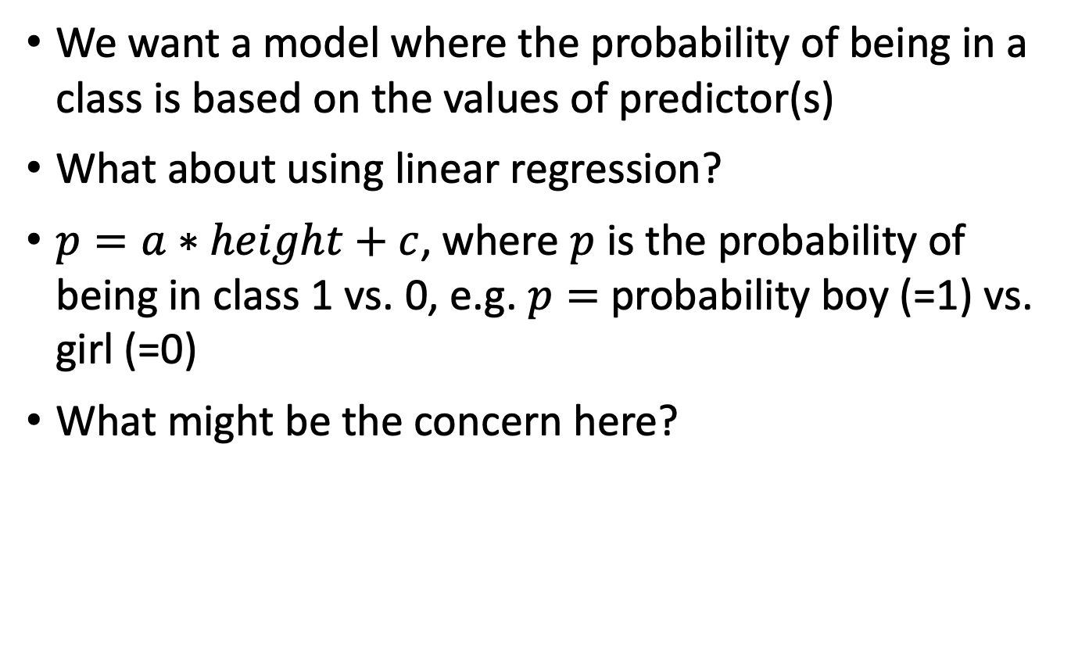
Thought experiment
We want a model where the probability of being in a class is based on the values of predictor(s)
What about using linear regression?
$p=a∗height+c$, where $p$ is the probability of being in class 1 vs. 0, e.g. $p=$probability boy (=1) vs. girl (=0)
What might be the concern here?

Slide 43


Linear regression?
$$p$$
1
0
$$height$$

Slide 44
Linear regression
Problem predictions – outside range 0 to 1
$$p$$
110 % boy?
1
0
$$height$$

Slide 45
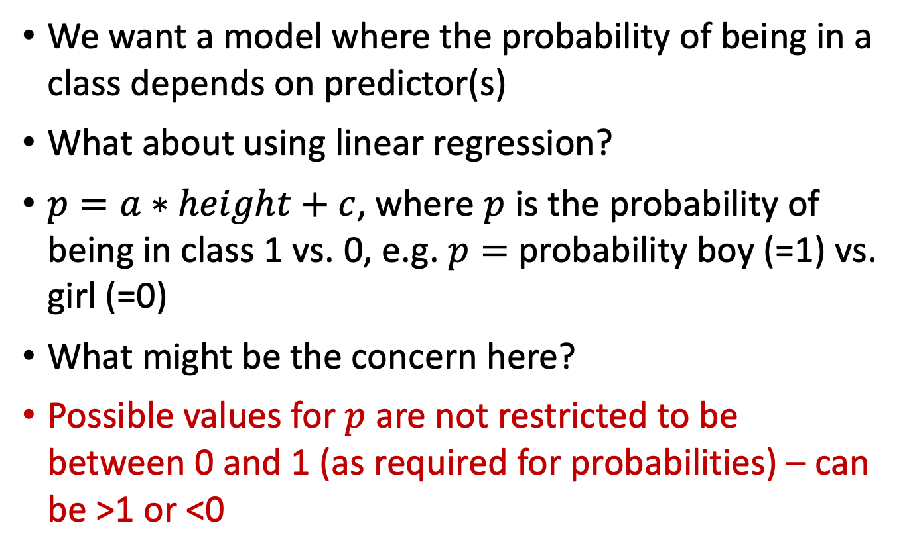
Class outcome regression modeling
We want a model where the probability of being in a class depends on predictor(s)
What about using linear regression?
$p=a∗height+c$, where $p$ is the probability of being in class 1 vs. 0, e.g. $p=$probability boy (=1) vs. girl (=0)
What might be the concern here?
Possible values for $p$ are not restricted to be between 0 and 1 (as required for probabilities) – can be >1 or <0

Slide 46
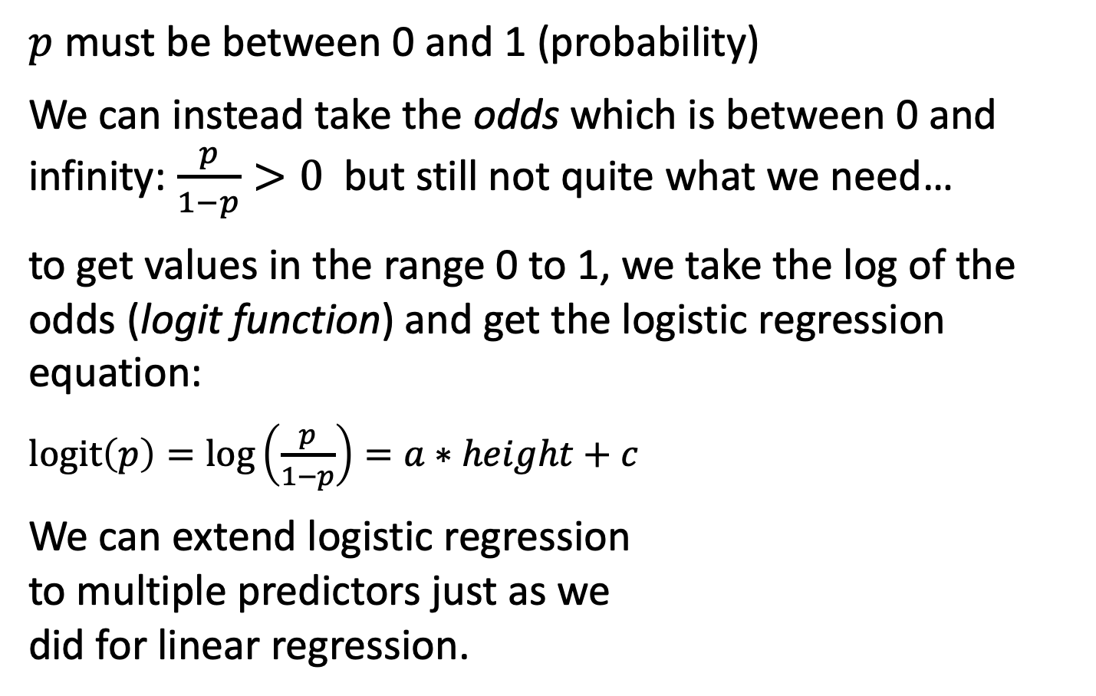
Logistic regression
$p$ must be between 0 and 1 (probability)
We can instead take the odds which is between 0 and infinity: $\frac{p}{1−p}>0$ but still not quite what we need…
to get values in the range 0 to 1, we take the log of the odds (logit function) and get the logistic regression equation:
$logit\left(p\right)=\log\left(\frac{p}{1−p}\right)=a∗height+c$
We can extend logistic regression
to multiple predictors just as we
did for linear regression.
Notes:
https://youtu.be/yIYKR4sgzI8?t=189

Slide 47
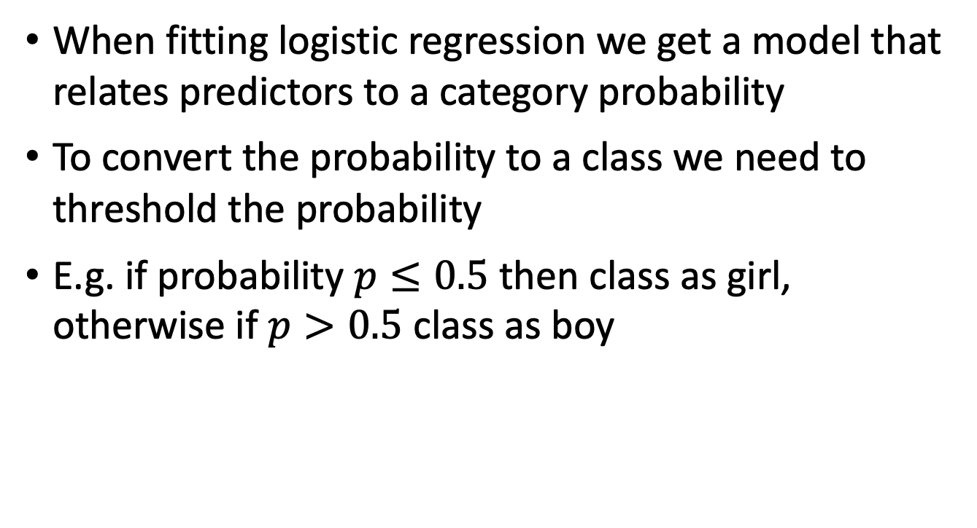
Logistic regression for classification
When fitting logistic regression we get a model that relates predictors to a category probability
To convert the probability to a class we need to threshold the probability
E.g. if probability $p≤0.5$ then class as girl, otherwise if $p>0.5$ class as boy

Slide 48
Logistic regression
A long history (relatively) – well known
Much statistical theory
Works well for many problems
Can be extended to multiple categories
Can provide interpretable models

Slide 49
Review of this lecture
  Introduction to classification
  Evaluation metrics for classes
  Validation and testing, continued
  Logistic regression

Slide 50
Next Monday – more classification!
K-nearest neighbors
  Parameter tuning
  Training-validation-test
  Cross-validation
Classification trees (recursive partitioning)
Support vector machines
Artificial neural networks
Comparison of classifiers

