Slide 1
Biostat 202: Opportunities and Challenges of “Big Data”.
Machine Learning 3:
Supervised learning, contd. [classification]
Aaron Wolfe Scheffler
Division of Biostatistics
Department of Epidemiology and Biostatistics

Slide 2
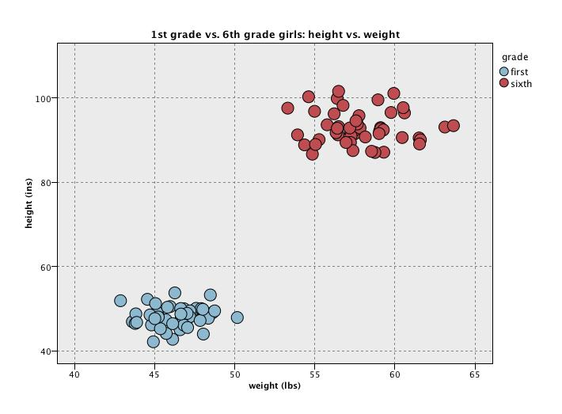
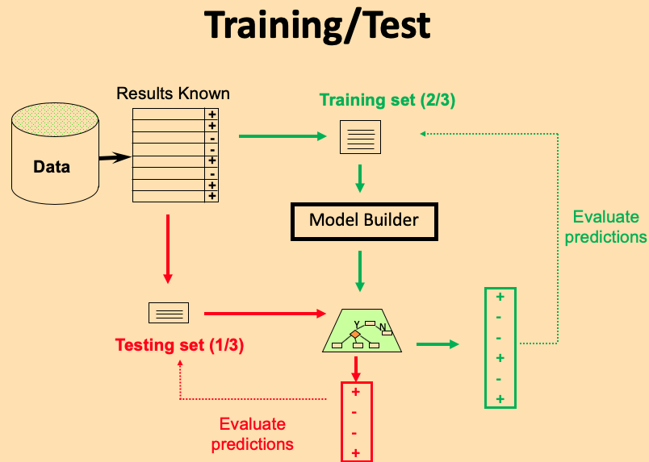
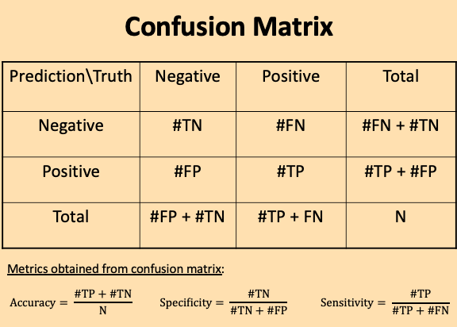
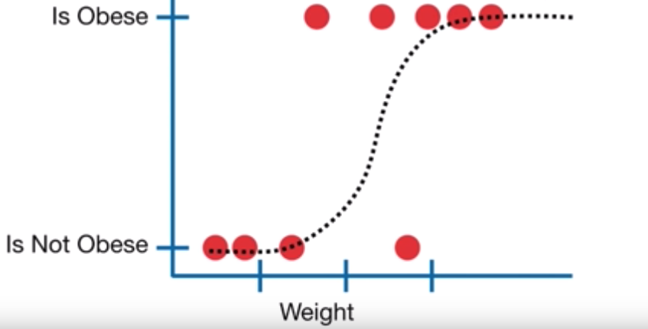

Review of last lecture
Introduction to classification
Evaluation metrics for classes
Validation and testing, contd.
Logistic regression
$logit\left(p\right)=\log\left(\frac{p}{1−p}\right)=a∗weight+c$

Slide 3
Overview of this lecture
- more classification!
K-nearest neighbors
  Parameter tuning
  Training-validation-test
Classification trees (recursive partitioning)
Support vector machines
Artificial neural networks
Comparison of classifiers

Slide 4
Classification
Machine Learning
Supervised
Regression (continuous outcome)
Classification (categorical outcome)
Unsupervised
Clustering
(grouping observations)
Data Reduction (transforming variables)

Slide 5
K-nearest neighbors classification

Slide 6
K-nearest neighbors classification
Training data: = female, = male
height
weight

Slide 7
K-nearest neighbors classification
height
Unknown new point – need to predict class
weight

Slide 8
K-nearest neighbors classification
k = 1 : blue wins
height
weight

Slide 9
K-nearest neighbors classification
k = 3 : red wins
height
weight

Slide 10
KNN VS. LOGISTIC
To predict the category for each class, KNN ONLY considers the k-nearest points - other points do not matter!
Contrast with logistic regression which uses all the data to construct a classification rule via the coefficient parameters
k=3 – red wins
height
weight

Slide 11

K-nearest neighbors classification
Captures local behavior, a nosy neighbor
Neighborhood defined by “closest points” (distance)
Common to standardize predictors to have mean 0 and standard deviation of 1 – allows equity among variables of different scales
Classification based on majority vote among k-nearest neighbors, vote also used to calculate probability of each class in neighborhood
Ties are broken at random

Slide 12
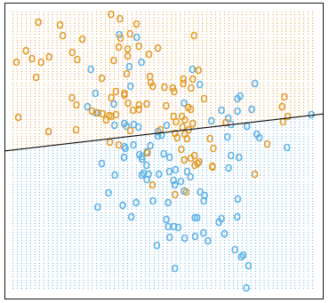
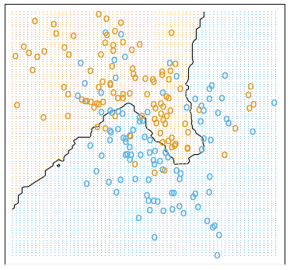
Classification/Decision Boundaries
Linear decision boundary (LDA) 15-nearest neighbor boundary
Example taken from Elements of Statistical Learning – Hastie et al. 2nd Ed. pp. 13-17

Slide 13
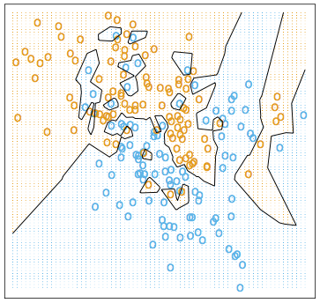
Choice of k affects boundary
SMALLER K = MORE LOCAL/FLEXIBLE DECISION BOUNDARY!!!
15 nearest-neighbor boundary 1-nearest neighbor boundary

Slide 14
Parameter tuning
Parameter tuning is the process of adjusting model parameters in order to find the “best” model
For example, we tune the K-nearest neighbors by adjusting the parameter k, the number of neighbors
Analogy: tuning the strings of a guitar to play the proper note is like parameter tuning to get the best prediction
Notes:
Image source: https://www.guitarworld.com/lessons/how-to-tune-your-guitar-by-ear

Slide 15
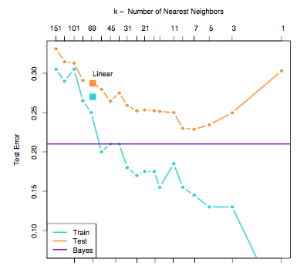
Choice of k

Slide 16
Choice of k
Fitting increased noise
Low to high complexity

Slide 17
Choice of k
Fitting increased noise
Low to high complexity
Training set error gets better with more complexity – fitting to noise helps

Slide 18
Choice of k
Fitting increased noise
Low to high complexity
Test error goes down then up again when overfitting
to training data
Training set error gets better with more complexity – fitting to noise helps

Slide 19
Choice of k
Best predictive
models (k = 7)
Fitting increased noise
Low to high complexity
Test error goes down then up again when overfitting
to training data
Training set error gets better with more complexity – fitting to noise helps

Slide 20
K-nearest neighbors classifier
Simple technique
No modeling, just use the training data to “vote”
Has been applied to many machine learning problems successfully
Have to “carry the data” to make a new prediction
Not good for a large number of predictors – suffers from the “curse of dimensionality”

Slide 21
Parameter tuning
Many machine learning algorithms have “tuning parameters” (hyperparameters) that control behavior of model (e.g. k in KNN)
Parameter tuning occurs in three stages:
  Stage 1: builds the model for several parameter values
  Stage 2: calculate performance for models using evaluation metrics
  Stage 3: select the model with optimal parameter settings, i.e. optimizes an evaluation metric in independent data set

Slide 22
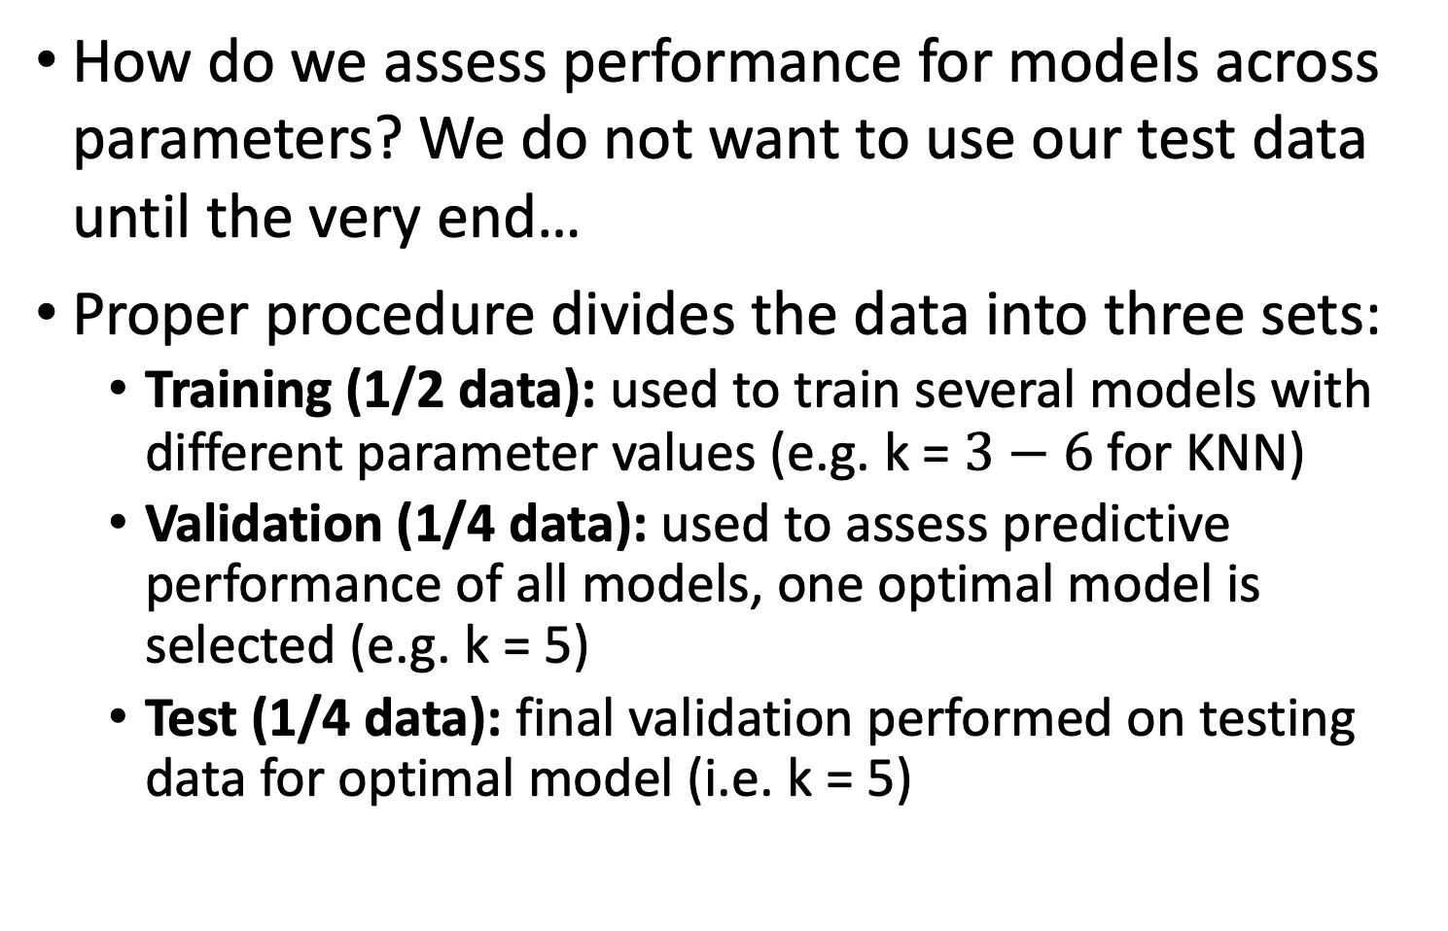
Parameter tuning
How do we assess performance for models across parameters? We do not want to use our test data until the very end…
Proper procedure divides the data into three sets:
  Training (1/2 data): used to train several models with different parameter values (e.g. k = $3−6$ for KNN)
  Validation (1/4 data): used to assess predictive performance of all models, one optimal model is selected (e.g. k = 5)
  Test (1/4 data): final validation performed on testing data for optimal model (i.e. k = 5)

Slide 23
Training/Test
Results Known
Training set (2/3)
+
+
-
-
Data
+
-
+
+
Model Builder
Evaluate predictions
+
-
-
+
-
+
Y
N
Testing set (1/3)
+
-
-
+
Evaluate predictions

Slide 24

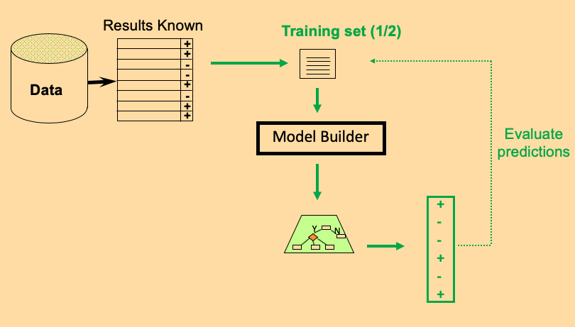
Train/Validate/Test
k = 3, 4, 5, 6
1. Train: repeatedly fit model to training data for multiple values of the procedures parameter(s), e.g. k = 3, 4, 5, 6 for K-nearest neighbors

Slide 25
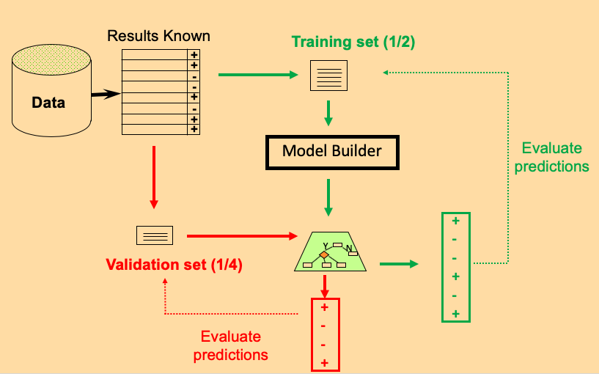
Train/Validate/Test
k = 3, 4, 5, 6
1. Train: repeatedly fit model to training data for multiple values of the procedures parameter(s), e.g. k = 3, 4, 5, 6 for K-nearest neighbors
2. Validate: each model based on training set has potentially been overfit… so utilize a validation set to determine best fitting model

Slide 26

Train/Validate/Test
k = 3, 4, 5, 6
1. Train: repeatedly fit model to training data for multiple values of the procedures parameter(s), e.g. k = 3, 4, 5, 6 for K-nearest neighbors
2. Validate: each model based on training set has potentially been overfit… so utilize a validation set to determine best fitting model
3. Test: we are choosing from many models so we may have over-fit…utilize a test set to determine predictive performance of the best fitting model from the purple box
BEST
MODEL
+
-
-
+
-
+
Testing set (1/4)
Y
N
(k = 5)
Evaluate predictions

Slide 27
Decision Trees
(Recursive Partitioning)

Slide 28
Recursive partitioning – how trees work
Recursive partitioning: Classification based on a series of decision cut-points along a single variable at a time
At the end of the series of questions a decision node is reached
Example: at risk or heart disease?
  [?] Is systolic blood pressure greater that 140?
  [?] If yes, is LDL Cholesterol greater than 190?
  [DECISION] If yes, at risk for heart disease!
Recursive portioning is successful because branches act like interaction terms (from Machine Learning Lecture 1)

Slide 29
Recursive partitioning logic

Slide 30
At risk for heart disease?
Target: risk for heart disease (RISK/NO RISK)
Features:
  Systolic BP
  LDL cholesterol
  Exercise (times/week)
  Alcohol (units/day)

Slide 31


At risk for heart disease? RISK vs NO RISK
Systolic BP < 140?
No Yes
Exercise < 2 times per week
LDL > 190?
Exercise < 3 times per week
Alcohol < 2 units/day?
RISK
NO RISK
RISK
NO RISK
RISK
NO RISK

Slide 32
How are trees “grown”?
Greedy approach - only considers one variable at a time for split
Start with first best split on a single variable based on some criterion – different implementations of decision trees use different criterion
  Information gain is on such criterion - favors splits that induce purity in the resulting node [used in Orange]
  Gini Index is related to information gain – slightly biased towards splitting along features with many categories
Then within each branch look for the best split on a single variable for the observations within that branch
Keep going until each branch is pure or has less than some number of observations (e.g. 5) – majority vote

Slide 33
Pruning trees
Full tree after growing is typically too complex
Goal is to find the sub-tree (contained in the fully grown tree) that minimizes a cost-complexity criterion (regularization!)
The cost-complexity criterion is a trade-off between the classification error rate and the complexity (size) of the tree.
Cut branches away that are not necessary and do not substantially improve prediction
This trade-off can be determined train/validate/test to minimize the classification error rate

Slide 34

Pruning a tree
Systolic BP > 140?
No Yes
Exercise < 2 times per week
LDL > 190?
Exercise < 3 times per week
Alcohol < 2 units/day?
RISK
NO RISK
Maybe this branch is unnecessarily complex, so it is “pruned”
RISK
NO RISK
RISK
NO RISK

Slide 35
Pruned Tree
Systolic BP > 140?
No Yes
Exercise < 2 times per week
LDL > 190?
Alcohol < 2 units/day?
RISK
NO RISK
NO RISK
RISK
NO RISK

Slide 36
Recursive Partitioning
Recursive partitioning methods are a very popular classification approach and come in many flavors:
  Classification and Regression Trees (CART), C5.0, CHAID, QUEST
  Methods differ based on method for both growing and pruning
Partitioning on cut-points approach is very popular in medicine, because mimics decision approach of clinicians
Cutting-edge ensemble extensions such as Random Forests average over a bunch of trees – hence forest (more on this later)

Slide 37
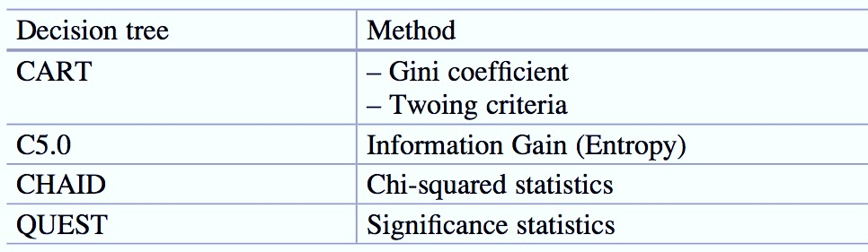

Decision tree methods
C5.0 is generally accepted as the best stand alone recursive partitioning method

Slide 38
Support Vector Machines
(SVM)

Slide 39
Support vector machines
Developed in computer science community in 1990s
Idea is to generate a line/plane that optimally separates points from different classes in a feature space
In SVM, this line/plane forms our classification rule and optimal separation is achieved when classes are as “far” apart as possible (i.e. have the “maximal margin”)

Slide 40
SVM – what is best line to separate categories?
Many classification rules are possible…

Slide 41
Maximizing margins
Classification Rule

Slide 42
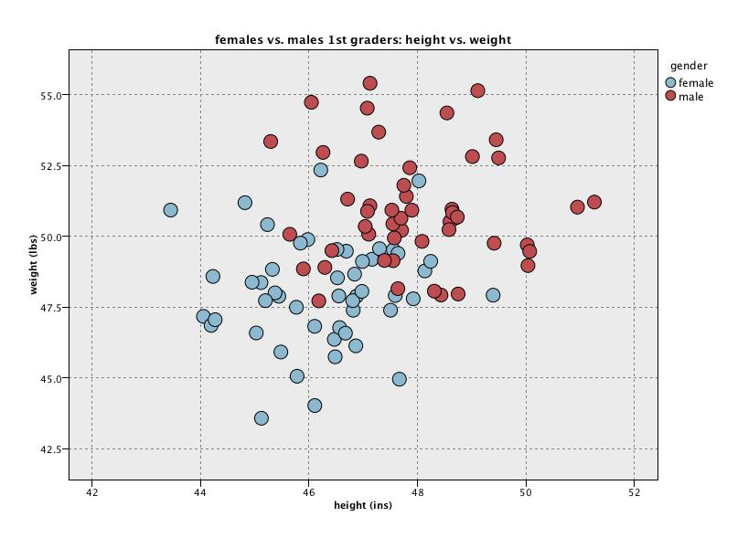
Soft margin
We cannot construct a maximal margin because of overlap in the data. Thus, we use a “soft margin” which balances potential misclassification with margin width

Slide 43
Linearity can be limited, may need
“non-linear” decision boundary
?

Slide 44
Linearity can be limited, may need
“non-linear” decision boundary
?
The trick of SVM is not to have non-linear models for the separation boundaries directly, but rather to warp the space that the data is in. That way, linear boundaries in the warped space become non-linear back in the original space.

Slide 45
Support vector machines
Considers data closest to the classification boundary, robust to outliers
Black box predictor, but not so good for interpretation
Was considered one of the best “out of the box” classifiers for complex big data problems
Was very popular, declining due to new methods
It may still work well

Slide 46
Artificial Neural Networks

Slide 47
Artificial neural networks
“A computing system made up of a number of simple, highly interconnected processing elements, which process information by their dynamic state response to external inputs.”
Inputs are fed into the neural network and processed by hundred of interconnected nodes which each perform some operation on the data (activation)
The combined activation of all nodes throughout the network and their interactions are reduced to a simple classification rule
The ultimate “black box” machine learning algorithm

Slide 48
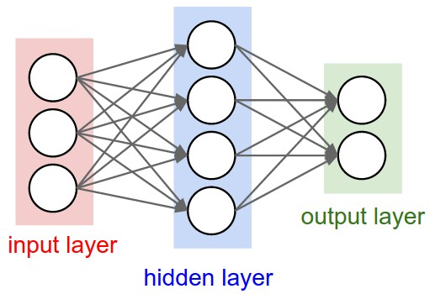
Artificial neural networks
Connections
Nodes
SysBP
HD
sex
NO HD
age
Underlying math is complex, but every node is a complex function of it’s inputs, and the parameters/weights (connections) of the function are learned from the training data. To expand model complexity, add more hidden layers.

Slide 49
Artificial neural networks
Very good when we have lots and lots of data that is complex (e.g. unstructured data)
Allows for interactions (like decision trees) and non-linear classification rules (like K-nearest neighbors or support vector machines with kernel trick)
Can be VERY prone to overfitting and models must be tuned carefully – have billions of parameters

Slide 50
Choosing a classifier
Logistic regression
  Good for interpretation
  Not highly flexible
K-nearest neighbors classification
  No “model” required
  Not so good for interpretation
  Not so good if you have very large number of predictors
Decision trees
  Easy to interpret and explain
  No “model” required
Support vector machines
  Can be very accurate
  Can deal with highly non-linear separation of features
  Requires effort to tune and difficult to interpret
Neural networks
  Very flexible structure, good for unstructured data, requires a lot of data to train
  Prone to overfitting, requires effort to tune and difficult to interpret
If your primary goal is good prediction, then you can run multiple classifiers to find the best, or even combine them to get an even better model overall (ensemble techniques of boosting, bagging and stacking –discuss later in the course)

Slide 51
Many of the models discussed today can be used for regression!
With some adaptation, the techniques we have discussed today can be applied to target continuous outcomes, i.e. regression problems
We will not discuss but Orange offers regression versions of the following algorithms:
  K-nearest neighbors
  Regression trees (recursive partitioning)
  Support vector machines
  Artificial neural networks

Slide 52
Review of this lecture
K-nearest neighbors
  Parameter tuning
  Training-validation-test
Classification trees (recursive partitioning)
Support vector machines
Neural networks
Comparison of classifiers

Slide 53
Next Thursday— supervised learning fin
Cross validation
Ensemble methods
  Bagging
  Boosting
  Stacking
Feature importance

