Slide 1
Biostat 202: Opportunities and Challenges of “Big Data”:
Machine Learning 4:
Cross-Validation, Ensembles, and Feature Importance
Aaron Wolfe Scheffler
Division of Biostatistics
Department of Epidemiology and Biostatistics

Slide 2
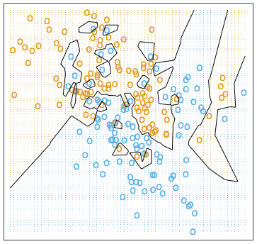
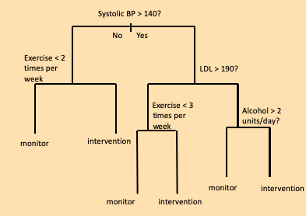
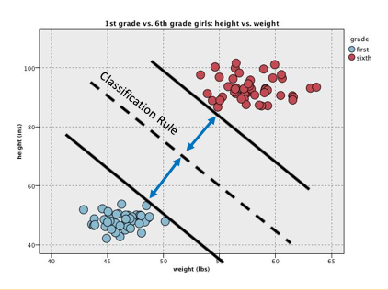
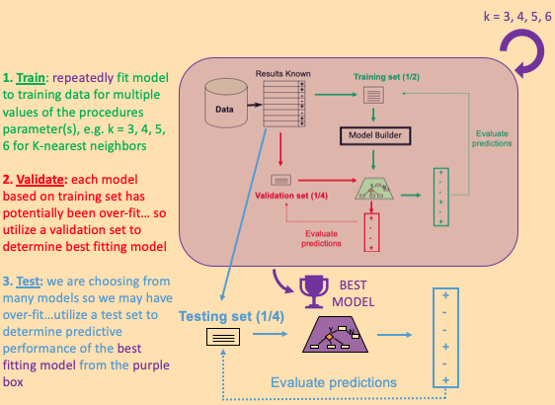
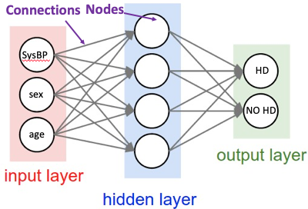
Review of last lecture
Classification trees
Support vector machines
Artificial neural networks
K-nearest neighbors
Train/validate/test

Slide 3
Outline
Cross-validation
Ensemble methods
  Bagging: Random Forests
  Boosting: Adaboost
  Stacking
Parameter tuning, continued
Feature importance

Slide 4
Cross-validation

Slide 5
Cross-validation
For complex models and ensemble, parameter tuning is almost always required
What if you don’t have enough data to split 3 or even 2 ways for train/validate/test?
If data is expensive, it is a big sacrifice to reserve a large proportion of data for validation and testing…
Solution: cross-validation

Slide 6
Cross-validation
Cross-validation
  First step: data is split into k subsets (folds) of equal size
  Second step: each subset is used in turn for validation (evaluation of prediction) and the remainder for training
This is called k-fold cross-validation (10-fold is common choice, also 5-fold for smaller datasets approx. <200 and even N-fold for very small datasets, called leave-one-out)

Slide 7
E.g. 5-fold cross-validation
1. Break up data into 5 “folds” of the same size
2. Set aside one fold for validation and use the rest to build model, repeat this process for each fold
Estimate the predictive performance of our model on the combined validation data (i.e. the validation_1-5 sets)
Fold 1 | Fold 2 | Fold 3 | Fold 4 | Fold 5
Iteration 1 | training_1 |  |  |  | validation_1
Iteration 2 | training_2 |  |  | validation_2 | training_2
Iteration 3 | training_3 |  | validation_3 | training_3
Iteration 4 | training_4 | validation_4 | training_4
Iteration 5 | validation_5 | training_5

Slide 8
Cross-validation
Notice that at no time is the predictive performance based on data that was used to train the model – so there is no over-fitting
Use of cross validation
  Single model assessment: replaces train/test
  Multiple model assessment (i.e. hyperparameter tuning): replaces train/validation – STILL NEED TO ASSESS FINAL MODEL ON A TEST SET!

Slide 9
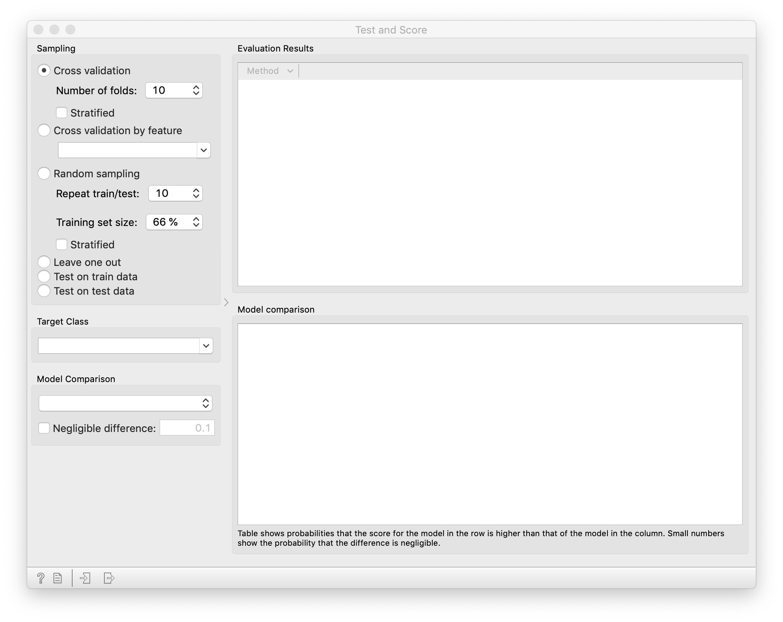
Cross-validation - Orange
The evaluation metrics are averaged across folds to yield an overall assessment of predictive performance
Often the subsets are stratified before the cross-validation is performed – e.g. same proportion of each class or group in each fold

Slide 10
Ensemble Methods

Slide 11
Ensemble methods
Train a bunch of predictive models and pool them to form a final prediction.
Advantage:
  improvement in predictive accuracy
Disadvantages:
  more computation
  it is difficult to understand an ensemble of classifiers
Examples: bagging, boosting, and stacking

Slide 12
Bagging
Bagging = “Bootstrap Aggregating”
Simplest way of combining predictions from a similar class of models
Train models on slightly different versions of the data and combine via voting or averaging with each model receiving equal weight
You can bag any model, most common is decision trees (e.g. random forest)

Slide 13
Bagging
Basic idea of bagging:
  Re-sample several training sets of size n from the dataset with replacement (bootstrap sample)
  Build a model for each training set
  Combine the models predictions (majority vote)
Improves performance in almost all cases if learning scheme is unstable (e.g. decision trees depend heavily on where the first cut occurs )

Slide 14
Bagging
Notes:
Image source: https://upload.wikimedia.org/wikipedia/commons/thumb/c/c8/Ensemble_Bagging.svg/2560px-Ensemble_Bagging.svg.png

Slide 15
Random Forests
FINAL PREDICTION BY VOTING ACROSS ALL TREES,
THE RANDOM FOREST!
Notes:
Image Source: https://community.alteryx.com/t5/Alteryx-Designer-Knowledge-Base/Seeing-the-Forest-for-the-Trees-An-Introduction-to-Random-Forest/ta-p/158062

Slide 16
Boosting
Use a sequence of “weak” learners to produce a strong one
Uses model voting/averaging to aggregate predictions but models are trained on the same data and re-weighted based on their performance
Justification: a sequence of weak learners that complement each other

Slide 17
Boosting
Basic idea of boosting: iterative procedure:
  Train a weak model on the data
  Determine which observations are incorrectly/correctly predicted
  Retrain the weak learner, this time encourage it to try and guess the previously misclassified data points
  Repeat process (say 100 times) then vote across all models
With each iteration, models are encouraged to become expert for instances classified incorrectly by earlier models
Subtlety comes from in how misclassified instances are reweighted

Slide 18
Boosting
Notes:
Image source: https://en.wikipedia.org/wiki/Boosting_(machine_learning)#/media/File:Ensemble_Boosting.svg

Slide 19
Adaptive Boosting (Adaboost)
Notes:
Image source: https://www.sciencedirect.com/topics/engineering/adaboost

Slide 20
Boosting algorithms
1997
Adaboost – Orange implemented
2016
XGBoost – considered best predictive algorithm for tabular data

Slide 21
Boosting vs Bagging
Notes:
Image source: https://www.datacamp.com/community/tutorials/adaboost-classifier-python

Slide 22
Stacking
Uses a “meta-learner” instead of voting to combine predictions across models
Individual initial models can be of many different types
Complex methodology to build meta-learner by learning again from the initial set of models (machine learning on top of machine learning)
Can help unlearn bias in each base model

Slide 23
Stacking
Notes:
Image source: https://towardsdatascience.com/ensemble-methods-bagging-boosting-and-stacking-c9214a10a205

Slide 24
Parameter Tuning

Slide 25
Parameter tuning, continued
Some algorithms have one parameter to tune
  KNN: k neighbors
  Linear/Logistic regression: alpha regularization parameter
Others have many
  Decision trees: number of splits, number of leaves, minimum number of subject, etc…
  Random forest: everything about the tree plus number of trees
Parameter tuning often requires extensive training and evaluation over a grid of possible hyperparameters

Slide 26
Parameter tuning, continued
Example: decision tree
  Min. number of instances in leaves [5, 10, 15]
  Do not split subsets smaller than [15, 20, 25]
  Limit the maximal tree depth to [20, 60, 80]
  Produces 3x3x3=27 possible configurations!
Parameter tuning is often done in an automated way by defining the parameter grid and telling the computer to find the configuration that produces a single optimal evaluation metric

Slide 27
Feature Importance

Slide 28
Feature importance
Even though we fool ourselves into only being concerned with prediction, we often want to understand which features impact our prediction
Given a target variable, which variables are important for prediction?
The define this, you can develop measures of feature importance
Feature importance can either be pair wise or model based
  Pairwise: based directly on measures of association between target and individual features (e.g. correlation)
  Model based: based on machine learning algorithms (e.g. regression coefficients, classification tree splits)

Slide 29
Feature importance – pairwise
Looking at pairwise association between individual features and target can help identify variables that may be important for subsequent prediction
Measures in Orange (target type dependent)
  Information gain: expected information (reduction of entropy or chaos) in a feature with respect to a target
  ANOVA: difference between average values of the feature in different classes
  Chi2: dependence between features and outcome class
  FCBF: information based measure, identifies redundancy due to correlation among features when estimating relevance to target

Slide 30
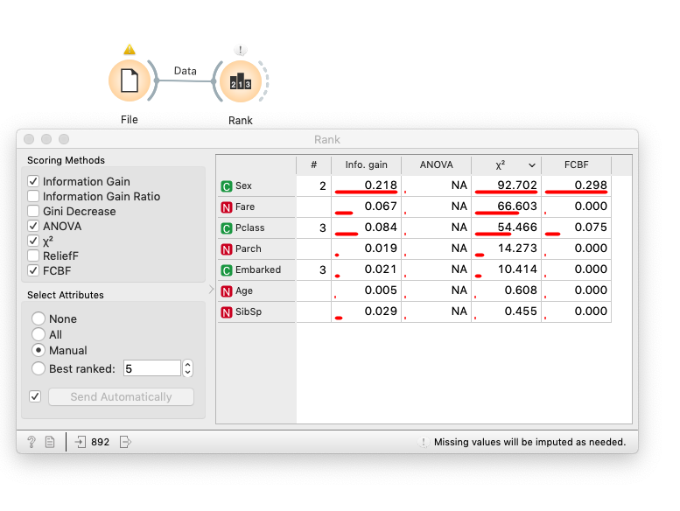
Titanic feature importance – pairwise

Slide 31
Feature importance – model based
Model output (if available)
  Decision trees, regression
  Rule induction (lab)
Permutation feature importance – model agnostic
  Fit model with data and evaluate predictive performance
  Return to data, scramble one feature randomly among observations
  Refit model and compare model performance to original data.
  Repeat for every variable. Most important variables will produce biggest drops in predictive performance
  You can do this with any model that has tabular data!

Slide 32
Feature importance – permutation
Notes:
Image source: https://www.kaggle.com/dansbecker/permutation-importance

Slide 33
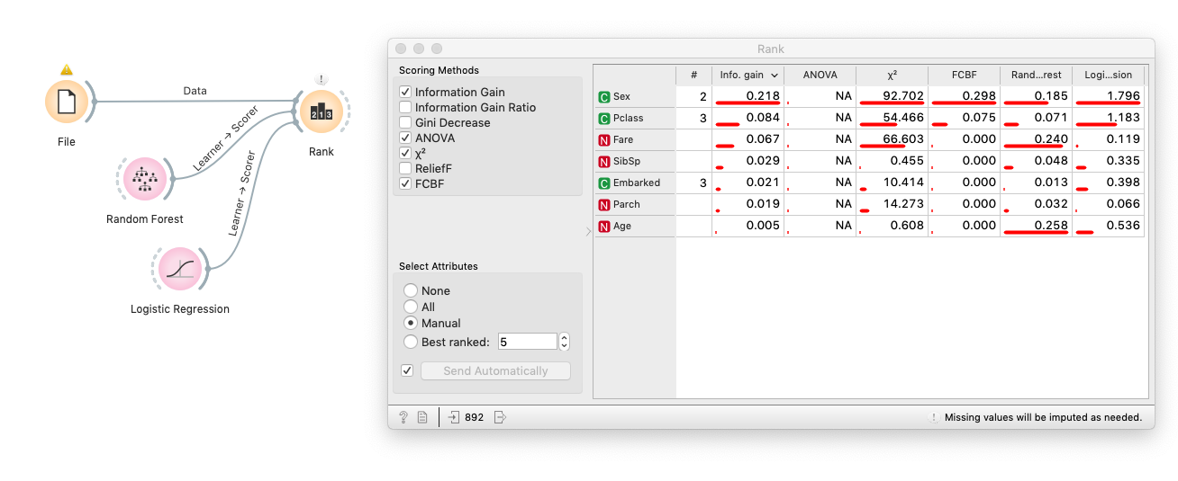
Titanic feature importance – model

Slide 34
Review of this lecture
Cross-validation
Ensemble methods
  Bagging: Random Rorests
  Boosting: Adaboost
  Stacking
Hyperparameter tuning continued
Feature importance

Slide 35
Next time
Clustering
  k-means clustering
  TwoStep clustering
  Kohonen self-organizing map (SOM)
Data reduction
  Principal components analysis (PCA)
  t-Distributed Stochastic Neighbor Embedding (t-SNE)
Guidance for choosing machine learning algorithms

