Slide 1
Biostat 202: Opportunities and Challenges of “Big Data”
- Causal Inference in ‘Big Data’
Aaron Wolfe Scheffler,
Division of Biostatistics,
Department of Epidemiology and Biostatistics

Slide 2
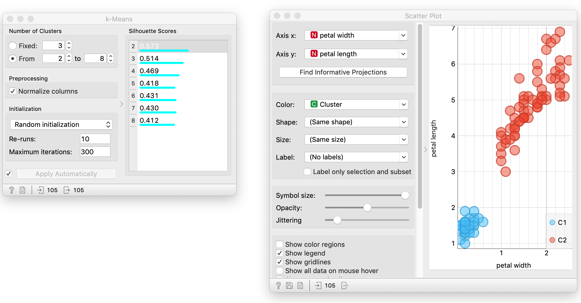
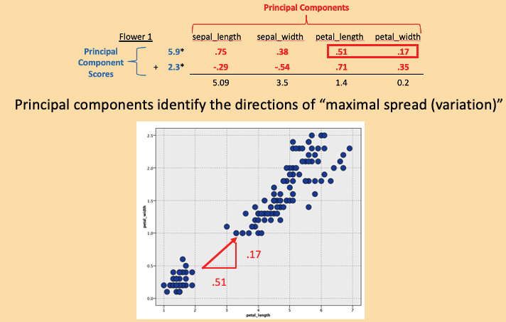
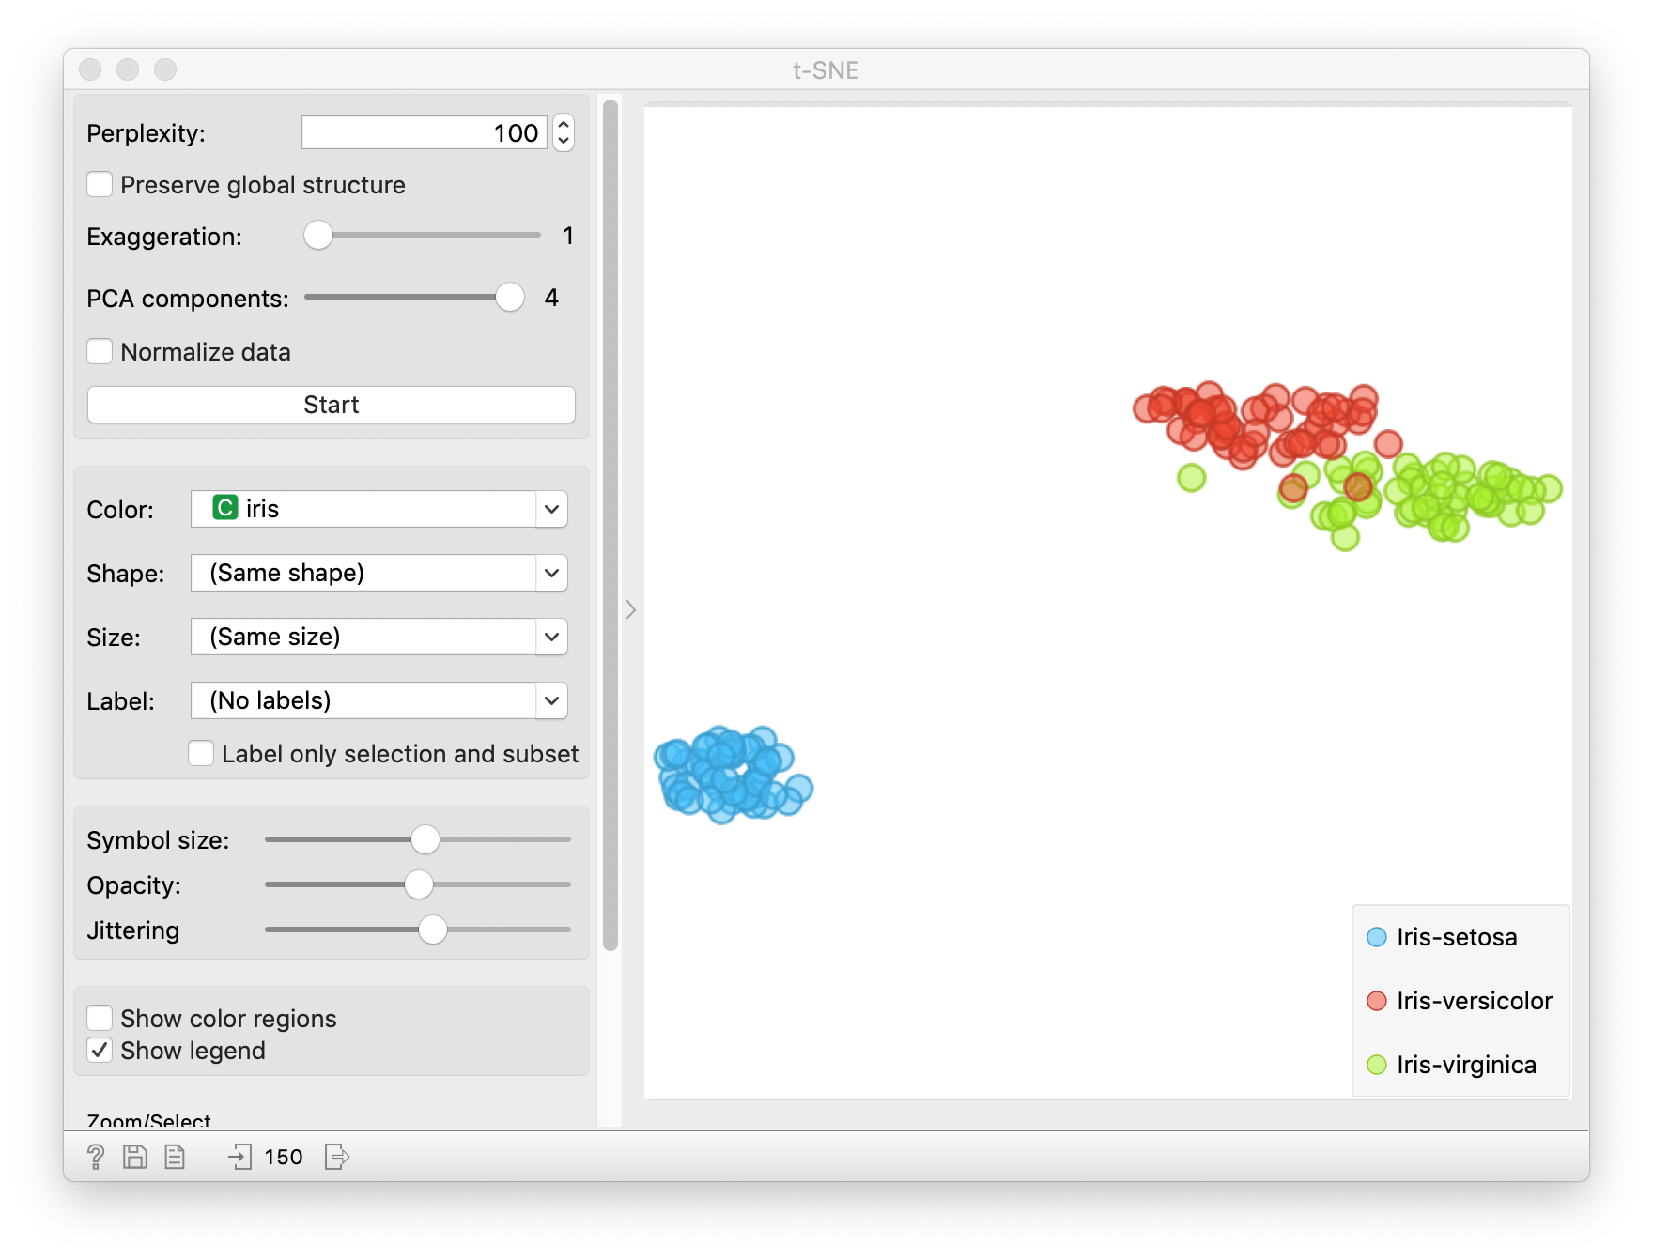
Review
Clustering
k-means
heirarchical
Dimension Reduction
PCA
t-SNE

Slide 3
Outline
Introduction: prediction versus causation
Threats to causal conclusions
Causal methods in (very) brief
Interpretability of machine learning methods
Some uses of big data and machine learning in causal inference
Summary

Slide 4
Outline
Introduction: prediction versus causation
Threats to causal conclusions
Causal methods in (very) brief
Interpretability of machine learning methods
Some uses of big data and machine learning in causal inference
Summary

Slide 5
Prediction versus causality
Data-mining and machine learning algorithms are only based on associations.
Often interested in causation, i.e., understand the cause of illness or develop interventions that cause improvement.
Correlation does not imply causation
  https://www.tylervigen.com/spurious-correlations
Often senior researchers have lapses and over-interpret correlations causally
The (social) media frequently confuses causation and correlation

Slide 6
Which of these are prediction versus causation questions?
Effect of Abaloparatide on fractures in postmenopausal women.
Estimating fetal risk of a disease using genetic screening.
Effect of cerebral protection device on brain lesions following aortic valve implantation.
Estimation of temporal trends in preterm birth rates and their association with obstetric interventions.
Survival for children with trisomy 13 and 18.
Notes:
All recent JAMA articles.

Slide 7
Prediction vs Causation
Bona fide prediction problems:
Early detection of cancer.
Identifying high risk patients for closer monitoring.
Prediction of disease epidemics.
Key aspects of prediction: Not concerned with causal interpretation of the effect of variables included in the model or interpreting presence or absence of the variable in the model causally. No interest in p-values – focus on prediction accuracy.
Notes:
Key words: effect, intervention = causal, estimate, predict = prediction.

Slide 8
Which of these are prediction versus causation questions?
Effect of Abaloparatide on fractures in postmenopausal women.
Estimating fetal risk of a disease using genetic screening.
Effect of cerebral protection device on brain lesions following aortic valve implantation.
Estimation of temporal trends in preterm birth rates and their association with obstetric interventions.
Survival for children with trisomy 13 and 18.
Notes:
Abaloparatide = treatment for osteoporosis. Trisomy 13 and 18 are genetic disorders that cause birth defects; babies with these defects often die by age 1.

Slide 9
Which of these are prediction versus causation questions?
Effect of Abaloparatide on fractures in postmenopausal women.
Estimating fetal risk of a disease using genetic screening
Effect of cerebral protection device on brain lesions following aortic valve implantation.
Estimation of temporal trends in preterm birth rates and their association with obstetric interventions.
Estimation of survival for children with trisomy 13 and 18.

Slide 10
Key words
effect, intervention = causal
estimate, predict, associate = prediction

Slide 11
Blurring the line?
Association!
Suggested causal link?
Notes:
Warfarin = drug used to treat blood clots

Slide 12
Outline
Introduction: prediction versus causation
Threats to causal conclusions
Causal methods in (very) brief
Interpretability of machine learning methods
Some uses of big data and machine learning in causal inference
Summary

Slide 13
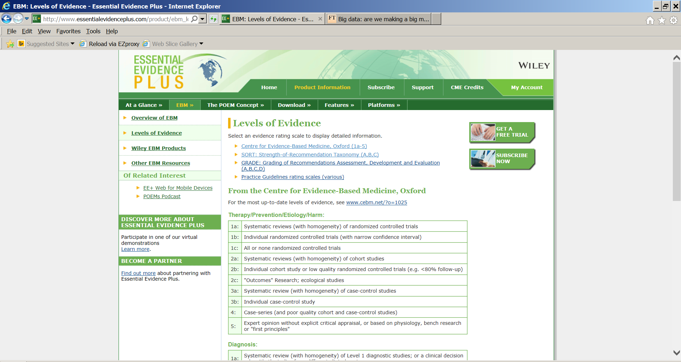

Why are these types of studies rated so lowly?
BIAS!!!
Electronic health record based study
Note! The strength of evidence depends on the data/sample, not the type of model utilized!
Notes:
Many venues of science rate the “quality” of evidence. Here is a typical classification of the type of study.
Most of the examples of big data are observational studies not designed for research purposes. That puts us way down on the list and suggests we need to take care.
Why? Observational study (but cohort study is 2b), poor data quality, selection bias.

Slide 14
Example: Ann Landers/Newsday surveys
Many years ago, the help columnist, Ann Landers, asked her readers “If you had it do to over again, would you have children?” She received about 10,000 responses, 70% of which said no.
Shortly thereafter, Newsday commissioned a nationwide random telephone survey.
9%
said no.
Samples:
10,000 write-ins; 1,373 random telephone contacts
Population:
U.S. households with children
Moral: Big data doesn’t overcome selection bias.

Slide 15
Example: More realistic
Suppose you are going to conduct a research study using electronic health records and want the results to generalize to all similar patients in the Bay Area?
Would you prefer to use data from UCSF or Kaiser? Why?
UCSF
UCSF
~ Ann Landers
Kaiser
~ Random telephone survey
Notes:
Think of the populations that are served by each provider.

Slide 16
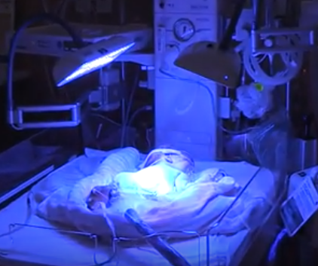
Example: Phototherapy and Cancer
Phototherapy (exposing the infant to bright fluorescent light) is widely used to treat jaundice in newborns. Jaundice is caused by a build up of bilirubin levels before the newborn’s liver starts working. High levels can cause brain damage. The light breaks down the bilirubin and allows it to be excreted.
Does phototherapy cause cancer?
Studied about 500,000 infants born in Kaiser Northern CA between 1995 and 2011.
Newman, et al Pediatrics, 2016
Notes:
Bilirubin: bi-luh-roo-bn

Slide 17
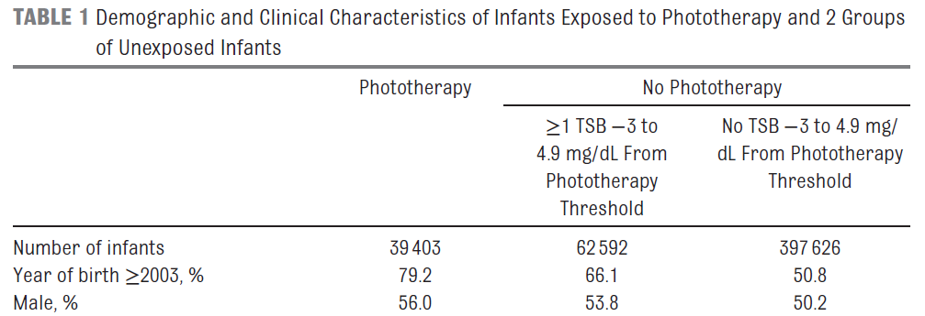
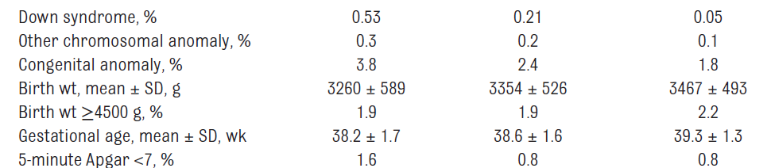
Example: Excerpt from Table 1
Concerns comparing the phototherapy and non-phototherapy groups?
Notes:
TSB = total serum birilubin

Slide 18
Example: Phototherapy and Cancer
Possibly different on:
Race, birth year, sex, Down’s syndrome, chromosomal or other congenital anomaly, birth weight, gestational age, Apgar score, direct antiglobulin test positive, maternal age, delivery mode, multiple birth, jaundice and more. Full richness of the EHR at Kaiser available.
What if we want to try and control for these differences using a statistical model (remove bias)?
As well as two-way interactions of all variables (e.g., cross-combinations of categorical variables) and nonlinear components of numeric variables. When totaled up, over 2,000 predictors.

Slide 19
Outline
Introduction: prediction versus causation
Threats to causal conclusions
Causal methods in (very) brief
Interpretability of machine learning methods
Some uses of big data and machine learning in causal inference
Summary

Slide 20
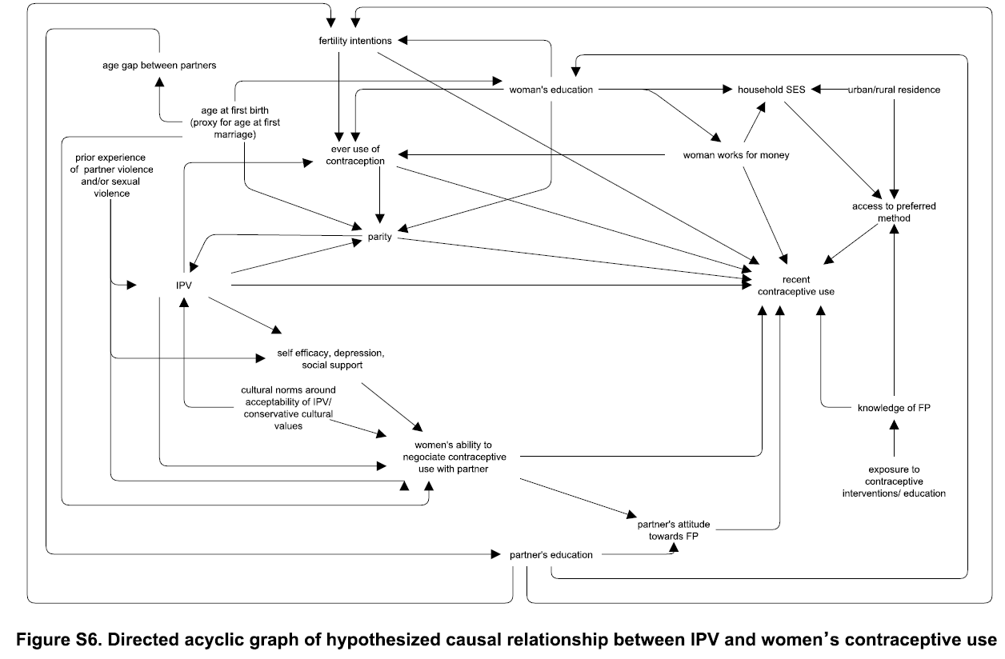
Causal inference
Maxwell, et al ,PLoS One. 2015; 10(2): e0118234.

Slide 21
Causal inference – the 5¢ tour
CONFOUNDER
Down’s syndrome
MEDIATOR
Maximum Bilirubin
RISK FACTOR
OUTCOME
Phototherapy
Cancer
Adapted from Newman, et al Pediatrics, 2016
Biostat 215 covers these topics in detail
Notes:
Biostat 215 covers these topics in detail. I just want to give you an exposure so you can see how big data methods may or may not help.

Slide 22
Epidemiologists have long studied the pitfalls of using observational studies to infer causation.
A fundamental idea in causal inference is to compare the same person with and without an intervention or condition. Can’t usually measure the person under both conditions.
For example, observe the same person with and without a history of knee injury to understand its impact on later osteoarthritis.
Or recording the outcomes in a catchment area of a trauma center with and without its closure.

Slide 23
Potential outcomes
Imagine a hypothetical experiment in which you get to observe each participant under both the treatment and control conditions holding all else the same, like a perfect cross-over experiment.
Y_{trt}, Y_{ctl}
Often, we only get to observe one of Y_{trt} or Y_{ctl}, depending on whether the participant is in the treatment or control condition.
Sometimes described as the “fundamental problem in causal inference.”
Notes:
Called potential outcomes or counterfactuals.
And this is not a new idea: I learned this in 1978 ….
From a book written in 1959 ….
Quoting a result from a 1923 paper by Jerzy Neyman – a contemporary and hated rival of R.A. Fisher.

Slide 24
Hypothetical example: treatment of depression
Does addition of an internet based cognitive behavioral component aid in treatment of depression?
Outcome = improvement in Beck Depression Inventory (BDI).
Control group treatment is team care approach, which has proven especially effective in the elderly.
Observational study based on clinical data (non-random).

Slide 25
Potential outcomes framework
 |  | Outcome under
Patient | Group | Ctl | Trt | Difference
1 | Trt | 4 | 8 | 4
2 | Ctl | 0 | 3 | 3
3 | Trt | 4 | 3 | -1
4 | Trt | 3 | 4 | 1
…
Ave in popl’n |  |  |  | 1.02 = Average Causal Effect
Patient | Group | Ctl | Trt | Difference
1 | Trt | 4 | 8 | 4
2 | Ctl | 0 | 3 | 3
3 | Trt | 4 | 3 | -1
4 | Trt | 3 | 4 | 1
…
Ave in popl’n |  |  |  | 1.02 = Average Causal Effect
ΔBDI
Notes:
Entries in table are improvement in BDI. So the first patient was in the Trt group and improved by 8 points. But if they had been in the Ctl group, they would also have improved, by only by 4 points.
Patient 3 improved by 3 points. But if they had been in the Ctl group they would have done better and improved by 4 points.
Notes:
Causal effect need not be the same in each patient.
Need not even be the same direction.
Could be different in different subgroups of the population, e.g., women, or those who would choose the treatment.
(Advance) We only get to see what is in blue, not what is in grey.

Slide 26
Thought #5 (from lecture 1)
If you are interested in causation you can’t measure it all.
You can, at most, measure half of it all and that half is subject to selection bias. (Unless you have run a well-conducted randomized experiment).

Slide 27
Potential outcomes are sometimes called “counterfactuals”
Counter – factual
Against – the truth
= Lying
I like “Potential outcomes framework”
or “Hypothetical outcomes framework” better
Notes:
Statisticians have enough bad press without such technical definitions.

Slide 28
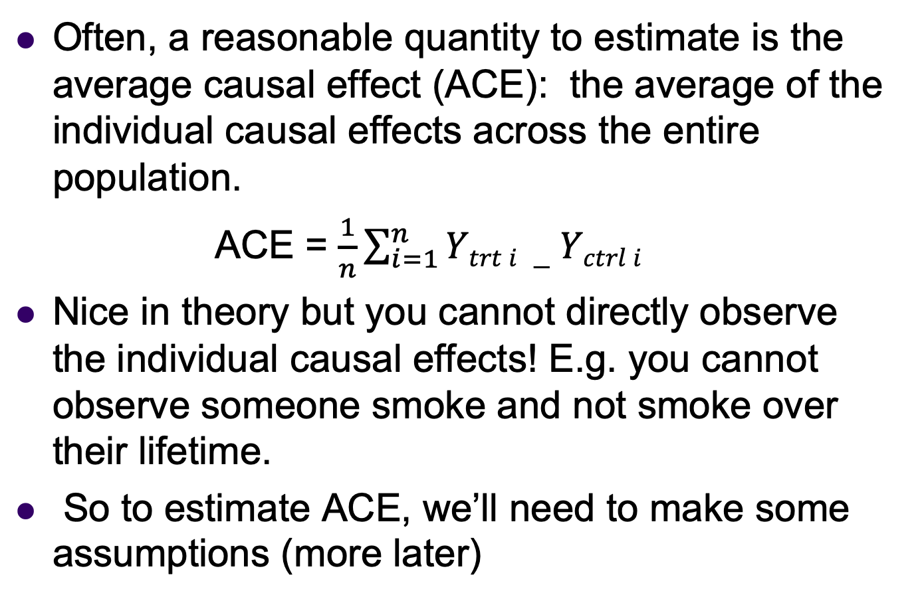
Potential Outcomes
– Average Causal Effect
Often, a reasonable quantity to estimate is the average causal effect (ACE): the average of the individual causal effects across the entire population.
ACE = $\frac{1}{n}\sum_{i=1}^{n}{Ytrt i −Yctrl i}$
Nice in theory but you cannot directly observe the individual causal effects! E.g. you cannot observe someone smoke and not smoke over their lifetime.
So to estimate ACE, we’ll need to make some assumptions (more later)

Slide 29

Example: Depression Data
$$∆ BDI$$
Notes:
Explain carefully: Y axis is delta BDI. Red is treatment group, blue is control.
Change in BDI values for blue and red are well interspersed. So average values are about the same. No treatment effect?
Perhaps there is confounding by age. Older participants are less likely to adopt the internet intervention (very few red dots on right of graph). And older participants do better in either treatment group.
And, for a given age the treatment group seems to do better.
In the older age range, we have very few comparators. This lack of overlap makes it almost impossible to understand the relationship between age and delta BDI (among the older ages) in the treatment group. So difficult to model.

Slide 30
Simple analysis: t-test
Average change in Treatment group = 5.0,
Average change in Control group = 4.6
Estimated difference =0.4,
p=0.57, via t-test,
So not statistically significant.

Slide 31
Non-comparable groups
The issue:
Estimation of the causal effect of treatment (the predictor of interest) is confounded by age (another predictor) since
a) age is associated with the outcome (change in BDI) and
b) age is associated with treatment
A traditional solution:
Include age in a multipredictor linear regression model along with treatment.

Slide 32
Example
$$∆ BDI$$
Treatment effect
1.4 (95% CI 0.6, 2.3)
Notes:
(Advance) We fit a regression model. (Advance) The black double-headed arrow line shows the treatment effect for a given age. So this is the estimated difference between treatment groups at a given age. Stat sign treatment difference.
Sometimes described as adjusting for age or holding age constant. If differences in age are the only reason why the groups are non-comparable and if we believe the simplistic regression model then this estimates the causal effect of treatment. Two BIG “if”s.
Being careful, neither nonlinearity in the relationship nor the need for different slopes in the two groups are even close to statistically significant, so we stick with the basic model, which is what many people would fit solely.

Slide 33
Issues with regression adjustment
Causal estimate is defined by using regression model (contrast the ACE).
What if model is wrong? As examples: assumption of a linear relationship when it is not. Left out variables? Interactions between variables?
How will we know? (Lack of overlap/extrapolation.)
Lack of comparison group for older ages (plenty of controls, not many treated).
Notes:
Lack of overlap is a serious concern because it is difficult to determine if differences are causal or due to the incorrect model.
Can see the lack of overlap here, but wouldn’t be able to in a more realistic example with many predictors.

Slide 34
Issues with regression adjustment (true model)
$$∆ BDI$$
Notes:
Here is the true model from which I generated the (made-up) data.
Observations:
I fit the wrong model
There is little or no treatment effect in the older age group
Since most of the data for comparison is in the younger age group (where the treatment effect is larger), I overestimated the average effect across all ages.
Note: data generating model was 4+(age-30)*3.5/40 for treatment and 2+(age-30)*6/40 for control. So average causal effect at a given age is the difference, or 3.875-age*0.0625. and the ACE is 3.875-\bar(age)*0.0625 or 3.875-45.65*0.0625 = 1.02.

Slide 35

Issues with regression adjustment (fit interaction)
$$∆ BDI$$
Treatment effect
3.2 (95% CI -.6, 7.1)
Previously:
1.4 (95% CI 0.6, 2.3)
Notes:
Here is the estimated model. (Advance)
What!? Treatment effect is now estimated to be 3.2! And not statistically significant. What is going on?
When you enter the interaction (Advance), the treatment effect is the estimated (extrapolated) value at age=0. Need to center variables so a value of 0 is a value of interest.

Slide 36
Outline
Introduction: prediction versus causation
Threats to causal conclusions
Causal methods in (very) brief
Interpretability of machine learning methods
Some uses of big data and machine learning in causal inference
Summary

Slide 37
Interpretability
Example: Prediction of healthy aging. Data source: Health ABC – a long running cohort study that enrolled about 3,000 healthy individuals in their 70s.
Outcome: Survival free of major diseases and disability.
Predictors: About 100 predictors including demographics, BP, medical history, physical performance (e.g., gait speed), and serum markers (e.g., IL-6).

Slide 38
Interpretability
Model selection strategy: Calculated Akaike Information Criterion (AIC) values, which are similar to cross-validated errors, for a large number of Cox survival analysis models. Exhaustively searched for models with about the optimal number of predictors.

Slide 39
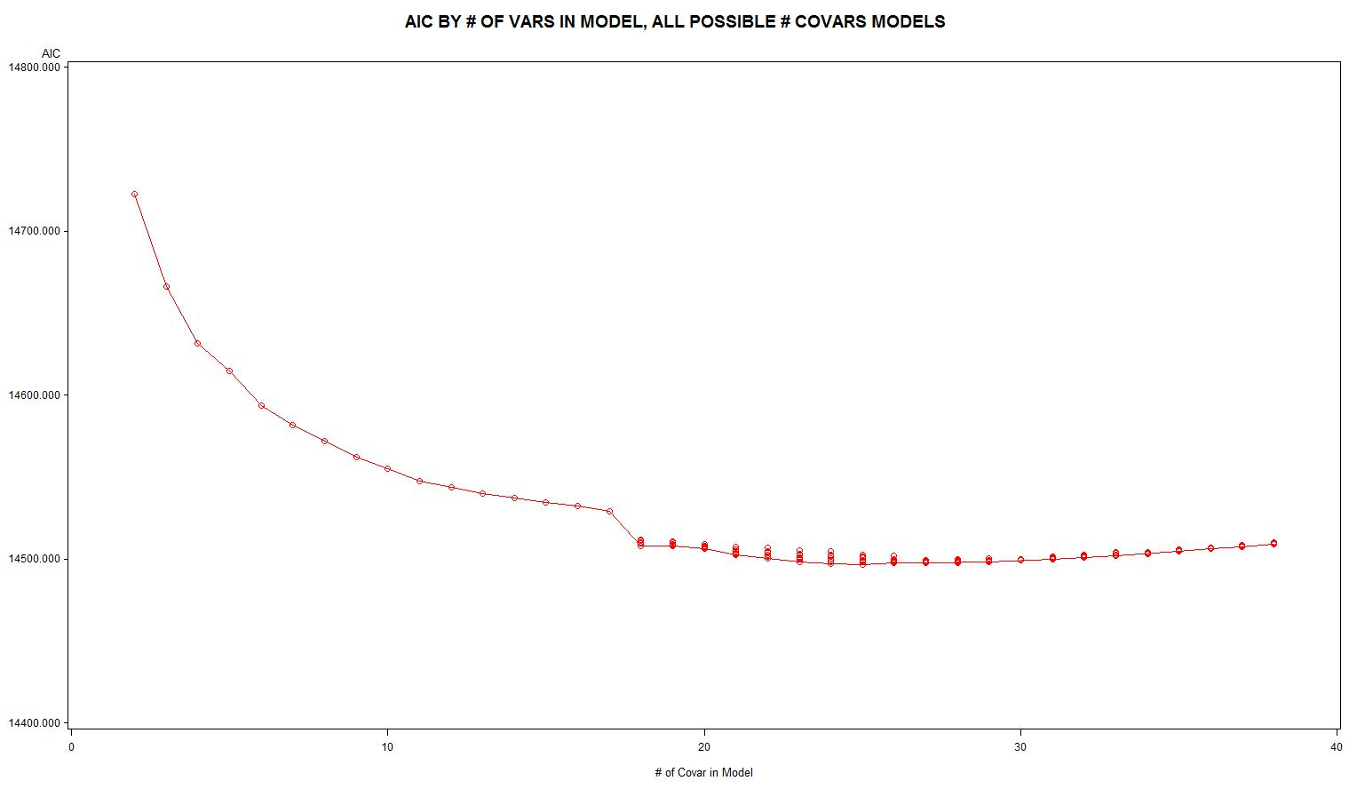
Example: Disease free-survival AIC plot
Number of predictors
Notes:
You see the same sort of plot as John showed you with error in the test set. At first models improve, up to about 25 predictors. Then start getting worse.

Slide 40
Example: Disease free-survival AIC plot – zoom in near optimal
Top models of that size
Number of predictors

Slide 41
Machine learning/causal inference
Results: About 120 models were within 10 of the model with the lowest (best) AIC. (Rule of thumb: statistically speaking AIC larger by 10 is a worse fitting model).
Observation: Possible to get nearly the same quality of prediction using very different models.
Predictor selection: Prediction algorithms cannot be depended upon to identify the “best” predictors. Which predictors get included or excluded from the model will vary with small perturbations in the dataset or analysis method.
Notes:
With large numbers of predictors it is quite common to get many models that perform nearly as well as the “best” model.

Slide 42
Example: Two models
For example, these two models were virtually identical in performance:
19 variable model: BLAGE WTK HGT WGTPDB HGTDB PULSE BESFEV BPAAIT CESD PACE400 PACE20 GRIP SEMITND TANDSTD COMP FALL RDW ALBUMIN STPCK
29 variable model: BLAGE WHITE WTK HGT WGTPDB HGTDB PULSE FAT BESFVC FEV1R BPAAIT TENG DSS CESD PACE400 PACE6 PACE20 GRIP SEMITND TANDSTD STANDY FFHIP COMP FALL CYSTC LDL RDW ALBUMIN STPCK
Cognition variables
Red indicates not in the other model
Notes:
For example, FFHIP is Ever fractured hip, TENG is a mental status test (3MS), DSS is the digit symbol score (cognition). So adopting the second model might lead you to believe cognitive ability is important.
BESFEV = forced expiratory volume

Slide 43
Machine learning/causal inference
And this is with a standard statistical analysis approach (Cox regression). Many other machine learning methods are worse because they don’t give interpretable coefficients.

Slide 44
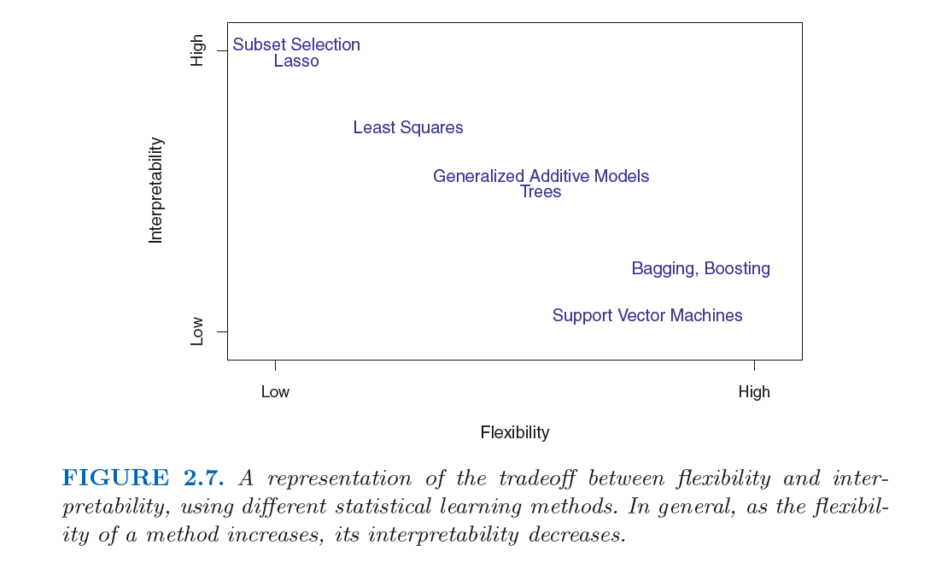
Machine learning/causal inference
From Introduction to Statistical Learning, James, et al., 2013

Slide 45
Outline
Introduction: prediction versus causation
Threats to causal conclusions
Causal methods in (very) brief
Interpretability of machine learning methods
Some uses of big data and machine learning in causal inference
Summary

Slide 46
Outline
Some uses of big data and machine learning in causal inference
  Conduct an RCT using large scale data
  Propensity scores
  Potential outcomes estimation
  Subgroup analyses

Slide 47
Clinical trials:
Randomized controlled trials (RCT) often function in “laboratory” like conditions, i.e. artificial
Pragmatic clinical trial:
  Focus on measuring effect of an intervention in a more pragmatic setting
  See lecture by Mark Pletcher on pragmatic trials (uploaded to CLE)
Intervention applied in more realistic setting e.g. across many sites
Predictors and outcomes measured through EHR records
Goal: put clinical trials in more realistic settings, leverage EHR data, and save $$$

Slide 48
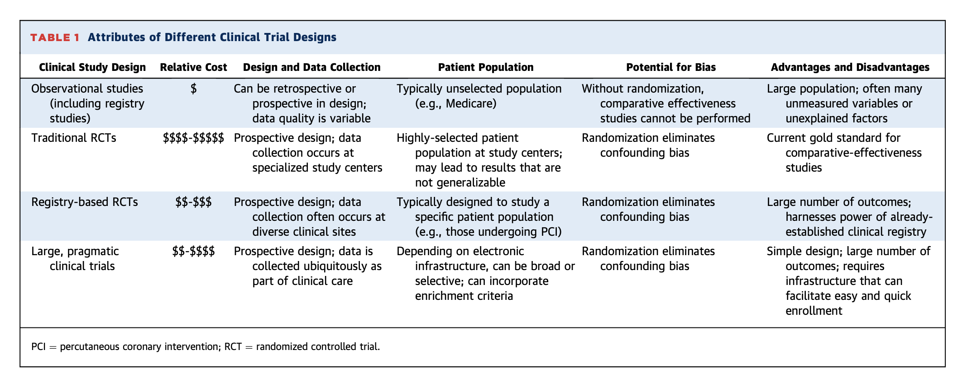
Pragmatic clinical trials:
Jones, et al (2016). The Changing Landscape of Randomized Clinical Trials in Cardiovascular Disease.

Slide 49
Outline
Some uses of big data and machine learning in causal inference
  Conduct an RCT using large scale data collection systems (Mark Pletcher’s lecture)
  Propensity scores
  Potential outcomes estimation
  Subgroup analyses

Slide 50

Propensity scores:
“[Propensity score] matching is the observational study analog of randomization in ideal experiments…– Rubin and Thomas (2000), Combining Propensity Score Matching With Additional Adjustments for Prognostic Covariates

Slide 51
Propensity scores:
Define prop(x) be the probability of being on treatment as a function of x, all the variables that determine treatment. For each subject this is called a propensity score.
In our depression example, suppose temporarily that the probability of selecting treatment only depends on age.

Slide 52
Propensity scores: example
Notes:
Assume likelihood of choosing the intervention only depends on whether age<50 or not.

Slide 53
Propensity scores: theory
Very important theoretical property: Consider individuals with the same value of prop(x). The ones receiving treatment have the same distribution of x as do those who do not. So values of the predictors are more likely to be balanced between the two groups which share a propensity for treatment assignment.
Therefore you only need to adjust for prop(x) to balance the groups.

Slide 54
Propensity score stratification
Select covariates x that may influence treatment assignment (e.g. age)
Estimate propensity of treatment for each subject given x (using supervised ML algorithm)
Match individuals in the treatment group with individuals in the control group based on their propensity scores (directly or via stratification)
Perform analysis on matched sample

Slide 55
E.g. Propensity score matching
match subjects based on propensity scores strata
https://www.summitllc.us/propensity-score-matching
Notes:
1. Size of bubble represents the propensity for assignment to the treatment intervention. Estimated via logistic regression or some other ML algorithm .
2. Match subjects based on covariates within common strata of propensity scores
3. Perform analysis, p
Great review: https://www.ncbi.nlm.nih.gov/pmc/articles/PMC2943670/pdf/nihms200640.pdf

Slide 56
Propensity scores: depression example
Adjusting for propensity score categories and using a linear regression model:
Estimated difference =1.4, CI [0.4, 2.3],
Contrast previous result:
No adjustment for propensity score categories: Estimated difference = 0.4, (p=0.57, via t-test)

Slide 57
Propensity scores: practical issues
What if not all the variables that determine treatment are measured? Or included correctly in the model?
Suggests being more inclusive with both predictors and interactions.
So something that is easier with large databases and machine learning.

Slide 58
Propensity score estimation using Orange
Getting estimates of the propensity score is a prediction problem.
So use your favorite machine learning algorithm to predict the probability of treatment (use a “Edit Domain” widget to set Treatment as the Target variable temporarily).
The propensity scores are these predicted probabilities.

Slide 59
Outline
Some uses of big data and machine learning in causal inference
  Conduct an RCT using large scale data collection systems (Mark Pletcher’s lecture)
  Propensity scores
  Potential outcomes estimation
  Subgroup analyses

Slide 60
Regression estimation
In the depression example, we used a linear regression model. We can use that to get an estimate of the causal effect for each person. Then we could calculate the average causal effect.
Also called G-computation in the causal literature and marginal estimates in economic statistics.
Can get marginal estimates for subpopulations, e.g., causal effect in younger participants.
Notes:
Stress the difference between this and the idea of propensity score adjustments. Much has to do with weighting of the data. Neither corrects for the issue when we try to estimate causal effects over patients samples we never observed.

Slide 61

Potential outcomes estimation
$$∆ BDI$$
Predicted causal effect for a ctl subject
Predicted causal effect for a trt subject
ACE estimated to be 1.2 (CI 0.4, 2.1)
Notes:
The filled circles represent the (model-based) predicted value for a participant in the treatment or control groups.
The open circles represent the (model-based) predicted potential outcome for the participants. So, for example, a participant in the treatment group has a predicted potential outcome in the control group. And vice versa.
Now have an estimate of the individual causal effect, which you can average to get ACE. Can either compare predicted potential outcome with predicted value or with the real value.

Slide 62
Potential outcomes estimation using Orange
Create duplicate rows of data with the treatment assignment switched and missing outcome data:

Slide 63
Potential outcomes vs propensity score adjustment
Potential outcomes: try to estimate the potential outcome using supervised learning
Propensity score adjustment: try to construct balanced groups
Both rely on models
Can be used alone or in tandem (“doubly robust”)
Neither helps us extrapolate to samples that do not represent the training data

Slide 64
Outline
Some uses of big data and machine learning in causal inference
  Conduct an RCT using large scale data collection systems (Mark Pletcher’s lecture)
  Propensity scores
  Potential outcomes estimation
  Subgroup analyses

Slide 65
Subgroup effects and precision medicine
Since the causal effect is not the same for everyone, are there subgroups for which the treatment is more or less efficacious (or even harmful)?
If we can identify the subgroups we can tailor treatment (precision medicine).
How many subgroups might there be?
Let’s consider the phototherapy/cancer example.

Slide 66
Subgroup problem
Race (5 categories), birth year (say 3), sex (2), Down’s syndrome (2), chromosomal (2) or other congenital anomaly (2), birth weight (6), gestational age (say 3), Apgar score (2), direct antiglobulin test positive (2), maternal age (2), delivery mode (2), multiple birth (2), jaundice (2).
So 5×3×2×2×2×2×6×3×2×2×2×2×2×2
=276,480 subgroups
(for 500,000 babies)

Slide 67

Subgroup analysis issues
Insufficient data in each subgroup.
Huge multiple testing problem (if we test each one at $α$ = 0.05 and there are no effects we expect 0.05×276,480 = 13,824 false positives
Notes:
Briefly describe multiple testing.

Slide 68
Subgroup problem – proposed solution
Use the potential outcomes estimation approach in the previous section (and your favorite machine learning algorithm) to get an estimated treatment effect for each person using all the possible subgroup variables as predictors.
Code each subject as having large/small treatment effect
Use a recursive partitioning algorithm to find subgroups with different treatment effects and try to predict people who fall into the large/small groups
  Reference for using this idea in RCTs: Foster, Taylor and Ruberg, Statistics in Medicine, 2011.

Slide 69
Subgroup analysis: decision tree
Systolic BP > 140?
No Yes
Exercise < 2 times per week
LDL > 190?
Alcohol > 2 units/day?
Large effect
Small effect
Large effect
Small effect
Small effect

Slide 70
Summary
Distinguish questions by whether they can be answered by prediction only or require more detailed analysis.
  effect, intervention = causal,
  estimate, association, correlation = prediction
Machine learning methods are not designed for drawing causal conclusions.
However, aspects of causal analyses may be prediction problems for which we can use the methods in the class
  Estimating propensity scores and predicting potential outcomes (e.g. regression estimation)
  Identifying subgroups on the basis of different estimated treatment effects

