Slide 1
Pragmatic Trials
Large and Small
Steps Towards a Learning Healthcare System
Data Science Course 2016
Mark J. Pletcher, MD MPH
Department of Epidemiology and Biostatistics

Slide 2
3 Related Concepts
Pragmatic vs. Explanatory Trials
Large Simple Trials
Learning Healthcare System

Slide 3
Outline
The Rationale
  Make trials more efficient
  Make trials more informative for decision-making
The Concepts
  Pragmatic vs. Explanatory, Large Simple Trials
  4 Examples: GISSI, TASTE, ADAPTABLE, VEST
The Vision: Learning Healthcare System
  Local efforts (UCSF CTSI)
  National efforts and resources
Science of using electronic health record data

Slide 4
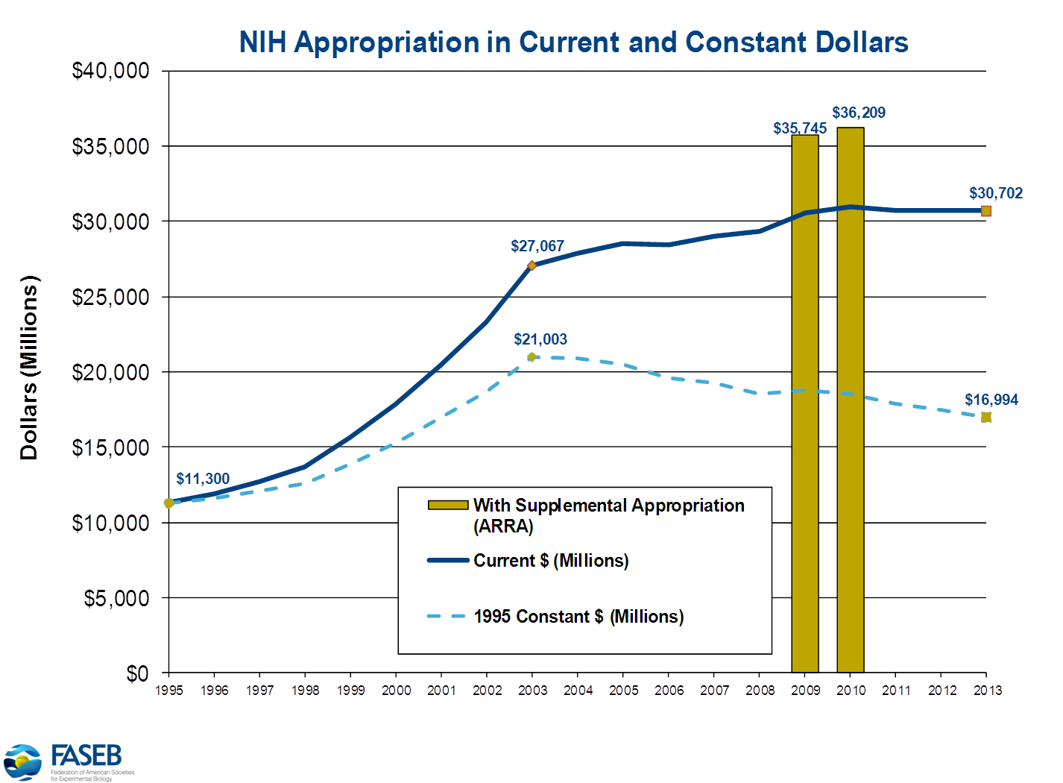

Slide 5
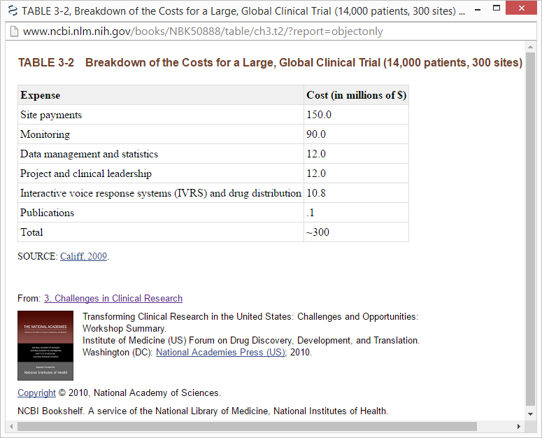

Slide 6
This is crazy!

Slide 7
Do randomized trials help us make decisions?
Traditional RCT design:
Control conditions carefully
Optimize internal validity and causal inference
Help us learn biology

Slide 8
Do randomized trials help us make decisions?
Traditional RCT design:
Control conditions carefully
Optimize internal validity and causal inference
Help us learn biology
These design decisions may not be optimal for informing decision-making

Slide 9
Do randomized trials help us make decisions?
Explanatory vs. Pragmatic Trials
Explanatory: designed to optimize causal inference and help us learn biology
Pragmatic: designed to help us compare effectiveness and make real-world decisions
Schwartz and Lellouch 1967 and 2009, http://www.ncbi.nlm.nih.gov/pubmed/19348976

Slide 10
Do randomized trials help us make decisions?
Explanatory vs. Pragmatic Trials
Explanatory: designed to optimize causal inference and help us learn biology → laboratory conditions
Pragmatic: designed to help us compare effectiveness and make real-world decisions → normal conditions
Schwartz and Lellouch 1967 and 2009, http://www.ncbi.nlm.nih.gov/pubmed/19348976

Slide 11
Explanatory vs. Pragmatic
Inclusion and Exclusion criteria
Explanatory: ?
Pragmatic: ?

Slide 12
Explanatory vs. Pragmatic
Inclusion and Exclusion criteria
Explanatory: Carefully restricted to individuals thought likely to adhere to and respond to intervention
Pragmatic: All-comers

Slide 13
Explanatory vs. Pragmatic
Intervention protocol
Explanatory: ?
Pragmatic: ?

Slide 14
Explanatory vs. Pragmatic
Intervention protocol
Explanatory: Strict, carefully-monitored fidelity, only use experienced clinicians, avoid co-interventions
Pragmatic: Flexible and practical

Slide 15
Explanatory vs. Pragmatic
Control
Explanatory: ?
Pragmatic: ?

Slide 16
Explanatory vs. Pragmatic
Control
Explanatory: Placebo or other designed to test a specific physiologic hypothesis
Pragmatic: Best alternative treatment or “usual care”

Slide 17
Explanatory vs. Pragmatic
Adherence
Explanatory: ?
Pragmatic: ?

Slide 18
Explanatory vs. Pragmatic
Adherence
Explanatory: Run-in period to weed out non-adherers, careful monitoring, “as treated” analysis
Pragmatic: All-comers, see what happens, imperfect adherence is part of the intervention

Slide 19
Explanatory vs. Pragmatic
Measurements
Explanatory: ?
Pragmatic: ?

Slide 20
Explanatory vs. Pragmatic
Measurements
Explanatory: Measure as much as possible, try to define mechanisms
Pragmatic: Leave participants alone as much as possible*
* Subgroup analyses still useful

Slide 21
Explanatory vs. Pragmatic
Primary Outcome Measurement
Explanatory: Measure what’s important for assessing physiology
Pragmatic: Measure what’s clinically apparent (easier and more important to patients?)

Slide 22
Explanatory vs. Pragmatic
The Pragmatic-Explanatory Continuum Indicator Summary (PRECIS)
Measures pragmatism in 10 key domains
Thorpe 2009, http://www.ncbi.nlm.nih.gov/pubmed/19348971

Slide 23
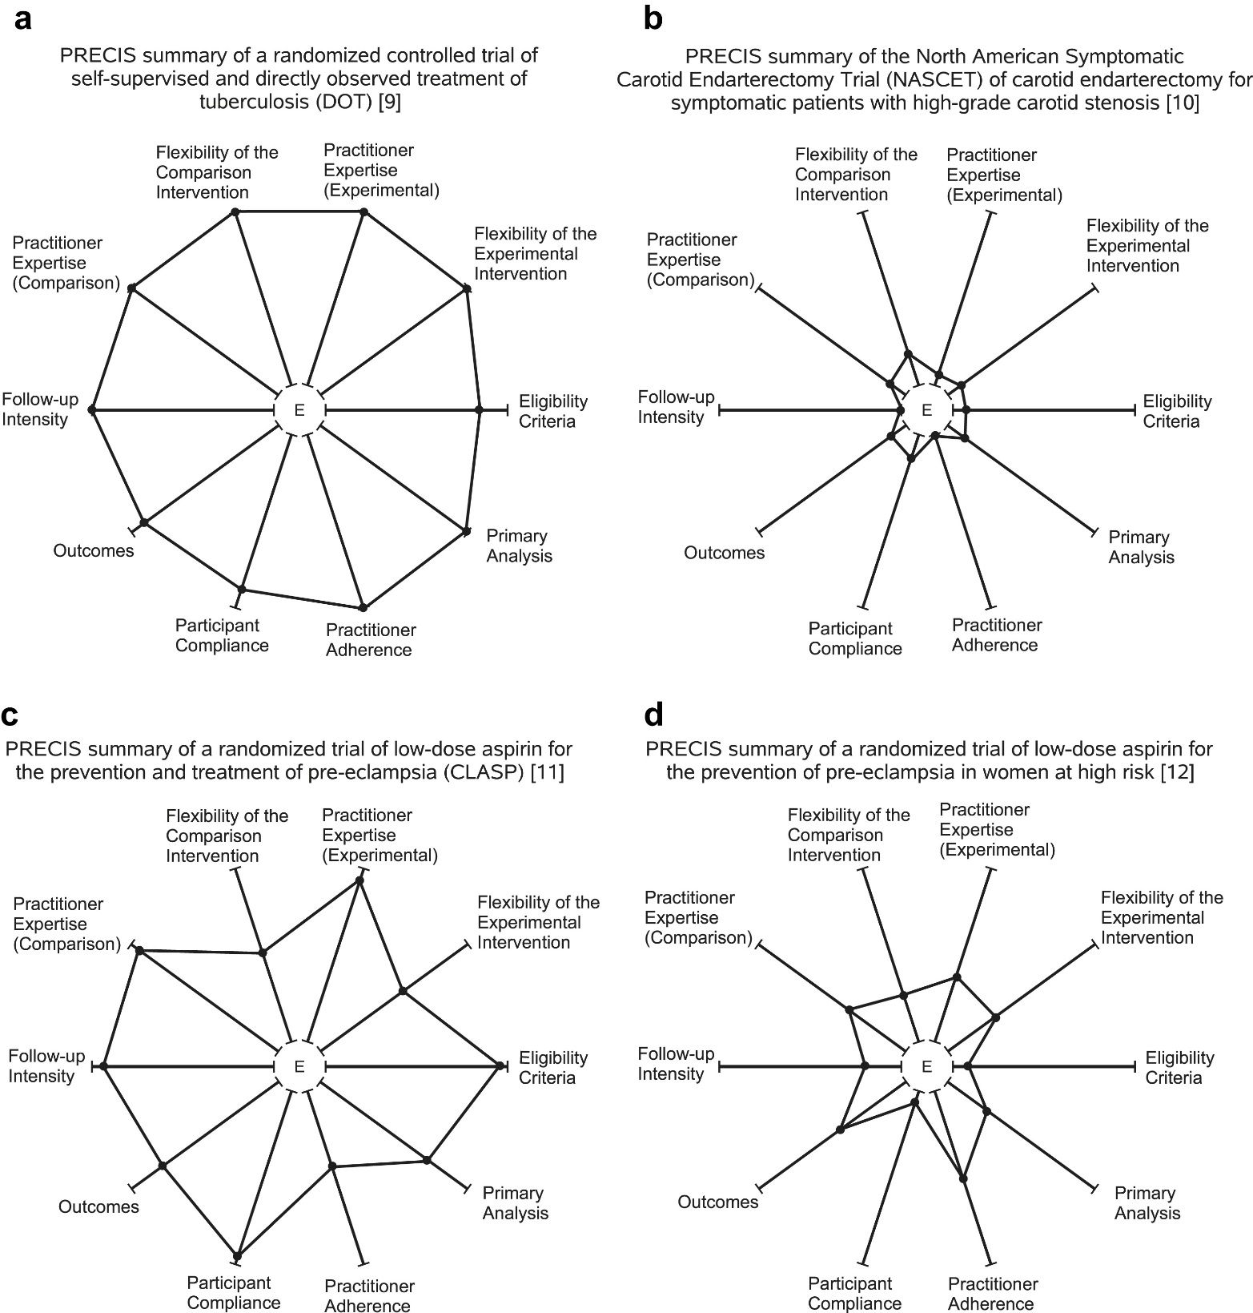
Fig. 2
Journal of Clinical Epidemiology 2009 62, 464-475DOI: (10.1016/j.jclinepi.2008.12.011)
Notes:
(a) PRECIS summary of a randomized controlled trial of self-supervised and directly observed treatment of tuberculosis (DOT) [9]. (b) PRECIS summary of the North American Symptomatic Carotid Endarterectomy Trial (NASCET) of carotid endarterectomy for symptomatic patients with high-grade carotid stenosis [10]. (c) PRECIS summary of a randomized trial of low-dose aspirin for the prevention and treatment of pre-eclampsia (Collaborative Low-dose Aspirin Study in Pregnancy [CLASP]) [11]. (d) PRECIS summary of a randomized trial of low-dose aspirin for the prevention of pre-eclampsia in women at high risk [12].

Slide 24
Fig. 2
Notes:
(a) PRECIS summary of a randomized controlled trial of self-supervised and directly observed treatment of tuberculosis (DOT) [9]. (b) PRECIS summary of the North American Symptomatic Carotid Endarterectomy Trial (NASCET) of carotid endarterectomy for symptomatic patients with high-grade carotid stenosis [10]. (c) PRECIS summary of a randomized trial of low-dose aspirin for the prevention and treatment of pre-eclampsia (Collaborative Low-dose Aspirin Study in Pregnancy [CLASP]) [11]. (d) PRECIS summary of a randomized trial of low-dose aspirin for the prevention of pre-eclampsia in women at high risk [12].

Slide 25
Explanatory vs. Pragmatic
Which kind of trial is cheaper?

Slide 26
Explanatory vs. Pragmatic
Which kind of trial is cheaper?
  Many “pragmatic” design features are also easier to implement
“Large Simple Trials” – related concept that emphasizes the cost benefits
  See JAMA Viewpoint by Eapen/Lauer/Temple
  Strongly supported by FDA (Rob Califf→Commissioner!)
Quintiles 2011 file:///C:/Users/mpletcher/Downloads/use-large-simple-trials.pdf
Roehr 2013 http://www.ncbi.nlm.nih.gov/pubmed/23449675
Eapen 2014 http://www.ncbi.nlm.nih.gov/pubmed/24715072

Slide 27
Large simple pragmatic trials
Win-win: both cheaper and better for informing real-world clinical decisions?

Slide 28
Example 1: GISSI
Gruppo Italiano per lo Studio della Streptochinasi nell’infarto Miocardico (GISSI) - 1986
RCT comparing streptokinase to usual care for all-cause in-hospital mortality in acute MI
  11,806 randomized, 11,712 follow-up
  10.7% vs 13%, RR=0.81, p<.0002
  More benefit if given earlier
Lancet 1986 http://www.ncbi.nlm.nih.gov/pubmed/2868337

Slide 29
Example 1: GISSI
Gruppo Italiano per lo Studio della Streptochinasi nell’infarto Miocardico (GISSI) - 1986
RCT comparing streptokinase to usual care for all-cause in-hospital mortality in acute MI
  11,806 randomized, 11,712 follow-up
  10.7% vs 13%, RR=0.81, p<.0002
  More benefit if given earlier
Super-simple, large, very important results
Lancet 1986 http://www.ncbi.nlm.nih.gov/pubmed/2868337

Slide 30
Example 2: TASTE Trial
Thrombus Aspiration in ST-Elevation Myocardial Infarction in Scandinavia (TASTE trial)
Registry in Sweden for angiography and angioplasty already collecting outcomes
RCT within registry patients: thrombus aspiration vs. conventional PCI
All-cause mortality at 30 days: No difference
Frobert 2010 http://www.ncbi.nlm.nih.gov/pubmed/21146656
Watchtell 2016 http://www.ncbi.nlm.nih.gov/pubmed/26758999

Slide 31
Example 2: TASTE Trial
Thrombus Aspiration in ST-Elevation Myocardial Infarction in Scandinavia (TASTE trial)
Registry in Sweden for angiography and angioplasty already collecting outcomes
RCT within registry patients: thrombus aspiration vs. conventional PCI
All-cause mortality at 30 days: No difference
Embedded “Registry Trial”
Frobert 2010 http://www.ncbi.nlm.nih.gov/pubmed/21146656
Watchtell 2016 http://www.ncbi.nlm.nih.gov/pubmed/26758999

Slide 32
Example 2: TASTE Trial
Thrombus Aspiration in ST-Elevation Myocardial Infarction in Scandinavia (TASTE trial)
Registry in Sweden for angiography and angioplasty already collecting outcomes
RCT within registry patients: thrombus aspiration vs. conventional PCI
All-cause mortality at 30 days: No difference
Cost?
Frobert 2010 http://www.ncbi.nlm.nih.gov/pubmed/21146656
Watchtell 2016 http://www.ncbi.nlm.nih.gov/pubmed/26758999

Slide 33
Example 2: TASTE Trial
Thrombus Aspiration in ST-Elevation Myocardial Infarction in Scandinavia (TASTE trial)
Registry in Sweden for angiography and angioplasty already collecting outcomes
RCT within registry patients: thrombus aspiration vs. conventional PCI
All-cause mortality at 30 days: No difference
Cost = $300,000 (compare with $300M)
Frobert 2010 http://www.ncbi.nlm.nih.gov/pubmed/21146656
Watchtell 2016 http://www.ncbi.nlm.nih.gov/pubmed/26758999

Slide 34
Example 3: ADAPTABLE Trial
Aspirin Dosing: A Patient-Centric Trial Assessing Benefits and Long-Term Effectiveness (ADAPTABLE)
RCT aspirin 325 vs. 81 mg for secondary prevention
Demonstration trial for PCORnet
Use electronic health records to:
  Find patients (n=10,000)
  Measure outcomes (MI, bleeding, death)
Johnston 2016 http://www.ncbi.nlm.nih.gov/pubmed/27423939
http://pcornet.org/

Slide 35
Example 3: ADAPTABLE Trial
Aspirin Dosing: A Patient-Centric Trial Assessing Benefits and Long-Term Effectiveness (ADAPTABLE)
RCT aspirin 325 vs. 81 mg for secondary prevention
Demonstration trial for PCORnet
Use electronic health records to:
  Find patients (n=10,000)
  Measure outcomes (MI, bleeding, death)
Embedded in EHR, network
Johnston 2016 http://www.ncbi.nlm.nih.gov/pubmed/27423939
http://pcornet.org/

Slide 36
Example 3: ADAPTABLE Trial
Aspirin Dosing: A Patient-Centric Trial Assessing Benefits and Long-Term Effectiveness (ADAPTABLE)
RCT aspirin 325 vs. 81 mg for secondary prevention
Demonstration trial for PCORnet
Use electronic health records to:
  Find patients (n=10,000)
  Measure outcomes (MI, bleeding, death)
Cost = ~$10 million
Johnston 2016 http://www.ncbi.nlm.nih.gov/pubmed/27423939
http://pcornet.org/

Slide 37
Example 3: ADAPTABLE Trial
Aspirin Dosing: A Patient-Centric Trial Assessing Benefits and Long-Term Effectiveness (ADAPTABLE)
RCT aspirin 325 vs. 81 mg for secondary prevention
Demonstration trial for PCORnet
Use electronic health records to:
  Find patients (n=10,000)
  Measure outcomes (MI, bleeding, death)
Will it succeed? Is it the right model?
Johnston 2016 http://www.ncbi.nlm.nih.gov/pubmed/27423939
http://pcornet.org/

Slide 38
Example 4: VEST
The Vest Prevention of Early Sudden Death Trial
RCT LifeVest (wearable defibrillator vest) vs. usual care → sudden death within the first 3 months for immediately post-MI patients with EF<35%.
https://clinicaltrials.gov/ct2/show/NCT01446965

Slide 39
Example 4: VEST
The Vest Prevention of Early Sudden Death Trial
RCT LifeVest (wearable defibrillator vest) vs. usual care → sudden death within the first 3 months for immediately post-MI patients with EF<35%.
How pragmatic is it? Redesign ideas?
https://clinicaltrials.gov/ct2/show/NCT01446965

Slide 40
Example 4: VEST
The Vest Prevention of Early Sudden Death Trial
Subjects | EF<35%, no renal failure, nursing home, etc
Recruitment | Find post MI patients in hospital, recruit and randomize
Intervention | Wear the Lifevest as much as possible; avoid co-interventions
Control | Usual care, co-interventions carefully monitored
Adherence | Carefully monitored, per-protocol analysis planned
Outcome | Sudden death, not all-cause mortality
https://clinicaltrials.gov/ct2/show/NCT01446965

Slide 41
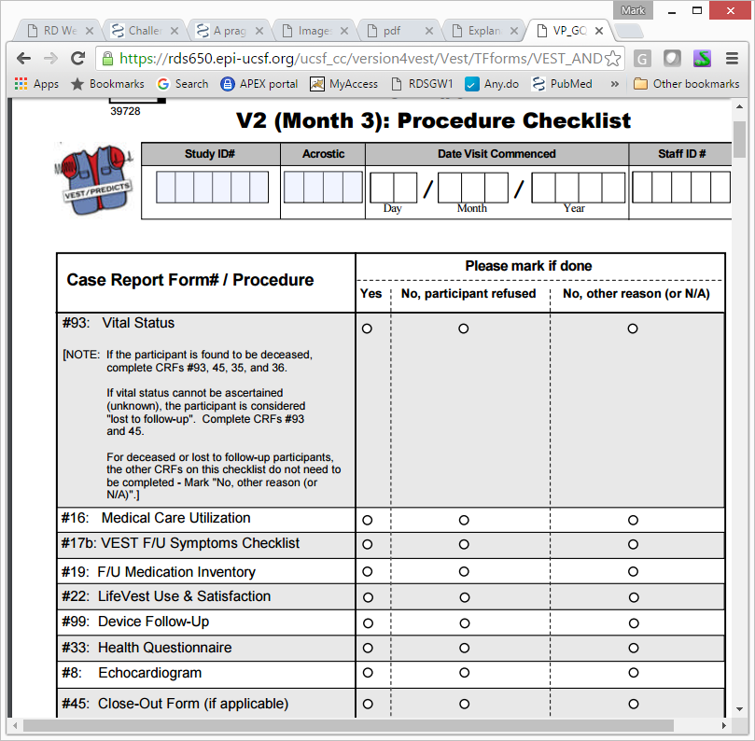

Slide 42
Example 4: VEST
How could VEST have been more pragmatic?
https://clinicaltrials.gov/ct2/show/NCT01446965

Slide 43
Example 4: VEST
How could VEST have been more pragmatic?
VEST prescription vs. usual care → all-cause mortality using death index, no other measurements
  No adherence monitoring except what is clinically appropriate and feasible
  Allow co-interventions
  No adjudication of sudden death; all-cause mortality is what counts
https://clinicaltrials.gov/ct2/show/NCT01446965

Slide 44
Example 4: VEST
How could VEST have been more pragmatic?
VEST prescription vs. usual care → all-cause mortality using death index, no other measurements
  No adherence monitoring except what is clinically appropriate and feasible
  Allow co-interventions
  No adjudication of sudden death; all-cause mortality is what counts
Hard to give nothing...
https://clinicaltrials.gov/ct2/show/NCT01446965

Slide 45
Example 4: VEST
How could VEST have been more pragmatic?
Could we randomize patients BEFORE we approach them?
  Find patients via EHR search and alert system
  Randomize to:
    A: Approach, offer and encourage LifeVest use
    B: Don’t approach at all – PURE Usual care (might use LifeVest)
  Note: randomization occurs BEFORE consent
https://clinicaltrials.gov/ct2/show/NCT01446965

Slide 46
Example 4: VEST
How could VEST have been more pragmatic?
Could we randomize patients BEFORE we approach them?
  Find patients via EHR search and alert system
  Randomize to:
    A: Approach, offer and encourage LifeVest use
    B: Don’t approach at all – PURE Usual care (might use LifeVest)
  Note: randomization occurs BEFORE consent
Is this ethical?
https://clinicaltrials.gov/ct2/show/NCT01446965

Slide 47
Example 4: VEST
“Randomized Encouragement Design”
Randomizing to encouragement to do something
  Likely much lower adherence rates → much larger sample size needed
    Adherence 40% vs. 10% instead of 90% vs. 3%?
  But much easier??
  Works best if:
    You are collecting outcome data passively (e.g., via EHR)
    You don’t need consent before randomizing
    The intervention could be considered “quality improvement”?
Pearl 1995 http://www.ncbi.nlm.nih.gov/pubmed/8963376
Hirano 2000 http://www.ncbi.nlm.nih.gov/pubmed/12933526

Slide 48
Example 4: VEST
- Extension of ITT thinking
- Encouragement is an “instrumental variable”
“Randomized Encouragement Design”
Randomizing to encouragement to do something
  Likely much lower adherence rates → much larger sample size needed
    Adherence 40% vs. 10% instead of 90% vs. 3%?
  But much easier??
  Works best if:
    You are collecting outcome data passively (e.g., via EHR)
    You don’t need consent before randomizing
    The intervention could be considered “quality improvement”?
Pearl 1995 http://www.ncbi.nlm.nih.gov/pubmed/8963376
Hirano 2000 http://www.ncbi.nlm.nih.gov/pubmed/12933526

Slide 49
Example 4: VEST
Could we have used a Randomized Encouragement Trial to study the LifeVest?
(maybe?)

Slide 50
Example 4: VEST
Could we have used a Randomized Encouragement Trial to study the LifeVest?
(maybe?)
Passive data collection via EHR could make pragmatic RCTs much more feasible...

Slide 51
Learning Healthcare System
A healthcare system that embeds pragmatic trials throughout delivery of healthcare, and learns as it goes...
Learning Healthcare System vision
  Every patient should be randomized! Multiple times!
  Continuous learning and refinement of care
  “A/B testing” embedded in EHR
    Google does it, why shouldn’t we?

Slide 52
Learning Healthcare Systems
UCSF CTSI is funding LHS demonstration projects
  Two projects funded:
    Detection and alerts to avoid hypoglycemia events in the hospital
    Using smart triggered standardized order sets in patients that may have COPD to improve quality of care + reduce readmissions and length of stay

Slide 53
Learning Healthcare Systems
Steps for LHS projects
  Identify an important health outcome that is easily measured by EHR query
  Develop an intervention to improve it
  Design a study to test whether it works

Slide 54
Learning Healthcare Systems
Challenges for LHS projects
  Data work is HARD
    Outcome assessment may be easy, but also need data to identify patients, create prediction algorithm, etc
  Intervention design is an art form
    Alert fatigue
    Workflow integration
    User testing and involvement in design is critical
  Study design is fun
    Unit of randomization?
    Consent required or not*?
    IRB approval pushing boundaries
*Pletcher 2014 http://www.ncbi.nlm.nih.gov/pubmed/24615554

Slide 55
Learning Healthcare Systems
Even UCSF Health is talking this up
  Learning Healthcare System is one of UCSF Health’s “True North Pillars” in a new strategic plan
Institute for Computational Health Sciences, Atul Butte
New cross-UC data initiative
IOM 2012 http://www.nationalacademies.org/hmd/Activities/Quality/LearningHealthCare.aspx
http://www.ncbi.nlm.nih.gov/books/NBK53494/

Slide 56
Learning Healthcare Systems
Hot topic nationally
  IOM Reports from 2007 and 2012
    See references below
  PCORnet: a national network with a common data model → A national Learning Healthcare System?
    PCORI has invested $100’s Millions
  NIH CTSA Program is emphasizing EHR investments
  NIH Collaboratory: Cutting edge, webinar series, living textbook
IOM 2007 and 2012 http://www.nationalacademies.org/hmd/Activities/Quality/LearningHealthCare.aspx
http://www.ncbi.nlm.nih.gov/books/NBK53494/
PCORnet vision http://www.ncbi.nlm.nih.gov/pubmed/23612587
NIH Collaboratory https://www.nihcollaboratory.org/Pages/default.aspx

Slide 57
Science of EHR data
All of this hinges on being able to use EHR data

Slide 58
Science of EHR data
Some challenges in using EHR data
  Collected for billing and clinical use, not research
    Example: diagnosis data (clinicians know how bad this is)
  Data structure designed to facilitate user interface
  Every system is different
    EPIC vs. Cerner vs. Others
    EPIC installations are all customized
  Data collection (not just the measurement value) inherently depends on health status
    A recipe for selection bias

Slide 59
Science of EHR data
Diagnosis data
  Sources
    Event-based (every visit, every lab)
    On Problem List
  Categories are sometimes hard
    Garbage in vs. omitted (vs. time to get it right)
  ICD10 vs. ICD9
    Different codes
    Requires extreme detail

Slide 60
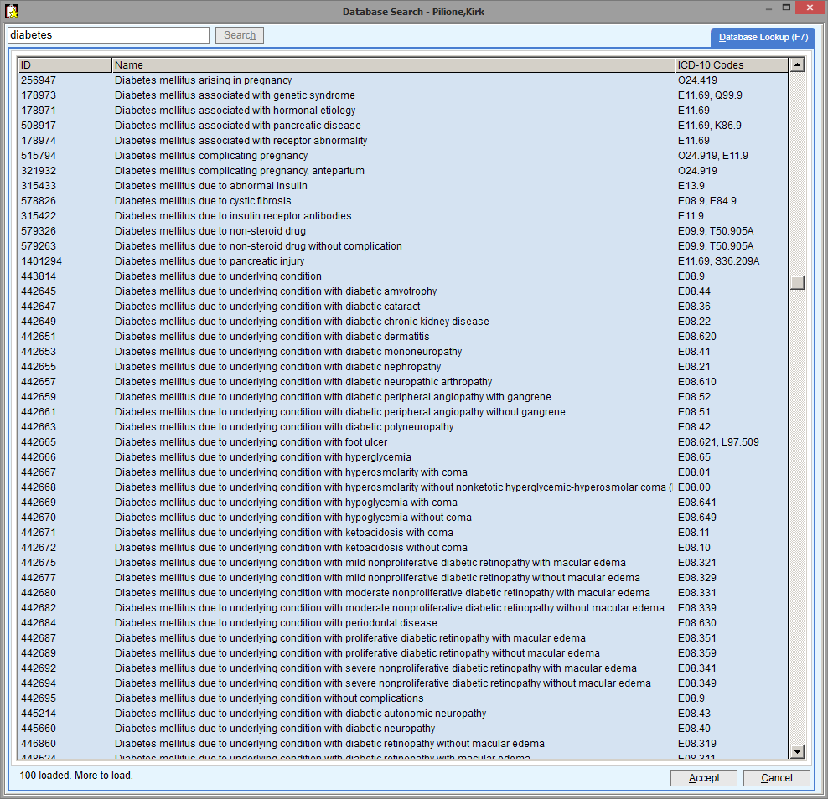

Slide 61
Science of EHR data
Medications data
  Also coded, but it works better
  But many sources
    Prescribing event
    Dispensing in facility
    Dispensing at pharmacy
    Med List
  How do you define what a patient is actually taking?
    Med list (hard to find, not necessarily updated, single snapshot)
    Start date easier than end date?
    “Medication possession ratio”, etc
      Requires pharmacy claims!

Slide 62
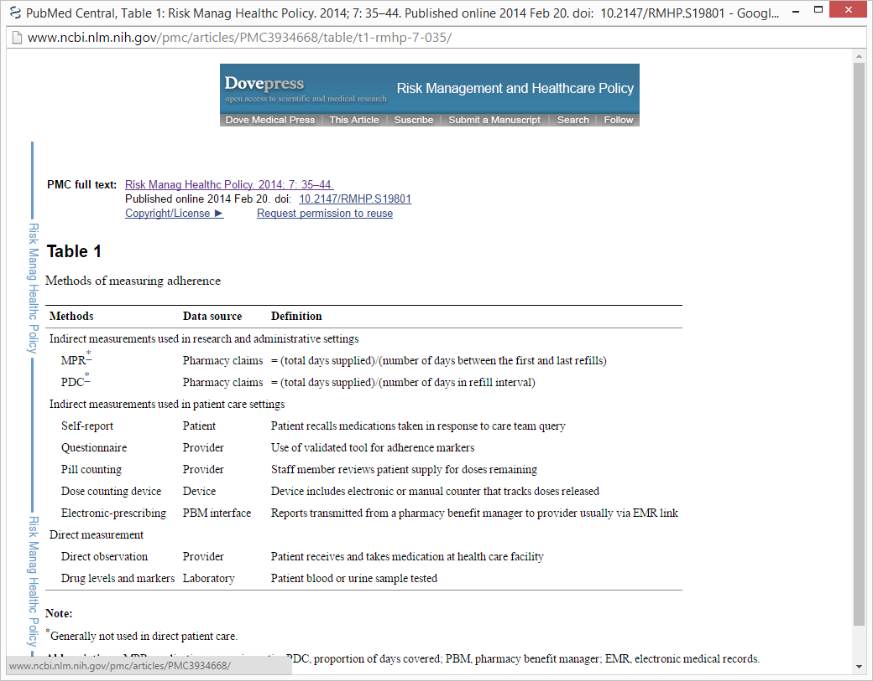
http://www.ncbi.nlm.nih.gov/pmc/articles/PMC3934668/

Slide 63
Science of EHR data
Laboratory data
  Oldest and cleanest?
    STOR data going back decades...
  Units, normal ranges, comparability are often questionable

Slide 64
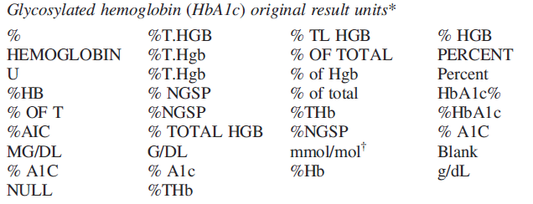
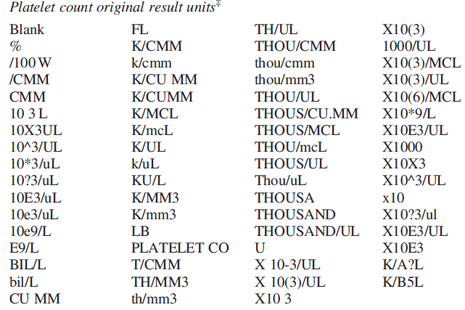
Slide from Mini-Sentinel and PCORnet
(courtesy of Lesley Curtis)
34 different result units for HbA1c
68 different result units for platelets
Source: Electronic clinical laboratory test results data tables : lessons from Mini Sentinel
MarshaA.Raebel1,,KevinHaynes,Tiffany S. Woodworth, Gwyn Saylor, Elizabeth Cavagnaro , Kara O. Coughlin, Lesley H. Curtis, Mark G. Weiner, Patrick Archdeacon and Jeffrey S. Brown

Slide 65
Science of EHR data
Other numeric data...2 examples
  Blood pressure
    Context important?
    In Emergency Dept vs. clinic, clinician-reported vs. dinamap, which arm, etc
    Often need the “metadata”
  Ejection fraction
    Radiology/Cardiology reports – structured free text?
    Code at UCSF – extracts from ~100 sources!
    (thanks to Alvin Rajkomar)

Slide 66
Science of EHR data
Hospitalization and death data
  Diagnosis data coded more carefully?
  Useful...but not complete?
    People use different hospitals
    People die out of hospital
    Closed system data better than open
      Kaiser vs. UCSF
    Claims data helps a LOT for this...but hard to get?

Slide 67
Science of EHR data
Text data from written notes
  Progress notes, discharge summary, nurses notes, etc
  Extremely important information...but hard to “mine”!
  Whole science of natural language processing
    Find concepts (e.g., heart attack, myocardial infarction, MI)
    Identify “negation” language (e.g., “No ___”, “rule out”, “r/o”)

Slide 68
Science of EHR data
Other special data types
  EKG signals
  Imaging files

Slide 69
Science of EHR data
Computable phenotype concept
  Coding of data can define useful research measurements
    Diabetes (diagnosis + meds + FASTING blood sugar level?)
    Hypertension (uncontrolled, treated, resistant, etc)
    Hospitalization for myocardial infarction (Diagnosis + EKG + NLP?)
  NEVER perfect
    Validation by chart review, etc...
    Variations in CP’s will provide different tradeoffs in terms of sensitivity and specificity (depends on research study needs)

Slide 70
Science of EHR data
Data Models
  Take source data and modify
    Simplified data model (combining sources, etc), easier to use
    Common data model for use across institutions
      Allows multi-site studies
      Allows crowd-sourced computable phenotype development
  “Extract-Transform-Load” - ETL
    Requires data manipulation, joining, concatenating datasets
    Decisions!
    Information loss at every step

Slide 71
Real-time data needs (e.g., ED recruiting)
EPIC EHR System
Hierarchical
EPIC-designed ETL (once a day)
Clinical/Ops “dashboards” and research exploration tools
Clarity
13,000 tables
EPIC-designed ETL
Cogito Data
200+ tables
UCSF Clinical Data Warehouse
Research datasets
Research Network Data Models
5-20 tables, e.g. i2b2, OMOP, PCORnet CDM
Figure B1. Clinical Data Flow, Transformation, and Usage in our EPIC-based EHR, with planned enhancements
IBM Infosphere
Metadata, reusable code library, etc

Slide 72
Science of EHR data
Some important UCSF-supported data models to know about:
  Caboodle (AKA Cogito, Star, “Constellation”)
    EPIC product, simplification of APEX data
    UCSF has de-identified flat files for many Caboodle tables!
  OMOP (hosted by OHDSI)
    Open source community effort
    http://www.ohdsi.org/ http://omop.org/ http://cdmqueries.omop.org/
    Competes with i2b2 https://www.i2b2.org/about/intro.html
  PCORnet Common Data Model
    National network funded to do EHR work http://www.pcornet.org/pcornet-common-data-model/
    http://www.pcornet.org/wp-content/uploads/2014/07/2015-07-29-PCORnet-Common-Data-Model-v3dot0-RELEASE.pdf

Slide 73
Real-time data needs (e.g., ED recruiting)
EPIC EHR System
Hierarchical
EPIC-designed ETL (once a day)
Clinical/Ops “dashboards” and research exploration tools
Clarity
13,000 tables
EPIC-designed ETL
Cogito Data
200+ tables
UCSF Clinical Data Warehouse
Research datasets
Research Network Data Models
5-20 tables, e.g. i2b2, OMOP, PCORnet CDM
Figure B1. Clinical Data Flow, Transformation, and Usage in our EPIC-based EHR, with planned enhancements
IBM Infosphere
Metadata, reusable code library, etc

Slide 74
Science of EHR data
“Big data” approaches to EHR data
  Define computable phenotype and use prediction tools
    Neural networks, etc
    Let’s just sic Google on it...?
  Unsupervised – will it work?
    Do we use Clarity 10,000 tables or Caboodle 200 or OMOP 20?
    NLP?
    Maybe if we choose the right problem?

Slide 75
Science of EHR data
Accessing UCSF APEX data
  Consultations from CTSI
    https://accelerate.ucsf.edu/consult
  Going directly to UCSF IT (AKA Academic Research Systems = ARS)
    https://it.ucsf.edu/services/clinical-data-research-consultations-formerly-threds-and-idr-data-extraction-service

Slide 76
Take Home Points
Potential win-win of large, simple, pragmatic trials
  Cheaper, and more relevant for decision-making
Learning healthcare system concept
  Embedding trials in healthcare delivery
  UCSF efforts
Using electronic health record data
  Critical for LHS vision, but hard!
  Active area of development at UCSF
  Resources available; some now and more coming soon

Slide 77
Take Home Points
Questions?
Potential win-win of large, simple, pragmatic trials
  Cheaper, and more relevant for decision-making
Learning healthcare system concept
  Embedding trials in healthcare delivery
  UCSF efforts
Using electronic health record data
  Critical for LHS vision, but hard!
  Active area of development at UCSF
  Resources available; some now and more coming soon

Slide 78
Extra slides to follow

Slide 79
Learning Healthcare Systems
Quality Improvement Research
  QI vs. Research: OVERLAP, not spectrum/dichotomy
  Too many projects try to avoid IRB approval
    Better to use good research methods (e.g., randomization)
    Waiver/modification of consent is often justifiable to IRBs
Randomized Quality Improvement Trial*
  A special beast
  Equipoise not relevant?
  Encouragement design especially reasonable?
*Pletcher 2014 http://www.ncbi.nlm.nih.gov/pubmed/24615554

