Slide 1
Biostat 202: Data visualization:
Telling stories with data
Aaron Wolfe Scheffler,
Division of Biostatistics,
Department of Epidemiology and Biostatistics
Biostat 202

Slide 2
Outline for today
Tables versus graphs
Table principles
Table practice
Graph principles
Graph types
Graph practice

Slide 3
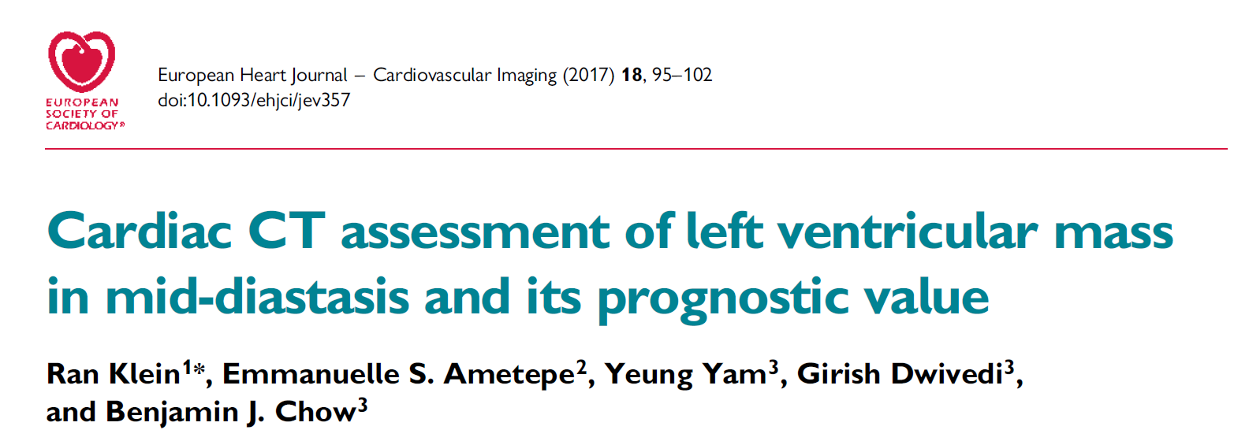
Study of heart disease patients
Goal is to predict Major Adverse Cardiac Events (MACE) and mortality.
Possible predictors: Left Ventricular Mass of the heart (LV mass) estimated during three heart phases and normalized by (divided by) body surface area (BSA) or weight. Also ejection fraction.

Slide 4
Table example – what is right/wrong?
European Heart Journal - Cardiovascular Imaging (2017) 18, 95-102 doi:10.1093/ehjci/jev357
Notes:
Describe table – open call – let people read.

Slide 5
Table example – focus on right side
Notes:
What is the point of this table? If you want a table or graph to tell a story, you have to decide on the story first.
Which predictor works best? Hard to tell.

Slide 6
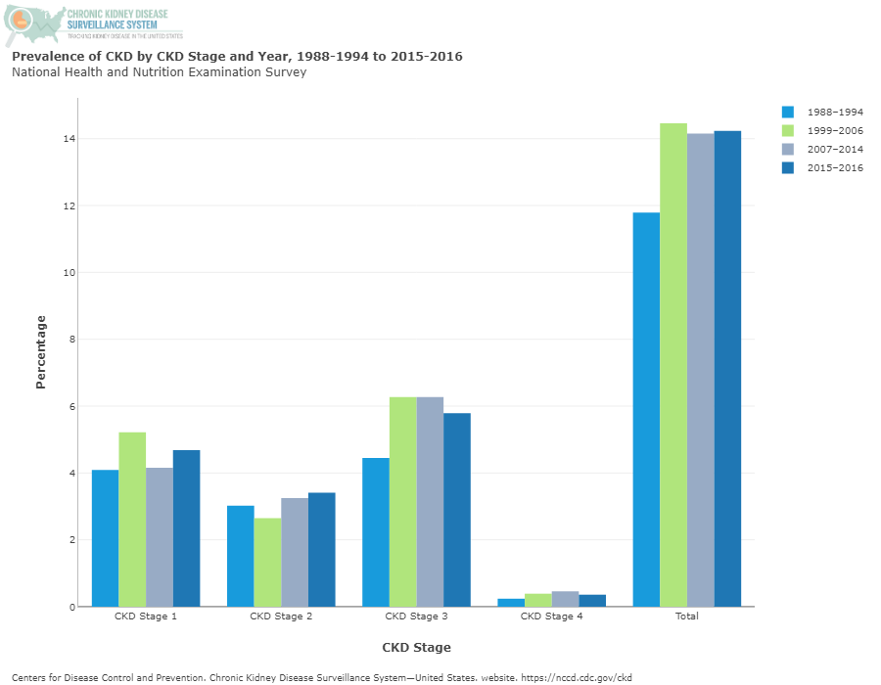
Graph example – what is right/wrong?
Notes:
Describe table.

Slide 7
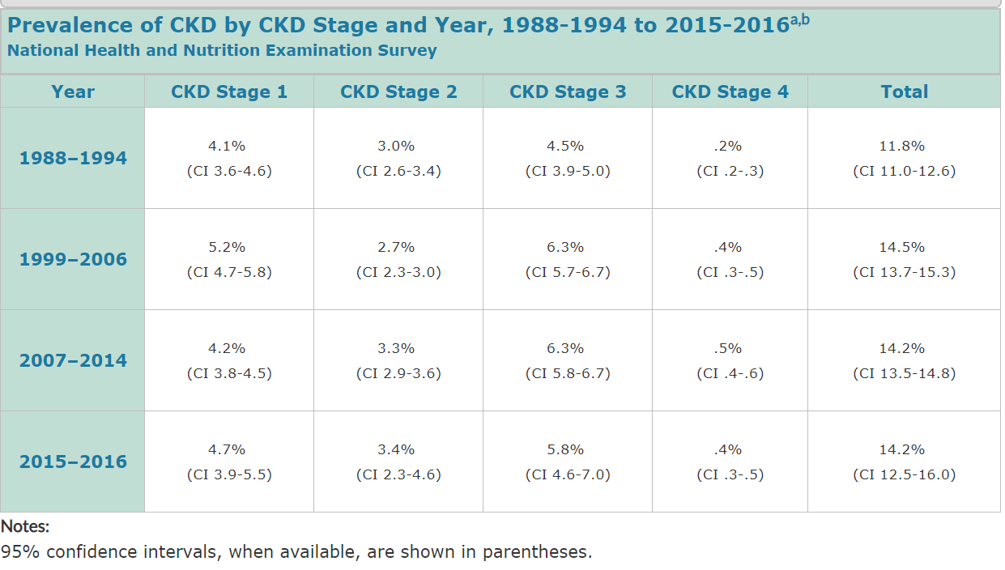
Same data in a table – what is right/wrong? Better/worse?

Slide 8
Outline for today
Tables versus graphs
Table principles
Table practice
Graph principles
Graph types
Graph practice
Notes:
Why tables versus graphs

Slide 9
Tables vs graphs
Use TABLES when
The user needs to look up specific values
You want to enable individual quantitative comparisons
You need to convey results to high precision
You want to convey both individual and summary information
You want to display items that are measured on very different scales. Workarounds: left vs right scales; log scales; multiple panels.
Notes:
Graphs are hard to extract specific values from, you can do this with a table

Slide 10
Tables vs graphs
Use GRAPHS when
You want to convey shapes
You want to convey patterns
You want to convey trends
You want to convey quantitative ideas quickly
Corollary: You should minimize tables in scientific presentations in favor of graphs!

Slide 11
Chronic Kidney Disease
Which when?
Notes:
Graph to show differences in stages. (Less good) trends over time. Table to give more precision, allow individual comparisons.
Possible solution, combine ala survival analysis plots.

Slide 12
Outline for today
Tables versus graphs
Table principles
Table practice
Graph principles
Graph types
Graph practice

Slide 13
Table principles
Should be self-explanatory!!!
It is easier to compare numbers in columns.
Round aggressively, preferably to two effective digits (ie where the numbers differ). Exception: you need to convey precise results.
Order rows and/or columns purposefully to convey information. Compare across columns
Lightly use visual elements to ease comparisons.
Notes:
First table example… maybe not self explanatory.

Slide 14
Outline for today
Tables versus graphs
Table principles
Table practice
Graph principles
Graph types
Graph practice

Slide 15
Table example – focus on right side
Notes:
How can we improve this table?
Explanation (MD, ED, ES): violates principal #1 which is tables are self explanatory
Explanation (AUC definition)
Effective digits in AUC
Light visuals could be improved
Order columns, put all on the left

Slide 16
Improving the cardiac prediction table
Improve table with
  Explanation
  Rounded to 2 digits
  Light visuals
  Order columns to put All on the left
What’s good? has primary comparisons in columns, lightly uses visual elements, and is ordered purposefully.
Notes:
Mention the positives!

Slide 17
Notes:
The improved table – long captions are okay! Spend some time reading. Guide reader with the caption.

Slide 18

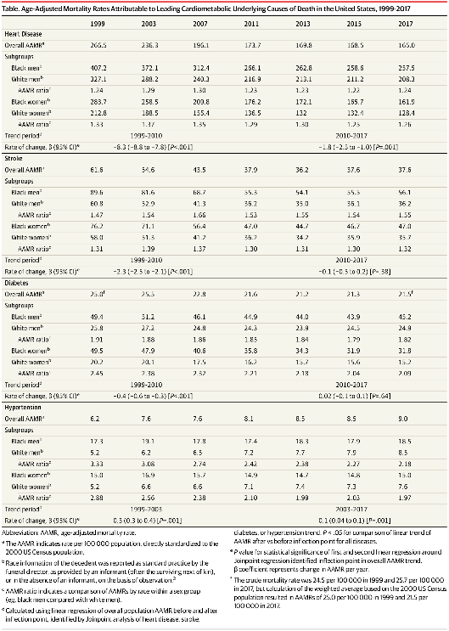
From: Trends in Cardiometabolic Mortality in the United States, 1999-2017
JAMA. 2019;322(8):780-782. doi:10.1001/jama.2019.9161
Table Title:
Age-Adjusted Mortality Rates Attributable to Leading Cardiometabolic Underlying Causes of Death in the United States, 1999-2017

Slide 19
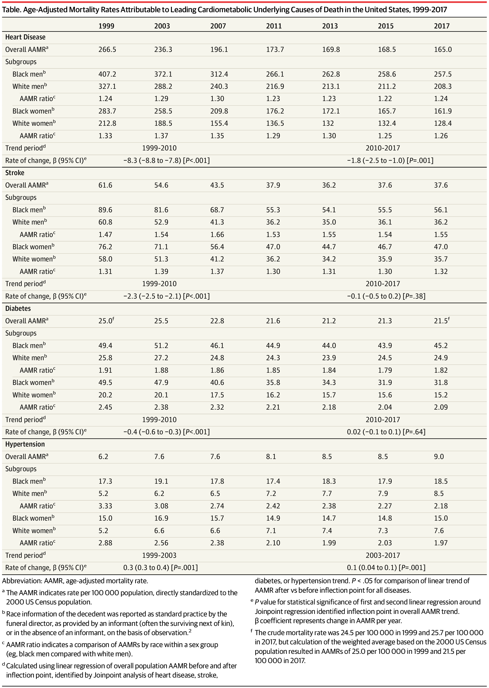
Improving the mortality trend table
Notes:
How to improve?
Do not need so many digits (aggressive rounding)
Light visuals
Is the main comparison in the columns? Well if trying to highlight race and gender differences, these should be in the columns.
Ratios are calculated across gender but not across race.

Slide 20
Improving the mortality trend table
Improve table with
  Rounded to 2 effective digits – how?
  Light visuals instead of overall shading
  Main comparison in columns?
Perhaps better as a graph. Why a table?
  Trying to get a lot of information in here

Slide 21
Outline for today
Tables versus graphs
Table principles
Table practice
Graph principles
Graph types
Graph practice

Slide 22
Graph principles
Should be self-explanatory.
Aim for interocular traumatic impact. Use the ideas below to convey your message clearly.
Choose a graph type to emphasize your desired message.
Maximize the data to ink ratio.
Minimize the impact of non-data ink.
Use colors, marker symbols and line types purposefully (Excel is ☹).

Slide 23
CKD graph: how to improve?
Notes:
Drop total column to allow comparison
Change color scheme
Change scale
Improve characterization of chronological trend
Explanation to guide reader

Slide 24
How could the CKD graph be improved?
Explanation
Drop total columns
Change scale
Change color scheme
Try your hand at it in the homework!

Slide 25
Graphs can convey data by
Points – location in space
Lines – trends (also points+lines)
Bars – by height (also points+bars)
Colors
Point types
Point size
Line types
Bar or symbol fill (color or shading)

Slide 26
Outline for today
Tables versus graphs
Table principles
Table practice
Graph principles
Graph types
Graph practice

Slide 27
Graph types
Points – scatter plot for two numeric variables
Lines – trend for numeric over time
Points and lines – connected plot, smoothed plot, estimate and error bars
Bars – bar chart for numeric by categorical; histogram for frequency versus numerical value to display shape.
Bars and lines – bar chart with error bars; boxplot for distributional shape.

Slide 28
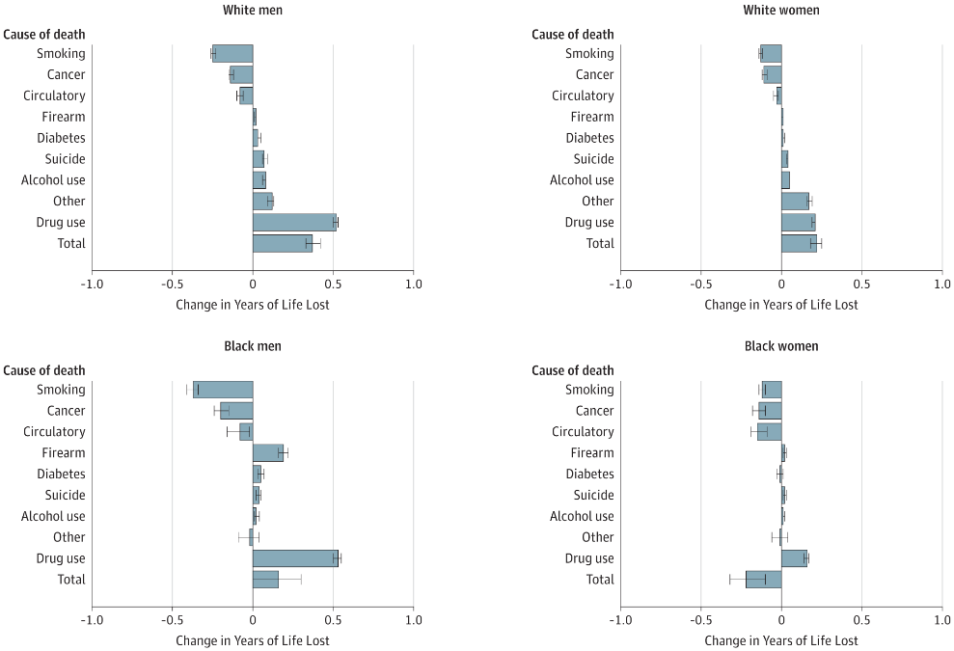
Examples of graphs and how they convey data
Notes:
Let’s zoom in on the upper left to make sure we understand what each panel is.

Slide 29
Examples of graphs and how they convey data
Notes:
Change in years of life lost due to various causes from 2010 to 2017. For example, the average years of life lost to smoking among U.S. men was about 2.5 in 2010 (it is more than 10 if you smoke). So the graph displays something like a drop from 2.5 to 2.25. Note: bars, points and lines! Bars create a visual impression. Ordering? Drug use!!
How does graph convey information?

Slide 30
Examples of graphs and how they convey data
Notes:
Takeaways: (intraocular!) white males suffered most. B/c of drug use. Black females improved. Black males improved on smoking.
Improve: different color for overall to call attention. Or a light visual aid to separate.

Slide 31
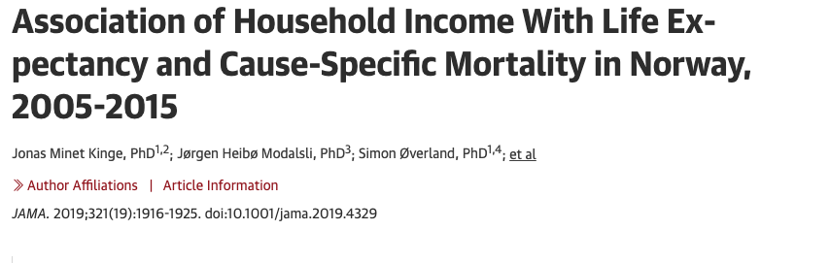
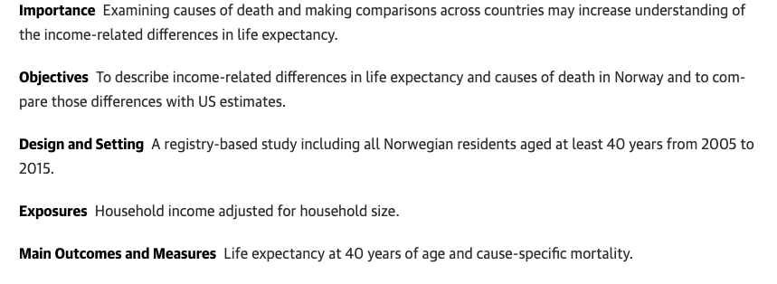
Notes:
Big gap between rich and poor ~ 8 and 13 years between men and women at the top and bottom 1% incomes, respectively.

Slide 32
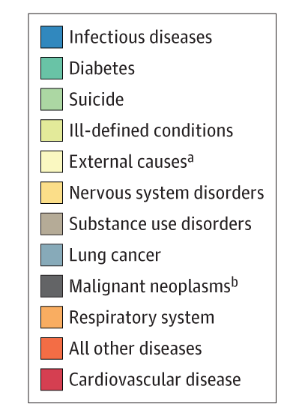
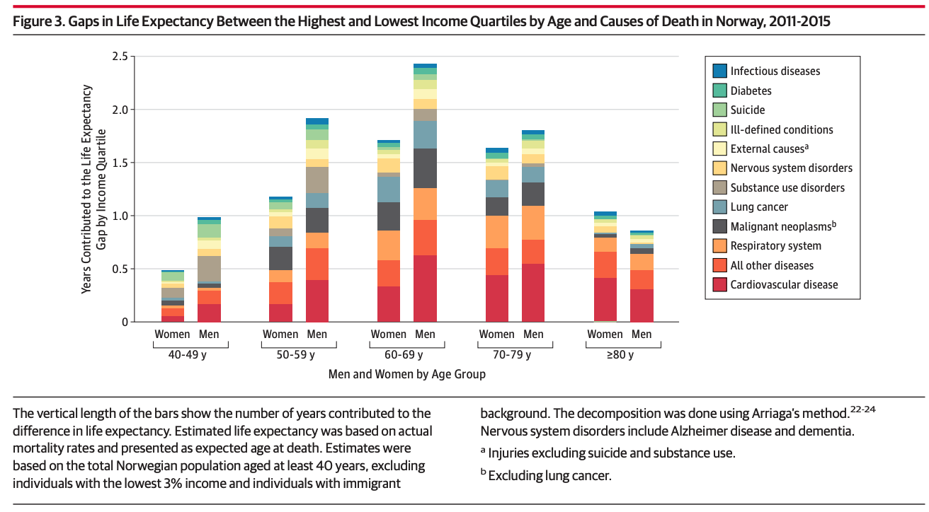
Examples of graphs and how they convey data
Notes:
Y-axis: years contributed to life expectancy gap by income quartile
X-axis: Men and women by age group
Really explain the gap in years lived is expressed.
Bad graph in a good journal.

Slide 33
How could the life expectancy graph be improved?
Stacked bar graph!?
Color scheme
Ordering

Slide 34
Avoid: pie charts and stacked bar charts

Slide 35
Avoid: pie charts and stacked bar charts
Comparing the areas is a difficult visual perception task.
We are really bad at comparing relative areas that are represented in these pie charts and stacked bar chart.
Wanna bet? Let’s see.

Slide 36
At all costs avoid pie charts and stacked bar charts
Comparing the areas is a difficulty perception task.
Notes:
Which colors are smallest and largest?

Slide 37
At all costs avoid pie charts and stacked bar charts
Comparing the areas is a difficulty perception task.
Notes:
Now, which are smallest and largest?

Slide 38
At all costs avoid pie charts and stacked bar charts
Comparing the areas is a difficulty perception task.
Notes:
Remove the zero, which is largest and smallest now?

Slide 39
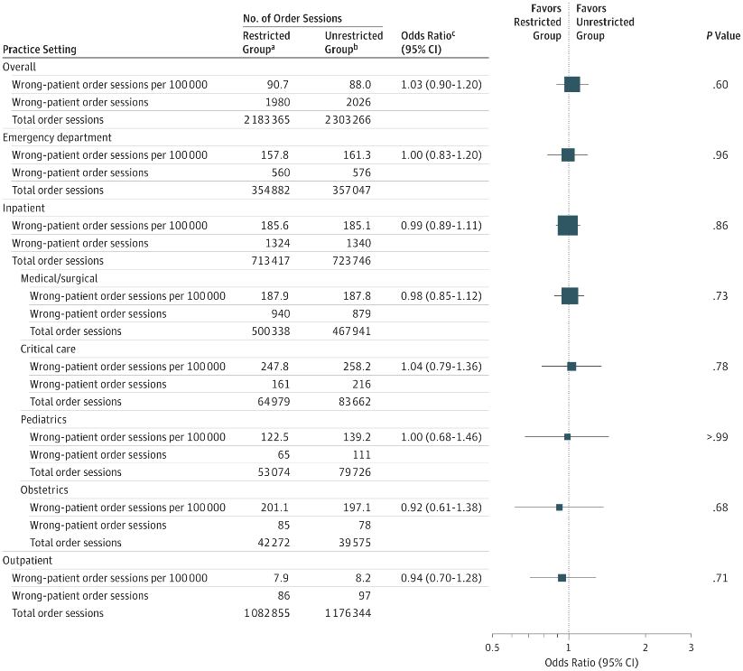
Notes:
You can have your cake and eat it too. Study of the errors due to have large number of windows open in HER. Stratified by medical departments – lots of info conveyed – comparisons, odds ratios, etc…
– lets zoom in.
Scan the graphs to get story – look at tables to get data and information. Make comparisons aided by the visual guidance.

Slide 40
Having your cake and eating it too
Notes:
Let’z zoom in. How could this be improved? What are two effective digits for Order Sessions per 100,000?

Slide 41
Graph types -
Two at a time
Two numerical variables
  Scatterplot
Numerical and Categorical
  Bar chart
  Box plot
Two categorical
  Table

Slide 42
Outline for today
Tables versus graphs
Table principles
Table practice
Graph principles
Graph types
Graph practice

Slide 43
Ex: HPV vaccine uptake in Netherlands
Pot et al (Prev Med, 2017) wanted to understand which variables were associated with intent for mothers to get their 12 year-old daughters vaccinated. Intention is measured on a scale from 1 (definitely not) to 7 (definitely yes). 8,062 responses.
One of those predictors was knowledge about the HPV vaccine. Knowledge was assessed as the sum across 8 questions with -1 for wrong, +1 for correct (so a range of -8 to 8).
What type graph to assess association?
Notes:
Study in the Netherlands. Examples of knowledge questions: 1. Condoms fully protect against HPV or 2. Women who are vaccinated are still advised to get screened.

Slide 44
Data consistent with Pot
intent
Notes:
Describe
Let’s look at the association of Intent with Knowledge. Looks funny and can’t see association because most of the points are on top of one another.

Slide 45
Add jitter
intent
Notes:
Let’s look at the association of Intent with Knowledge. Looks funny and can’t see association because most of the points are on top of one another.
Solution, jitter

Slide 46
Add smoother line
intent
Notes:
Let’s look at the association of Intent with Knowledge. Looks funny and can’t see association because most of the points are on top of one another.
Run a regression or smoother through.

Slide 47
Just plot mean values
intent
Notes:
Let’s look at the association of Intent with Knowledge. Looks funny and can’t see association because most of the points are on top of one another.

Slide 48
Mean values plus fitted line
intent
Notes:
It is now patently clear that there is a weak association between Intent and Knowledge.

Slide 49
Compare with original
intent
Notes:
Contrast with the original. Often an iterative process to hone in on the key information in the plot – which is there is a weak association between knowledge and intent.

Slide 50
Graph practice
OAI data – is the volume of cartilage in the knee different between those who have painful knee arthritis and those that do not?
Preferred graph type?

Slide 51
OAI cartilage volume
Cartilage volume
Notes:
People with progressive OA, pain or not

Slide 52
Cartilage volume
Notes:
Data to ink ratio? There are only two data points displayed. WASTE OF INK.

Slide 53
OAI cartilage volume
Notes:
Add standard errors or confidence intervals if you want to show the precision of the estimate and help decide if there are statistically significant differences or not.

Slide 54
OAI cartilage volume
Notes:
Use boxplots or histograms if you want to describe the variability in the data instead of the precision of estimates.

Slide 55
More variables at once (big data)
Adding additional variables to a two-variable graph
Numeric
  Symbol size
  Symbol color shading
Categorical
  Color
  Symbol type or line type
  Different panels

Slide 56
Graph practice
OAI data – is the volume of cartilage in the knee different between those who have painful knee arthritis and those that do not? And different between males and females?

Slide 57
OAI cartilage volume
Cartilage volume
Notes:
Add more bars – conclusions? Women have less cartilage volume.
Improve?

Slide 58
OAI cartilage volume
Cartilage volume
Notes:
Improve more? Use colors. STATA generated plots… not perfect

Slide 59
Graph practice
Back to the AUROC predictor data. Can we do better with a graph?
Preferred graph type to display predictor, phase and AUROC?
Predictor: categorical
Phase: categorical
AUROC: numerical

Slide 60
Graph practice
Notes:
Note how information is conveyed. Point gives AUROC and phase. Line, color and symbol convey predictors (along with legend).
Which is best predictor?
But what if we want to show sex as well?

Slide 61
Graph practice
Notes:
Getting a little busier… For females, what is the best method? Hard to tell (blue vs red).
For males, LVEF is clearly the best (grey).

Slide 62
Graph practice
Notes:
Can be read with some study, but get a little busy. If the story focuses on the overall, how can we emphasize that?
Still not perfect… why even have ordering for ED, ES, MD?

Slide 63
Graph practice

Slide 64
Graph practice
OAI data – is the volume of cartilage in the knee related to body mass index (BMI)?
Preferred graph type?

Slide 65
Examples of graphs and how they convey data
Scatterplot
Cartilage volume

Slide 66
Examples of graphs and how they convey data
Scatterplot with smoother
Cartilage volume
Notes:
How to better convey the relationship with BMI?

Slide 67
Examples of graphs and how they convey data
Scatterplot with smoother
Notes:
Make points smaller and line thicker.

Slide 68
Examples of graphs and how they convey data
Scatterplot with smoother and error bars
Notes:
It isn’t too busy. Can add confidence region

Slide 69
Graph practice
NHANES data – is trend in chronic kidney disease prevalence over time?
Does it differ between diabetics and non-diabetics?
Preferred graph type?

Slide 70
Examples of graphs and how they convey data
Time trend Annals
Notes:
Prevalence and year data is conveyed by point location. Diabetes status by color symbol and line type (in case printed in black/white).

Slide 71
Graph practice using SPSS modeler
Adding more variables

Slide 72
Other kinds of graphics
Geocoded map
Animation
Heat map
Network map

Slide 73
Other kinds of graphics
Chronic Kidney disease map and animation
https://nccd.cdc.gov/CKD/Detail.aspx?QNum=Q69&Year=2016&colors=all#refreshPosition

Slide 74
Other kinds of graphics
Genetic heatmaps

Slide 75
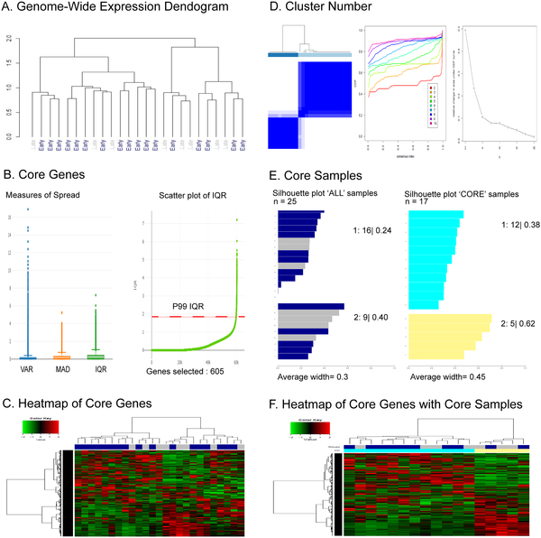

Fig 2. NOJAH genome-wide heatmap (GWH) analysis of RNA-Seq derived gene expression data using TCGA BRCA expression dataset.
Rupji M, Dwivedi B, Kowalski J (2019) NOJAH: NOt Just Another Heatmap for genome-wide cluster analysis. PLOS ONE 14(3): e0204542. https://doi.org/10.1371/journal.pone.0204542
https://journals.plos.org/plosone/article?id=10.1371/journal.pone.0204542

Slide 76
Fig 2. NOJAH genome-wide heatmap (GWH) analysis of RNA-Seq derived gene expression data using TCGA BRCA expression dataset.
Rupji M, Dwivedi B, Kowalski J (2019) NOJAH: NOt Just Another Heatmap for genome-wide cluster analysis. PLOS ONE 14(3): e0204542. https://doi.org/10.1371/journal.pone.0204542
https://journals.plos.org/plosone/article?id=10.1371/journal.pone.0204542

Slide 77
Fig 2. NOJAH genome-wide heatmap (GWH) analysis of RNA-Seq derived gene expression data using TCGA BRCA expression dataset.
Rupji M, Dwivedi B, Kowalski J (2019) NOJAH: NOt Just Another Heatmap for genome-wide cluster analysis. PLOS ONE 14(3): e0204542. https://doi.org/10.1371/journal.pone.0204542
https://journals.plos.org/plosone/article?id=10.1371/journal.pone.0204542

Slide 78
Other kinds of graphics
McCulloch co-authors on UCSF Profiles
https://profiles.ucsf.edu/display/176718/network/coauthors/cluster

Slide 79
Summary
Use tables for specific values, quantitative comparisons, precision, individual+summary information, differing scales.
Use graphs to convey information quickly, for shapes, patterns and trends.
Both should be self-explanatory and use a light touch on non-data
Tables: compare columns, round aggressively, order purposefully
Graphs: maximize data to ink, use color, symbols and line types purposefully.

