Slide 1

Cohort Studies
Person Time & Bias
June M. Chan, ScD
Professor, Epidemiology & Biostatistics and Urology
Steven & Christine Burd-Safeway Distinguished Professor

Slide 2
Overview
Open vs. Fixed Cohorts
What do we calculate in Cohorts?
Assignment of Person Time
Survivor Cohorts
Bias
  Measurement Error
  Reverse Causation
  Confounding by Indication
  Residual Confounding
  Selection bias
  Immortal person time bias

Slide 3
Overview
Open vs. Fixed Cohorts
What do we calculate in Cohorts?
Assignment of Person Time
Survivor Cohorts
Bias
  Measurement Error
  Reverse Causation
  Confounding by Indication
  Residual Confounding
  Selection bias
  Immortal person time bias

Slide 4

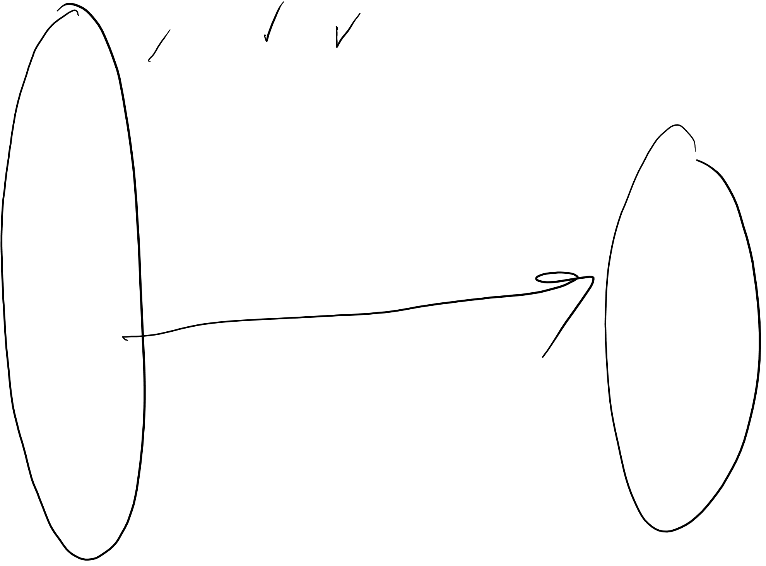
Recap of Epid Methods I – Study Design, week 1
Fixed (or “Closed”) Cohort
= event = loss to follow-up CE = competing event
CE
CE
Initial Cohort
Cohort at the end
of Follow-Up
Time since enrollment
Notes:
From Epid Methods 1, J Martin 2017
This is a modified schematic from your text for a cohort. This particular schematic illustrates a fixed cohort, also called a closed cohort A fixed cohort begins with a group of individuals, depicted with the stick figures, whom at time zero have some defined set of characteristics. Examples of a fixed cohort: UCSF graduating class of 2009; survivors of the atomic bombings of Japan; all those undergoing knee replacement surgery at Northern California Kaiser Permanente in 2015.
A fixed cohort can also be assembled explicitly for research purposes. Probably the most famous example is the Framingham cohort (more on this later). UCSF is the coordinating center for several research-dedicated fixed cohorts: Study of Osteoporotic Fractures; and the Health, Aging and Body Composition Study.
If the goal is to study the etiology of a particular event or outcome, we would typically include in the defined set of characteristics that none of the individuals have the event or outcome of interest. These individuals then experience their lives until the event of interest occurs, if it occurs at all. The event could be anything, a disease, death, cessation of smoking, attending a primary care visit for the first time, etc.
The timeline for a fixed cohort starts from the point of entry into the cohort or from the time of assembly. So, the x-axis here shows “time since enrollment” or “time since entry,” not calendar time. Time zero for each individual occurs when they enter the cohort.
Some persons develop the outcome of interest, here depicted with a solid circle. Others become lost to follow-up, while others stay in the cohort but have not yet developed the outcome of interest by the last date of observation.
Many descriptions of cohorts (including the S + N textbook) list three possible outcomes for a participant in a fixed cohort: Loss to follow-up, having the event of interest, or being followed without an event to the end. We want to emphasize a fourth possibility. A participant can experience an event that is a “competing event,” also called a “competing risk”. A competing event is one that precludes the occurrence of the event of interest. An example of a competing event in a study of the occurrence of cancer would be death by heart attack. We will discuss this more later.
Stick figures are modified from Keyes and Galea. Epidemiology Matters. Oxford.

Slide 5

Fixed Cohort
Fixed population
  Followed from defined starting point to defined ending point
  After enrollment is complete/start of follow-up, no one added
Membership-defining event
  Cohort of persons born in 2012 (calendar time)
  Cohort formed at entry into UCSF medical school (an event)
  Randomization to drug vs placebo in a clinical trial (an event)
Notes:
NOTE on terminology: per RGL p. 101, sometimes a Fixed cohort is used to describe a cohort where members are defined as exposed or unexposed at the start, and don’t change. That is a Fixed cohort, but not the only type; it is more of a rigid or constrictive definition than we will use.
For our purposes, we will define Fixed Cohort as a group of people whose membership does not change over time.
For example, Nurses Health Study: “Married [female] registered nurses, aged 30 to 55 in 1976, who lived in the 11 most populous states, and whose nursing boards agreed to supply NHS with their members' names and addresses, were eligible to be enrolled in the cohort if they responded to the NHS baseline questionnaire. The original states were California, Connecticut, Florida, Maryland, Massachusetts, Michigan, New Jersey, New York, Ohio, Pennsylvania, and Texas.”
http://www.nurseshealthstudy.org/about-nhs/history
Delivered surveys to 172,413 nurses and 71% response rate; membership has been 121,700 since 1976-1977 and has not changed since.

Slide 6
Fixed Cohort
Fixed population
  Followed from defined starting point to defined ending point
  After enrollment is complete/start of follow-up, no one added
Membership-defining event
  Cohort of persons born in 2012 (calendar time)
  Cohort formed at entry into UCSF medical school (an event)
  Randomization to drug vs placebo in a clinical trial (an event)
Closed cohort ⚐
  RGL, p101 – A closed cohort = a subtype of fixed cohort, where there are no losses to follow-up or dropout, and members only leave cohort due to death
  NOTE: more restrictive definition than Epid Methods I and how we will use it here.
Notes:
NOTE on terminology: per RGL p. 101, sometimes a Fixed cohort is used to describe a cohort where members are defined as exposed or unexposed at the start, and don’t change. That is a Fixed cohort, but not the only type; it is more of a rigid or constrictive definition than we will use.
For our purposes, we will define Fixed Cohort as a group of people whose membership does not change over time.
For example, Nurses Health Study: “Married [female] registered nurses, aged 30 to 55 in 1976, who lived in the 11 most populous states, and whose nursing boards agreed to supply NHS with their members' names and addresses, were eligible to be enrolled in the cohort if they responded to the NHS baseline questionnaire. The original states were California, Connecticut, Florida, Maryland, Massachusetts, Michigan, New Jersey, New York, Ohio, Pennsylvania, and Texas.”
http://www.nurseshealthstudy.org/about-nhs/history
Delivered surveys to 172,413 nurses and 71% response rate; membership has been 121,700 since 1976-1977 and has not changed since.

Slide 7
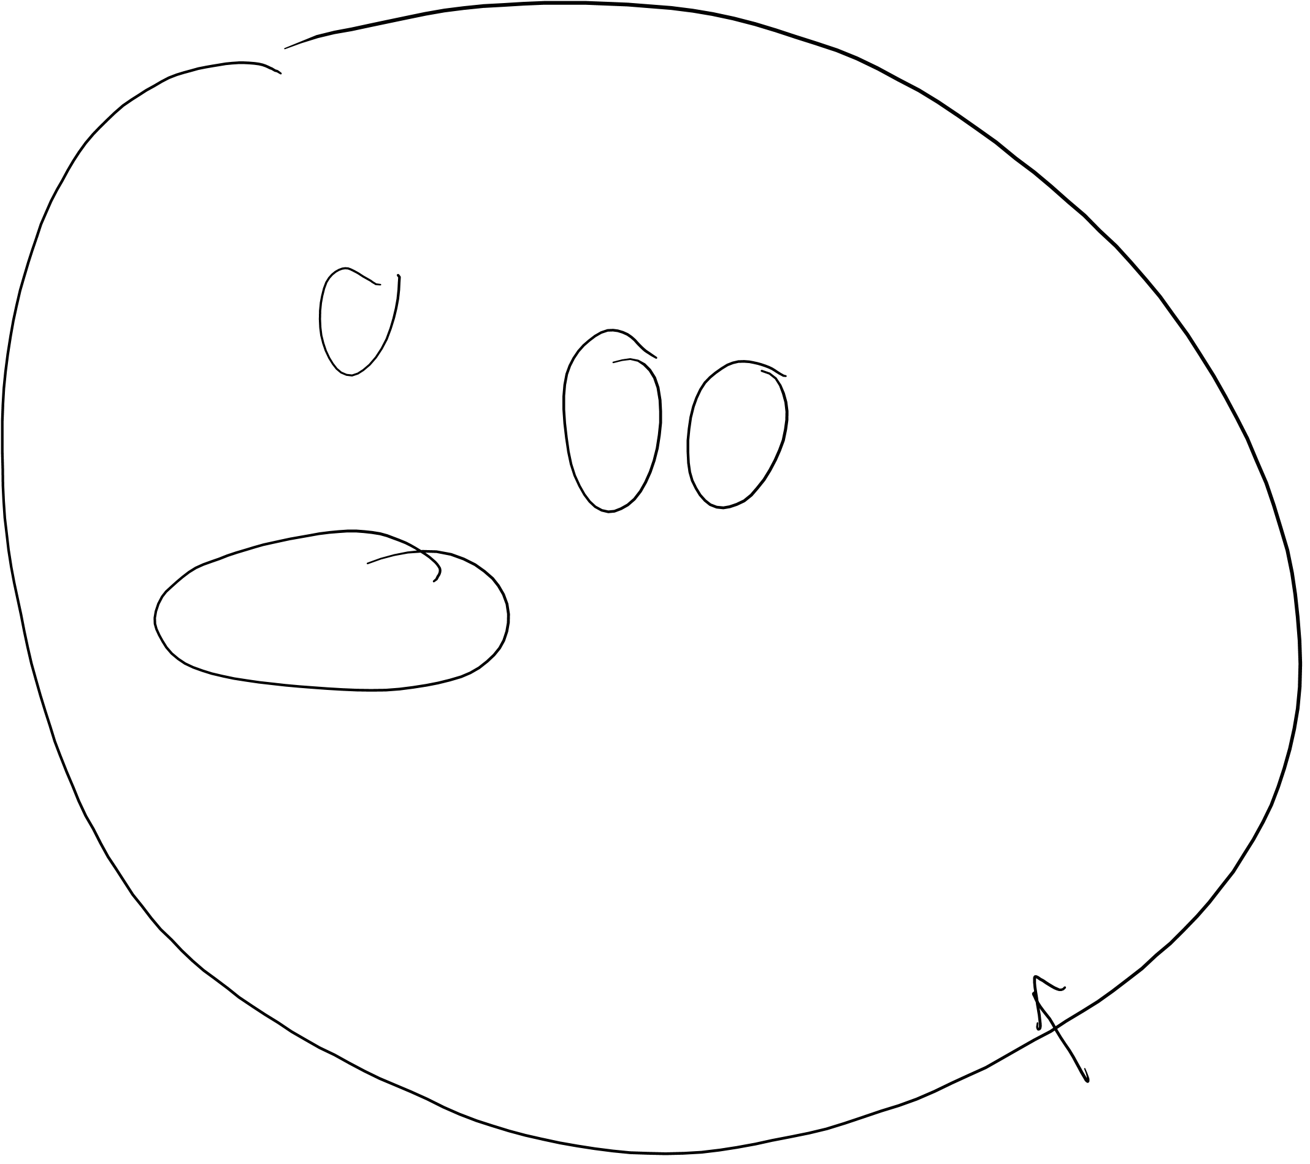
Recap of Epid Methods I – Study Design, Week 1
3 Ways to Sample An Underlying Fixed Cohort
= event = loss to follow-up CE = competing event
CE
CE
Cohort
Cross-sectional
= Case-control
Time
Notes:
From Epid Methods 1, J Martin 2017
How would a researcher study the people in a fixed cohort? There are at least 3 ways to sample an underlying fixed cohort for the purposes of studying the population:
Cohort sampling -- follow everyone at time zone (or a sample of everyone) as they move forward in time
Cross-sectional sampling -- sample everyone at one point in time
Case-control sampling -- a strategic sampling scheme limited to just those who developed your outcome of interest and a reference group.
These 3 methods of sampling correspond to our 3 most common study designs: cohort study, cross-sectional study, and case-control study.

Slide 8
Fixed Cohort – How to build
Define your population of interest to whom you wish to generalize the results
Choose all or a sample
Define the “event” that triggers start of follow-up time
Specify Eligibility

Slide 9

Fixed Cohort Ex – Nurses Health Study I
Eligibility:
  Married [female] registered nurses
  Aged 30 to 55 in 1976
  Lived in the 11 most populous states and nursing boards supplied names and addresses (California, Connecticut, Florida, Maryland, Massachusetts, Michigan, New Jersey, New York, Ohio, Pennsylvania, and Texas)
  Responded to the baseline questionnaire
Surveys mailed to 172,413 nurses & 71% response rate
N = 121,700 enrolled in 1976-1977
As a “fixed” cohort, this N ↓ over time due to death, loss to follow-up, or withdrawal and new participants NOT added after enrollment phase
Notes:
For example, Nurses Health Study: “Married [female] registered nurses, aged 30 to 55 in 1976, who lived in the 11 most populous states, and whose nursing boards agreed to supply NHS with their members' names and addresses, were eligible to be enrolled in the cohort if they responded to the NHS baseline questionnaire. The original states were California, Connecticut, Florida, Maryland, Massachusetts, Michigan, New Jersey, New York, Ohio, Pennsylvania, and Texas.” http://www.nurseshealthstudy.org/about-nhs/history
Delivered surveys to 172,413 nurses and 71% response rate; membership has been 121,700 since 1976-1977
NHS I PI’s: Grodstein F, Stampfer M, Hankinson, Colditz, Speizer
NHS II: Eliassen & Willett
NHS III: Chavarro J
Parallel study of men started by similar team of investigators (Willett, Stampfer, et al) – Health Professionals Follow-up Study. https://content.sph.harvard.edu/hpfs/
51,529 male health professionals (non-MD) completed qx in1986 - “composed of 29,683 dentists, 4,185 pharmacists, 3,745 optometrists, 2,220 osteopath physicians, 1,600 podiatrists, and 10,098 veterinarians. Among the study participants are 531 African-Americans and 877 Asian-Americans”

Slide 10
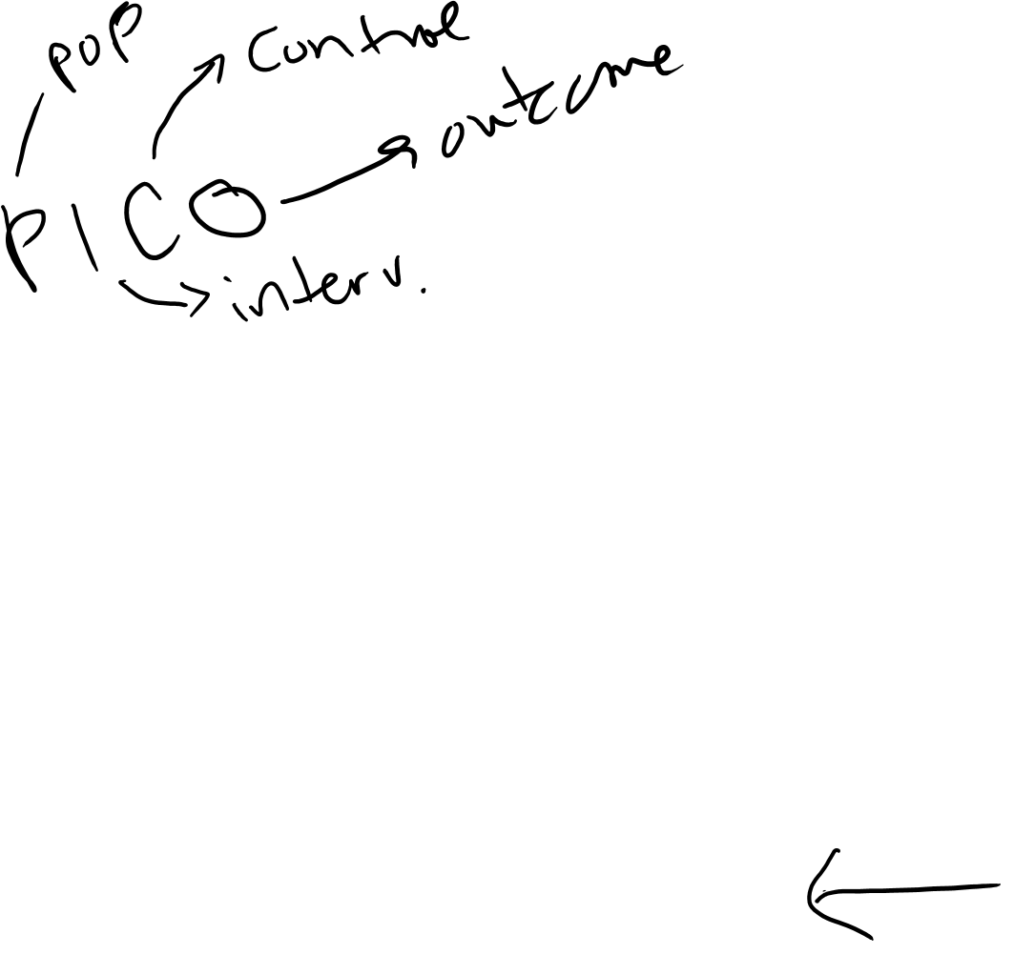
Fixed Cohort – How to build
Define Exposure status
  Person-time Exposed vs. Unexposed
  Sometimes straight-forward, sometimes not… more on this soon!
Define Outcome
  incident disease (count or event data)
  change in a continuous metric, like blood pressure or weight (outcome may be continuous “difference” or “change”)
Develop “baseline” & “follow-up” assessments
Consider duration of follow-up
  Long enough to observe events of interest
  Short enough that you can maintain participants, minimize loss
Notes:
PICO
P: Population
I: Intervention (or E, Exposed, if not RCT)
C: Comparison Group for Exposure (or Control group for the intervention)
O: Outcome

Slide 11
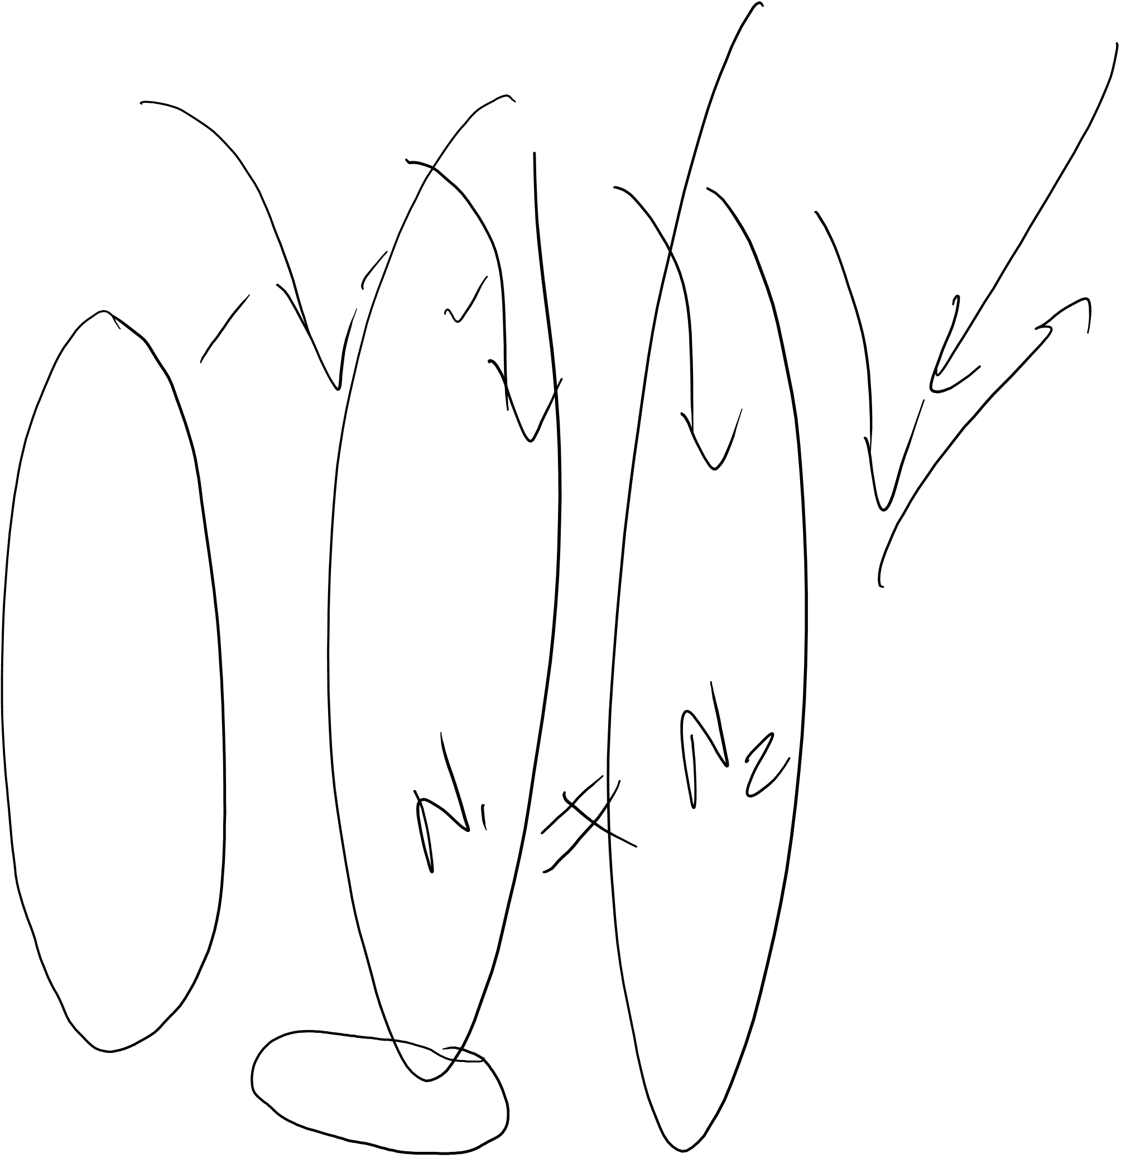
Recall Epid Methods I – Study Design
Dynamic (or “Open”) Cohort
New Members
CE
CE
Observation begins
Time (calendar)
Observation ends
Notes:
From Epid Methods 1, J Martin 2017
The other kind of cohort is a dynamic or “open” cohort, also referred to as a “dynamic population” in the Vanderbroucke reading. A dynamic cohort is generally a free living population defined by geography, membership, etc and whose time zero typically extends over some duration of calendar time. There is no sense of any short fixed period of enrollment. There is the expectation that new members of the cohort will be constantly joining. Dynamic cohorts typically have the expectation that its participants will often leave the cohort.
For example, San Francisco (SF) County residents, who are defined by geographic county lines, in a given calendar period, are a dynamic cohort. We know that new members will continually be moving into the county and established members will continually be moving out. Another example is the members of Kaiser Permanente (a Health Care Maintenance Organization (HMO), which provides health insurance to a given set of people) during some specified calender time period. It is a dynamic cohort that is administratively defined by membership. It is an open cohort since we expect that new members will continually enter and established members will leave. In this slide, we show a dynamic cohort that has about the same total members throughout the period of observation; as members leave the cohort, a similar number of new members join. Dynamic cohorts may also be increasing or declining in overall numbers.
Dynamic cohorts differ conceptually from fixed cohorts. In a dynamic cohort, time is generally calendar time and not observation time; this is because there was no single time of enrollment. Persons leave the cohort because of developing an event of interest, a competing event, no longer fulfilling the criteria of the cohort (e.g., no longer living in San Francisco or no longer being a member of the Kaiser HMO, or just simply the end of follow-up for the entire population (e.g., persons were followed up until last month). In a fixed cohort, in contrast, follow-up time starts with the construct that defines cohort membership and time is typically described in observation time since time zero. Just like a dynamic cohort, in fixed cohorts observation is ceased when the outcome of interest occurs, leaving the cohort (which is called “loss to follow-up” in the context of a fixed cohort, competing event, or administrative end of observation.
Many textbooks do not provide much discussion of dynamic cohorts, and this is unfortunate. Historically, for example, dynamic cohorts have been used for clinical research of cancer outcomes, facilitated in the US by the establishment of cancer registries in defined geographic areas. Currently, in the era of so-called “Big Data”, the use of dynamic cohorts from clinical practice settings is growing and encompasses a wider range of health outcomes.

Slide 12
Open Cohorts (Dynamic Cohorts)
No fixed roster – person-time accrued from a potentially changing roster of individuals
  Residents of California
  Members of Kaiser Permanente
  Cancer of the Prostate Strategic Urologic Research Endeavor (CaPSURE): men with prostate cancer, 1996-current
Individuals can leave and re-enter the cohort
  Connecticut Tumor Registry
  UCSF primary care

Slide 13
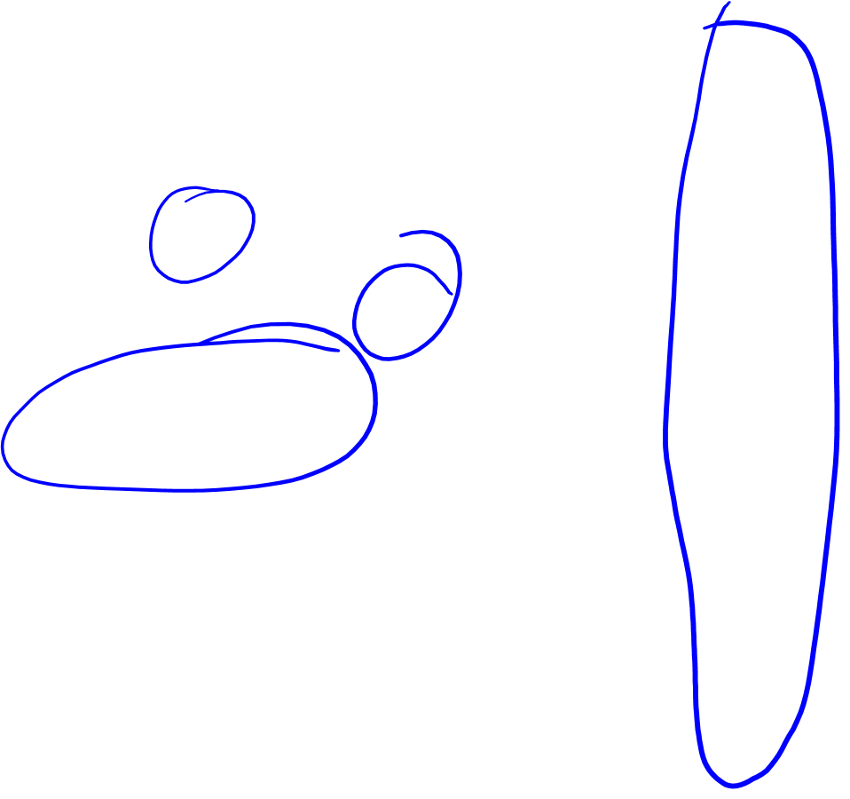
Recall Epid Methods I – Study Design
= Case-control
Sampling a Dynamic Cohort
New Members
CE
CE
Cross-sectional
Cohort
Observation begins
Observation ends
Time (calendar)
Notes:
From Epid Methods 1, J Martin 2017
Just like there are at least 3 main different ways to sample a fixed cohort, there are also 3 main different ways to sample a dynamic cohort. It is important to be conscious of which type of underlying cohort you are sampling.

Slide 14

Open Cohort – How to build?
Similar to Fixed, with additional considerations regarding “time”
  Define your population of interest – inherently changes over time
  Define your “sample” – this may be continuously growing/changing
  Define the “event” that triggers start of follow-up time
  Specify Eligibility
  Define Exposure & Outcome
    Be mindful of secular trends
    Data contributed may vary over time, e.g., EHR
  Develop “baseline” & “follow-up” assessments – to what extent will you follow someone after they have technically left your population of interest?
  Consider duration of follow-up
Notes:
Secular trends; societal norms or standards may change – “subjective” question asked in 1996 and 2006 may need to be interpreted differently: e.g., “Do would you rate your comfort level with using the Internet or mobile technology?”
The data available from the Electronic Health Record could vary over time. E.g., what if the standards changed for classifyng a tumor as “intermediate” grade… and the data from the cancer registry only provides “low” “intermediate” and “high” grade as options…

Slide 15

Summary of Measures of Association
Recap of Epid Methods I – Disease Association II
Design | Ratio (often easiest to assess for strength of association) | Difference (for public health impact, especially of interventions)
Cross- | prevalence ratio | prevalence difference*
sectional | prevalence odds ratio | prevalence odds difference*
Cohort | risk ratio | risk difference
 | rate ratio hazard ratio | rate difference hazard difference*
 | incidence odds ratio* | incidence odds difference*
Case-control | odds ratio (can estimate risk ratio, hazard ratio & rate ratio) | Risk & rate difference in case-cohort if observations weighted properly
* Rarely used
Notes:
From Epid Methods 1, J Martin 2017
This is the schematic from the previous lecture, showing all the possible ratio and difference measures that can be calculated from cross-sectional and from cohort studies, and now with case-control studies added. Case-control studies have traditionally been known as only deriving ratio measures of association, but as sophistication grows, it is now the case that investigators are also beginning to estimate difference-based measures, particularly in case-cohort study designs. This can be done if the fraction of the underlying cohort that is sampled is known. For ratio measures of association, we can measure the odds of exposure in cases and a reference group, calculate the OR of exposure, which we know is equal to the OR of disease. However, to obtain a difference measure we need the exposure-specific estimates. We will not be performing these difference measures in this course, but we want to make you aware that they can be derived.
This completes our lectures on disease association. We have covered the basic approach to reporting exposure-disease associations (ratio measures in all and difference measures where possible) for the 3 basic designs: cross-sectional, cohort and case-control.

Slide 16
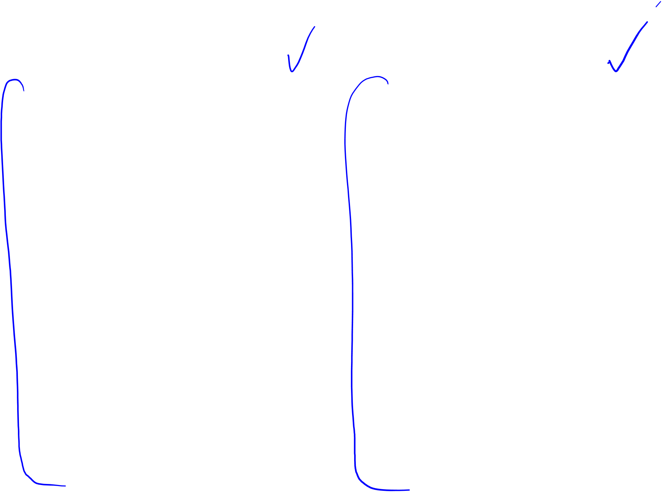
What do we calculate?
Fixed Cohort:
  N = Total # at beginning
  Cumulative Incidence
    Cumulative Incidence ratio
    Cumulative Incidence difference
  Incidence rate (IR)
    Incidence ratio
    Incidence difference
  Hazard
    Hazard Ratio
    (Hazard Difference*)
Open Cohort:
  N may vary over time
  Cumulative Incidence
    Cumulative Incidence ratio
    Cumulative Incidence difference
  Incidence rate (IR)
    Incidence ratio
    Incidence difference
  Hazard
    Hazard Ratio
    (Hazard Difference*)
* Rarely used

Slide 17
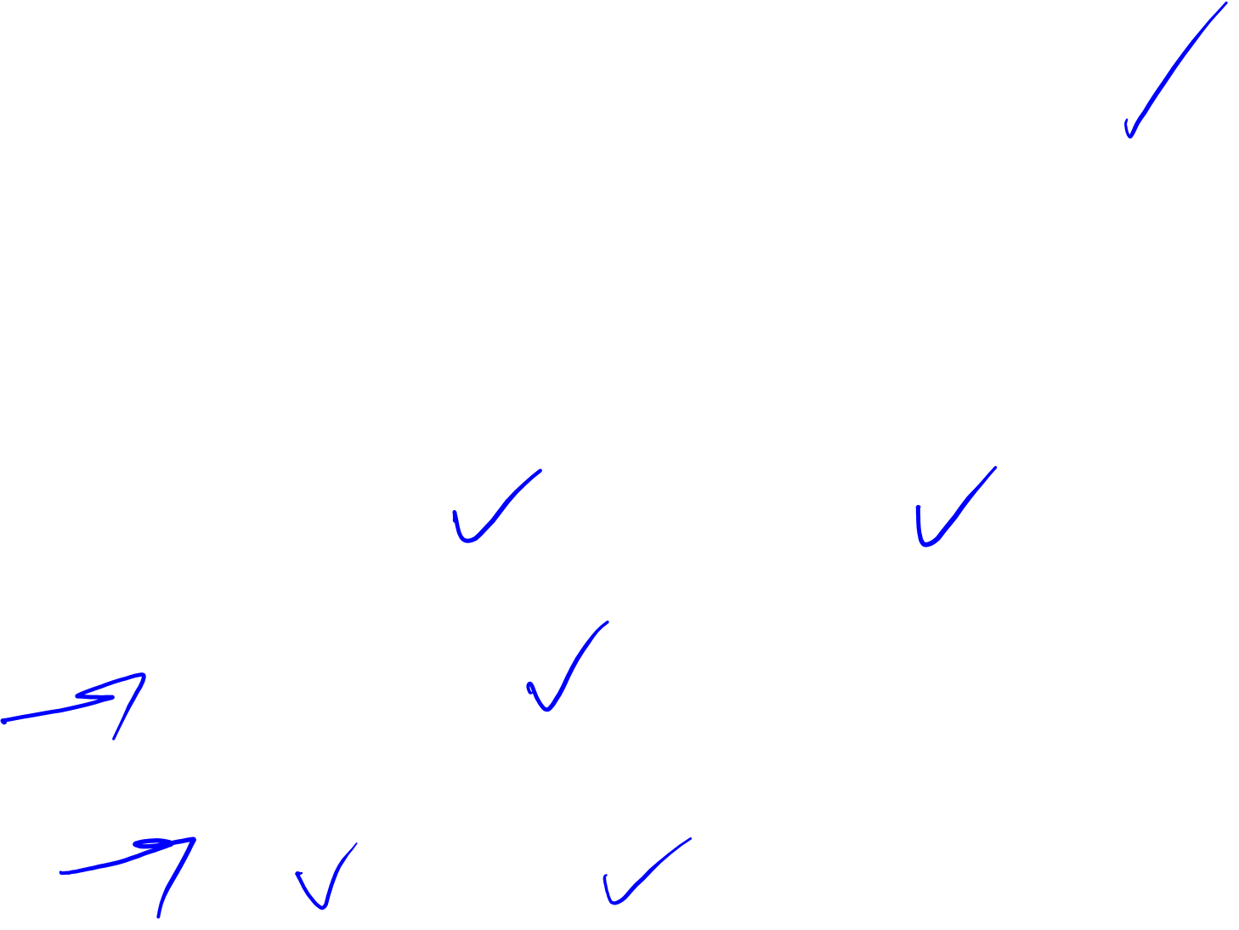
Cumulative Incidence in Cohorts
Basic Formula for Cumulative Incidence at time t₁:
  (cases observed during t₀ to t₁) / (total at risk at t₀)
  Where t₁ is some point during follow-up, and t₀ is baseline (start of follow-up)
In this basic formula, how do we deal with
  Loss to follow-up?
  Changing N over time? (e.g., Open Cohort)
Recall: Cumulative Incidence can be estimated by
  “shifting everyone left” and allowing censoring (addresses the variable follow-up times and changing N)
  Apply KM estimators
  Or estimate using hazard:
Assuming constant hazard and no competing risks
Notes:
Recall: Aaeln Johnson method introduced in Disease Occurrence II from Epid Methods I, to deal with competing risks

Slide 18

Relationship between Constant Hazard and Cumulative Incidence
Recap of Epid Methods I – Disease Occurrence II
A constant hazard (rate) produces an “exponential” cumulative incidence (or survival) function
If know the constant incidence rate, can derive the cumulative incidence/survival function or vice-versa from the “exponential formula”
where S(t) = cumulative survival and
F(t) = cumulative incidence
e= 2.71828; λ = rate; t = time units
Assumes no competing events
Notes:
From Epid Methods 1, J Martin 2017
There is a formal mathematical relationship between rate and cumulative incidence. For the special situation of a constant rate, it is represented by this formula. If the rate is constant, applying that rate to a given number of persons for a given time period produces a cumulative incidence that follows an exponential distribution given by the formula above, where F(t) = the cumulative incidence, e = 2.71828, λ = the rate per the person-time units, and t = the number of time units. Remember that F(t) and S(t) are bounded by 0 and 1. This formula is called the “exponential formula.” The proof for this can be found in advanced textbooks. Please note that this assumes no competing events.

Slide 19
Summarize
Fixed Cohort – Well-defined group of individuals, followed from a stated starting point to a stated end point, and whose membership does not change from beginning to end.
Open or Dynamic Cohort – Cohort whose membership composition may change over time.
Similar metrics can be calculated, with special consideration for the dynamic “N” of open cohorts
How one builds or implements an open cohort is similar to starting a fixed cohort, but may require more thoughtfulness regarding secular trends
Notes:
Closed Cohort: Often used synonymously with ‘fixed cohort’ but RGL (2008; p. 101) specifies that a ‘closed cohort’ is a ‘fixed cohort’ when there is no drop out or losses to follow-up.

