Slide 1

Cohort Studies
Person Time & Bias
June M. Chan, ScD
Professor, Epidemiology & Biostatistics and Urology
Steven & Christine Burd-Safeway Distinguished Professor

Slide 2
Overview
Open vs. Fixed Cohorts
What do we calculate in Cohorts?
Assignment of Person Time
Survivor Cohorts
Bias
  Measurement Error
  Reverse Causation
  Confounding by Indication
  Residual Confounding
  Selection bias
  Immortal person time bias

Slide 3
Cohort Studies & Classifying Person Time

Slide 4

Overview: Cohort Studies & Classifying Person Time
Individuals contribute varying amounts of person-time
Individuals can contribute person-time to multiple exposure categories over time
Exposed Groups: Prevalent vs. Incident use of ”exposure”
How we count this time is crucial
  Induction time
  Latent period
  Time of exposure accrual
  Time at risk of exposure effects
  Categorizing chronic exposures

Slide 5

Overview: Cohort Studies & Classifying Person Time
Individuals contribute varying amounts of person-time
Individuals can contribute person-time to multiple exposure categories over time
Exposed Groups: Prevalent vs. Incident use of ”exposure”
How we count this time is crucial
  Induction time
  Latent period
  Time of exposure accrual
  Time at risk of exposure effects
  Categorizing chronic exposures

Slide 6
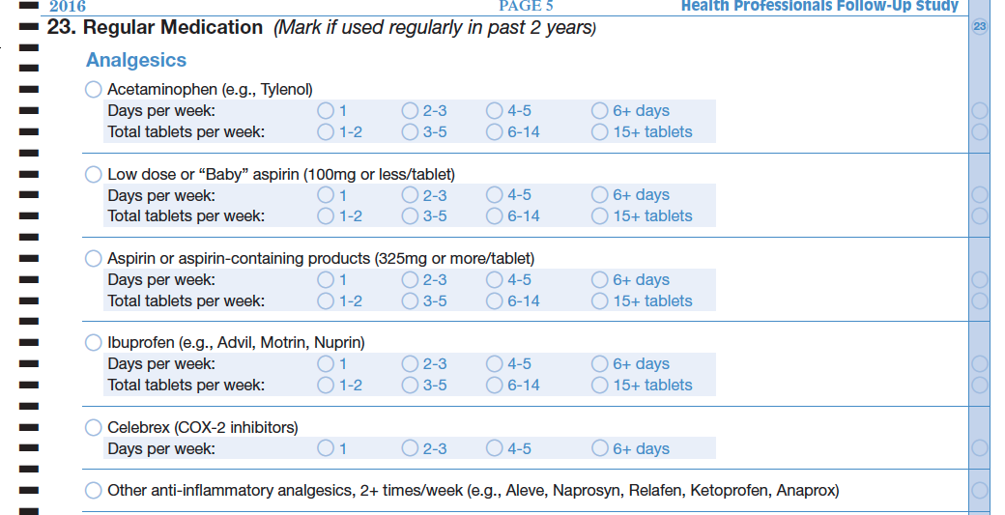

Example Qx that generates time-varying exposure data
Some version of this question asked at baseline in 1986 and every 2 yrs since for ~30 yrs (!)
Notes:
Sample qx from Health Professionals Follow-Up Study
https://content.sph.harvard.edu/hpfs/
51,529 male health professionals (non-MDs)

Slide 7

Individuals Contribute Variable Person Time
Using Not using
Entry to study
A
86 88 90 92 94 96 98 00 02 04 06 08 10 12 14
B
86 88 90 92 94 96 98 00 02 04 06 08 10 12 14
Drops out, moves to S. America and doesn’t want to be in the study anymore
7
Notes:
At baseline in 1986, question was: ”Current Medications (mark if used regularly)….Aspirin 2 or more times per week (Anacin, Buffrin, Alka Seltzer)”
Fixed cohort of the Health Professionals Follow-up Study, 51,529 male heath professionals enrolled in 1986, upon return of a baseline survey. Surveys and disease follow-up occur every 2 yrs thereafter; diet surveys administered every 4 years thereafter.
Person A contributes person time from 1986 through 2014, according to diagram above.
Person B contributes person time from 1986 to 1996 only.

Slide 8
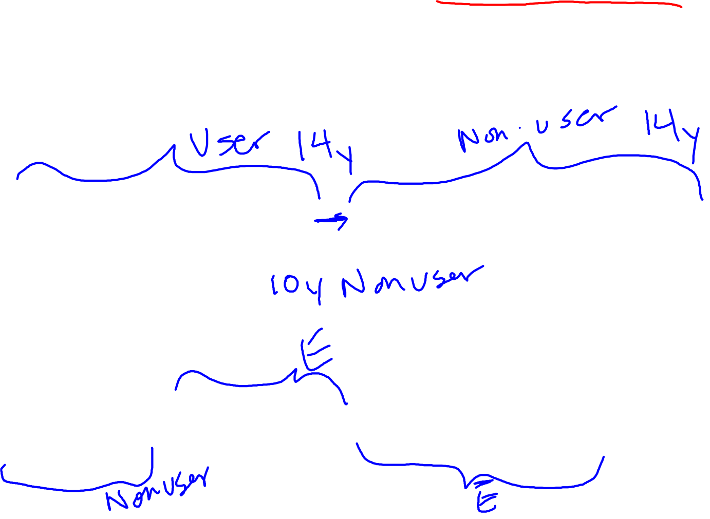
Individuals May Contribute to Multiple Exposure Categories Over Time
Using Not using
Entry to study
A
86 88 90 92 94 96 98 00 02 04 06 08 10 12 14
B
86 88 90 92 94 96 98 00 02 04 06 08 10 12 14
C
86 88 90 92 94 96 98 00 02 04 06 08 10 12 14
8
Notes:
At baseline in 1986, question was: ”Current Medications (mark if used regularly)….Aspirin 2 or more times per week (Anacin, Buffrin, Alka Seltzer)”

Slide 9
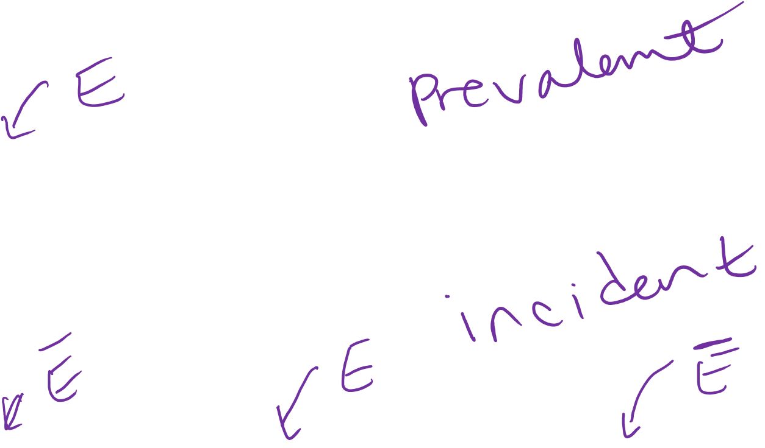
Prevalent vs. Incident User
Using Not using
Entry to study
A
86 88 90 92 94 96 98 00 02 04 06 08 10 12 14
C
86 88 90 92 94 96 98 00 02 04 06 08 10 12 14
9
Notes:
At baseline in 1986, question was: ”Current Medications (mark if used regularly)….Aspirin 2 or more times per week (Anacin, Buffrin, Alka Seltzer)”

Slide 10

Overview: Cohort Studies & Classifying Person Time
Individuals contribute varying amounts of person-time
Individuals can contribute person-time to multiple exposure categories over time
Exposed Groups: Prevalent vs. Incident use of ”exposure”
How we count this time is crucial
  Induction time
  Latent period
  Time of exposure accrual
  Time at risk of exposure effects
  Categorizing chronic exposures

Slide 11

Induction Time
RGL (2008, Ch. 2):
  “Period of time from causal action until disease initiation”
  Characteristic of each component cause, not disease
  Each component cause of a disease may have a different “induction time”
  Last component cause to act has an induction time of 0
General literature uses “induction time” differently and may refer to a disease with a long or short induction time.
  This causes confusion and ignores the multi-factorial nature of many diseases, and the fact that certain exposures may act very early, while others take action very close in time to disease

Slide 12

Latent Period
Time from disease occurrence until disease detection
Latent period may be shortened if we improve methods for disease detection, e.g., screening
Latent period is a characteristic of the disease and the methods available to detect the disease
RGL (2008, Ch. 2)

Slide 13
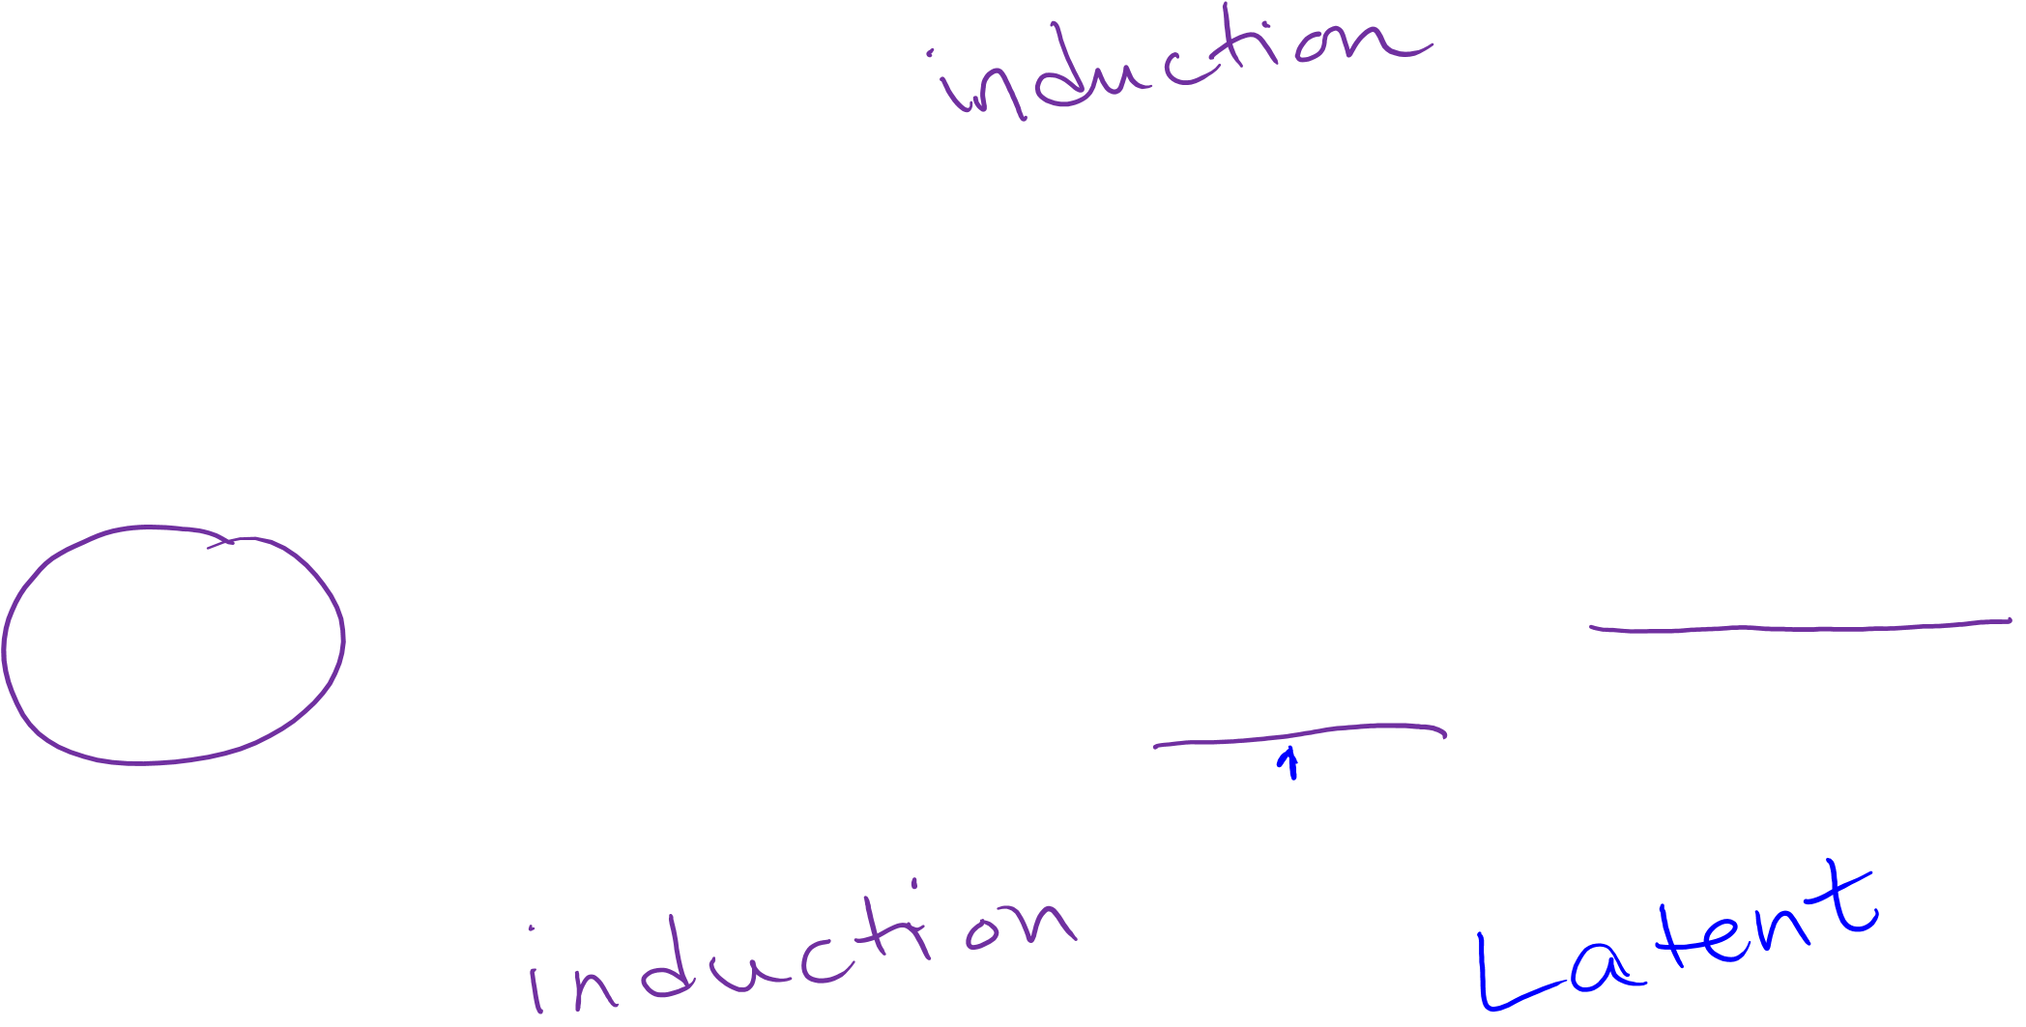
Induction Period vs. Latent Period
Soda Drinking in childhood
Impaired Insulin Sensitivity
Fasting Glucose ≥126mg/dL
Diagnosis Diabetes
13

Slide 14
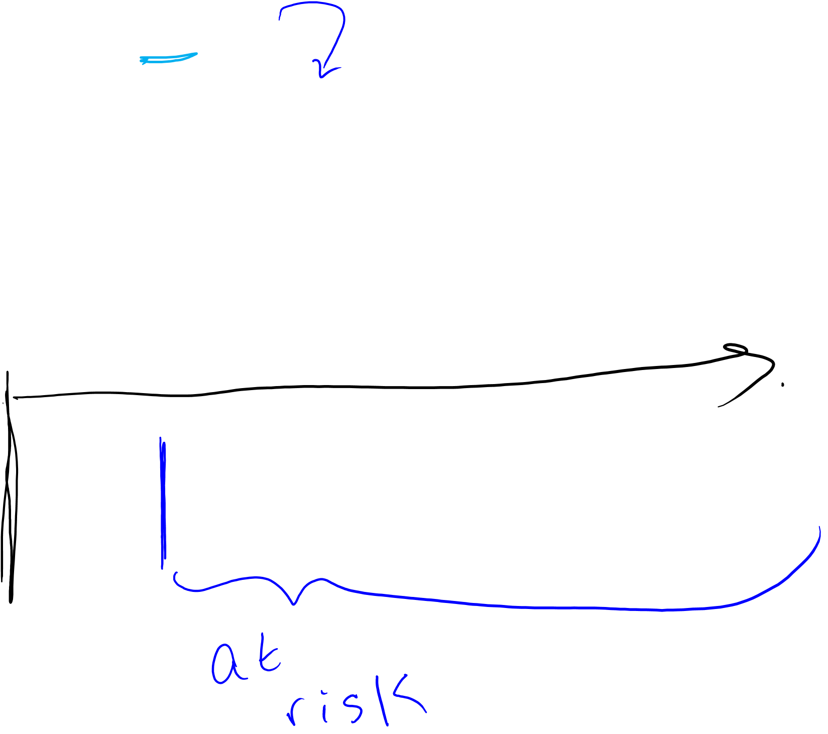
Time of exposure accrual & Time at risk of exposure effects
E: Soda drinking as adult
D: Incident type 2 diabetes in adulthood
Time of Exposure Accrual ~ years during which person drank soda as an adult
Time at risk for exposure effects – depends on hypothesis regarding association between soda and diabetes
Soda Drinking
Incident Diabetes (type 2)

Slide 15
In practice…
Follow fixed cohort of adults who consent and complete a survey, starting in 1986
At baseline and every 4 yrs, you ask participants to report usual diet of 132 foods and beverages, including soda
Classify ”regular soda drinking” as consuming soda 3+/week
To conduct your analysis
  Exclude anyone with diabetes before start of follow-up
  Classify your participants as regular soda drinkers, Yes/No during follow-up intervals (every 4 yrs)
  Follow existing cohort for incident diabetes (every 2 yrs)

Slide 16
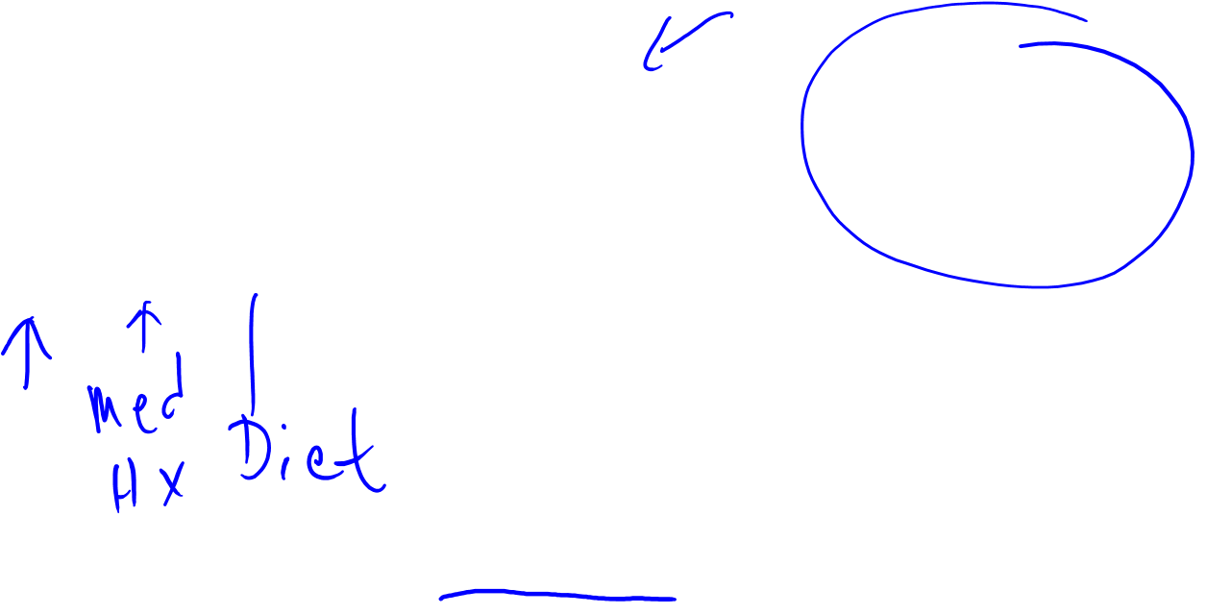
Time of Exposure Accrual & Time at Risk for Exposure Effects
Regular soda drinking in adulthood & incident diabetes
One model….
Using Not using
Time at risk of exposure effects
86 88 90 92 94 96 98 00 02 04 06 08 10 12 14
Diabetes
Time of exposure accrual
Notes:
At the time of Dbx dx, was this person classified as exposed or unexposed to “soda drinking”?
Unexposed.
Do you think the soda drinking he did between 86-2002 is relevant for the risk of diabetes in 2010? Did this person ever have his blood checked prior to 2010? (thinking about latent period)
This is where ideas about Induction Period and Latent period come in, and considerations regarding “lagging” exposure, or looking at “ever” vs “never” come into play

Slide 17

Classifying Chronic Exposures
Cumulative Exposure
  Function of intensity & time
  E.g., pack-years of smoking =
  (#packs per day) x (years smoking at that level)
  20 pack-years → 2 packs a day for 10 years
  or ½ pack a day for 40 years

Slide 18
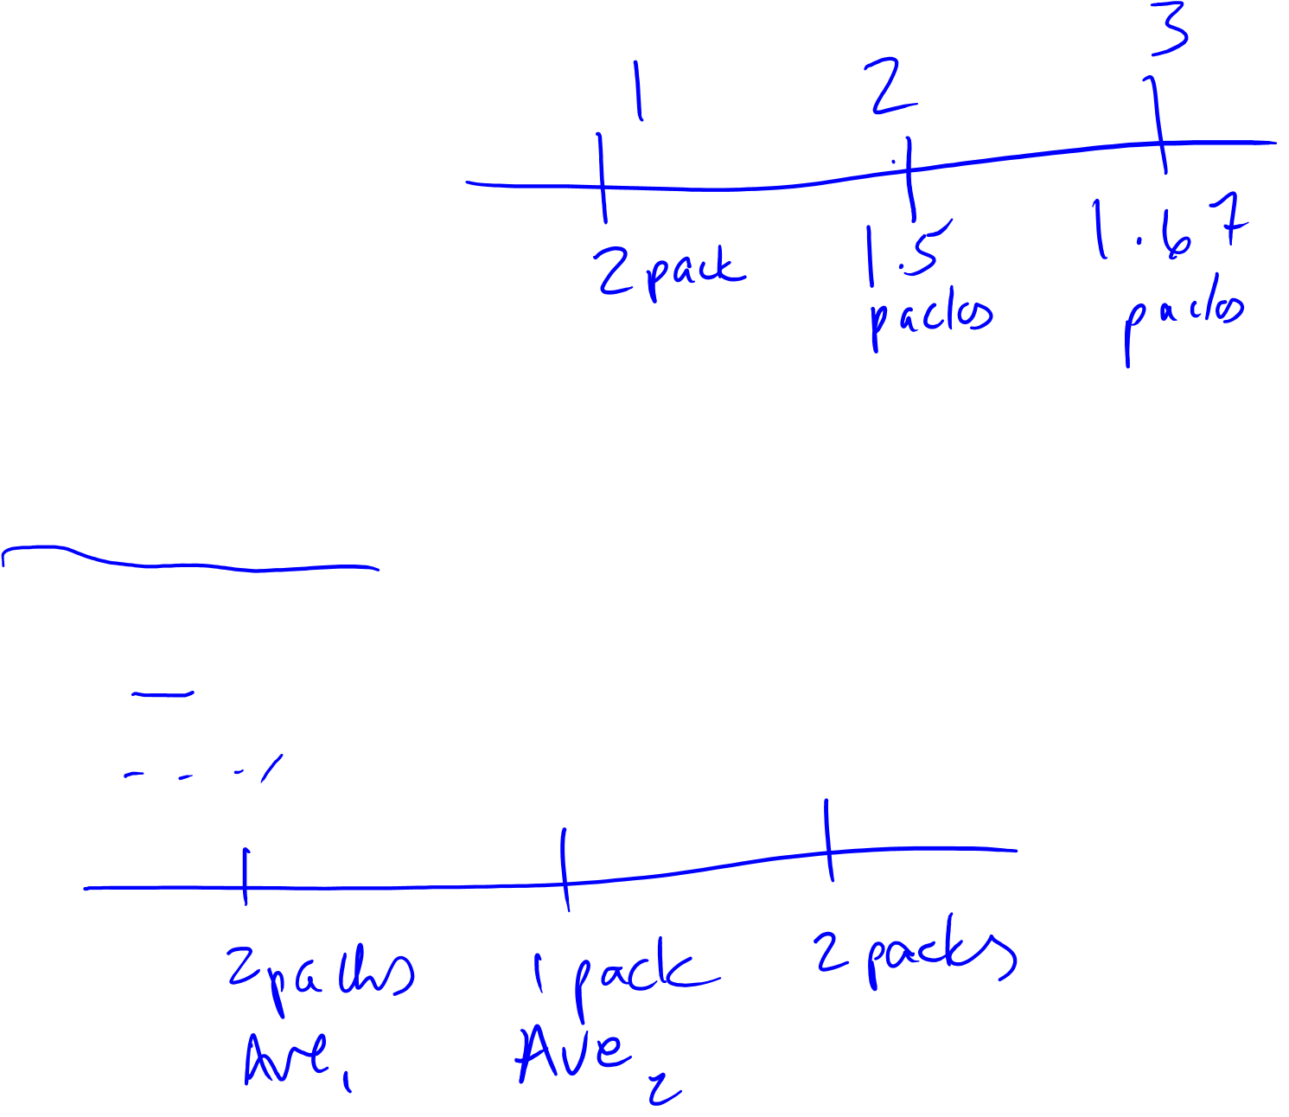
Classifying Chronic Exposures
Average & Cumulative Average Intensity
  Average:
    2 packs/day in yr 1, 1 pack/day in yr 2, 2 packs/day in yr 3
  Cumulative Average
    Yr1: 2 packs/day
    Yr2: (2+1)/2 = 1.5 packs/day
    Yr3: (2+1+2)/3 = 1.67 packs/day

Slide 19
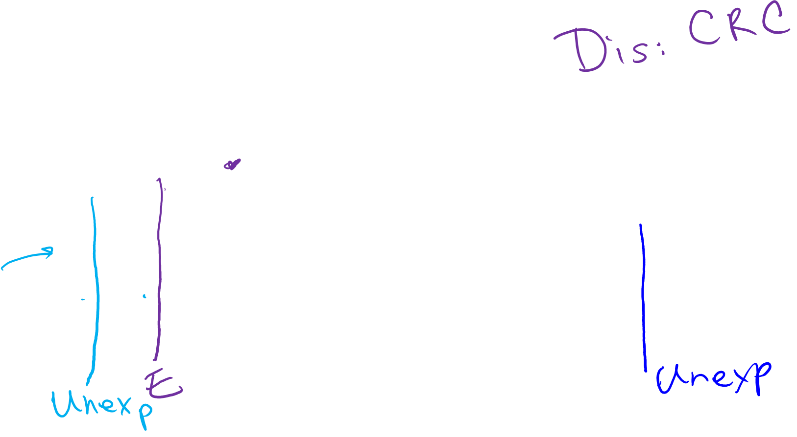
Alignment of Person-time and Event with Exposure Status
“the event and the person-time that is being accumulated at the moment of the event should both be assigned to the same category of exposure” (RGL 2008, p. 106)
Example: yes, using no, not using
86 88 90 92 94 96 98 00 02 04 06 08 10 12 14
Notes:
If diagnosed with outcome in 1992, dose the “event” count as occurring among exposed or unexposed group? (exposure = “current user of ASA”)? (A. exposed in 1992)
If dx’d in 2006, where dose the event get counted? exposed or unexposed? (unexposed)
Diagnosed in 1991? Unexposed (note, this is the case, even though, technically, in 1992, he reports that he’s been a regular user for the past 2 yrs, based on the wording of the qx. However, we do not know exactly when that change occurred, and if you are following along in time, when the even happens, as far as we know, he’s still unexposed. The survey data in 1990 is used to classify exposure during the interval 1990-1992; the survey in 1992 is used to classify exposure going forward in time, between 1992-1994; the survey in 1994 is used to classify exposure bt 1994 and 1996, and so forth.
What if we apply a 2 yr lag? This might be done as a sensitivity analysis to take into consideration an induction period of 2 yrs, associated with “current” aspirin use…More on this later…

Slide 20

Summary: Person Time in Cohorts
Participants may contribute varying amounts of person-time to different categories of exposure, over time.
Induction time = feature of component cause; describes time between the action and the occurrence of disease
Latent time = feature of the disease and the methods used to detect the disease; describes time between when the disease has occurred and when it is diagnosed
Exposure accrual time vs. time at risk of exposure effects
Chronic exposures: cumulative & average intensities
A clear and specific hypothesis, ideally, reflects some specifications, knowledge (or assumptions) for each of these “time” concepts

