Slide 1

Cohort
Person Time & Bias
June M. Chan, ScD
Professor, Epidemiology & Biostatistics and Urology
Steven & Christine Burd-Safeway Distinguished Professor

Slide 2
Overview
Open vs. Fixed Cohorts
What do we calculate in Cohorts?
Assignment of Person Time
Survivor Cohorts
Bias
  Measurement Error
  Reverse Causation
  Confounding by Indication
  Residual Confounding
  Selection bias
  Immortal person time bias

Slide 3
Overview
Open vs. Fixed Cohorts
What do we calculate in Cohorts?
Assignment of Person Time
Survivor Cohorts
Bias
  Measurement Error
  Reverse Causation
  Confounding by Indication
  Residual Confounding
  Selection bias
  Immortal person time bias

Slide 4
Patient or Survivor Cohorts

Slide 5

Survivor or Patient Cohorts
Cohorts defined by a disease or condition
These can be Fixed or Open
Fixed Example
  Cases from a case-control study
Open Example
  Registry based studies, CaPSURE
Considerations
  Population (denominator) is different → questions are different
  What do you do about exposure prior to disease?
  Shifting concept of ”prevention”
  Becoming easier to ‘define’ with electronic health records
  Strong clinical predictors become potential strong confounders
Notes:
Clinical Epid
Studies that may be more common here at UCSF, given our dept’s place in a school of medicine

Slide 6

Examples of Patient Cohorts & Questions
Adults who have had one MI
  How does usage of medicine X affect risk of 2nd MI?
  Does a Mediterranean diet prevent all cause mortality?
Patients who have been diagnosed with colorectal cancer
  Does usage of aspirin after diagnosis affect risk of progression?
Women with breast cancer
  Does exercise or weight loss after diagnosis prevent death?
Men with prostate cancer
  Is time to recurrence different among those who received surgery vs. radiation?

Slide 7
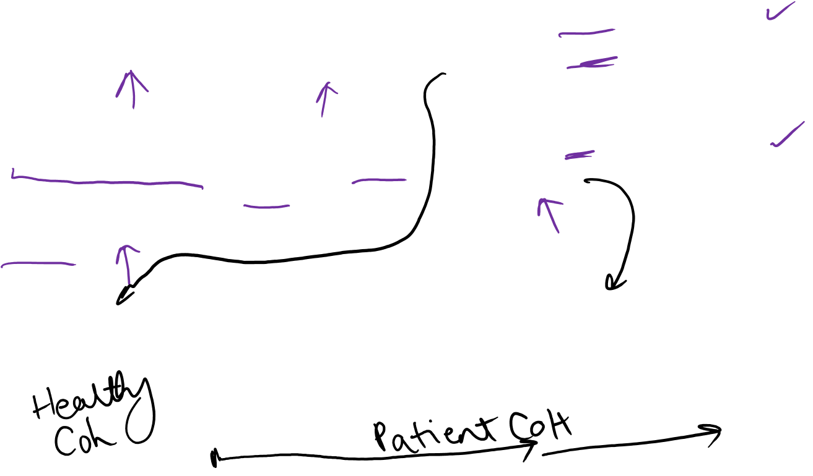
Contrast Questions used in Healthy vs. Patient cohorts
Question | Population | Exposure | Outcome
Is usage of aspirin associated with risk of colorectal cancer (CRC)? | General healthy adults from fixed cohort (e.g., NHS) | Aspirin use during adulthood, prior to diagnosis of CRC | Incidence of CRC, or time to CRC diagnosis
Does aspirin prevent cancer progression or death, in patients with CRC who had Surgery? | Cases diagnosed with CRC, 2000 -2010, using hospital cancer registry | Aspirin use after diagnosis and surgery | Time to progression or death
Dx
Progression
Death due to CRC
Surgery
Notes:
Draw:
Time of exposure accrual
Time at risk for the event
Consideration for Induction time?
SIDE NOTE
Aspirin use for 10-20 yrs is considered to reduce primary occurrence of CRC https://www.cancer.gov/types/colorectal/hp/colorectal-prevention-pdq#link/_964_toc “Magnitude of Effect: ASA use reduces the long-term risk for developing CRC by 40% about 10 to 19 years after initiation (hazard ratio [HR], 0.60; 95% CI, 0.47–0.76).[18] Daily doses of 75 to 1,200 mg of ASA reduce the 20-year risk of CRC death by about 33% (HR, 0.67; 95% CI, 0.52–0.86).[16,17]”
It has been given a “B” rating by the USPSTF in adults aged 50-59, with a >=10% 10-year CVD risk: https://www.uspreventiveservicestaskforce.org/Page/Document/RecommendationStatementFinal/aspirin-to-prevent-cardiovascular-disease-and-cancer
Aspirin for secondary prevention in patients with CRC is still under study, although several studies suggest a potential protective association (e.g., http://ascopubs.org/doi/full/10.1200/jco.2015.65.3519)

Slide 8
Measurement Error & Reverse Causation

Slide 9
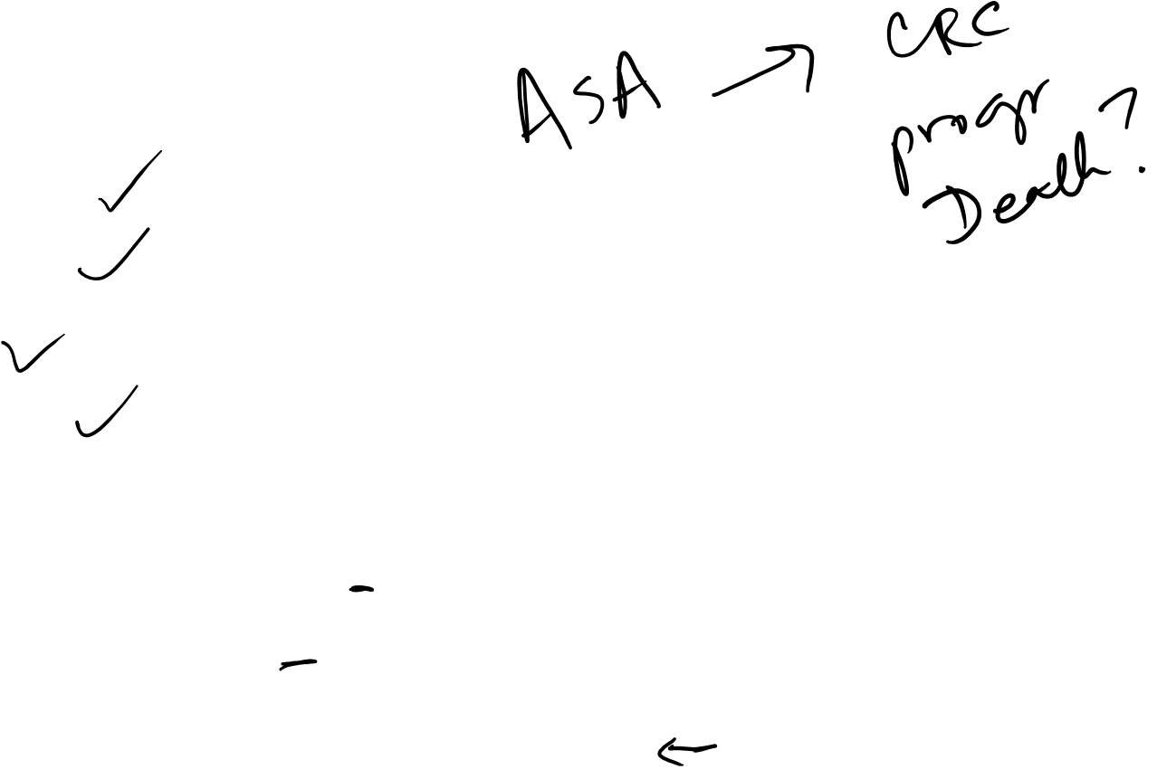
Exposure Definition & Implications for Measurement Error
Exposure Options
  Current use
  Prior use
  Dose
  Frequency
How might you collect data on ASA use?
  Medical chart abstraction
  Pharmacy database
  Survey of your population after diagnosis
Pros/Cons of these?

Slide 10
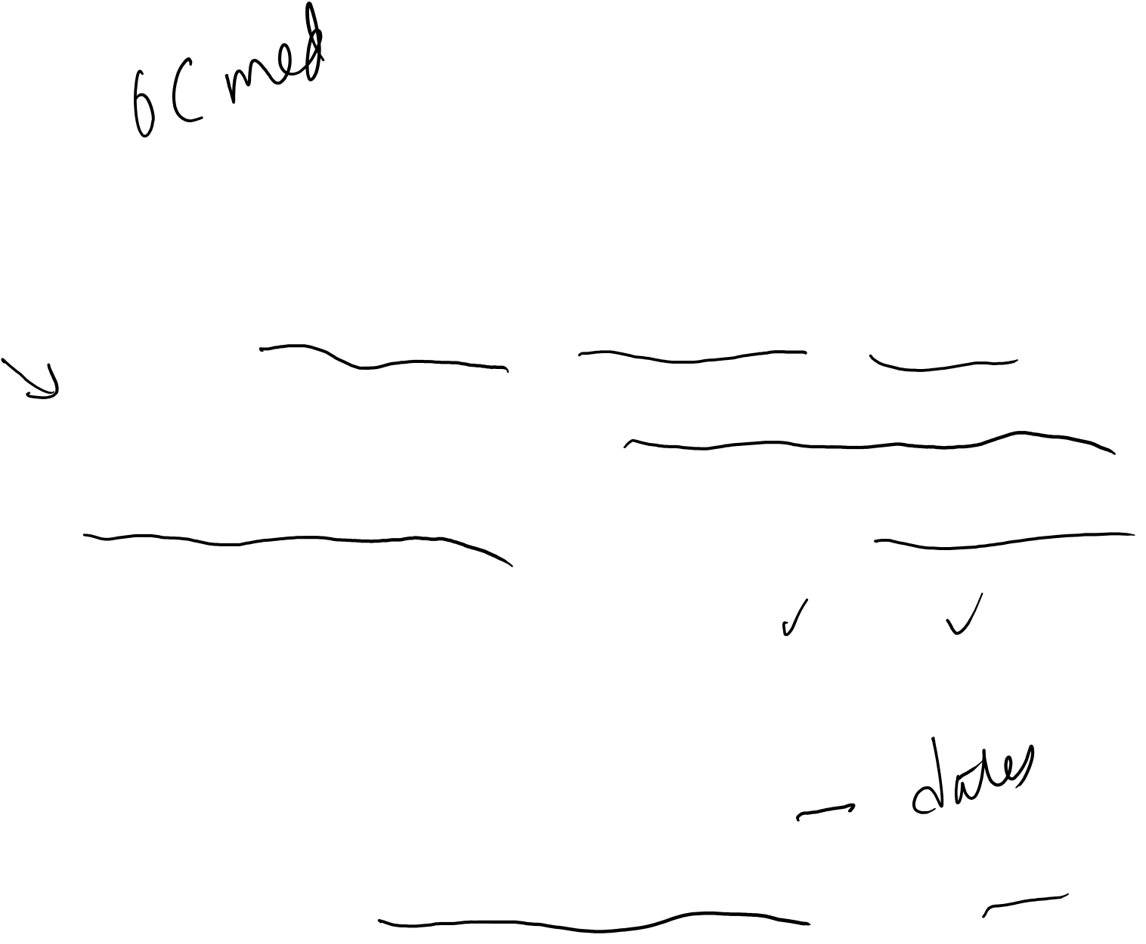
Possible Measurement Error in Exposure Assessment
Medical chart abstraction or Pharmacy Database
  May have details on dosage, dates prescribed, indication, etc
  ASA is not always a Rx med, so may not be in chart or database
  Prescribed or recommended is not the same as actual ingestion
Survey of your population after diagnosis
  Probably good way to assess “current use” or “current frequency”
  Patients may not report accurate details on dose
  If trying to assess long-term use in adulthood, relies on recall

Slide 11
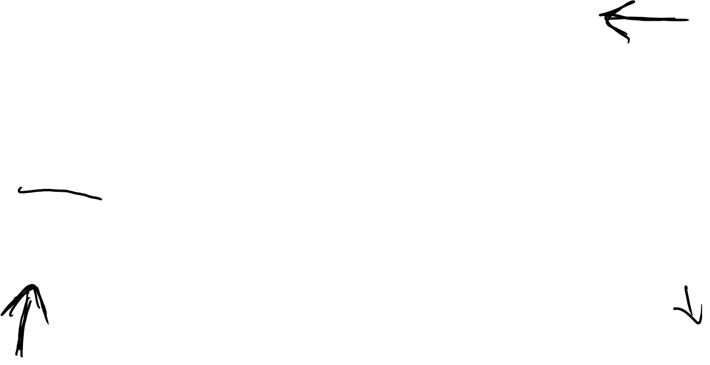
Measurement Bias is the Result of Measurement Error:
Refined Terminology for Measurement Error
Recap of Epid Methods I – Measurement Bias
 |  | Is error related to whether other variables in the analysis are measured in error? (“Dependence”)
 |  | Independent | Dependent
Is error related to true values of other variables in the analysis? (“Differentiality”) | Non-differential | Independent Non-differential Misclassification | Dependent Non-differential Misclassification
 | Differential | Independent Differential Misclassification | Dependent Differential Misclassification
Predictable: Bias almost always towards the null (if at all)
Predictable, but context-specific; bias can go in either direction
Complicated and harder to predict: bias can go in either direction
Notes:
Fr Epid Methods 1, J Martin 2017
This is a summary of the more refined terminology for measurement error. We have talked about two axes. The first axis is whether error is related to the true values of other variables in the analysis. This axis is informally called the “differentiality” axis. If no, we said this is called non-differential misclassification. If yes, then it is called differential misclassification. The other axis concerns whether error is related to the occurrence of other errors in other variables in the same participants. Are the errors correlated? This is called the axis of “dependence”. If errors on one variable are not related to errors on other variables, this is called “independent” misclassification. If errors on one variable are related to errors on other variables, we call the errors dependent misclassification. Putting these two axes together, we have this table.
Errors in the green box have a predictable direction, which is (almost always) towards the null, if they occur at all (remembering that independent non-differential misclassification of outcome in the face of 100% specificity will not bias a risk or prevalence ratio). Errors in the blue box will also go in the predictable direction that is context-specific. Importantly, the bias can go in either direction, either toward or away from the null. These two orange boxes are the most complicated. They are not simple to predict because there are two processes going on. Of note, dependent non-differential misclassification can result in bias away from the null.

Slide 12
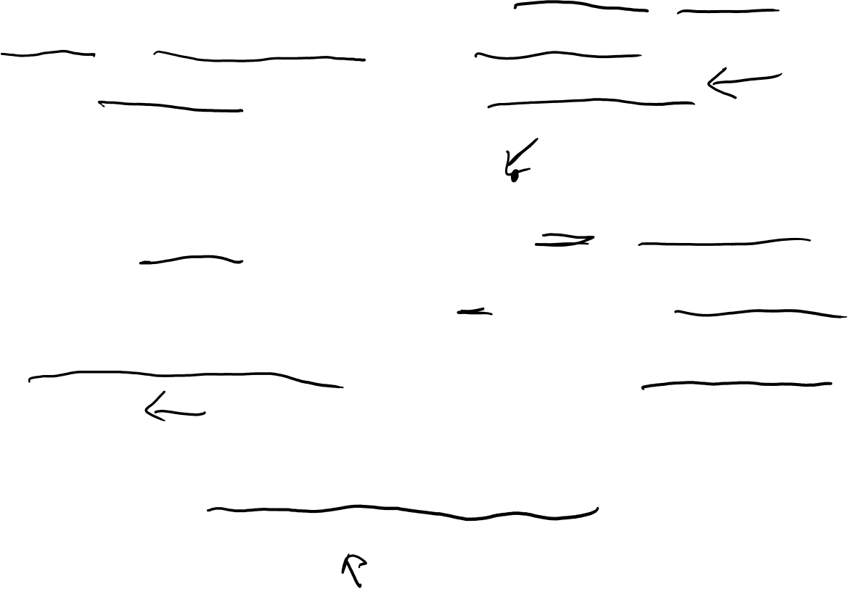
Measurement Error Bias?
To consider if there is bias, need to consider outcome too
P: Cases of early stage CRC diagnosed 2010-2015, registry
I, C: ASA use – current use (Y/N) within first 3m of Dx (Binary)
O: CRC progression as assessed via med chart review
Measurement Error Bias?
  Medical chart or Pharmacy Database
    It can either over- (don’t take the drug) or under- (over the counter) estimate ASA use
    Assume chart and registry operate well → errors are not dependent on error in outcome assessment
    Probably non-differential with regards to outcome; bias to the null
  Self-report
    What gets reported may more accurately reflect use
    Probably also independent and non-differential; bias to the null
    But may be more “missing” datapoints (selection bias)
Notes:
Self-report - The “missing” –ness of data when using self-report could lead to selection bias, depending on how you define the cohort and what you do with folks who do not respond at all to the survey.
NOTE: This is an example of a binary exposure (current use, y/n) with non-differential measurement error. As it is binary, we can suggest that it’s likely to bias to the null.
However, if the exposure had been with more than 2 categories, and in particular if the effect estimates for any given category were not reflective of a linear relationship, then it becomes harder to estimate the direction of the non-differential bias.

Slide 13
Non-Binary Exposure with Non-Diff Msrmt Error
-Direction of Bias is harder to Anticipate
Aspirin Use | Colorectal cancer | No Colorectal cancer
Never use
1-3x per week
4-7 per week
>7x per week
Notes:
In the example shown here, let’s imagine that your exposure variable has 4 categories instead of 2. In this case, the possible direction of measurement error between categories is multiple and harder to anticipate. In particular, for the middle categories, the misclassification that can happen in varying directions, such that the net effect is harder to anticipate. If we layer upon this scenario the possibility that the association between the exposure and the outcome is not linear, it becomes even harder to anticipate the overall effect on the direction of bias.

Slide 14
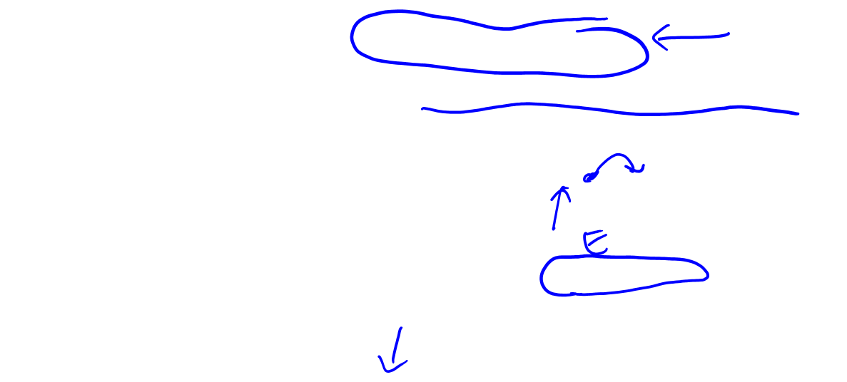
What about if you update exposure beyond the first 3m?
If people start taking ASA due to pain prior to diagnosis of progression, then one may see a positive association between ASA and risk progression, due to Reverse Causation
Using Not using
Pain due to worsening of disease
92 94 96 98 00 02 04 06 08 10 12 14
Dx
Progression
Death due to CRC
How do we deal with this?
Sometimes you will see a “lagged” analysis, where assign exposure during one interval to the follow-up interval 1 or more cycles ahead.
E.g., exposure collected in 1992 is applied to the follow-up interval of 1994-1996, etc.

Slide 15
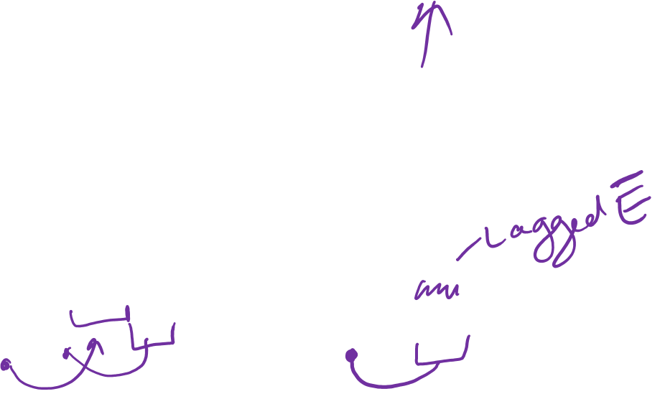
Ex: Lagging Exposure to avoid Reverse Causation
Using Not using
Pain due to worsening of disease
92 94 96 98 00 02 04 06 08 10 12 14
Dx
Progression
Death due to CRC
Lagging Exposure:
Sometimes you will see a “lagged” analysis, where assign exposure during one interval to the follow-up interval 1 or more cycles ahead.
E.g., exposure collected in 1992 is applied to the follow-up interval of 1994-1996, etc.
Notes:
With a lagged analysis, note that one is essentially making an assumption about a certain “induction time” for that exposure relative to the outcome.

Slide 16
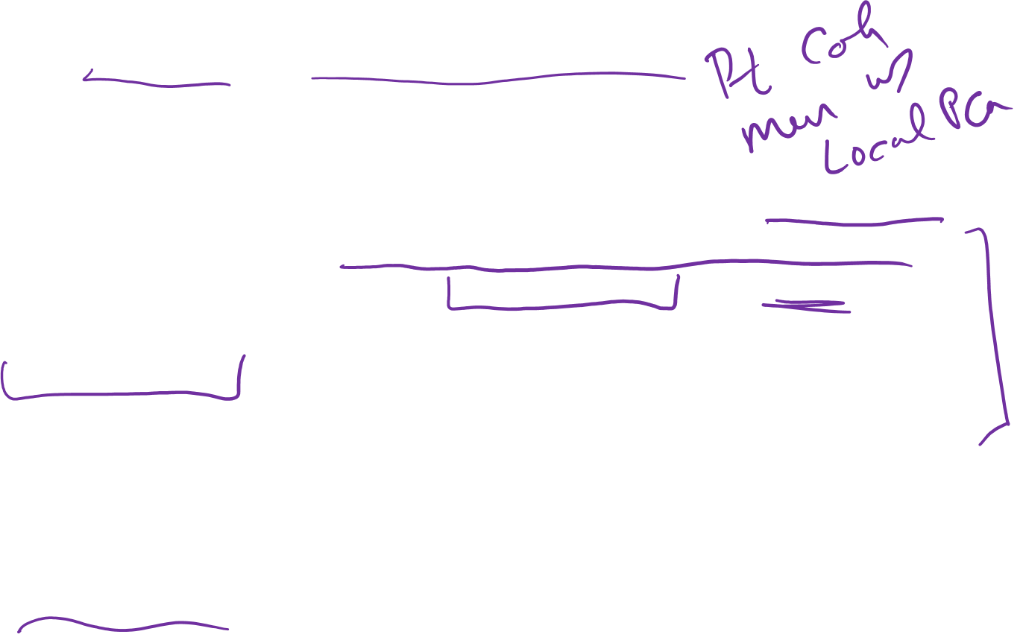
Ex: Exercise and Prostate Cancer Death
“We updated activity every 2 years, maintaining a 4- to 6-year lag…We applied their 1994 first postdiagnosis physical activity to deaths occurring between 1998 and 2000, their 1996 postdiagnosis physical activity to deaths occurring between 2000 and 2002, and so on. This approach allowed us to capture recent activity in relation to survival while minimizing reverse causation as a result of the effect of illness preceding death on physical activity.”
- Kenfield SA J Clin Onc, 2011
Notes:
By applying a 4-6 yr lag in the sensitivity analysis described here, this is akin to assuming that there is a 4-6 yr induction time for physical activity and the outcome of prostate cancer death.
Reverse causation is a type of confounding.
Structurally can be similar to conf by indication, discussed next

Slide 17
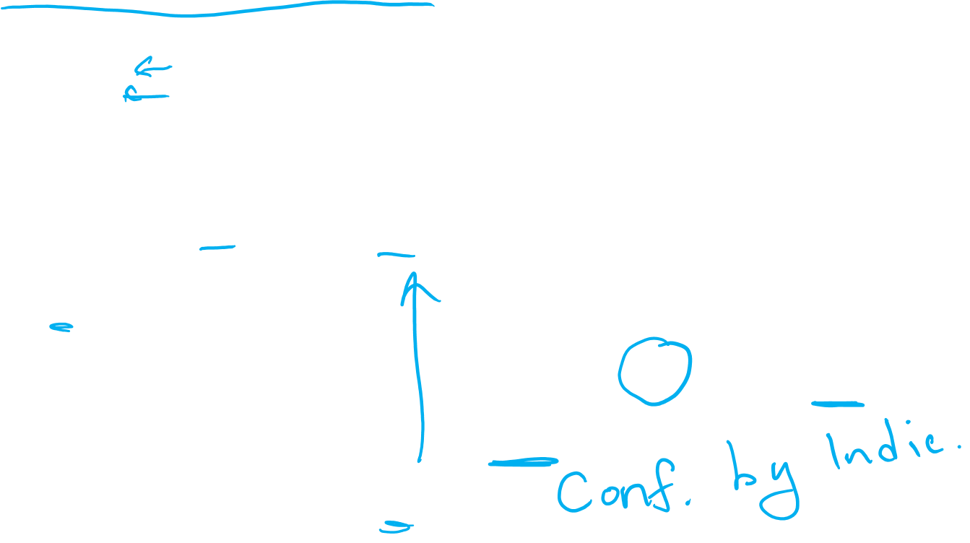
Confounding by Indication
“The effect of drug A on the risk of outcome (Y) will be confounded if the drug is more likely to be prescribed to individuals with certain condition (L) that is both an indication for treatment and a risk factor for the disease.”
- Hernan & Robins, 7.1, p. 84
A: Aspirin
Y: Death
L: Heart Disease
U: Atherosclerosis
A
Y
L
A
Y
L
U
17

Slide 18
Ex: Residual Confounding
Fruit & Veg Intake & Risk of Lung Cancer in Nurses Health Study

Slide 19
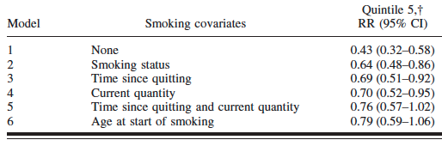

Ex: Residual Confounding
Fruit & Veg Intake & Risk of Lung Cancer in Nurses Health Study
*Model 1 is adjusted for age, follow-up cycle, total energy intake, and availability of diet data after baseline. Model 2 is adjusted for the covariates in model 1
plus smoking status (never, past, or current). Model 3 is adjusted for the covariates in model 2 plus time since quitting among past smokers. Model 4 is adjusted
for the covariates in model 2 plus quantity among current smokers. Model 5 is adjusted for the covariates in models 3 and 4. Model 6 is adjusted for the covariates
in model 5 plus age at start of smoking.
†Quintile 1 is the reference category.

Slide 20
Summary
Patient or Survivor cohorts are defined by individuals having a shared condition or disease
Questions addressed in patient cohorts are different given the study population (denominator) is different
Reviewed examples of Bias
  Measurement error bias
  Reverse causation
  Confounding by indication
  Residual confounding

