Slide 1
Review:
Person-time and bias
Dan Kelly, MD, MPH
February 13, 2020

Slide 2
Ideal Randomized Experiments + IPW or Standardization
Conceptualize Target Trial
Observational Studies
Case-Control
Cohort
Can compute average causal effects
Minimize or eliminate Bias
Fulfill Identifiability Criteria
Case-Control – Matching, stratified analyses
Cohort
DAGs to identify bias
Stratified analyses, alignment of T₀, E, A
QBA - how bad is the bias?
Interaction / EM

Slide 3
What happens when misalignment of T₀, E, and A occurs?
Causes biases
  Selection bias
  Measurement bias
  Reverse causation
  Immortal person-time
    Selection and measurement biases
Affects identifiability criteria
  Exchangeability
  Consistency
Ultimately considered an emulation failure of the target trial

Slide 4
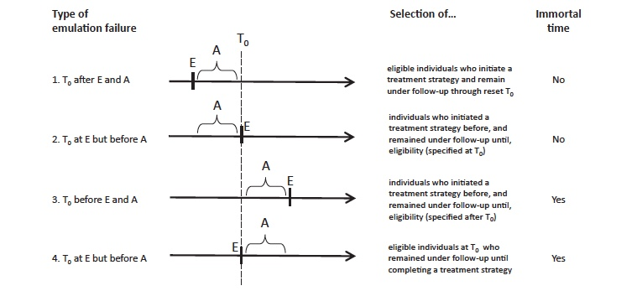
Types of bias depend on different scenarios of T₀, E, and A misalignment (emulation failures)
Bias?
Selection
Selection
Selection
Reverse Causation
Selection
Reverse Causation
Measurement
Prevalent users
after A

Slide 5
How does person-time and bias affect the identifiability criteria?
Exchangeability
  Never vs. Ever users
    Are these really the same types of people?
    Do the diseases that develop in these people represent the same phenotypes?
Consistency
  Never vs. Ever users
    Is ”current use” the same as “ever” exposure as ”prior use” from 10 years ago?
    Does the treatment represent (or define) a broad or narrow range of possible exposures?

Slide 6
Summary
Important to align T₀, eligibility and treatment assignment in observational studies
Selection bias can occur in scenarios where A comes BEFORE T₀, regardless of where E is, due to prevalent users
Multiple biases can occur in scenarios where A comes AFTER T₀, regardless of where E is, due to immortal person-time
Misalignment can affect exchangeability and consistency
Sometimes misalignment is unavoidable but there are potential solutions when the study is justified
  Time-varying exposure usage is one potential solution

