Slide 1

Cancer Registry Data & Cancer Surveillance
Scarlett Lin Gomez, PhD
Department of Epidemiology & Biostatistics
Helen Diller Family Comprehensive Cancer Center
Greater Bay Area Cancer Registry

Slide 2
Outline
Causes of cancer
Cancer registry data
  The old
    Types of cancer registries
    Classic cancer surveillance activities & studies
  The new
    Contemporary cancer surveillance activities & studies
  The future
    The New SEER: “Not your grandmother’s SEER”

Slide 3
Outline
Causes of cancer
Cancer registry data
  The old
    Types of cancer registries
    Classic cancer surveillance activities & studies
  The new
    Contemporary cancer surveillance activities & studies
  The future
    The New SEER: “Not your grandmother’s SEER”

Slide 4
Much of cancers are avoidable
Doll & Peto, JNCI 1981
Differences in rates among “settled communities”
Differences in rates between migrants and non-migrants
Differences in rates over time
Known risk factors

Slide 5
% Contribution (men/women) of risk factors to cancer types
Cancer site | Smoking | Excess body weight | Drinking alcohol | Few fruits & veggies | Physical inactivity | HPV infection | Red/ processed meat | UV radiation | Low dietary calcium | Low fiber
Lung | 82 | 60 |  | 9
Breast |  | 11 | 6 |  | 4
Prostate
Colorectal |  | 5 | 17/8 |  | 16 |  | 5-8 |  | 5 | 10
Melanoma |  |  |  |  |  |  |  | 96/94
Laryngeal | 74 |  |  | 17
Esophageal | 50
Bladder | 47
Liver |  | 34 | 25/12
Oral cavity & pharyngeal |  |  | 46/27 | 18
Uterine |  |  |  |  | 27
Cervix |  |  |  |  |  | 100
Anal, vaginal, penis |  |  |  |  |  | 57-88
American Cancer Society

Slide 6
Smoking has been and continues to be the biggest contributor to cancer
IARC

Slide 7
Lung cancer risk factors - smoking
Secondhand smoke (environmental tobacco smoke [ETS])
  Breathing in tobacco smoke from others
  Mainstream smoke: the smoke exhaled by the smoker
  Sidestream smoke: the smoke from the lighted end of a cigarette, pipe or cigar, or tobacco burning in a hookah
Thirdhand smoke
  Residual nicotine and other chemicals left on the indoor surfaces by tobacco smoke.
  Only way to protect nonsmokers from thirdhand smoke is to create a smoke-free environment.

Slide 8
Risk factors – lung cancer
In and outdoor air pollution
Radon: Naturally occurring radioactive gas that results from the breakdown of uranium in soil and rocks.
Asbestos
Arsenic-high levels in drinking
Occupational exposures (e.g. coal products, cadmium) asbestos, some metals (nickel, arsenic and cadmium), radon (among miners) and ionizing radiation
Radiation
Hormones
Infections (COPD, TB)

Slide 9
Malignant Melanoma – established risk factors
Moles
UV-radiation from sun exposure (intermittent vs. chronic)
Phenotypes that tans poorly and sunburns easily
Melanin
Fair-skin, blond/red hair, blue/green eyes
Number of nevi
Tanning beds
Number of sunburns
Genetic risk factors
  CDKN2A (p16 mutations)
  Melanocortin 1 receptor (MC1R)
Age
Weakened immune system
Notes:
In the human skin, melanogenesis is iIn the human skin, melanogenesis is initiated by exposure to UV radiation, causing the skin to turn tan. Melanin is an effective absorbent of light; the pigment is able to dissipate over 99.9% of absorbed UV radiation.^{[1]} Because of this property, melanin is thought to protect skin cells from UVB radiation damage, reducing the risk of cancer, and it's considered that exposure to UV radiation is associated with increased risk of malignant melanoma, a cancer of the melanocytes cells. nitiated by exposure to UV radiation, causing the skin to turn tan. Melanin is an effective absorbent of light; the pigment is able to dissipate over 99.9% of absorbed UV radiation.^{[1]} Because of this property, melanin is thought to protect skin cells from UVB radiation damage, reducing the risk of cancer, and it's considered that exposure to UV radiation is associated with increased risk of malignant melanoma, a cancer of the melanocytes cells.

Slide 10
Prostate Cancer – Established Risk Factors
Age
African ancestry
  African-American men and Caribbean men of African ancestry have the highest risk. The reasons for this are unclear.
Family history
  Having a father or brother with prostate cancer more than doubles a man's risk of developing this disease.
  The risk is much higher for men with several affected relatives, particularly if their relatives were young at the time the cancer was found
Genetics
  >40 prostate cancer GWAS conducted
  ~ 170 risk variants identified
  ~25.4% of the total FRR is explained by known genetic risk factors for prostate cancer (Matejcic, et al., Nature comm, 2019)

Slide 11
Breast Cancer – Established Risk Factors
Non-Modifiable (mostly)
Age
Family history
Reproductive factors
  Early menarche
  Late onset of menopause
  Parity
  Age at first birth > 30 y
Precancerous breast lesions
Genetic mutations
Dense breast tissue
Modifiable
Lifestyle factors
  Obesity
  Lack of physical activity
  Alcohol consumption
Use of exogenous hormones
  Menopausal hormones
  Oral contraceptives

Slide 12
Non-modifiable risk factors for colorectal cancer
  Age, ~90% occur in people 50+ years of age.
  Race
  Sex
  Family history of CRC
  Lynch syndrome
  FAP
  Common genetic variants
  Previous dx of CRC or colon polyps
  Inflammatory bowel diseases (e.g. Crohn’s or ulcerative colitis)

Slide 13
Potentially modifiable risk factors for colorectal cancer
Obesity
Type 2 DM
Alcohol
Height
NSAIDs
Tobacco smoking
Postmenopausal hormones
Physical activity
Red and processed meats
Fruits and vegetables
Microbiome
Coffee
Circadian rhythm
Garlic (from food)
Milk
Calcium (from food)
Selenium (from food)

Slide 14
Causes of cancer and potential reductions in cancer burden through preventive measures
Colditz, Wolin, Gehlert, Science Translational Medicine 2012

Slide 15
Outline
Causes of cancer
Cancer registry data
  The old
    Types of cancer registries
    Classic cancer surveillance activities & studies
  The new
    Contemporary cancer surveillance activities & studies
  The future
    The New SEER: “Not your grandmother’s SEER”

Slide 16
What is a population-based cancer registry?
Repository of information that includes all newly diagnosed tumors
  Defined time period
  Defined geographic area
    e.g., county, counties, state, country
  Defined population
    Residents of area at diagnosis
  Consolidated from multiple reporting sources
    Hospitals, path labs, physician practices, etc.

Slide 17
Why is being “population-based” important?
Cancer burden is not equally distributed
  age, sex, race/ethnicity, social class, geography, etc.
Population-based cancer data are complete
  for given population groups/regions, etc.
Because everyone is included, findings from population-based cancer data are representative & generalizable
Provides “real-world” view

Slide 18
Federal Cancer Surveillance: SEER
1971 National Cancer Act (War on Cancer):
  Mandate to collect, analyze, and disseminate data to support prevention, diagnosis, treatment of cancer
  SEER established in 1973
  Ongoing population-based cancer surveillance program
  Followed on three earlier serial cancer surveillance programs

Slide 19
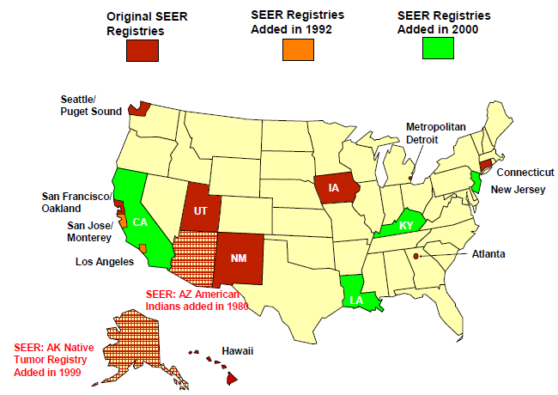
Surveillance, Epidemiology and End Results (SEER) program
9 regions with coverage from 1973+
All 18 regions with coverage 1992+
28% of the total US population

Slide 20
% US population in SEER regions by race/ethnicity
http://www.seer.cancer.gov/registries/data.html

Slide 21
What data items are collected on patients?
Patient demographic information
    Name, social security number, address at diagnosis, date of birth, race, ethnicity, gender, marital status, birthplace
Treatment information (first course only)
  Surgery, chemotherapy, radiation therapy, hormone therapy, immunotherapy
Survival information
All patients followed for vital status for life
Recurrence, disease progression NOT reported

Slide 22
What data items are collected on tumors?
  Tumor information
  Anatomic site, histology, detailed extent of disease (stage: tumor size, tumor extension, lymph nodes, metastasis at diagnosis, etc.)
Site-specific Tumor markers (including 32 biomarkers)
    Breast (ER/PR, HER2, Multigene assays (Oncotype DX and MammaPrint))
    CRC (CEA, KRAS)
    Testis (hCG, AFP, LDH)
    Pharynx (HPV)
    Liver/ billiary tract (AFP)
    Ovary (CA-125)
    Neuroendocrine (Serum Chromogranin, urinary 5-HIAA)
    Prostate (PSA)
    Hematologic Malignancies (JAK2)
    Melanoma (LDH)

Slide 23
Outline
Causes of cancer
Cancer registry data
  The old
    Types of cancer registries
    Classic cancer surveillance activities & studies
  The new
    Contemporary cancer surveillance activities & studies
  The future
    The New SEER: “Not your grandmother’s SEER”

Slide 24
Outline
Causes of cancer
Cancer registry data
  The old
    Types of cancer registries
    Classic cancer surveillance activities & studies
  The new
    Contemporary cancer surveillance activities & studies
  The future
    The New SEER: “Not your grandmother’s SEER”

Slide 25
Classic public health surveillance
Annual report
Marin breast cancer: addressing community concerns
Melanoma and policy

Slide 26
GBACR Annual Report
Highlights significant findings for cancer incidence and mortality from 1988 through 2015, with a focus on the latest 5 years for which data are available
  https://cancerregistry.ucsf.edu/research/gbacr-publications

Slide 27
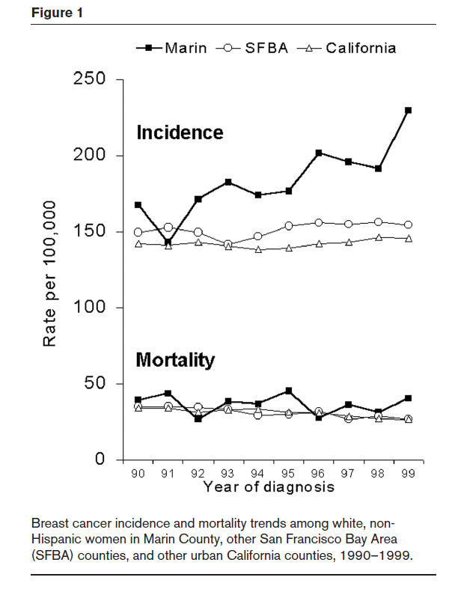

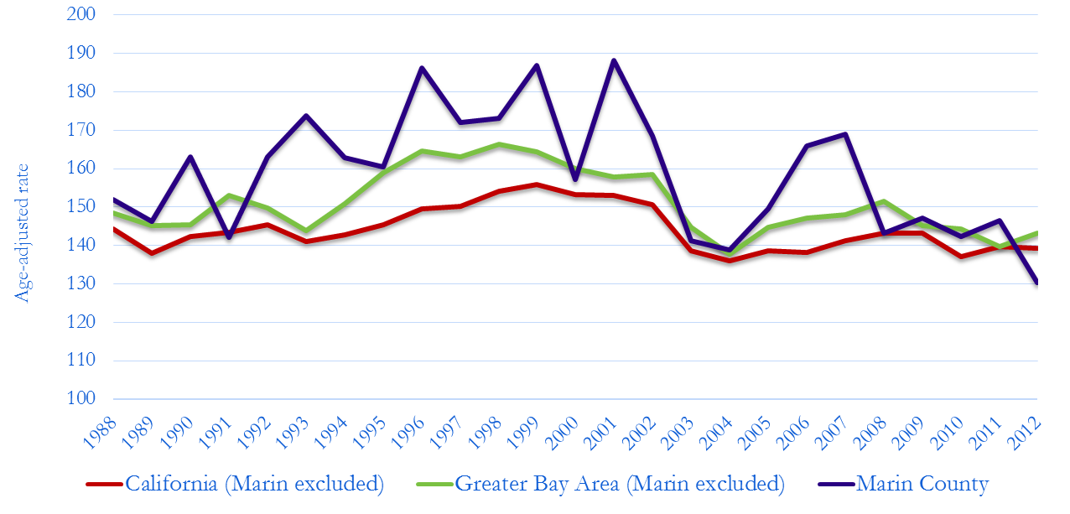
Breast cancer in Marin County
Clarke et al., Breast Cancer Res, 2002

Slide 28

Melanoma and tanning bed legislation
Research cited as motivation for new law
  Hausauer AK et al. (Arch Dermatol 2011)
California SB 746, passed in 2011
  Changes age at tanning bed access from 14 to 18
2011 Legislative Accomplishments
SB 746 – Tanning and Cancer Prevention
The science is clear: tanning beds cause cancer. Doctors, pediatricians, dermatologists, scientists, insurers and health organizations recommend governments prohibit all children from using ultra-violet tanning beds. SB 746 reduces the occurrence of melanoma, one of the most deadly skin cancers, by prohibiting children under the age of 18 from using ultra violet tanning beds.
Notes:
Background
Melanoma rates rising in young white women
Approach
Identify subgroups at most risk to target for intervention
CCR data

Slide 29
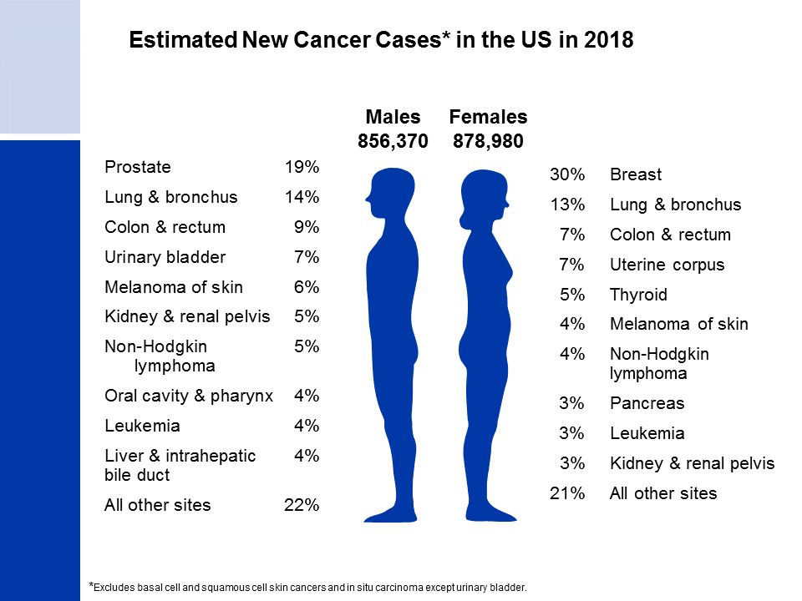
Notes:
It is estimated that about 1.7 million new cases of cancer will be diagnosed in 2018. Prostate cancer is the most common cancer among males (19%), followed by lung (14%) and colorectal (9%) cancers. Among females, breast (30%), lung (13%), and colorectal (7%) cancers are the most common.
Rankings based on estimates should be interpreted with caution because they are model-based projections.

Slide 30
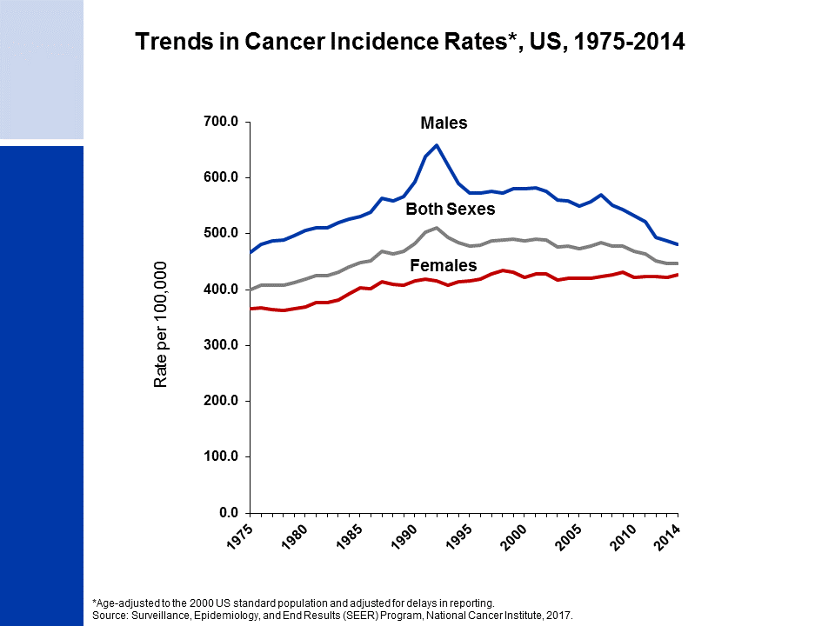
Notes:
This slide shows trends in cancer incidence rates for all sites combined from 1975 to 2014. The current average annual cancer incidence rate (2010-2014) is about 20% higher in men than in women. The reasons for this are not well understood, but likely reflect differences in environmental and hormonal exposures. During the most recent 10 years of data, rates declined by about 2% per year in males and were stable in females. The decrease among males is driven by declines in prostate, lung, and colorectal cancers, whereas the stable trend in women is because declines in lung and colorectal cancers are offset by increasing or stable rates for breast, thyroid, and uterine corpus cancers, which account for more than 40% of all cancers in women.
The 9 oldest SEER registries represent approximately 9% of the US population and are the source for historic (since 1975) population-based cancer incidence data.

Slide 31
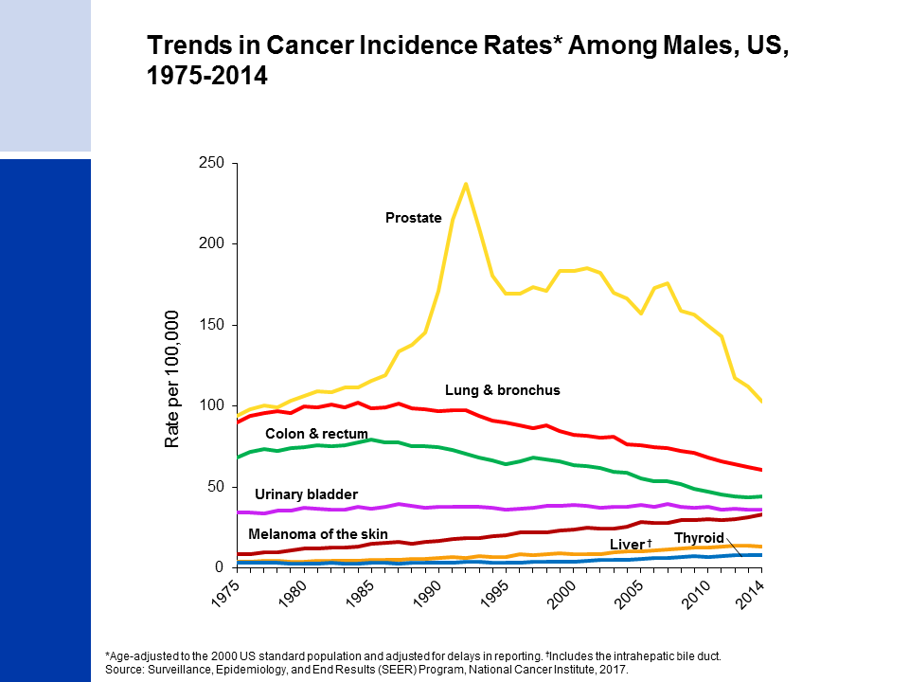
Notes:
Incidence rates for prostate cancer have changed substantially over the past 20 years, increasing rapidly from 1988 to 1992, declining sharply from 1992 to 1995, and generally decreasing from 2000 to 2014, with a marked drop between 2011 and 2012. This erratic trend primarily reflects changing patterns in the utilization of prostate-specific antigen (PSA) blood testing for the detection of asymptomatic prostate cancer. Incidence rates have been declining for lung and colorectal cancers in males for more than two decades, whereas rates for melanoma are increasing. Rates for thyroid and liver cancers appear to have stabilized in recent years after increasing for decades.

Slide 32
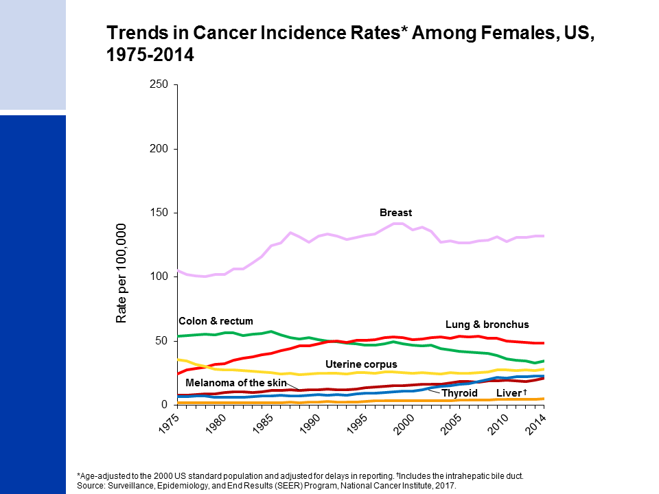
Notes:
Breast cancer incidence rates in females have been increasing very slightly over the last 10 years of available data (2005-2014), with the trend entirely driven by increasing rates among nonwhite women. This trend was preceded by a 7% decline from 2002 to 2003, which is primarily attributed to a reduction in use of hormone replacement therapy. Lung cancer rates began to decline in the mid-2000’s after increasing since at least 1975. Differences in the lung cancer pattern between males and females reflect differences in smoking pattern, including later uptake and slower cessation among women. Colorectal cancer incidence rates have been declining since the mid-1980s. In contrast, incidence rates are increasing for cancers of the liver and thyroid, although the pace of the increase may be slowing for thyroid, particularly among whites.

Slide 33
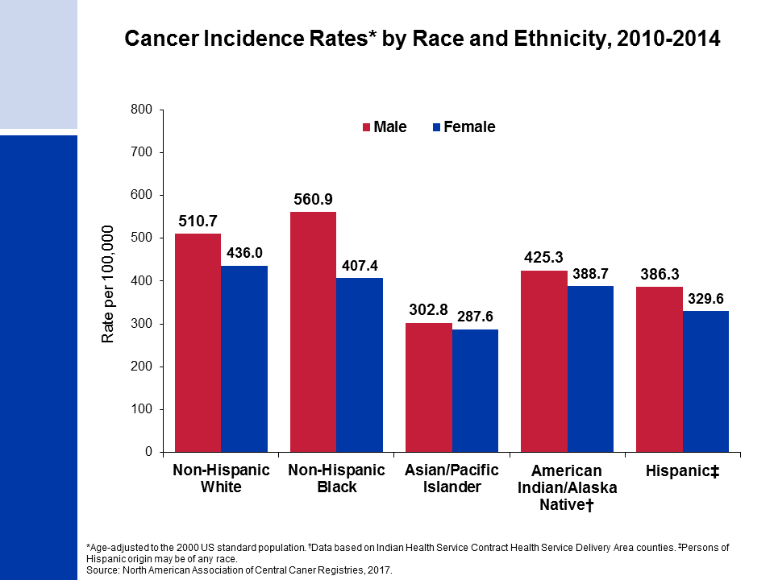
Notes:
Cancer incidence rates are higher in males than in females for each racial/ethnic population. The highest incidence rates are in blacks among males and in whites among females. Asian/Pacific Islanders have the lowest rates in both sexes.
It is important to note that these are broadly defined groups within which cancer rates vary substantially. In addition, rates for populations other than white and black may be underestimated due to incomplete information on race/ethnicity in medical records.

Slide 34
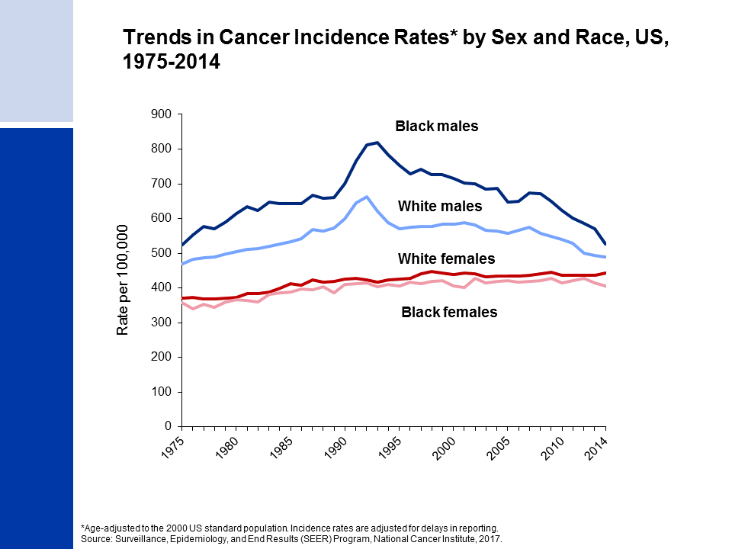
Notes:
Since the mid-1970s, cancer incidence rates for all sites combined have been substantially higher among black than white males, while among females rates are similar but slightly higher in whites. The higher rates among white compared to black females has been driven by lung and breast cancers; however, breast cancer incidence rates in these two groups are converging.

Slide 35
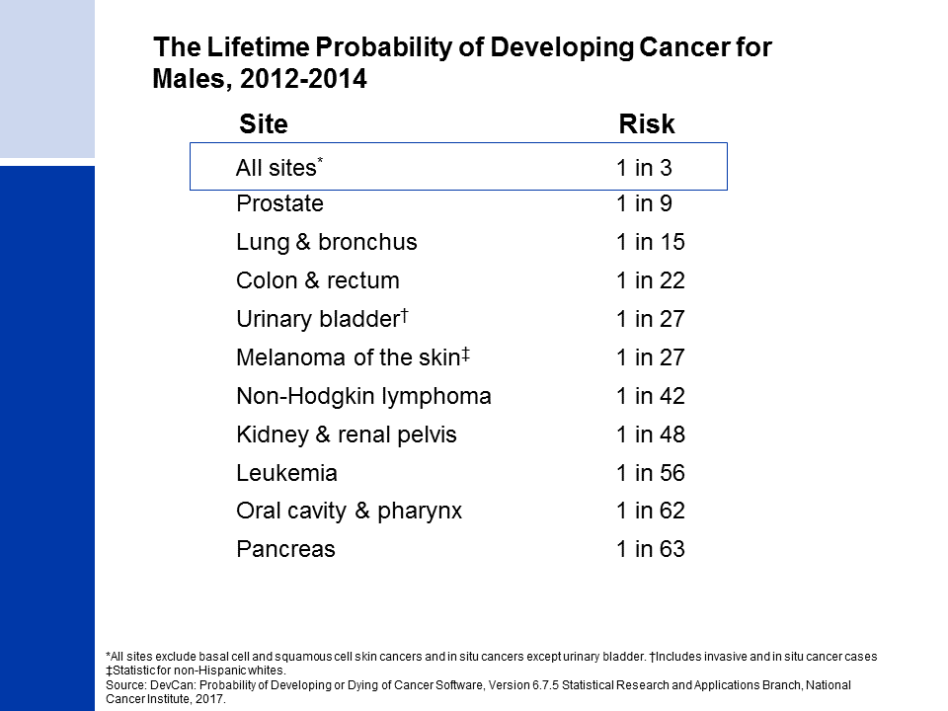
Notes:
For American males, the average lifetime risk of developing cancer is 39.7%, a little more than 1 in 3. These figures are based on the average experience of the entire male population and vary for individuals because of lifestyle and other factors. For example, cancer risk among smokers is higher than among nonsmokers.

Slide 36
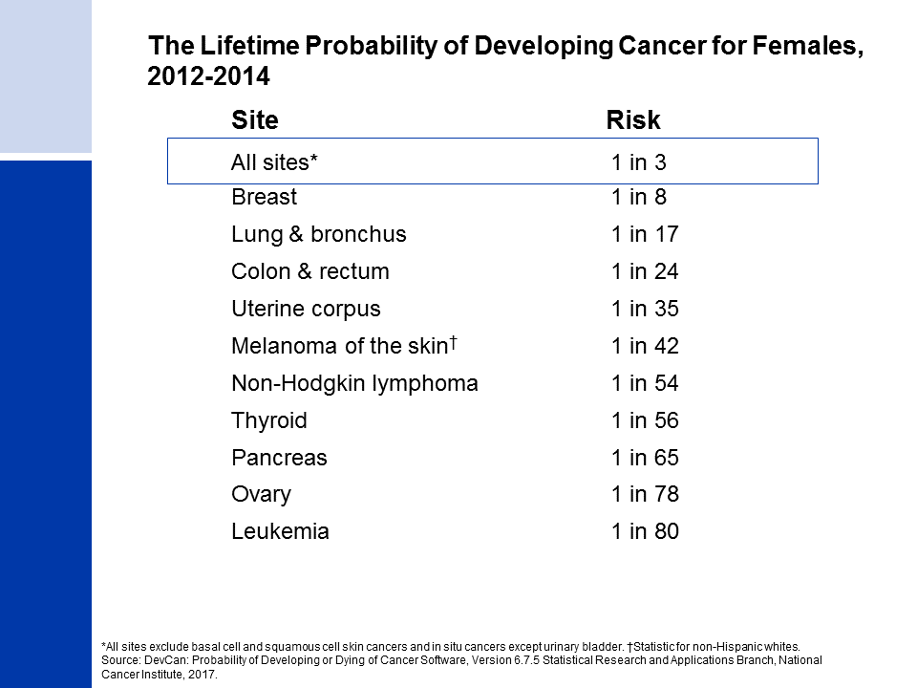
Notes:
The risk of an American woman developing cancer over her lifetime is 37.6% (slightly more than one in three).

Slide 37

Notes:
There have been notable improvements in survival rates for most cancer types due to earlier detection and/or advances in treatment. For example, due to improvements in treatment, the five-year relative survival rate for leukemia has increased from 34% in the mid-1970s to 64% in the most recent time period.
These survival trends are based on patients diagnosed in the nine oldest SEER registries and may vary slightly from those of more complete population coverage.

Slide 38
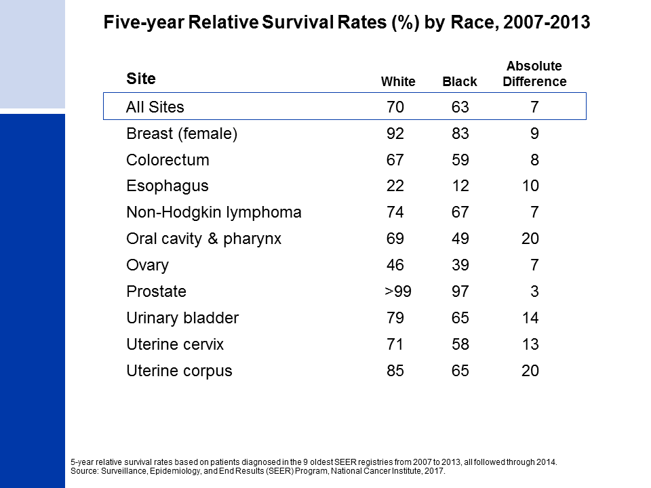
Notes:
While gains in survival have occurred for both whites and blacks, blacks have lower survival rates than whites for most cancer types. The largest differences are for cancers of the oral cavity and uterine corpus. Factors that contribute to racial disparities in survival include a later stage of diagnosis among blacks, as well as a lower likelihood of receiving high quality treatment. Additional factors include differences in tumor characteristics unrelated to early detection and differences in the prevalence of comorbidities (other health conditions).

Slide 39
Siegel, et al. CA Cancer J Clin 2020.

Slide 40
Research studies using registry data
Patient contact studies (interview, biospecimens, medical record abstraction, etc.)
  Case-control
  Case series – patterns of care/comparative effectiveness, survivorship
  Cohort
    Start with healthy population, link to cancer registry
Secondary data analysis
  Using existing data
  Descriptive epidemiology
  Cancer surveillance research

Slide 41
Data resources
Registry data as is – cancer patients & survivors
Registry data + census/population data - rates
Linked to other databases, e.g.,
  SEER-Medicare
    Claims data for persons >=65 from before, during and after initial cancer diagnosis and treatment
  CCR-California OSHPD (Office of Statewide Health and Policy Development) hospital claims data
  Hospital characteristics
  SEER linked to other databases
    HIV/AIDS, transplant database, NLMS, Medicaid, pharmacy data, genetic testing data, etc.

Slide 42
Linkages overview
File of cancer patients/survivors
(e.g., case series, clinic population)
Linkage by:
Identifiers (deterministic)
Geocoded data
Incident cancers
Detailed treatment
File of non-cancer individuals
(e.g., occupational cohort (CTS, cosmetologists), MEC, transplant recipients, HIV/AIDS registry)
Exposure information
Cancer registry data
Comorbidities, health status
File of claims data
(e.g., OSHPD, Medicare, Medi-Cal, electronic health records)
Payer/insurance status
Environmental attributes
File of geographic characteristics
(e.g., census data, medical facilities)

Slide 43
Outline
Causes of cancer
Cancer registry data
  The old
    Types of cancer registries
    Classic cancer surveillance activities & studies
  The new
    Contemporary cancer surveillance activities & studies
  The future
    The New SEER: “Not your grandmother’s SEER”

Slide 44
Health disparities
Notes:
A central feature of most of our work, esp given diversity in our region and state

Slide 48
Incidence rates over time of invasive breast cancer among AA ethnic groups and NH Whites, California, 1988-2013
Non-Hispanic White
Japanese
Filipina
South Asian
All Asian American
Chinese
Vietnamese
Korean
Southeast Asian
*increase statistically sig in every group, except Japanese
Gomez et al. BCRT 2017

Slide 49
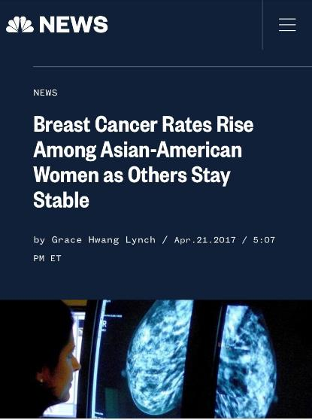
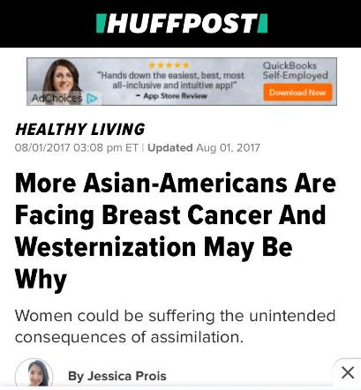
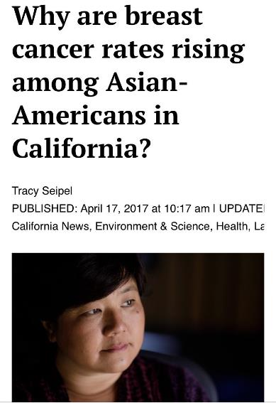
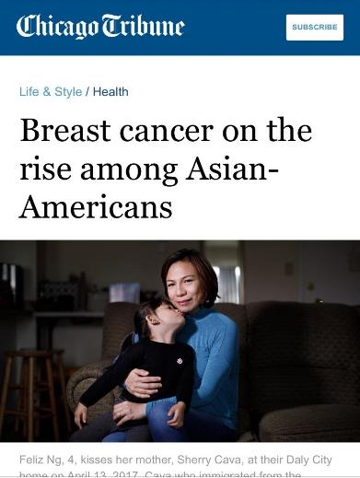
“When Margaret Abe-Koga was diagnosed with breast cancer in 2015, she was as surprised as anyone.
After all, no one ever had breast cancer in her Japanese-American family, she doesn’t have the genetic marker, and she’d been led to believe that Asian-Americans weren’t – as Abe-Koga put it – “a high-propensity group” for the disease.
[The results from the study] stunned Abe-Koga, 46, … For generations, she said, Asian-Americans have been under the wrong impression that breast cancer “is not prevalent in our community” so “it’s not something that people think about.” ”
Tracy Seipel (Mercury News), Chicago Tribune, April 27, 2017

Slide 50
Clinical cancer surveillance
Notes:
Because of close collaboration with NCI cancer centers – Stanford, UCSF, UCSD – we have engaged with clinicians to use cancer registry data to address questions of timely clinical significance. Example: using CCR data to assess patterns of and outcomes following bilateral mastectomy for early-stage breast cancer.

Slide 51

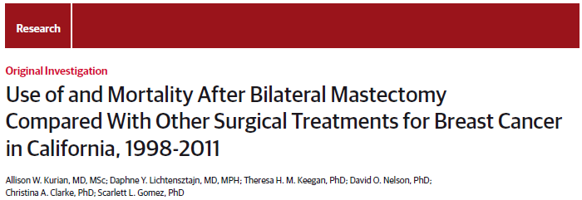
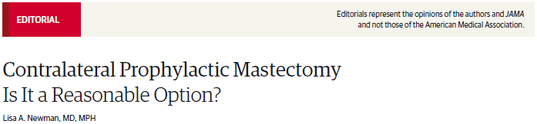

Slide 52

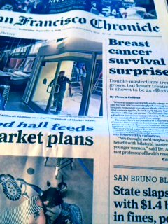
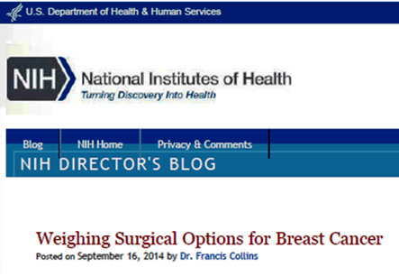
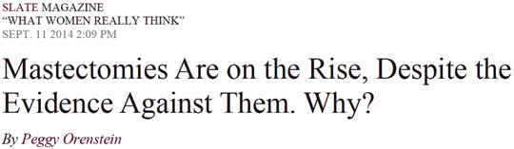
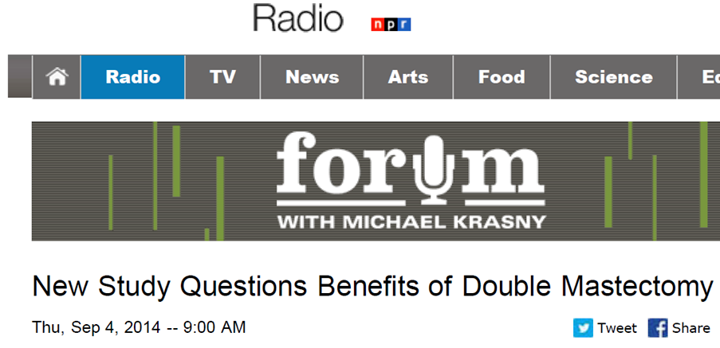

Slide 53
Enhanced resource development
Notes:
A focal activity over the past 20 years has been to assess whether we can expand the use of cancer registry data through improving data quality or linking to other datasets

Slide 54
Lung Cancer Incidence in AANHPI females
Cohort members
N = 2,211,476
(Females N=1,275,838; Males N=935,638)
EHR data
Sutter Health Northern CA
EHR data
Kaiser Permanente Hawai’i
EHR data extraction & harmonization
Sociodemographic factors
Sex
Race/ethnicity
Language, translator request
Known and putative risk factors
Smoking status
Previous lung diseases
Infectious diseases
Reproductive history
Body size
Geospatial measures assigned
Sutter addresses geocoded
(KPHI address already geocoded)
Neighborhood SES and ethnic enclave variables values assigned to census units
Particulate matter exposures (PM2.5 and PM10) and traffic density calculated (Sutter only)
CA & HI cancer registry linkage
Matching criteria: names, DOB, SSN
Follow-up through 2013 (soon 2016)
Lung cancer cases
Microscopically confirmed, carcinoma
N = 7274
(Females N=3867; Males N=3407)
Tumor factors (from registries)
Date of diagnosis
Tumor stage
Tumor histology

Slide 55
Cohort description – Female lung cancer cases (N=3867)
 | Cases (N)
AANHPI | 613
NHPI | 201
Native Hawaiian | 160
Other Pacific Islander | 41
Asian | 412
Chinese | 75
Filipina | 80
Japanese | 74
Other Asian (single group) | 67
Multiple Asian | 116
Non-Hispanic White | 1489
Black | 91
Hispanic | 81

Slide 56
Cohort description – Female lung cancer cases (N=3867)
 | Cases (N)
AANHPI | 613
NHPI | 201
Native Hawaiian | 160
Other Pacific Islander | 41
Asian | 412
Chinese | 75
Filipina | 80
Japanese | 74
Other Asian (single group) | 67
Multiple Asian | 116
Non-Hispanic White | 1489
Black | 91
Hispanic | 81
Notes:
The chart shows the proportions of never-smoking female lung cancer among cases for each AANHPI group
“Other Asian” has been expanded to include Asian Indian, Korean, and Vietnamese due to low case numbers
As a reference, 25% of NHW female cases occurred among never-smokers
Proportions of LCINS ranged from 25% among NH females to 86% among Asian Indian and 80% among Chinese females.

Slide 57
Incidence of never-smoking lung cancer among females
 | AAIR | 95% CI
AANHPI | 17.1 | (14.9, 19.9)
NHPI | 15.2 | (10.2, 22.5)
Native Hawaiian | 16.7 | (10.5, 26.4)
Other Pacific Islander | ~
Asian | 17.5 | (15.0, 21.0)
Chinese | 22.8 | (17.3, 35.9)
Filipina | 20.1 | (14.1, 31.5)
Japanese | 6.4 | (3.6, 28.7)
Other Asian (single group) | 20.3 | (13.4, 32.1)
Multiple Asian | 22.2 | (16.1, 32.4)
Non-Hispanic White | 10.1 | (9.0, 11.6)
Black | ~
Hispanic | 8.5 | (5.7, 13.0)

Slide 58
Neighborhood Context:
California Neighborhoods Data System
California Neighborhoods Data System
  Existing geospatial and other secondary data for characterizing contextual factors
  Social and built environment attributes
  Statewide
  Small geography – block group level desirable
  1990, 2000, 2010
Incorporate data into surveillance analyses of population-level data (e.g., California Cancer Registry)

Slide 59
Neighborhood context in cancer control
Gomez, Shariff-Marco, DeRouen, et al. The impact of neighborhood social and built environment across the cancer continuum: current research, methodologic considerations, and future directions. Cancer 2015.

Slide 60
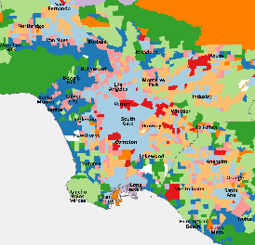
9-Class Neighborhood Archetypes
2000 California Census Tracts
9-class Archetypes
Inner city
New urban/ Pedestrian
Upper middle-class suburb
High status
City pioneer
Hispanic small towns
Suburban pioneer
Mixed SES class suburb
Rural/Micropolitan
 | Urbanicity | SES | Demographics | Age and households | Land use | Commuting and streets | Food
Upper middle-class suburb |  | High | White/API | Midlife Fewer female HH | Greenspace Recreation | Low connectivity
High status |  | High | White | Older | Greenspace Recreation |  | Healthy
New urban/ Pedestrian | Downtown |  | Diverse (non-Hispanic) | Young, Singles | Mixed use | High traffic
Mixed SES class suburb |  |  |  | Families | Some mixed use Recreation | Commuting Low connectivity | Healthy
Suburban pioneer | City | Middle | Diverse | Families, Owning | Mixed use
Rural/ Micropolitan | Rural | Low | White | Older Single HH |  | Low traffic
City pioneer | City | Lower-middle | Diverse | Older Single, female HH Rentals | Mixed use | High traffic
Hispanic small towns |  | Lower-middle | Hispanic |  | Some mixed use Less greenspace | Less commuting Low traffic | Unhealthy
Inner city | Urban | Low | Black, Hispanic | Rentals, Vacancy |  |  | Unhealthy
Los Angeles

Slide 61
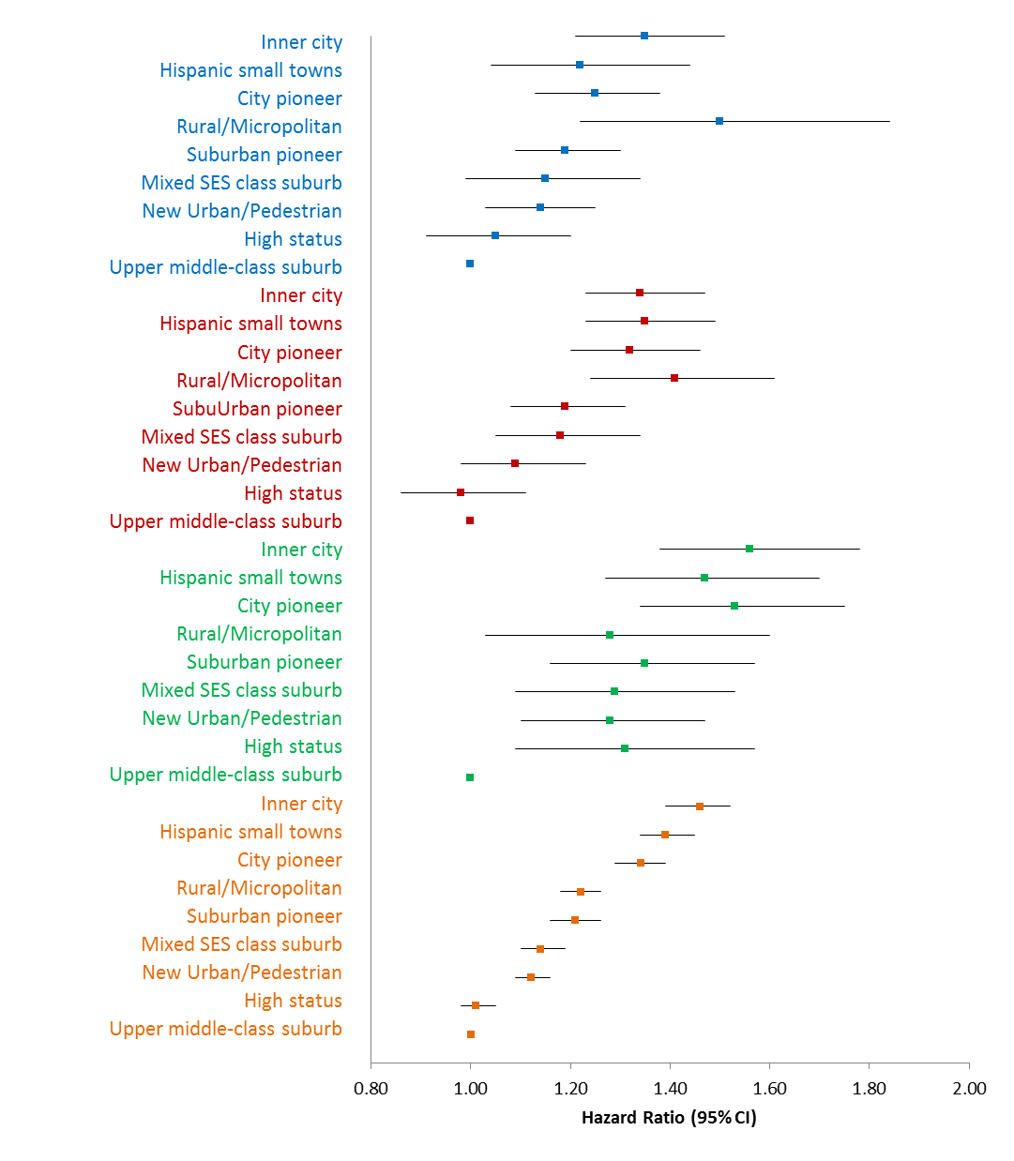

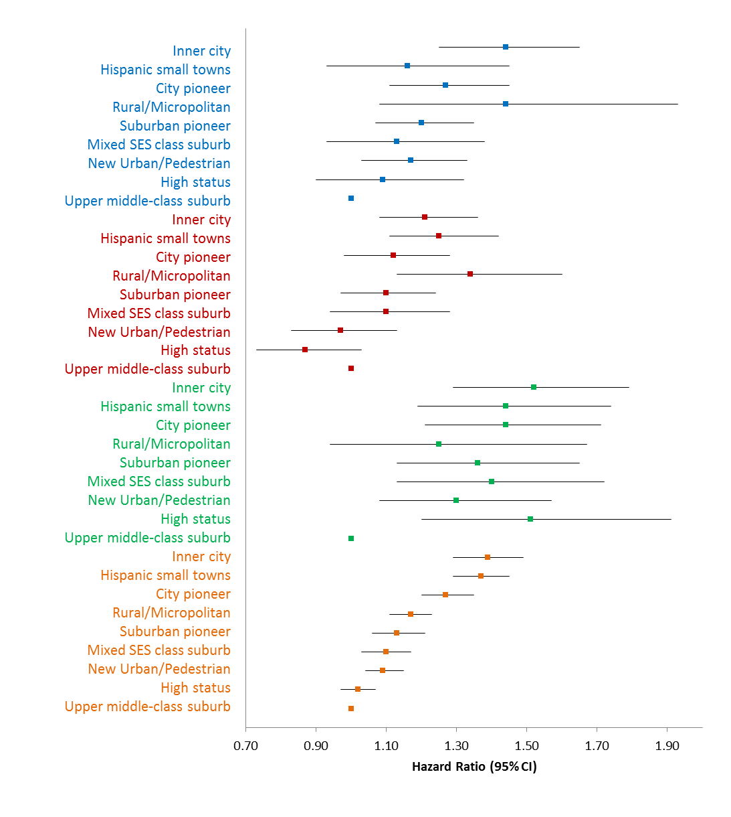
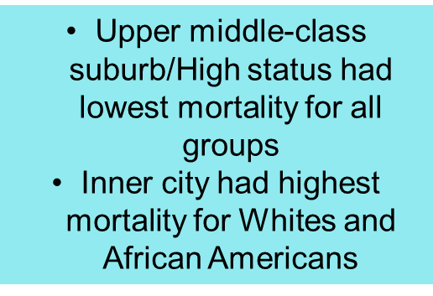
Mortality Associations by Race/Ethnicity
(All Cause and Breast-Cancer Specific)
Asian/Pacific Islander
Asian/Pacific Islander
Hispanic
Hispanic
NH African American
NH African American
More heterogeneity across racial/ethnic groups
Upper middle-class suburb and High had lowest mortality for NH Whites
Inner City had highest mortality for all groups except Hispanics
NH White
NH White
¹Model adjusted for age at diagnosis, year of diagnosis, SEER summary stage, histology, grade, ER status, PR status, chemotherapy, radiation, surgery and clustering by census tract
Notes:
As their distributions of archetypes varied by race/ethnicity, this Figure shows you the hazard ratios and 95% CIs by racial/ethnic group.
The Y-axis shows the data for each racial/ethnic group, and the archetypes are listed using the same ranking as shown in the earlier table, but this time the reference group is at the bottom and the highest mortality at the top.

Slide 62
Outline
Causes of cancer
Cancer registry data
  The old
    Types of cancer registries
    Classic cancer surveillance activities & studies
  The new
    Contemporary cancer surveillance activities & studies
  The future
    The New SEER: “Not your grandmother’s SEER”

Slide 63
The future
“This is not your grandmother’s SEER”
Norman Sharpless, NCI Director

Slide 64
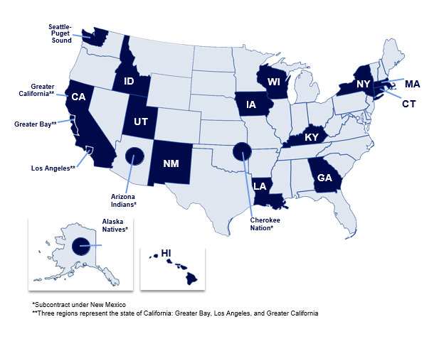
(Expanded!) Surveillance, Epidemiology and End Results (SEER) program
16 population-based registries now covering 34% of the US population
  Registries represent racial and ethnic minorities
  Various geographic areas
With new registries −550,000 incident cases annually
Current solicitation out to add more registries!

Slide 65
Current SEER and CCR initiatives
Linkages, and more linkages!
  Payer claims data
  Genetic testing data
    Tumor
    Germline
  Pharmacy data
  Medicaid claims data
  Hepatitis registry data
Automation
  Electronic pathology reporting
  Web-based reporting portals
  Natural language processing to code unstructured text
  Image processing to read pathology slides

Slide 66
Current SEER and CCR initiatives
Virtual tumor repository
  Registries serve as clearinghouse for location and annotation of tumor specimens
  Registries can facilitate access to stored tissue (formalin-fixed, paraffin-embedded blocks)
Virtual pooled registry
  Facilitate and streamline linkage of study data to data from multiple cancer registries
Patient-generated health data (PGHD)
  Collect additional information on PGHD including patient-reported outcomes, data from wearables, etc.

Slide 67
Current SEER and CCR initiatives
Algorithms to identify recurrences, disease progression
Geospatial resources
  Small-area level measures – e.g., neighborhood SES
  Sub-county zones
  Residential history through linkage to commercial databases

Slide 68
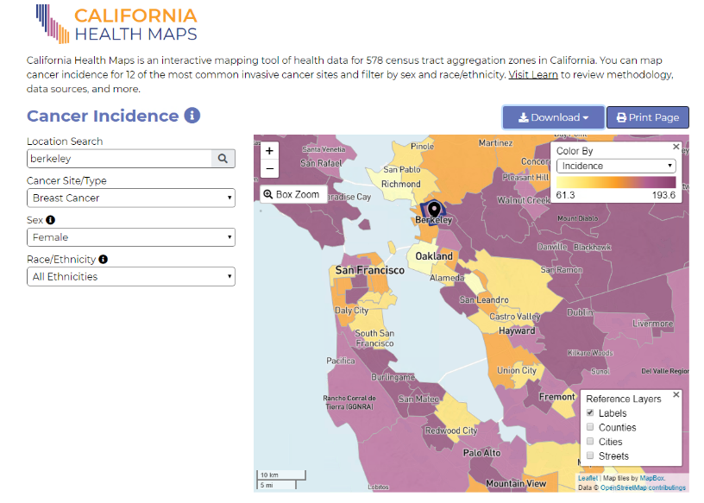
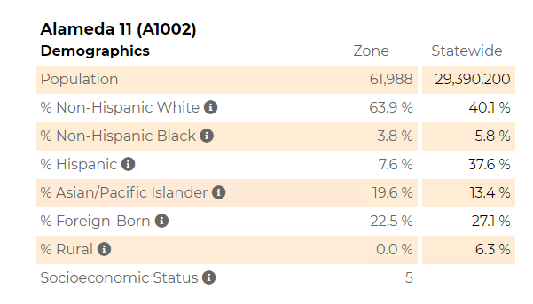
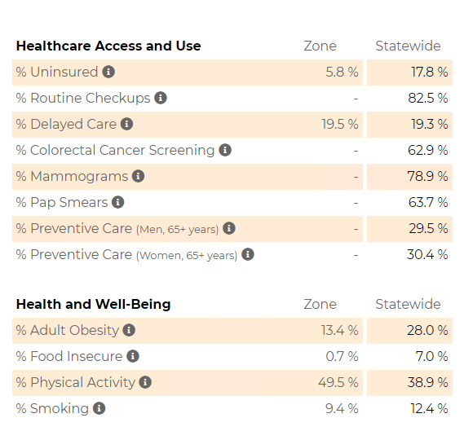
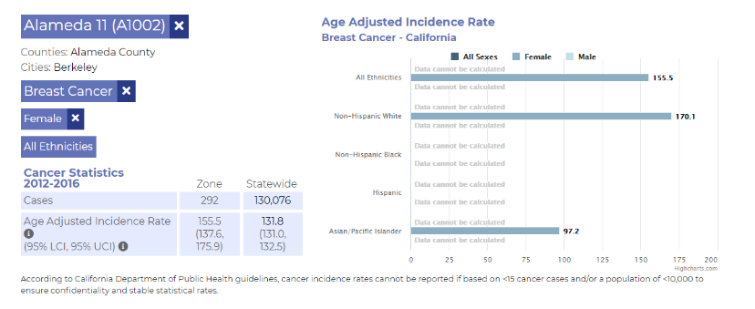
www.californiahealthmaps.org

