Slide 1
Effects of Measurement Errors
(on Validity) &
Data Analysis
John Witte
1/31/14

Slide 2
Overview
1. Recap from last week
2. Validity in Epidemiologic Studies
  Validity of Estimation
  Confounding
  Selection Bias
  Information Bias
  Generalizability
3. Data Analysis
  Data Editing
  Data Description and Summarization
  Missing Values
  Testing and Estimation
  Multiple Comparisons

Slide 3
Ecologic Study Designs
Multiple-group Design
The rate of disease is compared among many groups during one period of time to search for spatial patterns.
Time-trend Design
Follow one group or population over time to assess relationship between a change in exposure frequency and a change in disease frequency.
Mixture of Multiple group and Time trend

Slide 4
Criteria for Comparing Study Designs
Three general criteria:
  1. Relevance of the information to the investigator
    Extent to which expected findings will satisfy the specific objectives of the study
    Investigator's desire to estimate specific population parameters

Slide 5
Criteria for Comparing Study Designs
Three general criteria:
  2. Quality or accuracy of the information expected in the data
    Ability of the investigator to determine that the exposure preceded disease occurrence.
    Ability of the investigator to eliminate the possibility that the statistical findings were due to various methodological problems or sources of error.

Slide 6
Criteria for Comparing Study Designs
Three general criteria:
  3. Cost of the information
    The ultimate worth of a study is the total value of all derived information--now and in the future--relative to the total (direct and indirect) costs of the study.

Slide 7
2. Validity in Epidemiologic Studies
Errors
  Systematic errors => biases
    Low bias => _________________
  Random errors
    Low random errors => ______________
  Low total error (systematic and random) => ___________

Slide 8
Validity in Epidemiologic Studies
Errors
  Systematic errors => biases
    Low bias => valid
  Random errors
    Low random errors => precise
  Low total error (systematic and random) => accurate

Slide 9
Example: Validity and Precision
Assume that two people are playing darts, with the goal of getting one’s throws as close as possible to the bull’s-eye.
Notes:
Player 1’s aim is unbiased (valid), but their darts generally land in the outer regions of the board (imprecise).
Player 2’ aim is biased (invalid), but their darts cluster in a fairly narrow region on the board (precise).

Slide 10
Validity of Estimation
Internal validity:
    Validity of inferences based on an observation set when applied to the source population
External validity:
    Generalizability of inferences to a population different or broader than the source population
Internal validity required for external validity

Slide 11
Violations of Internal Validity
  Confounding
  Selection bias
  Information bias

Slide 12
Confounding
  Assume a causal path from an exposure of interest to disease.
  Also assume there is another causal pathway from an extraneous factor to disease.
  If these are associated, then effect of extraneous factor can be mistaken for the effect of the exposure.
  Focus of future lecture.

Slide 13
Selection Bias
Leads to invalid results because the study subjects are not representative of the source population.
Then the relation between exposure and disease differs among participants and the source population.
Observed associations a mixture of forces determining participation and disease occurrence.
  In case-control study, this could be an incorrect control group (e.g., subjects with outcome affected by exposure of interest).

Slide 14
Selection Bias and Confounding
  In cohort studies, if there is differential selection at the start of follow-up, the selection bias is a form of confounding.
  We can analytically adjust for this if we have have accurately measured the determinants of participation
    e.g., we know the relative probabilities of selection for the observations that were collected.
  That is, if we have (or can estimate) exposures measured before follow-up.
  In a case-control study, if the selection factors that affect subject selection are not affected by exposure, any resulting selection bias also be controlled analytically.
  But most often selection bias cannot be controlled for analytically.

Slide 15
Self-Selection Bias
Who participates in studies?
“Healthy worker effect”
  Due to effect of a factor that impacts both worker status and health.
This is actually a form of confounding.

Slide 16
Berkson’s Bias
Selection affected by both exposure and disease.
If exposure and disease are both positively associated with selection, this can result in downward bias.
Example: exogenous estrogens and Endometrial cancer.
Need to quantitatively consider the impact of selection bias!
Notes:
Hypothesized that estrogens increased bleeding, which resulted in earlier detection of cancers among exposed that would have gone undetected.
Unlikely that endometrial cancer would remain latent for long periods of time.
Used as controls women with benign gynecologic diseases. But this group overestimates the exposure of estrogens in the source population since these are risk factors for benign conditions. This severely underestimates the association for endometrial cancer.
They also proposed restricting the subjects to women who experienced vaginal bleeding.

Slide 17
Information Bias
  Measurement error, misclassification, and bias
  Differential misclassification
  Non-differential misclassification
  Misclassification of confounders
  Complexities of simultaneous misclassification

Slide 18

Measurement Error, Misclassification
    Continuous observations or measurements are generally made with some degree of error.
    Discrete or categorical observations are made with error as well.
    Error in observations of discrete variables is called misclassification

Slide 19
Misclassification of Dichotomous Vars
Sensitivity = Pr(report disease | true disease)
Sensitivity = Pr(report exposure | true exposure)
Specificity = Pr(report no disease | truly no disease)
Specificity = Pr(report no exposure | truly no exposure)

Slide 20
Correcting for Misclassification
If you know the sensitivity and specificity for a classifier…
You can work from their definitions to calculate the expected true number of exposed and unexposed given the observed numbers.
transition matrix |  | to
 |  | e=1 | e=0
from | E=1 | sensitivity | 1-sensitivity
 | E=0 | 1-specificity | specificity
Notes:
Since the observed counts verr = v * T, we can recover
the true counts v if we know or can assume T:
1: Use the matrix T to calculate its inverse Tinv
2: Multiply verr * Tinv = v * T * Tinv = v

Slide 21
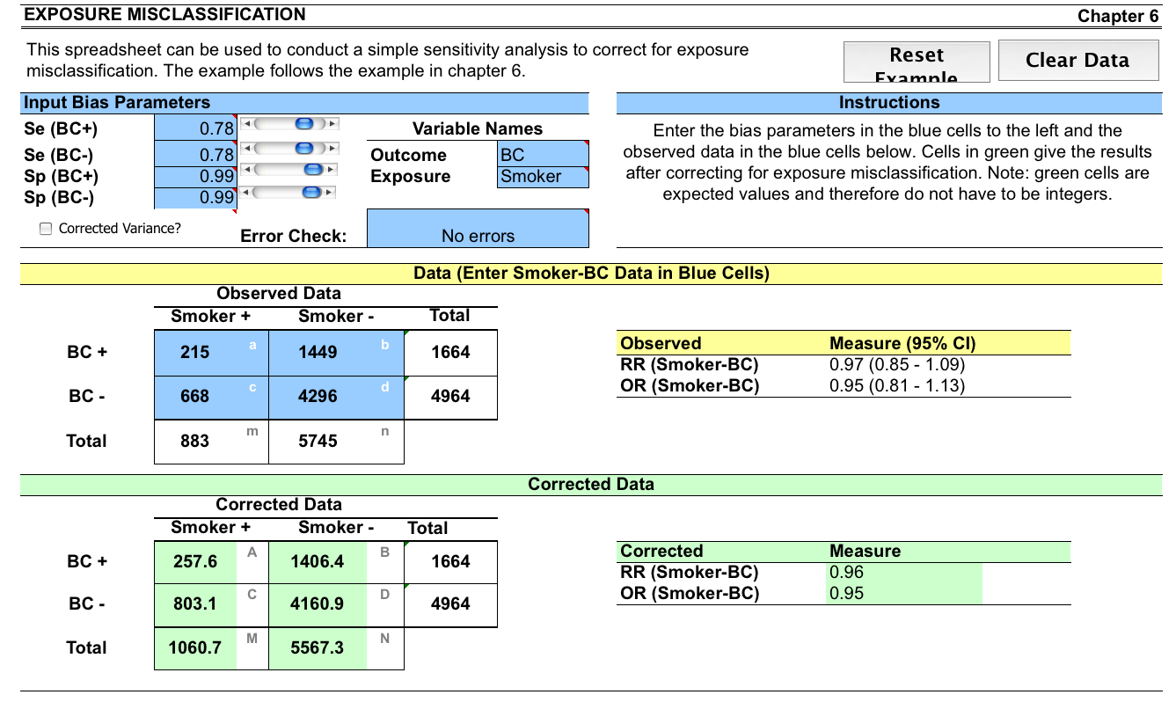
Validity in Epidemiologic Studies

Slide 22
Differential Misclassification
Probabilities of misclassification (the sensitivities and specificities) for exposure are different for cases and controls.
Probabilities of misclassification for disease status are different for the exposed and unexposed.
If
  the probabilities of misclassification of exposure do not depend of disease status; and
  the probabilities of misclassification of disease status do not depend on exposure status
then there is non-differential misclassification.

Slide 23
Non-differential Misclassification
Always bias results toward the null?

Slide 24
Non-differential Misclassification
Always bias results toward the null?
Expect effect estimates to be pushed towards the null;
  but by luck misclassification may yield results biased away from the null.
The “rule” does not apply:
  If categories have more than 2 levels
  If observations are not independent
Notes:
  The effect estimate is biased towards the null; the p-value could be larger or smaller.
  Different studies with different measurement processes and sample sizes will have different levels of bias

Slide 25
More Complex Misclassification
  Simultaneous misclassification
    Misclassification of either (or both) exposure and disease
    Misclassification of exposure and disease could be independent processes, or coordinated processes => dependent misclassification
  Misclassification of confounders or other covariates
    They may be misclassified alone or in combination with any of the other variables under consideration
  This can all get rather complicated.
  Need to quantitatively consider the impact of information bias!

Slide 26
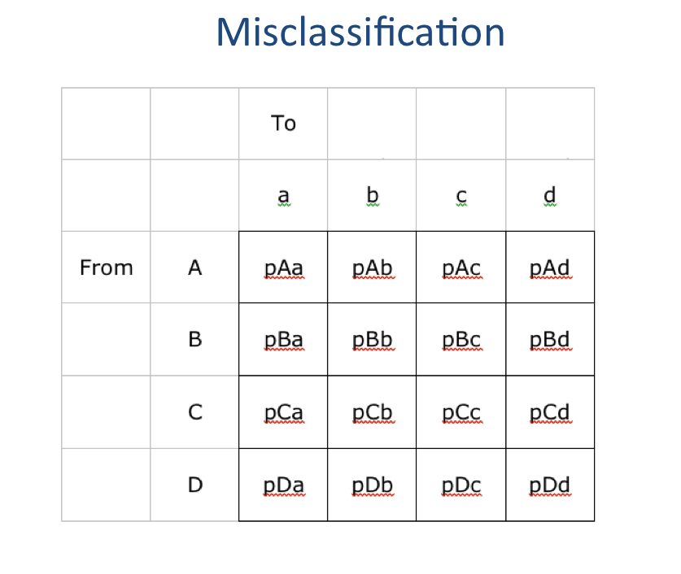

Slide 27
Validity versus Generalizability
Tension between goals of study validity and generalizability
  The better the study population represents the target population, the better results of the study will apply to the target population
  Using a more restrictive study population may improve study validity
    Studies can be restricted to be homogenous at suspected confounders
    A well specified and accessible study population can be defined to limit selection bias, with respect to that study population

Slide 28
3. Data Analysis
Data Editing
  Sanity checks
    Plot and/or tabulate the data
    Are there outliers / nonsense values?
    How much data is missing? How are missing values coded?
    What are the units? Do you have a dictionary?
  Recoding values
    Categorization
    Change of scale

Slide 29
Categorization of Continuous Variables
Choose cut points to split continuous variables into categorical variables.
  Depending on application, choose cut points based on percentiles, range, subject matter knowledge.
  Number of categories based on type of analysis you want to try, ease of communication.
  Avoid “empty cells”.
  About 5 categories may suffice.
Assumption of homogeneity within categories.

Slide 30
  Missing Data
Imputation
  Fill in the blanks: mean values?
  Assumptions of missing at random?
  Use auxiliary models and perhaps outside information to get reasonable values for missing data.

Slide 31
Test Statistics
Values that you can calculate based on a dataset.
If the null hypothesis is true, assume you know or have an approximation to the distribution of the test statistic.
If the observed test statistic is ‘surprising’ based on the null distribution, that counts as evidence against the null.
P-value indicates how surprising is the test statistic.
The statistical testing framework is designed to handle sampling variability well.
But does not stand up to biases or incorrectly specified models.

Slide 32
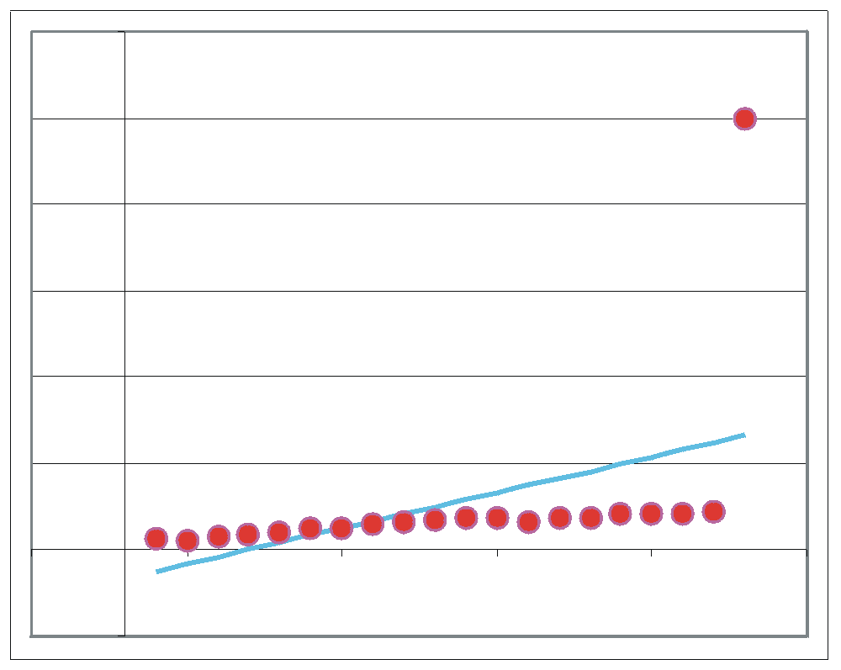
Influence Analysis
Are a small number of observations driving the results?
Leverage

Slide 33
Sensitivity Analysis
How strongly do the results depend on particular choices made during the data handing and data modeling steps?
  Definitions of variables?
  Criteria for excluding observations?
  Handing of missing data?
  Methods of adjusting for confounders?
  Statistical model?
  Statistical methods / computational tools?
Try some variations on the main analysis and see if they point to the same conclusions.

Slide 34
Multiple Comparisons: Bonferonni
If you conduct 100 statistical tests at alpha=0.05 significance levels, and the null hypothesis is always true, how many false positives do you expect?
What is the probability that all 100 of the 95% confidence intervals will contain the null value?
How can we make confidence intervals corresponding to each of the 100 tests such that under the null they would all cover the null value 95% of the time?
How many false positives would you expect?
This is the Bonferonni method for controlling family-wise error rate – the probability of a false positive result across a whole set of results.

Slide 35
Problems with Bonferonni
Does not apply if the tests are not independent (conservative).
Some users of the statistical results may not care about the results of some of the tests.
Should the tests of interest be penalized because irrelevant tests were run as well?
In a hypothesis-generation study, the Bonferonni adjustment may lead to promising candidate hypotheses being rejected.

Slide 36
False Discovery Rates (FDR)
Calculate P-values for each test in a family of tests
For each P-value calculate a corresponding FDR (q-value)
FDR: fraction of results from the family of tests with p-values less than or equal to the given p-value are false positives.

Slide 37
Permutation Methods
1. Calculate the effect size
2. Shuffle the values of the outcome variable
3. Recalculate the effect size on permuted data
Repeat 2 and 3 many times
Check how the actual effect size compares to the distribution of permuted effect estimates.
Based on the fact that under the null hypothesis, there is no association between the exposure and outcome.

