Slide 1
EPI258: Grant Writing Workshop
Lecture 1
January 6, 2021
Erin Van Blarigan, ScD
Associate Professor
Dept. of Epidemiology and Biostatistics
UCSF
Slides updated from: Judy Hahn, PhD

Slide 2
Plan for Today
Introductions
  Academic background, research interests, personal interests
Course organization details
Review syllabus
What to expect in an academic career
Types of grants
Introduction to Specific Aims

Slide 3
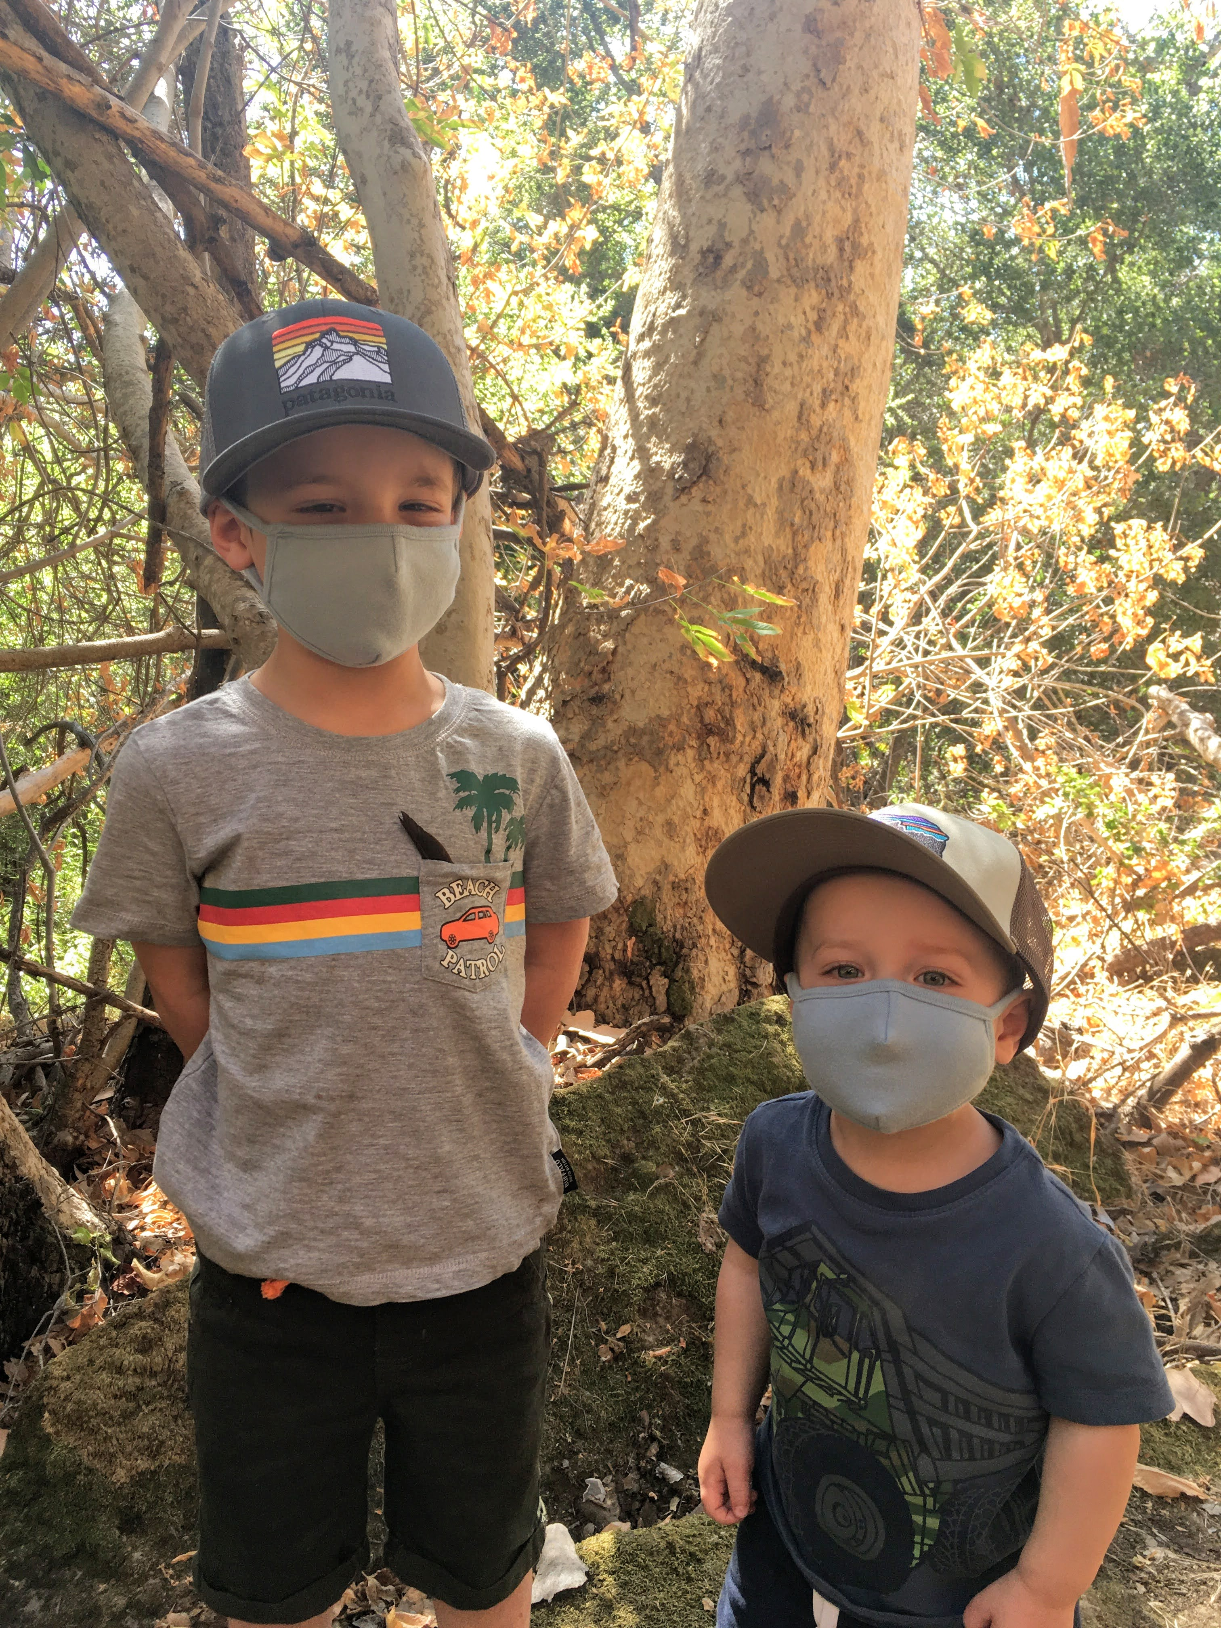
Meet Your Instructors
Erin L. Van Blarigan, ScD
Academic background: Nutritional Epidemiology of Cancer
Research interests:
  Nutrition and physical activity in relation to quality-of-life and survival among people with cancer
  Develop digital health tools to help cancer survivors adopt and maintain healthy lifestyles
  Optimization of behavioral interventions
Grants: R25 fellow pre-doc (Harvard) & post-doc (UCSF) → KL2 (UCSF) →K07 (NCI) & RAP awards → R01 (NCI)
Personal interests: cooking & baking, crossfit, hiking with our dog, reading fiction, and mom of 2

Slide 4
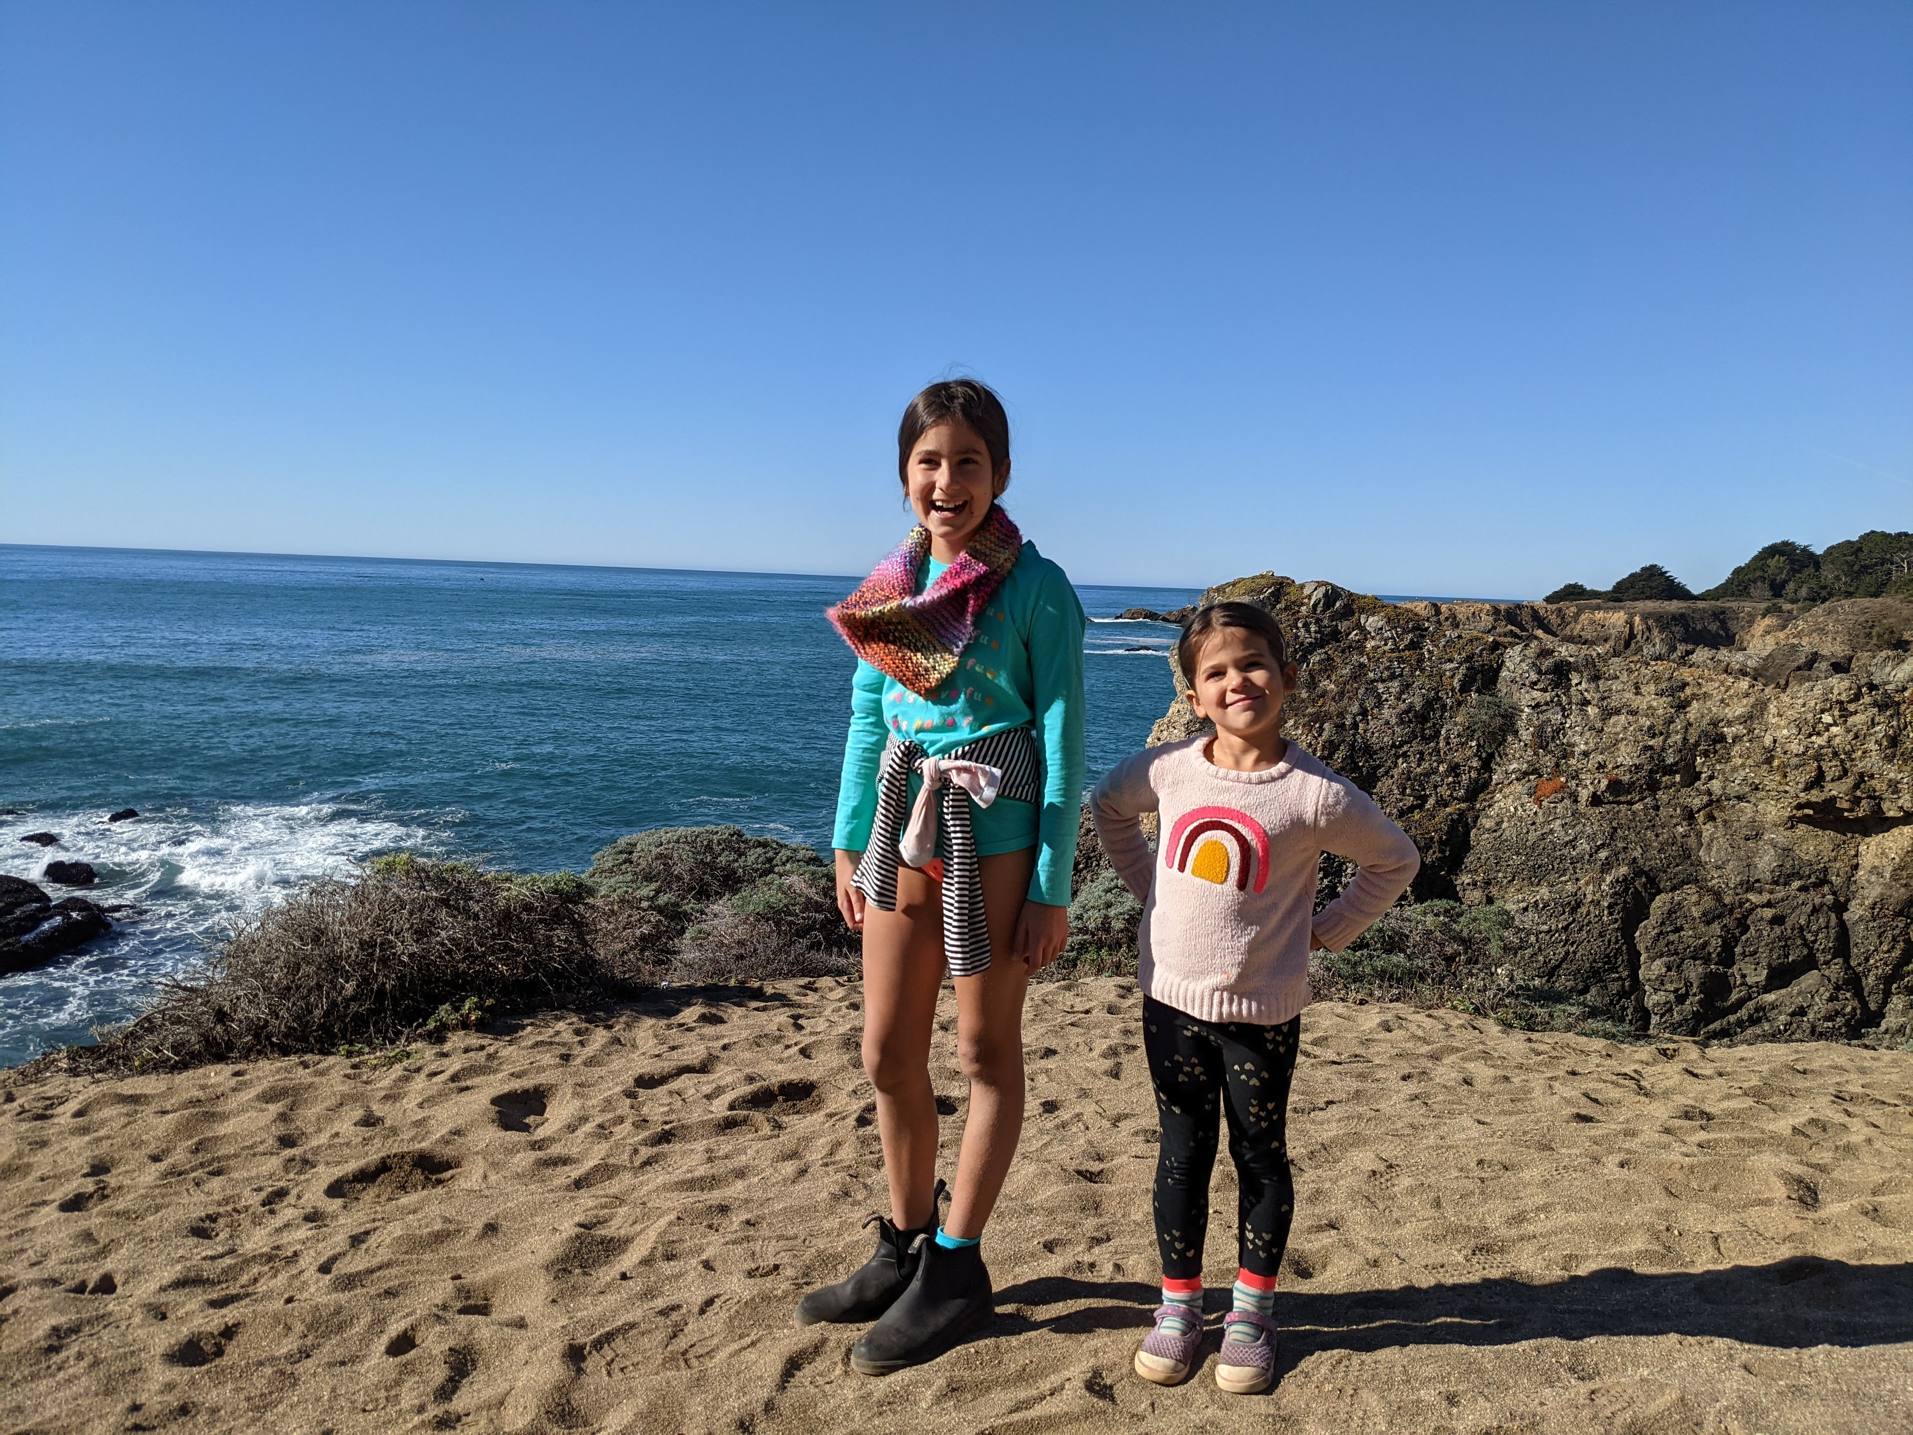
Meet Your Instructors
Co-instructor: Amy Conroy, PhD, MPH
Academic background: Behavioral scientist with multidisciplinary training
Research interests:
  Couple-based approach to understand and intervene upon health behaviors
  Focus on engagement in HIV care and treatment, intimate partner violence, heavy alcohol use, cardiometabolic disorders
  Most research is in southern Africa (Malawi, South Africa)
Grants:
  F31 (predoc) → T32 (postdoc)→ RAP grant → K01 → R34 → R01
  Funders: NIMH, NIAAA, NHLBI, NIAID
Personal interests: Playing the piano, skiing, yoga,
and raising two girls (ages 5 and 10)

Slide 5
Introductions
Name
Position
Academic background
Research interests
Personal interests

Slide 6
Course Organizational Details
Meet by Zoom from 1:10-3p on Wednesdays, Jan 6th – March 17th
10-min break (approx. 2-2:10 p)
Lecture/guest presentation for 20-50 min then small group discussion/peer review assignments in remaining time
Please keep video on when we have guest presenters and during small group discussions; ok on or off for our lectures
Notes:
This is a writing workshop, so emphasis will be on peer/facilitator review of writing more so than didactics

Slide 7
How to Contact Your Instructor
Office hours from 2-3p on Thursdays
  open Zoom, link on CLE, feel free to drop in
E-mail: erin.vanblarigan@ucsf.edu
  Please send questions related to homework due Monday morning before 3p on Fridays
Use the CLE forum to ask your classmates too!
Notes:
Questions received before 3p may not be answered prior to homework due date of 8a Monday morning

Slide 8
Syllabus

Slide 9
Academic Career
Typical Trajectory
PhD Post-doc Assistant Professor
Associate Professor
(Full) Professor
Notes:
Post doc

Slide 10
Faculty Research Responsibilities
Obtain funding and lead research
  Extent varies depending on faculty track (adjunct, clinical, in-residence, etc.) and personal goals
Co-investigator on others’ research
Report research results (peer-reviewed publications, conferences)
Mentoring trainees and more junior faculty
Reviewing grants (internal/external) and manuscripts

Slide 11
Writing Grants
Critical to an academic career
Benefits, in addition to funds:
Time to do a comprehensive literature review
Opportunities to build new collaborations
Peer-review really helps improve your work
Success begets success – funders want to know you have a track record

Slide 12
Grant Funding by Career Stage
 | Pre-doctoral | Post-doctoral | Early faculty | Mid-established faculty
Fellowship /Mentored career development | F31, F31 diversity, F00 | F32 / K99, T32 | K01/K08/K23 K99/R00 | K05, K24
Research grants | R36 Diversity supplement, Foundation awards | Diversity supplement, Intramural awards (RAP), Foundation awards | Diversity supplement, Intramural awards (RAP), R-grants, DOD, Foundation awards | R-grants (R01, R21, R34) U01, P30; DOD; Foundation awards
Notes:
Link to diversity related funding opportunity announcements on the CLE

Slide 13
Direct and Indirect Costs
Direct costs – salaries, supplies, travel, etc.
Indirect costs – what the university uses to cover facilities and administrative costs
  Added on top of direct costs (with some adjustments), calculated as a % of direct costs
  Varies by grant type and institution and funder

Slide 14
Notes
Mentored career grants (K’s) are excellent ways to have time to write papers, start your research
  Must commit 75% effort; may need additional non-federal funds
R grants supply a shrinking % effort
UCSF has an excellent track record of obtaining NIH funding and many resources
Get involved with a successful investigator that you work well with

Slide 15
Some resources
All About Grants Podcast:
  http://grants.nih.gov/podcasts/All_About_Grants/index.htm
F kiosk
  http://grants.nih.gov/training/F_files_nrsa.htm
K kiosk
  http://grants.nih.gov/training/careerdevelopmentawards.htm
  More resources posted on CLE

Slide 16
Isn’t there $$ beyond the NIH?
Yes! Can you find some?
Check foundations and private institutes in your area of research
Examples:
  Robert Wood Johnson, Gates
  Doris Duke (MDs)
  American Association of University Women
  Afya Bora Consortium (international), Aga Khan Foundation (international)
  Many more
Examples of Non-NIH Funding Opportunities can be found here: http://www.fic.nih.gov/Funding/NonNIH/
Notes:
*may not be an exhaustive list

Slide 17
A note about training grants
Important to “tell a story”:
  Where you’ve been (demonstrate capacity for research)
  Where you’d like to go
  And how you cannot get there without this grant
Think 5 years ahead
Training awards (Fs and Ks) are all about you, your mentors/sponsors, and where you see your career going

Slide 18
Research Sections
While a lot is hanging on the training/candidate sections of your application (who you are, who your mentors are, what you have access to at your institution), the research section needs to be strong as well
The project must serve as a training vehicle for you
All proposals resemble the research section of the F/K (with varying page limits)

Slide 19
Specific Aims
Introductory paragraph(s): Big picture down to narrower picture and knowledge gap in 1-2 paragraphs (1/2 pg or less)
What is the big public health problem?
  Colorectal cancer is the 2nd leading cause of cancer death.
What is the more focused public health problem?
  Healthy lifestyle associated with better survival, but most people with colorectal cancer do not follow national lifestyle guidelines for cancer survivors.
  Critical need to develop sustainable and effective lifestyle interventions for cancer survivors.
What is known/what is the knowledge gap?
  Multi-component interventions can improve diet and exercise but are costly. The individual and joint effect(s) of intervention components are not known.

Slide 20
Specific Aims
Paragraph linking big picture to your Specific Aims: who/what/why
  What is the long-term goal of YOUR research?
    To improve outcomes among cancer survivors
  What are the short-term goals achieved through this application?
    To optimize a remotely delivered lifestyle intervention for cancer survivors
    Training / career goals
    Must have clear rationale: How will the proposed research (partially) close the research gap / provide the training you need?
Notes:
Who/what/why may not be in that particular order

Slide 21
Specific Aims
The Aims (Aim 1, Aim 2, Aim 3)
  Include testable hypotheses or steps needed before you are able to test the hypothesis that will inform your long-term goal
    For example, developing or piloting an intervention is not a testable hypothesis, but it does inform the hypothesis that you will eventually test
    Aims without testable hypotheses are ok for training and exploratory grant proposals; not a strong approach for R01’s
    RCTs, even pilot RCTs, are NOT allowed on F grants
  The aims must stand alone – one aim cannot be dependent on the success of the previous aim
Summary / pay off paragraph
  How this application move the field forward?
  What are the next steps after this project?
  How will this grant help your training and career development?
Notes:
- Exceptions to every rule

Slide 22
The Specific Aims page
Work on this over and over.
It will be what most reviewers read.
Get input from mentors, colleagues, etc.

Slide 23
Checklist of Specific Aims for F/K’s
Attention grabbing opening sentence
Briefly summarize current knowledge
Explicitly state gap in knowledge/unmet need
Long-term goal
Objectives of the application [research & training for F/K grants]
Central hypothesis / rationale
Aims
Payoff
  Expected outcomes
  Generality regarding positive impact

Slide 24
Assignment 1
Assignment 1, due 8 am, Monday 1/11:
Create a bulleted outline of the Specific Aims section for your research idea. Read the text and fill in your bullets in the “Create Your Bulleted Outline” document that can be downloaded from http://www.grantcentral.com/downloads/
Turn in a link to the PA (or other grant mechanism) to which you plan to apply and a list of potential sponsors/mentors for your grant. In a few sentences, describe the sponsors/mentors’ areas of expertise and what role they will play in your training.
Upload word document to link for Assignment 1 on CLE
Notes:
We will discuss our outlines next week.

Slide 25
Week 1 Discussion
Who am I, where is my career going, and why do I need this grant to get there?
  What’s your hook (exciting research idea)?
  What are you doing now?
  Where do you want to be in 5 years?
  How will a training/research grant help you get there?

