Slide 1
mortality after early postoperative Angiotensin-receptor blocker (ARB) withdrawal
June 5, 2014
Susan M. Lee, MD, FRCPC
Biostats 209 advisor: John Kornak, PhD
Mentors: Art Wallace, MD, PhD & Steven Takemoto, PhD

Slide 2
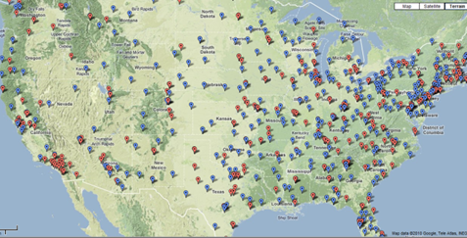
‘Big Data’ at the VA
Lifelong care
130 surgical hospitals across the USA
Data from 1.2 million surgical admissions over the last decade
Can ask questions we were previously underpowered to study
Don’t need a million dollar grant to study a million patients!

Slide 3
Why study ARB discontinuation?
Previous work: HR for mortality after ACEi discontinuation at 14-days = 3.44!!
  Residual confounding + survivor bias?
ARBs also prescribed for long-term CV risk reduction
Preop ACEi/ARB both associated with hypotension under GA
What to do with ACEi and ARB perioperatively is controversial
Even less data about early postoperative use

Slide 4
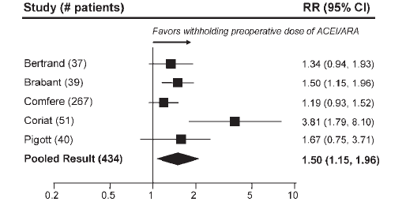
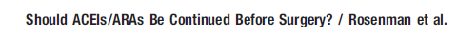
More hypotension under GA
RR 1.5 for hypotension requiring vasopressors at or shortly after induction of GA

Slide 5


ACEi/ARB postop effects controversial
ACEi/ARB bad
ACEi/ARB good
Increased 30-day mortality: 883 vascular patients (propensity-matched)
Increased AKI: 1358 cardiac surgery patients (adjusted with logistic regression)
Decreased long-term mortality: 1693 vascular patients (propensity-matched)
Decreased AKI: 536 cardiac surgery patients (adjusted by propensity-score)
Railton et al Can J Anaesth 2010;57(8):736-44.
Arora et al Clin J Am Soc Nephrol 2008;3(5):1266-73.
Feringa et al Arch Gerontol Geriatr 2009;48(1):116-20.
Benedetto et al Ann Thorac Surg 2008;86(4):6-6.

Slide 6
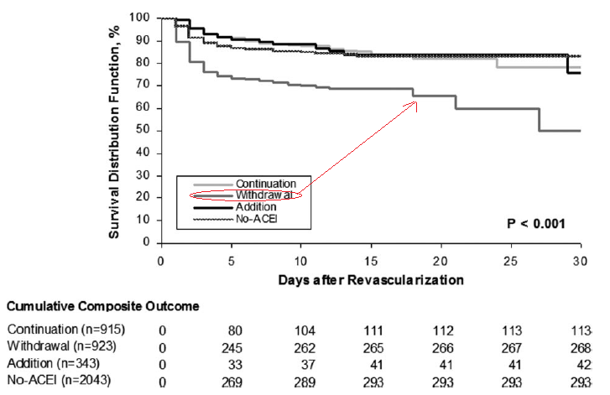
Postop: withdrawal of ACEi harmful
Drenger et al. Circulation 2012;126(3):261-69.
Notes:
This is a prospective observational study of 4224 patients undergoing coronary artery bypass graft
surgery. Composite outcome = nonfatal ischemic + renal complications + in-hosp mortality

Slide 7
Research Question
Patients:
  Veterans 1999-2011
  Regularly prescribed ARB
  Inpatient surgery (emergency & elective)
Comparison:
  Restarted on ARBs by POD#2
  Discontinued from ARB at POD#2
Outcomes:
  All-cause mortality
  Complications within 90-days

Slide 8
Exclusions
Starting with 1,213,086 surgical admissions in 846,454 patients
Exclusions:
  Surgery within prior 90 days
  Missing ICD-9 codes
  No ARB prescription within year preop
  Preop inconsistent / discontinued / new
    >182day gap
    <3 refills

Slide 9
Further exclusions
LOS <1 day (outpatient surgery)
NPO POD#0-2
Death POD#0-2
  Of the 87 excluded, 33% restarted ARB before death
Final cohort: 26,913 surgical admissions (26,044 patients)
  Preop consistent ARB prescriptions
  Inpatient surgery
  Alive and taking po meds on POD#2

Slide 10
Statistical methods
Step 1 – multivariable logistic regression to identify predictors associated with ARB nonresumption
Step 2 – Cox proportional hazards regression to identify 30-day mortality risk associated with ARB nonresumption
Step 3 – develop a propensity score based on Step 1 and re-do Cox model adjusted for score and in matched subset
Step 4 – model diagnostics and interactions

Slide 11
Confounding?
Multiple confounders
‘confounding by indication’
  Indication for discontinuing ARB postop → mortality
Comorbidities, surgical factors
Postop acute kidney injury
Low BP immediately postop
Blood loss (marked by transfusion)

Slide 12
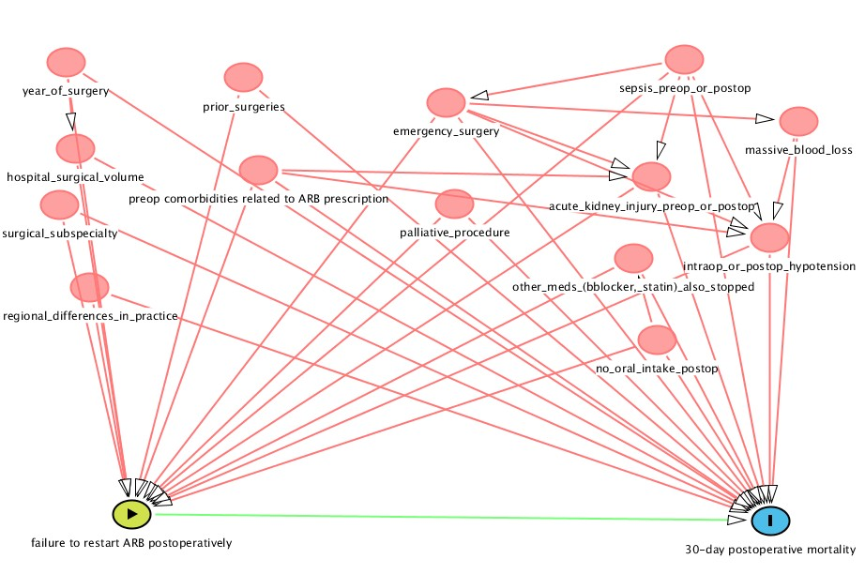
TONS of confounders

Slide 13
Step 1 – logistic regression
Starting with likely confounders
  Backward selection (p<0.08)
Identify predictors of ARB nonresumption
Need this step to do the propensity score

Slide 14
Step 2 – Cox model
Survival analysis
Possibility of ‘immortal time’ (survival) bias
  Reason for excluding early postop deaths (day 0-2)
  Also repeated analysis with ARB restart as time-varying covariate
Multiple predictors
  Backward selection used
Question: is failure to resume ARB independently associated with increased mortality?

Slide 15
Step 3 – propensity score
Many in cohort at extremes (very sick, very well) – may not be comparable
Matching by PS restricts analysis to those that could have been restarted or not
  (as opposed to definitely restarted or not)
Examination of postop complication patterns in PS-matched subset

Slide 16
Step 4 – interactions, diagnostics
Too many terms to test for all interactions
  No obvious interactions to look for
Each included variable checked for interaction with predictor of interest (ARB restart by day 2)
Cox models tested graphically & statistically for departure from proportional hazards

Slide 17
Baseline characteristics
96% male (typical of VA population)
Older (average age 67)
Comorbidities common
  Hypertension (39%)
  DM (28%)
  Ischemic heart disease (27%)
  Dyslipidemia (23%)
Most were ASA 3 or higher (92%)
Most were elective (93%)

Slide 18
Overall rates of ARB resumption

Slide 19
Overall rates of ARB resumption

Slide 20
Predictors of nonresumption
Associated with ARB nonresumption at day 2:
  ASA 4-5, emergency surgery
  IHD, valvular disease, heart failure, fluid disorder
  Fewer preop refills (2-3 only)
  Low BP on POD1
  Postop ARF or transfusion by day 2
Associated with ARB resumption at day 2:
  History of diabetes, peripheral vascular disease
  Orthopedic and neurosurgery
Notes:
Cardiac risk (MI, CHF, CKD, stroke, DM)

Slide 21
Cox proportional hazards model
  Backward selection (p<0.1)
Predictor: ARB discontinuation at postop day 2
Outcome: 30-day mortality
Adjusted for:
  Age, ASA score, emergency surgery
  Preop comorbidities: cancers, heart failure, peripheral vascular disease, chronic kidney disease
  Early postop events (low BP, myocardial ischemia, renal)

Slide 22
Is stopping the ARB bad?
Unadjusted HR for death at 30-days:
  2.08 (95% CI 1.76-2.46) p<0.001
Adjusted HR 1.57 (95% CI 1.33-1.87) p<0.001
YES, adjusted for likely confounders, stopping the ARB is still bad.

Slide 23
Risk factors for death at 30 days
Factor | HR (95% CI) | p-value
ARB discontinued at day 2 | 1.57 (1.33-1.87) | <0.001
Age >75 (vs <60) | 4.10 (2.57-6.54) | <0.001
Heart Failure | 1.79 (1.47-2.19) | <0.001
Chronic kidney disease | 1.90 (1.36-2.66) | <0.001
Peripheral Vascular disease | 1.43 (1.17-1.75) | <0.001
Acute renal failure (at day 2) | 1.45 (1.19-1.76) | <0.001
Hypotension POD1 | 2.18 (1.57-3.03) | <0.001
ASA 4 or 5 (vs 3) | 1.92 (1.61-2.30) | <0.001
Emergency surgery | 3.81 (3.16-4.61) | <0.001

Slide 24
Risk factors for death at 30 days
Factor | HR (95% CI) | p-value
Lymphoma | 2.26 (1.17-4.40) | 0.02
Metastatic cancer | 2.08 (1.43-3.02) | <0.001
Non-metastatic cancer | 1.53 (1.21-1.92) | <0.001
Accounts for confounding due to palliative nature of some procedures

Slide 25
Development of propensity score

Slide 26
Propensity score before and after
Propensity score ranged from -3 to 1.9
Matched with 1 nearest neighbour (caliper 0.005)
Unmatched
  ARB resumed mean score: 0.64
  ARB discontinued mean score: 0.14
  Mean comparison p<0.0001 by t-test
Matched
  Mean score for both groups: 0.40
    Range -2.0 to 1.76
  Mean comparison p=0.9 by t-test

Slide 27
Baseline characteristics (8,679/group)
Comorbidity | ARB discontinued POD2 n (%) | ARB restarted POD2 n (%) | P-value
CAD | 2251 (50.8%) | 2184 (49.2%) | 0.24
Heart failure | 1047 (52.2%) | 958 (47.8%) | 0.04
CKD | 254 (49.2%) | 262 (50.8%) | 0.72
PVD | 1307 (50.1%) | 1301 (49.9%) | 0.90
Stroke | 230 (47.6%) | 253 (52.4%) | 0.29
Valvular disease | 421 (47.6%) | 464 (52.4%) | 0.14
Low BP POD1 | 223 (50.6%) | 218 (49.4%) | 0.81
Transfusion POD0-2 | 130 (50.0%) | 130 (50.0%) | 1.00
Emergency surgery | 715 (50.8%) | 693 (49.2%) | 0.54

Slide 28
After propensity-score matching
HR in matched subset only (n=17,358):
1.71 (95% CI 1.40-2.09) p<0.001
Propensity-score adjusted HR:
1.60 (95% CI 1.34-1.92) p<0.001
Recall – multivariable adjusted HR:
1.57 (95% CI 1.33-1.87) p<0.001

Slide 29
Interaction#
Only important interaction was with age
Age-categorized hazard ratios including interaction:
  <60 years: HR 3.30 (95% CI 2.01-5.44) p<0.001
  60-75 years: HR 1.46 (95% CI 1.13-1.89) p=0.004
  >75 years: HR 1.35 (95% CI 1.05-1.74) p=0.02
HR greatest in younger patients

Slide 30
Graphically:

Slide 31
Model diagnostics
Generally proportional
  Schoenfeld test (p=0.26)
Repeated by age-category
  Still non-significant
Similar for categorized age groups

Slide 32
ARB as time-dependent covariate
ARB use as TDC for deaths after POD2:
  <60 years: HR 2.74 (95% CI 1.75-4.31) p<0.001
  60-75 years: HR 1.45 (95% CI 1.13-1.87) p=0.004
  >75 years: HR 1.28 (95% CI 0.99-1.66) p=0.06
ARB use as TDC for deaths after POD0:
  <60 years: HR 2.52 (95% CI 1.64-3.87) p<0.001
  60-75 years: HR 1.44 (95% CI 1.13-1.84) p=0.003
  >75 years: HR 1.25 (95% CI 0.98-1.61) p=0.07

Slide 33
Conclusion
ARB nonresumption at POD2 increases mortality at 30-days, even after adjustment for likely confounders
Increased risk is highest in youngest age group

Slide 34
Acknowledgements
Biostats Advisor
  John Kornak
Mentors/Collaborators
  Art Wallace
  Steve Takemoto
  Jackie Leung
ACEi study team
  Sesh Mudumbai et al

