Slide 1
Repeated Measures, Lecture 3, Part 1
Charles E. McCulloch,
Division of Biostatistics,
Dept of Epidemiology and Biostatistics,
UCSF

Slide 2
Outline
More on mixed and xtgee
Examples
Robust standard errors
Summary

Slide 3
MIXED for continuous outcomes
There can be multiple random effects specified by adding additional ||’s and random effects at the end.
In this way you can handle multiple hierarchies or levels of clustering. Order is from highest to lowest level of clustering.
Example: backpain data
mixed logcost i.pracstyl i.educ || doctor: || patient:, reml

Slide 4
MIXED for continuous outcomes
Specifying a random factor with a colon tells MIXED to allow different intercepts for each level of the factor, e.g., different intercepts for each patient.
This is often sufficient, but there are cases in which more features of the model need to be included, for example, patient, animal or physician specific terms.
If so, these are added after the colon.
Notes:
Subject specific intercepts allow each person to have their own level.
In a study of cognitive functioning, what might the individual data look like? E.g., MMSE score from a study of cognitive decline.
Not only would each person have their own level of cognitive ability, but they might also decline at different rates. So their slope with time would also be random.

Slide 5
Mouse tumor/weight data
How do these compare?
Notes:
Note differences in slopes over time.

Slide 6
Mouse tumor/weight data
So - an adequate model would need animal specific slopes and intercepts.
Stata code
mixed logw i.group day group#c.day || mouseid: day, cov(uns) reml
Do the treatment groups change differently over time (assuming linearity)?
Including baseline by time interactions to test
for differences between groups in change over time
Mouse specific day coefficients (slopes with day).
Mouse specific intercepts
Notes:
Why is there an interaction in the model? (time invariant predictor of treatment group).
What would the new syntax be?

Slide 7
Mouse tumor/weight data
More details in lab 2, but the “|| mouse:” portion specifies that mouse is a random effect (i.e., allows a mouse specific intercept or constant term) and the “day” term specifies that the slopes over days that are associated with a mouse are also random effects. That is, it allows each mouse to have its own growth trend.
The “cov(un)” specifies that the variance and covariances of the random intercepts and slopes are unstructured. That is, the variances of the random intercepts and slopes are not assumed the same and they may be correlated.

Slide 8
Using xtgee: 5 things to specify
What is the distributional family (for fixed values of the covariates) that is appropriate to use for the outcome data? Normal, binary, binomial (other?).
Which predictors are we going to include in the model? (Nothing new here).
In what way are we going to link the predictors to the data? (Through the mean? Through the logit of the risk?)
What correlation structure will be used or assumed temporarily in order to form the estimates?
Which variable indicates how the data are clustered?

Slide 9
xtgee: syntax
Example: Fecal Fat
xtgee fecfat i.pilltype i.sex, i(patid) t(pilltype) family(gaussian) corr(exch)
which can be shortened using defaults to
xtgee fecfat i.pilltype i.sex, i(patid)

Slide 10
More on xtgee
Here are the commonly used options:
Family
binomial
Gaussian (i.e., normal) default
gamma
nbinomial
Poisson
Notes:
Examples: binomial – readmission within 30 days, Gaussian – BMI, gamma – cost, Poisson, negative binomial – number of hospital days

Slide 11
More on xtgee
Link
identity (model mean directly) default for Gaussian
log default for Poisson
logit default for binomial
power
probit

Slide 12
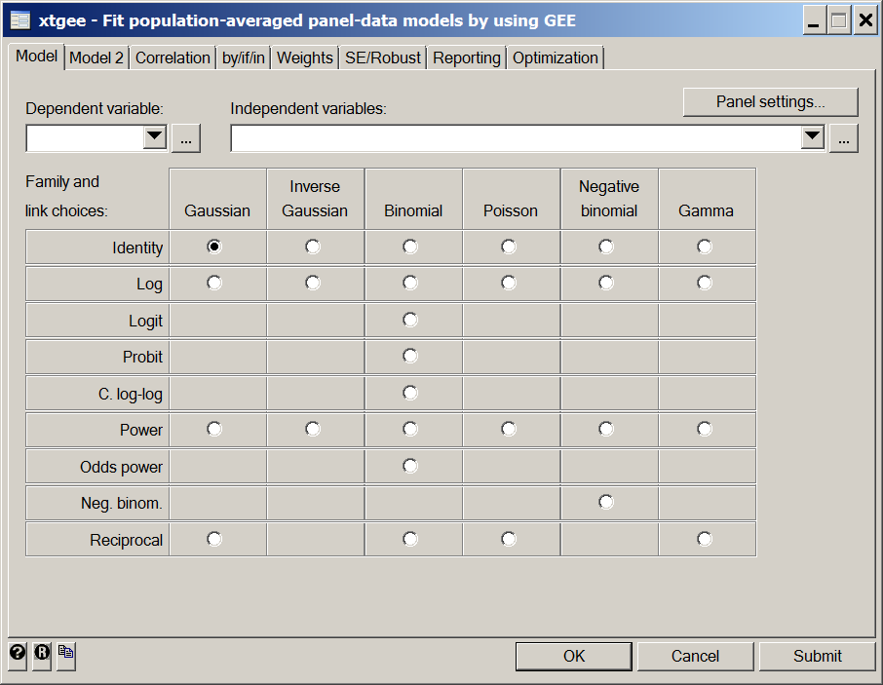
More on xtgee: main menu
Notes:
The menu interface for xtgee in Stata.

Slide 13
More on xtgee
Correlation structure
independent
exchangeable default
ar #
unstructured

Slide 14
Examples
Let’s try this on the birthweight data.
. xtgee bweight birthord initage, family(gaussian) link(identity) corr(exchangeable) i(momid)
. xtgee bweight birthord initage, fam(gau) link(i) corr(exch) i(momid)
. xtgee bweight birthord initage, i(momid)
all give the same output:

Slide 15
Examples
Iteration 1: tolerance = 7.180e-13
GEE population-averaged model Number of obs = 1000
Group variable: momid Number of groups = 200
Link: identity Obs per group: min = 5
Family: Gaussian avg = 5.0
Correlation: exchangeable max = 5
Wald chi2(2) = 30.87
Scale parameter: 324458.3 Prob > chi2 = 0.0000
------------------------------------------------------------------------------
bweight | Coef. Std. Err. z P>|z| [95% Conf. Interval]
---------+--------------------------------------------------------------------
birthord | 46.608 9.944792 4.687 0.000 27.11657 66.09943
initage | 26.73226 8.957553 2.984 0.003 9.175783 44.28874
_cons | 2526.622 162.544 15.544 0.000 2208.042 2845.203

Slide 16
Examples
The command
. xtcorr
Estimated within-momid correlation matrix R:
c1 c2 c3 c4 c5
r1 1.0000
r2 0.3904 1.0000
r3 0.3904 0.3904 1.0000
r4 0.3904 0.3904 0.3904 1.0000
r5 0.3904 0.3904 0.3904 0.3904 1.0000
gives the estimated correlation structure.

Slide 17
Examples: variation I
. xtgee bweight birthord initage, i(momid) corr(uns)
GEE population-averaged model Number of obs = 1000
Group and time vars: momid birthord Number of groups = 200
Link: identity Obs per group: min = 5
Family: Gaussian avg = 5.0
Correlation: unstructured max = 5
Wald chi2(2) = 30.43
Scale parameter: 324495.1 Prob > chi2 = 0.0000
------------------------------------------------------------------------------
bweight | Coef. Std. Err. z P>|z| [95% Conf. Interval]
---------+--------------------------------------------------------------------
birthord | 44.70366 9.935604 4.499 0.000 25.23023 64.17708
initage | 28.07164 8.79559 3.192 0.001 10.83261 45.31068
_cons | 2505.539 159.0359 15.755 0.000 2193.834 2817.243
------------------------------------------------------------------------------
. xtcorr
Estimated within-momid correlation matrix R:
c1 c2 c3 c4 c5
r1 1.0000
r2 0.1905 1.0000
r3 0.2977 0.4714 1.0000
r4 0.2475 0.4326 0.6417 1.0000
r5 0.3641 0.3814 0.4286 0.4487 1.0000
The estimated correlations are a bit different, but the coefficients and SEs have remained almost unchanged

Slide 18
Examples: variation II
. xtgee bweight birthord initage, i(momid) corr(uns) robust
Iteration 1: tolerance = .04763573
Iteration 2: tolerance = .00062083
Iteration 3: tolerance = .00001004
Iteration 4: tolerance = 1.668e-07
GEE population-averaged model Number of obs = 1000
Group and time vars: momid birthord Number of groups = 200
Link: identity Obs per group: min = 5
Family: Gaussian avg = 5.0
Correlation: unstructured max = 5
Wald chi2(2) = 29.05
Scale parameter: 324495.1 Prob > chi2 = 0.0000
(standard errors adjusted for clustering on momid)
------------------------------------------------------------------------------
| Semi-robust
bweight | Coef. Std. Err. z P>|z| [95% Conf. Interval]
---------+--------------------------------------------------------------------
birthord | 44.70366 9.84746 4.540 0.000 25.40299 64.00432
initage | 28.07164 9.141285 3.071 0.002 10.15506 45.98823
_cons | 2505.539 161.11 15.552 0.000 2189.769 2821.308
------------------------------------------------------------------------------
Robust doesn’t change the coefficients, but recalculates the SEs

Slide 19
Robust standard errors
The “robust” option asks Stata to estimate the standard errors empirically from the data. This has the significant advantage that it gives valid standard errors even when the assumed correlation structure is wrong. It is also better than assuming an unstructured variance-covariance structure, because it bypasses the estimation of the correlations over “time” to directly get an estimate of the standard errors.
The robust option works well when there are many “subjects” and not too much data per subject and not much missing data. So, for example, it would work very well when there are 2,000 subjects most measured yearly for four years. It would not work well if the “subjects” were 8 centers in a multi-center trial, each with 1,000 patients enrolled.

Slide 20
Examples: variation III (mixed)
mixed bweight birthord initage || momid:, reml
Mixed-effects REML regression Number of obs = 1000
Group variable: momid Number of groups = 200
Obs per group: min = 5
avg = 5.0
max = 5
Wald chi2(2) = 30.75
Log restricted-likelihood = -7649.3763 Prob > chi2 = 0.0000
------------------------------------------------------------------------------
bweight | Coef. Std. Err. z P>|z| [95% Conf. Interval]
-------------+----------------------------------------------------------------
birthord | 46.608 9.951014 4.68 0.000 27.10437 66.11163
initage | 26.73226 9.002678 2.97 0.003 9.08734 44.37719
_cons | 2526.622 163.3387 15.47 0.000 2206.484 2846.76
------------------------------------------------------------------------------
------------------------------------------------------------------------------
Random-effects Parameters | Estimate Std. Err. [95% Conf. Interval]
-----------------------------+------------------------------------------------
momid: Identity |
sd(_cons) | 358.1759 23.71804 314.5797 407.8139
-----------------------------+------------------------------------------------
sd(Residual) | 445.0229 11.13253 423.7298 467.386
------------------------------------------------------------------------------
LR test vs. linear regression: chibar2(01) = 209.20 Prob >= chibar2 = 0.0000
Notes:
mixed gives additional information. But it does assume that the correlation structure is exchangeable. So gives almost the same answers as xtgee with exch and robust turned off.

Slide 21
Summary
xtgee is a flexible regression command
Handles a single level of clustering
Handles a wide variety of distributions, links and correlation structures
Five questions: distribution, predictors, link, correlation structure, cluster variable
mixed can handle multiple levels for normally distributed data.
GEE methods have the advantage of robust SEs.
Mixed effects models have the advantage of being able to handle more general types of designs and partition variability.

