Slide 1
Methods to improve study accuracy and precision of estimates
2014-2-7
Joel Mefford meffordj@humgen.ucsf.edu

Slide 2
Precision and Statistics
RGL Chapter 10

Slide 3
Example: Validity and Precision
Assume that two people are playing darts, with the goal of getting one’s throws as close as possible to the bull’s-eye.
Player 1’s aim is unbiased (valid), but their darts generally land in the outer regions of the board (imprecise).
Player 2’ aim is biased (invalid), but their darts cluster in a fairly narrow region on the board (precise).
Who wins?

Slide 4
Is it ever better to use a biased estimator that is not valid?

Slide 5
Study Validity & Precision
Systematic error (bias):
  Sources?
  Mitigation?
Random variation (errors)
  Sources?
  Mitigation?

Slide 6
Study Validity & Precision
Systematic error (bias) affects the validity of a study.
  A valid estimate is one that is expected to equal the true parameter value; various biases detract from validity.
  Avoid or adjust-out selection bias and information bias
  Block confounding
  Use models that correspond to data-generating-process
Random variation (errors) reflects a lack of precision (e.g., wide CI).
  Statistical precision = 1 / random variation
  Some study designs and statistical methods may control random variation better than others.

Slide 7
Study Efficiency:
Factors Affecting Study Efficiency:

Slide 8
Study Efficiency:
Factors Affecting Study Efficiency:
“Balance” of design
Comparable numbers of:
Cases and Controls
Exposed and non-Exposed
Observations in various covariate-strata
Completeness/ fraction of missing values
SIZE
Cost-efficiency:
Ease of access to subjects or data
Duration of study
…

Slide 9
Study Size:
Standard errors and confidence intervals generally scale as
1/sqrt(n) for studies of size n.

Slide 10
Dealing with random error
This is where statistics comes into Epidemiology:
P-values
Significance tests
Hypothesis tests
Point estimation
Interval estimation

Slide 11
P-values
Two major types of P-values
  One-sided
    The probability under the test (e.g., null) hypothesis that a corresponding quantity, the test statistic, computed from the data will be equal to or greater than (or less than for lower) the observed value
  Two-sided
    Twice the smaller of the upper and lower P-value
Continuous measure of the compatibility between hypothesis and data.

Slide 12
Misinterpretation of P-values
Common misinterpretations:
  ?

Slide 13
Misinterpretation of P-values
These are all incorrect:
  Probability of a test hypothesis
  Probability of the observed data under the null hypothesis
  Probability that the data would show as strong an association or stronger if the null hypothesis were true.
P-values are calculated from statistical models that generally do not allow for sources of bias except confounding as controlled for via covariates.

Slide 14
Testing
Significance testing
Hypothesis testing

Slide 15
Hypothesis Testing
The hallmark of hypothesis testing involves the use of the alpha (α) level (e.g., 0.05) and an alternative hypothesis.
P-values are commonly misinterpreted as being the alpha level of a statistical hypothesis
An α-level forces a qualitative decision about the rejection of a hypothesis (p < α)
The dominance of hypothesis testing is reflected in the way p-values are reported in the literature, as inequalities
The neatness of a clear-cut result is much more attractive to the investigator, editor, and reader
Should not use statistical significance as the primary criterion to interpret results!

Slide 16
Hypothesis Testing (continued)
Type I error
Type II error
  Power
Type III error?...
Notes:
Power: Over numerous repetitions.
Another example: If you increase the alpha level, then the probability of a Type II error is reduced is if an effect exist between the exposure and the disease. But increases the probability of a Type I error if an effect does not exist.

Slide 17
Hypothesis Testing (continued)
Type I error
  Incorrectly rejecting the null hypothesis
Type II error
  Incorrectly failing to reject the null hypothesis
  Power
    If the null hypothesis is false, the probability of rejecting the null hypothesis is the power of the test
    Pr(Type II error)= 1-Power
A trade-off exist between Type I and Type II error
  Dependent upon the alpha level, and the testing paradigm
  Example: If there is no effect between the exposure and disease, then reducing the alpha level and will decrease the probability of a Type I error. But if an effect does exist between the exposure and disease, then the lower alpha level increases the probability of a Type II error.
Notes:
Power: Over numerous repetitions.
Another example: If you increase the alpha level, then the probability of a Type II error is reduced is if an effect exist between the exposure and the disease. But increases the probability of a Type I error if an effect does not exist.

Slide 18
Statistical Estimation
Most likely the parameter of inference in an epidemiologic study will be measured on a continuous scale
  Point estimate: The measure of the extent of the association, or the magnitude of effect under study (e.g., OR)
  Confidence Interval: a range of parameter values for which the test p-value exceeds a specified alpha level.
  The interval, over unlimited repetitions of the study, that will contain the true parameter with a frequency no less than its confidence level
  Accounts for random error in the estimation process.
Estimation better than testing.
Notes:
Continuous scale: Infinite number of values such as the OR and RR.
Point estimate: A single value on the measurement scale of the parameter. Unlikely the point estimate will equal the true parameter due to confounding, measurement error, selection bias, and random error.
Confidence limits: The endpoints of the confidence interval. The width of the confidence interval depends upon the random variability of the data collection process and the arbitrarily set alpha level.

Slide 19
CI and Significance Tests
The confidence equals the compliment of the alpha level
95% Confidence Interval
90% Confidence Interval
Null Effect
Point Estimate

Slide 20
Over-emphasis on testing?
"It has been widely felt, probably for thirty years and more, that significance tests are overemphasized and often misused and that more emphasis should be put on estimation and prediction.” (Cox 1986)
Why?

Slide 21
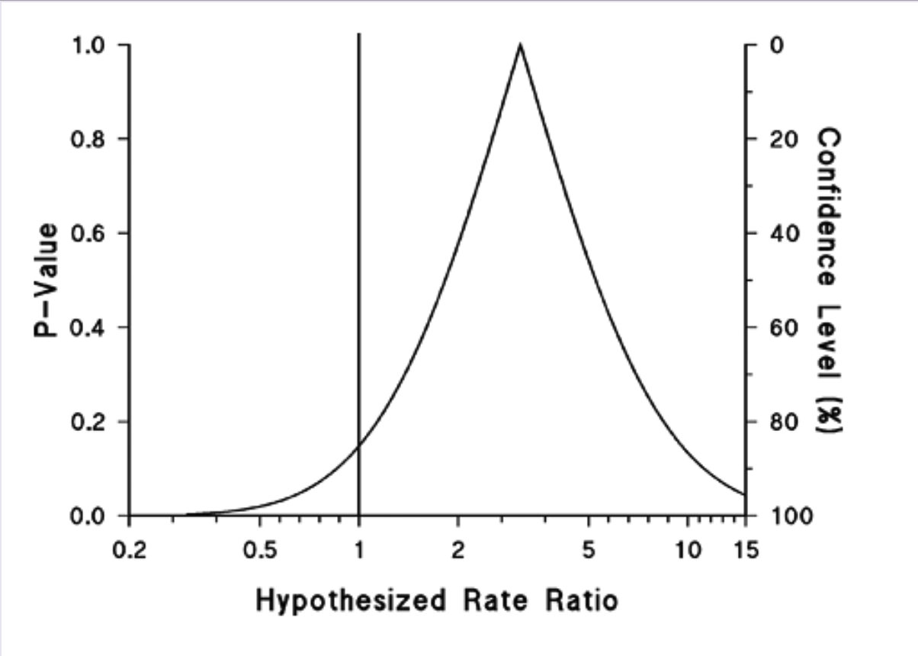
P-value Function
RGL Fig. 10-3

Slide 22
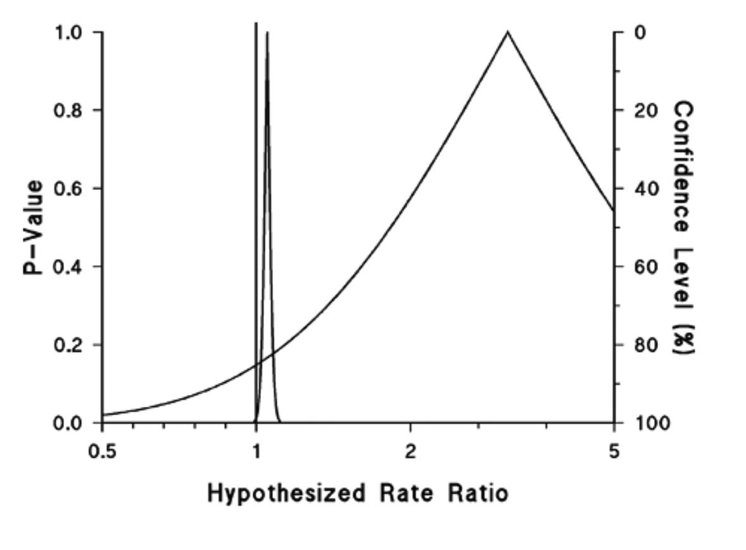
P-value Function
RGL Fig. 10-4

Slide 23
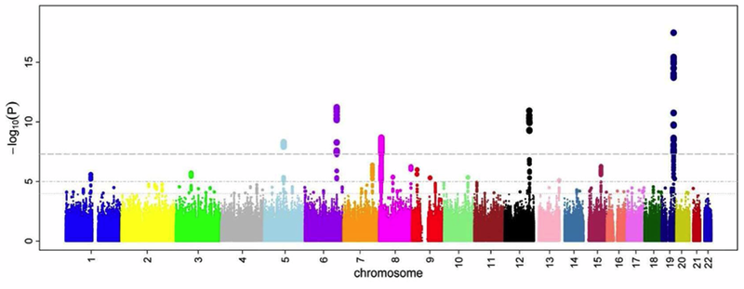
Manhattan plots: genetic epi
Big biology – run huge numbers of tests.
Ikram MK et al (2010) Four Novel Loci (19q13, 6q24, 12q24, and 5q14)
Influence the Microcirculation In Vivo. PLoS Genet. 2010 Oct 28;6(10):e1001184.
doi:10.1371/journal.pgen.1001184.g001

Slide 24
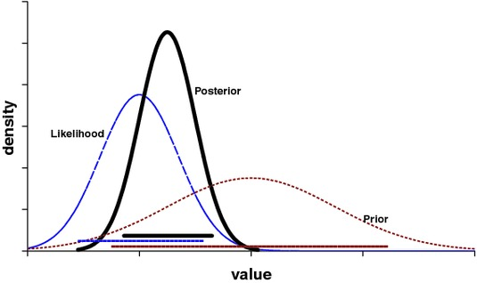
Other intervals … posterior
http://www.springerimages.com/Images/LifeSciences/1-10.1007_s10681-007-9516-1-0

Slide 25
Design Strategies to Improve Study Accuracy
RGL Chapter 11

Slide 26
Improving Study Accuracy
Modify design to control confounding (reduce bias) and / or reduce variance (improve statistical efficiency)
Increase sample size
Experiments / randomization
Restriction
Apportionment Ratios
Matching
Compare efficiency of studies for a given sample size.

Slide 27
1. Increase Sample Size
This will increase precision / power.
Sample size calculations can be somewhat arbitrary.
Need cost-benefit analysis to determine ultimate sample size.
Post-hoc power

Slide 28
2. Experiments / Randomization
What does this achieve?
? Applications to observational studies?
  Treatment completely at random…

Slide 29
2. Experiments / Randomization
Eliminate / reduce confounding by unmeasured factors probabilistically.
Even if one has a small study, can match on known risk factors when randomizing.

Slide 30
3. Restriction
What is restriction?
  How might it improve a study?
  What are potential down-sides?

Slide 31
3. Restriction
Limit who can be included in a study to prevent confounding
Restricts pool of potential participants
While this may decrease generalizability, it may help with validity
If a population is too heterogeneous might not be able to answer any questions.

Slide 32
4. Apportionment of Study Subjects
Try to improve study efficiency by selecting certain proportion of subjects into groups.
Can be based on exposures and disease status.
Common in case-control studies: selecting multiple controls per case.
Maximum efficiency in case-control study is
    n/(m+n) where m=# cases, n=# controls. (Under the null and when no need to stratify)
    1:1 = 50%, 1:2=66%, 1:3=75%, 1:4=80%, 1:5=83%
Most cost-efficient ratio of controls to cases (under null):
  = sqrt (C₁ / C₀), C₁ = cost of case, C₀ = cost of control

Slide 33
Apportionment Ratios to Improve Efficiency
 | Case (D) | Noncase (not D)
Exposed (E) | 15 | 10
Unexposed (not E ) | 5 | 10
OR = 3.0, 95% CI =0.79-11.4
 | Case (D) | Noncase (not D)
Exposed (E) | 15 | 50
Unexposed (not E ) | 5 | 50
OR = 3.0, 95% CI =1.01-8.88
 | Case (D) | Noncase (not D)
Exposed (E) | 15 | 100
Unexposed (not E ) | 5 | 100
OR = 3.0, 95% CI =1.05-8.57

Slide 34
5. Use most appropriate statistics
t-tests and ANOVA vs Wilcoxon Rank Sum and Kruskal Wallis

Slide 35
Power and sample size calculations
Roughly: how and when are these calculations made?
Experiences?

Slide 36
Power and sample size calculations
In a statistical analysis there are 5 factors that jointly determine whether
statistically significant results will be found:
sample size
power
significance level, alpha
effect size
standard error in effect size

Slide 37
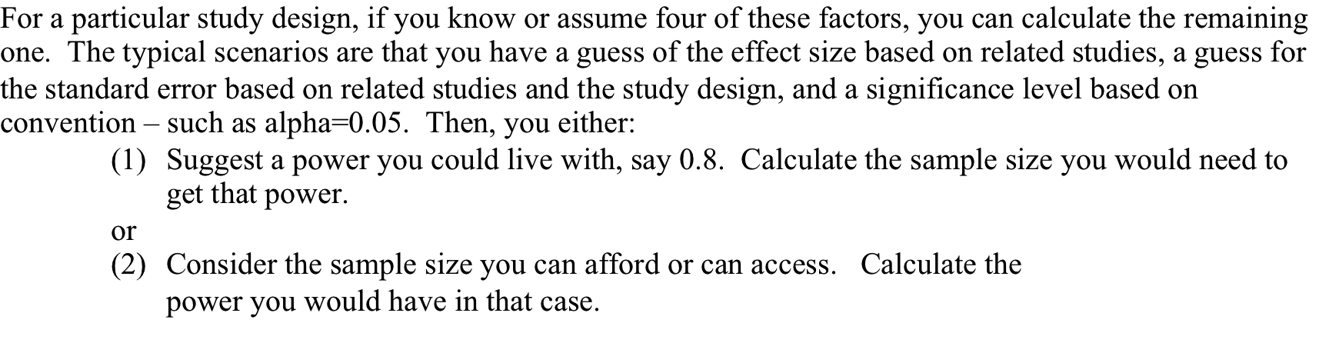
Power and sample size calculations

Slide 38
Power and sample size calculations

Slide 39
Power and sample size calculations

Slide 40
Power and sample size calculations

Slide 41
Power and sample size calculations

Slide 42
Power and sample size calculations

Slide 43
Power and sample size calculations
Design around multiple testing:
2 – stage design

Slide 44
Power and sample size calculations
Design around multiple testing:
2 – stage design
Screen of 20,000 genes:
“genome wide significance” alpha = 2.5e-6
Stage 1: Run tests with a very permissive significance level (alpha = 0.1)
Screen 20000 genes for association with peripheral neuropathy
Move 2000 most significant hits on to phase 2
Stage 2:
Analyze 2000 genes, (greatly enriched for associations)
adjust alpha for 2 thousand tests, not 20 thousand

Slide 45
Post-hoc power calculations
After a study has been conducted, you know some of the quantities you needed
  to guess to do power calculations before the study
  Effect size
  Standard error in effect size
Why not recalculate power using the observed effect size and standard error?

Slide 46
Post-hoc power calculations

Slide 47
6. Matching
What is the key objective in matching?
What types of factors should be matched?

Slide 48
Matching
Exercise:
Make a DAG that explicitly accounts for the matching process:
  E. Exposure
  D. Disease
  C. Matching variable. Assume it is a confounder of the E -> D relationship
  S. Matching (selection) process
What are the consequences of matching for estimation/ testing of
  an E -> D effect

Slide 49
Matching
Exercise:
Make a DAG that explicitly accounts for the matching process:

Slide 50
Matching
Selection of reference series (unexposed, or controls) by making them similar to index subjects on distribution of one or more potential confounders.
This balancing of subjects across matching variables can give more precise estimates of effect with proper analysis.
Key advantage of matching is not to control for confounding (which is done through analysis), but to control for confounding more efficiently!
Matching must be accounted for in one’s analysis:
  In cohort studies matching unexposed to exposed does not introduce a bias, but we should still perform a stratified analysis to enhance precision
  In case-control studies, matching controls to cases on an exposure can introduce selection bias

Slide 51
Matching in Cohort Study
Exposed matched to unexposed
Matching removes confounding by preventing association between matching factor and exposure.
But bias can still exist if matching factor affect disease risk or censoring.
May or may not improve efficiency.

Slide 52
Case-Control Matching Introduces Selection Bias
M
Matching variable
associated with E
?
E
D
By matching on M, we have eliminated any association between M and D in the total sample.
But selection is differential wrt both exposure and disease.
Exposure distribution (E) of controls is now like the cases’.
The controls’ disease risk falsely elevated by the increased prevalence of another risk factor
If M-E not associated, then matching will not lead to bias, but may be inefficient.

Slide 53
Example: Beta-carotene and lung cancer

Slide 54
Types of Matching
Individual – one or more comparison subjects is selected for each index subject (fixed or variable ratio)
Category – select comparison subjects from the same category the index subject belongs to (male, age 35-40)
Frequency – Total comparison group selected to match the joint distribution of one or more matching variables in the comparison group with that of the index group (~category)
Caliper – select comparison subjects to have the same values as that of the index
    Fixed caliper – criteria for eligibility is the same for all matched sets (age ± 2 years)
    Variable caliper – criteria for eligibility varies among the matched sets (select on value closest to index subject, i.e. nearest neighbor)

Slide 55
Appropriate Matching
(Matching factor is a confounder)
?
Exposure
Disease
Matching Factor

Slide 56
Unnecessary Matching:
(Matching factor is unrelated to exposure)
?
Exposure
Disease
Matching Factor

Slide 57
Overmatching
What is overmatching? (Definition or example)

Slide 58
Overmatching
Loss of information due to matching on a factor that’s only associated with exposure (non-confounder). Still need to undertake stratified analysis to address selection bias, but this was unnecessary.
Irreparable selection bias due to matching on factor affected by exposure or disease.

Slide 59
Overmatching:
(Matching factor is associated with exposure)
?
Exposure
Disease
Matching Factor

Slide 60
Overmatching
?
E
D
M

Slide 61
Matching on a Intermediate Variable
Matching
Factor
Exposure
Disease

Slide 62
When to Match?
In conclusion, when might matching be a good strategy?

Slide 63
When to Match?
Decision should reflect cost / benefit tradeoff.
Costs:
  Cannot estimate effect of matching variable on disease.
  May be not cost effective if limits potential study subjects.
  Might overmatch.
Benefits:
  May provide more efficient study and manner to control for potential confounding.
Compare sample sizes needed to obtain a certain level of precision with matching versus no matching (assuming correct analysis)
One should not automatically match!

Slide 64
Extra slides on power calculations in Stata

Slide 65
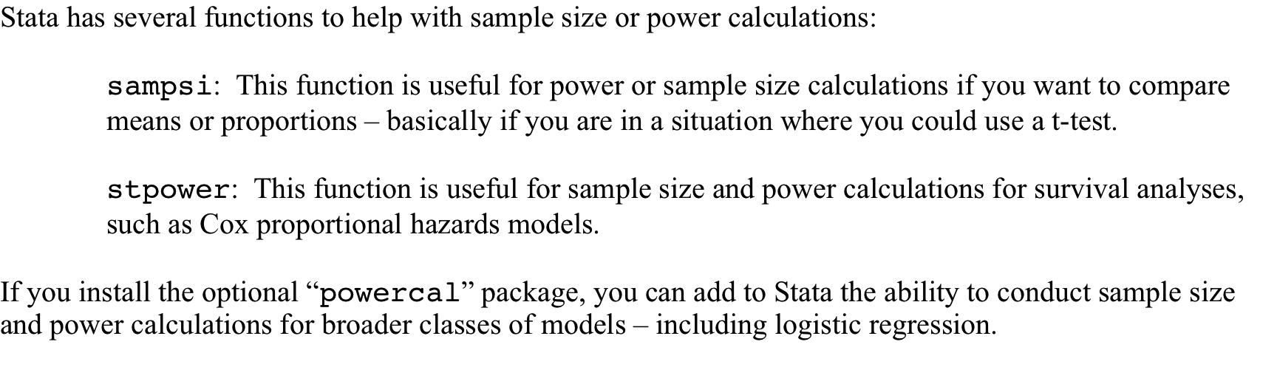
Power and sample size calculations

Slide 66
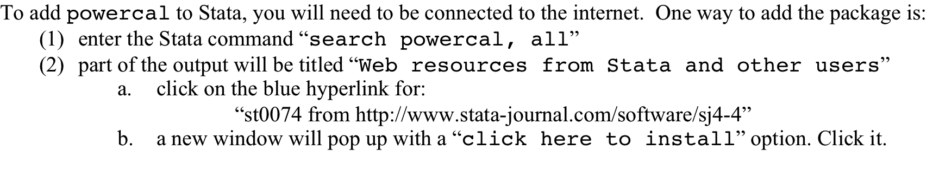
Power and sample size calculations

Slide 67
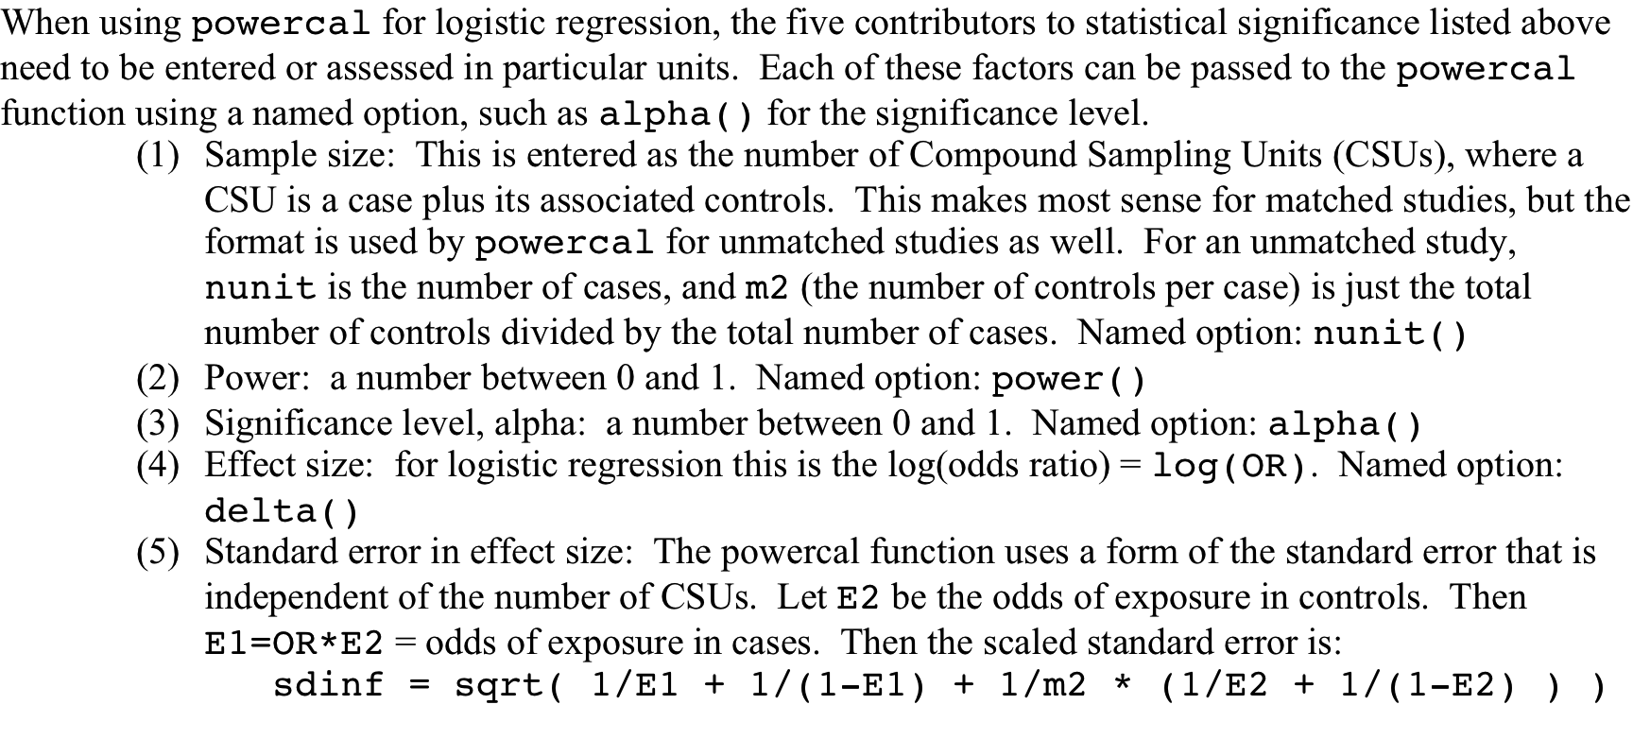
Power and sample size calculations

Slide 68
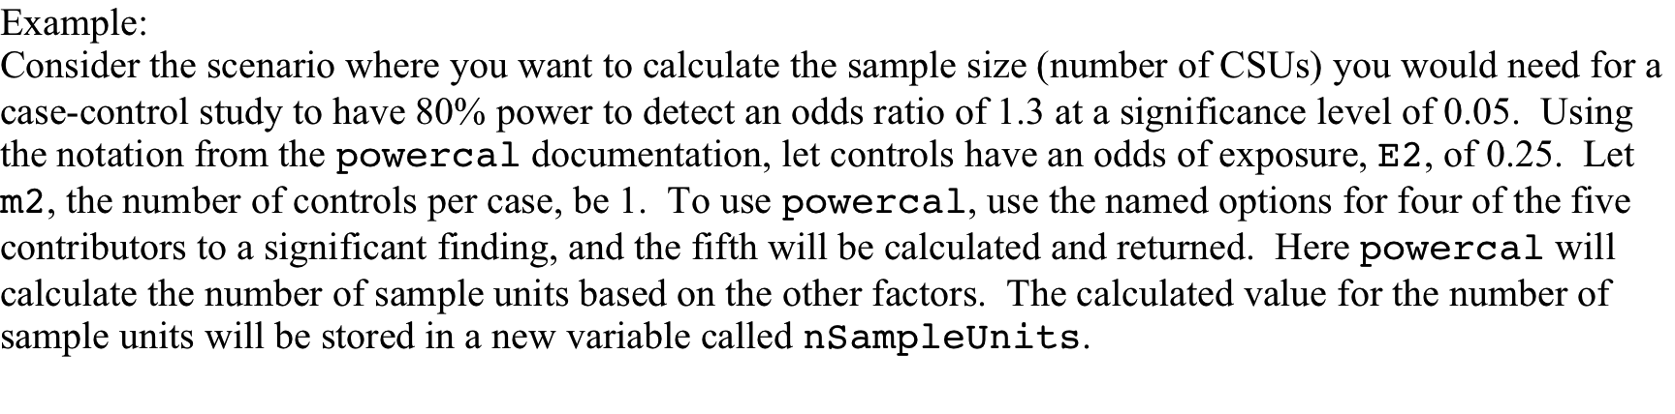
Power and sample size calculations

Slide 69
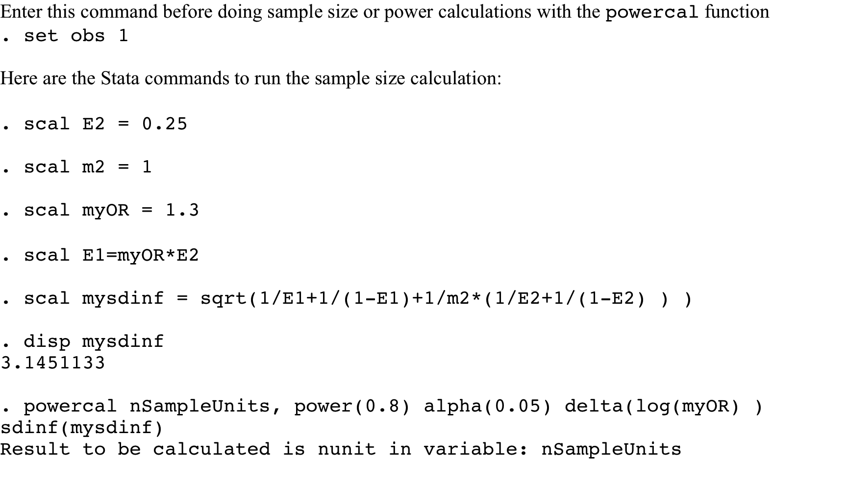
Power and sample size calculations

Slide 70
Power and sample size calculations

Slide 71
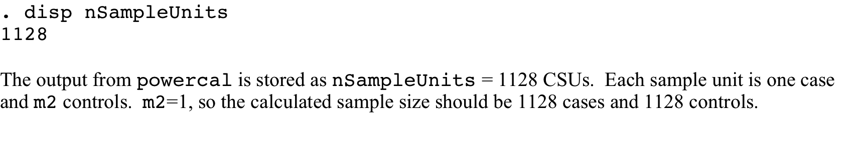
Power and sample size calculations

Slide 72
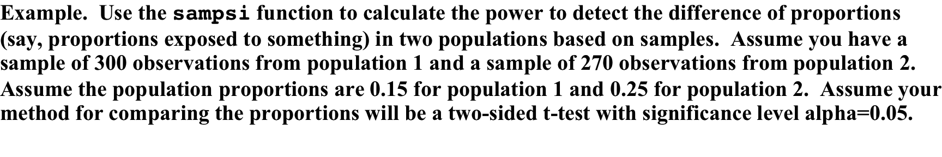
Power and sample size calculations

Slide 73
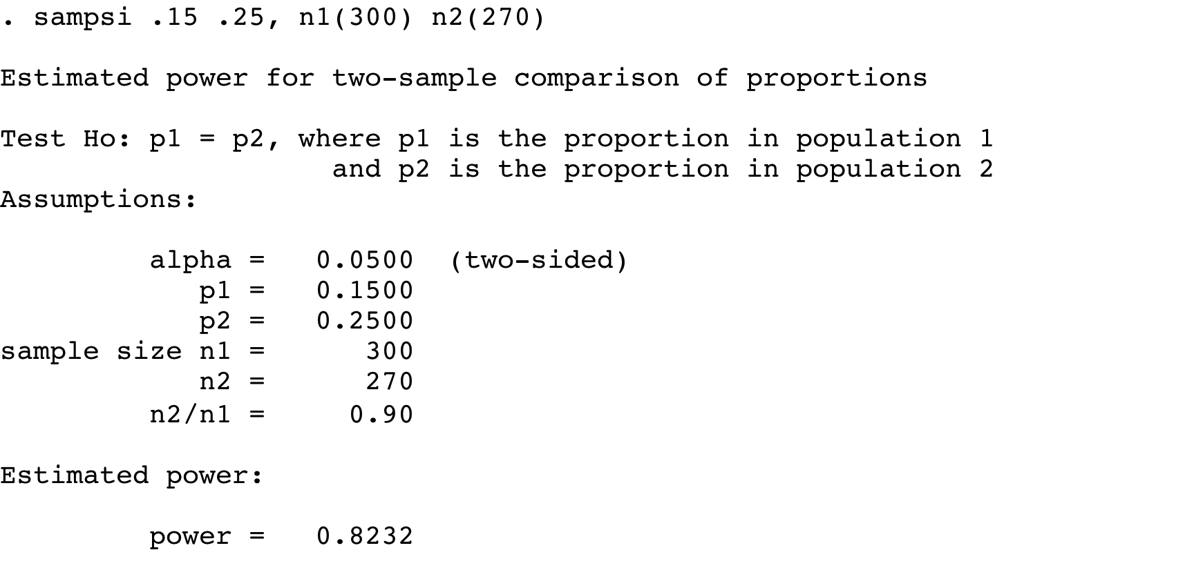
Power and sample size calculations

