Slide 1
Designing Clinical Research
Course Logistics
Mark Pletcher, MD MPH
Dept of Epidemiology and Biostatistics, and Medicine
Recorded 7/9/2020
Notes:
Hello DCR Students, you should have already watched the Course History and Objectives recorded lecture. This will be a brief video focused on Course Logistics.

Slide 2
Course Overview
Weekly schedule
Lectures
Small group discussion sessions
Reading the book
Written assignments
Final project
5-page protocol

Slide 3
Course Overview
Weekly schedule
Lectures
Small group discussion sessions
Reading the book
Written assignments
Final project
5-page protocol
Also:
Syllabus, News posts
Overview of topics
Attendance and grading policy

Slide 4
Weekly schedule – Live sessions
Tuesdays
  9:00-9:45 Zoom office hours, drop-in
  9:45-10:00 Zoom course announcement
  10:00-12:00 Zoom small group sessions
Fridays
  10:00-11:00 Zoom office hours, drop-in
Required

Slide 5
Weekly schedule – Live sessions
Tuesdays
  9:00-9:45 Zoom office hours, drop-in
  9:45-10:00 Zoom course announcement
  10:00-12:00 Zoom small group sessions
Fridays
  10:00-11:00 Zoom office hours, drop-in
Special sessions planned
  Thur 7/23 1:00-2:00 Zotero session
  Fri 7/31 9:00-10:00 Zotero session
Required

Slide 6
Weekly assignments
Readings in Designing Clinical Research
  Several chapters per week
  Optional problem sets
Watch recorded lectures
  Some high quality, some low quality
  Can watch at 1.5x speed
Written assignments
  Will build towards the 5-page Final Project
Other miscellaneous items

Slide 7
Weekly assignments
Written assignments
  Bring draft to Tuesday small group session
  Turn in by Wednesday at midnight
  Back from your small group leader by ~Friday evening

Slide 8
Weekly assignments
Written assignments
  Bring draft to Tuesday small group session
  Turn in by Wednesday at midnight
  Back from your small group leader by ~Friday evening
Please comply with guidelines
  File-naming conventions, etc
  See Guidelines in syllabus

Slide 9
Weekly assignments
Written assignments
  Bring draft to Tuesday small group session
  Turn in by Wednesday at midnight
  Back from your small group leader by ~Friday evening
Please comply with guidelines
  File-naming conventions, etc
  See Guidelines in syllabus
Weekly assignments will be in Syllabus

Slide 10
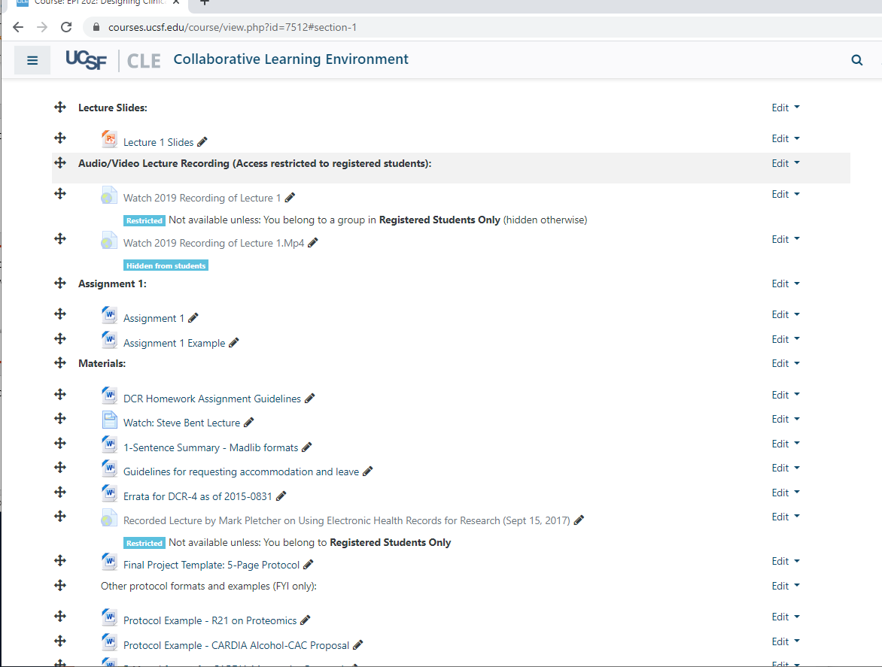
Syllabus Orientation

Slide 11
Overview of lecture topics
 | Lecture title | Lecturer
1 | Introduction to the Course, Clinical Research, and Research Questions | Mark Pletcher
2 | Subjects and Variables | Tom Newman
3 | Sample size, P-values and Confidence Intervals | Steve Cummings
4 | Observational Designs and Studies of Diagnostic Tests | Warren Browner
5 | Causal Inference and Randomized Trials | Deborah Grady
6 | Questionnaires, Data Collection Forms and Data management | Michael Kohn
7 | (Various) | (Various)

Slide 12
Overview of written assignments
DCR-4 Reading | Written Assignments
Chapters 1 and 2 | 1-sentence Research Question Significance section with references
Chapters 3 and 4 | 1-page protocol outline Flesh out Study Subjects section
Chapters 5 and 6 | 1) Sample size justification
Chapters 7,8 and 12 or 13 | Flesh out Study Design and Measurements 2nd 1-page protocol outline
Chapters 9-11 | 1) Flesh out a) Confounder approach; b) Randomization/Blinding approach; c) Gold standard/Test eval approach
Chapters 12 or 13, and 15 and 16 | 1-page data collection form excerpt (or critique of one?) Data dictionary Data collection/management plan
 | Final Project

Slide 13
Small Group Sessions
Heterogeneous student backgrounds
  The methods are universal!
  Learn from each other
  Learn by critiquing (constructively, of course)
Attendance is critical
Outstanding set of Small Group Leaders
  Affiliated faculty, practicing researchers, former trainees

Slide 14
Small Group Sessions
Using Zoom for small groups
  Zoom info in calendar invites and in Forum
  Turn your video on, please!
  Breakout groups planned
  Be prepared to share your screen
  Google doc use also planned
  Feedback please! We want to optimize these sessions.

Slide 15
Small Group Sessions
Small Group Leaders
Ben Breyer
Laura Jelliffe
Megie Okumura
Joel Simon
Ali Mirzazadeh
Pam Murnane
Catie Oldenburg
Erin van Blarigan
Yeyi Zhu
Jennifer Smith
Sunitha Kaiser

Slide 16
Small Group Sessions
Small Group Leaders
Ben Breyer
Laura Jelliffe
Megie Okumura
Joel Simon
Ali Mirzazadeh
Pam Murnane
Catie Oldenburg
Erin van Blarigan
Yeyi Zhu
Jennifer Smith
Sunitha Kaiser
See DCR Roster 2020 link on the website for your Small Group Assignment

Slide 17
Final Project
Develop over 7 weeks of course
Template and examples provided in syllabus
Feedback along the way from Small Group Leader and colleagues
Due Monday Sept 14th 2020 at 5 pm

Slide 18
Grading
To get an “A” in the course:
  Excellent attendance (body and mind)
    1 excused absence is allowed
  No missing homework
  Very high quality Final Project

Slide 19
Course Logistics
Agnes Ng (briefly) and Atul Sharma
  Enrollment issues, email changes, logistics, website/syllabus issues, Zoom support for online Small Group
  Agnes.Ng@ucsf.edu
  Atul.Sharma2@ucsf.edu, 510-375-3630
Clair Dunne (backup)
  Copy Clair on any issues that may need immediate attention or you are unable to reach Agnes
  Clair.Dunne@ucsf.edu

Slide 20
Course Logistics
Zotero class (citation management software) at the Parnassus library this Friday
  This Friday, July 31, at 9am
  Zoom link is in your syllabus

Slide 21
Course Logistics
Please provide feedback!

