Slide 1
Designing Clinical Research
Physiology and Anatomy of Clinical Research
Mark Pletcher, MD MPH
Dept of Epidemiology and Biostatistics, and Medicine
Recorded July 8, 2020
Notes:
Good morning. This is Lecture 1 of Designing Clinical Research. You should have already watched short introductory lectures on History and Course Objectives, and on Course Logistics; this is the first content lecture.

Slide 2
Physiology and Anatomy of Clinical Research
Physiology: How it works
Anatomy: What are the parts
Notes:
Today we’ll be discussing the Physiology of research – how it works – and the Anatomy of research – really that means what are the parts of a good research plan.

Slide 3
Physiology and Anatomy of Clinical Research
Physiology: How it works
Anatomy: What are the parts
Choosing a good research question
Choosing a basic study design
Feasibility vs. importance
Examples

Slide 4
Physiology of Clinical Research
How does research work?

Slide 5
The Human Subjects Research Cycle, v1
Current Understanding of the World
Question
Analyze and Interpret
Study Design
Do the Study
Notes:
The basic process of research is cyclical. We start with current understanding about how the world works; we all know there are gaps in that understanding, which leads one to ask questions; those questions can potentially be answered by conducting research studies, which we need to design, the implement, and the analyze and interpret; that interpretation then hopefully refines our current understanding of the world…but there are always more questions, and the cycle continues.
But what does it really mean to “Do the Study”? Let’s expand this research cycle diagram just a bit.

Slide 6
The Human Subjects Research Cycle, v2
Current Understanding of the World
Question
Analyze and Interpret
Study Design
Measure
Sample
Notes:
Doing human subjects research really comes down to 2 basic processes: Drawing a sample from a population, and then making measurements in that sample.
These two processes are where things can and always do go wrong! As I emphasized in our Course Objectives lecture, research is always flawed in various ways because it must occur in the real world where there is noise, random error, mistakes, etc.
Good study design helps minimize flaws in sampling, and flaws in measurement, and helps to produce results that maximize production of new knowledge.

Slide 7
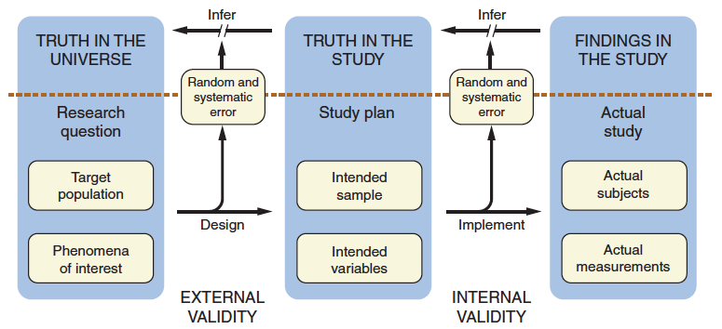
The Human Subjects Research Cycle, v3

Slide 8
DCR-4 Figure 1.4
Notes:
I like to use this slightly modified version of Figure 1.4.

Slide 9
DCR-4 Figure 1.4, modified
Accessible population
Generalizability
and
Interpretation
Notes:
I like to use this slightly modified version of Figure 1.4.

Slide 10
DCR-4 Figure 1.4, modified
Accessible population
Generalizability
and
Interpretation
Goal: Use actual measurements in an actual sample to draw inferences about phenomena in a population
Notes:
Our basic goal here is to…
This somewhat complex figure helps breakdown that process into a series of step

Slide 11
DCR-4 Figure 1.4
Accessible population
Generalizability
and
Interpretation
Step 1) Define specifically what you want to know

Slide 12
DCR-4 Figure 1.4
Accessible population
Generalizability
and
Interpretation
Step 2) Design a feasible plan to access a relevant sample of participants and make the required measurements

Slide 13
DCR-4 Figure 1.4
Accessible population
Generalizability
and
Interpretation
Step 3) Implement the plan, recruit the intended study subjects, and get accurate and precise measurements

Slide 14
DCR-4 Figure 1.4
Accessible population
Generalizability
and
Interpretation
Good design reduces random and systematic error, and allows better inference

Slide 15
DCR-4 Figure 1.4
Accessible population
Generalizability
and
Interpretation
Internal validity

Slide 16
DCR-4 Figure 1.4
Accessible population
Generalizability
and
Interpretation
External validity

Slide 17
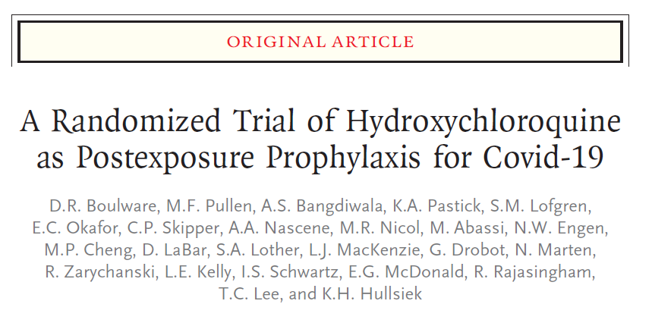
Example
Boulware et al, NEJM 2020 PMID 32492293

Slide 18
DCR-4 Figure 1.4
Accessible population
Generalizability
and
Interpretation
Recently exposed to COVID-19
Does HCQ prevent infection
Step 1) Define specifically what you want to know

Slide 19
DCR-4 Figure 1.4
Accessible population
Generalizability
and
Interpretation
Recently exposed to COVID-19
Accessible by social media
Does HCQ prevent infection
Lab-confirmed or self-reported illness like COVID19
Step 2) Design a feasible plan to access a relevant sample of participants and make the required measurements

Slide 20
DCR-4 Figure 1.4
Accessible population
Generalizability
and
Interpretation
Recently exposed to COVID-19
Accessible by social media
66% health worker, 12% HTN
Does HCQ prevent infection
Lab-confirmed or self-reported illness like COVID19
12% vs 14% (mostly self-reported illness, 10% lost to f/u)
Step 3) Implement the plan, recruit the intended study subjects, and get accurate and precise measurements

Slide 21
DCR-4 Figure 1.4
Accessible population
Generalizability
and
Interpretation
Recently exposed to COVID-19
Accessible by social media
66% health worker, 12% HTN
Does HCQ prevent infection
Lab-confirmed or self-reported illness like COVID19
12% vs 14% (mostly self-reported illness, 10% lost to f/u)
Internal validity issue: 10% lost to follow-up, etc.

Slide 22
DCR-4 Figure 1.4
Accessible population
Generalizability
and
Interpretation
Recently exposed to COVID-19
Accessible by social media
66% health worker, 12% HTN
Does HCQ prevent infection
Lab-confirmed or self-reported illness like COVID19
12% vs 14% (mostly self-reported illness, 10% lost to f/u)
External validity issues: Healthcare workers on social media all we care about? Mostly self-reported illness?

Slide 23
Anatomy of a Research Plan
What are the parts?

Slide 24
Anatomy of a Research Plan
Research question(s)
Background and significance
Study design
Sample
Measurements
  Exposure(s)
  Outcome(s)
Statistical issues
  Sample size justification
Implementation plans, Ethics, Data management, etc

Slide 25
Anatomy of a Research Plan
3 versions we use in DCR:
  1-Sentence Summary
  1-Page Outline
  5-Page Protocol
Notes:
Just like there are many versions of the Research Cycle, there are also many versions of a research plan…

Slide 26
Anatomy of a Research Plan
3 versions we use in DCR:
  1-Sentence Summary
  1-Page Outline
  5-Page Protocol
Other examples
    Grant application*
    Methods section for a publication
    ClinicalTrials.gov submission*
    Manuscript proposal for analysis of existing study data*
    UCSF IRB’s Protocol for a Clinical Trial*
    Operations Manual
* - Example files on the CLE Syllabus

Slide 27
Anatomy of a Research Plan
1-Sentence Summary example:
  The Prevention of Premature Atherosclerosis in Young Adults (POPAYA) Trial is a randomized controlled trial designed to estimate the effect of 10 mg atorvastatin for 5 years versus placebo on coronary calcification in young adults age 30-40 with LDL 130-190 mg/dl

Slide 28
Anatomy of a Research Plan
NAME of the study
1-Sentence Summary example:
  The Prevention of Premature Atherosclerosis in Young Adults (POPAYA) Trial is a randomized controlled trial designed to estimate the effect of 10 mg atorvastatin for 5 years versus placebo on coronary calcification in young adults age 30-40 with LDL 130-190 mg/dl

Slide 29
Anatomy of a Research Plan
DESIGN of the study
1-Sentence Summary example:
  The Prevention of Premature Atherosclerosis in Young Adults (POPAYA) Trial is a randomized controlled trial designed to estimate the effect of 10 mg atorvastatin for 5 years versus placebo on coronary calcification in young adults age 30-40 with LDL 130-190 mg/dl

Slide 30
Anatomy of a Research Plan
Primary EXPOSURE variable
1-Sentence Summary example:
  The Prevention of Premature Atherosclerosis in Young Adults (POPAYA) Trial is a randomized controlled trial designed to estimate the effect of 10 mg atorvastatin for 5 years versus placebo on coronary calcification in young adults age 30-40 with LDL 130-190 mg/dl

Slide 31
Anatomy of a Research Plan
Primary OUTCOME variable
1-Sentence Summary example:
  The Prevention of Premature Atherosclerosis in Young Adults (POPAYA) Trial is a randomized controlled trial designed to estimate the effect of 10 mg atorvastatin for 5 years versus placebo on coronary calcification in young adults age 30-40 with LDL 130-190 mg/dl

Slide 32
Anatomy of a Research Plan
Study population
1-Sentence Summary example:
  The Prevention of Premature Atherosclerosis in Young Adults (POPAYA) Trial is a randomized controlled trial designed to estimate the effect of 10 mg atorvastatin for 5 years versus placebo on coronary calcification in young adults age 30-40 with LDL 130-190 mg/dl

Slide 33
Anatomy of a Research Plan
1-Sentence Summary “Formula”
for trials:
  The [study name] is a [study design] designed to estimate the effect of [intervention] versus [comparator] on [outcome] in [study sample]
for observational studies:
  The [study name] is a [study design] designed to examine the association between [primary exposure] and [outcome] in [study sample]
There are extremely important advantages to fitting into this framework (e.g., power calculations)

Slide 34
Anatomy of a Research Plan
1-Sentence Summary “Formula”
for trials:
  The [study name] is a [study design] designed to estimate the effect of [intervention] versus [comparator] on [outcome] in [study sample]
for observational studies:
  The [study name] is a [study design] designed to examine the association between [primary exposure] and [outcome] in [study sample]
Take a moment to try this for the NEJM article…

Slide 35
Anatomy of a Research Plan
1-Sentence Summary “Formula”
for trials:
  This study is a randomized controlled trial designed to estimate the effect of Hydroxychloroquine for 5 days (800 then 600) versus placebo on lab-confirmed COVID 19 or self-reported illness similar to COVID 19 in persons reporting recent serious exposure to a person with confirmed COVID 19 infection recruited via social media.

Slide 36
Choosing a research question
Current Understanding of the World
Question
What would you like to know?
Where are the important gaps and feasible opportunities?
Analyze and Interpret
Study Design
Measure
Sample
Notes:
OK, we’re going to switch gears now and talk about choosing a research question.

Slide 37
Choosing a research question
The FINER Criteria
Feasible
Interesting
Novel
Ethical
Relevant

Slide 38
Choosing a research question
The FINGER Criteria
Feasible
Interesting
Novel
Good for your career
Ethical
Relevant

Slide 39
Choosing a research question
For this course:
  Primary data collection vs.
  Secondary data analysis

Slide 40
Choosing a research question
For this course:
  “Non-traditional” DCR research types
  Qualitative research
  Data synthesis like decision analysis, cost-effectiveness analysis, meta-analysis
  Animals/molecules without humans
  Many concepts still apply, but need to modify instructions…

Slide 41
Choosing a research question
For this course:
  Bottom line recommendations:
  Design at least 1 study with primary data collection
  Design at least 1 study you plan to do (near-term feasibility)
  Do at least a 1-page outline for both
  You can decide later which to use for Final Project

Slide 42
Choosing a study design
Choosing a study DESIGN is hard too…

Slide 43
Choosing a study design
4 classic designs
Randomized controlled trial
  INTERVENTION (with random assignment to control)
Cross-sectional study
  Take a look at a given population (sample) right now
Cohort study
  Choose a sample and follow over time
Case-control study
  Choose two samples (cases and controls) with and without the outcome, compare exposures

Slide 44
Choosing a study design
You will learn more during the course…
  Lecture 1d: Study Design Basics
  DCR-4
    Chapters 7-13
  Lectures 4 and 5
  Discuss throughout course in Small Group Sessions
  “Try out” alternative designs in your homework
  Our Training in Clinical Research Program
    1-year program: Advanced Training in Clinical Research (ATCR)
    2-year program: Masters of Advanced Science (MAS degree)
    Doctoral Program in Epidemiology and Translational Science (PhD)

Slide 45
Examples from my own research
Three different studies
  VEST
  COVID-19 Citizen Science
  POPAYA

Slide 46
VEST
The Vest prevention of Early Sudden death Trial (VEST)
  Rationale:
    500,000 sudden deaths in US/year
    High risk in low ejection fraction patients immediately post-MI
    Implantable defibrillators work, but NOT immediately post-MI
      First 2-3 months RCTs have shown no benefit and possible harm
    Could a wearable defibrillator provide “gap” protection during those 2-3 months?

Slide 47
VEST
Here’s our plan: Find immediately post-MI patients with EF < 35%, randomize 2:1 to LifeVest or usual care, follow for 3 months, primary outcome sudden death
Fill in the 1-sentence summary:
  [study name] is a [study design] designed to estimate the effect of [intervention] compared with [control] on [outcome] in [study sample].

Slide 48
VEST
Here’s our plan: Find immediately post-MI patients with EF < 35%, randomize 2:1 to LifeVest or usual care, follow for 3 months, primary outcome sudden death
ANSWER:
  VEST is a randomized controlled trial designed to estimate the effect of a wearable LifeVest defibrillator compared with usual care on sudden death in immediately post-MI patients with low ejection fraction (<35%).

Slide 49
VEST
Challenges from intrusion of the real world...
  All-cause mortality is a better outcome, but much larger sample size required according to power calcs
  MUCH harder than anticipated finding study subjects
  During study enrollment, LifeVest became de facto standard of care in some communities

Slide 50
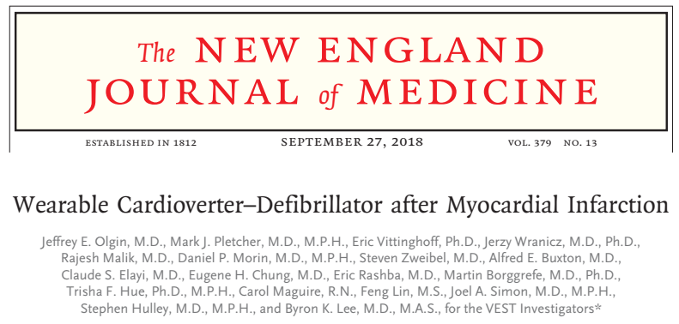
VEST
Results published in 2018

Slide 51
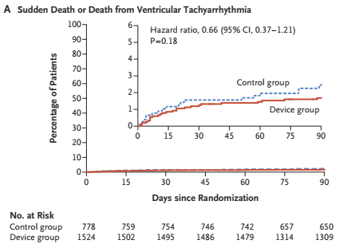
VEST

Slide 52
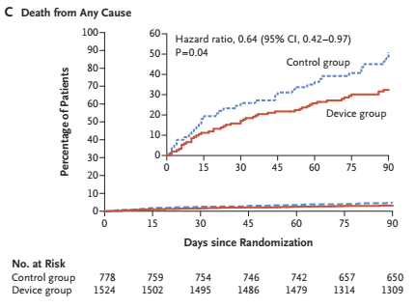
VEST

Slide 53
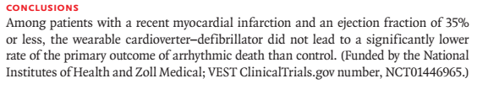
VEST
Summary
  Unanticipated and challenging results!
    Did we get the mechanism wrong?
    Was our total mortality finding due to chance?
  Study operations are challenging and fascinating…

Slide 54
COVID-19 Citizen Science
Can we find people with symptoms before they get diagnosed?
  Syndromic surveillance
How well are people adhering to behaviors like hand-washing and social distancing?
Do those behaviors actually prevent infection?
What is the impact of shelter-in-place on mental health and economic hardship?

Slide 55
COVID-19 Citizen Science
Invite ANYONE to sign up and download study app
Daily symptom data
Weekly behavior data
Self-reported testing, results, anxiety, etc
22,000 recruited thus far
1-sentence summary?

Slide 56
COVID-19 Citizen Science
Invite ANYONE to sign up and download study app
Daily symptom data
Weekly behavior data
Self-reported testing, results, anxiety, etc
20,000 recruited thus far
1-sentence summary?
I have not actually specified a research question!

Slide 57
COVID-19 Citizen Science
Here’s one:
  CCS is a observational cohort study designed to estimate the association between hand-washing > 5x/day compared with hand-washing less frequently during the past 2 weeks and self-reported fever, chills or high temperature in COVID-19 Citizen Scientist volunteer participants without previous evidence of infection.

Slide 58
COVID-19 Citizen Science
Exciting new study
Critical weakness is…

Slide 59
COVID-19 Citizen Science
Exciting new study
Critical weakness is…completely self-selected patient sample! What is the target population that it represents? Highly skewed towards highly-educated and non-Hispanic whites…
We’re looking for funding to do more deliberate population-based sampling!

Slide 60
CVD risk factor Tx in young adults
Does treatment of high cholesterol during young adulthood improve cardiovascular health?
Rationale:
  Atherosclerosis starts during young adulthood or earlier
  Cumulative exposure to LDL associated with:
    Coronary calcification
    Coronary heart disease events
  We treat high blood pressure >140 early in life, why not high cholesterol?

Slide 61
CVD risk factor Tx in young adults
Does treatment of high cholesterol during young adulthood improve cardiovascular health?
Study Design #1: POPAYA
  The Prevention of Premature Atherosclerosis in Young Adults (POPAYA) Trial is a randomized controlled trial designed to estimate the effect of 10 mg atorvastatin for 5 years versus placebo on coronary calcification in young adults age 30-40 with LDL 130-190 mg/dl

Slide 62
Study Design: Importance vs. Feasibility
Must be very clever…
Importance
Don’t bother
Usual tradeoff zone
0 --
Don’t bother
|
0
Feasibility

Slide 63
Study Design: Importance vs. Feasibility
How could we increase importance?
Importance
POPAYA
Don’t bother
0 --
Don’t bother
|
0
Feasibility

Slide 64
CVD risk factor Tx in young adults
Study Design #2: RCT→Events
This is a randomized controlled trial designed to estimate the effect of 10 mg atorvastatin versus placebo for 20+ years on coronary heart disease events after initiation of therapy in young adults age 30-40 with LDL 130-190 mg/dl

Slide 65
Study Design: Importance vs. Feasibility
What would be more feasible?
Any opportunities for “cleverness”?
RCT→Events
Importance
POPAYA
Don’t bother
0 --
Don’t bother
|
0
Feasibility

Slide 66
Study Design: Importance vs. Feasibility
What would be more feasible?
Any opportunities for “cleverness”?
Think through design options…
RCT→Events
Importance
POPAYA
Don’t bother
0 --
Don’t bother
|
0
Feasibility

Slide 67
CVD risk factor Tx in young adults
Study Design Option #3: Cross-sectional
This is a cross-sectional study designed to examine the association between statins and coronary calcification in young adults with high cholesterol undergoing a coronary calcium scan.

Slide 68
Study Design: Importance vs. Feasibility
How do increase importance?
What would be more feasible?
Any opportunities for “cleverness”?
RCT→Events
Importance
POPAYA
Don’t bother
X-sectional
0 --
Don’t bother
|
0
Feasibility

Slide 69
CVD risk factor Tx in young adults
Study Design Option #4: Cohort Study
This is a retrospective cohort study designed to examine the association between statin therapy started during young adulthood and coronary heart disease events in young adults with high cholesterol.

Slide 70
Study Design: Importance vs. Feasibility
How do increase importance?
What would be more feasible?
Any opportunities for “cleverness”?
RCT→Events
Importance
POPAYA
Don’t bother
Cohort
X-sectional
0 --
Don’t bother
|
0
Feasibility

Slide 71
CVD risk factor Tx in young adults
Study Design Option #5: Case-Control Study
The Statin Duration Study is a case-control study designed to examine the association between self-reported prior duration of statin therapy and coronary heart disease events in adults with and without coronary heart disease events on a statin and matched on age and estimated pre-statin LDL levels and CHD risk.

Slide 72
Study Design: Importance vs. Feasibility
How do increase importance?
What would be more feasible?
Any opportunities for “cleverness”?
RCT→Events
Importance
POPAYA
Don’t bother
Case-control
Cohort
X-sectional
0 --
Don’t bother
|
0
Feasibility

Slide 73
Study Design: Importance vs. Feasibility
Focus in on feasible studies with reasonable “value”
RCT→Events
Importance
POPAYA
Don’t bother
Case-control
Cohort
X-sectional
0 --
Don’t bother
|
0
Feasibility

Slide 74
Summary
Human research
  Take a sample from population
  Make measurements in the sample
Research happens in the real world
  Every study is flawed
  Good design is critical to minimize and maximize inference
Practical advice
  Design a study you want to actually do
  Design multiple studies

