Slide 1
Biostat 202: Opportunities and Challenges of “Big Data”:
Machine Learning 1:
Introduction & Regression
Aaron Wolfe Scheffler
Division of Biostatistics
Department of Epidemiology and Biostatistics

Slide 2

Goal: Use machine learning algorithms for the purpose of prediction or identifying patterns in data
Case study: dataset from a heart disease study, want to predict systolic blood pressure
1. Data
2. Train/fit model
3. Output
4. Interpret
Prediction
Dimension Reduction
Clustering
Algorithm(s)
= INFORMATION?
Pop quiz: Do machine learning/data mining techniques generate information?

Slide 3
Overview of machine learning (ML) lectures
ML Lecture 1: Introduction to ML and supervised learning [regression]
  Machine learning/data mining “definition”
  Structured vs unstructured data
  Supervised vs unsupervised machine learning
  Linear regression
  Validation
ML Lecture 2: Supervised learning [classification]
  Introduction to classification/evaluating classifiers
  Validation continued
  Logistic regression
ML Lecture 3: Supervised learning, continued [classification]
  Classification, continued: K nearest neighbors, decision trees, support vector machines, neural networks
  Cross validation
  Combining models: boosting, bagging, deep learning
ML Lecture 4: Unsupervised learning [clustering/dimension reduction]
  Clustering
  Data reduction and PCA
Orange throughout

Slide 4
Overview of this lecture
Machine learning/data mining “definition”
Structured vs unstructured data
Supervised vs unsupervised machine learning
Linear regression
Validation (central to evaluating predictions)

Slide 5
Pop quiz: name that data!
Blood glucose levels
MRI/X-ray image
Census data
Physician notes
Electronic medical records

Slide 6
Pop quiz: name that data!
Blood glucose levels (structured)
MRI/X-ray image (unstructured)
Census data (structured)
Physician notes (unstructured)
Electronic medical records (both!)

Slide 7
Supervised vs unsupervised
Machine Learning
Supervised
Regression (continuous outcome)
Classification (categorical outcome)
Unsupervised
Clustering
(grouping observations)
Data Reduction (transforming variables)

Slide 8
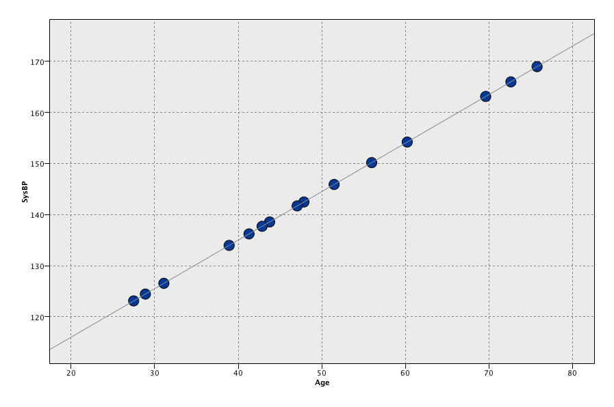


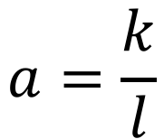



Fitting linear regression
$$y$$
slope
$$a=\frac{k}{l}$$
SysBP
$$k$$
intercept
$$l$$
$$c$$
Age = 0
Age
$$x$$

Slide 9
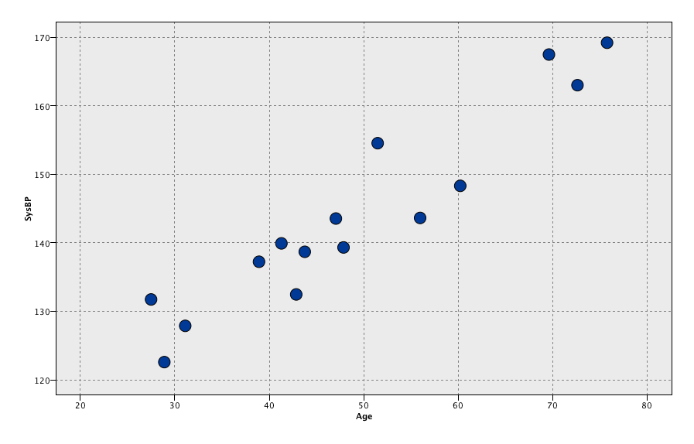
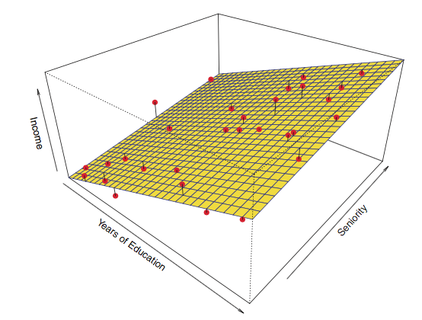

Model selection
Want to find “true” predictive patterns in the data
Want to avoid overfitting spurious detail – do not confuse noise for signal
Solution – independent validation – reserve some data that has not been used in model fitting for the purpose of model evaluation and comparison.
Nonlinear trends
Many predictors

Slide 10
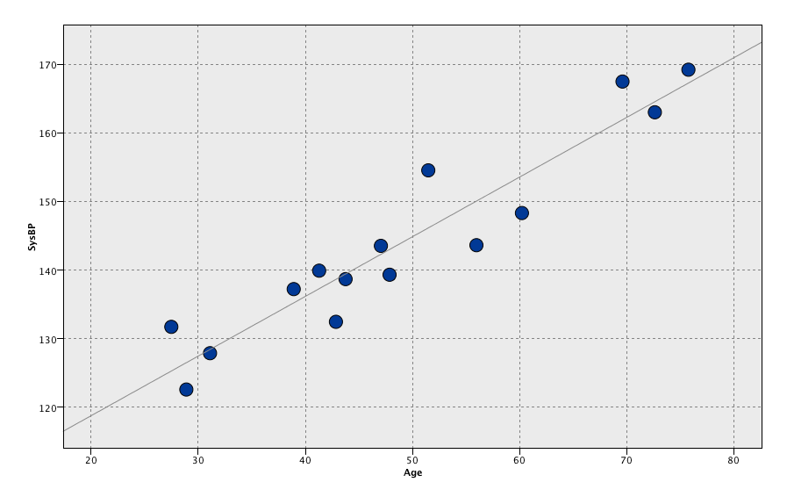
Training/Test
Training set (2/3)
Data
Build regression model
Evaluate predictions
Testing set (1/3)
Evaluate predictions

Slide 11
Simulation of overfitting

Slide 12
Evaluation metrics for continuous predictions
Linear correlation^2 (r^2) – square of correlation coefficient between the observed target values and predicted target values
Mean absolute error (MAE) -- the average absolute deviation between observed target values and predicted target values
observed
predicted
0

Slide 13
Case study – Heart data
  Data:
    n = 303
    14 attributes
  Target:
    SysBp: systolic blood pressure
  Predictors:
    Age: age (years)
    Sex: gender
    ChestPain: chest pain type
    Chol: cholesterol
    Fbs: fasting blood sugar >120 mg/dL
    restecg: resting electrocardiographic results
    MaxHR: maximum heart rate achieved
    ExAng: exercise induced angina
    Oldpeak: ST depression induced by exercise
    Slope: slope of peak exercise ST segment
    Ca: # of major vessels colored by flouroscopy
    Thal: Thallium stress test
    AHD: diagnosis of heart disease (1 = yes, 0 =no)
Goal: Predict systolic blood pressure using multiple linear regression.

Slide 14
Review of this lecture
Machine learning/data mining “definition”
Structured vs unstructured data
Supervised vs unsupervised machine learning
Regression (supervised)
Validation (central to evaluating predictions)

Slide 15
Thursday’s Lecture
  Introduction to classification
  Evaluation metrics for binary/flag predictions
  Validation and testing, continued
  Logistic regression

