Slide 1
Biostat 202: Opportunities and Challenges of “Big Data”.
Machine Learning 2:
Supervised learning [classification]
Aaron Wolfe Scheffler
Division of Biostatistics
Department of Epidemiology and Biostatistics

Slide 2
Announcements
Assignment 2 due today
Project Component 1 due Sunday, 8/16 @ midnight

Slide 3
Overview of this lecture
  Introduction to classification
  Evaluation metrics for categorical data
  Validation and testing, continued
  Logistic regression
  Heart disease case study

Slide 4
Classification
Machine Learning
Supervised
Regression (continuous outcome)
Classification (categorical outcome)
Unsupervised
Clustering
(grouping observations)
Data Reduction (transforming variables)

Slide 5
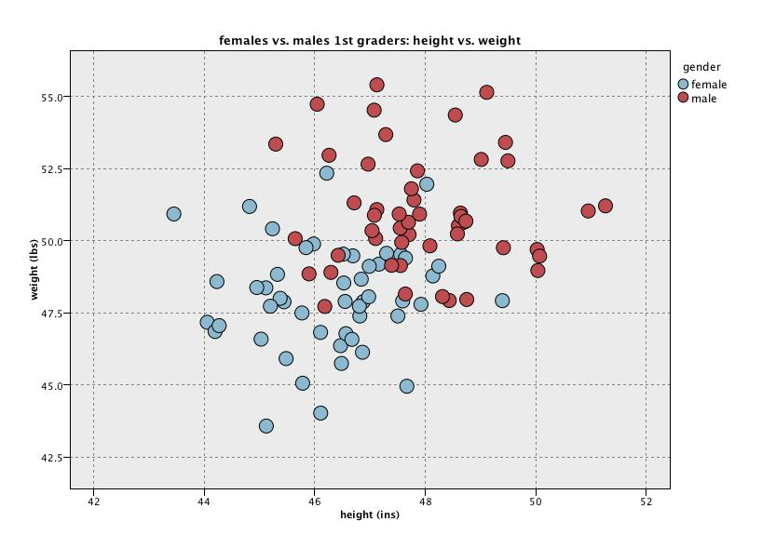

2D classification example

Slide 6
Definitions
True Positive (TP) – observation is positive and was predicted as positive
True Negative (TN) – observation is negative and was predicted as negative
False Positive (FP) – observation is negative and was predicted as positive
False Negative (FN) – observation is positive and was predicted as negative
Classification accuracy – proportion of observations classified correctly
    = (#TP + #TN)/N
    = (4 + 4)/10 = 80%
Weight
Predict girl
Classification Rule
Predict boy
Height
Girl (positive class)
Boy (negative class)

Slide 7
Evaluation metrics for categorical data
Possible evaluation metrics:
  Classification Accuracy – or conversely, the classification error rate = 1 – classification accuracy
  Cost-Benefit – some errors (e.g. FP, FN) are counted more than other, often context dependent
  Sensitivity, specificity, precision
  Area Under Receiver Operating Characteristic (ROC) Curve (AUC)
Guiding questions in selecting evaluation metrics
  What is my analytical goal, i.e. research question?
  What metric can best help me evaluate how reliable by predicted results are in the context of my analytical goal?

Slide 8
Evaluation Metric Practice!
Download “Biostat 202 Evaluation Metric Exercise” document from CLE

Slide 9
Logistic Regression

Slide 10
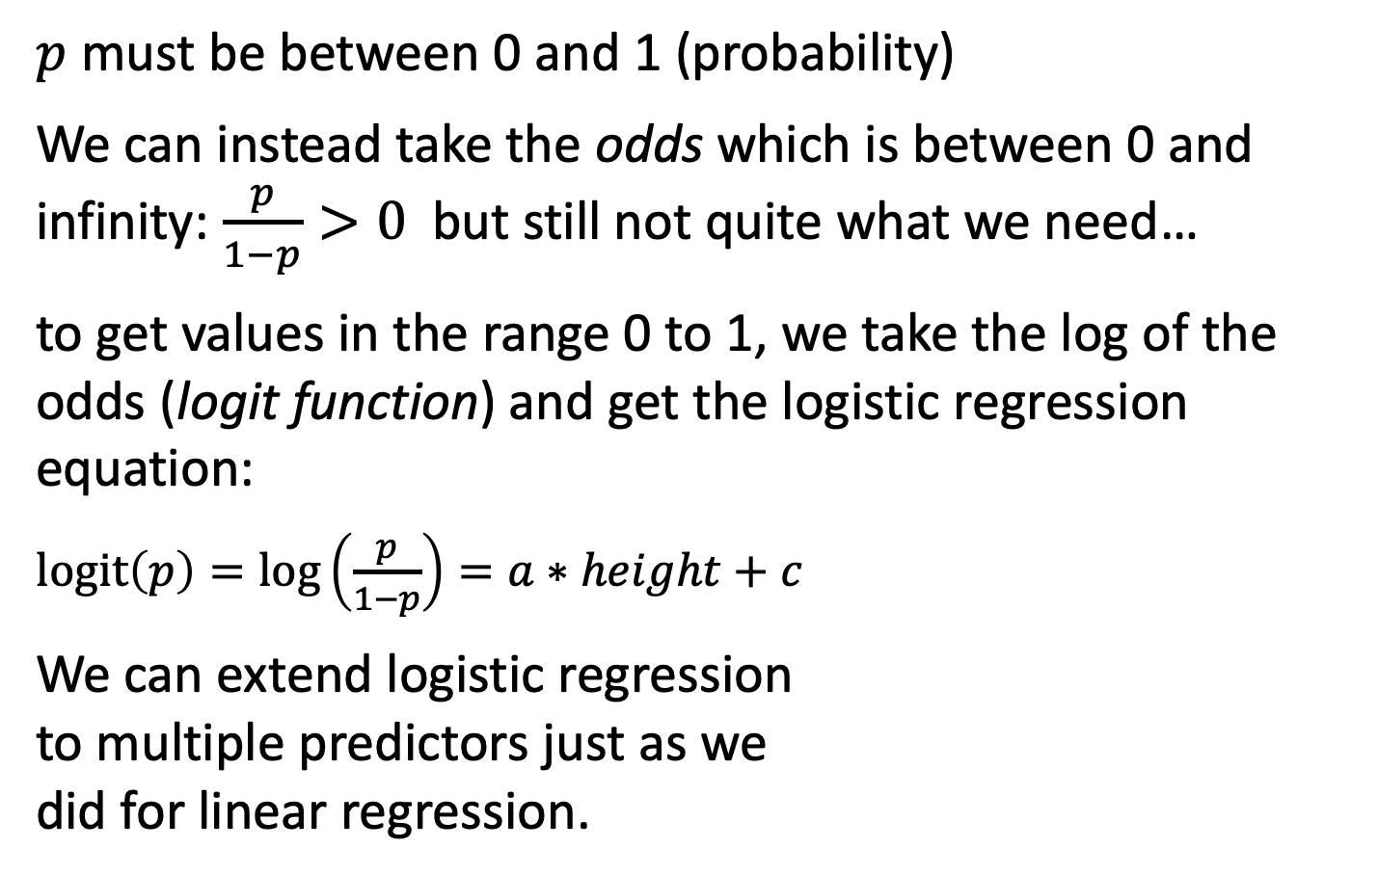
Logistic regression
$p$ must be between 0 and 1 (probability)
We can instead take the odds which is between 0 and infinity: $\frac{p}{1−p}>0$ but still not quite what we need…
to get values in the range 0 to 1, we take the log of the odds (logit function) and get the logistic regression equation:
$logit\left(p\right)=\log\left(\frac{p}{1−p}\right)=a∗height+c$
We can extend logistic regression
to multiple predictors just as we
did for linear regression.
Notes:
https://youtu.be/yIYKR4sgzI8?t=189

Slide 11
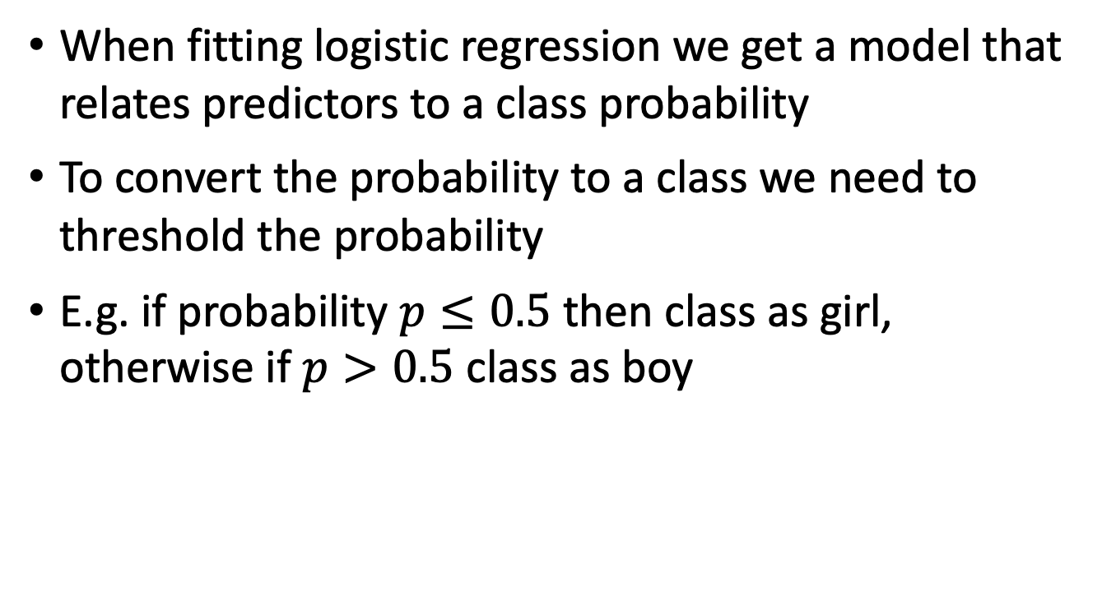
Logistic regression for classification
When fitting logistic regression we get a model that relates predictors to a class probability
To convert the probability to a class we need to threshold the probability
E.g. if probability $p≤0.5$ then class as girl, otherwise if $p>0.5$ class as boy

Slide 12
Ongoing case study – Heart data
  Data:
    n = 303
    14 attributes
  Target:
    AHD: diagnosis of heart disease (1 = yes, 0 = no)
  Predictors:
    Age: age (years)
    Sex: gender
    ChestPain: chest pain type
    Chol: cholesterol
    Fbs: fasting blood sugar >120 mg/dL
    restecg: resting electrocardiographic results
    MaxHR: maximum heart rate achieved
    ExAng: exercise induced angina
    Oldpeak: ST depression induced by exercise
    Slope: slope of peak exercise ST segment
    Ca: # of major vessels colored by flouroscopy
    Thal: Thallium stress test
    SysBp: systolic blood pressure
Goal: Predict (probability) of heart disease using logistic regression.

Slide 13
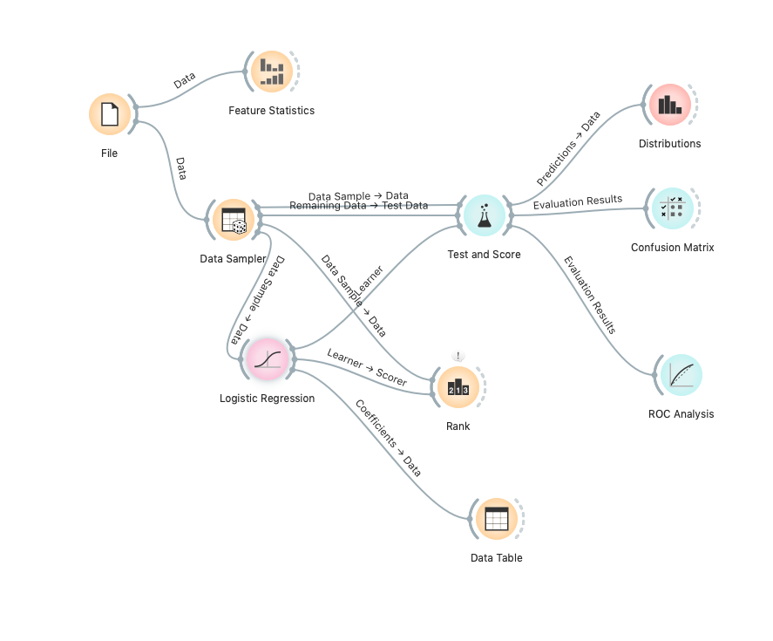
Logistic Regression Orange Demo

Slide 14
QUESTIONS?

Slide 15
Next Monday – more classification!
K-nearest neighbors
  Parameter tuning
  Training-validation-test
  Cross-validation
Classification trees (recursive partitioning)
Support vector machines
Artificial neural networks
Comparison of classifiers

Slide 16
LAB
Download Assignment 3 from CLE
Download Framingham.csv from CLE

