Slide 1
Biostat 202: Opportunities and Challenges of “Big Data”.
Machine Learning 3:
Supervised learning, contd. [classification]
Aaron Wolfe Scheffler
Division of Biostatistics
Department of Epidemiology and Biostatistics

Slide 2
Announcements
Assignment 3 due Thursday
Project Component 2 due 8/23 @ midnight

Slide 3
Overview of this lecture
- more classification!
K-nearest neighbors
  Parameter tuning
  Training-validation-test
Classification trees (recursive partitioning)
Support vector machines
Artificial neural networks
Comparison of classifiers

Slide 4
Ongoing case study – Heart data
  Data:
    n = 303
    14 attributes
  Target:
    AHD: diagnosis of heart disease (1 = yes, 0 = no)
  Predictors:
    Age: age (years)
    Sex: gender
    ChestPain: chest pain type
    Chol: cholesterol
    Fbs: fasting blood sugar >120 mg/dL
    restecg: resting electrocardiographic results
    MaxHR: maximum heart rate achieved
    ExAng: exercise induced angina
    Oldpeak: ST depression induced by exercise
    Slope: slope of peak exercise ST segment
    Ca: # of major vessels colored by flouroscopy
    Thal: Thallium stress test
    SysBp: systolic blood pressure
Goal: Predict (probability) of heart disease using different classifiers.

Slide 5
K-nearest neighbors classification

Slide 6
K-nearest neighbors classification
k = 3 : red wins
height
weight

Slide 7
Parameter tuning
Parameter tuning is the process of adjusting model parameters in order to find the “best” model
For example, we tune the K-nearest neighbors by adjusting the parameter k, the number of neighbors
Analogy: tuning the strings of a guitar to play the proper note is like parameter tuning to get the best prediction
Notes:
Image source: https://www.guitarworld.com/lessons/how-to-tune-your-guitar-by-ear

Slide 8
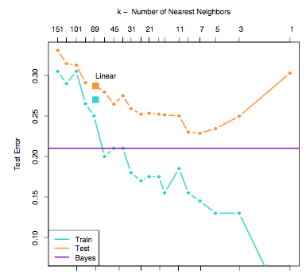
Choice of k
Best predictive
models (k = 7)
Fitting increased noise
Low to high complexity
Test error goes down then up again when overfitting
to training data
Training set error gets better with more complexity – fitting to noise helps

Slide 9

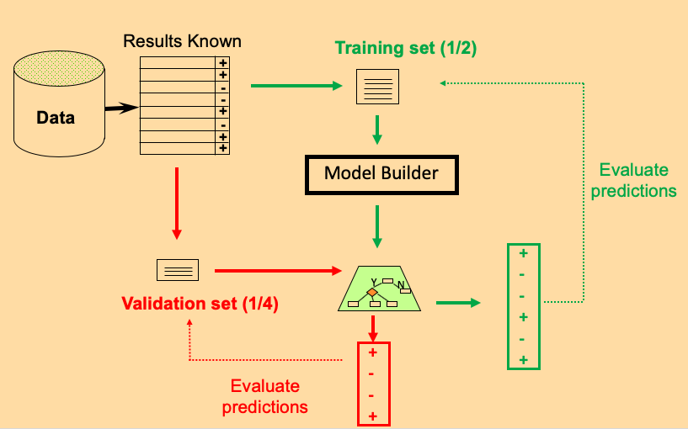

Train/Validate/Test
k = 3, 4, 5, 6
1. Train: repeatedly fit model to training data for multiple values of the procedures parameter(s), e.g. k = 3, 4, 5, 6 for K-nearest neighbors
2. Validate: each model based on training set has potentially been overfit… so utilize a validation set to determine best fitting model
3. Test: we are choosing from many models so we may have over-fit…utilize a test set to determine predictive performance of the best fitting model from the purple box
BEST
MODEL
+
-
-
+
-
+
Testing set (1/4)
Y
N
(k = 5)
Evaluate predictions

Slide 10
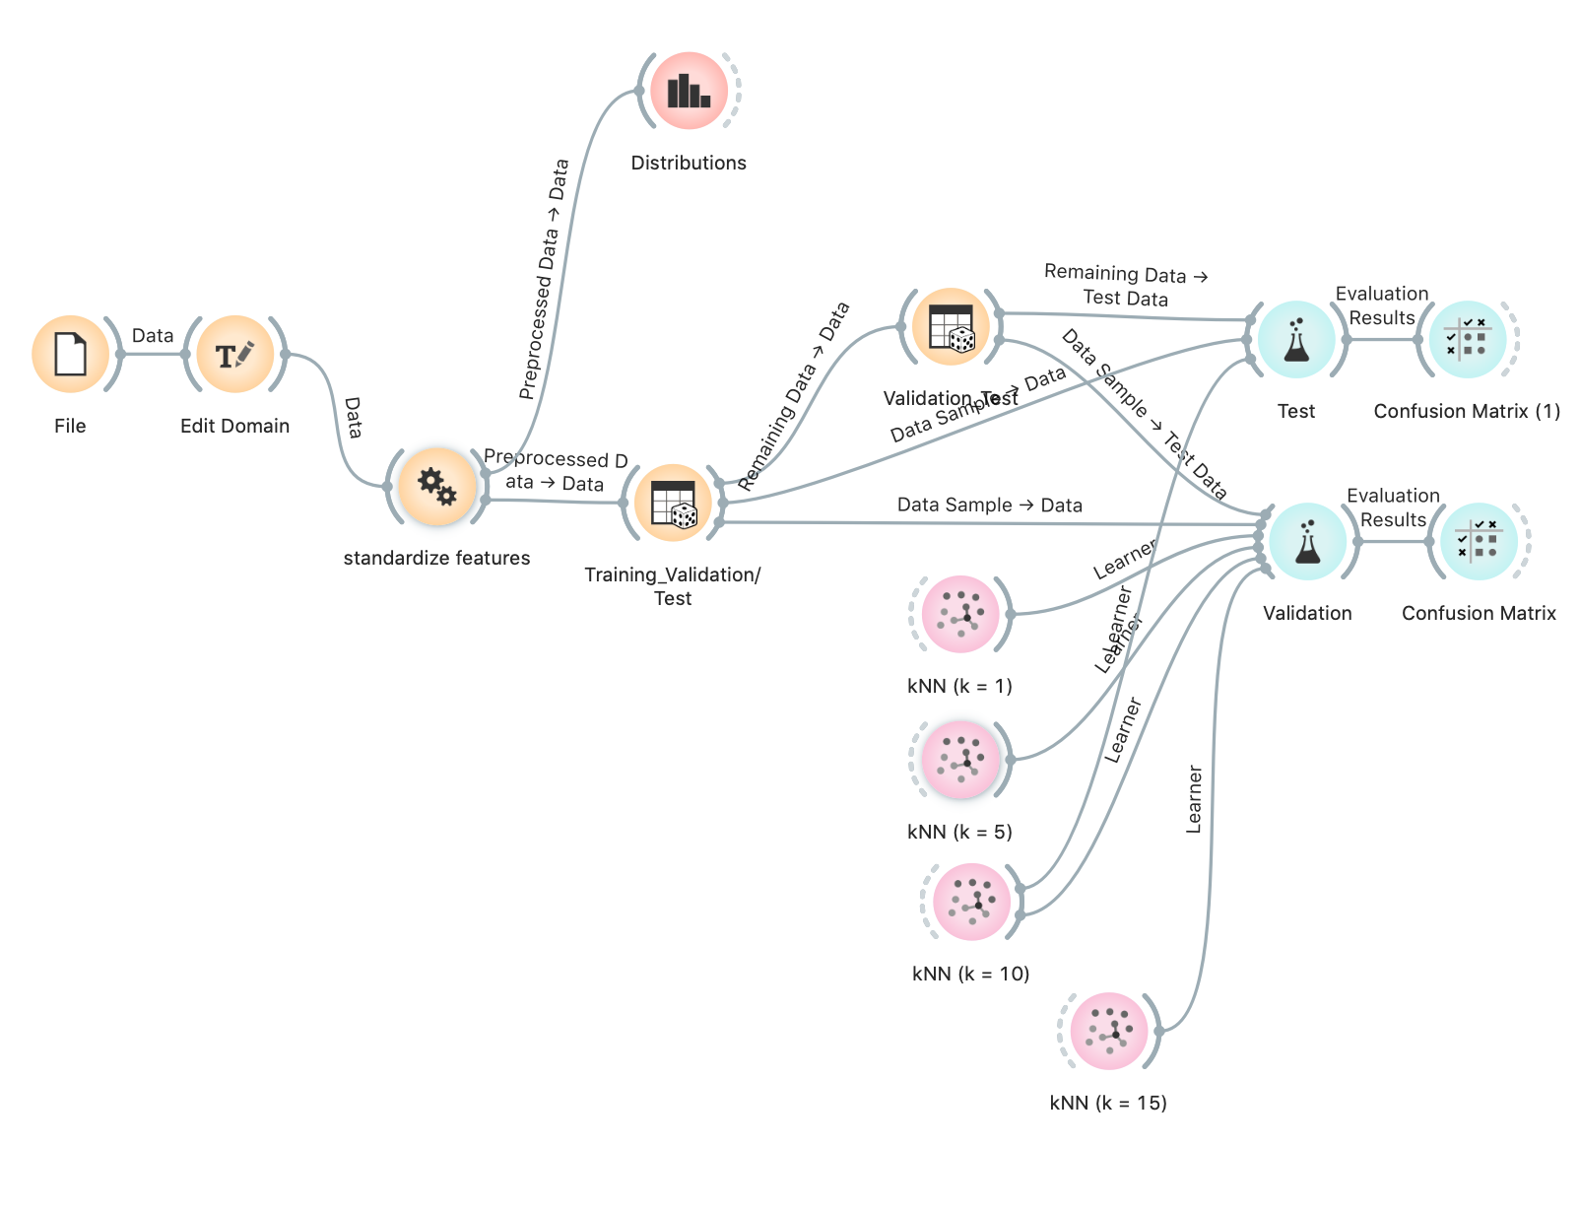
K-Nearest Neighbors workflow – available on CLE

Slide 11
Decision Trees
(Recursive Partitioning)

Slide 12


At risk for heart disease? RISK vs NO RISK
Systolic BP < 140?
No Yes
Exercise < 2 times per week
LDL > 190?
Exercise < 3 times per week
Alcohol < 2 units/day?
RISK
NO RISK
RISK
NO RISK
RISK
NO RISK

Slide 13
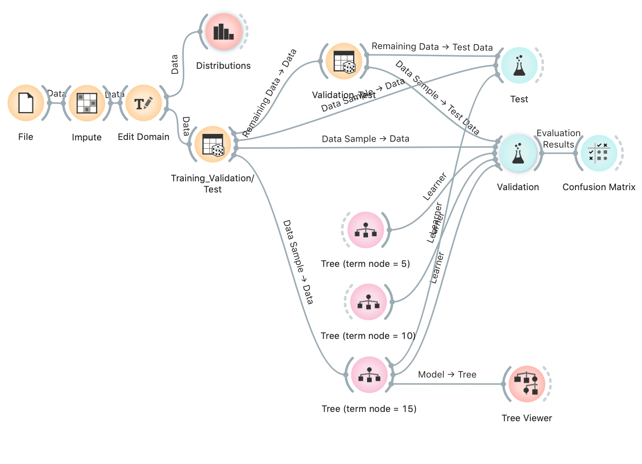
Tree workflow – available on CLE

Slide 14
Support Vector Machines
(SVM)

Slide 15
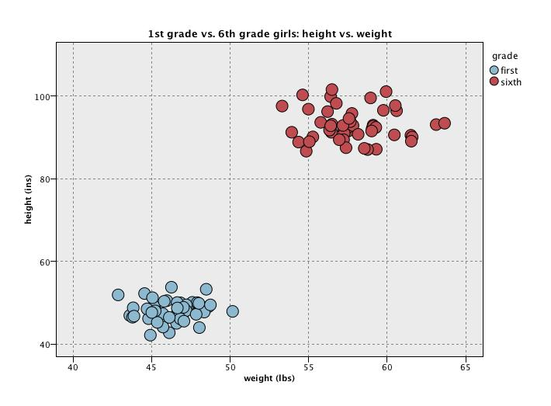
Maximizing margins
Classification Rule

Slide 16
Linearity can be limited, may need
“non-linear” decision boundary
?
The trick of SVM is not to have non-linear models for the separation boundaries directly, but rather to warp the space that the data is in. That way, linear boundaries in the warped space become non-linear back in the original space.

Slide 17
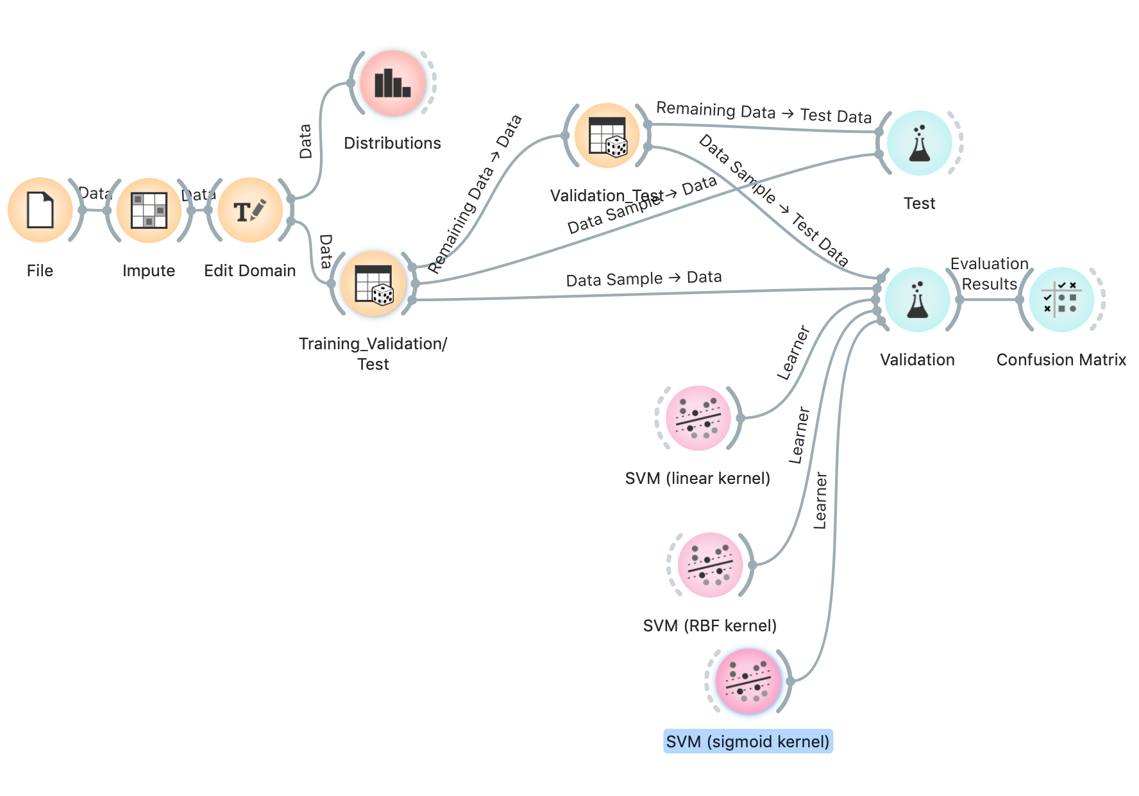
SVM stream – available on CLE

Slide 18
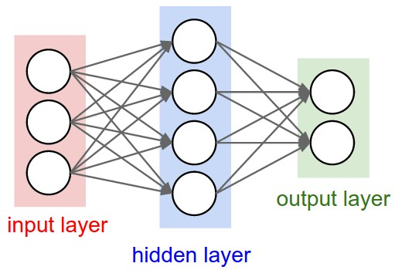
Artificial neural networks
Connections
Nodes
SysBP
HD
sex
NO HD
age
Underlying math is complex, but every node is a complex function of it’s inputs, and the parameters/weights (connections) of the function are learned from the training data. To expand model complexity, add more hidden layers.

Slide 19
Artificial neural network - visualization
https://www.youtube.com/watch?v=3JQ3hYko51Y
Notes:
Billions of parameters!

Slide 20
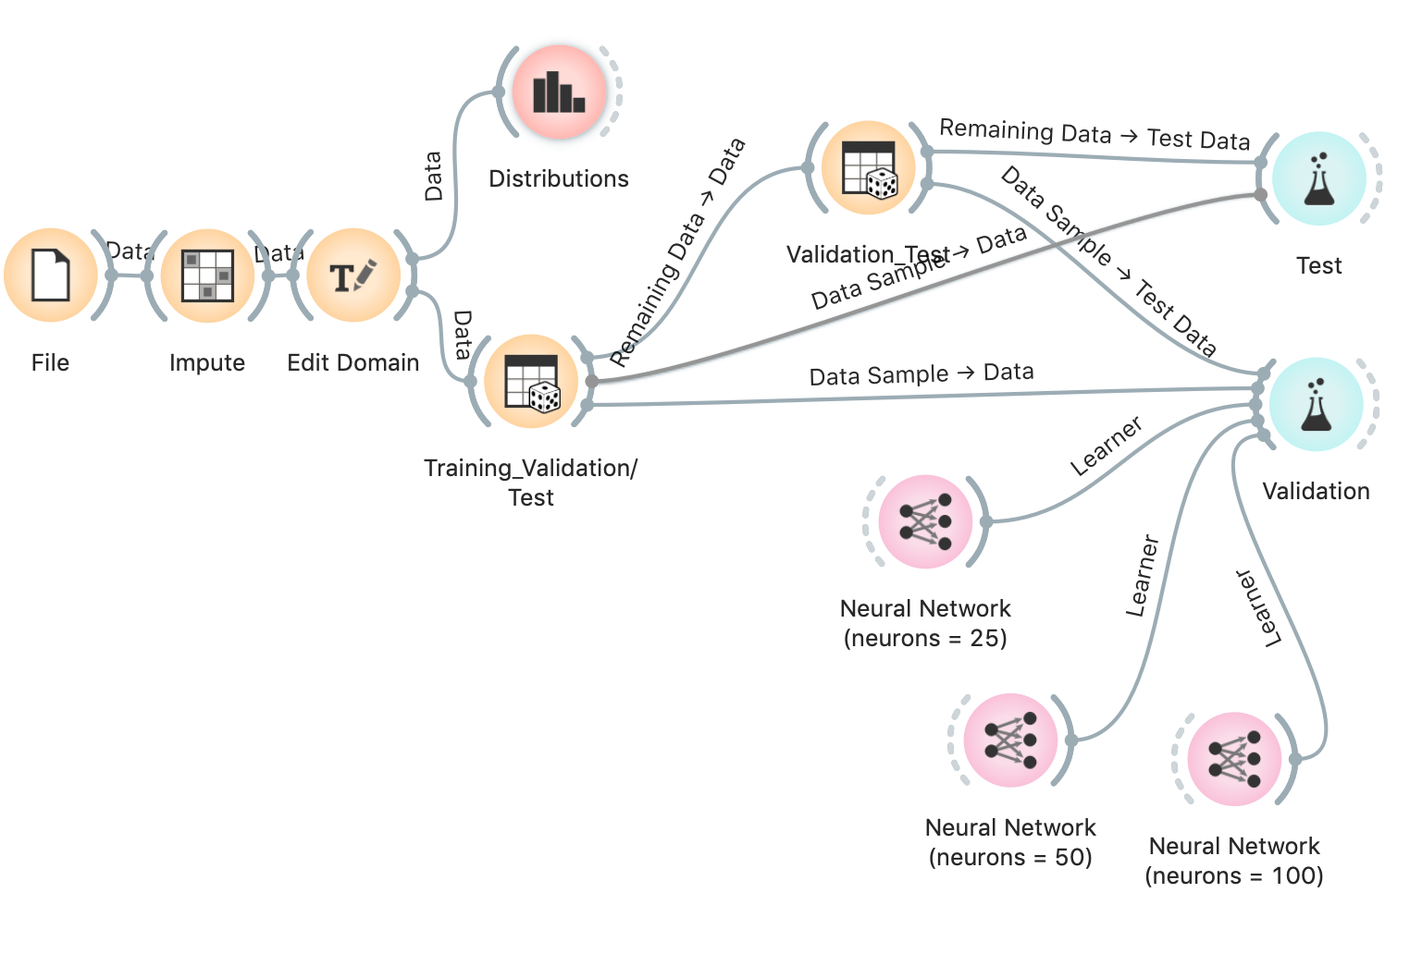
Artificial Neural Network stream – available on CLE

Slide 21
Many of the models discussed today can be used for regression!
With some adaptation, the techniques we have discussed today can be applied to target continuous outcomes, i.e. regression problems
We will not discuss but Orange offers regression versions of the following algorithms:
  K-nearest neighbors
  Regression trees (recursive partitioning)
  Support vector machines
  Artificial neural networks

Slide 22
Next Thursday— supervised learning fin
Cross validation
Ensemble methods
  Bagging
  Boosting
  Stacking
Parameter tuning
Feature importance

Slide 23
Orange Issues
Some quick survey questions

