Slide 1
Biostat 202: Opportunities and Challenges of “Big Data”:
Machine Learning 4:
Cross-Validation, Ensembles, and Feature Importance
Aaron Wolfe Scheffler
Division of Biostatistics
Department of Epidemiology and Biostatistics

Slide 2
Outline
Cross-validation
Ensemble methods
  Bagging: Random Forests
  Boosting: Adaboost
  Stacking
Parameter tuning, continued
Feature importance

Slide 3
Cross-validation

Slide 4
E.g. 5-fold cross-validation
1. Break up data into 5 “folds” of the same size
2. Set aside one fold for validation and use the rest to build model, repeat this process for each fold
Estimate the predictive performance of our model on the combined validation data (i.e. the validation_1-5 sets)
Fold 1 | Fold 2 | Fold 3 | Fold 4 | Fold 5
Iteration 1 | training_1 |  |  |  | validation_1
Iteration 2 | training_2 |  |  | validation_2 | training_2
Iteration 3 | training_3 |  | validation_3 | training_3
Iteration 4 | training_4 | validation_4 | training_4
Iteration 5 | validation_5 | training_5

Slide 5
Ensemble methods
Train a bunch of predictive models and pool them to form a final prediction.
Advantage:
  improvement in predictive accuracy
Disadvantages:
  more computation
  it is difficult to understand an ensemble of classifiers
Examples: bagging, boosting, and stacking

Slide 6
Bagging
Notes:
Image source: https://upload.wikimedia.org/wikipedia/commons/thumb/c/c8/Ensemble_Bagging.svg/2560px-Ensemble_Bagging.svg.png

Slide 7
Boosting
Notes:
Image source: https://en.wikipedia.org/wiki/Boosting_(machine_learning)#/media/File:Ensemble_Boosting.svg

Slide 8
Boosting vs Bagging
Notes:
Image source: https://www.datacamp.com/community/tutorials/adaboost-classifier-python

Slide 9
Stacking
Notes:
Image source: https://towardsdatascience.com/ensemble-methods-bagging-boosting-and-stacking-c9214a10a205

Slide 10
Feature importance
Even though we fool ourselves into only being concerned with prediction, we often want to understand which features impact our prediction
Given a target variable, which variables are important for prediction?
The define this, you can develop measures of feature importance
Feature importance can either be pair wise or model based
  Pairwise: based directly on measures of association between target and individual features (e.g. correlation)
  Model based: based on machine learning algorithms (e.g. regression coefficients, classification tree splits)

Slide 11
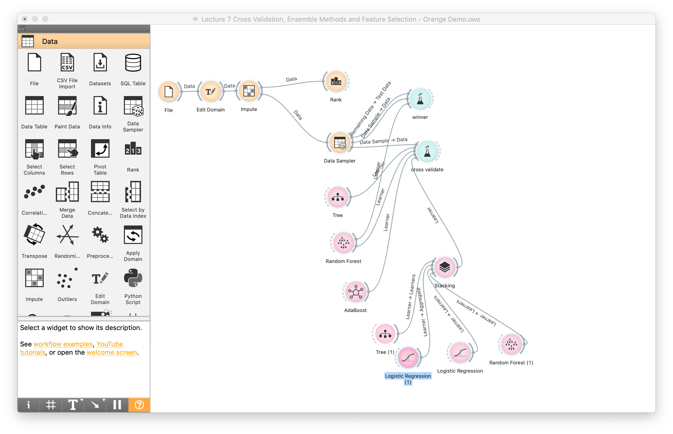
Orange Demo of Topics

Slide 12
Next time
Clustering
  k-means clustering
  TwoStep clustering
  Kohonen self-organizing map (SOM)
Data reduction
  Principal components analysis (PCA)
  t-Distributed Stochastic Neighbor Embedding (t-SNE)
Guidance for choosing machine learning algorithms

Slide 13
Lab- Prediction Competition
Predict time to readmission among diabetic patients
Prepare reproducible models
Collaborate as teams, submit work individually
You will have one hour (max) to perform this task

