Slide 1
Biostat 202: Opportunities and Challenges of “Big Data”:
Machine Learning 5:
Clustering and Data Reduction
Aaron Wolfe Scheffler
Division of Biostatistics
Department of Epidemiology and Biostatistics

Slide 2
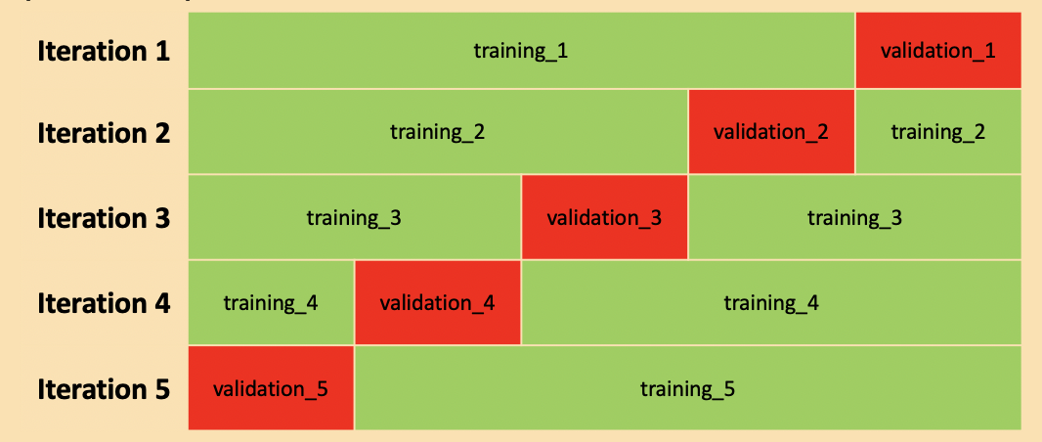
Review of last lecture
Boosting
Stacking
Feature Importance
Cross-validation
Bagging

Slide 3
Overview of this lecture
Clustering
  k-means clustering
  Hierarchical clustering
Data reduction
  Principal components analysis (PCA)
  t-Distributed Stochastic Neighbor Embedding (t-SNE)

Slide 4
Supervised vs. unsupervised
Machine Learning
Supervised
Regression (continuous outcome)
Classification (categorical outcome)
Unsupervised
Clustering
(grouping observations)
Data Reduction (transforming variables)

Slide 5
Supervised vs. unsupervised
Machine Learning
Supervised
Regression (continuous outcome)
Classification (categorical outcome)
Unsupervised
Clustering
(grouping observations)
Data Reduction (transforming variables)

Slide 6
Supervised vs unsupervised
Supervised Learning
Have data where you know outcome in order to train the model
Train the model to predict future outcomes from sets of predictors
Unsupervised Learning
No desired outcomes
Separate data points into groups with “similar” properties (clustering)
Or reduce data to fewer variables in some way that still captures important structure of the data
Prediction: Regression (continuous outcomes) and classification (categorical outcomes)
Clustering and data reduction

Slide 7
Clustering

Slide 8
Clustering problems
Determine whether there are distinct (unknown) subclasses of brain cancer based on symptomatic and tumor characteristics
Netflix example: you want to discover microgenres of movies and apply labels

Slide 9
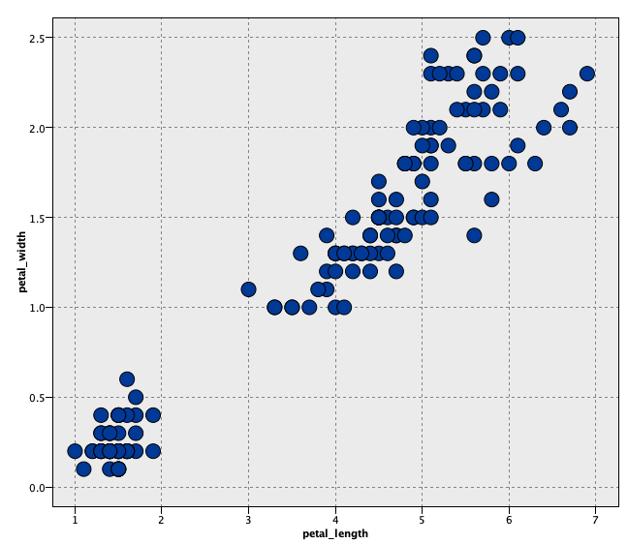
2D Clustering: Iris example
How many clusters?
Where are the clusters?

Slide 10
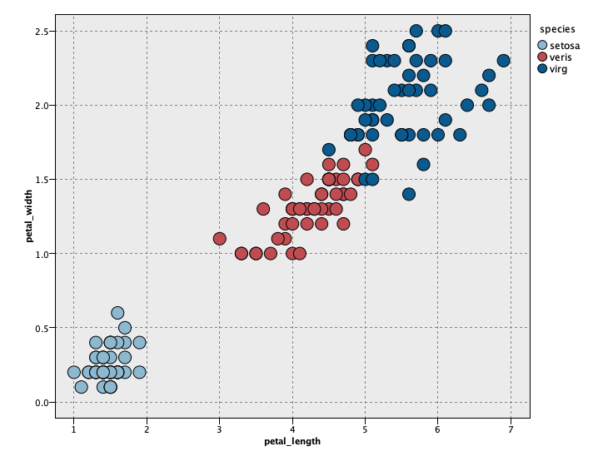
2D Clustering: Iris example
There are 3 species!

Slide 11
Cluster analysis (data segmentation)
Objective is to group (or segment) collection of observations into subsets (or clusters)
There is no “Target” in cluster analysis (unsupervised)
Clusters are not predefined, they are discovered!
Observations within a cluster are more similar (or less dissimilar) than observations in different clusters

Slide 12
2D clustering: Iris example
When determining clusters
We want long green lines (large distance between cluster centers)
We want small ellipses (points within clusters grouped tightly together)
Goal: maximize similarity within clusters and minimize similarity between clusters

Slide 13

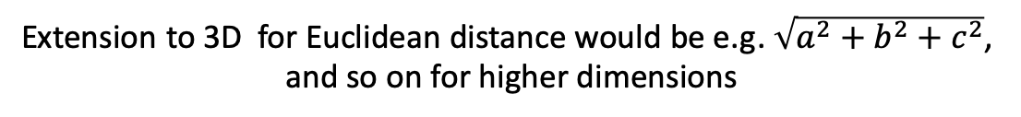
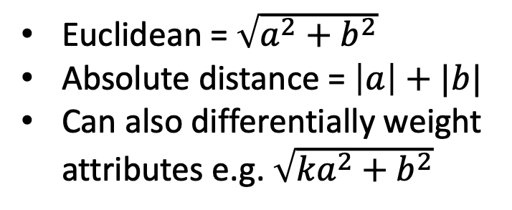
Measures of similarity/dissimilarity
Need to define similarity (or dissimilarity) and we need to be able to measure it
Consider 2 observations with only 2 variables x₁ and x₂ –dissimilarities could be
x₂
Euclidean = $\sqrt{a^{2}+b^{2}}$
Absolute distance = $\left|a\right|+|b|$
Can also differentially weight attributes e.g. $\sqrt{{ka}^{2}+b^{2}}$
(most common)
a
b
x₁
Extension to 3D for Euclidean distance would be e.g. $\sqrt{a^{2}+b^{2}+c^{2}}$,
and so on for higher dimensions

Slide 14
Measures of similarity/dissimilarity
Generally need to “standardize variables” (recall from k-nearest neighbors)
Ordinal variables are treated the same as continuous variables
Nominal variable differences between groups need to be explicitly given. A common choice is difference 1 if the groups are the same and 0 if they are different (this needs to be standardized following calculation)
Goal: maximize similarity within clusters and minimize similarity between clusters!!!

Slide 15
k-means clustering

Slide 16
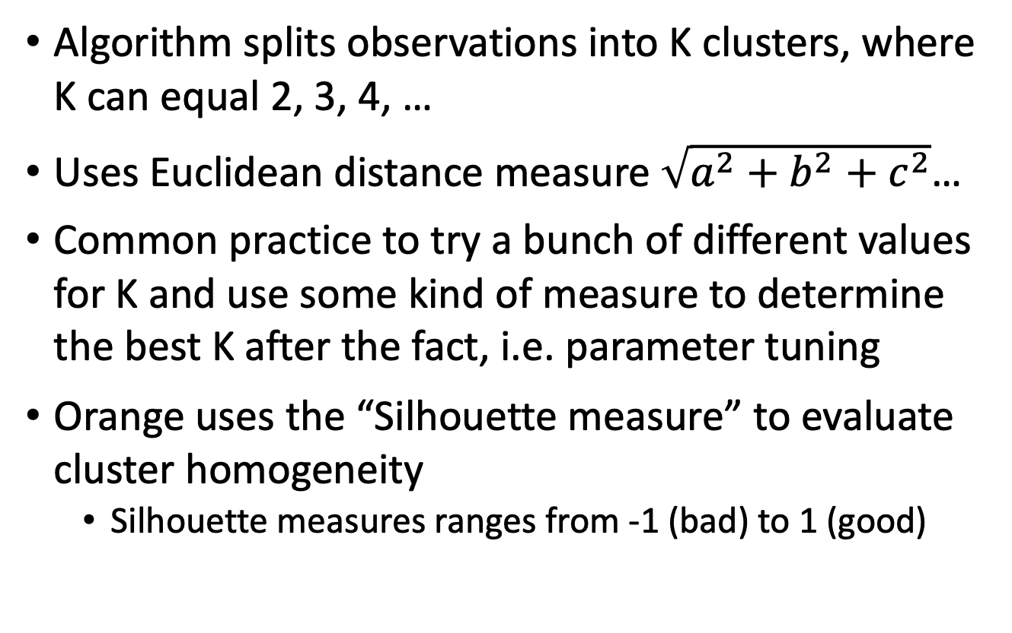
k-means clustering overview
Algorithm splits observations into K clusters, where K can equal 2, 3, 4, …
Uses Euclidean distance measure $\sqrt{a^{2}+b^{2}+c^{2}}$…
Common practice to try a bunch of different values for K and use some kind of measure to determine the best K after the fact, i.e. parameter tuning
Orange uses the “Silhouette measure” to evaluate cluster homogeneity
  Silhouette measures ranges from -1 (bad) to 1 (good)

Slide 17
k-means algorithm
Algorithm proceeds as follows:
  Randomly assign a cluster number (between 1 and K) to each of the observations/instances in the dataset. These are the initial cluster assignments
  Iterate between the following until the cluster assignments no longer change:
    For each cluster determine the center (centroid) of the cluster
    Reassign each observation to the cluster whose center is closest to them in terms of Euclidean distance (i.e., the center that is the most similar to the observation)
The algorithm increases the within-cluster similarity relative to the between cluster similarity at every step

Slide 18

k-means algorithm
  The center of a cluster is simply the point associated with the mean of each of the attributes for the observations assigned to that cluster – e.g. in the Age direction the center would be located at the mean Age for all subjects in the cluster.
  Note that for different initial random assignments of observations to clusters, k-means may lead to different final clustering (it is a local not global minimizer of dissimilarity)
The final clusters may be sensitive to your starting values!

Slide 19
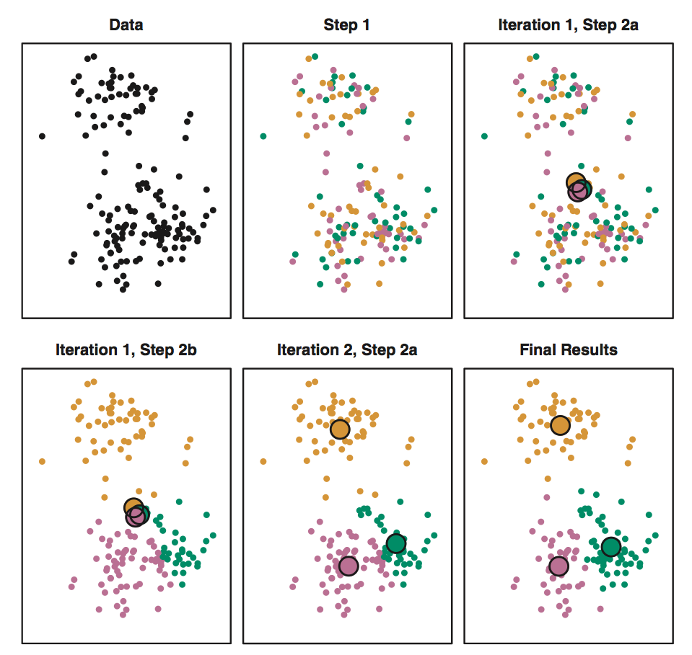
k-means algorithm (k = 3)
Data
Step 1a.
Step 1b.
Adapted from ISLR,
James et al., 2013
p. 389
…
Step 2a.
Step 2b.
Final clusters!

Slide 20
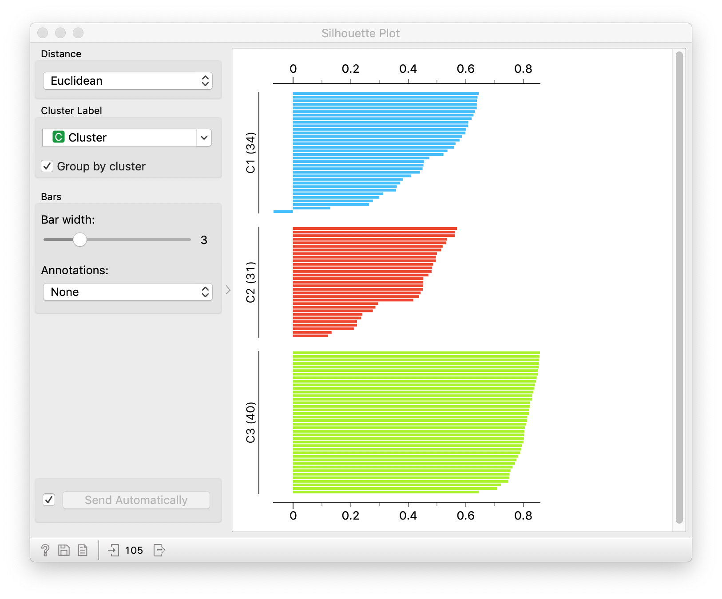
Silhouette Measure
Measures the degree of similarity (cohesion) of observations within a cluster compared to other clusters (separation)
[-1 (dissimilar), 1 (similar)]
An evaluation metric for cluster assignment
Goal: high average silhouette via clustering
Example silhouette measures for three clusters of individuals.

Slide 21
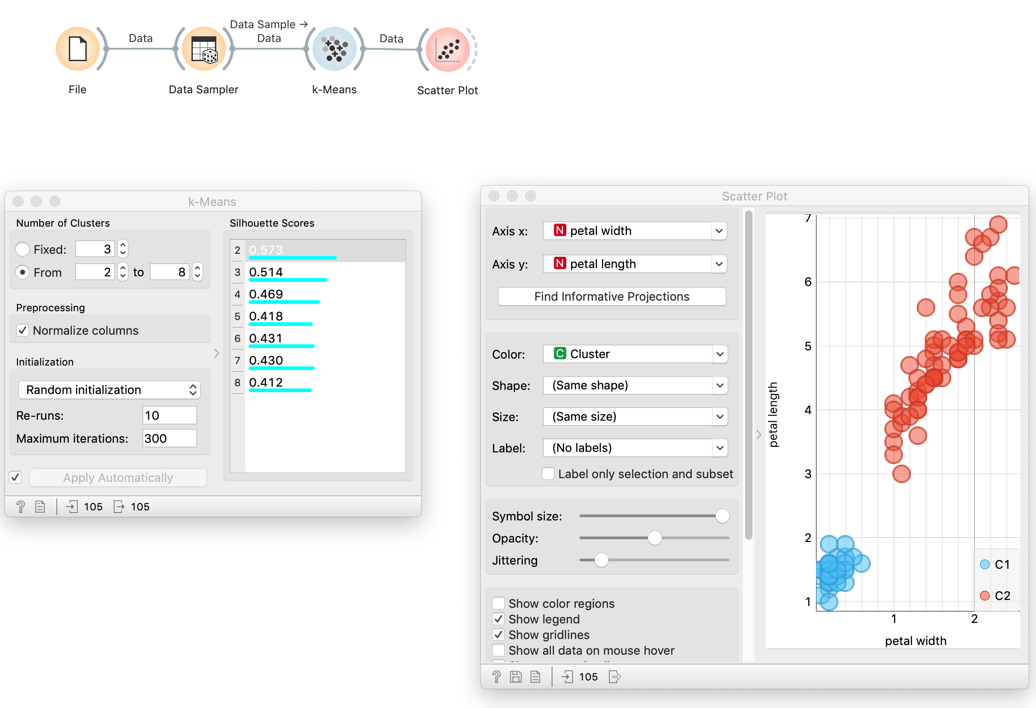
K-means in Orange - Iris Example

Slide 22
k-means clustering
k-means is fast – good for big data with large number of observations
Suffers from curse of dimensionality (like KNN)
Number of clusters must be defined by user – only heuristic methods for choosing number of clusters (Orange gives “Silhouette measure”)
Sensitive to initial values – different starts can lead to different results – try running the algorithm repeatedly as a sensitivity analysis

Slide 23
Clustering vs. classification
Cluster analysis is NOT classification!
In our Iris example, the clusters correspond to particular species but this comparison is provided for purely expository reasons
Cluster analyses hypothesizes there is some latent characteristic which generates these clusters, something we might need to construct a label for after our cluster analysis (e.g. Netflix movie genres)
So we do not wish to predict a label but rather potentially reveal a label or grouping and interpret

Slide 24
Other clustering algorithms

Slide 25
Hierarchical clustering method
  Joins (agglomerative) or divides (divisive) observations
  Hierarchically joins/divides similar/dissimilar subclusters together based on distance
Notes:
Image source: https://www.researchgate.net/publication/321399805_Blind_Nonlinearity_Equalization_by_Machine_Learning_based_Clustering_for_Single-_and_Multi-Channel_Coherent_Optical_OFDM/figures?lo=1

Slide 26
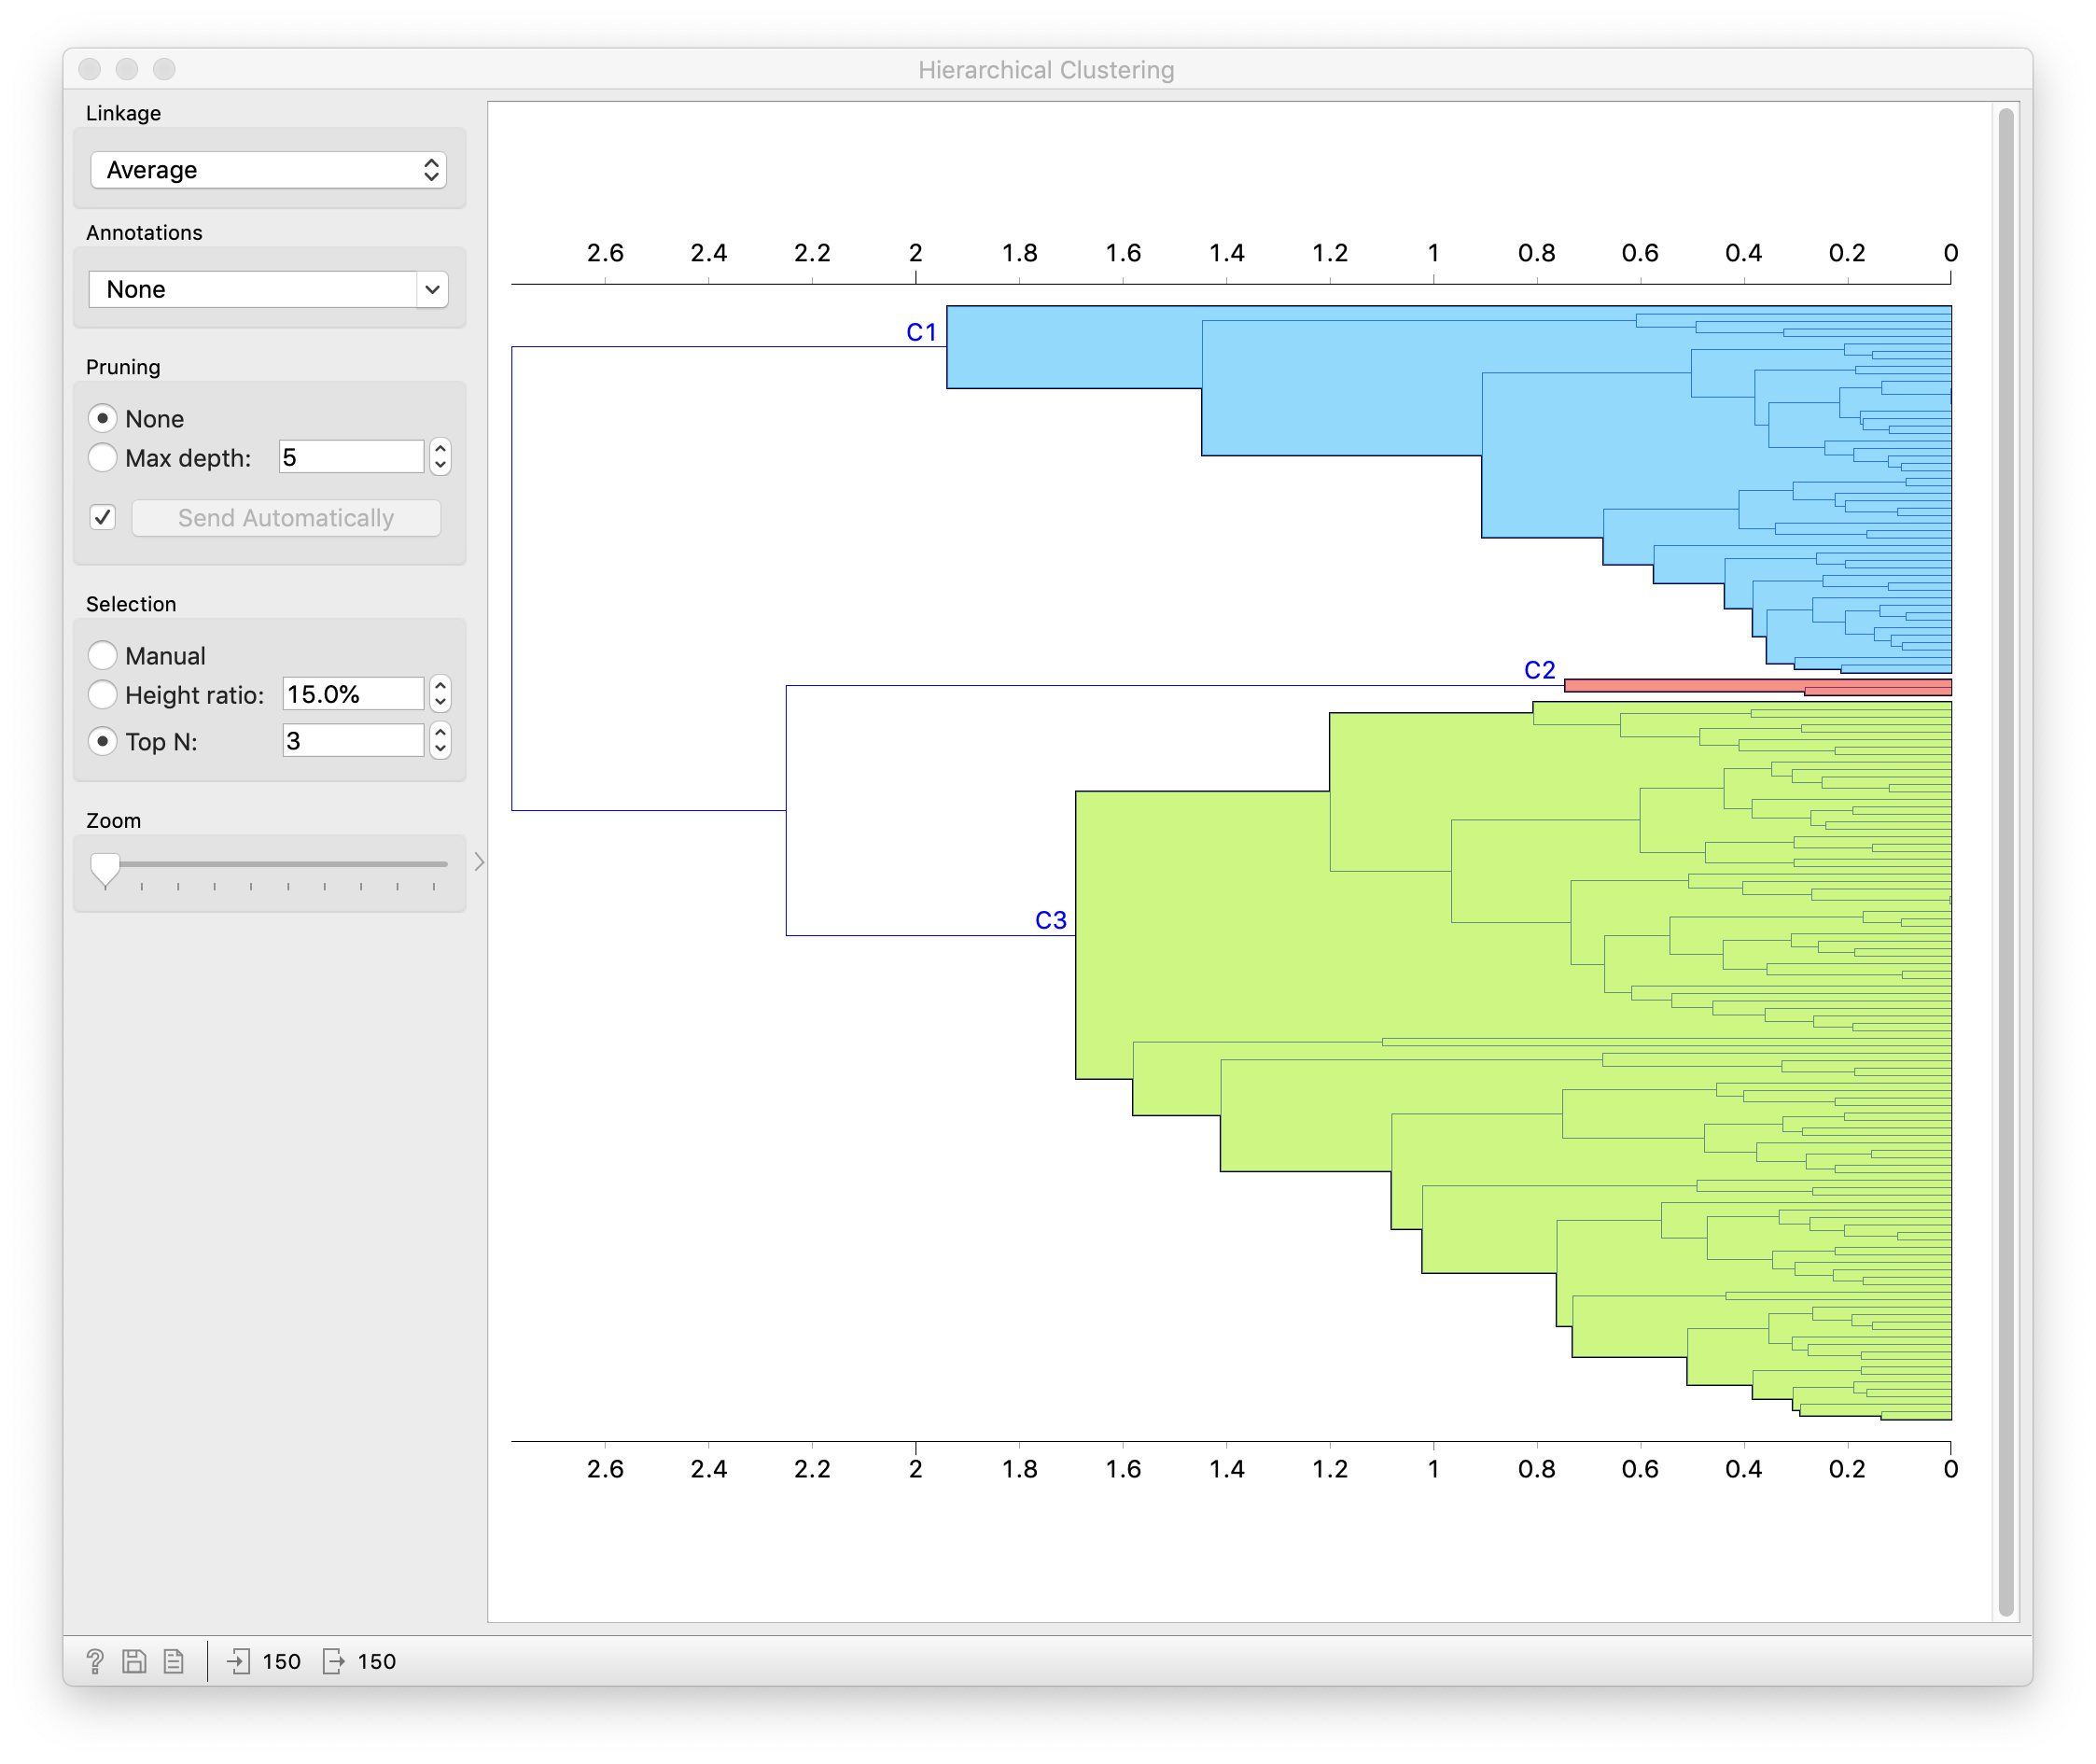
Iris example – agglomerative hierarchical clustering

Slide 27
Notes:
Image source: https://www.slideshare.net/mirjalil/large-scale-data-clustering-an-overview

Slide 28
Cluster analysis (data segmentation)
Unsupervised learning technique that tries to group similar observations together, drive dissimilar observations apart
Methods are differentiated by how they define similar/dissimilar
Often need to tune the number of clusters using some evaluation metric, e.g. silhouette measure

Slide 29
Data Reduction Methods

Slide 30
Shadow Analogy
Notes:
https://upload.wikimedia.org/wikipedia/commons/thumb/3/33/Looking_down_from_The_Eiffel_Tower%2C_Paris_8_April_2007.jpg/440px-Looking_down_from_The_Eiffel_Tower%2C_Paris_8_April_2007.jpg

Slide 31
Data reduction methods
Data reduction is the transformation of data into a corrected, simplified or ordered form
Examples:
  Averaging - reduce all observations to a summary number
  Embedding - taking data from a higher dimension to a lower dimension while maintaining important characteristics among observations such as separation, distance
  Image compression - reduce image size, maintain attributes, see below
High quality
Low quality

Slide 32
Why data reduction?
Interpretation:
  Wish to visualize high dimensional data in a 2D/3D space
Memory/storage:
  Cannot store raw data, need to reduce to store/analyze
  E.g. summarize step counts by minute rather than second
Pre-processing:
  Reduce dimension of data to perform an analysis
  E.g. for k-nearest neighbors to avoid the “curse of dimensionality”

Slide 33
Principal components analysis (PCA)

Slide 34
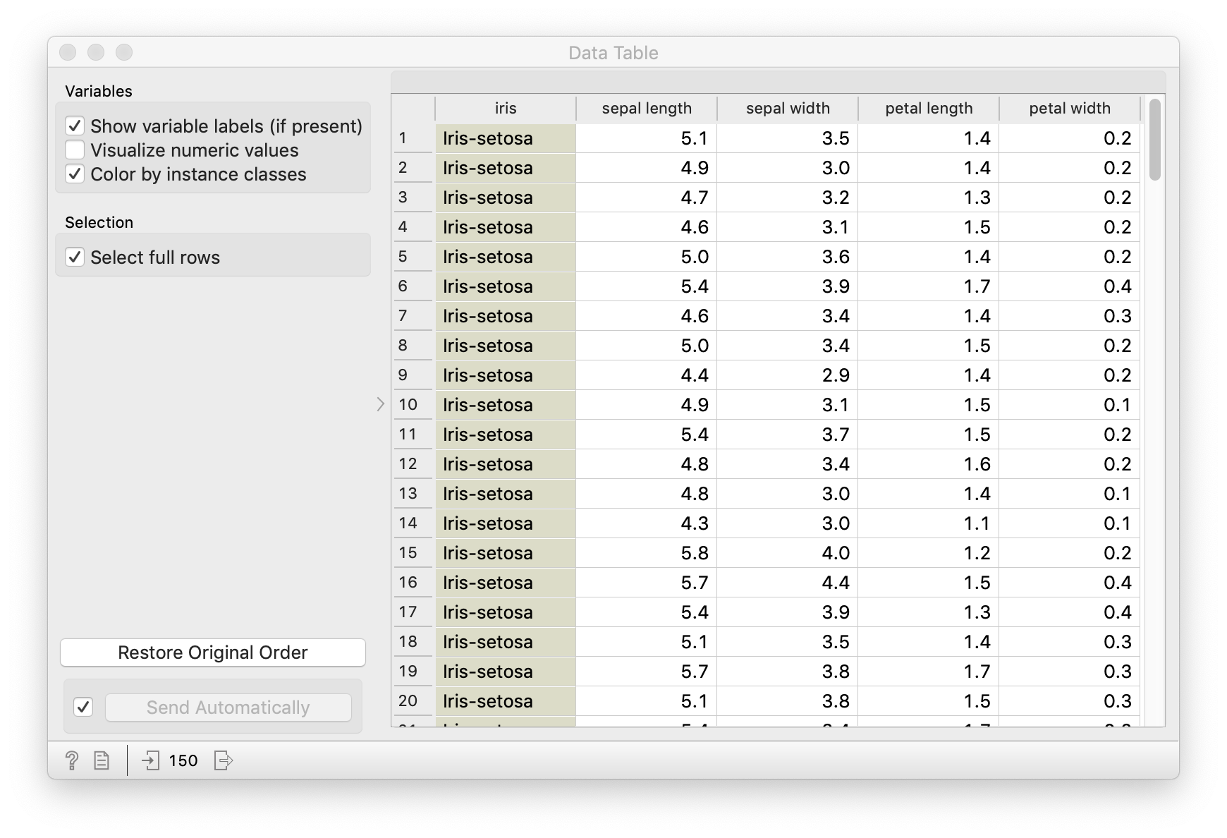

Slide 35
Principal components analysis: Iris example
Each flower has four attributes (aside from species), e.g. Flower 1
Sepal Length | 5.1
Sepal Width | 3.5
Petal Length | 1.4
Petal Width | 0.2
Can we come up with a “recipe” for each flower from some “ingredients” composed of our flower attributes?
Ingredients
Flower 1 |  | sepal_length | sepal_width | petal_length | petal_width
 | 5.1 * | 1 | 0 | 0 | 0
+ | 3.5 * | 0 | 1 | 0 | 0
+ | 1.4 * | 0 | 0 | 1 | 0
+ | 0.2 * | 0 | 0 | 0 | 1
 |  | 5.1 | 3.5 | 1.4 | 0.2
Recipe
(amount of
ingredient)

Slide 36
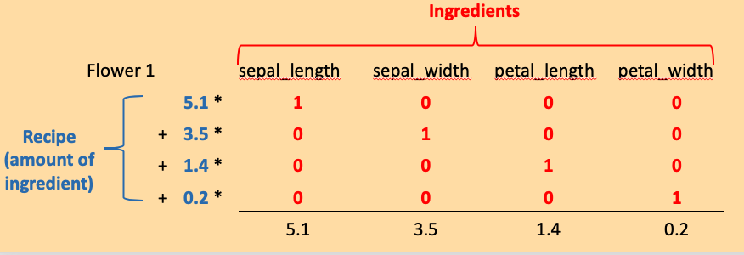
Principal components analysis: Iris example
Our ingredients only consider one attribute at a time. What if our ingredients could combine attributes that often go together? Maybe we could approximate the same “recipe” with fewer ingredients?
Original recipe:
(4 ingredients)
New recipe:
(2 ingredients)
Ingredients
Flower 1 |  | sepal_length | sepal_width | petal_length | petal_width
 | 5.9* | .75 | .38 | .51 | .17
+ | 2.3* | -.29 | -.54 | .71 | .35
 |  | 5.09 | 3.5 | 1.4 | 0.2
Recipe
(amount of
Ingredient)
Wow! Almost the “same” flower with fewer ingredients!!!

Slide 37
Principal components analysis (PCA)
Principal components analysis finds an optimal set of “ingredients” i.e. principal components (PC) which we can use to represent our data
Principal components analysis also tells us the amount of each PC we need to form each observation (PC scores)
PC are optimal in a specific way
  Each PC captures a certain amount of variation within the data
  The PC can be ordered in terms of importance (i.e. amount of variation explained)
  PC are orthogonal, meaning the score for one PC vs another PC within a subject are uncorrelated
Generally prior to PCA, need to standardize variables
Data reduction: we can use a few PC to to represent our data and still have essentially the same content! Then all you need to do is store the PC and the PC scores!! Can also predict or cluster based on PC scores!!!

Slide 38
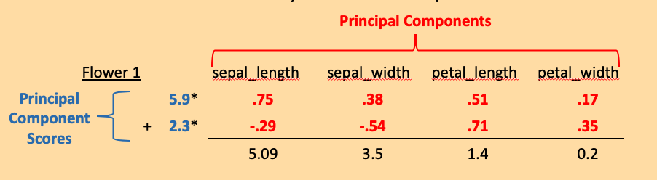
Principal components analysis
How does this new mathematical vocabulary fit into “recipe” framework?
Principal components identify the directions of “maximal spread (variation)”
.17
.51

Slide 39
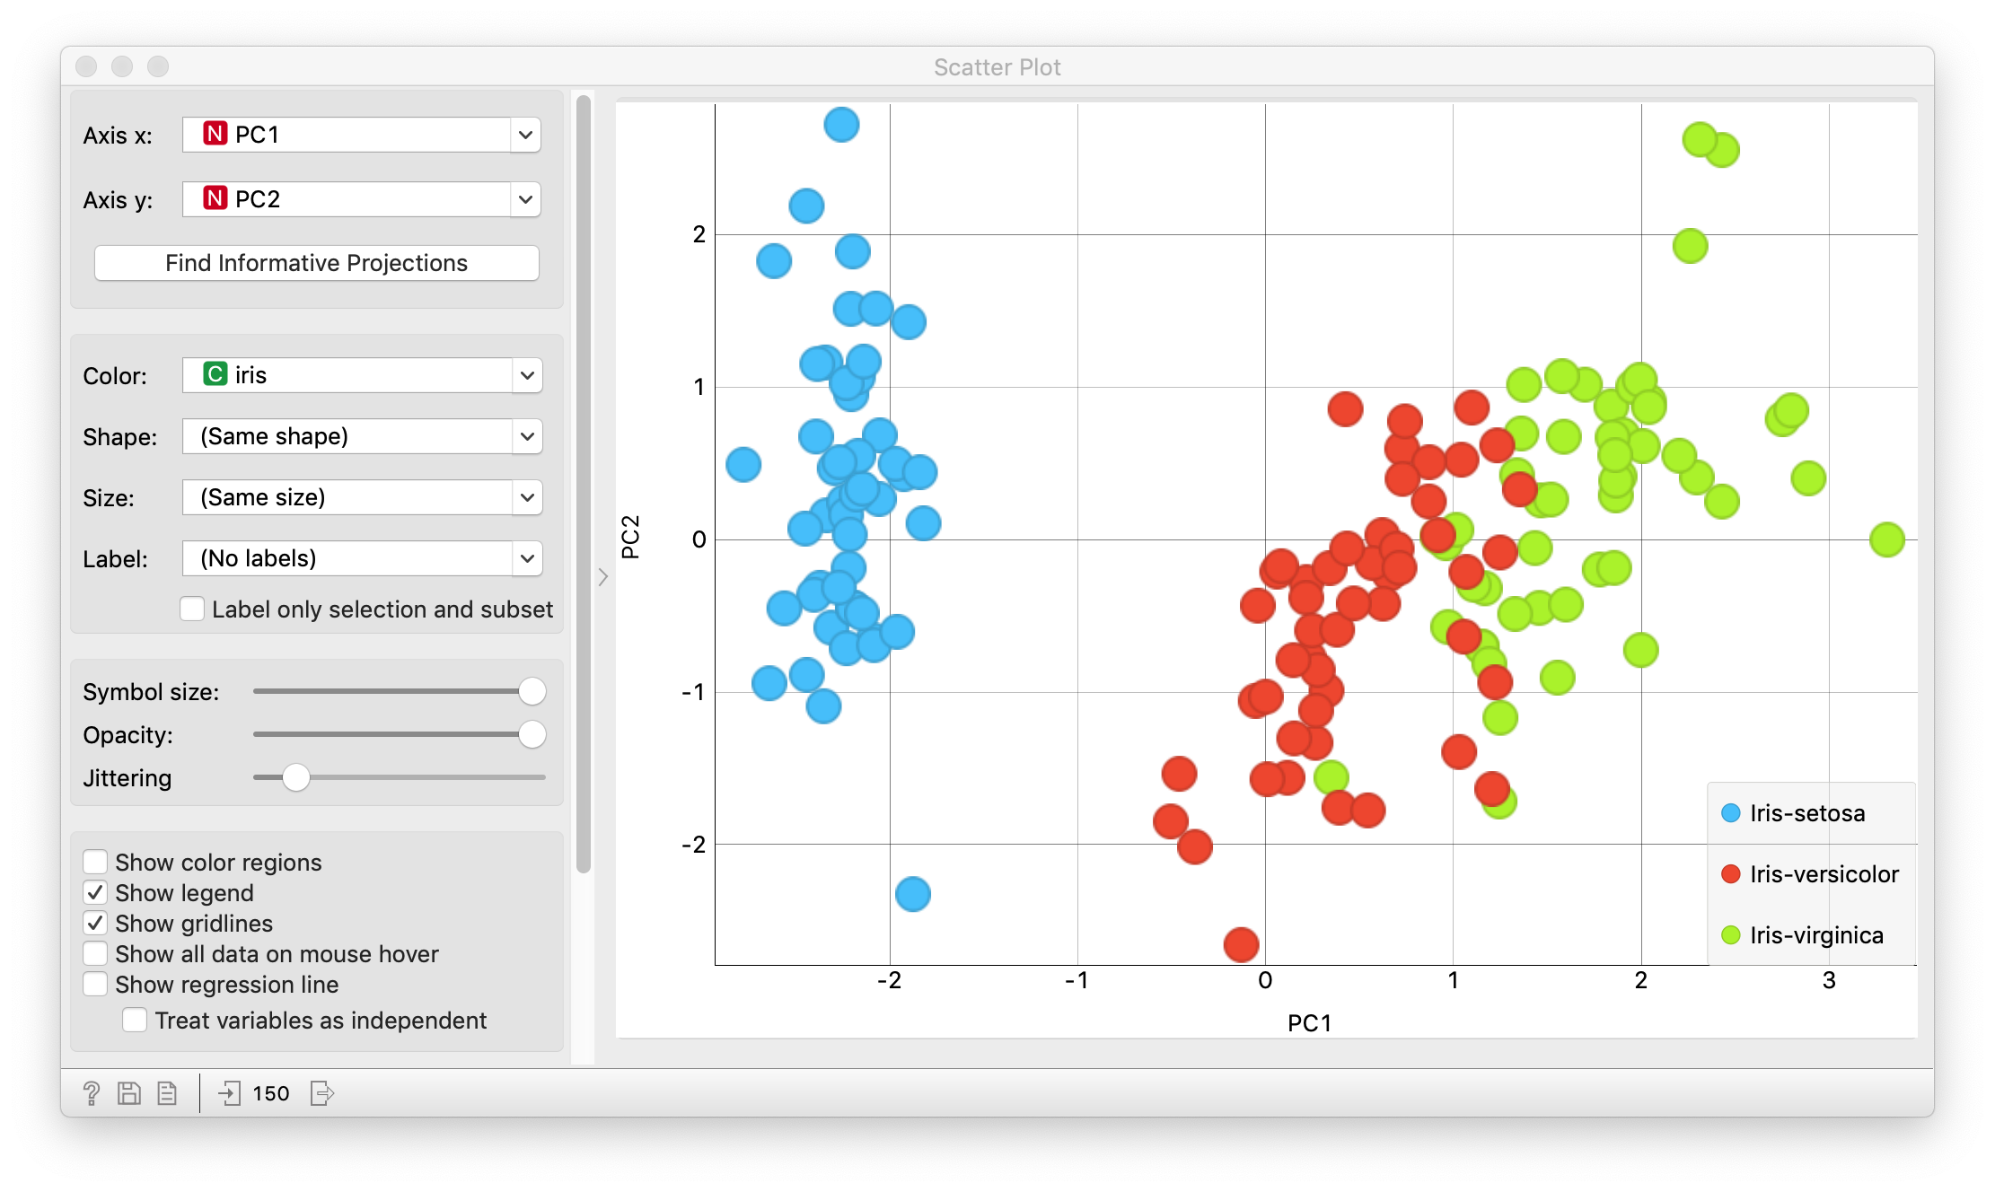
Principal components analysis – Scores
We can even examine and compare the principal component scores among subjects to reveal informative patterns!

Slide 40
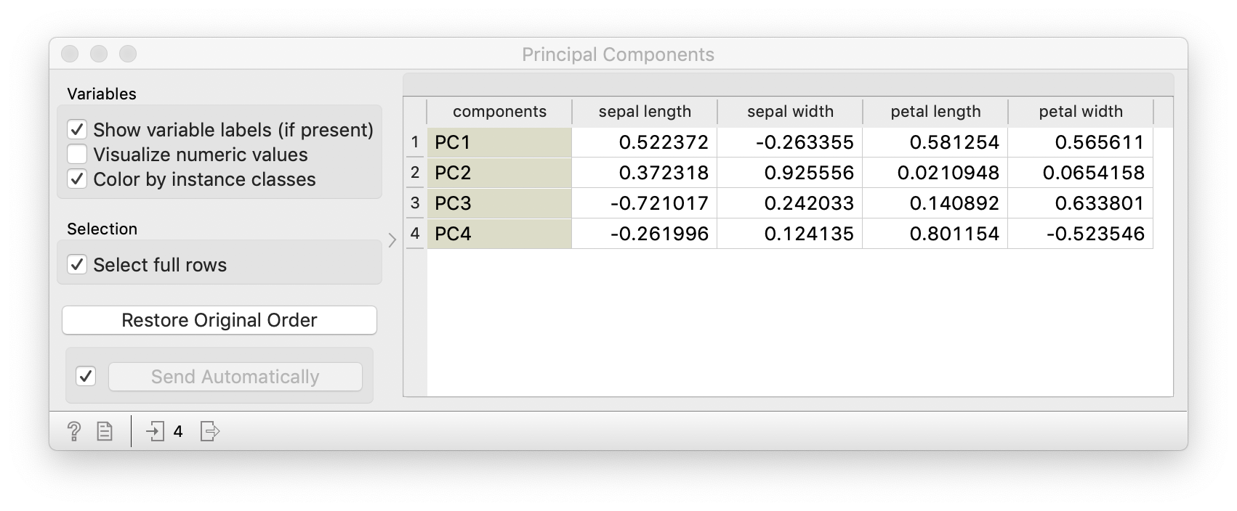
Principal Components Analysis – Principal Components (ingredients)

Slide 41
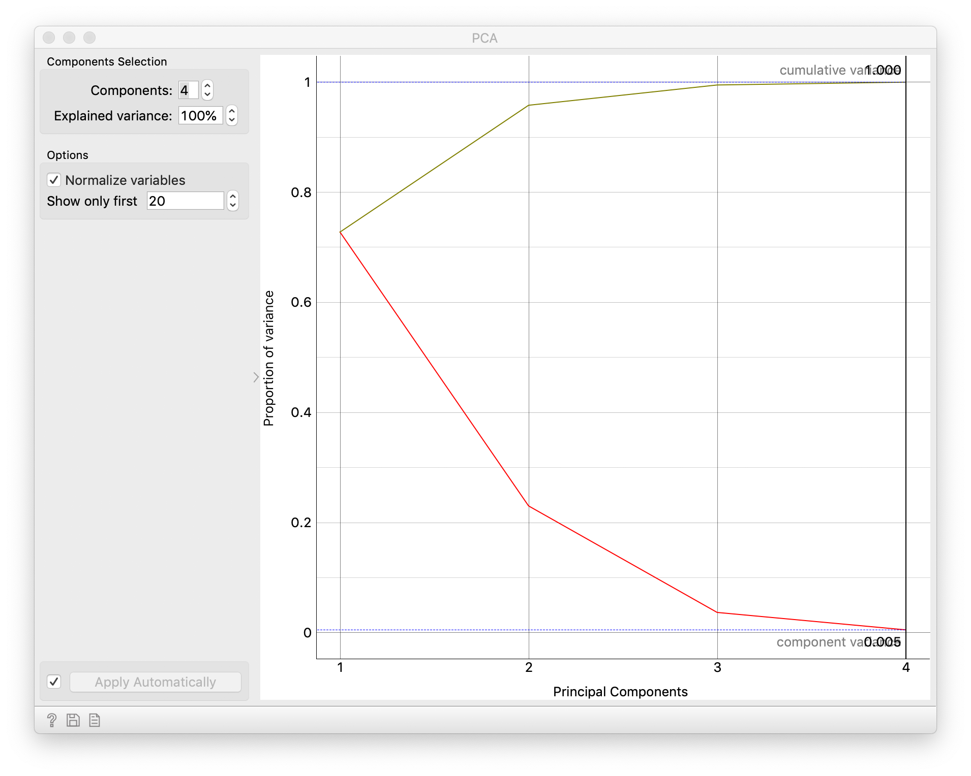
Principal components analysis – Variance explained

Slide 42
Other dimension reduction methods

Slide 43
t-Distributed Stochastic Neighbor Embedding (t-SNE)
Method for visualizing high-dimensional data in 2D or 3D space WITHOUT supervision or a target
Maps each high-dimensional observation into a 2D/3D space such that “nearby” points in high dimensions are found near each other with high probability in the lower dimensional space (sensitive to initialization)
Popular for identifying potential clusters through low-dimensional embedding e.g. Iris data!
Embedding method, does not assign subjects to clusters – clustering would be a second step

Slide 44
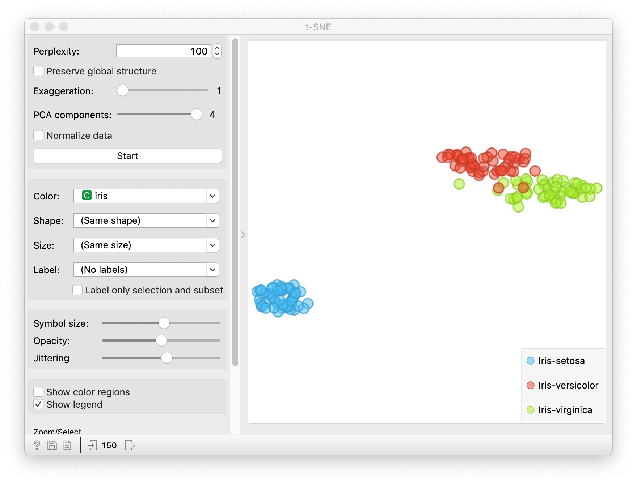
t-SNE for Iris Data

Slide 45
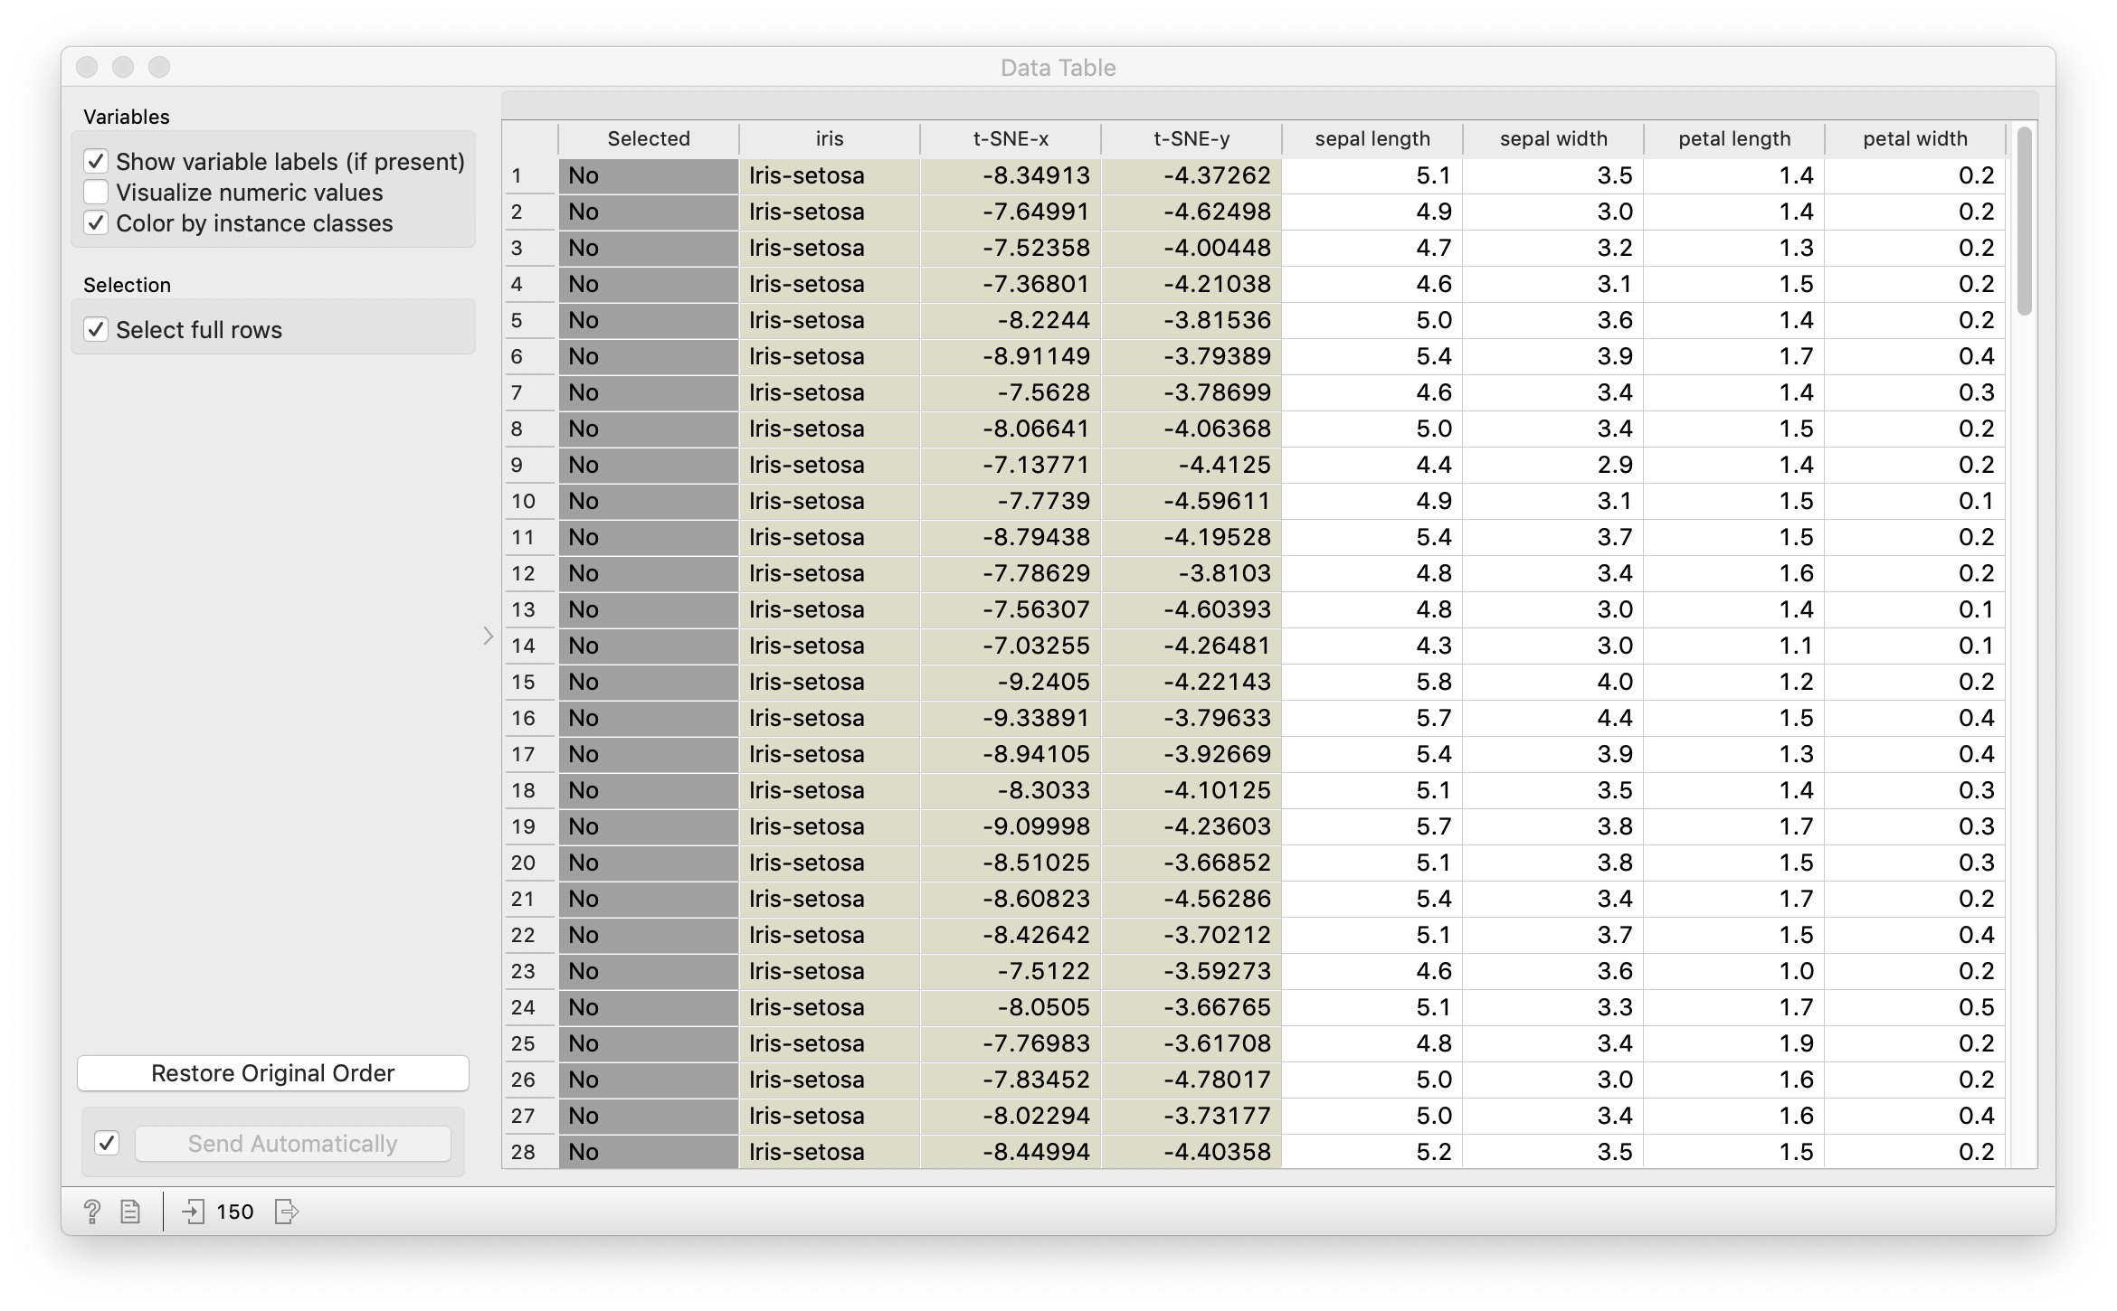
t-SNE for Iris Data: coordinates

Slide 46
Dimension Reduction
Reduces your high-dimensional data to a lower dimensional space WITHOUT regard to a target
You can use representations in lower dimensional space for further machine learning
  Less noise
  Less overfitting
Can produce computational gains in both storage and training
Loose interpretation in reduced dimensional space

Slide 47
Clustering vs Dimension Reduction
Clustering
Discover latent classes or structure in data
Maximizes within cluster similarity
Minimize similarity between clusters
Cluster labels can be assigned
Dimension Reduction
Reduces feature dimension to lower dimension
Can capture leading directions of variation
Does not assign a label
Subsequent machine learning can be used on reduced dimension data

Slide 48
Review of this lecture
Clustering
  k-means clustering
  Hierarchical clustering
Data reduction
  Principal components analysis (PCA)
  t-Distributed Stochastic Neighbor Embedding (t-SNE)

