Slide 1
Biostat 202: Opportunities and Challenges of “Big Data”:
Machine Learning 5:
Clustering and Data Reduction
Aaron Wolfe Scheffler
Division of Biostatistics
Department of Epidemiology and Biostatistics

Slide 2
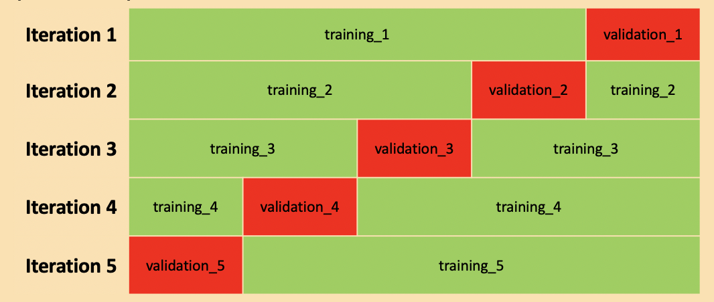
Review of last lecture
Boosting
Stacking
Feature Importance
Cross-validation
Bagging

Slide 3
Overview of this lecture
Clustering
  k-means clustering
  Hierarchical clustering
Data reduction
  Principal components analysis (PCA)
  t-Distributed Stochastic Neighbor Embedding (t-SNE)

Slide 4
Supervised vs. unsupervised
Machine Learning
Supervised
Regression (continuous outcome)
Classification (categorical outcome)
Unsupervised
Clustering
(grouping observations)
Data Reduction (transforming variables)

Slide 5
Supervised vs unsupervised
Supervised Learning
Have data where you know outcome in order to train the model
Train the model to predict future outcomes from sets of predictors
Unsupervised Learning
No desired outcomes
Separate data points into groups with “similar” properties (clustering)
Or reduce data to fewer variables in some way that still captures important structure of the data
Prediction: Regression (continuous outcomes) and classification (categorical outcomes)
Clustering and data reduction

Slide 6
Clustering

Slide 7
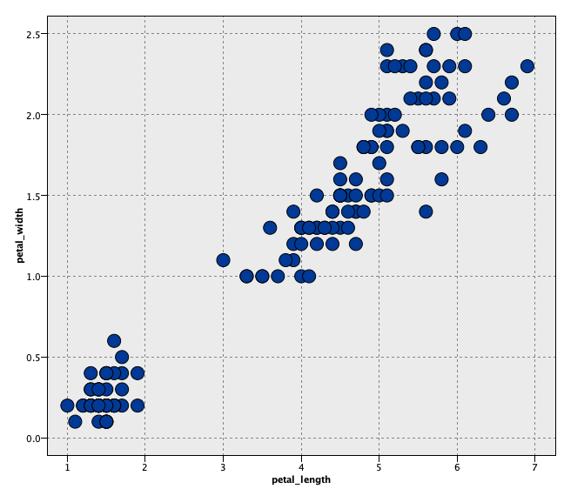
2D clustering: Iris example
When determining clusters
We want long green lines (large distance between cluster centers)
We want small ellipses (points within clusters grouped tightly together)
Goal: maximize similarity within clusters and minimize similarity between clusters

Slide 8

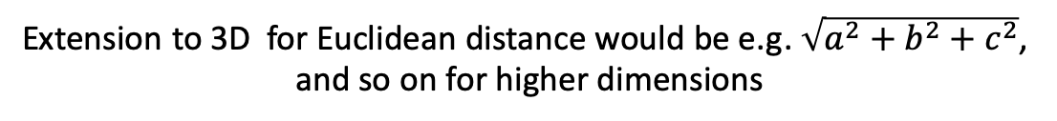
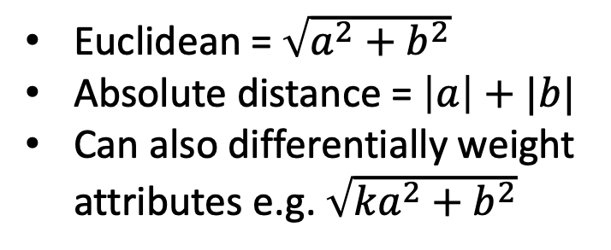
Measures of similarity/dissimilarity
Need to define similarity (or dissimilarity) and we need to be able to measure it
Consider 2 observations with only 2 variables x₁ and x₂ –dissimilarities could be
x₂
Euclidean = $\sqrt{a^{2}+b^{2}}$
Absolute distance = $\left|a\right|+|b|$
Can also differentially weight attributes e.g. $\sqrt{{ka}^{2}+b^{2}}$
(most common)
a
b
x₁
Extension to 3D for Euclidean distance would be e.g. $\sqrt{a^{2}+b^{2}+c^{2}}$,
and so on for higher dimensions

Slide 9
k-means clustering

Slide 10
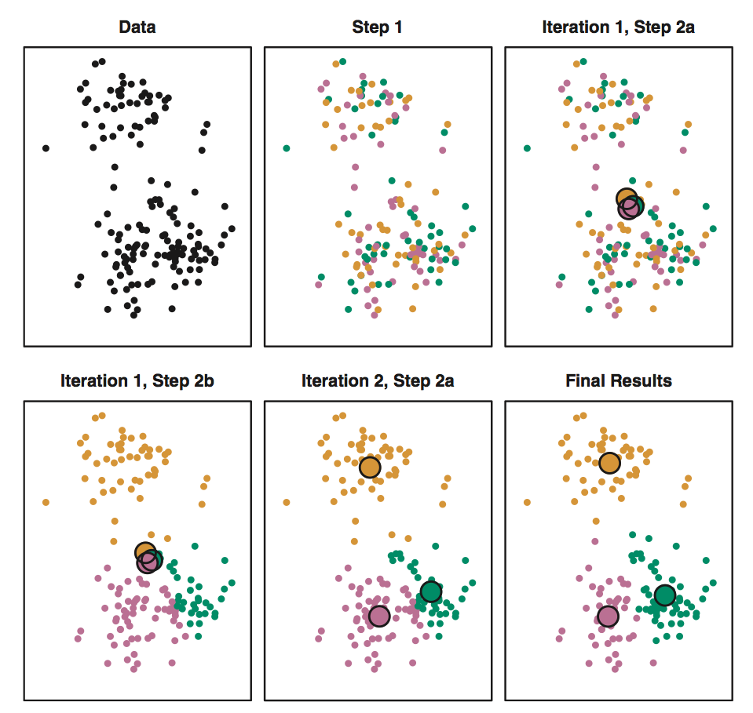
k-means algorithm (k = 3)
Data
Step 1a.
Step 1b.
Adapted from ISLR,
James et al., 2013
p. 389
…
Step 2a.
Step 2b.
Final clusters!

Slide 11
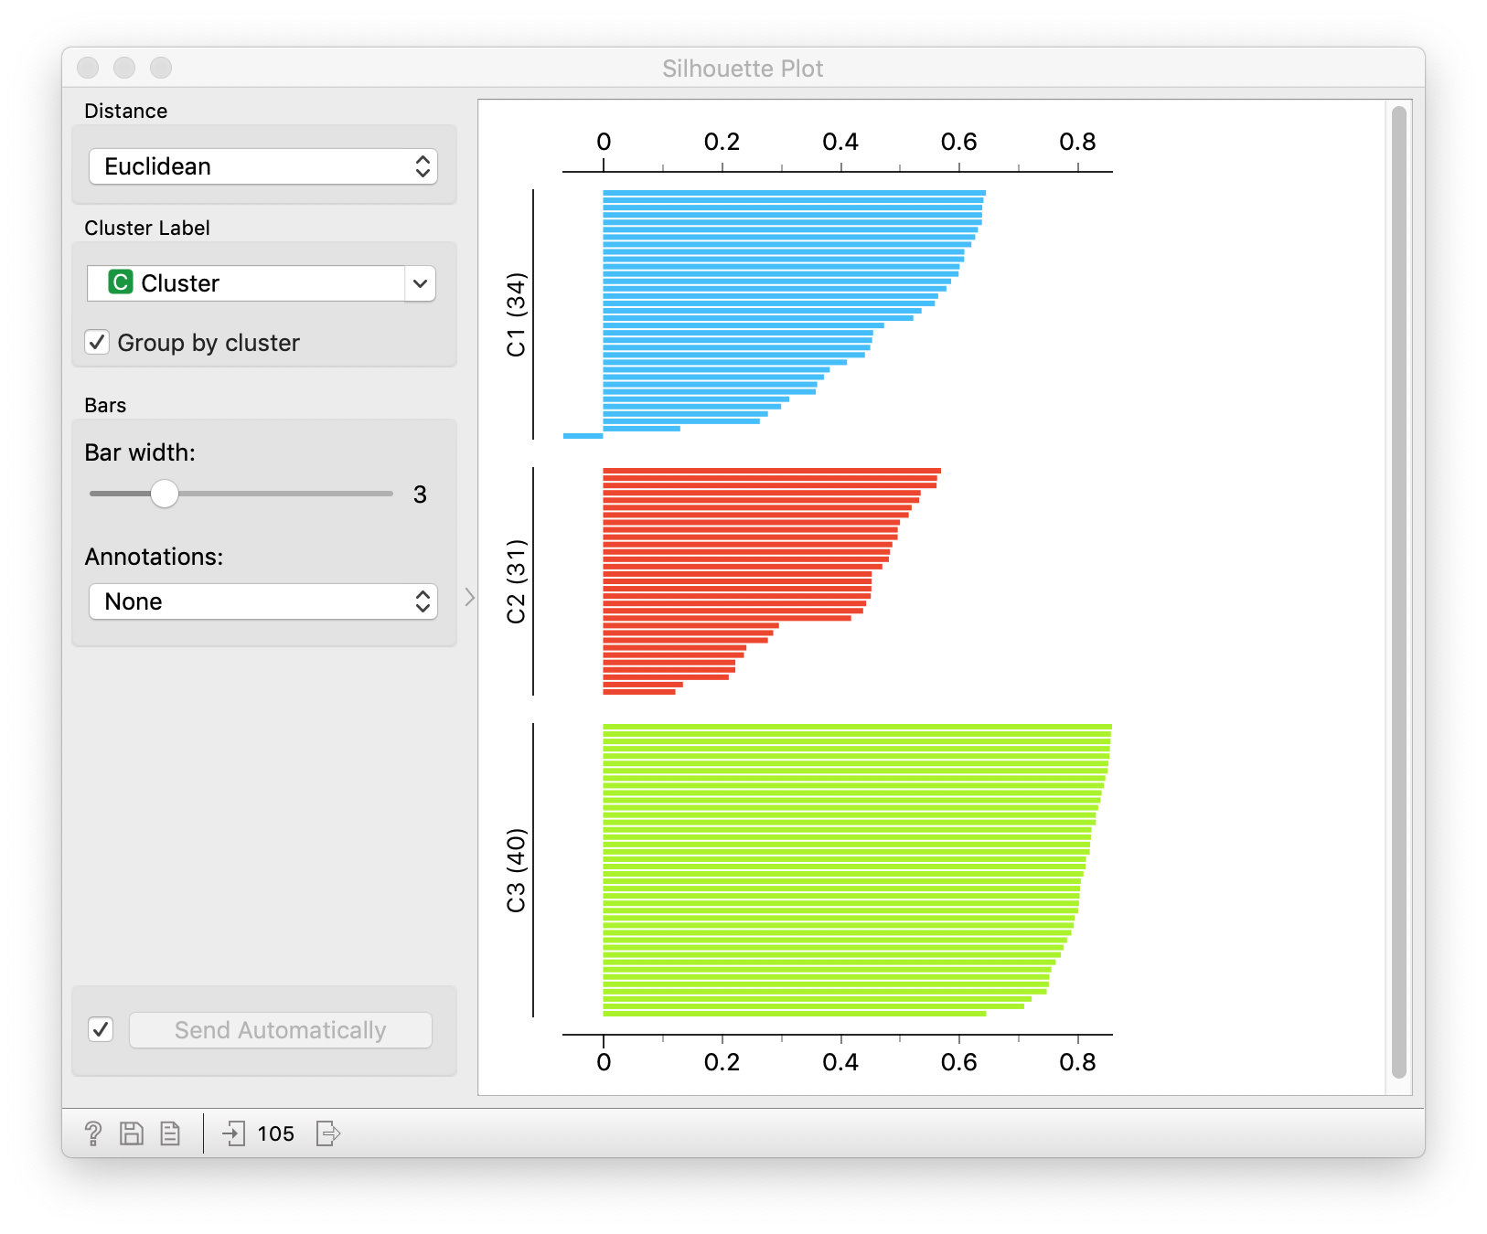
Silhouette Measure
Measures the degree of similarity (cohesion) of observations within a cluster compared to other clusters (separation)
[-1 (dissimilar), 1 (similar)]
An evaluation metric for cluster assignment
Goal: high average silhouette via clustering
Example silhouette measures for three clusters of individuals.

Slide 12
Clustering vs. classification
Cluster analysis is NOT classification!
In our Iris example, the clusters correspond to particular species but this comparison is provided for purely expository reasons
Cluster analyses hypothesizes there is some latent characteristic which generates these clusters, something we might need to construct a label for after our cluster analysis (e.g. Netflix movie genres)
So we do not wish to predict a label but rather potentially reveal a label or grouping and interpret

Slide 13
Other clustering algorithms

Slide 14
Hierarchical clustering method
  Joins (agglomerative) or divides (divisive) observations
  Hierarchically joins/divides similar/dissimilar subclusters together based on distance
Notes:
Image source: https://www.researchgate.net/publication/321399805_Blind_Nonlinearity_Equalization_by_Machine_Learning_based_Clustering_for_Single-_and_Multi-Channel_Coherent_Optical_OFDM/figures?lo=1

Slide 15
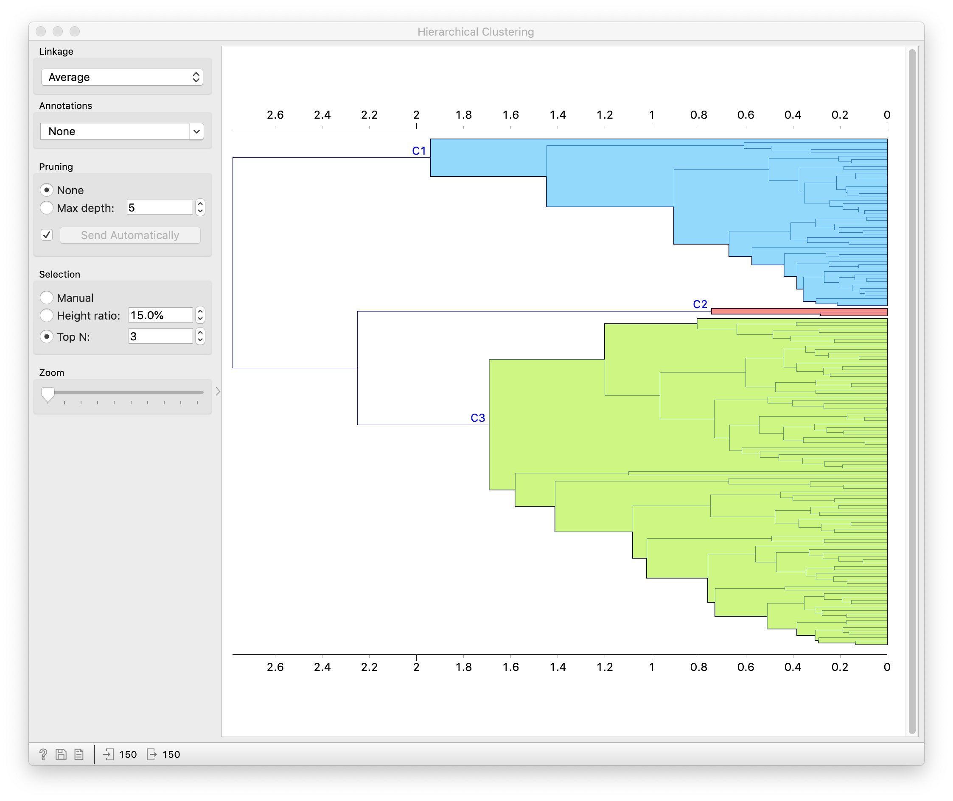
Iris example – agglomerative hierarchical clustering

Slide 16
Notes:
Image source: https://www.slideshare.net/mirjalil/large-scale-data-clustering-an-overview

Slide 17
Data Reduction Methods

Slide 18
Shadow Analogy
Notes:
https://upload.wikimedia.org/wikipedia/commons/thumb/3/33/Looking_down_from_The_Eiffel_Tower%2C_Paris_8_April_2007.jpg/440px-Looking_down_from_The_Eiffel_Tower%2C_Paris_8_April_2007.jpg

Slide 19
Why data reduction?
Interpretation:
  Wish to visualize high dimensional data in a 2D/3D space
Memory/storage:
  Cannot store raw data, need to reduce to store/analyze
  E.g. summarize step counts by minute rather than second
Pre-processing:
  Reduce dimension of data to perform an analysis
  E.g. for k-nearest neighbors to avoid the “curse of dimensionality”

Slide 20
Principal components analysis (PCA)

Slide 21
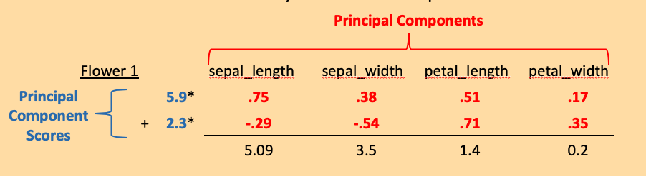
Principal components analysis
How does this new mathematical vocabulary fit into “recipe” framework?
Principal components identify the directions of “maximal spread (variation)”
.17
.51

Slide 22
Other dimension reduction methods

Slide 23
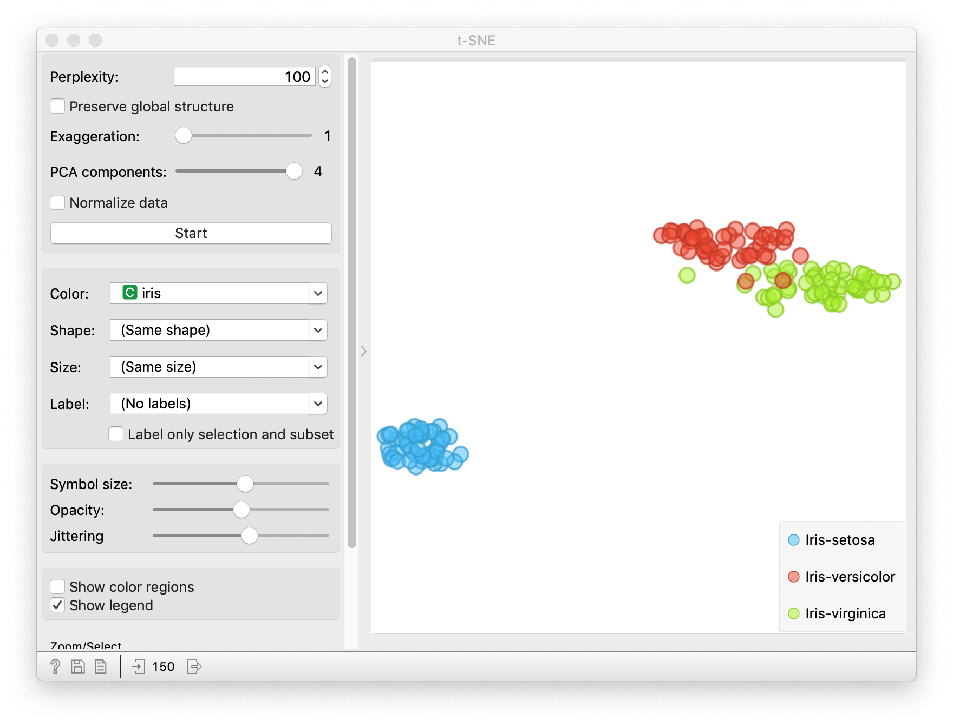
t-SNE for Iris Data

Slide 24
Clustering vs Dimension Reduction
Clustering
Discover latent classes or structure in data
Maximizes within cluster similarity
Minimize similarity between clusters
Cluster labels can be assigned
Dimension Reduction
Reduces feature dimension to lower dimension
Can capture leading directions of variation
Does not assign a label
Subsequent machine learning can be used on reduced dimension data

Slide 25
Choosing a Machine Learning Method

Slide 26
Choosing a Machine Learning Method
Common question: “Which machine learning algorithm should I use?”
Answer: It depends,
  Do you have supervised or unsupervised data?
  If supervised, do you have continuous, binary class, or multi-class outcome(s)?
  If unsupervised, are you interested in looking for latent groupings or data reduction?
  Do you have predictors that are continuous, categorical, ordinal, text-based, or some combination of the above?
  How large is your training set?
  Do you need a fast algorithm?
  Do you have time to explore multiple approaches?
  Do you need an interpretable model?
  For classification, do you need class probabilities, or will “hard” classes suffice?

Slide 27
Do you have supervised or unsupervised data?
  Supervised data → use classification or regression methods
  Unsupervised data → use clustering or data reduction algorithms
If supervised, do you have continuous, binary class, or multi-class outcomes?
  Continuous data → use regression methods (e.g. multiple linear regression)
  Class data → use classification methods (e.g. classification trees
If unsupervised, are you interested in looking for natural groupings, or data reduction/simplification?
  To group data into similar sets → clustering algorithms, e.g. k-means
  To reduce data → use data reduction algorithms (e.g. principal components analysis, t-SNE)

Slide 28
Do you have predictors that are continuous, categorical, ordinal, text-based, or some combination of the above?
  Some algorithms will not work with certain types of predictors
How large is your training set?
  Small data → “high bias/low variance” methods (e.g. linear regression, logistic regression, SVM)
  Large data → “low bias/high variance” methods (e.g. decision trees, KNN); lower level of assumptions – need a lot of data to train
Do you need a fast algorithm? (e.g. for real-time work)
  More complex algorithms can be relatively slow, especially if there are algorithm parameters to be optimized (e.g. neural nets) – not likely to be an issue in most medicine datasets
Do you have time to explore multiple approaches?
  If so, you may as well try many and see which does “best” for your data (making sure you are dutifully evaluating on independent data) or use ensemble methods

Slide 29
Do you need an interpretable model?
  Consider whether you’ll need to understand the role your predictors play in prediction
For classification, do you need class probabilities, or will “hard” classes suffice?
  Some classification methods don’t provide class probabilities, so if you want probabilities your options are less
There are also many “cheat sheets” for choosing machine learning algorithms on the internet, but you can see there is a lot of variability…

Slide 33
Machine Learning Computational Tools
We have focused on Orange but there are other tools/software/programming languages if you want to dig further. Here are some free ones
Weka -- http://www.cs.waikato.ac.nz/ml/weka/ - Java based machine learning platform - Data Mining: Practical Machine Learning Tools and Techniques 3rd edition, Witten, Frank and Hall, 2011
R -- https://www.r-project.org/ -- R has many machine learning libraries and tools. They have a machine learning and statistical learning “Task View” page which much of what is available in R (including an R interface to the Weka package) – packages mlr and caret are wrappers for calling multiple machine learning algorithms
Python -- https://www.python.org/ -- if you want to go even further down the programming line – many numerical and scientific libraries – see e.g. python resources to get started

Slide 34
Review of this lecture
Clustering
  k-means clustering
  Hierarchical clustering
Data reduction
  Principal components analysis (PCA)
  t-Distributed Stochastic Neighbor Embedding (t-SNE)

