Slide 1
Table and Graph Criticism Exercise

Slide 2
Table principles
Should be self-explanatory!!!
It is easier to compare numbers in columns.
Round aggressively, preferably to two effective digits (ie where the numbers differ). Exception: you need to convey precise results.
Order rows and/or columns purposefully to convey information. Compare across columns
Lightly use visual elements to ease comparisons.
Notes:
First table example… maybe not self explanatory.

Slide 3
Graph principles
Should be self-explanatory.
Aim for interocular traumatic impact. Use the ideas below to convey your message clearly.
Choose a graph type to emphasize your desired message.
Maximize the data to ink ratio.
Minimize the impact of non-data ink.
Use colors, marker symbols and line types purposefully (Excel is ☹).

Slide 4
Group assignment
For table and graph
What works? (3+ things)
What doesn’t work? (3+ things)
How did the papers purpose constrain the presentation?

Slide 5


Slide 6
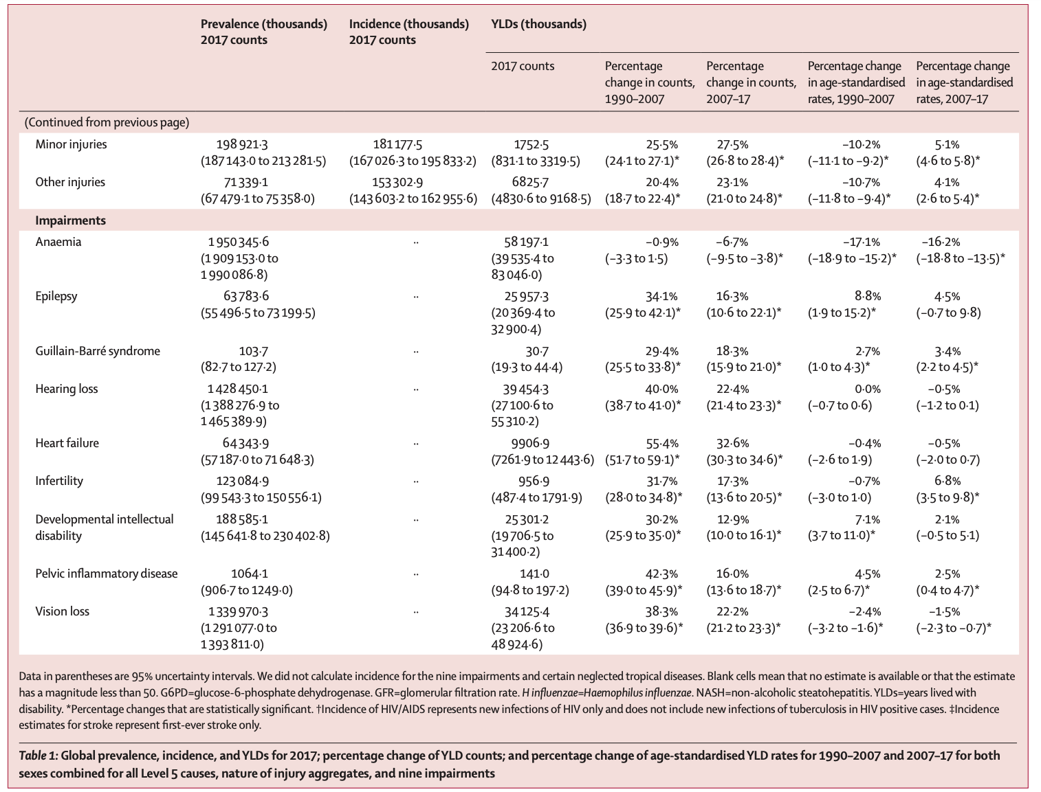

Slide 7
