Slide 1
Biostat 202: Opportunities and Challenges of “Big Data”:
Review and Case Studies
Aaron Wolfe Scheffler
Division of Biostatistics
Department of Epidemiology and Biostatistics
9/9/2019

Slide 2
“Big Data”
https://hac.nursing.umich.edu/2018/02/26/big-data-finding-its-mark/
Big Data
All Data

Slide 3
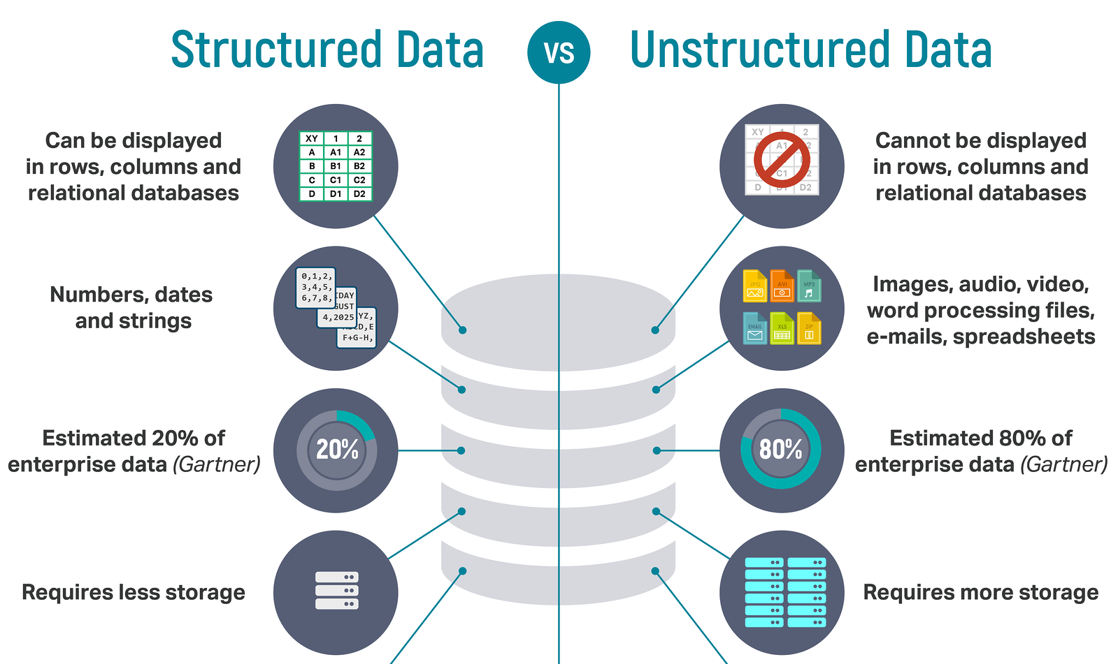
Structured vs unstructured data
https://tinyurl.com/yxhz3568
Our focus

Slide 4
Goal: Use machine learning algorithms for the purpose of prediction or identifying patterns in data
1. Data
2. Train/fit model
3. Output
4. Interpret
Prediction
Dimension Reduction
Clustering
Algorithm(s)
= INFORMATION?

Slide 5
A historical view
https://tinyurl.com/y37tgvt6

Slide 6
Supervised vs unsupervised
Machine Learning
Supervised
Regression (continuous outcome)
Classification (categorical outcome)
Unsupervised
Clustering
(grouping observations)
Data Reduction (transforming variables)

Slide 7
Supervised vs unsupervised
Supervised Learning
Have data where you know outcome in order to train the model
Train the model to predict future outcomes from sets of predictors
Unsupervised Learning
No desired outcomes
Separate data points into groups with “similar” properties (clustering)
Or reduce data to fewer variables in some way that still captures important structure of the data
Prediction: Regression (continuous outcomes) and classification (categorical outcomes)
Clustering and data reduction

Slide 8
Model Validation
Train-test
  Assess performance of one model
Train-validate-test
  Assess performance of multiple models (e.g. parameter tuning)
Cross-validation
  Use training data as a validation set iteratively when you have small data

Slide 9
Evaluation Metrics
Continuous targets
  Correlation
  Mean squared error
Categorical targets
  Accuracy
  Sensitivity
  Specificity
  Area under the ROC curve (AUROC)
Clustering
  Silhouette measure

Slide 10
Ensemble methods
Train a bunch of predictive models and pool them to form a final prediction.
Advantage:
  improvement in predictive accuracy
Disadvantages:
  more computation
  it is difficult to understand an ensemble of classifiers
Examples: bagging, boosting, and stacking

Slide 11
Causal Inference
Prediction vs causation
  estimate, predict, associate = prediction
  effect, intervention = causal
Threats to causal inference in observational data
  Selection bias
Some uses of big data and machine learning in causal inference
  Propensity scores (induce balance, attempt to replicate randomization)
  Potential outcomes (estimate average causal effect [ACE])

Slide 12
Thoughts on Big Data
Data mining can be used for good and evil.
Big data isn’t the same as big information.
Modern machine learning methods can search for associations quickly and flexibly.
Having big data doesn’t solve selection bias.
Distinguish prediction problems from causal investigation.
Data mining methods are good at finding spurious associations and hard to use reproducibly. Need to wary of over-fitting.
Randomization can be used with big data.

Slide 13
Case Studies

Slide 14
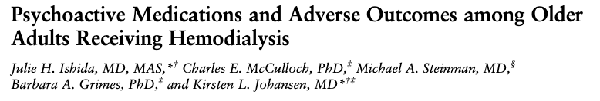
Example
BACKGROUND: Guidelines recommend avoidance of several psychoactive medications such as hypnotics in older adults due to their adverse effects. Older patients on hemodialysis may be particularly vulnerable to complications related to use of these agents, but only limited data are available about the risks in this population.
OBJECTIVES: To evaluate the association between the use of psychoactive medications and time to first emergency department visit or hospitalization for altered mental status, fall, and fracture among older patients receiving hemodialysis.
PARTICIPANTS: A total of 60 007 adults 65 years or older receiving hemodialysis with Medicare Part D coverage in 2011.
MEASUREMENTS: The predictors were use of sedative-hypnotics and anticholinergic antidepressants (modeled as separate time-varying exposures). The outcomes were time to first emergency department visit or hospitalization for altered mental status, fall, and fracture (modeled separately).

Slide 15
Example
Goal: predict time to first emergency department (ED) visit or hospitalization due to altered mental status etc...
  Supervised learning, prediction
Target: time to first ED visit or hospitalization (continuous)
Predictors: psychoactive medication, demographics, etc…
Techniques: regression
Validation: form validation data set (separate EHR system?), assess correlation and mean squared error

Slide 16
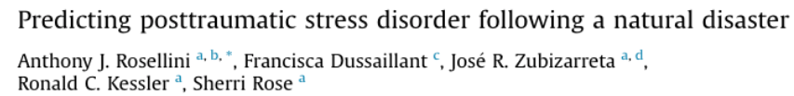
Case Study # 1
“Earthquakes are a common and deadly natural disaster, with roughly one-quarter of survivors subsequently developing posttraumatic stress disorder (PTSD). Despite progress identifying risk factors, limited research has examined how to combine variables into an optimized post-earthquake PTSD prediction tool that could be used to triage survivors to mental health services. The current study developed a post-earthquake PTSD risk score using machine learning methods designed to optimize prediction. The data were from a two-wave survey of Chileans exposed to the 8.8 magnitude earthquake that occurred in February 2010. Respondents (n=23,907) were interviewed roughly three months prior to and again three months after the earthquake. Probable post-earthquake PTSD was assessed using the Davidson Trauma Scale (DTS; Davidson et al.,1997)…[where a] DTS total score > 40 indicates a probable PTSD diagnosis… Pre-earthquake [independent] variables included (i) dichotomous indicators of sex, marital status, and living situation, (ii) several dichotomous and categorical employment and education-specific variables (e.g., employment status; years of school), (iii) categorical variables representing the condition of the walls and roof of the home (rated by the interviewer), and (iv) health variables, including a categorical overall health rating and several dichotomous variables representing 30-day health and long-term health problems.”
Notes:
Sherri Rose coming to UCSF 9.20.2019: https://epibiostat.ucsf.edu/events/epi-tools-workshop-sherri-rose

Slide 17
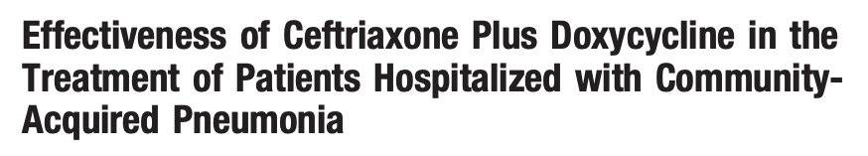
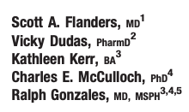
Case Study # 2
“Limited data exist on the effectiveness of ceftriaxone plus doxycycline in the treatment of patients hospitalized with community-acquired pneumonia (CAP). We performed a retrospective cohort study of all adults hospitalized for pneumonia between January 1999 and July 2001 at an academic medical center. Outcomes were compared for patients with CAP treated with ceftriaxone plus doxycycline versus other appropriate initial empiric antibiotic therapies. A total of 216 patients were treated with ceftriaxone plus doxycycline and 125 received other appropriate initial empiric antibiotic therapies. Medical record review by trained research assistants blinded to the research question was used to gather demographic data, comorbid illnesses, physical examination findings on initial presentation, and laboratory or radiographic results on initial presentation. Data from the hospital administrative database were used to identify the initial empiric antibiotic regimen. All antibiotics prescribed within the first 48 hours of hospitalization were considered initial empiric therapy with few exceptions. [Medical records were also] used to identify length of stay, death during the index hospitalization, and return to the emergency department or readmission within 30 days of discharge. The National Death Index was used to identify all deaths that occurred after hospital discharge.”
Notes:
Chuck at work!

Slide 18
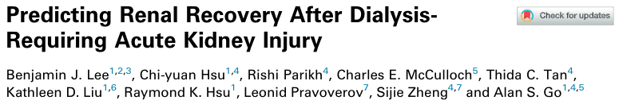
Case Study # 3
“After dialysis-requiring acute kidney injury (AKI-D), recovery of sufficient kidney function to discontinue dialysis is an important clinical and patient-oriented outcome. Predicting the probability of recovery in individual patients is a common dilemma. This cohort study examined all adult members of Kaiser Permanente Northern California (KPNC) who experienced AKI-D between January 2009 and September 2015 and had predicted inpatient mortality of <20%. The primary outcome was recovery of native kidney function after AKI-D, defined as renal replacement therapy (RRT) independence within 90 days after RRT initiation and survival for > 4 weeks after RRT discontinuation. Candidate predictors included demographic characteristics, comorbidities, laboratory values, and medication use. For this analysis, we classified patients as having AKI-D if they underwent RRT (acute intermittent hemodialysis and/or continuous RRT) during hospitalization in the absence of any preadmission chronic RRT and had peak in patient serum creatinine concentration > 50% of preadmission baseline…We excluded patients who had baseline eGFR values <15ml/min per 1.73 m2 (because it is difficult in this eGFR range to distinguish true AKI-D from progression of severe CKD) or predicted probability of in patient mortality > 20% using a KPNC-validated risk score (because the issue of renal recovery is clinically relevant only among those patients with AKI-D who are likely to survive the acute hospitalization).”
Notes:
Chuck at work!

Slide 19
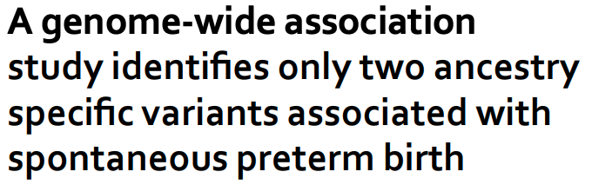
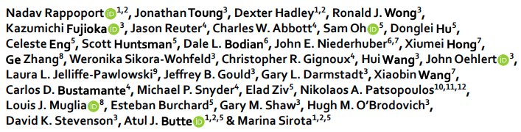
Case Study # 4
“Preterm birth (PTB), or the delivery prior to 37 weeks of gestation, is a significant cause of infant morbidity and mortality. Although twin studies estimate that maternal genetic contributions account for approximately 30% of the incidence of PTB, and other studies reported fetal gene polymorphism association, to date no consistent associations have been identified. In this study, we performed the largest reported genome-wide association study analysis on 1,349 cases of PTB and 12,595 ancestry-matched controls from the focusing on genomic fetal signals. We tested 2,015,750 SNPs for their association to the spontaneous PTB phenotype…with sex and the first ten principal components of genetic ancestry as covariates in the model. The ancestry-matched control population was obtained from the Health and Retirement Study, the vast majority of whom are older than 55 years of age at the time of recruitment, which started in 1992. In the early 1990s, major advances in neonatal care, led by the introduction of surfactant therapy, greatly increased the likelihood of survival for infants born before 30 weeks. Since all of the controls were retirees born well before 1990, we assumed that they were very unlikely to have been born extremely preterm (before 30 weeks), and, therefore, can serve as an appropriate control population for our genome analyses.”
Notes:
Marina Sirota will give our last guest lecture! Those who attend get an extension on the final project!

Slide 20
Consider the following (suggestions):
What type of data? Is there an outcome, if so continuous or categorical?
What is the research question (predictive, causal)?
What model should you use to investigate the research question?
How would you assess model validity/performance?
How would you interpret model output to address the research question?

Slide 21
Biostatistics 202: Machine Learning Guide
Supervised learning - prediction of a target
 | Model | Interpretability?
Regression - continuous target
 | Linear regression | High
Classification - categorical target
 | Logistic regression | High
 | Classification trees (decision trees) | High
 | K-nearest neighbors | Low
 | Support vector machines | Low
 | Artificial neural networks | Low
Ensemble methods | Random forests (bagging) | Medium
 | Adaptive boosted trees (boosting) | Medium
 | Stacking | Low
*Note: all classification methods may be adjusted to allow for prediction of continuous targets.
Unsupervised learning - clustering and/or data reduction
Clustering
 | k-Means
 | Heirarchical clustering
Data Reduction
 | Principal component analysis
 | t-distributed stochastic neighbor embedding

Slide 22
FILL IN WITH YOUR GROUP
Goal:
Target:
Predictors:
Techniques:
Validation:

Slide 23
Next: visualization lab

