Slide 1
Pain Management: Special Patient Populations
Charity Hale, Pharm.D.
Pain Management Pharmacist
October 2020

Slide 2
Objectives
Introduce POLST form
Understand intro to Intrathecal Pain Pumps

Slide 3
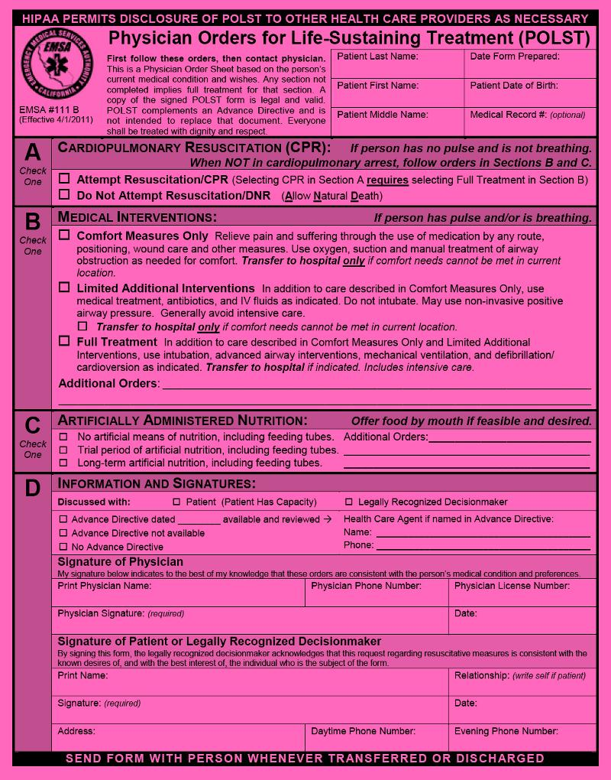
POLST Form:

Slide 4
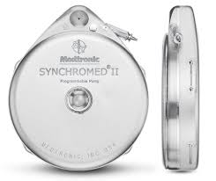
Intrathecal Pump
The intrathecal pump AKA a “pain pump” is a round metal device about the size of a hockey puck (20 mL or 40 mL) and it’s surgically implanted beneath the skin (typically the abdomen)
A catheter delivers medication into the intrathecal space
George Mandybur. "Intrathecal Drug Pump." Mayfield Clinic. N.p., Apr. 2016. Web. 7 Sept. 2016.

Slide 5
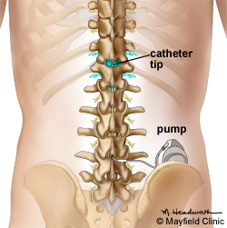
Intrathecal Pump
The fluid filled space around the spinal cord is called the subarachnoid or intrathecal space
CSF flows through this area bathing and protecting the brain and spinal cord
Medications delivered directly to the spinal cord controls the symptom (pain) with a significantly smaller dose than is needed with systemic (oral or IV) medications
Goal of pump is to achieve better symptom control and to reduce side effects by reducing systemic exposure to medications
George Mandybur. "Intrathecal Drug Pump." Mayfield Clinic. N.p., Apr. 2016. Web. 7 Sept. 2016.

Slide 6
Intrathecal Pump Interrogation
The pump is programmed to slowly release medication over a period of time
  Continuous infusion
  Bolus doses with lock out interval
“Interrogation” is the term used for pulling this information off of the pump
  Drug / concentration
  Rate (continuous or bolus)
  Next refill date
    Pump will alarm when the reservoir is low, and the pump needs to be refilled

Slide 7
Intrathecal Conversion
Implanted Intrathecal Pump:
  Hydromorphone 30 mg/mL
  Baclofen 500 mcg/mL
Infusion Rate:
  Hydromorphone 5.207 mg/day
  Baclofen 86.78 mcg/day
Pump refill date : 11/23/16
Low Reservoir Alarm Date: 11/16/16

Slide 8
Oral Morphine Equivalents
How many 24-hour OME are provided via the intrathecal pump?

Slide 9
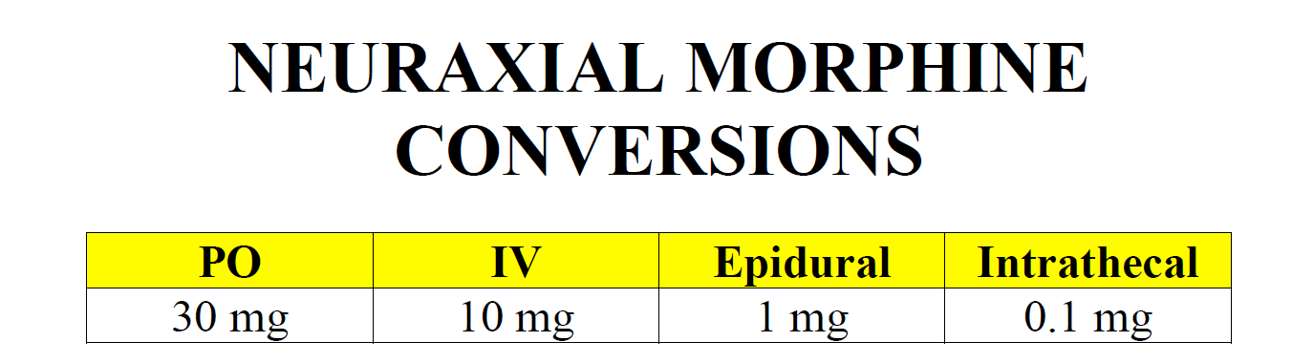
Oral Morphine Equivalents

Slide 10
Oral Morphine Equivalents
How many OME are provided via the intrathecal pump?
  10,420 mg OME
Intrathecal hydromorphone X 100 = IV hydromorphone
  5.207 X 100 = 521 mg IV hydromorphone
IV hydromorphone X 20 = OME
  521 mg X 20 = 10,420 mg OME

Slide 11
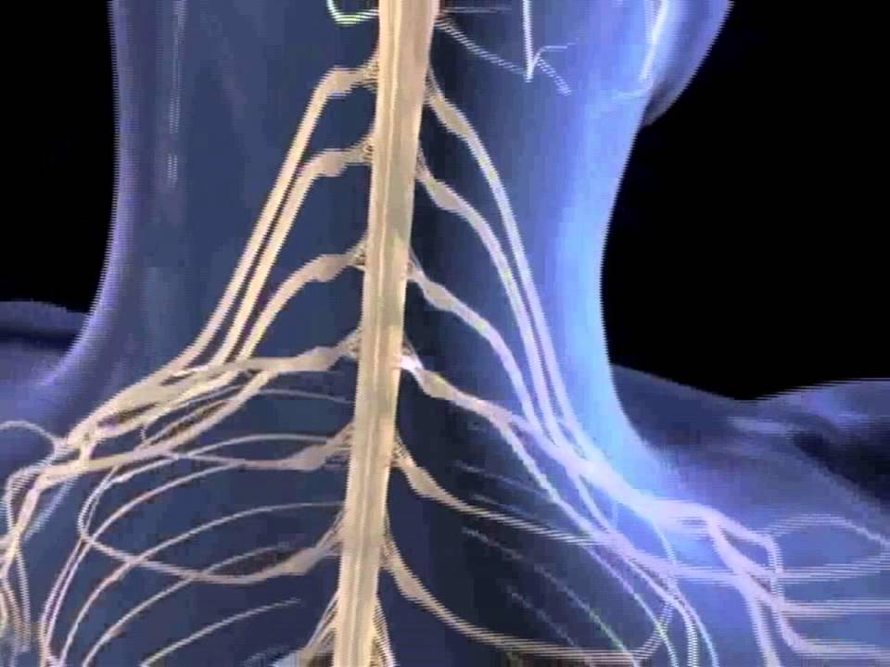
Questions / Comments?

