Slide 1
Palliative care vs.
Hospice
Pouria Kashkouli, M.D., FACP
Associate Clinical Professor
Department of Internal Medicine
Palliative Care and Hospice

Slide 2
Case:
60 year old woman with history of ovarian cancer with peritoneal carcinomatosis , CAD, and DVT who presents is admitted to the hospital with nausea, vomiting, and abdominal pain. Patient is currently on a chemotherapy holiday. She was admitted for partial bowel obstruction which is resolving. On your rounds today the patient asks you about a something she overhead her neighbor discussing with a physician – Palliative care vs. hospice?

Slide 3
Terminology
Palliative Care = Hospice Care = DNR/DNI = Comfort Care

Slide 4

Palliative Care (PC) ?
Palliative care still befuddles many people when they first hear the term.
Even after seeing it people may feel like a blind scientist touching different parts of an elephant.

Slide 5
WHO Definition of PC
“Palliative care is an approach that improves the quality of life of patients and their families facing the problems associated with life-threatening illness, through the prevention and relief of suffering by means of early identification and impeccable assessment and treatment of pain and other problems, physical, psychosocial and spiritual.”

Slide 6
Dame Cicely Saunders
Born June 24th, 1918
Oxford Trained nurse: Noted the plight of the dying and, in particular the need for pain control
In 1947 became a social worker after back injury ended her career as an nurse.
1957 became a doctor on advise of medical mentor at age 39.
  Idea of regular opioids for pain, rather than prn.
  Total pain: Physical, social (interpersonal relationships), spiritual (anger, regret, meaningless), & psychological pain ( anxiety, fear, anger).
Birth of hospice and concept of total pain. St. Christopher’s Hospice in London (1967).
  1971 Hospice Movement in the United States
  2005 died at St. Christopher Hospice.

Slide 7
Dr. Balfour Mount
Considered father of Palliative Care in North America
In January 1973, Dr. Mount, a urologic-cancer surgeon, was influenced by a discussion group of Elisabeth Kubler-Ross' book On Death and Dying to lead a study at the conditions at Montreal's Royal Victoria Hospital.
In September 1973, impressed by what he learnt working with Dame Saunders, Dr. Mount decided to create a hospice-like ward at the Royal Victoria.
He decided against hospice, his first choice, because hospice in French means Nursing home and called the new program palliative care, based on the word palate’s etymology.

Slide 8
What’s the difference?
Symptom Management
No Life expectancy Limit
Medicare Elected Benefit
Advance Care Planning
Less than 6 months prognosis
Palliative Care
Hospice
Curative / Life Prolonging Therapy
Quality of Life
Bereavement for up to a year
Provided with other treatments
Forgo medical treatments
Interdisciplinary Team

Slide 9
Old Model of Care
Curative Care
Comfort Care
Death
Disease Course
Notes:
Palliative Care is a relatively new field. Dichotomy of care. Curative Care is the primary focus until the final days of life

Slide 10
Simultaneous Care Model
Advance Directive
Advance Care Planning
Chronic and Curative Care
Hospice Care
Palliative Care
Bereavement Support
Disease Course
Death
Phase I
Healthy or Reversible Illness
Phase 2
Early onset, chronic conditions
Phase 3
Progressive, frequent complications
Phase 4
Hospice eligible
AHA CPI Analysis
Notes:
Progressive Palliative Care: Cumulative, something that is applied more and more over time. More emphasis on Pc over time.
Other definition cutting edge, moderate change or improvement over time, reforming how we practice how we provide them better care, quality of care and quality of life.
Palliative care is provided at the same time as curative care, maximizing quality of life throughout the course of disease.

Slide 11
General PC Principles
Focuses on symptom management
Patient and family is unit of care
Attention to physical, psychological, social and spiritual needs
Can be combined with disease-directed interventions
Bereavement/grief support
Interdisciplinary team approach

Slide 12
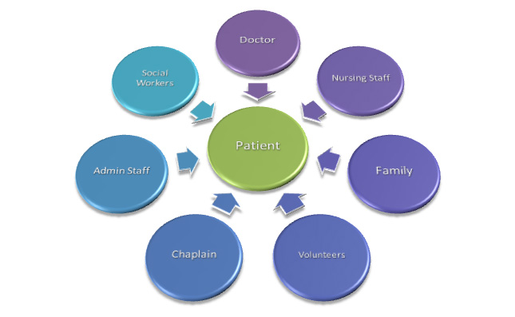
Palliative Care Model

Slide 13
Appropriate PC Referrals
Patients with refractor symptoms including pain, dyspnea, nausea, vomiting, anxiety
Frequent ED visits or hospital admissions for same diagnosis
Prolonged LOS (> 7 Days) without evidence of improvement or with poor prognosis
Patient actively dying and primary team would like assistance in providing comfort, symptom management, support for patient and family
Team / patient / family need help with complex decision making and determination of goals of care.
Assistance determining hospice eligibility and / or education about hospice.
Any patient being considered for hospice referral.

Slide 14
Need for Palliative Care
1990 - approximately 3 million Americans > age 85; now almost 6 million; by 2050, 19 million
60% Medicare patients dying of cancers with poor- prognosis are hospitalized within 30 days of death
10% hospitalized more than once
  23.7% admitted to ICU
  28.8% died in hospital
  6% received chemo within 2 weeks of death
Many die with unrelieved suffering
  Unnecessary, unrelieved pain
  Uncontrolled (but controllable) physical symptoms
  Unresolved psychosocial and spiritual problems
  In fear and loneliness, often feeling unwanted burdens

Slide 15
What do patients want?
Pain and symptom control
Avoid inappropriate prolongation of the dying process
Achieve sense of control
Relieve burdens on family
Strengthen relationships with loved ones
More than 80% of Americans would prefer to die at home
  25% of deaths occur at home.

Slide 16
Cause of Death—Demographic & Social Trends
Early 1900s
Current
Medicine's Focus
Comfort
Cure
Cause of Death
Infectious Diseases
Chronic Illnesses
Communicable Diseases
Death rate
1720 per 100,000
800.8 per 100, 000
(1900)
(2004)
Average Life
50
77.8
Expectancy
Site of Death
Home
Institutions
Caregiver
Family
Strangers/
Health Care Providers
Disease/Dying
Relatively Short
Prolonged
Trajectory

Slide 17
Growth of Palliative Care
Palliative care in U.S. hospitals has increased for ten consecutive year
Steady growth in response to increasing number and needs of patients
Also contributing to increase is realities of care-giving faced by patient’s families

Slide 18
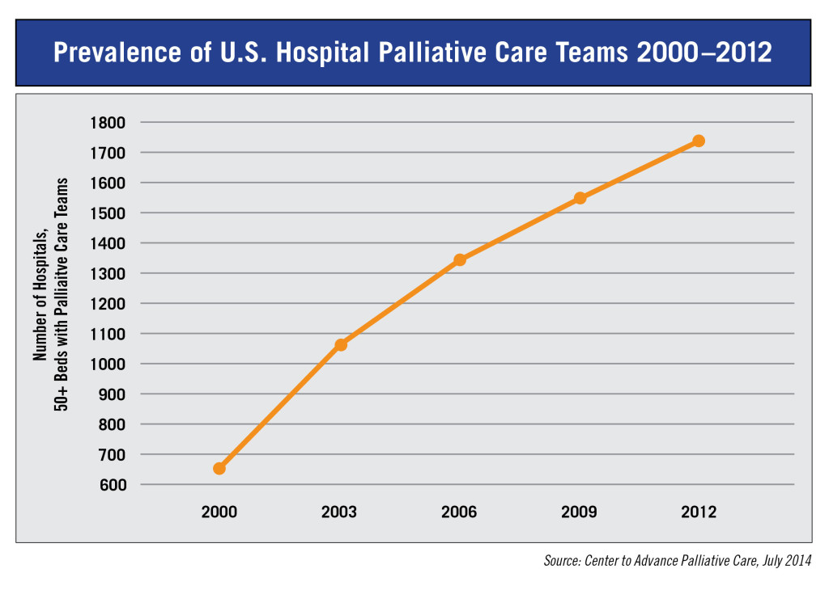
Growth of Palliative Care
Notes:
Over ten years, palliative care has been one of the fastest growing trends in health care
Number of palliative care teams in the hospitals has increased 138% since 2000. 63% of hospitals with over 50 beds have a palliative care team.
This is were I want to take a step back and talk about demographics and health care economics that have driven this change.

Slide 19
What is hospice care?
Hospice care focuses on improving the quality of life for persons and their families faced with a life-limiting illness.
The primary goals of hospice care are to provide comfort, relieve physical, emotional, and spiritual suffering, and promote the dignity of terminally ill persons.
Hospice care neither prolongs nor hastens the dying process.
Care is palliative (not curative) to control pain and symptoms associated with the terminal illness.

Slide 20
What is hospice care?
Hospice treats the whole person, not just the disease.
It focuses on the needs of both the patient and the family.
Care is provided by an interdisciplinary team including the physician, nurse, social worker, chaplain, nursing assistant, and volunteers.
Therapy and dietician services are provided per the patient’s needs.
Hospice addresses patient and family needs such as:
  Pain and symptom management
  Emotional, psychosocial, and spiritual support
  Help with funeral planning and arrangements
  Bereavement for family/ caregivers after the patient’s death

Slide 21
Where is hospice care provided?
Hospice care is a philosophy or approach to care rather than a place.
Care may be provided in a person’s home, nursing home, hospital, or independent facility devoted to end-of-life care.
Hospice was originally designed to be a non-institutional benefit. However, it is possible to receive Medicare covered hospice care while residing in a nursing home.

Slide 22
Basic Principles of Hospice Care
Affirms life
Regards dying as normal process
Neither hastens nor postpones death
Relives pain and other symptoms
Integrates medical, psychological, and spiritual aspects of care
Offers a support system to patients and families

Slide 23
When is Hospice Care Appropriate?
A referral to hospice is appropriate when the patient and family have opted for palliative treatment for life-limiting or “terminal” illness.
Medicare guidelines further require that the physician has determined that life expectancy is six months or less if the disease follows its normal course.

Slide 24
Determining Prognosis
A major barrier to hospice referral
  Physicians afraid of being
  wrong
  Data indicates physicians
  overestimate prognosis
  by a factor of 5

Slide 25
Illness/Dying Trajectories:
Sudden Death—Unexpected Cause
< 10% (MI, accident, etc.)
Health Status
Death
Time
Field & Cassel, 1997
Notes:
25

Slide 26
Illness/Dying Trajectories:
Steady Decline—Short Terminal Phase
Health Status
Death
Time
Field & Cassel, 1997
Notes:
26

Slide 27
Illness/Dying Trajectories:
Slow Decline, Periodic Crisis, Death
Decline
Health Status
Crises
Death
Time
Field & Cassel, 1997
Notes:
27

Slide 28
Illness/Dying Trajectories:
Lingering, Expected Death
Frailty
Health Status
Death
Time
Lunney et al., 2003
Notes:
28

Slide 29
Hospice Care Diagnosis
Hospice care is not just for patients dying of cancer
Other hospice diagnoses include:
  End stage heart disease
  End stage pulmonary disease
  End stage renal disease
  End stage liver disease
  Dementia due to Alzheimer’s Disease and Related Disorders
  HIV disease
  Stroke & Coma

Slide 30
Payment for Hospice Care
There is a Medicare hospice benefit for Medicare part A beneficiaries
All but one state (Oklahoma) have a Medicaid hospice benefit
Many commercial insurances also cover hospice care as well
Most hospices are committed to caring for all patients, regardless of an individual’s ability to pay

Slide 31
Hospice Service Periods
The patient’s primary physician and hospice team evaluate the patient’s eligibility for hospice care on a regular basis.
The first and second certification periods are 90 days; subsequent periods are 60 days.
If a patient no longer meets criteria for hospice care, they may be discharged and readmitted at a later date

Slide 32
Hospice Core Services
Hospice core services must be routinely provided by the hospice, and cannot be delegated to the facility.
Hospice core services include:
  Physician services
  Nursing services
  Social work services
  Counseling services
    Bereavement and spiritual
    Dietary

Slide 33
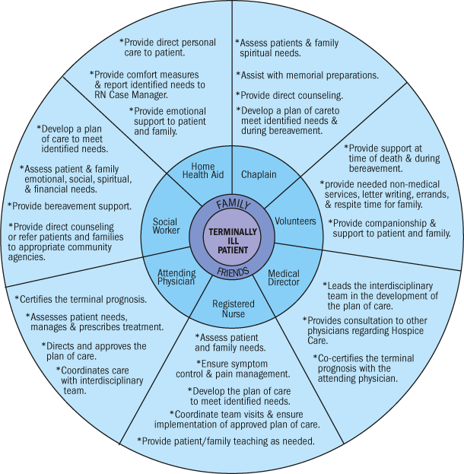

Slide 34
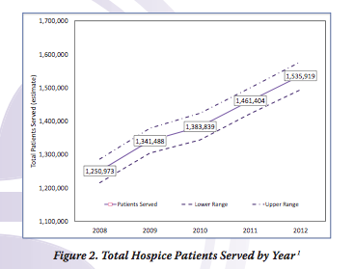
Hospice Facts and Figures
Demographics
  65% of patients over age of 75
  58% of patients are female

Slide 35
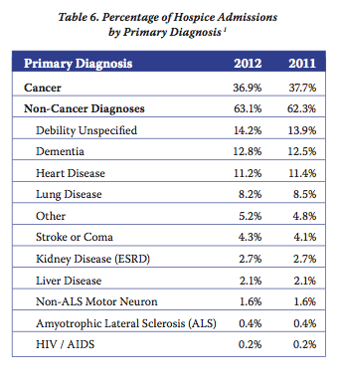
Hospice Facts and Figures

Slide 36
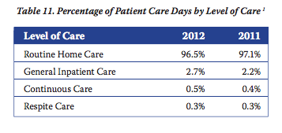
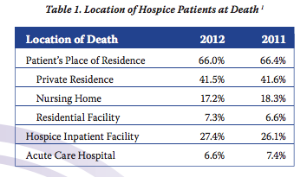
Hospice Facts and Figures

Slide 37
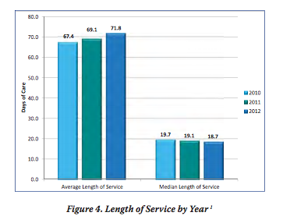
Hospice Facts and Figures
Length of Stay Data
  Average LOS 71.8 days
  Median LOS 18.7 days
  35% of patients LOS < 7days
  Only 9%of patient LOS> 180 days
  Stated another way, there are many patients receiving care for many months, but half of all beneficiaries spend less than 18.7 days enrolled.

